Slide 1
Wire scanners and Halo measurements in ESS Cold linac
Benjamin Cheymol
Beam diagnostic workshop, Lund 2012-03-21

Slide 2
Outline
Introduction
Thermal load
Integration
Detector
Halo measurement

Slide 3
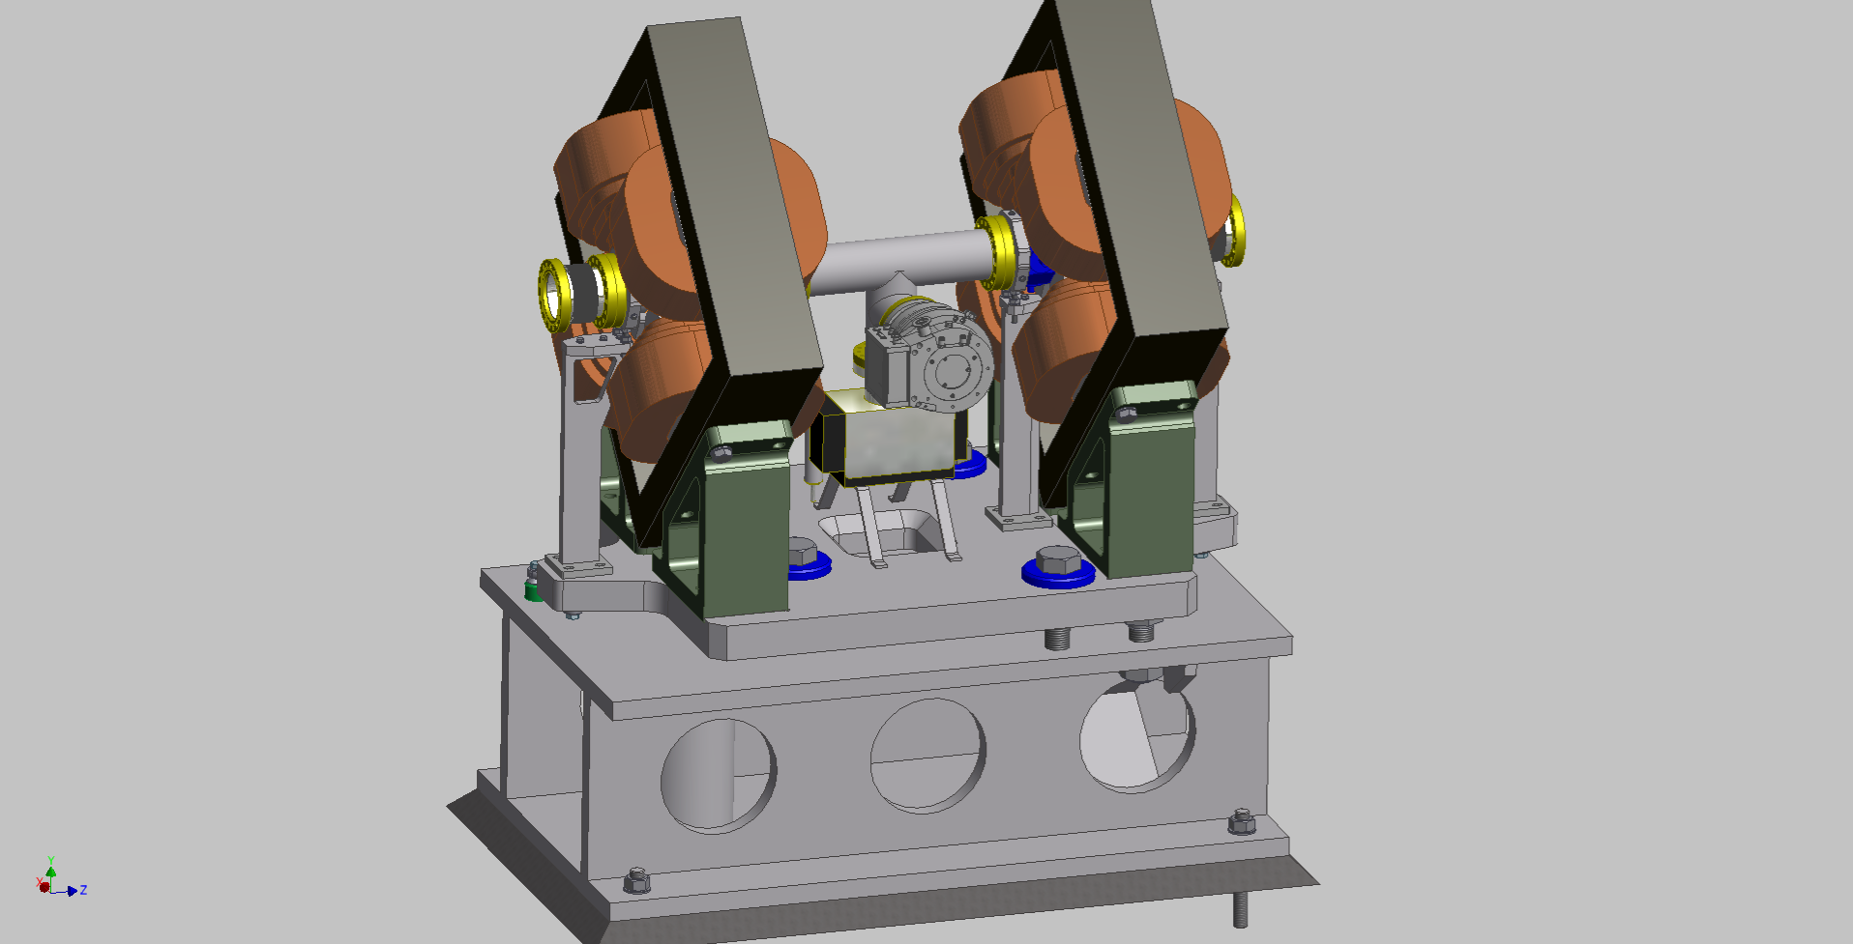
Introduction
Profile measurement with wire scanner will be used for commissioning and cross check for non invasive profile during operation
WS and non invasive profile will be positioned in the warm section of the cold linac.

Slide 4
Introduction
Graphite wire can not be used close to the cryo module
Tungsten wire will be used
The wire scanner will be operated in SEM mode in the Spoke section.
Shower will be measured in medium and high beta sections.
Mechanical design similar to the warm linac wire scanner (Slow wire scanner)

Slide 5
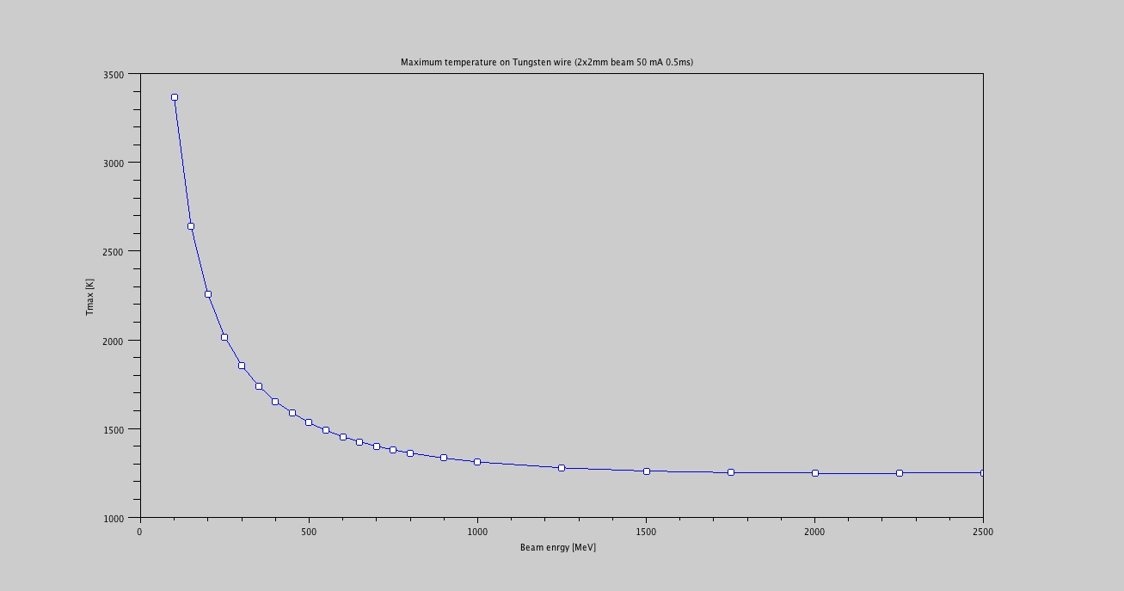
Thermal load
Less critical than the warm Linac
500 μs beam pulse can be used above 300 MeV (2x2 mm beam size)
3500
Tungsten wire 50 mA, 500 μs
σ_{x}=σ_{y}=2mm
3000
2500
Tmax [K]
2000
1500
1000
500
1000
1500
2000
2500
Beam energy [Mev]

Slide 6
Detector
Different option for detector
Scintillator
Ionization chamber
Cerenkov detector
Solid state detector
Cover all the azimuthal coordinate
Segmented detector
Spatial information of the shower

Slide 7
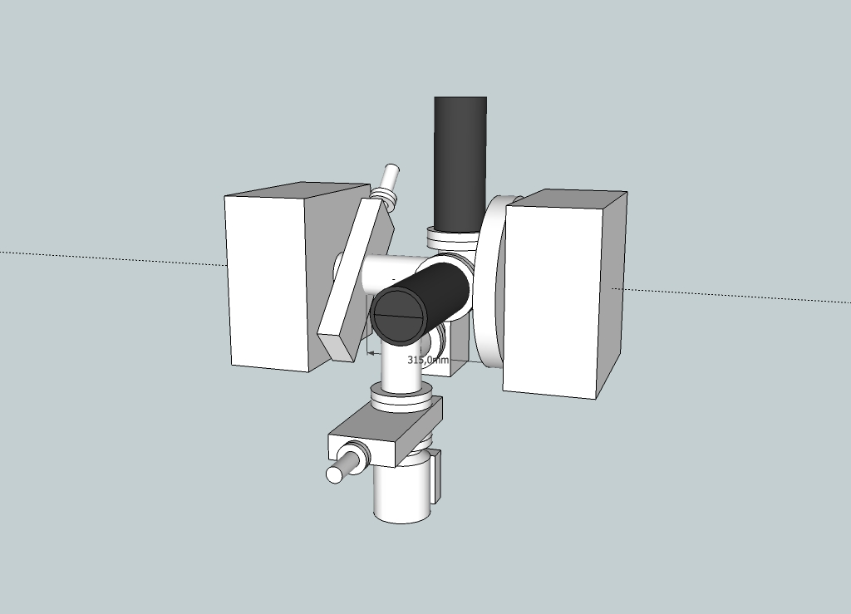
Integration
Wire scanner will share the same space with non invasive profile
Example of integration with non invasive profile (luminescence monitor)

Slide 8
Issues
Shielding due to the non invasive profile has to be estimated
Estimation of the emittance increase
Uncontrolled losses
Quadrupole activation
Heating of cryomodule

Slide 9
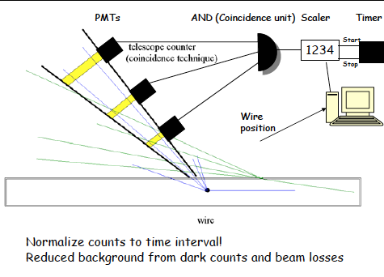
Halo measurement
A telescope can be used to detect event in coincidence
At low energy the number of event is low
Impossible to fit in the warm section
Investigate the possibility of using active element in the beam

Slide 10
Outlook
Monte Carlo simulations on going
Shielding
Detector choice
Cry module heating
Check the different solutions for Halo measurement

Slide 11
Thanks for your attention

