Slide 1
BPM electronics
(An overview of the requirements and the possible solutions for ESS)
Hooman Hassanzadegan
ESS, Beam Instrumentation Group

Slide 2
Outline
BPM system requirements
Platform for the BPM electronics
Overview of the signal detections methods for the BPM pickups
BPM electronics
  Analog front end
  Digital unit
Timing requirements
Next steps

Slide 3
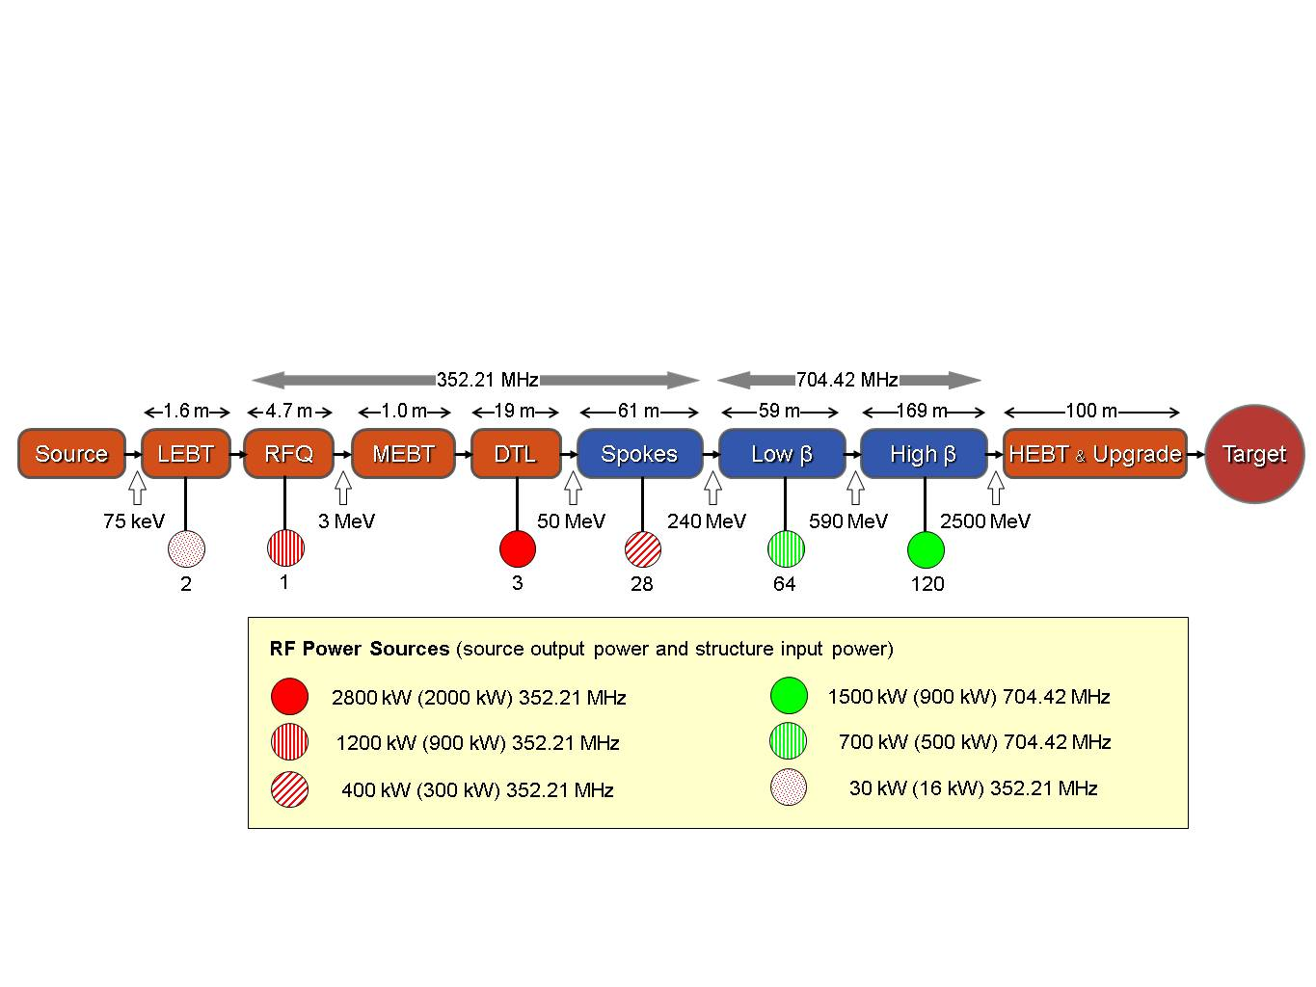
BPM system requirements
The total number of BPMs shall be 107 including:
MEBT: 4
DTL: 8 (2 per tank)
Spoke cavities: 30
Low-β elliptical cavities: 10
High-β elliptical cavities: 28
HEBT: 22
The BPM system shall be able to measure:
Beam position
Beam phase
Beam intensity

Slide 4
BPM system requirements (cont’d)
The BPM pickups will have different designs. Nevertheless, it is preferred to use the same electronics for all the pickups and adapt it to the pickups through minor modifications if needed.
Pickup pictures from SNS, Jim O’Hara, LNAL, “SNS Linac Beam Position Monitor pickups”, 2002

Slide 5
BPM system requirements (cont’d)
2.86 ms
Beam
50 mA
2.86 ms
50 mA
Nominal pulse
14 Hz
BPM
Fast measurement
(instantaneous)
14 Hz
100 μs
+
50 mA
Diagnostics pulse
averaging
Slow measurement
(average)
50 mA
1 Hz
The BPM system shall be able to make a fast and a slow measurement of the beam position, phase and intensity in nominal and diagnostics pulse modes.

Slide 6
BPM system requirements (cont’d)
2.86 ms
Beam position accuracy: ±100 μm (RMS)
Beam position resolution: 20 μm
Phase measurement accuracy: ±1° (RMS)
Phase measurement resolution: 0.2°
Measurement range: 50% of the beam pipe dia.
Phase measurement range: ±180°
ADC sample rate: > 1 MSPS
Electronics response time: < 1 μs
Refresh rate (end user): 14 Hz
Trigger
RF voltage
envelope
Beam
14 Hz
Beam Current
RF voltage
We are discussing with the Beam Physics group to finalize the requirements.
352 MHz
6

Slide 7
Electronics platform comparison
 | VXS | μTCA | PXI | cPCI/cPCIe
Vendor number | 16+ | ~10 | 70+ | Many
Maturity | Medium | Medium | High | High
Max. transfer rate | Star/dual star: 30Gbps, Mesh: 112 Gbps | 1 GbE, 2GbE, 10 GbE; Up to 12.5 Gbps 250MB/s/lane (PCIe) | PXI: 132 MB/s PXIe: 250 MB/s/lane (up to 16 lanes) | PCI: 132 MB/s PCIe: 250 MB/s/lane (up to 16 lanes)
Backplane timing and synchronization | 112 S.E. pins, 32 diff. pairs | 84 pair for MCH, 7 pairs per AMC for 12 AMCs | 10 MHz and 100 MHz clock, 8x shared trigger, star triggers
Topology | Star, dual star, full mesh | Star, dual star, full mesh | Master-slave, star | Master-slave, star
Redundancy | YES | YES | Power Supply only | Power Supply only
Users | Military, Avionics | DESY XFEL | EBG MedAustron,… | CERN, LANL, ORNL, ITER (planned), JET, ETE, EBG MedAustron
Crate cost | High (From 3000 €) | Medium (From 2000 €) | Medium (From 880 € for 4 slot version) | Medium (From 900 € for 6 slot version)
Documentation |  | Poor | Fair | Good
Ease of use |  | Fair | Easy to start | Fair
RTM | NO | YES | NO (alternative: FlexRIO) | NO
Power | 90 W (5V), 66W (3.3V) | 20 – 80 W per slot | 30 W per slot | 30 W per slot
*** Full table by Miha Rescic from Cosylab (Currently working at ESS)

Slide 8
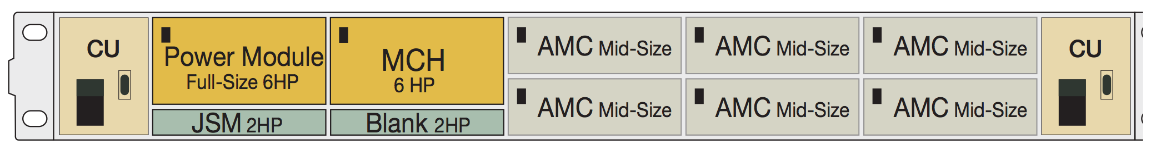
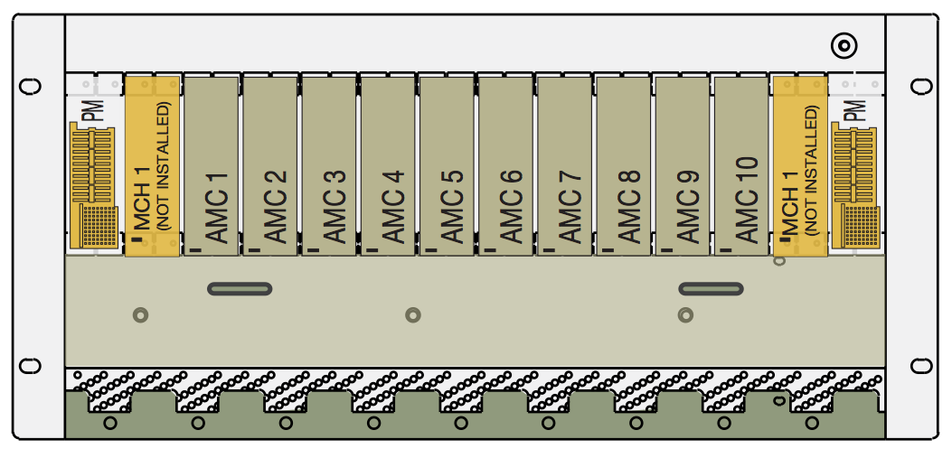
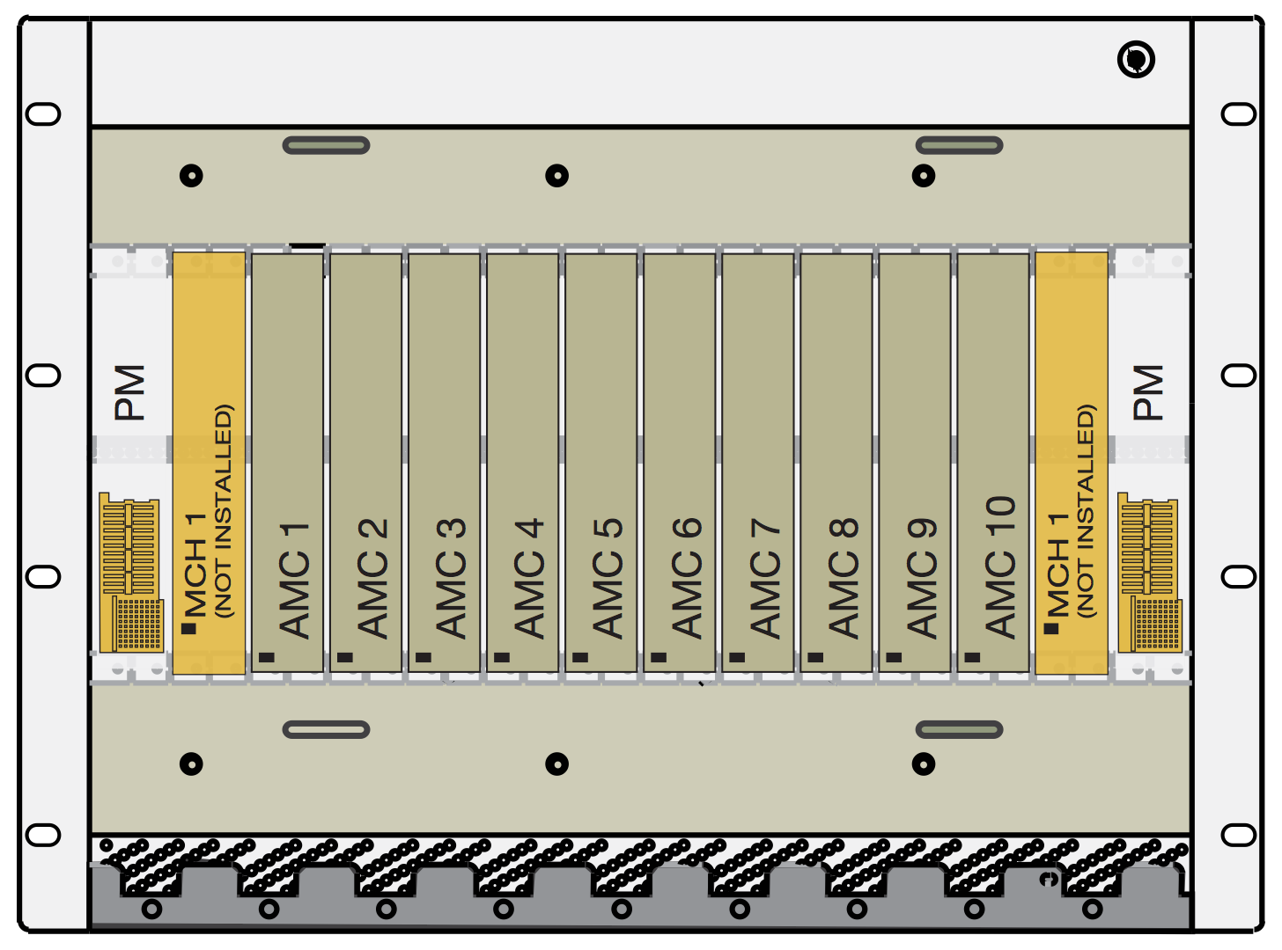
μTCA chassis platforms (ELMA)

Slide 9
μTCA systems at DESY
Slide from Bastian Lorbeer’s presentation at the DITANET workshop at CERN, Jan 2012

Slide 10
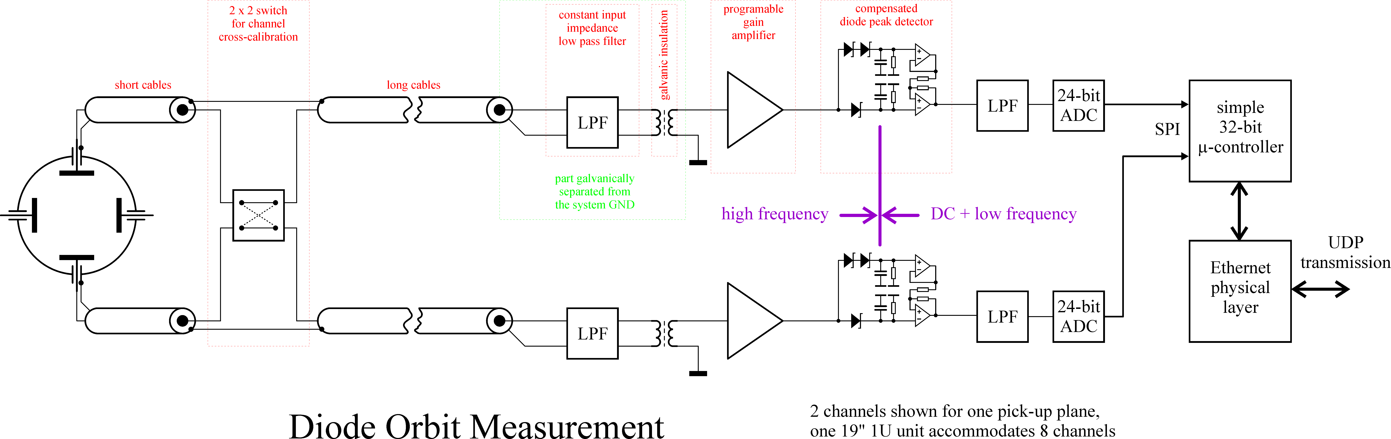
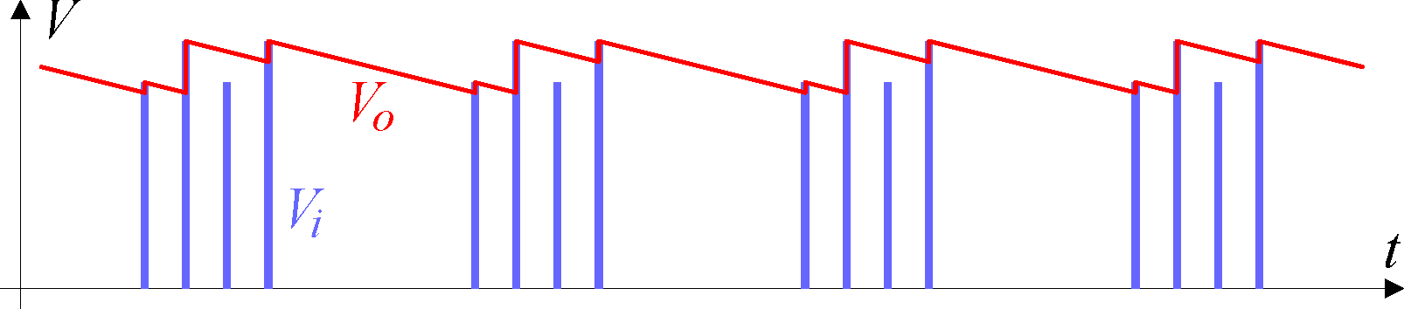
BPM signal detection (method 1)
Simple diode detector and S&H + LPF (LHC – CERN and DESY)
From Marek Gasior’s presentation at the DITANET workshop at CERN, Jan 2012

Slide 11
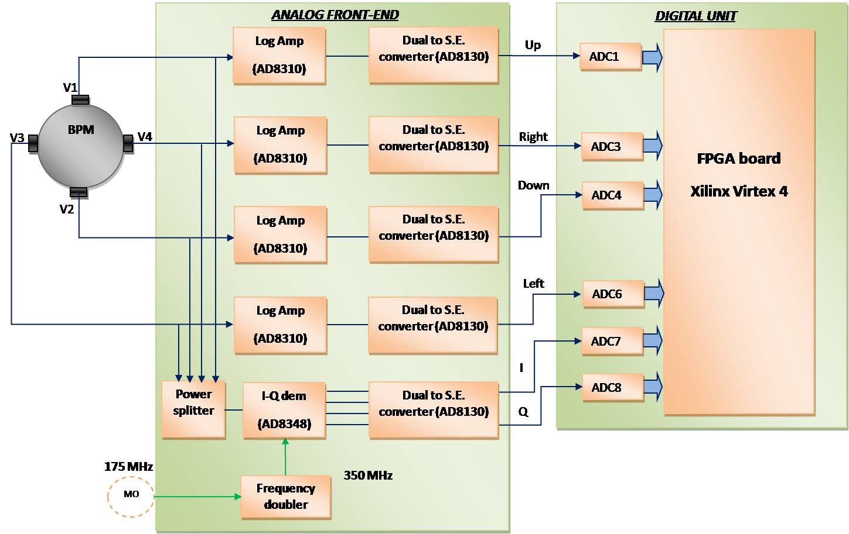
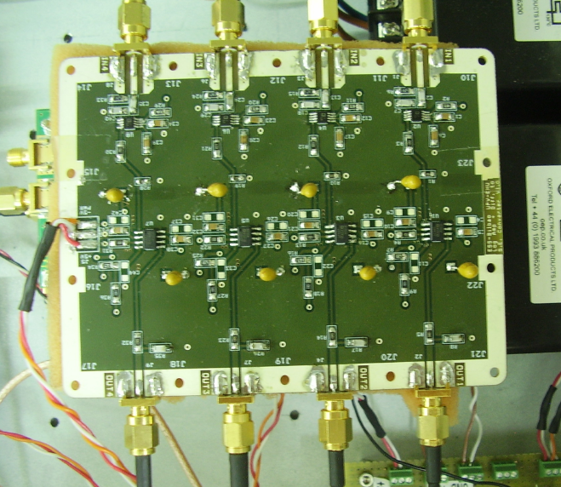
BPM signal detection (method 2)
Signal detection with log-amps (ESS-B and CERN)
ESS-Bilbao log-amp detector board
ESS-Bilbao BPM system
11
AD8310 response
Commercial log-amp detector

Slide 12
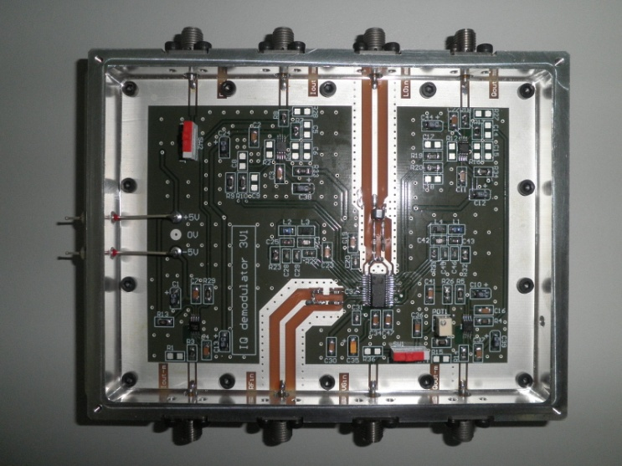
BPM signal detection (method 3)
Signal detection with an IQ demodulator:
9.028 MHz
9.028 MHz
From Claire Simon’s presentation (CEA) at the DITANET workshop at CERN, Jan 2012
IQ demodulator (ESS-Bilbao BPM)

Slide 13
BPM signal detection (method 4)
Down-conversion to IF + IQ detection (SNS)
f = f_{RF} +/- f_{IF}
IQ (under-) sampling
Demux + sign correction
Ref.
f = f_{IF} , T_{sampling} = n T_{RF} + T_{RF} /4
+Q
+Q
I
f = f_{RF}
+I
+Q
+I
+I
-I
-Q
-I
-Q
Input
Mixer
Q
IQ DEMUX (FPGA)
Calibration timing + AFE gain control (FPGA)
From the pickups
ADC sampling
ADC clock generation (PLL)
Down conversion to IF
Photo ref: J. Power et al. , Beam Position Monitor System for the SNS LINAC, Proc. PAC 2003

Slide 14
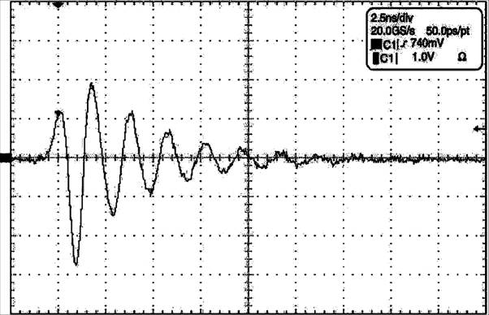
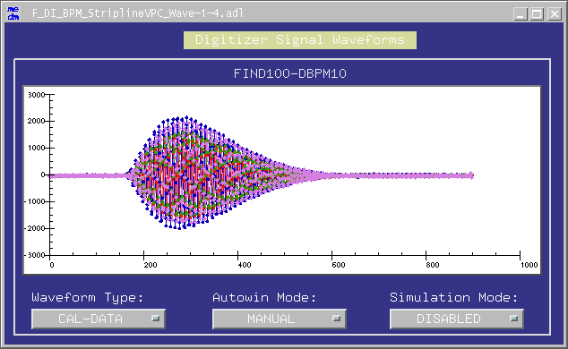
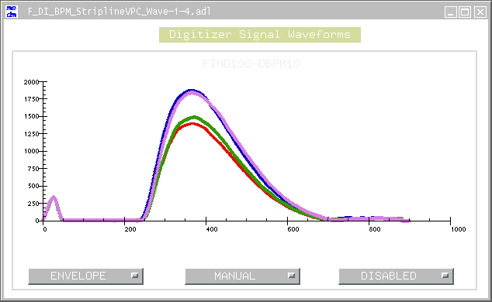
BPM signal detection (method 5)
Ringing filter + ADC sampling at very high frequency (SLS):
Low-passed pickup signal (scope measurement).
FPGA calculates envelopes of RFFE signals. Beam position calculated from integrals.
5ns
Pickup Voltage
RFFE output, digitized by BPM electronics (5Gsps), after
gain/offset/jitter correction & FIR filtering in FPGA.
Time
40ns
40ns
ADC Digits
ADC Digits
200
400
Sample No.
200
400
Sample No.
14
Slide from Boris Keil’s presentation at the DITANET workshop at CERN, Jan 2012

Slide 15
Comparison of signal detection methods
 | Diode | Log. Amp. | Homodyne (sampling in Baseband) | Heterodyne (sampling in IF) | Ringing filter + Fast ADC
Complexity | Low | Low | Low | medium | high
Cost | Low | Low | Medium | High | Very high
Performance | Acceptable | Good | Good (with error compensation) | Good | Good
Possibility of use for LLRF | No | No | Yes | Yes | No
Not Compatible with LLRF
Compatible with LLRF

Slide 16
AFE implementation on μRTM
picture from Bastian Lorbeer’s presentation (DESY BPM) at the DITANET workshop at CERN, Jan 2012
The analog front-end can be developed in house through external collaborations.

Slide 17
Digital electronics
Off-the-shelf AMCs
ATCA carrier board with RTM and COTS ADC (DESY)
The digital electronics such as the FPGA unit and the ADC module (COTS) can be directly bought from the market.

Slide 18
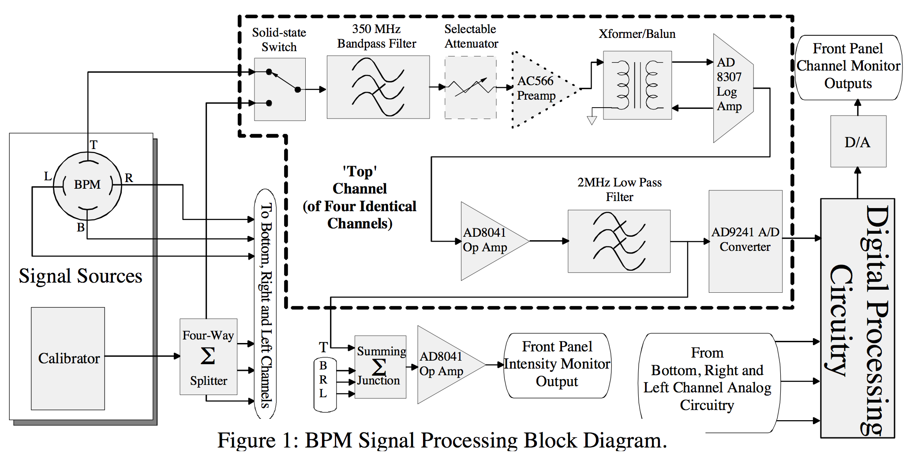
Auto-calibration and linearization
R. B. Shurter et. Al, Analog Front-end Electronics for Beam Position Measurement on the Beam Halo Measurement, Proc. PAC’01
Maurice Cohen-Solal, Design, test and calibration of an electrostatic beam position monitor, Ph. Rev. ST - AB
DC offset compensation, linearization and auto-calibration can be done by the FPGA.
J. Power et al, “Beam Position Monitor Systems for the SNS Linac”, PAC’03

Slide 19
Timing requirements for the BPM system
2.86 ms
Trigger
Intra-pulse:
ADC sampling
Data storage on the AMC memory, etc.
Inter-pulse:
Data communication to the control system
Auto calibration
Error compensation, etc.
RF voltage
Envelope
Beam
14 Hz
Beam Current
RF voltage
RF reference phase:
RF phase detection
IQ demodulation
352 MHz

Slide 20
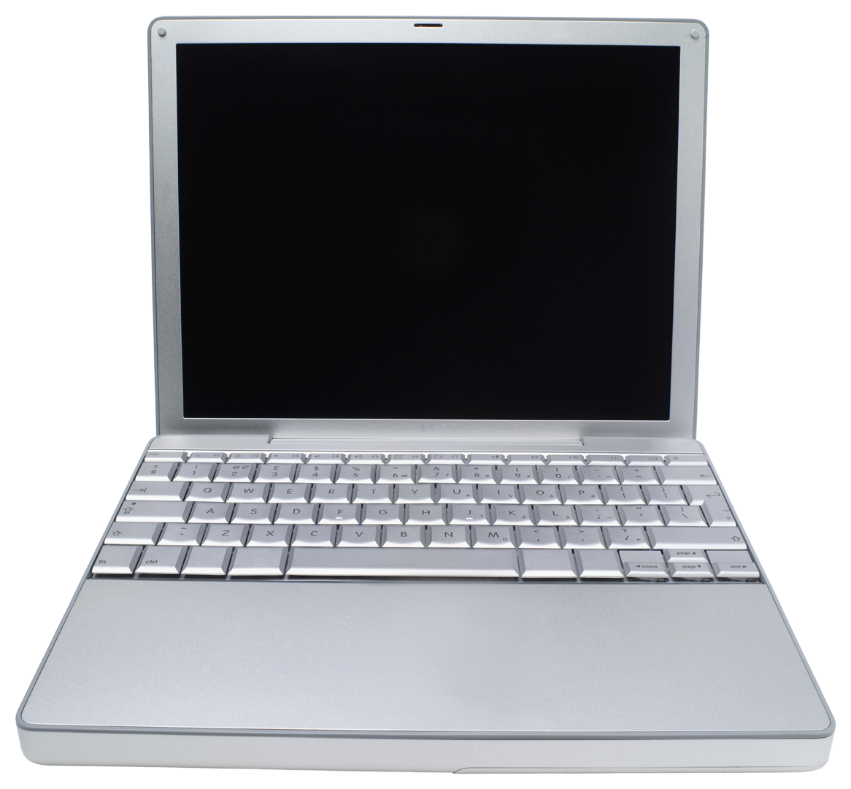
Timing system for BPM and LLRF
HMI
Ethernet
Coaxial cable
MO
352 MHz
Timing
LLRF 1
BPM 1
LLRF n
CPU
CPU
CPU
CPU
Event Gen.
L.L. elect.
L.L. elect.
L.L. elect.
Interface to the control system
Optical fiber
Optical fiber
Timing
Fanout
Optical fiber
Event Rec.
Ref:
CDR -> 5. Control Systems
CDR -> 4.8.2 Low Level RF control

Slide 21
Summary of the minimum timing requirements for the LLRF and BPM systems
Timing signal | Freq. | Synchronization | Spec. | Source | Comment
RF ref. ph. | 352 MHz or 704 MHz | Synchronization needed for the whole Linac | Drift: <0.5° | Coaxial cable or Optical fiber
Pulse rate | 14 Hz | Synchronization needed for the whole Linac | Stability: 1ppm | Event based | + Programmable delay
ADC/DAC sampling | 10 MHz – 100 MHz | Synchronization needed within the shelf |  | backplane
Non real-time or slow | --- | Not needed | --- | Ethernet
Calibration ref. (BPM) | 352 MHz | Not needed |  | Internal to the shelf

Slide 22
Space allocation for the electronics
RF distribution from the klystron gallery to the tunnel, source: ESS RF group

Slide 23
Next steps
Choosing an appropriate signal detection method
Analog front end prototyping
Tests with a μTCA crate
Building a BPM test bench

