Slide 1
BCM & BLM system requirements
Hooman Hassanzadegan
ESS, Beam Instrumentation Group

Slide 2
Outline
BCM system requirements
BCM connection to the MPS system
BLM requirements
BLM electronics
Summary

Slide 3
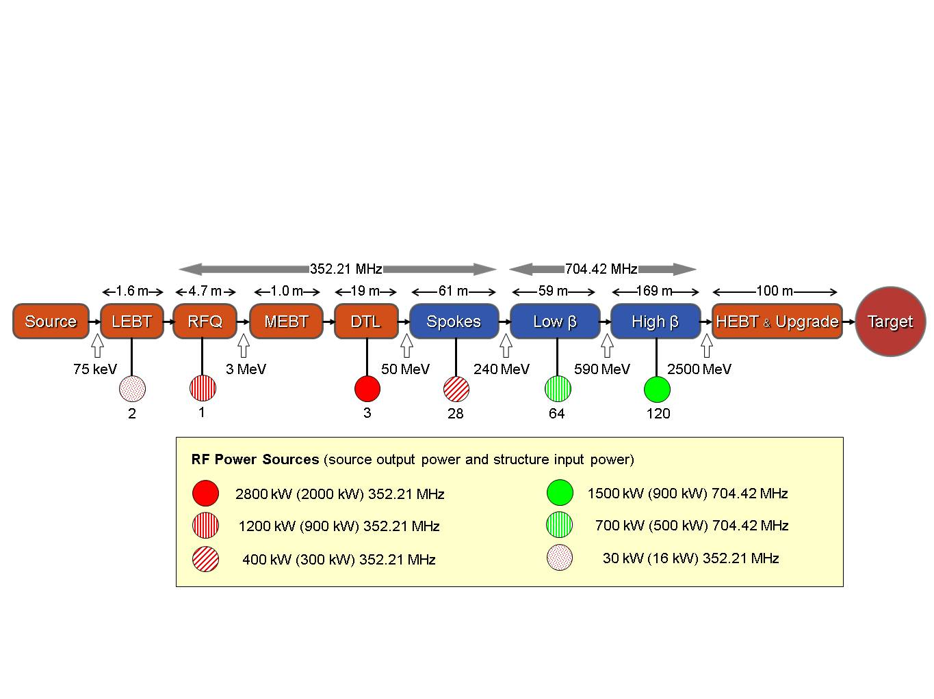
BCM system requirements
The total number of BCMs shall be 13 (might be increased) including:
RFQ: 2
MEBT: 2
DTL (4 tanks): 5
Spoke cavities: 1
Low-β elliptical cavities: 1
High-β elliptical cavities: 1
HEBT: 1

Slide 4
BCM system requirements (cont’d)
2.86 ms
Beam
50 mA
The ESS BCMs shall be able to provide the end user with a “fast” and a “slow” measurement as the following:
2) fast: the instantaneous beam current showing the macro pulse profile such as its head and tail.
1) slow: the average beam current during the flat top of the macro pulse.
14 Hz
BCM
Fast measurement
(beam current profile)
+
Slow measurement
(average beam current)
50 mA
averaging

Slide 5
BCM system requirements
2.86 ms
50 mA
Nominal pulse
Nominal pulse:
Accuracy (20 mA – 60 mA): ±1%
Resolution: 0.1%
Response time (coil + elect.): < 1 μs
Sample rate: > 1 MSPS
Refresh rate (end user): 14 Hz
14 Hz
100 μs
50 mA
Diagnostics pulse
1 Hz
We are discussing with the Beam Physics group to finalize the BCM requirements.
The BCM system also shall be able to measure the beam current in the diagnostics pulse mode.
5

Slide 6
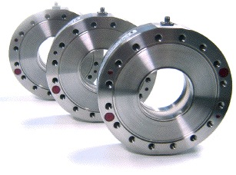
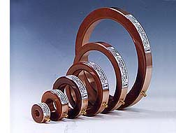
BCM hardware
The BCM coil and the associated electronics are commercially available on the market.
Issues to be further studied include:
Position dependence
Online calibration

Slide 7
Connection to the MPS system
The BCMs of the warm linac (until the end of the DTL) shall be connected to the MPS system so that the beam could be shut off if losses exceed a user-defined threshold.
The BCM system will send a 0/1 signal to the MPS indicating whether the losses are above or below the threshold.
The total reaction time for the MPS (including the current measurement time and the data communication) shall be less than 10 μs.
BCM connection to the MPS

Slide 8
BLM system requirements (electronics)
Dynamic range (for loss detection): 10⁶
BLM read out no 1: averaged over 1 sec. (display in the control room)
BLM read out no 2: averaged over 10 min. (data storage)
BLM interface to the MPS: one 1/0 signal per BLM
Beam abort generation in: 2 μs (half of the time needed to melt the beam pipe)
BLM responsible person: Lali Tchelidze

Slide 9
BLM electronics (analog vs. digital)
Option 1: Analog
Option 2: Digital
Source: ORNL BPMs (Alexander Zhukov)

Slide 10
Summary
We are still in the early stage of identifying our requirements for the BCM and BLM systems.
For both systems we have foreseen two types of data acquisition (i.e. fast and slow) to be used for machine protection or monitoring purposes.
We plan to connect both the BCM and the BLM system to the MPS so that we can shut the beam off if losses exceed a user defined threshold.
We are studying the possibility of doing part of the electronics in house or through external collaborations. As another possibility, the electronics can be bought from the market.

