Slide 1
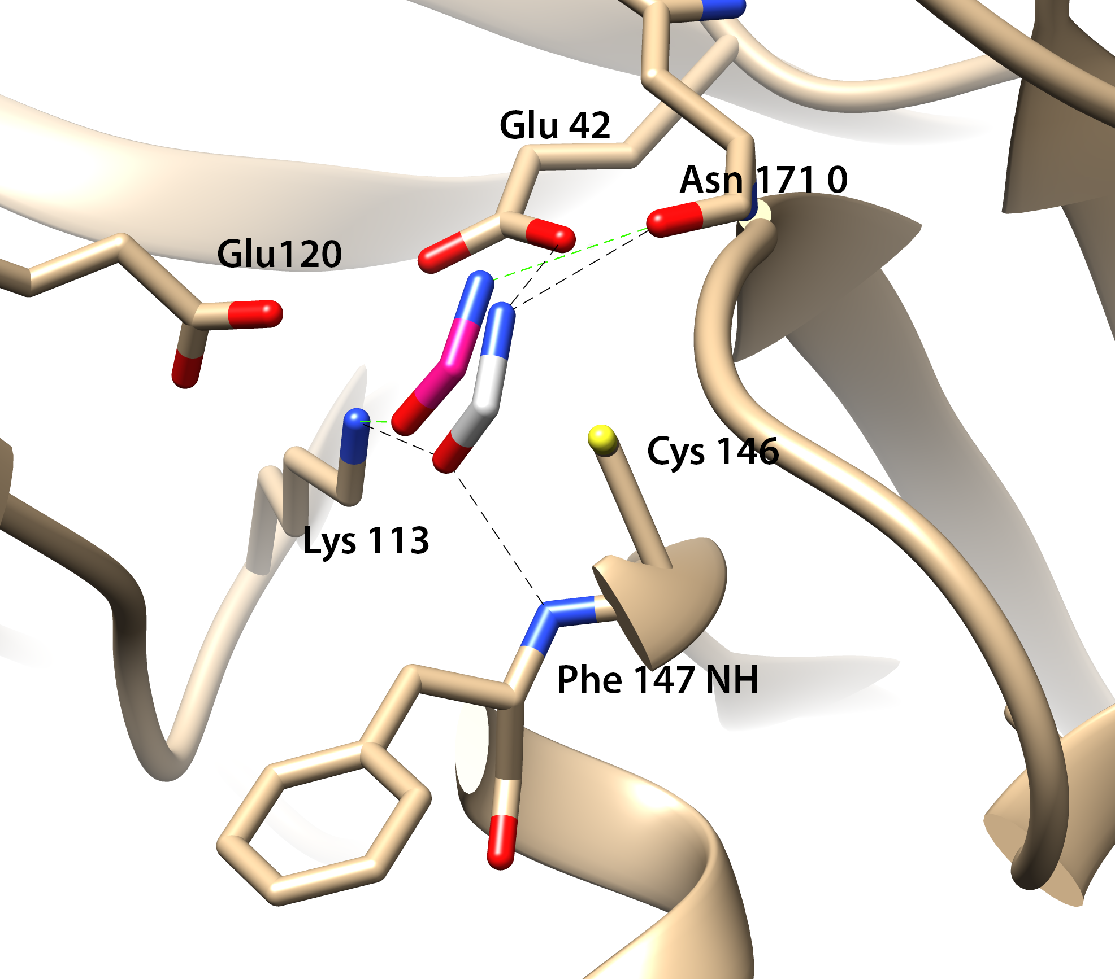
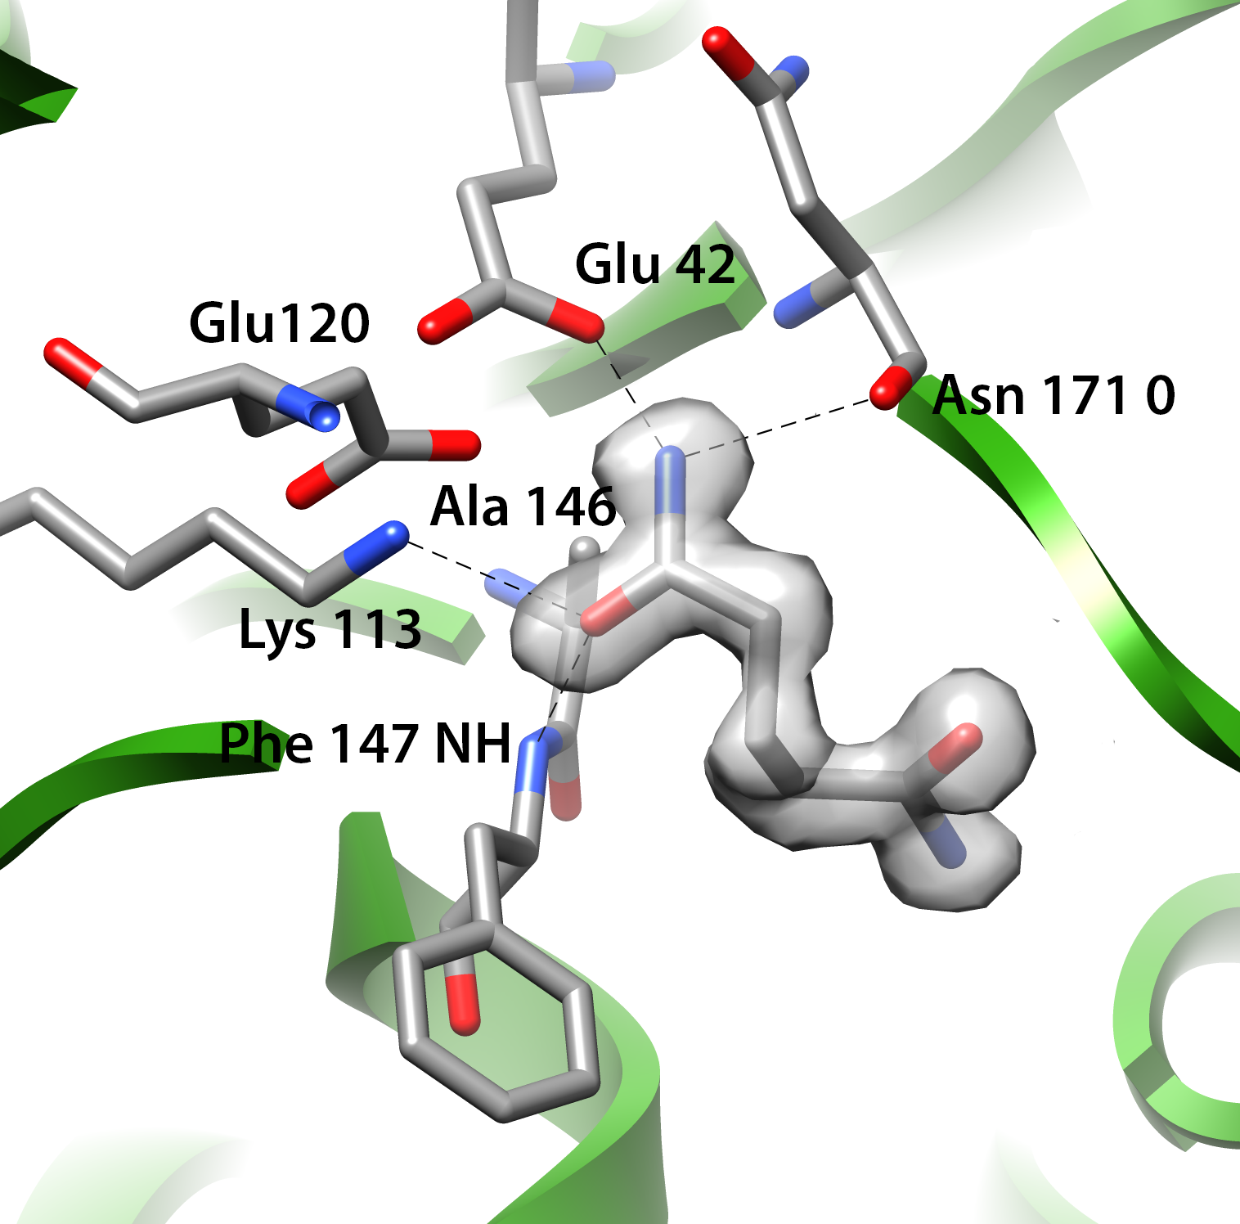
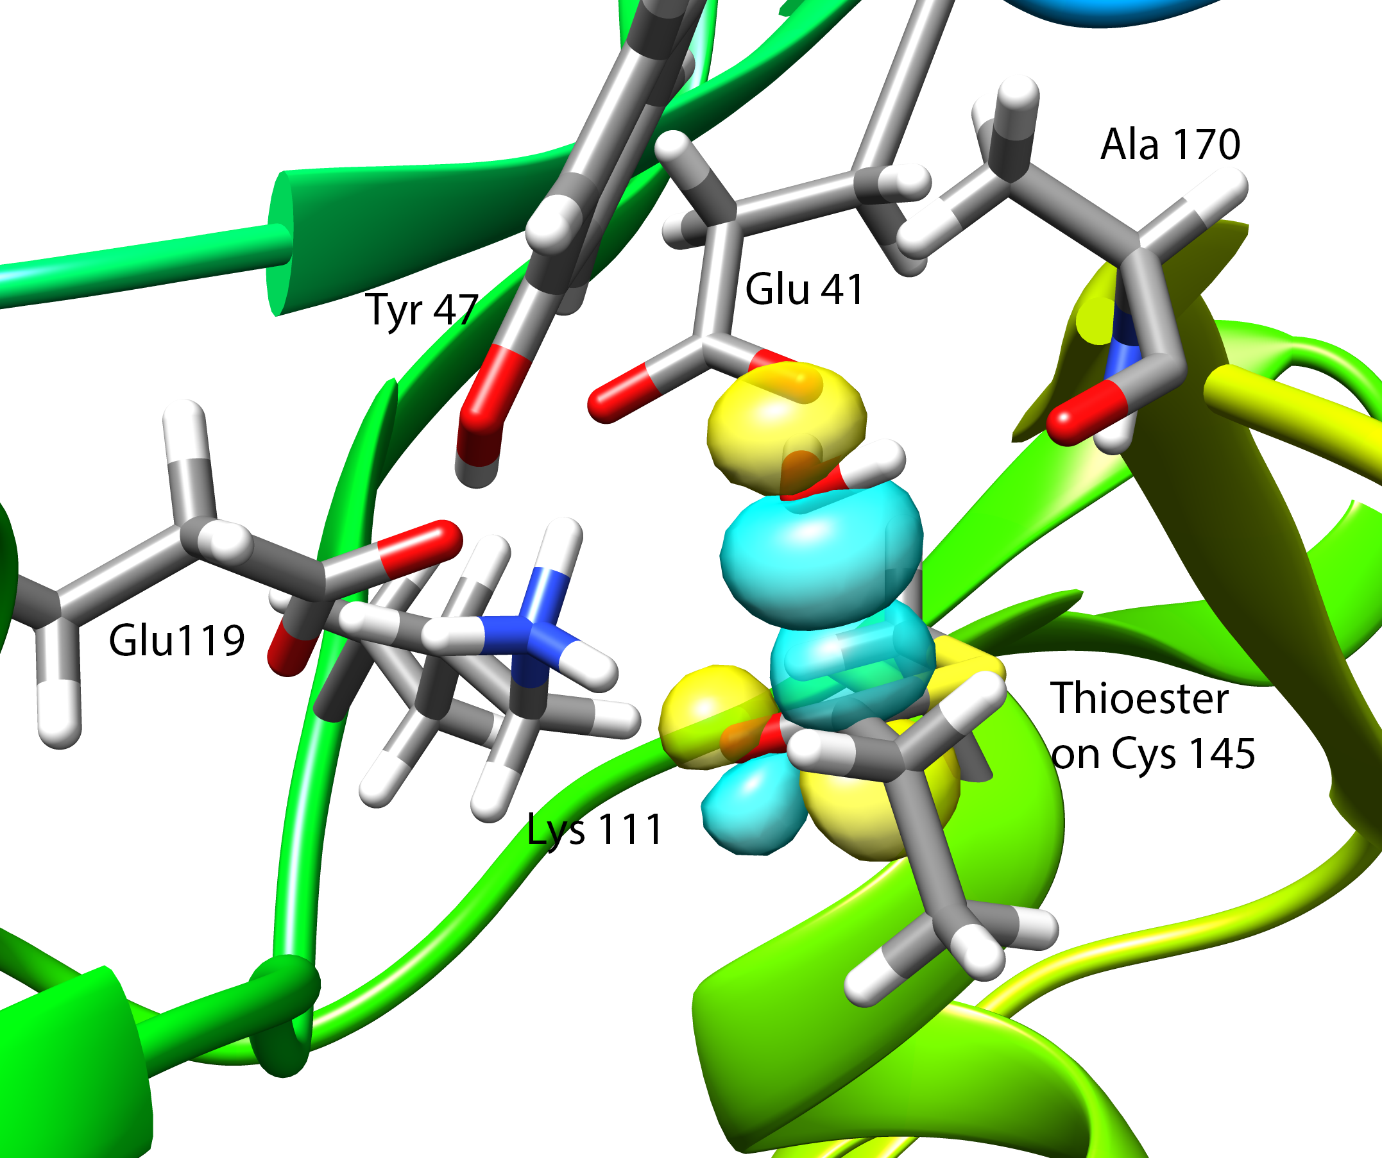
Substrate position and hydrolysis in the amidases
Stanley Makumire, Gerhard Venter, Siyun Su, Trevor Sewell
Docking of 14 amides predicts the substrate amide hydrogen bonding in both WT and C146A variants. The involvement of the backbone carbonyl of Asn 171 was unknown.
Crystal structure of glutaramide in the C146A amidase variant verifies the prediction. This location leads to the formation of a thioester
Intermediate.
Quantum mechanical calculations show orbital overlap with a water positioned by the carboxyl of the active site glutamate and the same backbone carbonyl leading to hydrolysis and product formation.

Slide 2
Why we need neutron crystallography
Oxidation of the active site cysteine due to X-ray exposure
Oxidized Cysteine
We need to know the precise arrangement of the hydrogen atoms in the intact active site
Cysteine is responsible for the nucleophilic attack on the amide carbonyl carbon - however this cysteine is always oxidized during the x-ray diffraction experiment. This has impaired the visualization and interpretation of the active site

Slide 3
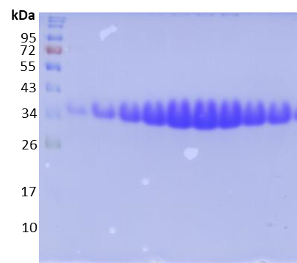
What we have done so far
Nesterenkonia ap. AN1 amidase (NitN)
Shipped to Zoë at ESS
NitN amidase crystals

