Slide 1
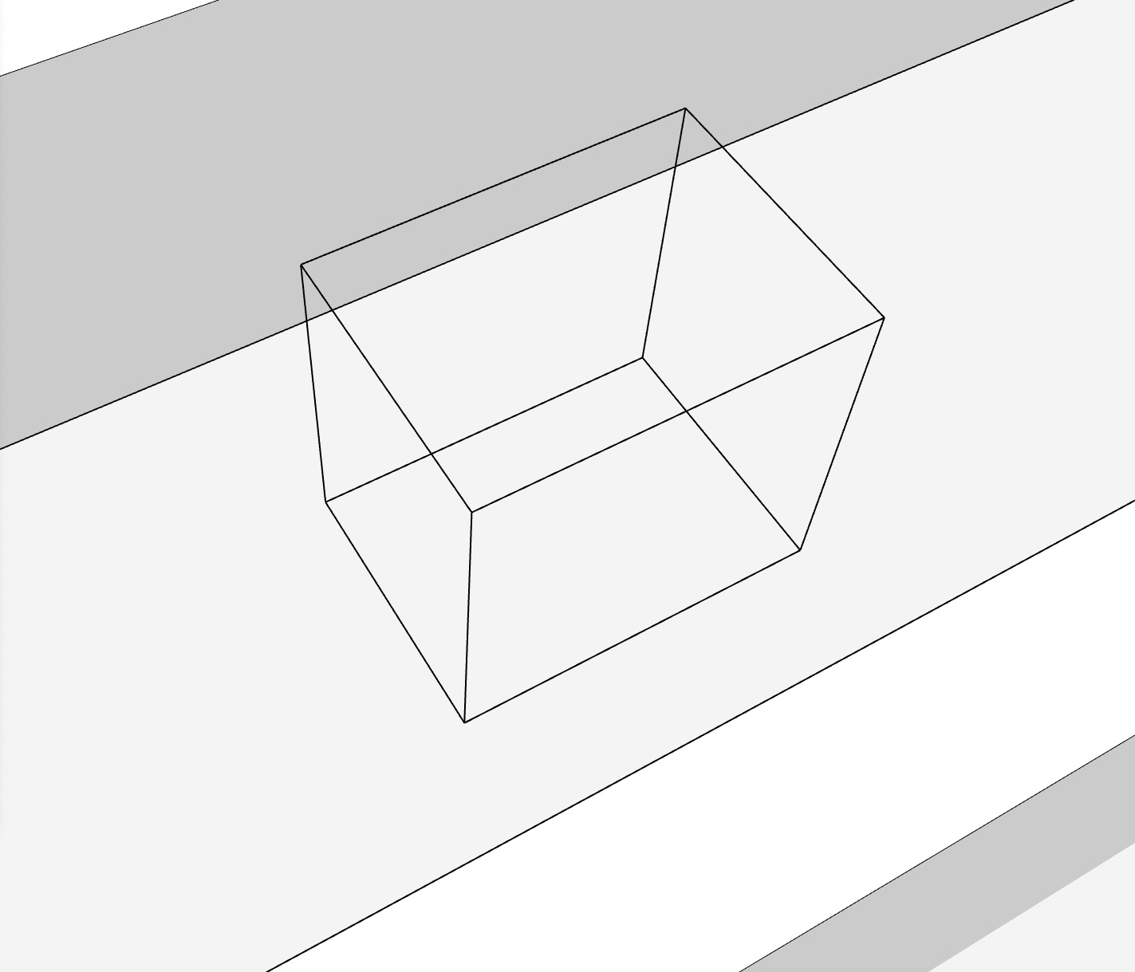
model is only indicative

Slide 2
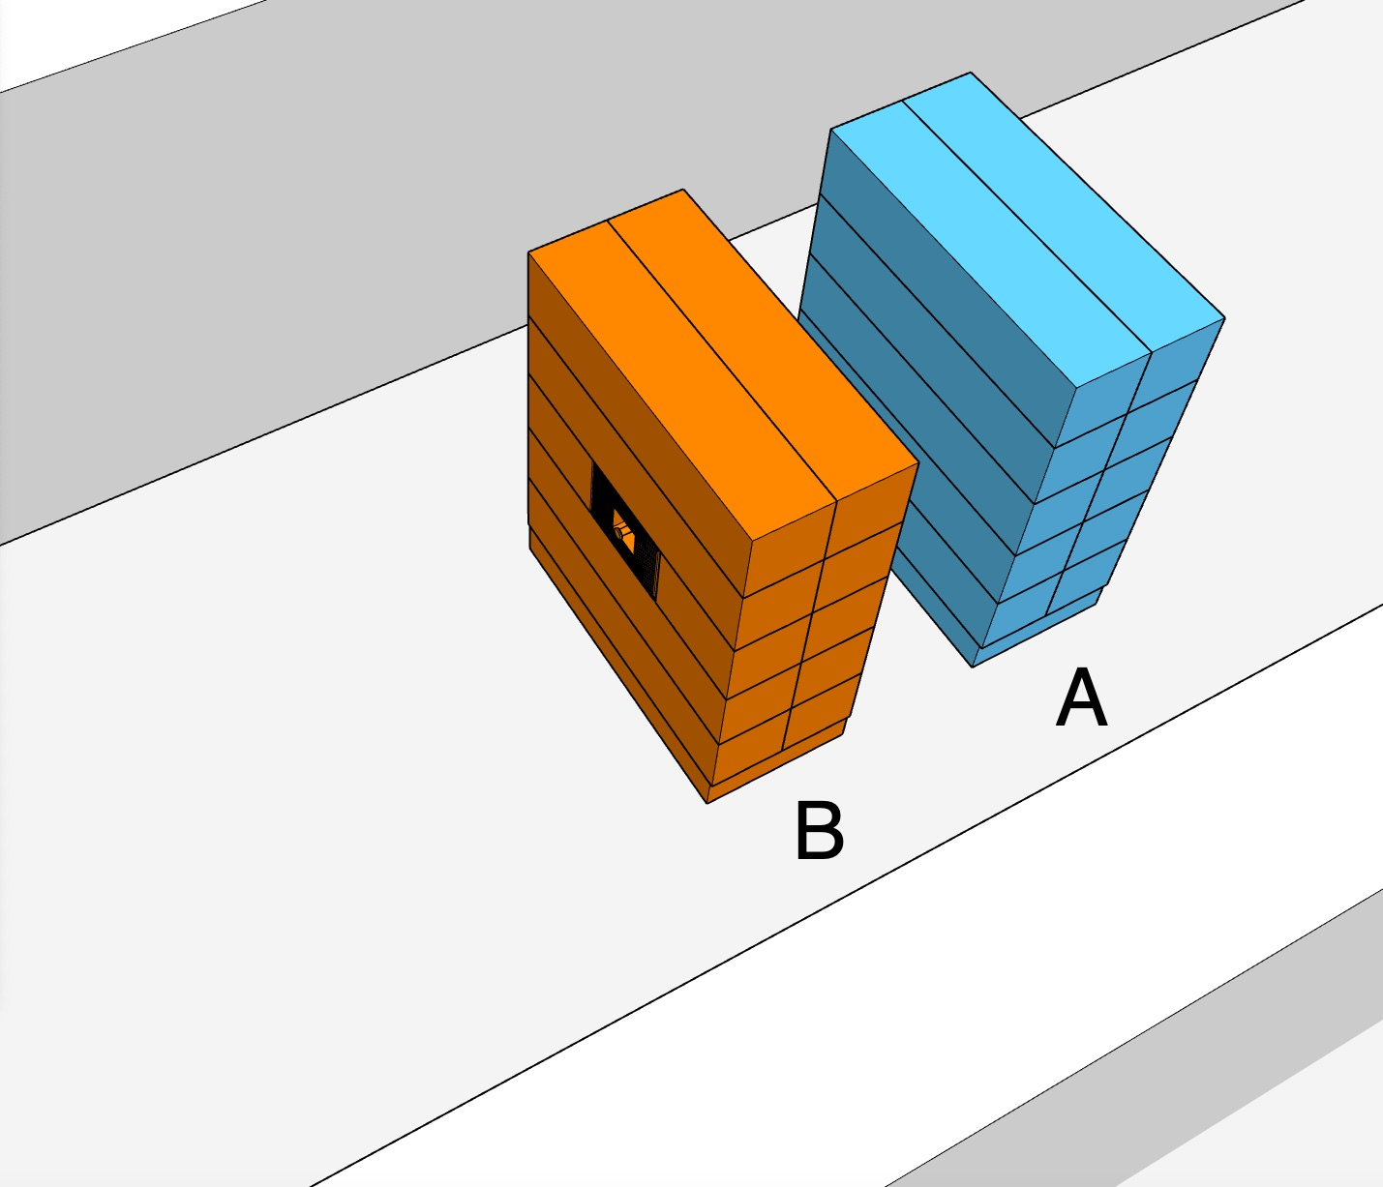
model is only indicative

Slide 3
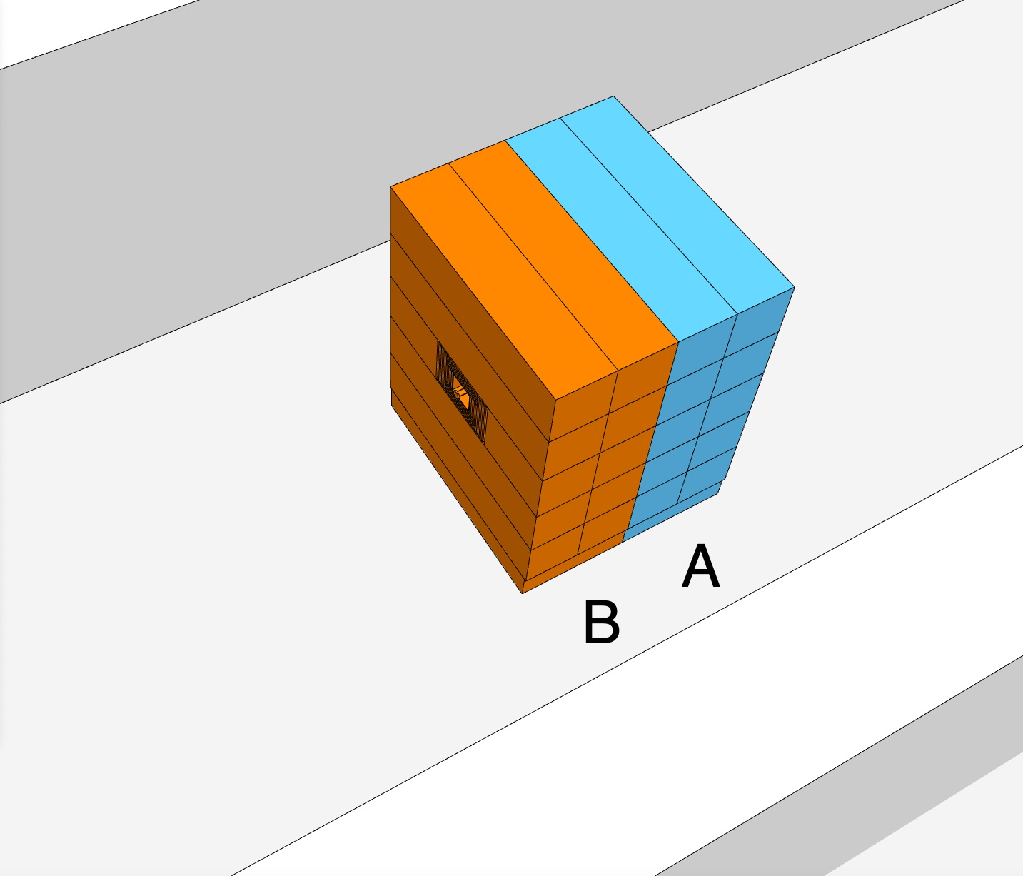
model is only indicative

Slide 4
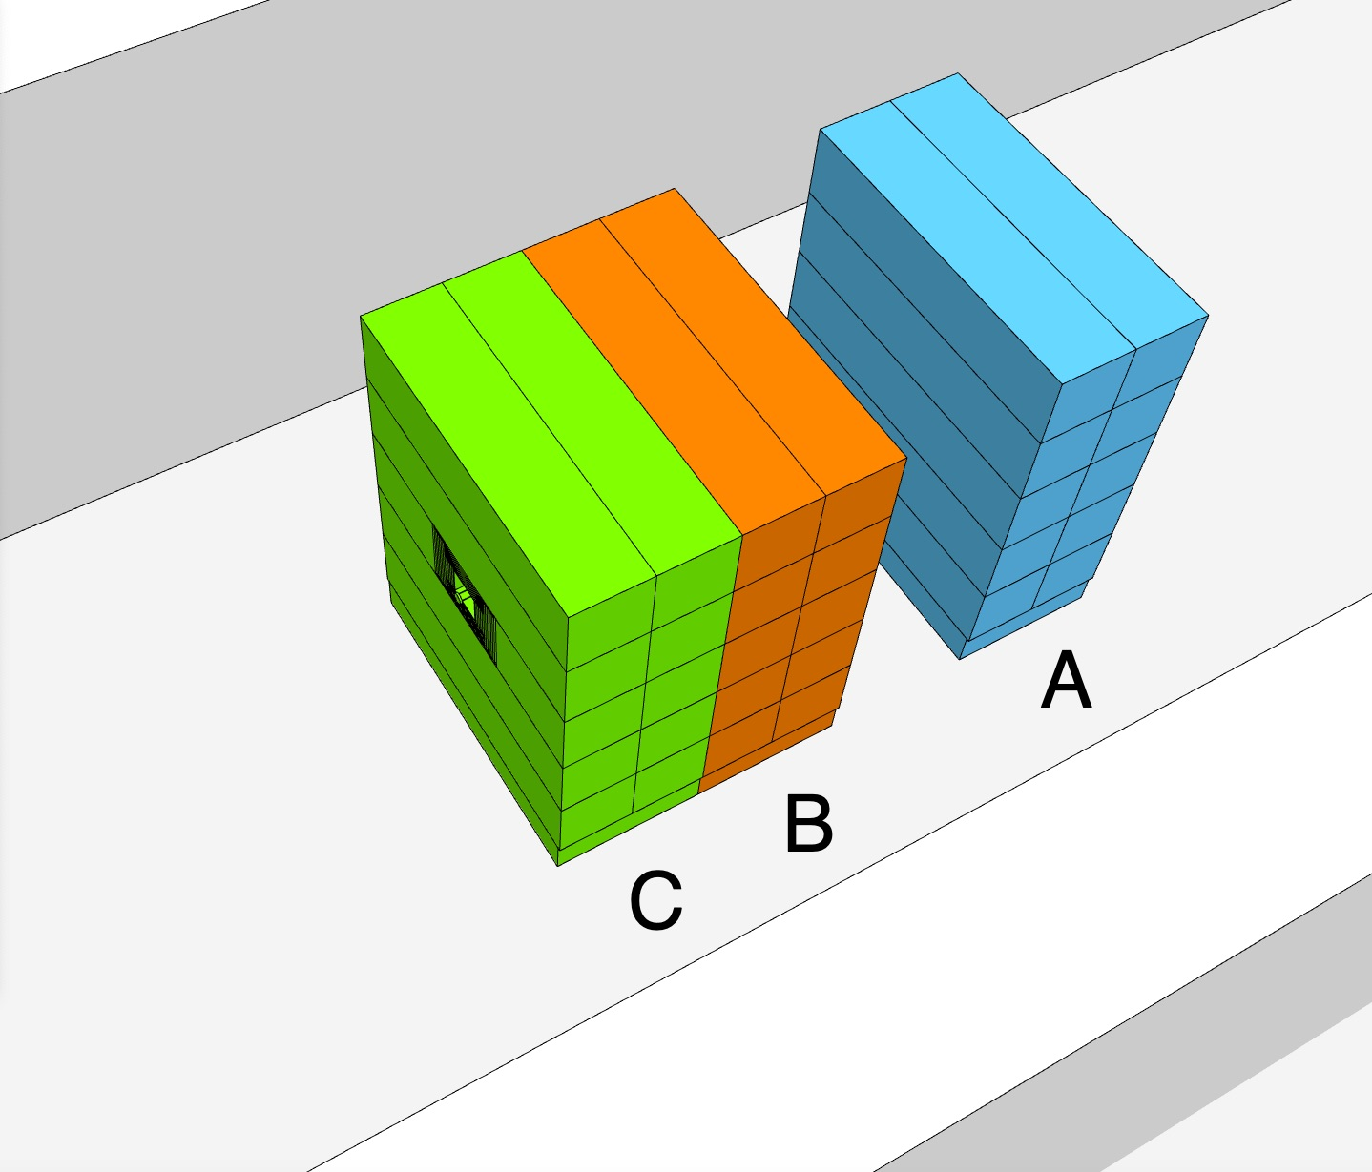
model is only indicative

Slide 5
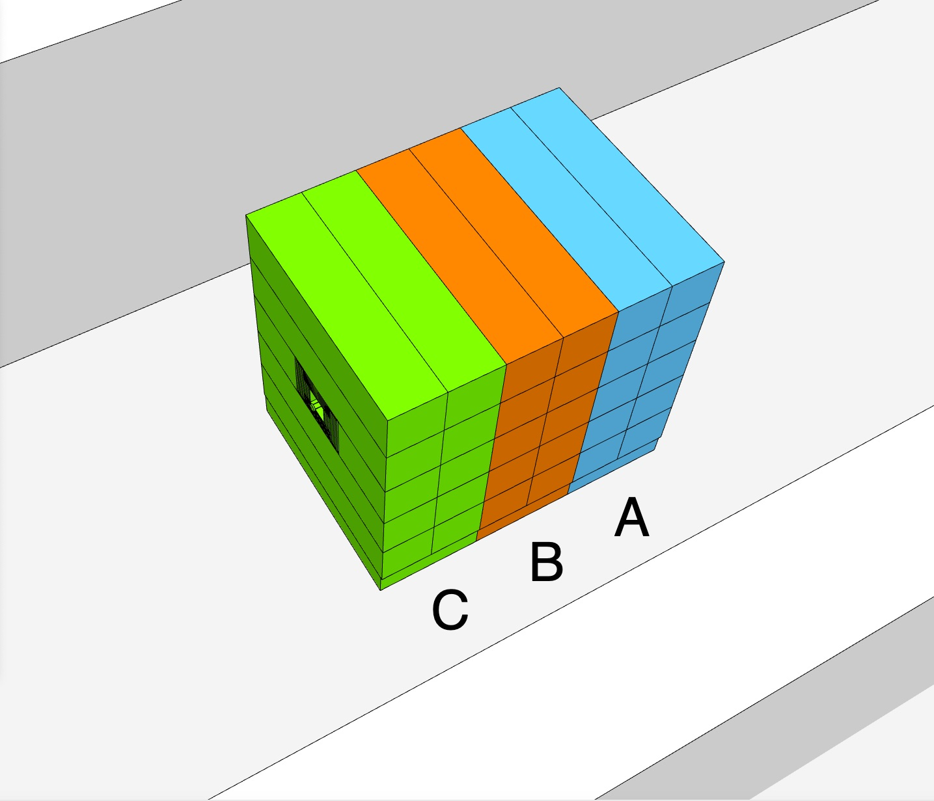
model is only indicative

Slide 6
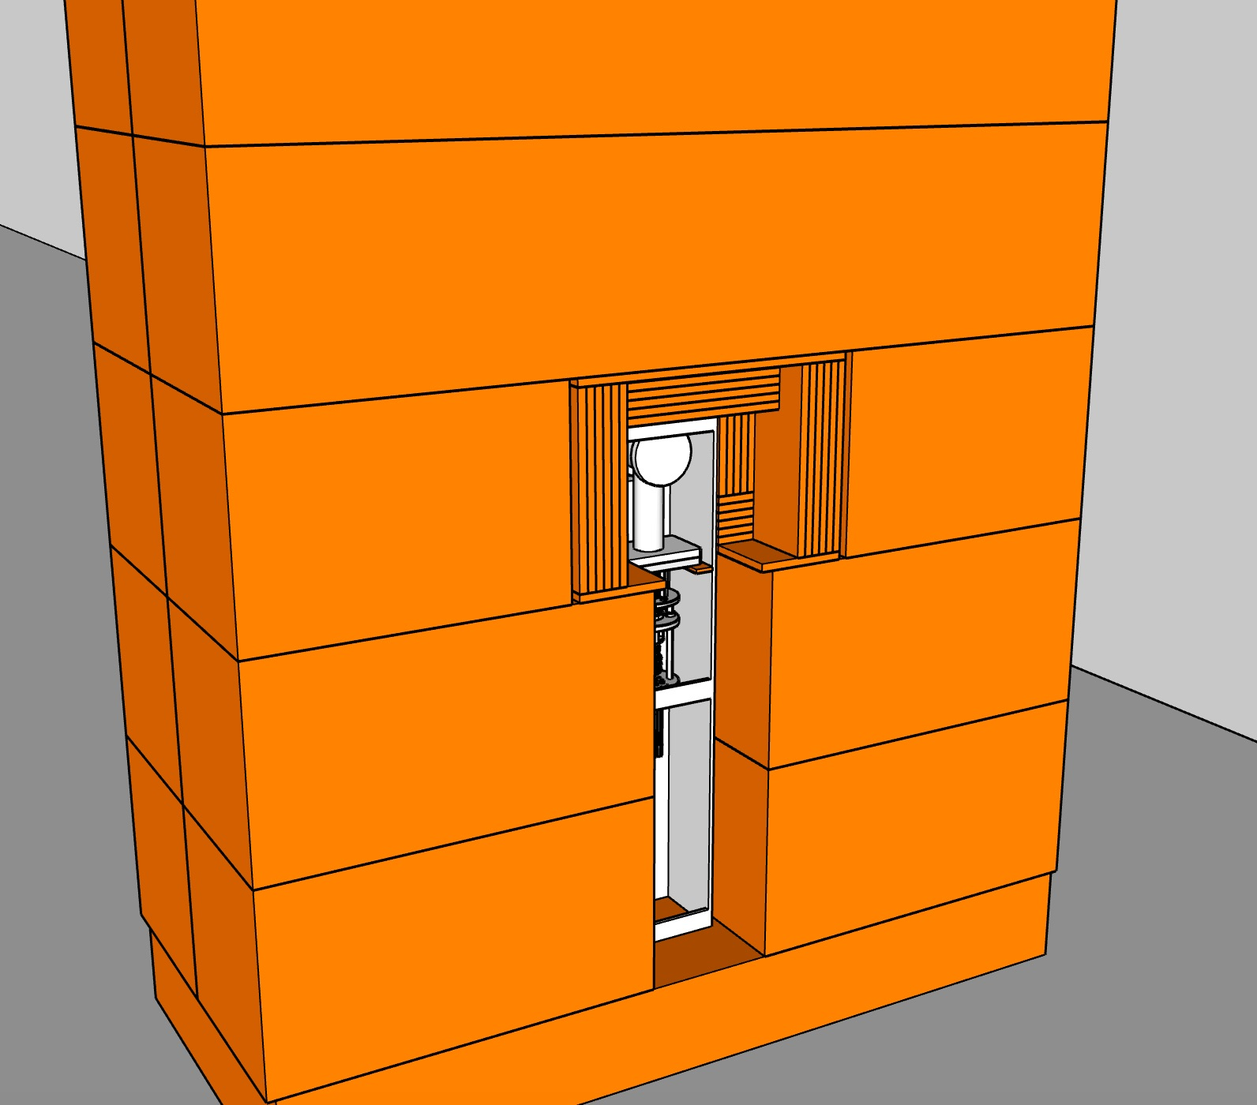
model is only indicative

Slide 7
model is only indicative

