Slide 1
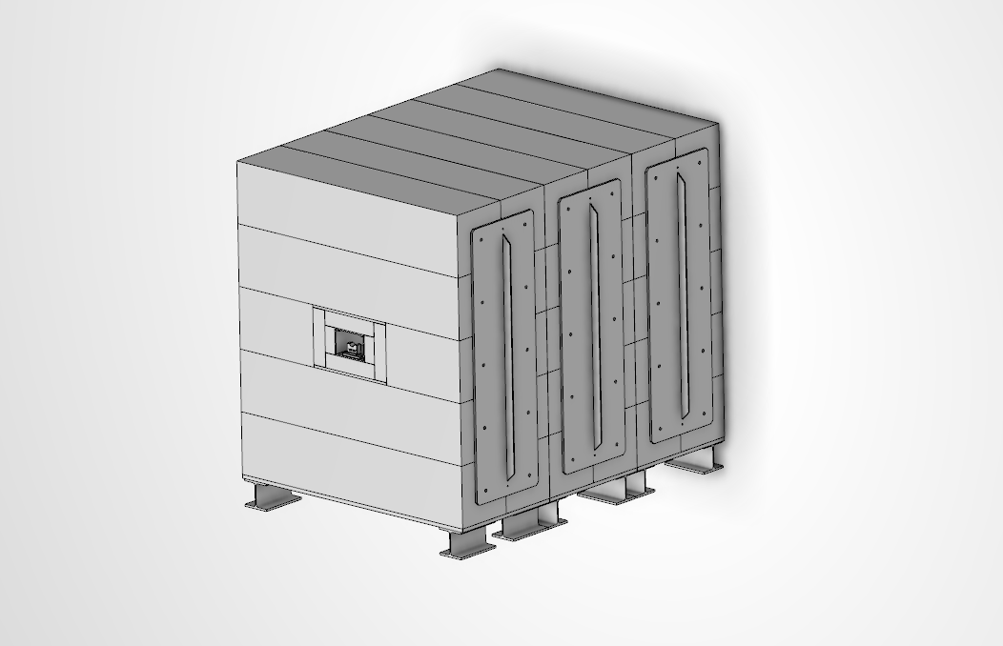
DTL FC Shielding Design
Saverio Ardovino
Mechanical Designer (MET)
European Spallation Source ERIC
26/01/2021

Slide 2
Design & Release Workflow
Requirement Specification
Design
Design Review
Installation
3D model
2D model
Manufacturing, Inspection & Test
Release in CHESS
Saverio
Reviewer(s)
Approver(s)
Technical
WP Leader
MET Section

Slide 3
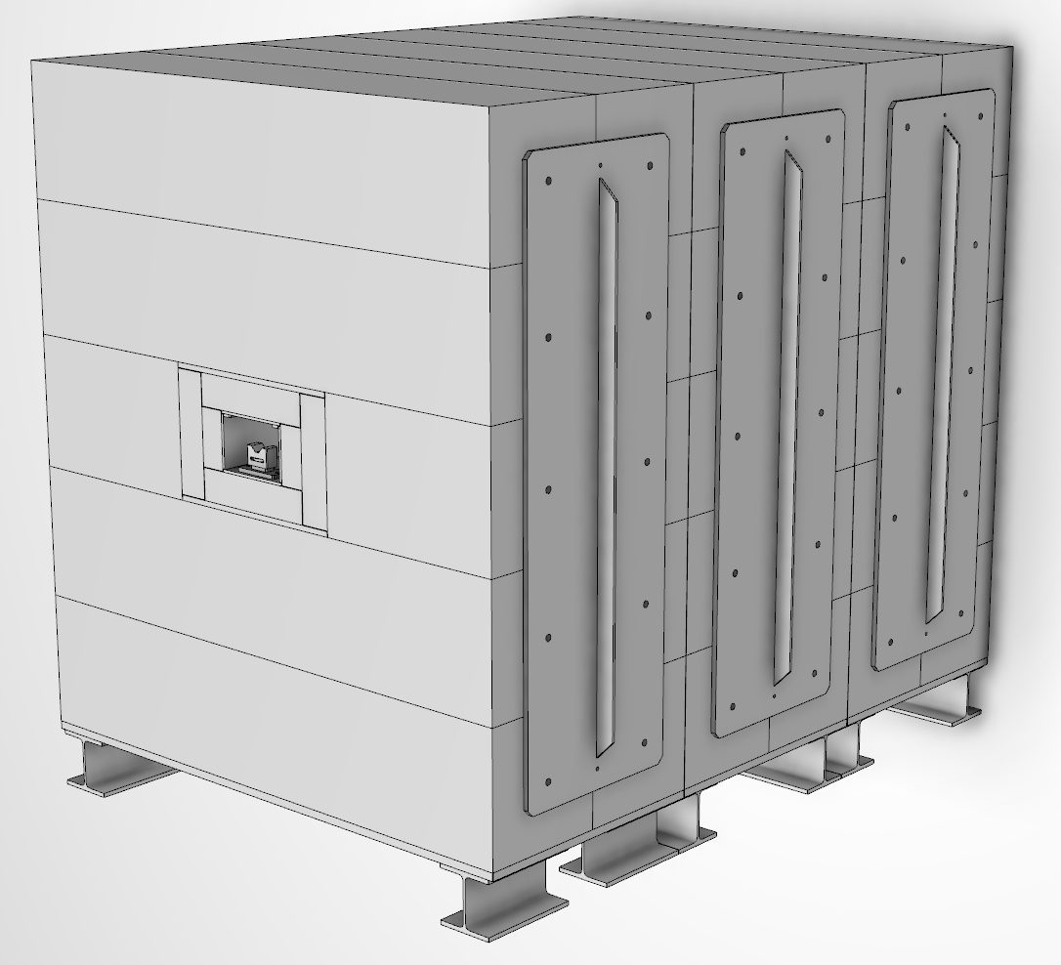
Design Description

Slide 4
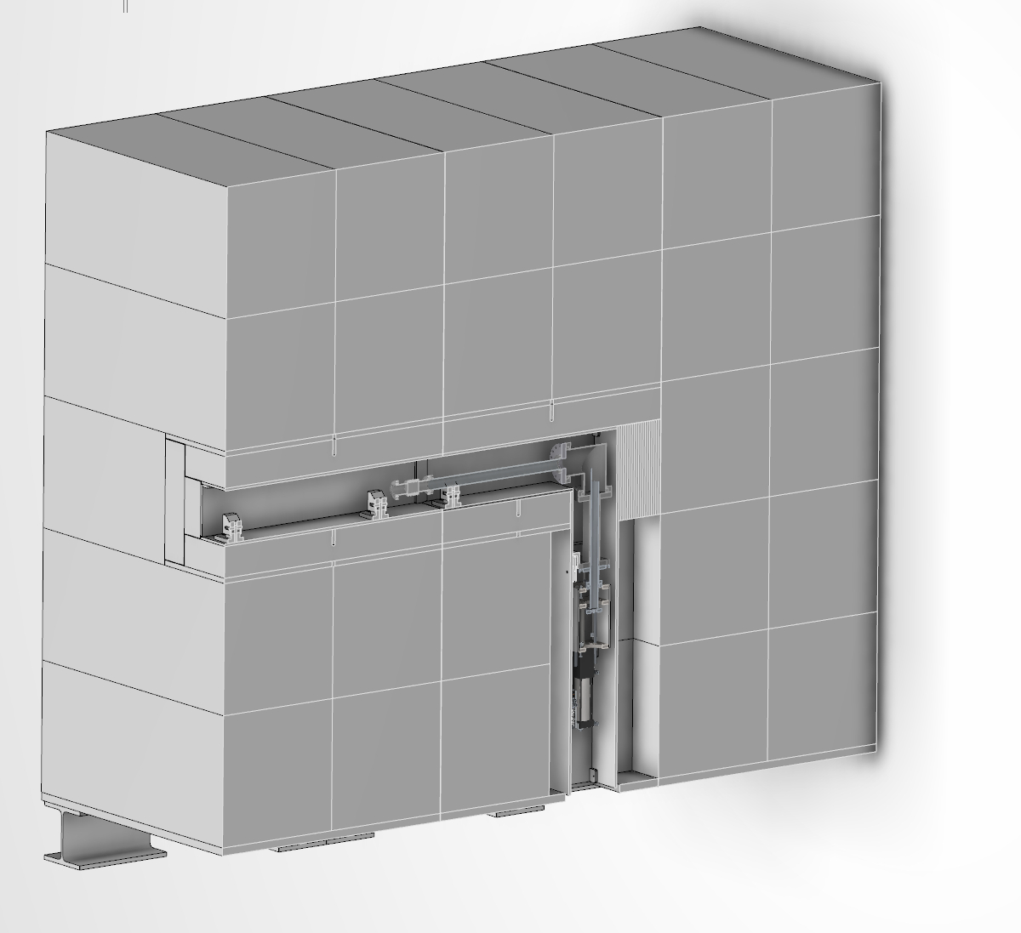
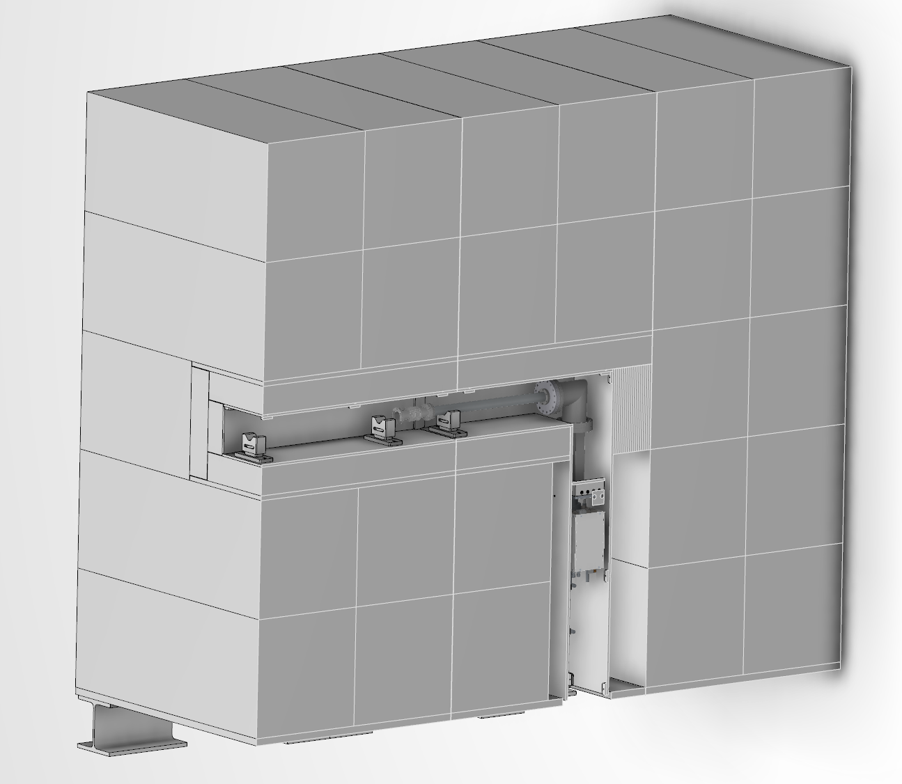
Design Description

Slide 5
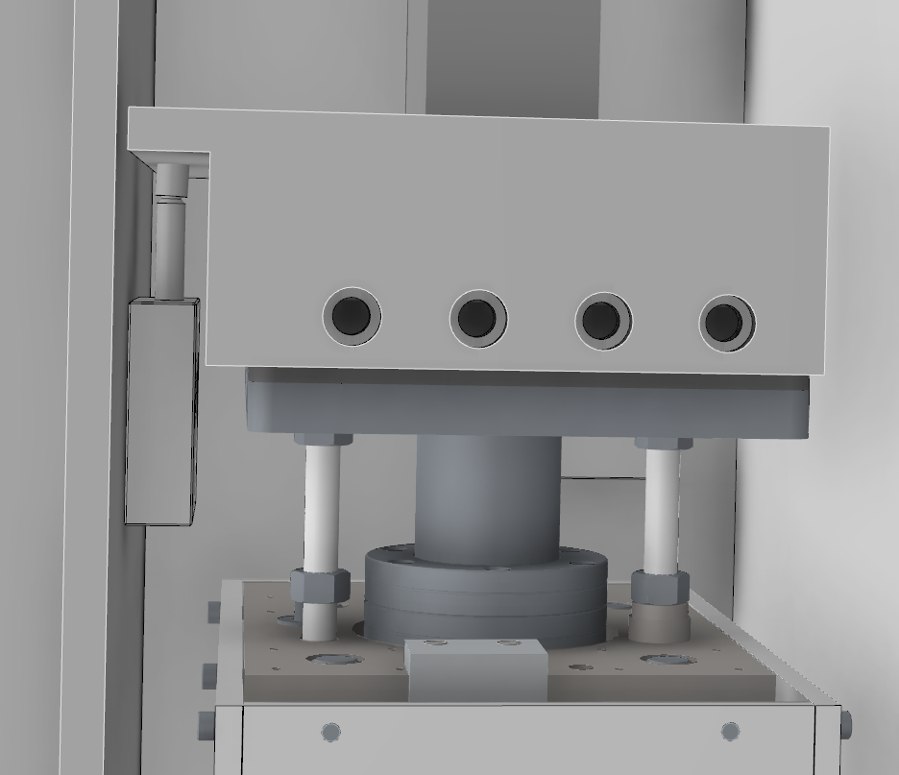
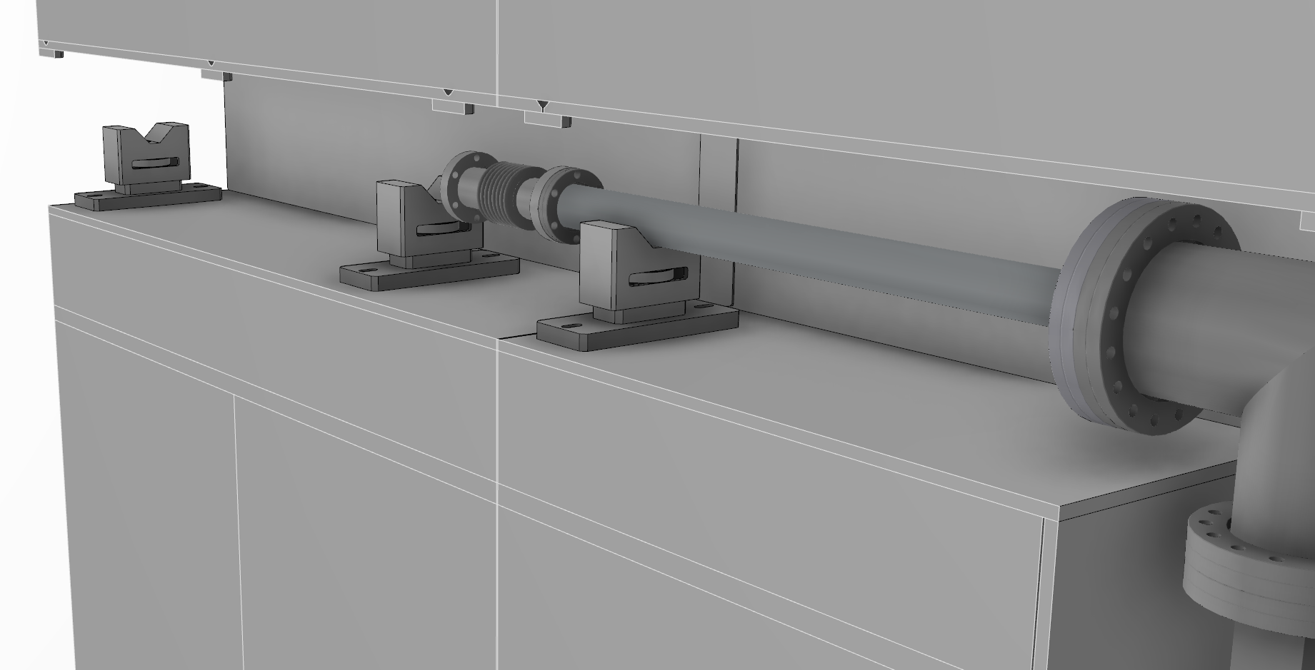
Design Description

Slide 6
Thanks

