Slide 1
Current status of resolution functions for slit geometries :
Bonse-Hart systems
Jan Ilavsky
APS, ANL
1. Bonse-Hart slit length small, large, & infinite
2. Bonse-Hart smearing by slit width and when needed
3. Bonse-Hart smearing when using fly scanning, data binning and it impact.

Slide 2
Slit smeared Bonse-Hart system
Notable tidbits:
Q resolution is beam size independent
Shorter instruments are easier and simpler
APS USAXS cost is < $1M, less than typical SAXS Eiger detector.
Instrument has interesting potential for imaging and tomography capabilities.
J. Appl. Cryst. (2009). 42, 469–479

Slide 3
slit length types
Small SL << inst. Q_{max} OR data Q_{max}
APS SL ~ 0.03 while typ. Q_{max} ~ 0.1 – 0.6 [1/A]
Easy to desmear (no need to fake data to higher Q).
Large SL ~ data/instrument Q_{max}
Difficult to desmear (need to fake data to higher Q).
SL = ∞ … no solid angle Ω
= no absolute primary int. cal., no way to desmear.
S. Length profile - rectangular seems “good enough”

Slide 4
Smearing by slit width
Slit width is “resolution” :
Si 111 ~ 1.2 e-4 [1/A]
Si 220 ~ 0.8 e-4 [1/A]
Si 440 ~ 0.3 e-4 [1/A]
Important only at small Q values, below 0.001 [1/A].
Rare issue. Really rare, in ~20 years needed once…
Rectangle or Gaussian? Likely Gaussian, but no proof or test to verify.

Slide 5
This is not completely unreasonable model…
Real sample:
Standard step scanning…
2500 measured points
1 hour of data collection
Flyscan?

Slide 6
USAXS slit width shape
Width function = rocking curve
Si 111
Si 220
Si 440
Future? …
  Si 660
  Si 311

Slide 7
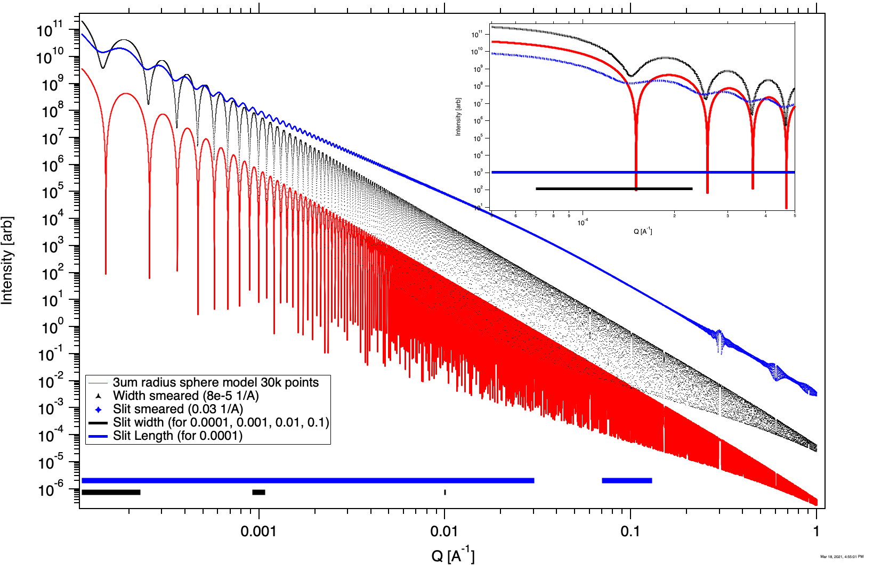

Slide 8
Fly scanning and q resolution
Fly scanning = continuous move, recording data collected between two angles while moving. We use 8k points over measured angular region.
  More efficient, collection times ~ ½ of step scanning with same X-ray dose
  Minimizes vibrations, accelerations, moving/counting overhead
  Typical step scan time is 3+ minutes with 300 points [:move/settle/count:]
  Typical flyscan time ~ 90 sec (+ 20 sec overhead), min. 30 sec (+overhead)
  Can re-bin to needed points later as needed ! Typical 500, but as high as 3k.
Flyscan re-binning of data has impact on Q resolution (dQ) …
  Slit length is given by geometry, fixed value for all points
  Per point Q resolution is given by :
    Slit width (crystal optics, e.g. 8e-5 [1/A], ~Gauss shape)
    Bin width, varies per point, rectangular shape
    Shape – convolution of rectangle & Gauss, shape varies across Q range.
  Summary: dQ shape and width varies as function of Q.

Slide 9
Flyscan resolution

Slide 10
APS USAXS output data
Typical user gets desmeared data (Lake method in Irena) = easier for staff, no need to worry about user fitting data with pinhole model by mistake.
Desmearing adds noise and is not suitable for noisy (weak) data, for such data user gets slit smeared data and strong suggestion to use Irena only. Irena understand what data user has based on data (wave) names (and metadata).
All data (Igor, ASCII, or Nexus) have
  Slit length if slit smeared in [1/A] (a value in metadata)
  Intensity array, on absolute scale [1/cm] if sample thickness was provided
  Q array in [1/A]
  Uncertainty array for Intensity (estimated, empirical formula)
  dQ array (Q resolution) in [1/A]
    Flyscan data = convolution of bin width & slit width
    Step scan data = slit width
Ugly truth: while one Irena tool can handle dQ, very few users bother to use it.

