Slide 1
Welding of Port Tubes to Monolith Vessel
Scope of Work, Requirements and Acceptance Criteria
Dr. Sara Ghatnekar Nilsson, WPM Monolith Systems, target division

Slide 2
Agenda
1 ESS Basics
2 Scope of Work, Requirements and Acceptance Criteria
3 Tolerances

Slide 3
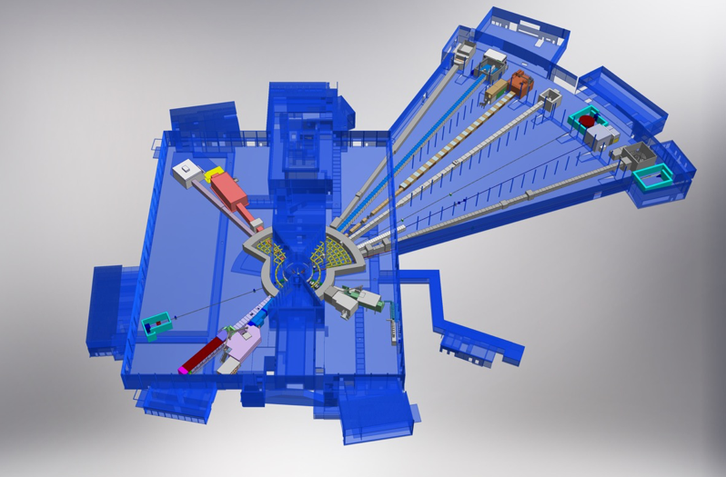

ESS Basics, Target and Instruments
Monolith
BEER
NMX
Instrument hall
West sector
C-SPEC
BIFROST
MIRACLES
MAGIC
ODIN
Neutron beam guides
T-REX
DREAM
HEIMDAL
LoKI
VESPA
FREIA
Instrument hall
North sector
SKADI
ESTIA
Accelerator tunnel
ESS Instrument Layout

Slide 4
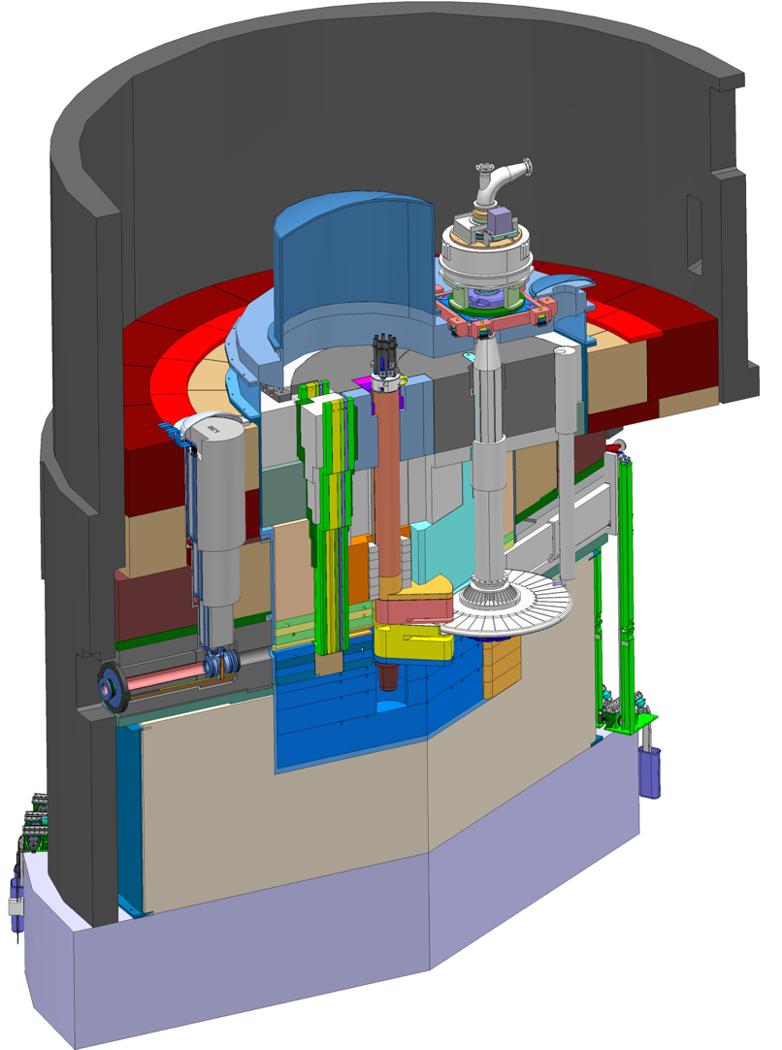
ESS Basics, Monolith Vessel and Port Tubes
Monolith Vessel
Moderator and Reflector
Proton Beam Instrumentation Plug
Monolith Vessel
Neutron beams to sample stations.
PBW Vessel
Neutron Beam Port Tube
Proton
beam
Target Wheel
Target Monitoring Plug
Proton
Beam Window
ESS-Beam Instrumentation
Proton beam
nn-bar
Port tubes

Slide 5
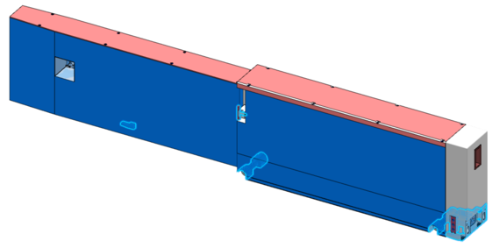
ESS Basics, Monolith Vessel and Port Tubes
Moderator and Reflector
Proton Beam Instrumentation Plug
Monolith Vessel
Neutron beams to sample stations.
Neutron beam port tube
Neutron beam insert carrying the optics
Neutron Beam Port Tube
Proton
beam
Target Wheel
Target Monitoring Plug
Neutron beam
Proton
Beam Window
ESS-Beam Instrumentation

Slide 6
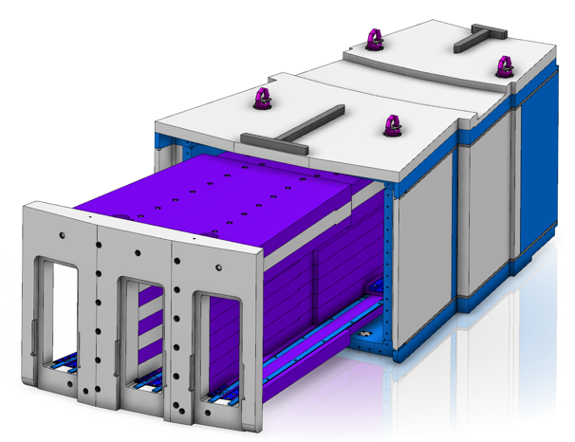
ESS Basics, Monolith Vessel and Port Tubes
Manufacturer Vessel: AVS and Cadinox
In-Kind from ESS-Bilbao
Method: Submerged arc-weld and TIG weld towards vacuum side
Facts: Diameter≈6m, H:6m, W:40 tons
Manufacturer tubes and nn-bar: Ensa and Asturfeito
ESS-managed contract
Method: Laser weld
Facts tubes at Vessel side:
L:2.7m, H:0.7m, Width:0.2m
W:1.2 tons
Facts nn-bar:
L: 2.7m, H:0.9m, Width:1m
W:11 tons (frame) + 18 tons (adapter)

Slide 7
2
Scope of Work, Requirements and Acceptance Criteria

Slide 8
Scope of Work
3 tubes in place
3 tubes in place
view from inside of the Monolith Vessel
The scope of work is under a contract between ESS-Bilbao and Ensa and is focused in the welding of the 39 Port Tubes, the NN-Bar Frame and the Connecting Pipe to the Monolith Vessel.
The delivery of Port Tubes and NN-Bar Frame is under the scope of Ensa. The Monolith Vessel and Connecting Pipe supply is In-Kind delivery from ESS-Bilbao.
Work on site consists of:
Work preparation (protections, scaffolding, laydown area, water, air, electricity, tools, etc)
Lifting and alignment of components before welding
Welding of 39 Port Tubes + 1 NN-Bar Frame + 1 Connecting Pipe
Non-destructive testing of the welds (includes pressure test)
Dimensional control after welding

Slide 9
Legal Requirements
Legal requirements that need to be fulfilled:
AFS 2017:3 (Swedish regulations)
AFS 2016:1 (PED, Swedish regulations)
Construction code: EN 13445
Directive 2014/68/EU (PED)
Mechanical classification: MQC4A
AFS 2006:8 pressure testing (Swedish regulations)
The requirements are met by following:
KFM (Design basis)
Welding procedures: EN ISO 15614-1
Welds acceptance criteria: EN ISO 5817 (Class B)
Welders qualification: EN ISO 9606-4/ EN ISO 14732
Special training of welders (RSQ)
Visual Testing (VT): EN ISO 17637/ EN ISO 23277
Dye penetrant Testing (PT): EN ISO 3452-1/ EN ISO 5817 (Level B)
Radiographic Testing (RT): EN ISO 17636-1 (Class B) / EN ISO 10675-1 (Level 1) / EN ISO 19232-3 (Class A)

Slide 10
Functional Requirements
Fulfil dimensional requirements after welding.
The welds must :
  Withstand mechanical loads according to KFM ESS-0135150
  Be leak tight and according to vacuum standards
KFM ESS-0135150
Installation drawing
ESS-3185128

Slide 11
Requirement on Weld Thickness
A decision was made to have 8mm thickness in the welding area.

Slide 12
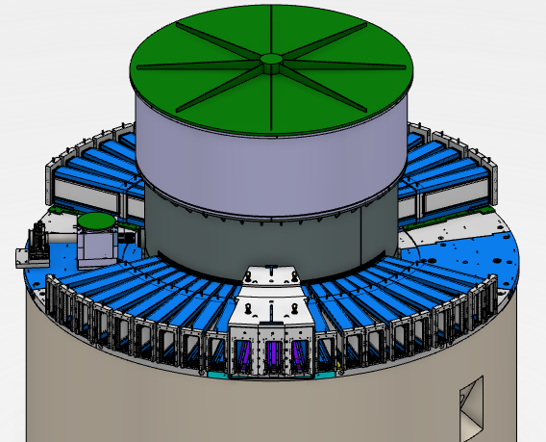
Acceptance Criteria
Welds acceptance criteria: EN ISO 5817 (Class B)
Individual leak tests of the tubes < 10⁻⁶ Pa m³ / s (10⁻⁵ mbar l / s).
Shape and position of tubes after welding must be fulfilled according to tolerances on installation drawing.
Pressure test of the Confinement system (PBW port block, tubes and lower & upper Vessel).

Slide 13
3
Tolerances

Slide 14
Tolerances
Originally, the space requirements between tubes and inserts were extremely tight. The main reasons were to prevent streaming, and that the tolerance input from NSS was in the range of fractions of mm in order to not loose the scientific signal-to-noise ratio.
Several tolerance chain workshops have been held at ESS with a holistic perspective under leadership of ESS Technical Coordinator Dr. Masatoshi Arai, resulting in a relaxation of some strict tolerances, e.g. the range in the xyz-window around the focal point that Instruments can view in order to not loose signal-to-noise ratio were relaxed to X±5mm; Y±3mm; Z±2mm

Slide 15
3
Tolerances by Robert Svensson
Work Unit Lead for Neutron Beam Port Blocks

