Slide 1
Installation and alignment constraints
iCDR, TIK 4.5
PRESENTED BY KRiSTER BLOMBERG
ESS-3235303

Slide 2
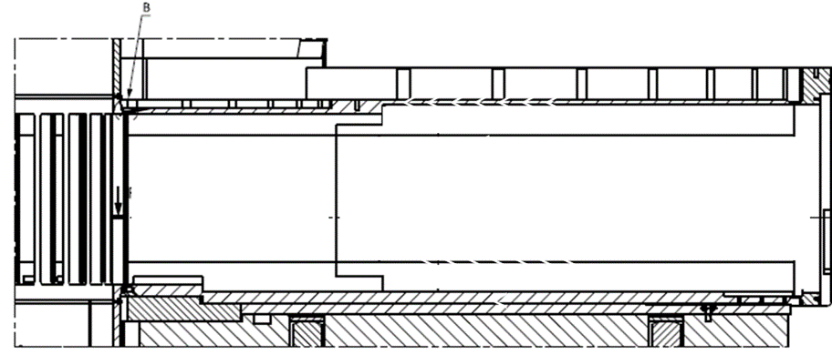
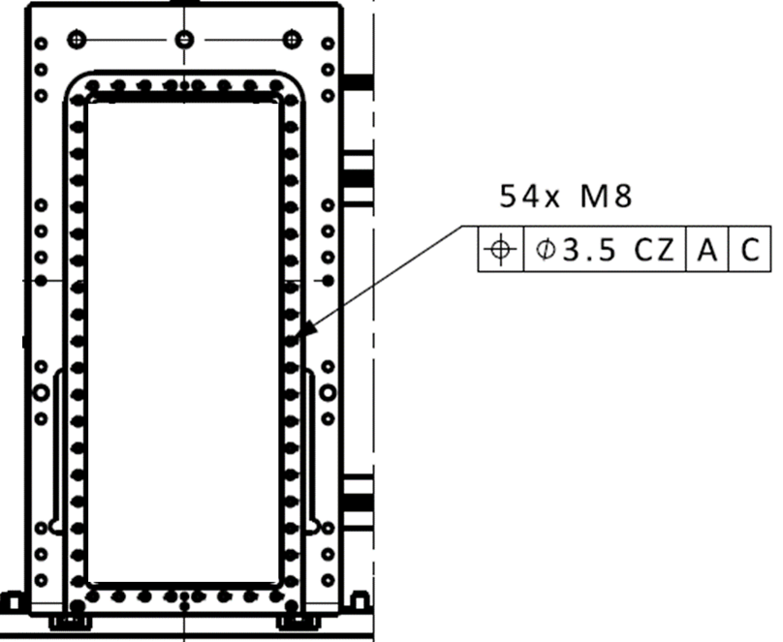
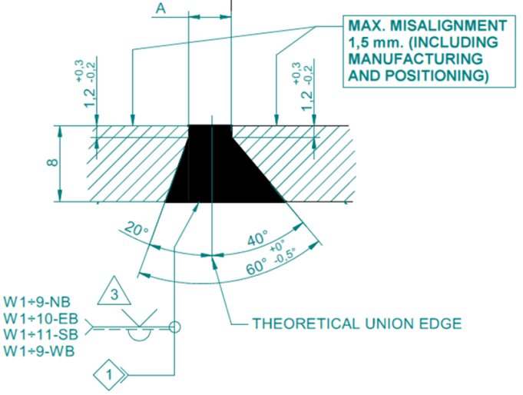
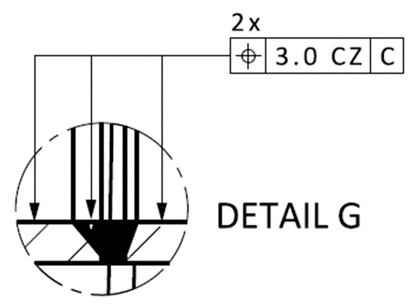
Porttube requirements in BPCS-Y-direction
according to ESS-3185128 and 5EC8GS501
BPCS Y
BPCS-Y
BPCS-Y

Slide 3
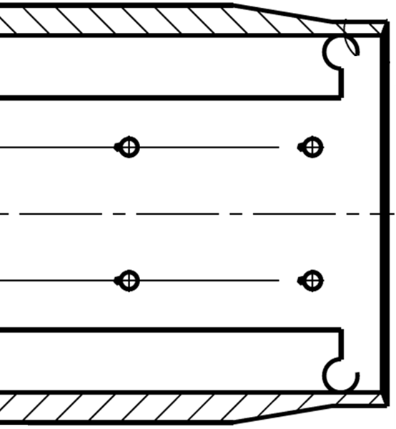
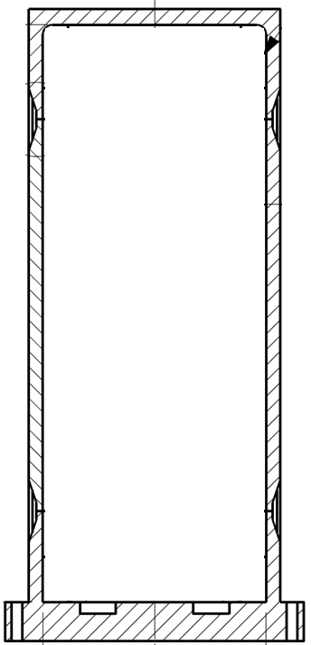
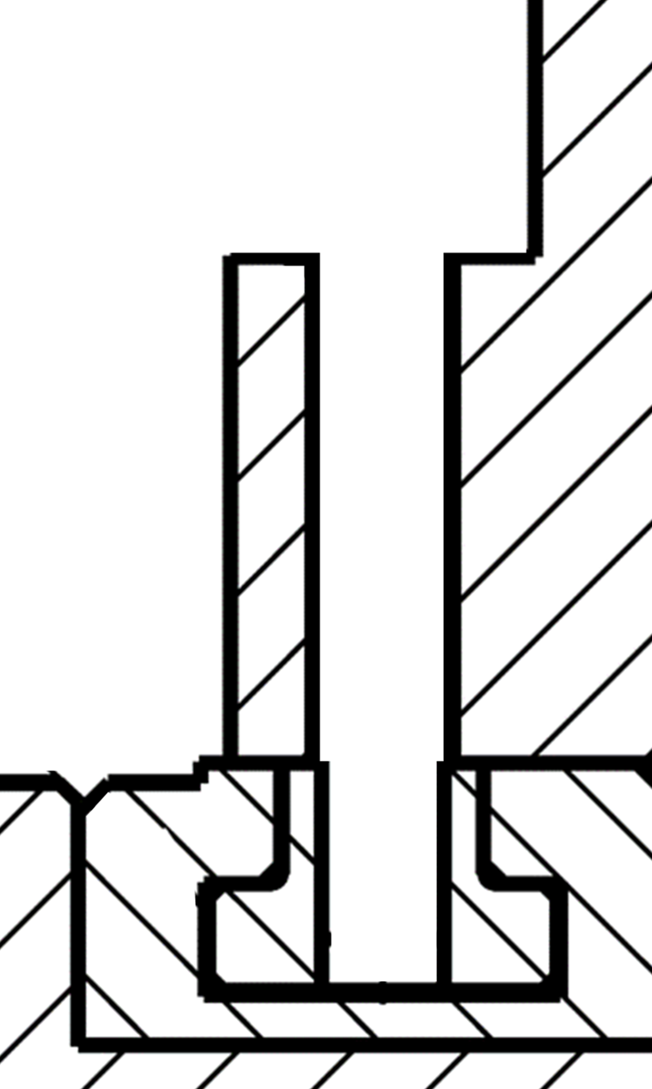
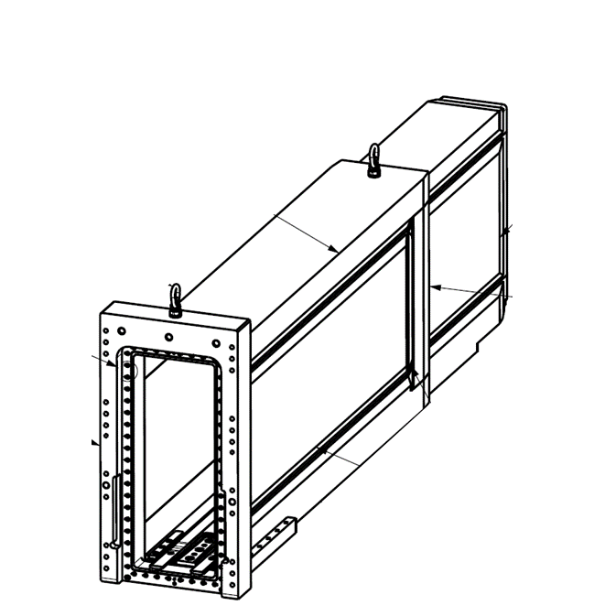
Porttube alignment in BPCS-Y-direction
Pre-welding alignment
IB210-01 Y Alignment Unit Outer (will be replaced by screws before tack-welding)
BPCS Y
BPCS-Y
A
B
View A
IB210-01 XY Alignment Unit Inner (will be removed before tack-welding)
View B

Slide 4
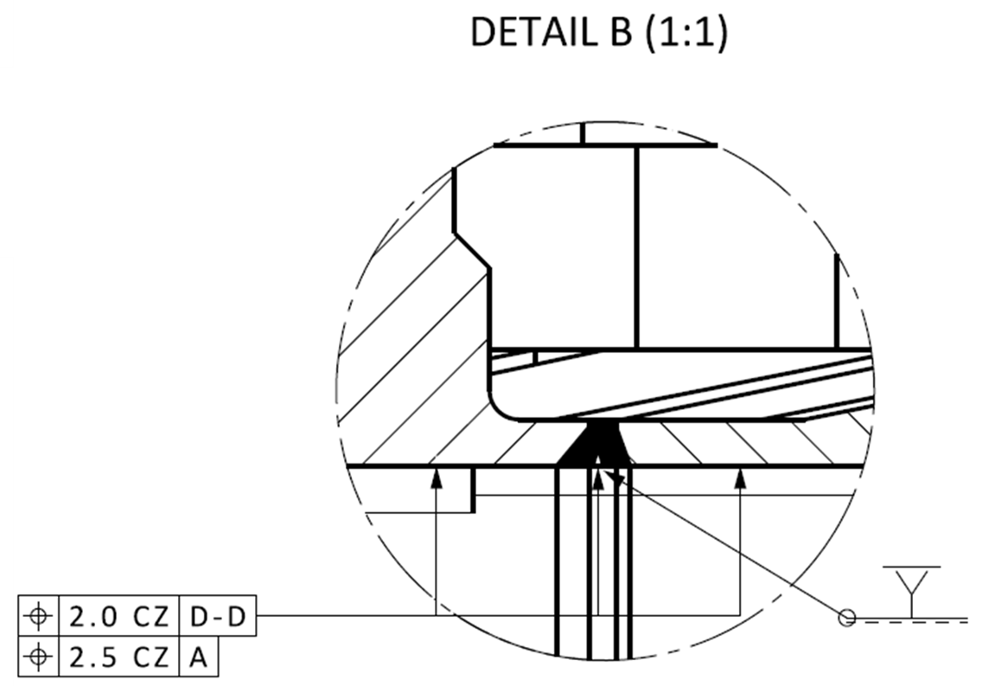
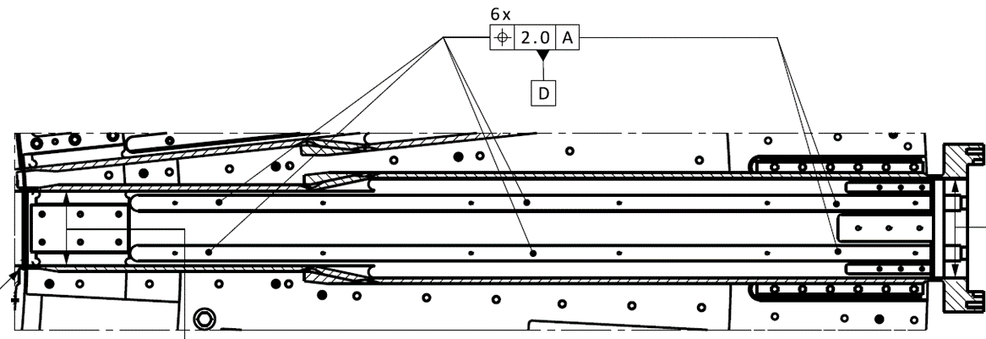
Porttube requirements in BPCS-Z-direction
according to ESS-3185128 and 5EC8GS501
BPCS Y
BPCS-Z
BPCS-Y

Slide 5
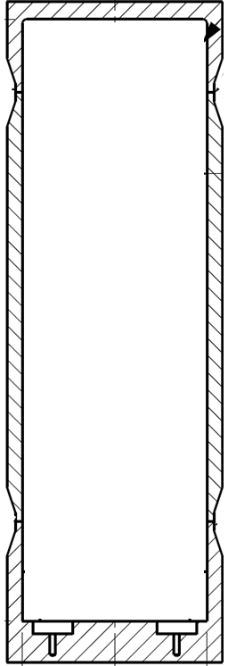
Porttube alignment in BPCS-Z-direction
Pre-welding alignment
IB210-01 Z Alignment Unit (present during tack-welding)
Constrained/alignment by Bottomplate
BPCS-Z
BPCS-Z
BPCS-Z
IB210-01-PTS Porttube Shim
(optional)
A
C
B
View A
View B
View C

Slide 6
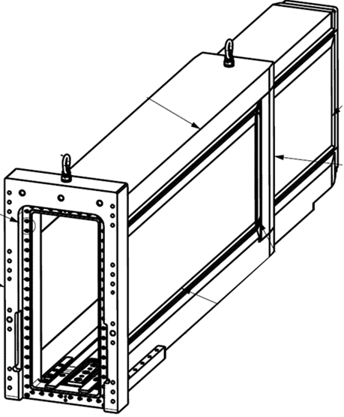
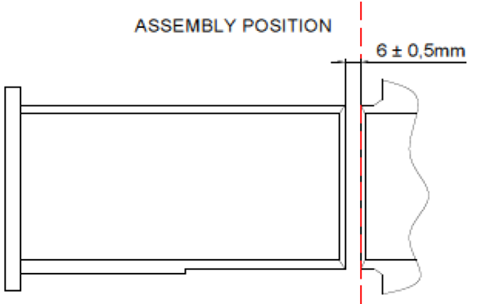
Porttube requirements in BPCS-X-direction
according to ESS-3185128 and 5EC8GS501
A
B
BPCS-X
View A – AFTER WEDLDING
BPCS-X
View B – BEFORE TACK-WELDING

Slide 7
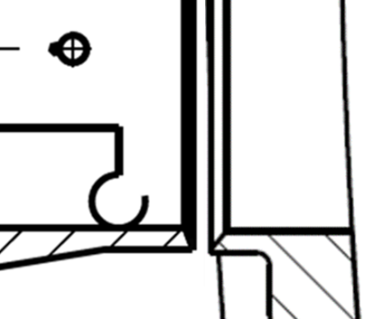
Porttube alignment in BPCS-X-direction
Pre-welding alignment
A
IB210-01 XY Alignment Unit Inner (will be removed before tack-welding)
BPCS-X
GO
NOMINAL
STOP
IB210-01 X Gauge (will be used to verify the gap)
View A

