Slide 2
Sample Environment
Labs and workshops
PRESENTED BY Caroline curfs

Slide 3
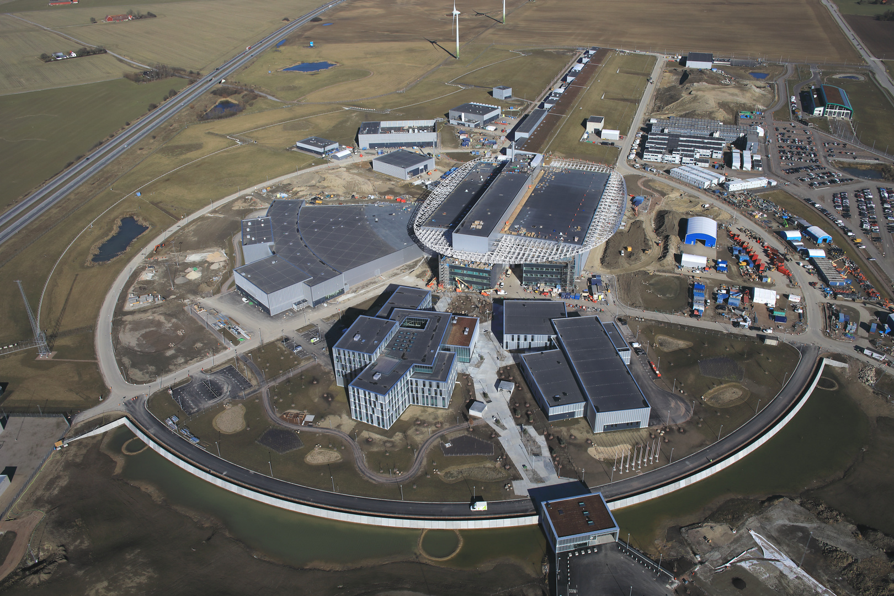
SE Labs and workshops
Overview
D04
57 sqm
Close to LOKI and FREIA
Not far from ESTIA, SKADI and VESPA
D08
Ground floor : 115 sqm
1st floor: 45 sqm
close to ODIN and DREAM
B02
SE space outside the restricted zone
currently shared with ECDC and MCA (and Chopper and detectors) for collaborative projects
E03
Ground floor:
65 m² (quiet area)
257 m² (labs and workshops)
1st floor:
65 m² (quiet area)
267 m² (labs and workshops)

Slide 4
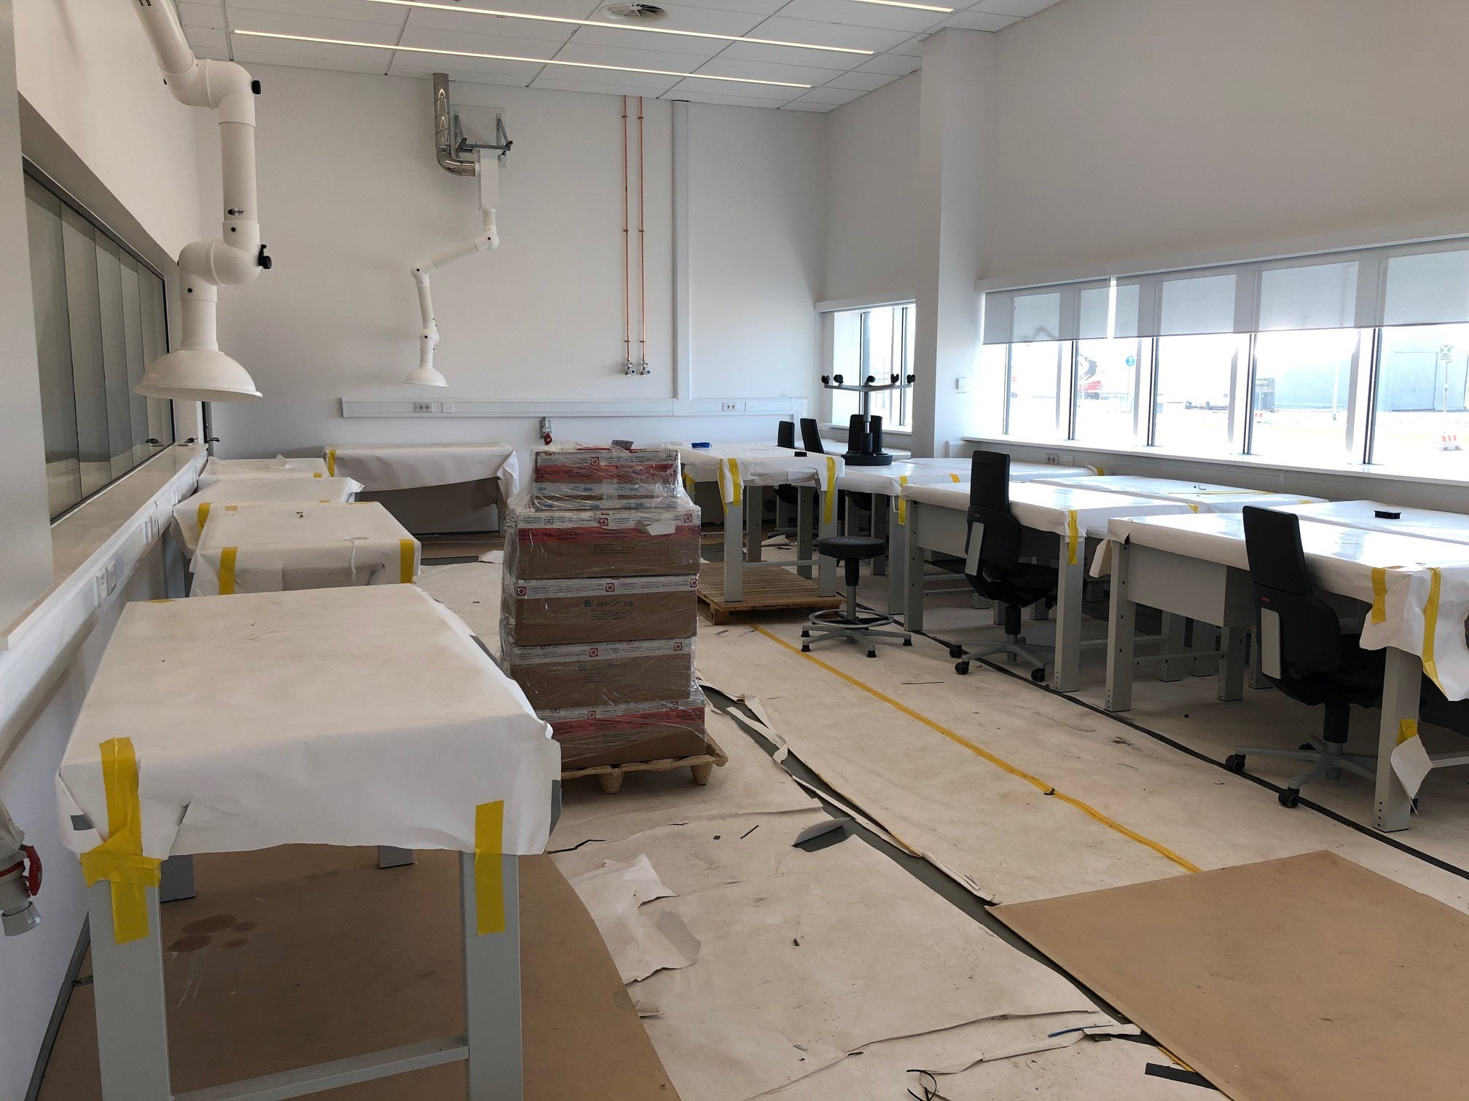
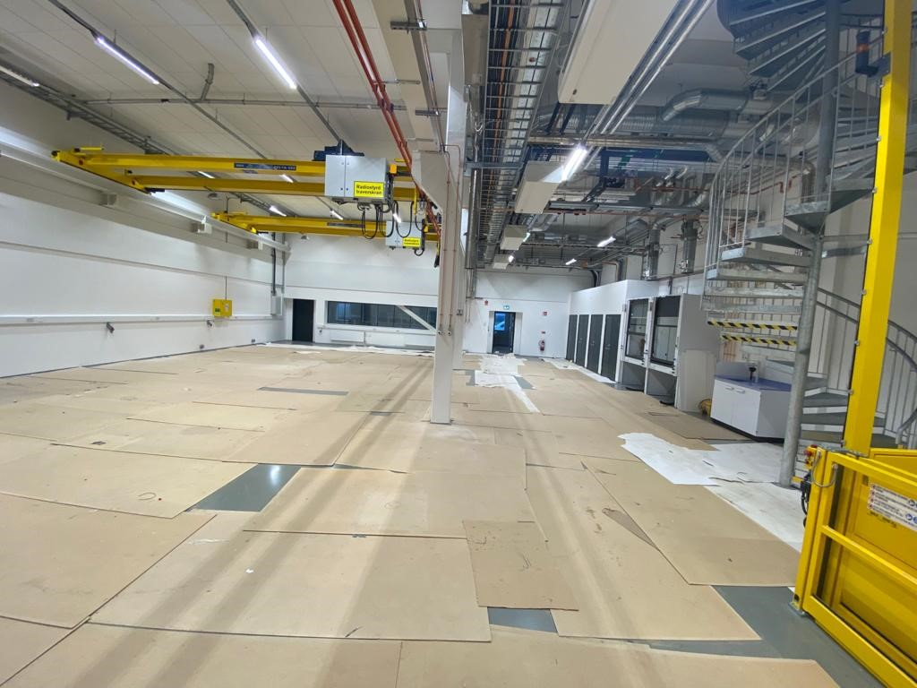
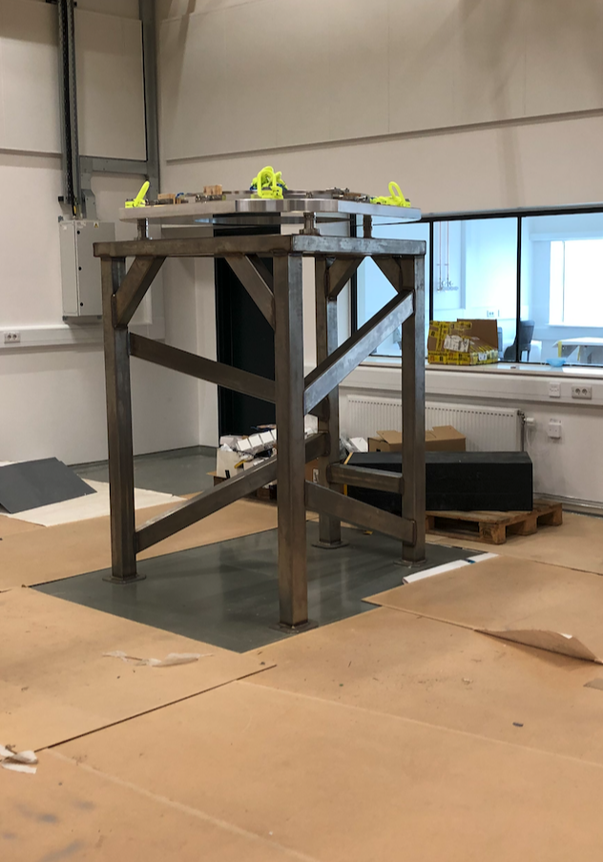
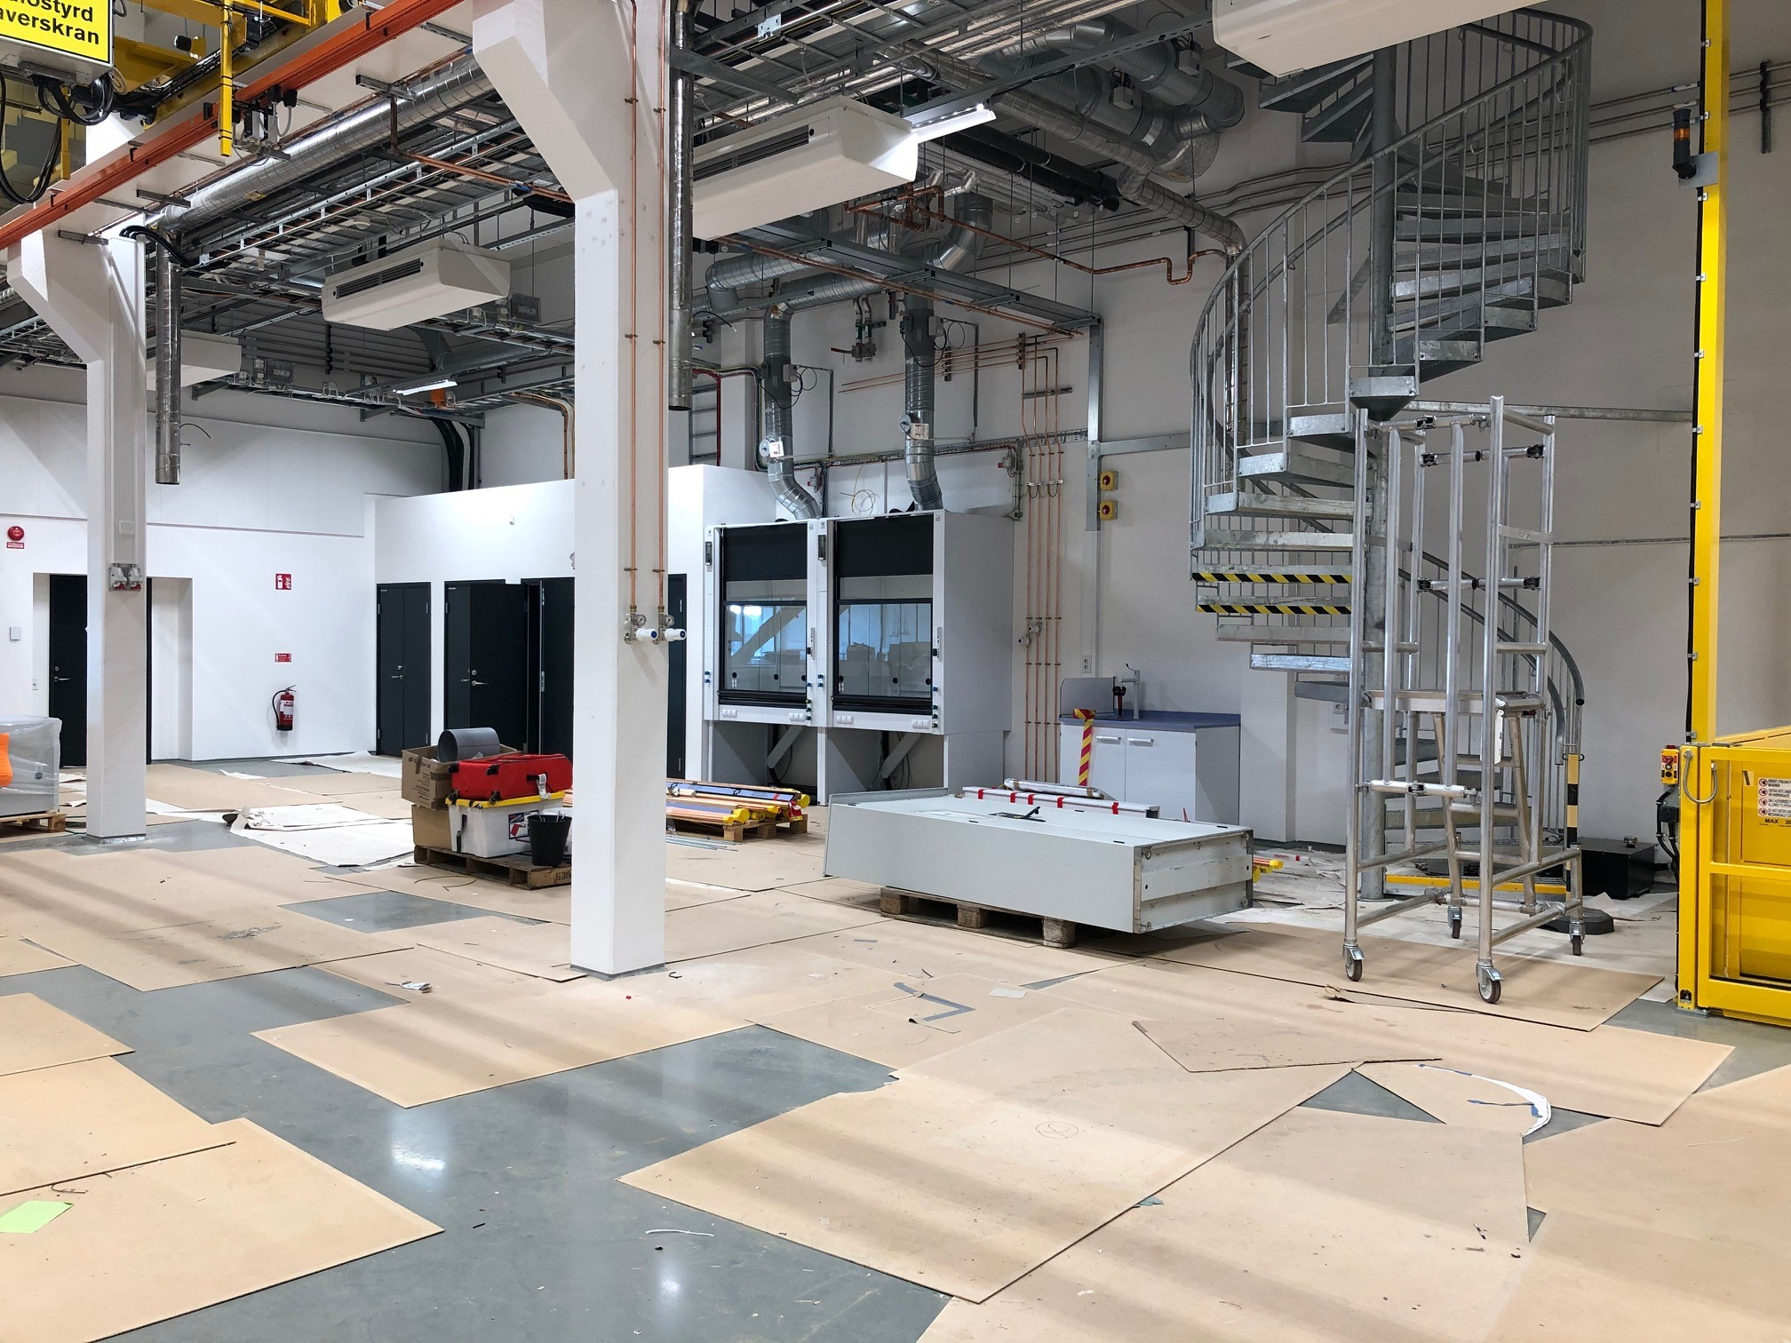
E03 – Ground floor
Main area : Hot/cold water, cooling water and fume hood utilities still missing
Quiet area : Ready
Main area
For magnets (non-magnetic floor), cryogenics, furnaces and alignment
Sample Env. Techn. Lab
Sample Env. Techn. Lab
Loading Bay
Quiet area
For delicate cryogenic work and electronics
2021-04-23
PRESENTATION TITLE/FOOTER
Alignment station

Slide 5
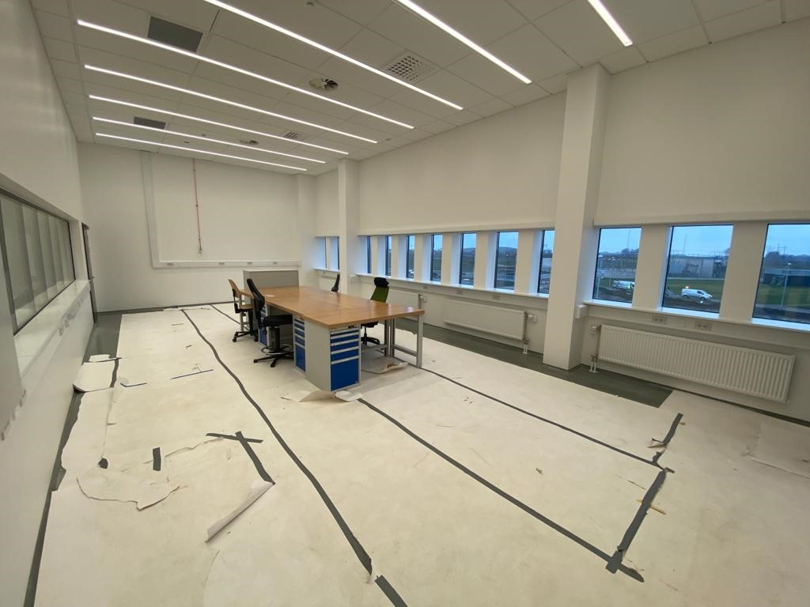
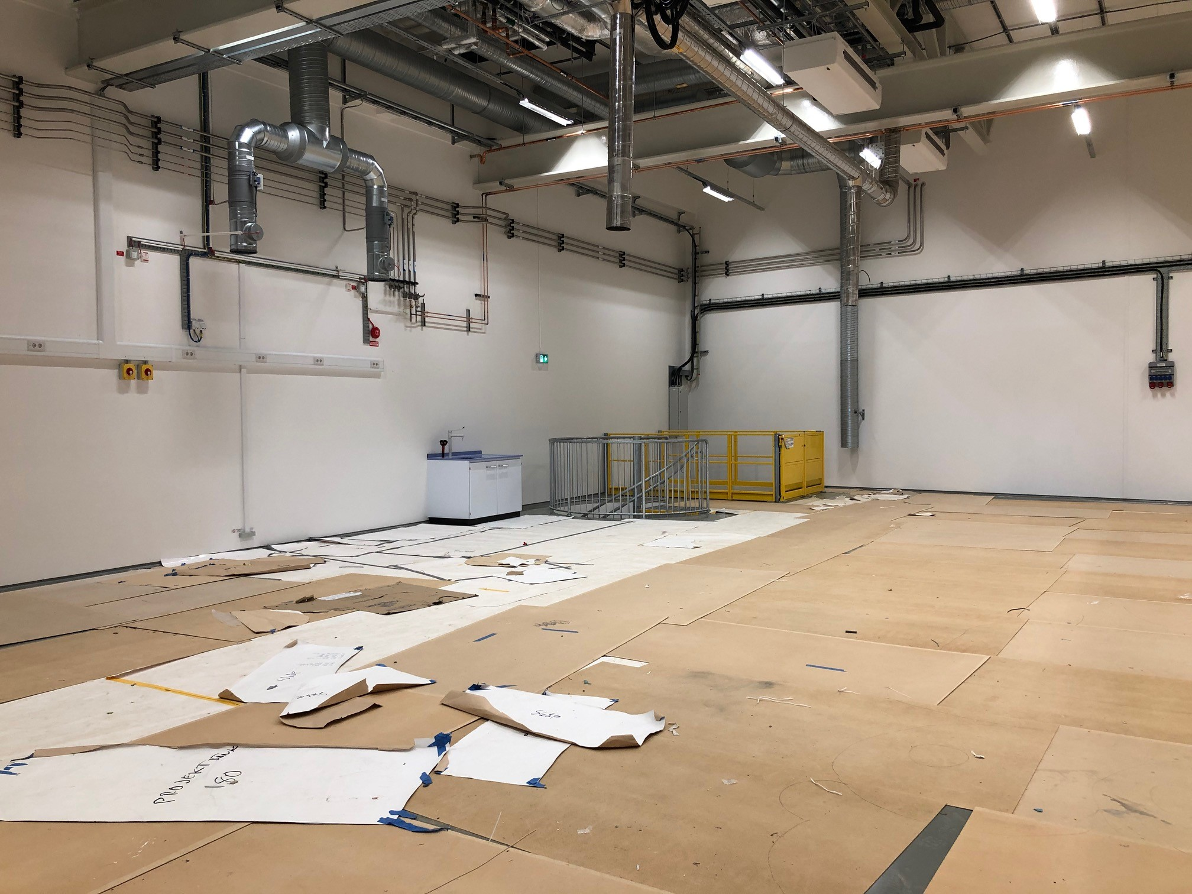
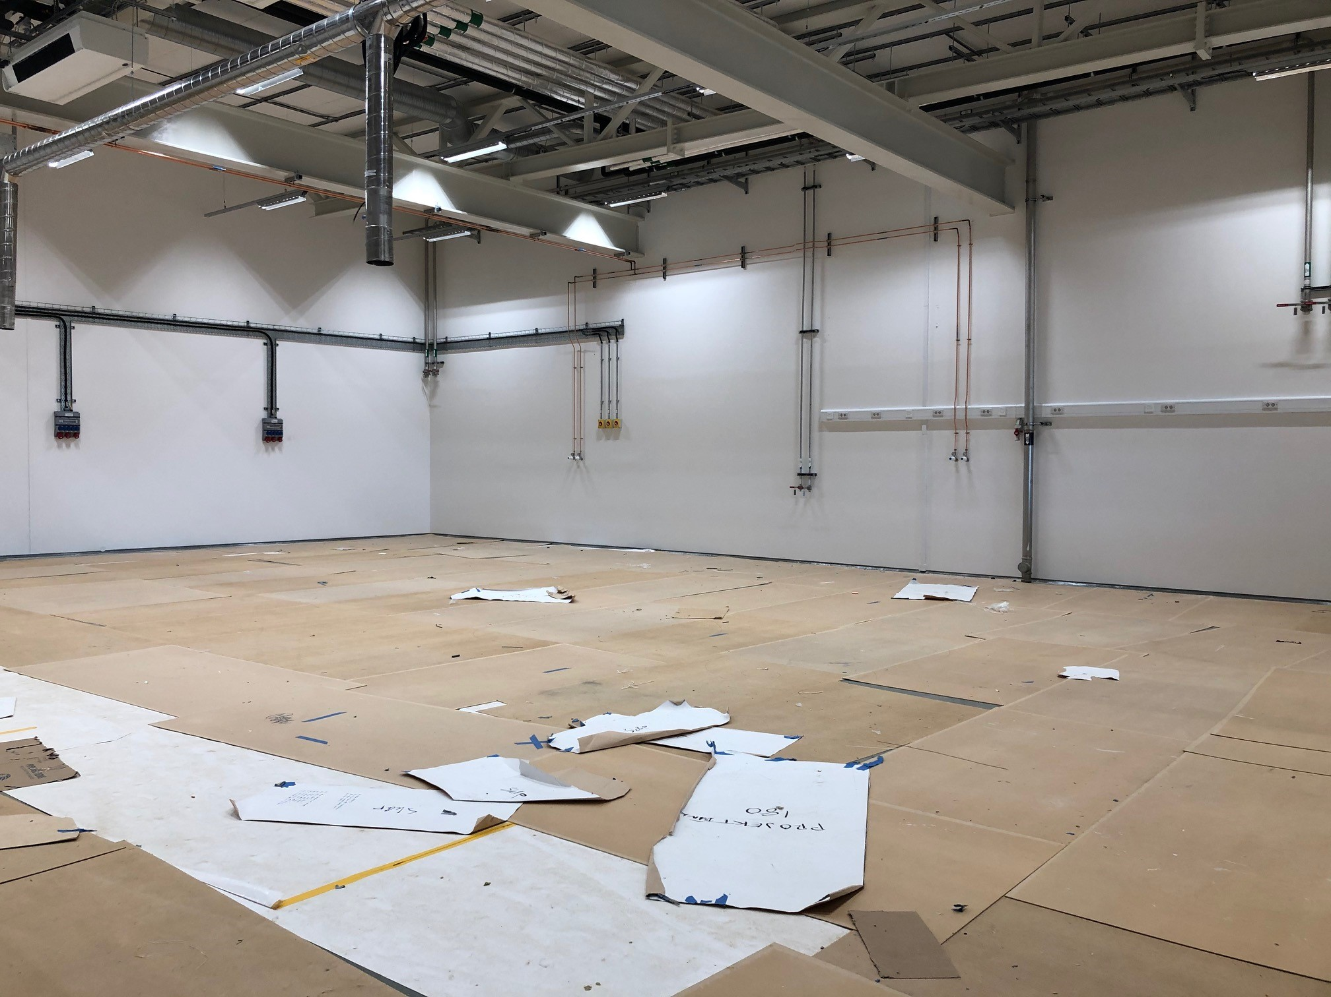
E03 – First floor
Main and quiet areas :
Ready
Dedicated to high pressure, mechanical engineering, control integration and mechanical workshop
Quiet area
Main area
Mechanical Workshop

Slide 6
D04 – Ground floor
Space dedicated for fluids, electrochemistry, lasers and soft matter sample environments
Close to the life science lab for LOKI and ESTIA
Sample Env.

Slide 7
D08 – Ground and first floor
Ground floor: Cryogenic, magnets and furnaces
1st floor: DAC lab
Close to the Radioactive Materials Laboratory.
Dedicated to SE for DREAM and ODIN
Sample Env. Techn. Lab
RML (rad. Mat. Lab)
DAC
Ground floor
First floor
7
7

Slide 8
Thank you

Slide 10
Integration Platform Ymir at ESS
PRESENTED BY Tobias richter

Slide 11
ECDC Scope
Experiment Control and Data Curation
  Experiment Control
  Beamline and Device Controls (EPICS)
  Data Acquisition
  Detector Software Event Formation
  Data Management / Curation
Strong need for a facility to test hardware in practise.

Slide 12
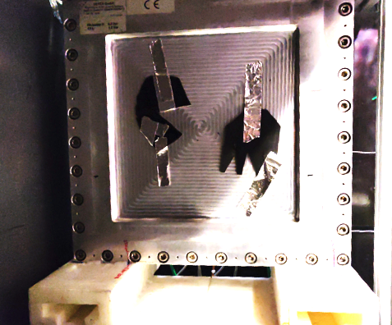
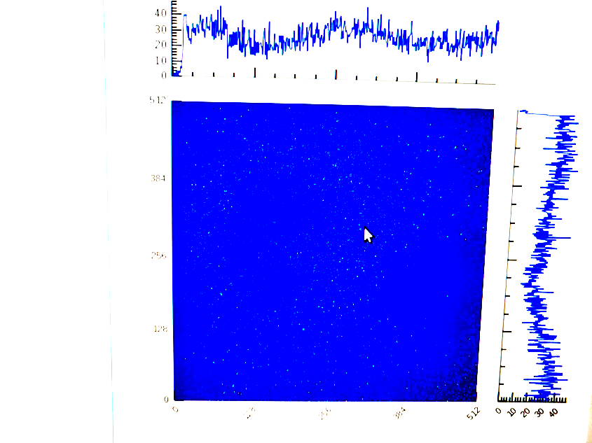
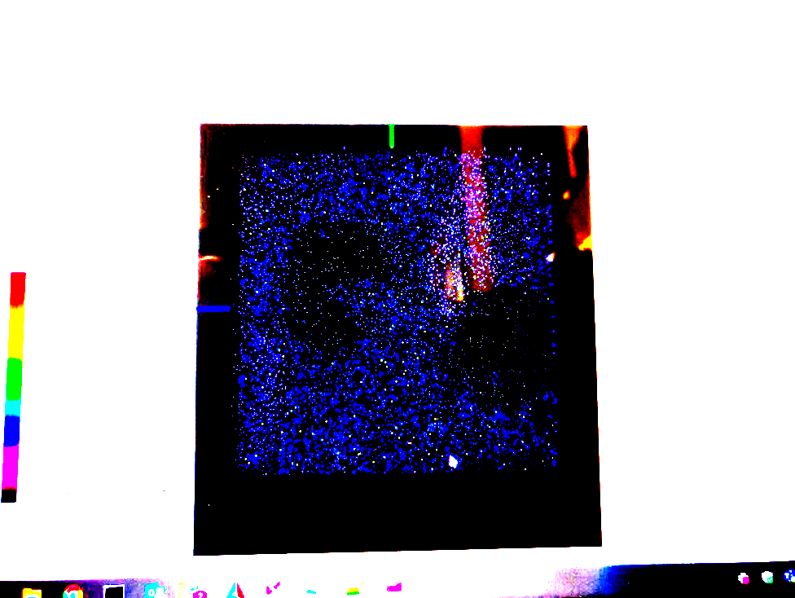
Historic Driver of Progress:
DAQ & Controls Verification Beamtimes
December & September 2019
@ HZB (BER II V20)
Detector
Readiness Report:
ESS-1511935
SciChat
NICOS (just-bin-it)
Mantid

Slide 13




Integrated Data Acquisition with absolute Timing Reference
Source Chopper
Front Monitor
Mini chopper
Back Monitor
Reactor
EPICS Forwarder
V4
DETECTOR GROUP CONTROL & TIMING DEMONSTRATOR
Timing system
ADC
TEST
STATUS
DATA
TIMING
CONTROL
JTAG
POWER
File writer
Kafka
EFU

Slide 14
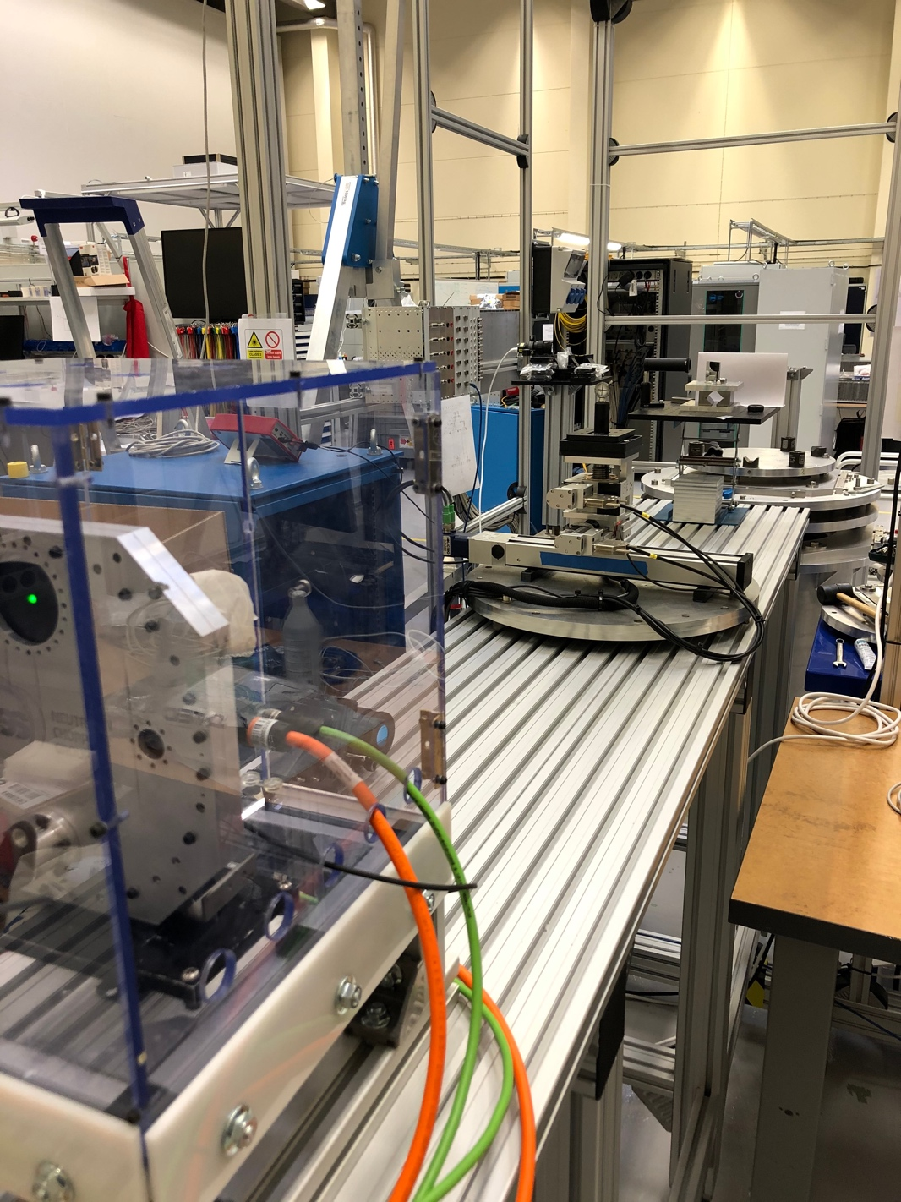
Local Integration, Testing and Demonstration Platform
Utgård and Ymir
  Currently away from the construction site in Lund in Medicon Village
  Main driver of progress across groups, through integration tests and demos
  Is now routinely used for engagement with instrument teams for feedback and evaluation
  Supported by 800 kEUR co-funding grant from Swedish Tillväxtverket
https://jira.esss.lu.se/issues/?jql=labels%20%3D%20Ymir-demo-goal

Slide 15
Stakeholders, Needs and Capabilities
Group | Areas Responsible
ECDC | data acquisition, control, event formation
ICS WP12 | EPICS device integration and infrastructure
ICS INFRA | lab networks and infrastructure
DMSC-DST | science network and infrastructure
MCAG | motion devices and low level controllers
NCG | chopper and low level controllers
SAD-SE | sample environment devices and systems
SWAP | data catalogue, logbook, sample information
DG | detectors and readout electronics
Verification Needs
  Collaboration of Teams
  Integration and Coordinated Operation of Devices and Services
  Deployment Pipeline
  Debugging and Logging
  Support
  Authentication and Permissions
  Automation
  Reliability
  Correctness
  Downstream Processing
  …
Equipment
  Realistic Sample Area
  Timing System
  Network
  Compute and Storage Capacity
  Chopper
  Detector Readout Master
  Motion Axes
  Sample Environment Equipment
  “Cabin” Workstation
  …

Slide 16
Ymir Project
TVV Co-funding – Three Main Objectives
  Establish Ymir as a generic integration and demo platform in B02
    easy access outside the restricted zone with realistic instrument environment
    useful for testing (SATs) and integration to a level that is not achievable in a less realistic environment
    demo platform for instrument teams and technology groups to practise and learn
  Light tomography setup
    collaboration with LU and imaging instrument data scienist
    provides a realistic measurement environment where someone can take an interest in performance of the hardware and inspect results to put the integration to a true test
    allows strong integration of downstream processing (DRAM, scipp, etc) like for imaging/ODIN
  Scanning evaluation
    event based acquisition offers opportunities to optimise for fast operations like alignment scans or spatial mappings
    tight integration of event mode recording and motion control with feedback from downstream processing can speed up cold and hot commissioning
    offers the opportunity to pre-commission complex motion (e.g. hexapods)

Slide 17
167 m²
Summer 2021:
Ymir moves to B02 on site

Slide 18
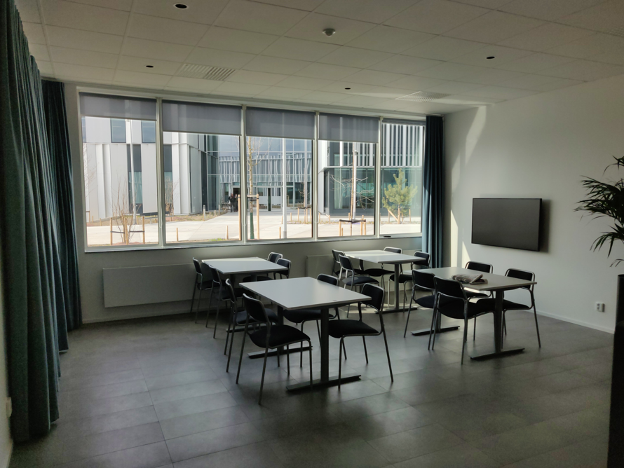
B02 Location
Close to B01 main offices

Slide 19
Sample Environment Testing & Integration
Lab for Integration, Test, Verification, Demonstrations, etc
All required supplies available:
  Non-magnetic Floor
  He infrastructure
  Cooling water
  Pressurised Air
  Network, Power, Timing system
Electrical installations can still be ready end of June
Remaining design work on sample mounting started
Official Sample Mounting Options
system | CAD ready | Manufacturing drawings ready | resources required | manufacturing time (estimate) | cost (estimate)
Tårta (L1 + L2) | ✔️ | Maybe | Potentially drawing work | 8-16 weeks | 110kSEK
Stand for partial Tårta (for L1) | - | - | Design work needed (could be kept to a simple Rexroth assembly, speeding up both design and manufacturing) | 8-10 weeks | 30 kSEK
Tårta L3 | ✔️ | Maybe | Possibly more drawing work | unknown | 37kSEK
I-frame (L1 only) | ✔️ | ✔️ |  | 8-12 weeks | 160kSEK
I-frame (L2) | ✔️ | - | Engineer needed to create manufacturing drawings | unknown | unknown

Slide 20
Summary
Ymir has an appreciated role as driver for integration progress throughout the organisation
Good collaboration between NSS, ICS and SD stakeholder groups with well established interactions and workflows
Focus drive the DAQ and controls framework integration to be ready for instruments
    Verify important functionality
    Test and integrate most devices
    Eliminate bugs and test robustness
    Improve user experience
    Evaluate operational workflows
Moving to site (B02) keeps close proximity and collaboration with sample environment group and allows cold commission of site IT installations and infrastructure like
  timing system
  storage and network layout
  compute hardware and deployment
  integration into EPICS services
  downstream processing and workflows like tomography reconstruction, scanning, data catalogue, etc

