Slide 1
Investigation into the role of alkanes in cyanobacterial membranes
PRESENTED BY Sophie Ayscough, Postdoctoral Research FellOW

Slide 2
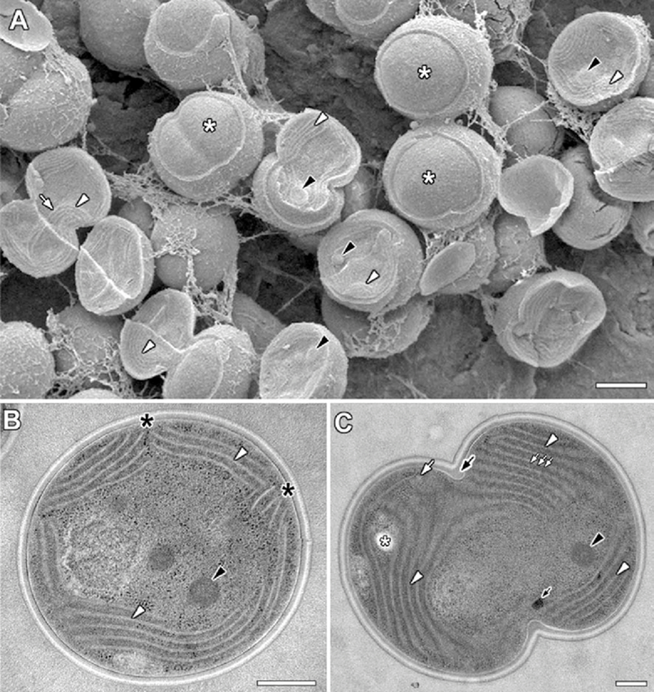
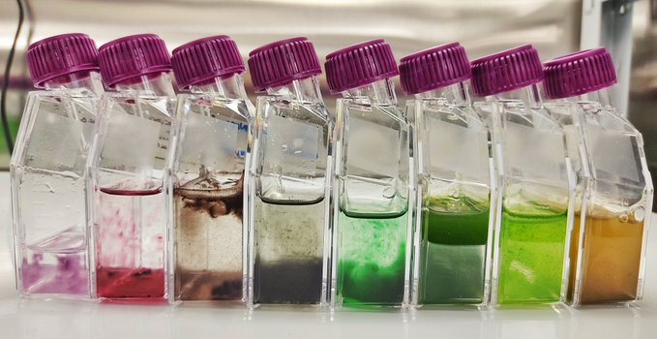
Cyanobacteria
Background
  Possibly the most important organism on earth.
  Responsible for oxygenating our atmosphere.
  The pre-cursor to chloroplasts in plants and algae.
  The proteins involved in photosynthesis are hosted in a complex folded membrane system-called the thylakoid
Van De Meene, Allison ML, et al. Archives of microbiology 184.5 (2006): 259-270

Slide 3
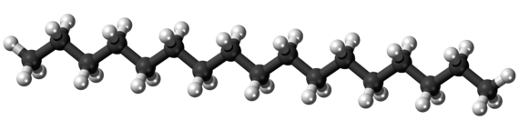
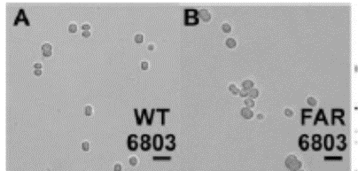
Alkanes in cyanobacterial membranes
Alkanes (hydrocarbons) C15-C22 are found in photosynthetic membranes of cyanobacteria, algae and plants.
The role of these alkanes in unknown.
Our collaborator David-Lea Smith (UEA) has done some initial work on hydrocarbons in cyanobacteria.
  The cyanobacteria Synechocystis contains up to:
    17 mol% heptadecane (C17) in its membranes.
  GE Mutants (FAR) were designed that can’t produce hydrocarbons.
    Mutants are misshapen and grow more slowly

Slide 4
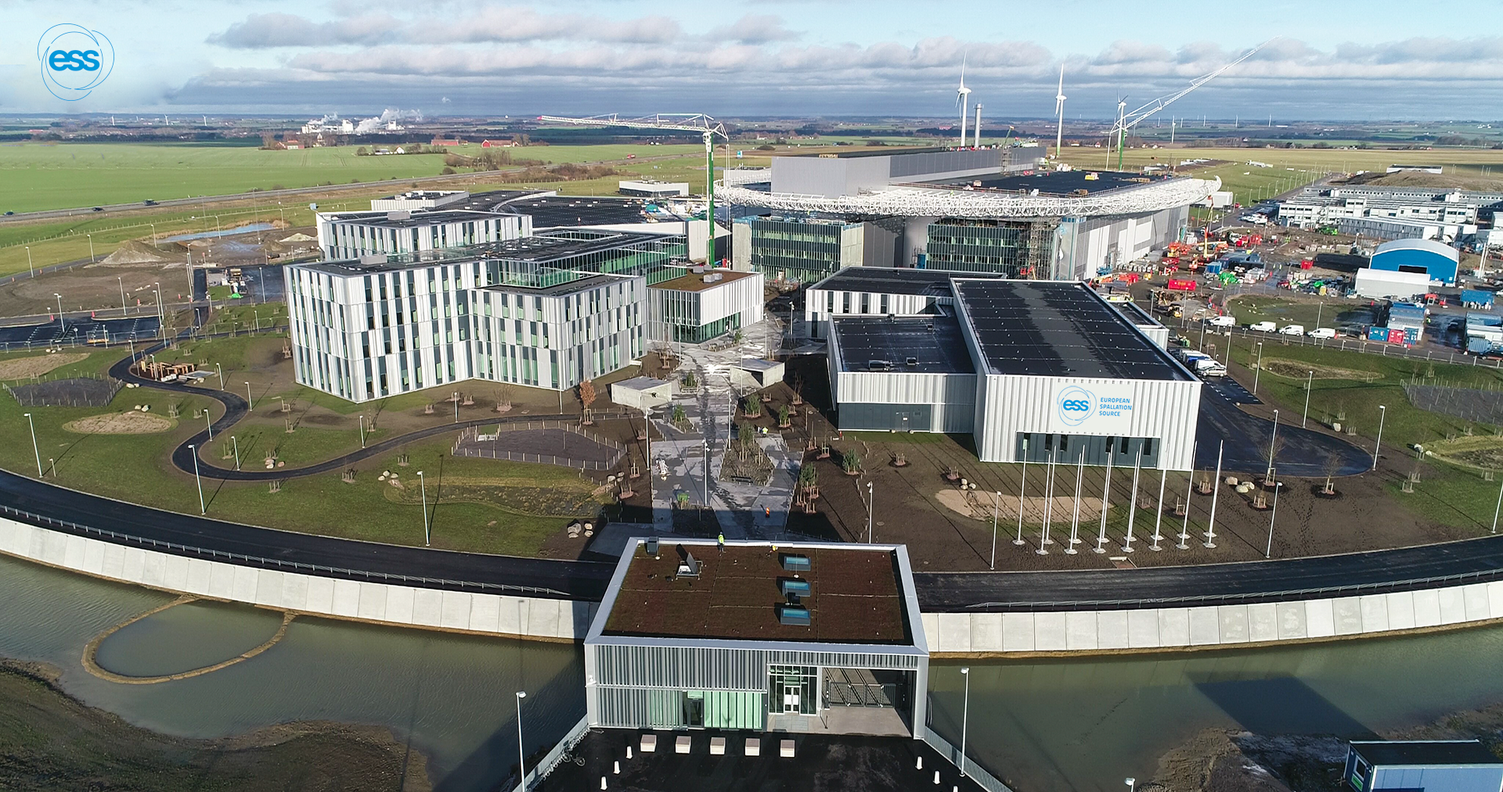
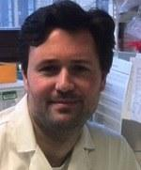
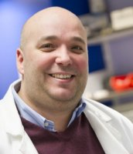
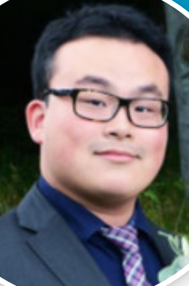



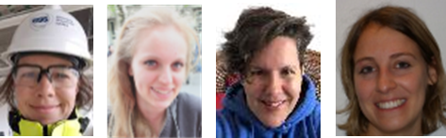
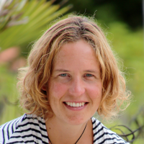


Where the science happens
EO4
ESS SULF
Lipid extraction and cyanobacterial help from ESS DEMAX group.

Slide 5
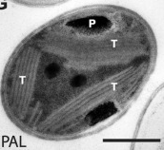
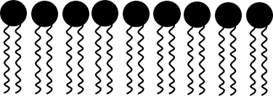
Thylakoid membranes
The site of photosynthesis in cyanobacteria
PS2
PS1
T
Phycobilisomes
TEM image of Synechocystis
Liberton, Michelle, et al., J. Bio. Chem. (2013): 3632-3640

Slide 6
Questions of the project
  Where do alkanes sit in the lipid membranes?
  Do alkanes enable curvature in the membrane?
  What properties do the alkanes give the membrane that helps cyanobacteria?
  Approach: study both model system (commercial lipid vesicles) and live cyanobacterial cells (grown in lab)

Slide 7
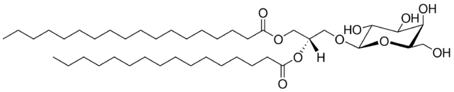
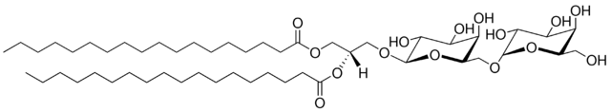
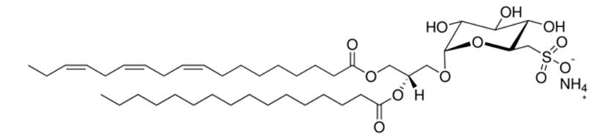
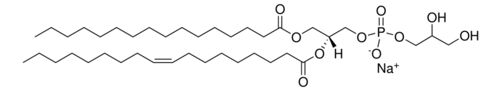
Thylakoid membrane lipids
Composition
Four main lipid components:
MGDG
DGDG
SQDG
PG
Lipid tail length and level of unsaturation more complex in cell membranes.

Slide 8
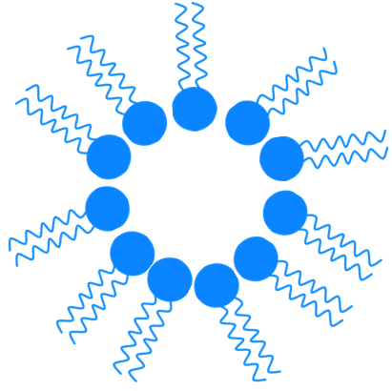


Lipid phase transitions
T
T
L_{β}
L_{α}
H_{II}
Lamellar gel
Lamellar fluid
Inverse Hexagonal phase

Slide 9

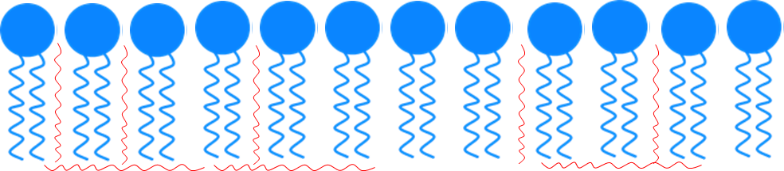
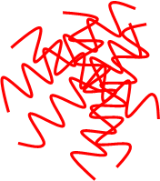
Lipid phase transitions + heptadecane
L_{β}
L_{α}
H_{II}
Lamellar gel
Lamellar fluid
Inverse Hexagonal phase

Slide 10
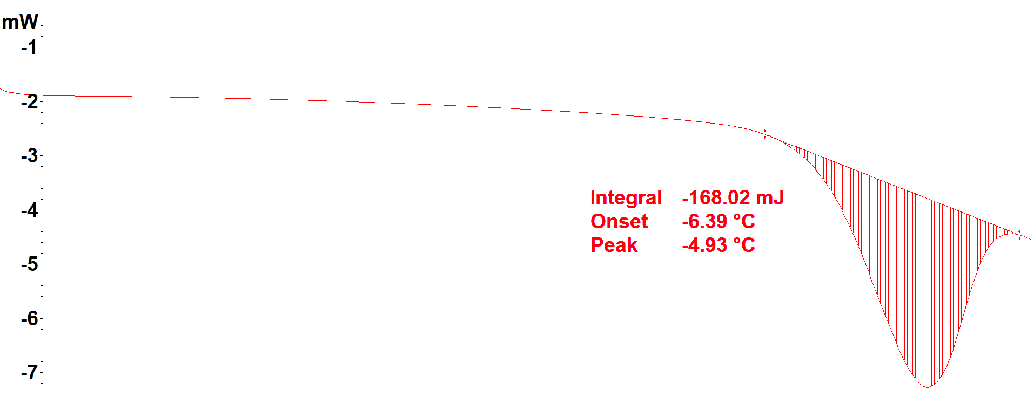
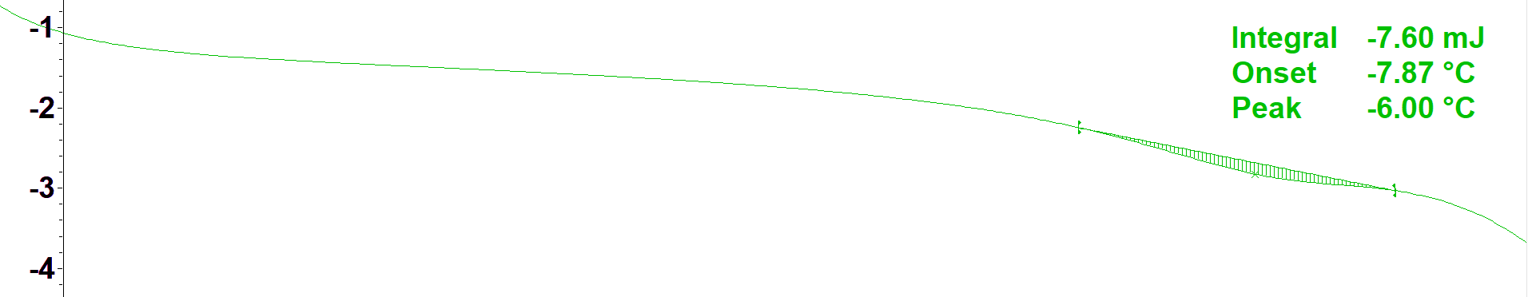
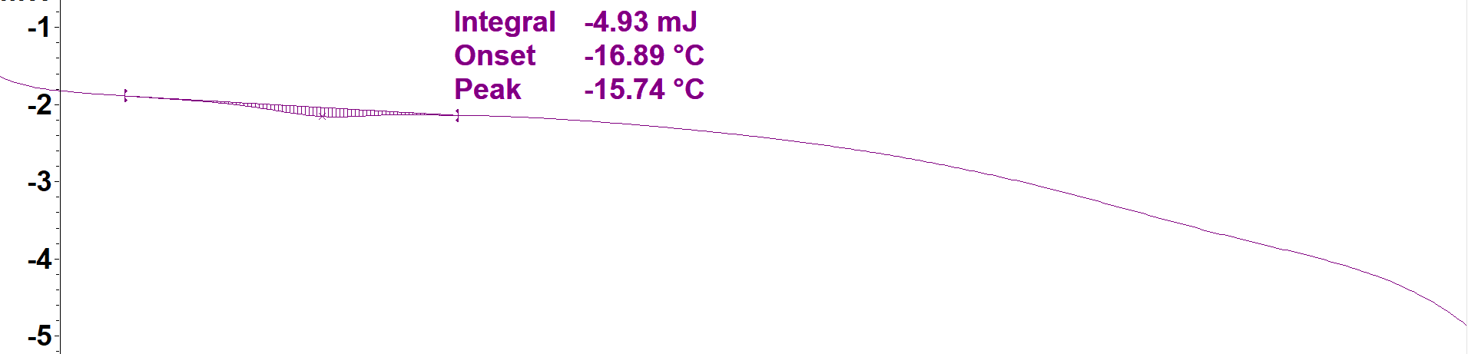
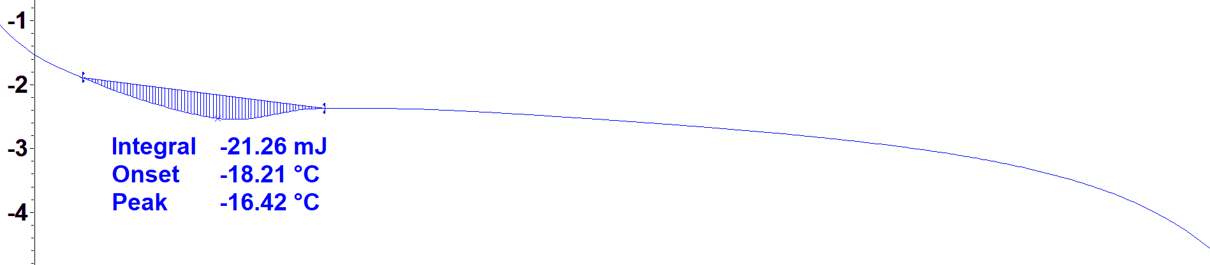
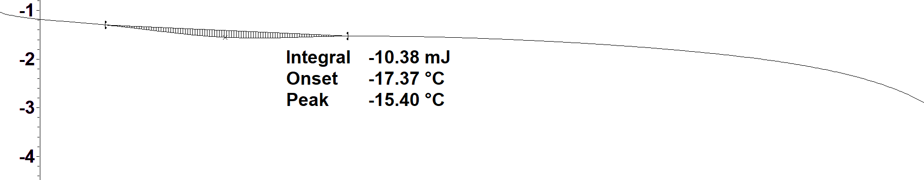
L_{α} to L_{β}
0 mol% heptadecane
35:65 DOPE:POPC lipid at 30wt% hydration
DSC measures heatflow as a measure of temperature/ time
Allows measurement of material transitions
Lipids measured containing increasing mol% of heptadecane (C17)
We observe a decrease in the gel to fluid transition temperature and in the enthalpy of the transition.
  Heptadecane (C17) increases the fluidity of lipid bilayers.
We aim to confirm this with thylakoid lipids by DSC, neutron-spin echo and pipette force measurements.
5 mol% heptadecane
10 mol% heptadecane
18 mol% heptadecane
30 mol% heptadecane
-15
-10
-5
°C

Slide 11
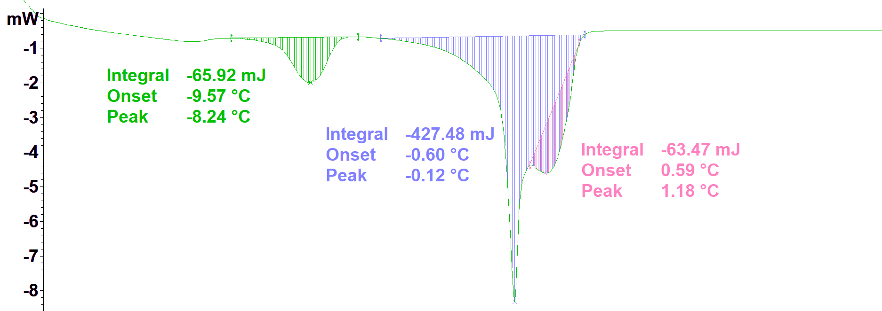
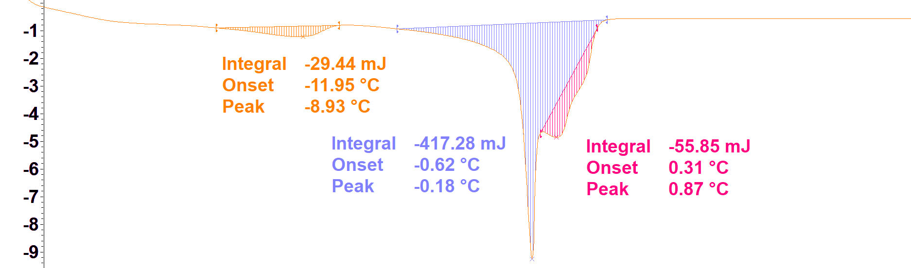
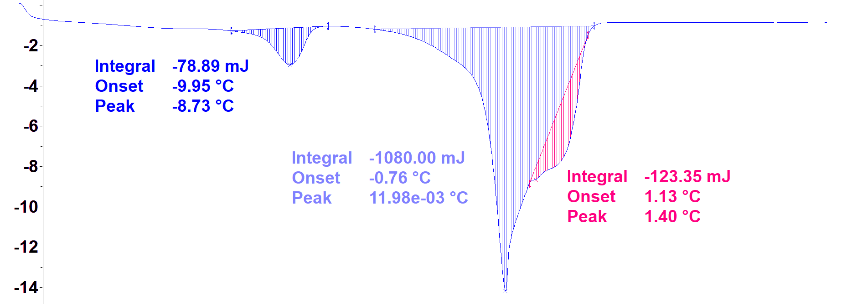
L_{β} to H_{II} transition in DOPE
  Lamellar to inverse hexagonal phase transition investigated in DOPE lipid
  In DOPE (30%wt hydration) there is no change transition temperatures with increasing heptadecane content
  At high hydration and low (less than 30 mol%) alkane concentrations no increase in curvature observed in DOPE
  Aim to check with hATR-IR
0 mol% heptadecane
17 mol% heptadecane
30 mol% heptadecane
-20
-10
0
10
°C

Slide 12
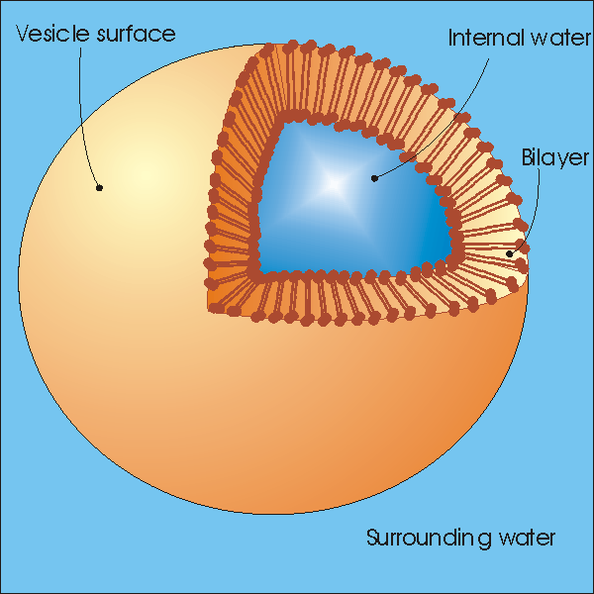
Determining the location of alkane in the membrane
Using Small Angle Neutron Scattering and selective deuteration
H-heptadecane
D-heptadecane
By using D₂O buffer, hydrogenous lipids and deuterated alkane, we hope to be able to locate where the alkane sits in the lipid bilayer.

Slide 13


Small Angle Neutron Scattering
Theory of small angle scattering
Detector
Sample
Neutron Source
θ
q
Intensity
q
$$q=\frac{2πsinθ }{λ}$$

Slide 14
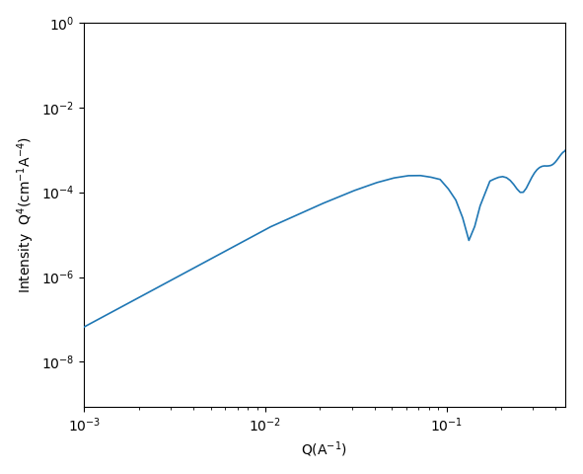
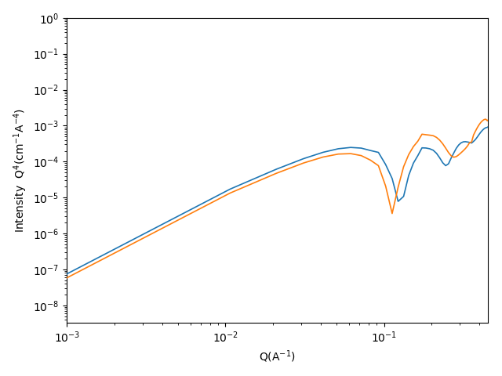
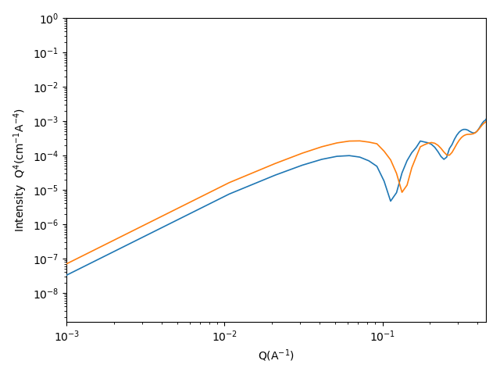
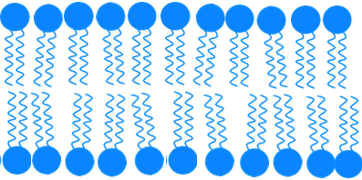
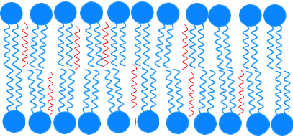
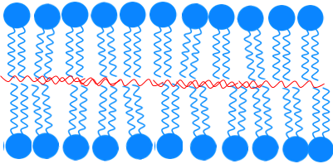
No alkane
5 volume% alkane
5 volume% alkane
SLD
SLD
SLD
0
z
0
z
0
z

Slide 15
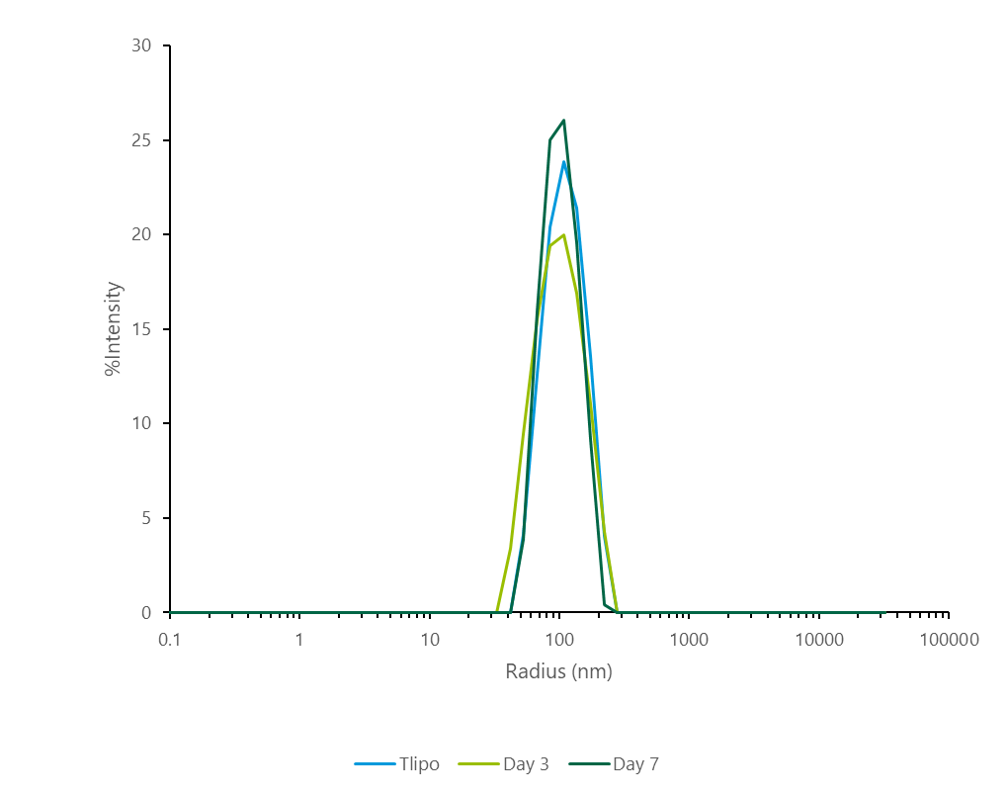
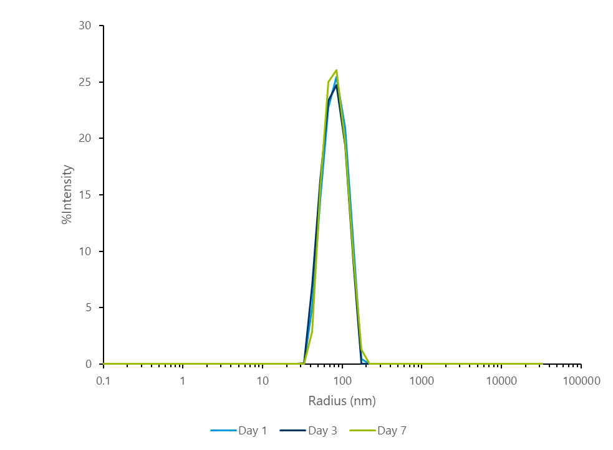
Stability of liposomes
MGDG:DGDG:POPG liposomes measured by DLS
Lipid only
Lipid only + 17mol% heptadecane

Slide 16
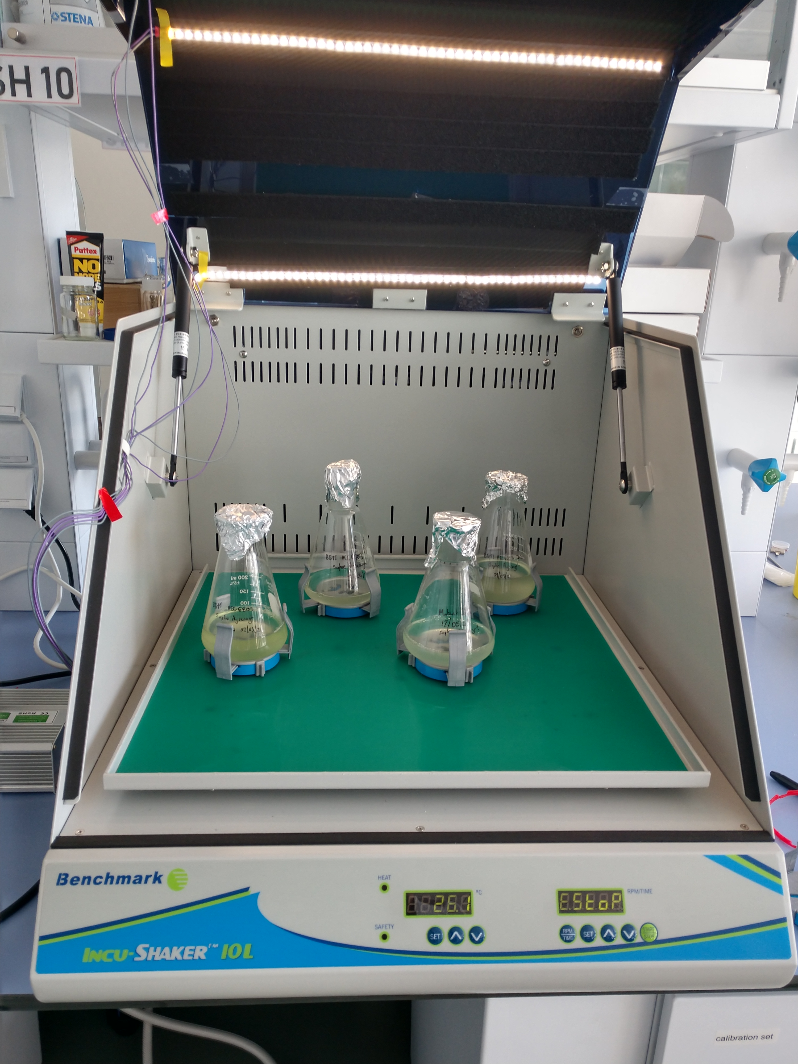
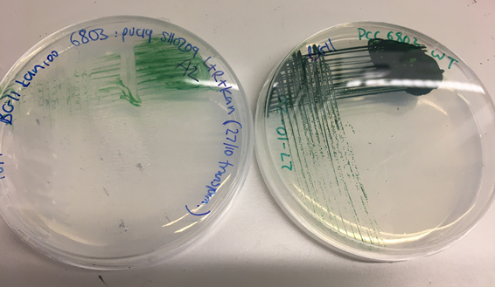
Investigation of membranes in-vivo
Measuring the scattering of live cyanobacteria
Plan to directly measure scattering of cyanobacteria.
  Growing wild-type and mutant strains at E04 ESS labs.
  Regular arrangement of thylakoid membranes means small angle scattering produces Bragg features:
    Can determine thickness of membranes
    Can determine level of ordering within live bacteria.

Slide 17
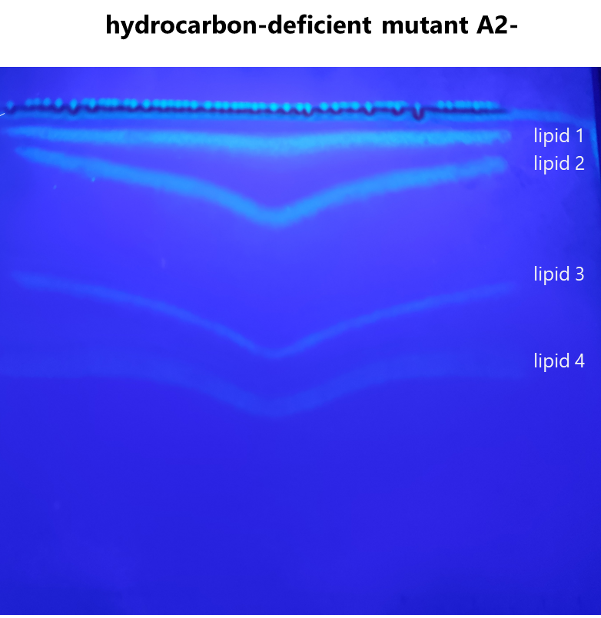
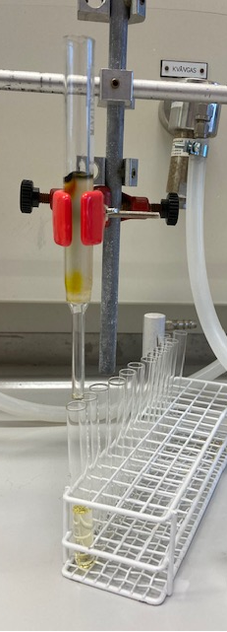
Lipid extraction from cyanobacteria
Membrane extraction at UEA, lipid extraction and ID at MV (DEMAX)
  Since the exact lipids we are interested in cannot be bought…
  We are extracting the lipids from the cyanobacteria.
  Initial work done by grant collaborators at UEA (UK)
  For identification of the lipids and extraction of larger amounts working with DEMAX in Lund.
Above: TLC of cyanobacterial membrane done at UEA.
Right: Column separation of lipids in Lund (DEMAX)

Slide 18
Future work
  Optimise lipid extraction
  hATR -IR
  (+ other lab based characterization)
  SANS and NSE on lipids and bacteria
  Work with MD group on interpretation of data analysis
EO4
DEMAX

