Slide 2
Science Day 2021
June 2021
PRESENTED BY Arno Hiess et al

Slide 3
Science Day 2021
A well-established forum to exchange on our scientific collaborations
Previous Science Days
2020: no science day …
2019: https://indico.esss.lu.se/event/1245/
2018: https://indico.esss.lu.se/event/990/
2017: https://indico.esss.lu.se/event/821/
2016: https://indico.esss.lu.se/event/564/
2015: https://indico.esss.lu.se/event/305/
2014: June 10, Borgeby Castle, Bjärred
2013: May 16 and Oct 17, High Court, Malmö

Slide 4
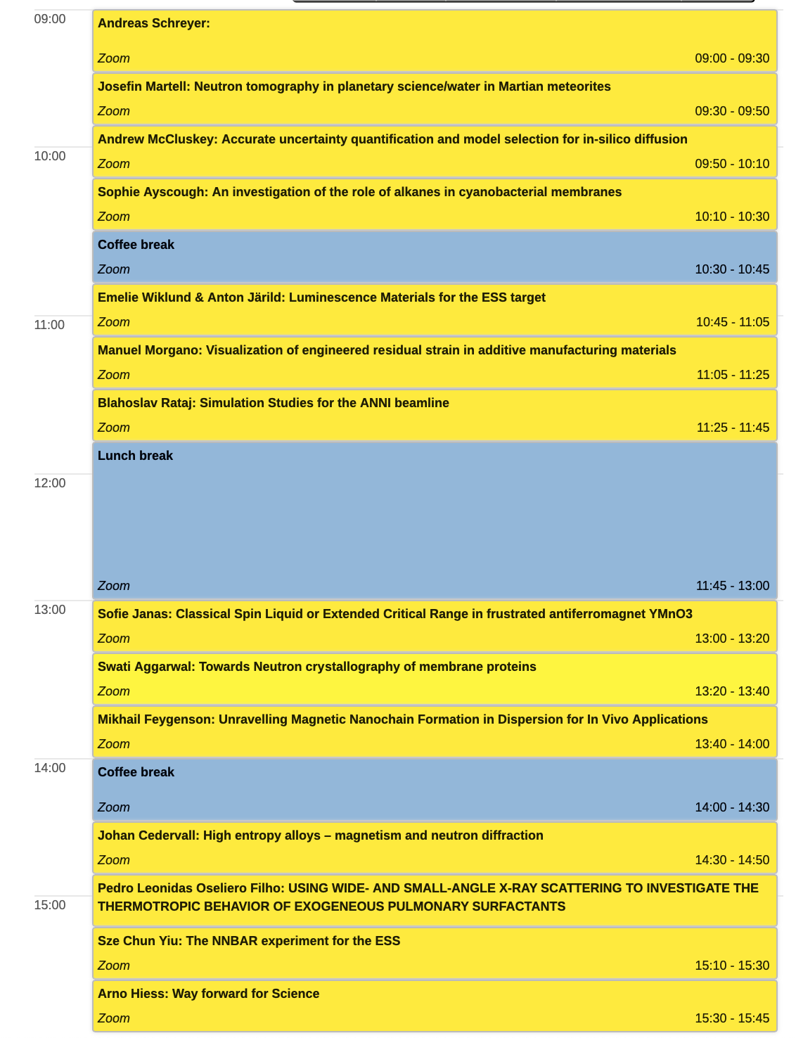
Science Day 2021
A well-established forum to exchange on our scientific collaborations
Agenda 2021
2. June 2021 ; zoom video conference format
https://indico.esss.lu.se/event/2699/timetable/#20210602
4 x 3 science talks (20min) by junior scientists
covering many scientific topics are reflected by different SFTs
inspires exchange and strengthens collaboration cross-discipline
increases visibility for science using neutrons
about 50 - 60 participants per session
many thanks to Bea and SFT coordinators
PLEASE SEND SLIDES TO BEA FOR UPLOAD TO INDICO !

Slide 5
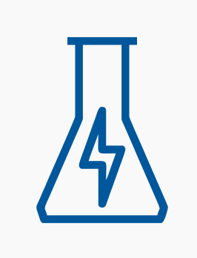


Science Day 2021 and Beyond
A forum to exchange on our scientific collaborations
Considerations for Science Day 2022
in-person meeting (only)
consider topical sessions, external keynote speakers
link closer to ESS project & future operation – not only from science directorate but also other ESS entities
ensure complementarity with User Meeting – especially in 2022
Liaise with Carina, Bea, Arno or your SFT coordinator to provide input!
PLEASE SEND SLIDES TO BEA FOR UPLOAD TO INDICO !
Pascale
Premek
Esko
Valentina
Søren

Slide 6
ESS ILL User Meeting 2022
First thoughts only
2018 (in person)
10-12 Oct (WE-FR, 3 days), Grenoble WTC, 500 participants
Programme: 5x plenary sessions (3x talks), parallel workshops (5x 2h), posters, exhibition
2020 (virtual)
23-25 Sept (WE-FR, 3 days), zoom, >700 main event participants, 70-350 workshop participants
Programme main event: 4x plenary sessions only (4x talks each); no poster sessions
Separate workshops: 4x scientific topics, 2x methodological topics; different format.
2022 (hybrid format: in-person in Lund, possibility for remote participation)
date and duration: 3 days (WE-FR) in September or October 2022
Programme (similar to 2018): plenary sessions (keynotes), parallel workshops, posters, exhibition

Slide 7
Update on Science Focus Teams (SFTs)
Strengthen scientific collaboration
SFT topics shall group scientists speaking the same ‘language’ to facilitate productive exchange
re-defining SFT grouping / scope by scientific / methodological topics: 5 --> 7 ? now or later?
confluence pages set-up for internal exchange !
considering new format for annual research report and (quarterly) internal newsletter; previous reports: https://confluence.esss.lu.se/display/SA/Science+Focus+Teams+-+Research+Reports
Liaise with Carina, Bea, Arno or your SFT coordinator to provide input!
Pascale
Premek
Esko
Valentina
Søren

