Slide 2
ODHDS Development Plan, V&V, and High-Level Requirements
PRESENTED BY Donya daryadel

Slide 3
Agenda
ODH Development lifecycle and V&V plan
ODH High level requirements

Slide 4
1
ODH Development lifecycle and V&V plan

Slide 5
ODH Development lifecycle phases
It is based on ESS Handbook for Engineering Management [1].
It includes below phases:
  Phase 1: Requirements and Analysis phase
  Phase 2: System Design Phase
  Phase 3: Detailed Design Phase
  Phase 4: Manufacturing and preparation for installation and commissioning phase
  Phase 5: Installation, testing and commissioning phase
  Phase 6: Operation and maintenance
  Phase 7: Modifications

Slide 6
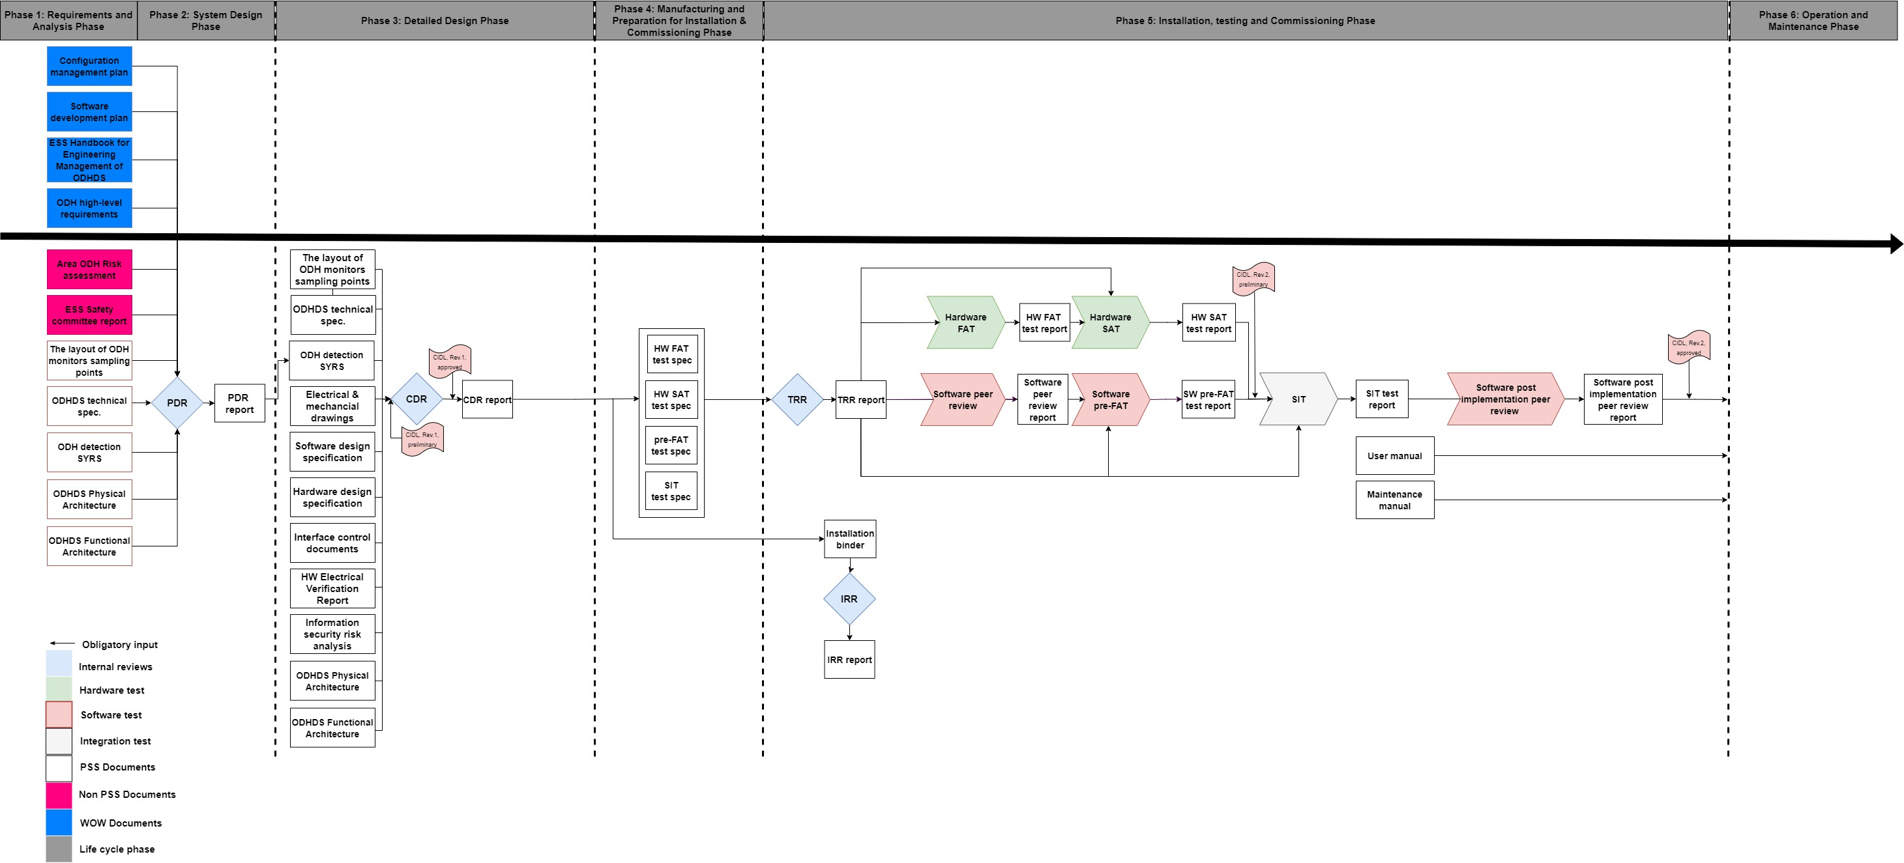
ODHDS DEVELOPMENT LIFE CYCLE

Slide 7
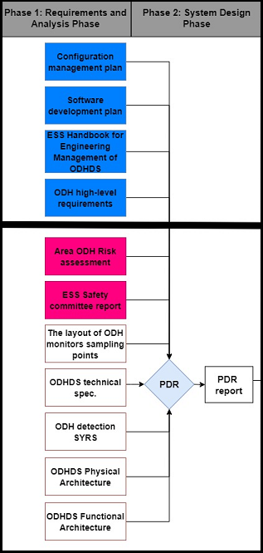
ODHDS DEVELOPMENT LIFE CYCLE
Requirements and analysis phase and system design phase
Phase 1: Requirements and Analysis phase
Phase 2: System Design phase
Reviews:
  Preliminary Design Review (PDR)

Slide 8
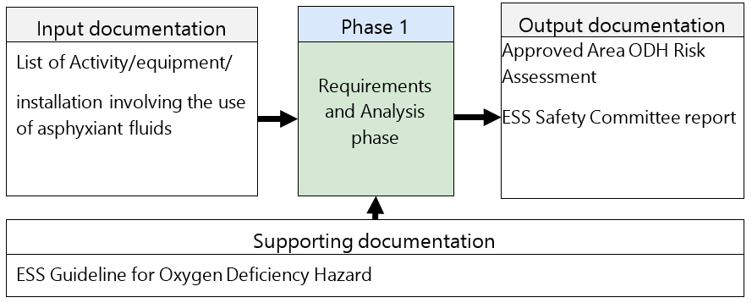
Phase 1: Requirements and analysis phase

Slide 9
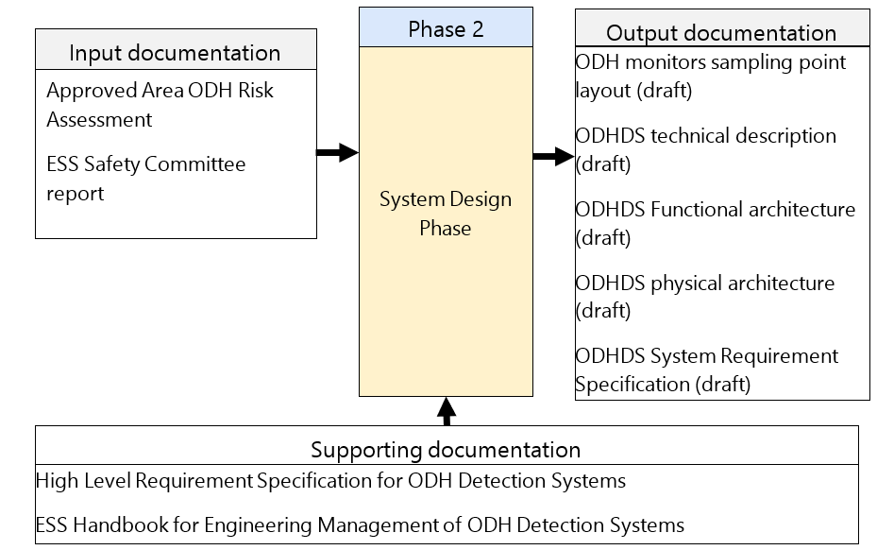
Phase 2: System Design phase

Slide 10
Preliminary Design Review (PDR)
Input:
  Output documents of phases 1 & 2
Output:
  Approved PDR Report
  An approval from the committee to start the detailed design phase

Slide 11
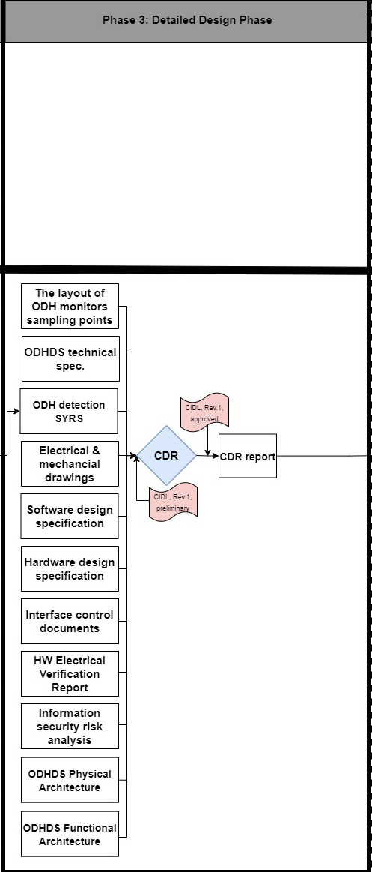
ODHDS DEVELOPMENT LIFE CYCLE
Detailed Design Phase
Phase 3: Detailed Design phase
Reviews:
  Critical Design Review (CDR)

Slide 12
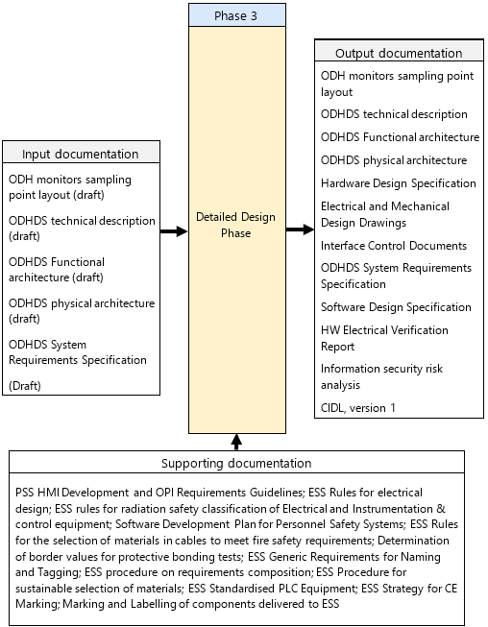
Phase 3: Detailed Design Phase

Slide 13
Critical Design Review (CDR)
Input:
  Output of phase 3
Output:
  Approved CDR Report
  An approval from the committee to start test specification development

Slide 14
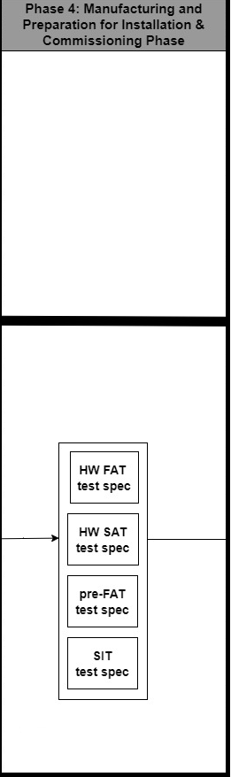
ODHDS DEVELOPMENT LIFE CYCLE
Manufacturing and preparation for installation and commissioning phase
Phase 4: Manufacturing and preparation for installation and commissioning phase

Slide 15
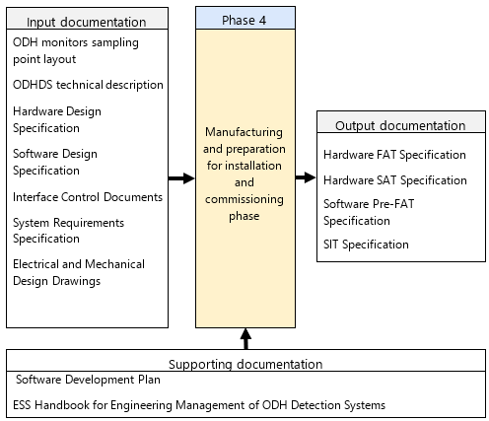
Phase 4: Manufacturing and preparation for installation and commissioning phase

Slide 16
ODHDS DEVELOPMENT LIFE CYCLE
Manufacturing and preparation for installation and commissioning phase
Phase 5: Installation, testing and commissioning phase
Reviews:
  Installation Readiness Review (IRR)
  Test Readiness Review (TRR)
Verification tests:
  Hardware FAT
  Hardware SAT
  Software peer review
  Software pre-FAT
  SIT
  Software post implementation peer review
Validation

Slide 17
Installation Readiness Review (IRR)
Input: Installation Binder
  Electrical and mechanical drawings
  HW Electrical Verification Report
  Risk Assessment Method Statement (RAMS)
  Document List
Output:
  Approved IRR report
  Approval to start installation

Slide 18
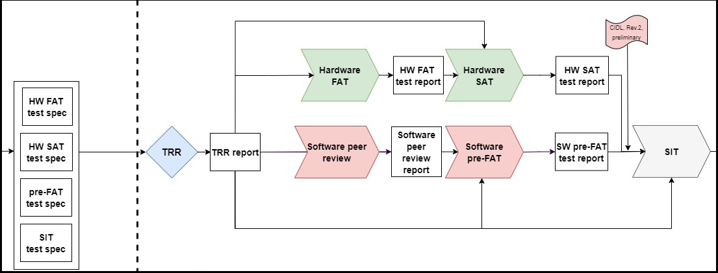
Test Readiness Review (TRR)
Input: Test Binder
  Test specification/Peer review template
  Risk Assessment Method Statement (RAMS)
Output:
  TRR Report
  An approval from the committee to start the test

Slide 19
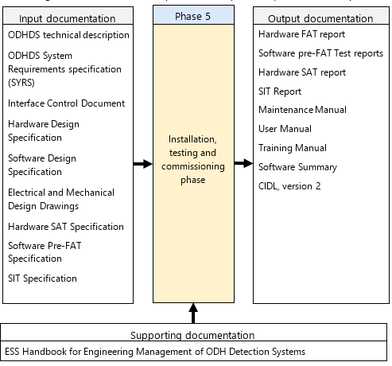
Phase 5: Installation, testing and commissioning phase

Slide 20
Hardware FAT
Verifies that the as-built hardware system meets the specified design.
Includes component test.
Could be performed by the vendor and it shall in such case be approved by ESS.

Slide 21
Hardware SAT
Verifies a complete HW system with cable connections from the FAT tested control cabinets to field devices is installed as specified in the design in its operational environment.
Shall be performed by ESS on the site.

Slide 22
Software peer review
Visual inspection of the software by an independent software developer
Reveals potential software design defects and avoid systematic failures.
The review result shall be documented in a software peer review report following the software peer review template

Slide 23
Software pre-FAT
Verifies the software functionality through simulations in test environment.
The test result shall be documented in a software pre-FAT report document.
Ensures compliance with the system requirements.

Slide 24
Site Integration Test (SIT)
Verifies that installed hardware and software work together properly
Ensures that the combination of hardware and software is serving the purpose of ODHDS functions and procedures.

Slide 25
Software post-implementation peer review
To be done after the SIT is performed successfully and before the system is put into operation
Performed by software peer reviewers
Ensures everything is done correctly and all punch list items are implemented in the software.

Slide 26
Validation
To validate that ODHDS meets the system requirements after software post implementation peer review

Slide 27
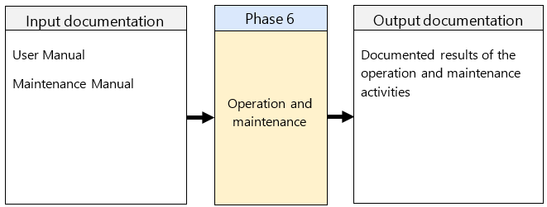
Phase 6: Operation and maintenance

Slide 28
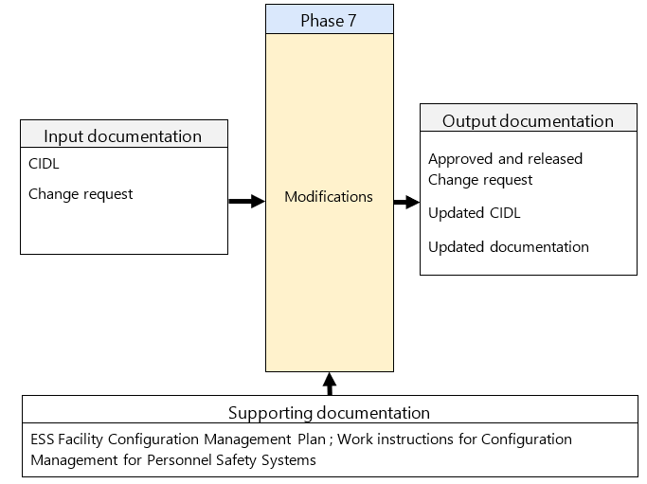
Phase 7: Modifications

Slide 29

2
ODH High level requirements

Slide 30
ODH High level requirements
Standards
There is no specific standard for ODH Detection system.
Oxygen Deficiency has been mentioned in the Swedish Work Environment Authority regulations AFS2020:1.
Evacuation alarm
99 § To prevent accidents and acute illness due to fire, gas outflow, lack of oxygen or the like, there must be detectors and alarm devices to the extent necessary. When assessing what is the necessary scope, consideration must be given
  1. workplace size, location and use
  2. the physical and chemical properties of the materials, substances and products and the equipment present, and
  3. the number of people for whom the workplace is intended, and their qualification.
  100 § Alarms must be able to be triggered manually in the event of danger. If necessary, there must be a device that automatically triggers the alarm in the event of fire, gas outflow, lack of oxygen or the like.
  General advice: Examples of how alarms can be designed can be found in the Fire Protection Association's publications SBF 110.

Slide 31
ODH High level requirements
The Swedish Work Environment Authority regulations AFS2020:1
There must be detectors and alarm devices to the extent necessary.
Alarms must be able to be triggered manually in the event of danger.
If necessary, there must be a device that automatically triggers the alarm in the event of fire, gas outflow, lack of oxygen.
General advice: Examples of how alarms can be designed can be found in the Fire Protection Association's publications SBF 110.

Slide 32
ODH High level requirements
Swedish Fire Protection Association's publications SBF110
6.2.2.6: An outage or short circuit in a circuit for alarm devices may never entail a total loss of coverage in an alarm device area.
6.6.3.6: The sound level of the signal for evacuation alarms in places where there are people more than temporarily shall be at least 10 dB(A) over the ambient normal highest level of the background noise. However, it may not be less than 65 dB(A).
6.6.3.7 The sound level of the signal for evacuation alarms where there are people shall not be more than 115 dB(A).

Slide 33
ODH High level requirements
Categories
General requirements
ODH monitors requirements
ODHDS design principle
ODH sign and alarm system requirements
H2 detection system interface requirements
User interface requirements
Power requirement
Supervision Requirements

Slide 34
ODH High level requirements
General requirements
ODH_HLREQ1: The ODHDS design shall comply with requirements listed in PSG High Level Design Requirements.
ODH_HLREQ3: If the ODH risk assessment determines the area/building as ODH class 0, the ESS safety committee shall evaluate the need for the ODH detection system.

Slide 35
ODH High level requirements
General requirements
ODH_HLREQ2: If the area/building is classified as ODH class 1 or 2 , the ODH risk assessment shall determine the ODH monitors redundancy is required for each or some leak points in that area/building.
  Questions to the committee:
    Do the committee members have any experience about redundancy in ODH monitoring?
    How the requirements for redundancy in any sampling points can be identified?

Slide 36
ODH High level requirements
ODH monitors requirements
ODH_HLREQ4: The ODH monitors that are connected to the ODHDS shall provide the following information to the ODHDS:
  Monitor’s health status.
  Real-time analogue O2 readout.
  ODH warning and alarm signals.
ODH_HLREQ5: All text and instructions on ODH monitors shall be displayed in English.

Slide 37
ODH High level requirements
ODHDS design principle
ODH_HLREQ6: The ODHDS shall trigger the ODH warning signal of the affected area if the O2 level is detected less or equal to 19.5% from any monitors placed in that area.
ODH_HLREQ7: The ODHDS shall trigger the ODH alarm signal of the affected area if the O2 level is detected less or equal to 18% from any monitors placed in that area.
ODH_HLREQ8: The ODHDS shall trigger the ODH alarm devices inside and outside the hazardous area if the O2 level is detected less or equal to 18% in that area to alert personnel to evacuate the area and make them aware the hazard exists nearby areas according to the ODH activation matrix.

Slide 38
ODH High level requirements
ODH sign and alarm system requirements
ODH_HLREQ9: The ODH alarm devices shall be in the form of red flashing or rotating strobe lights and sirens.
ODH_HLREQ10: ODH alarm devices shall be seen and heard from any position inside the hazardous area and at each entrance leading to that area.
  Note 1: The sound level of the ODH alarms should be at least 10 dB(A) over the ambient normal highest level of background noise, but not more than 115 dB(A) at a distance of one meter from the alarm device. Typically, it is required that the sound level of ODH sounders is higher than 65 dB(A) in permanently occupied places.
  Note 2: In areas where high ambient noise is expected, and fulfilling of Note 1 is not feasible, additional visual signals shall be considered.

Slide 39
ODH High level requirements
ODH sign and alarm system requirements
ODH_HLREQ11: The ODH alarm devices shall stream the same tone throughout all affected ODH areas upon ODH evacuation alarm.
ODH_HLREQ12: The ODHDS design should ensure that a hardware error in a supply circuit for the ODH alarm devices (i.e., power loss or short circuit) does not result in a total loss of ODH alarm coverage in a designated area/building.
ODH_HLREQ13: Signs shall be installed at each entrance of ODH areas/buildings, warning people not to enter the building if the evacuation alarm goes off.

Slide 40
ODH High level requirements
Supervision Requirements
ODH_HLREQ14: ODHDS shall provide LCR, MCR operator(s), and gate guard with the information necessary to supervise the system and ODH classified areas. This information includes but is not limited to:
  ODH warnings
  ODH alarms
  Health status of the ODHDS and ODH monitors
ODH_HLREQ15: ODHDS shall provide the off-site alarm receiving center with the following signals:
  ODH warnings
  ODH alarms
  Health status of the ODHDS and ODH monitors
  These interface signals shall be configured so that in case of a wire break for each of them, the relevant ODH warning/alarm/fault shall be triggered by ODHDS.

Slide 41
ODH High level requirements
H2 detection system interface requirements
ODH_HLREQ16: The ODHDS shall interface with H2 gas detectors/H2 gas detection to provide evacuation alarm.
  Note: Where H2 is the only source of ODH, no ODH monitor will be installed because the flammability hazard becomes significant at lower concentrations compared to the ODH.
ODH_HLREQ17: If there are sources of ODH other than H2 in a designated area/building, installation of ODH monitors shall comply with ATEX requirements

Slide 42
ODH High level requirements
User interface requirements
ODH_HLREQ18: The ODH HMI shall provide means to reset the ODH alarm.
  Note: Typically, the HMI is located on the ODHDS local cabinet.
ODH_HLREQ19: The ODH OPIs shall be developed using Control System Studio (CSS).

Slide 43
ODH High level requirements
Archiving requirements
ODH_HLREQ20: The ODHDS shall be integrated into Experimental Physics and Industrial Control System (EPICS) to enable archiving the ODHDS data in the EPICS archiver.
  The data sent to EPICS shall be sufficient to notify personnel about emergency situations (e.g., control room, first responders, crisis management team, etc.) and enable the post-mortem analysis of the ODH related incidents.
  This includes, but is not limited to the following data:
  The O2 level measured by each ODH monitor.
  The alarm and warning notifications from each ODH monitor.
  The ODHDS diagnostics signals.
ODH_HLREQ21: The ODHDS shall store the data sent to the EPICS archiver locally as a backup solution if the EPICS archiver is unavailable.
  A time frame of minimum 24 hours shall be considered for this backup.

Slide 44
ODH High level requirements
Power requirement
ODH_HLREQ22: The ODHDS battery capacity shall allow TBD hours operation of the system in normal state and thereafter TBD minutes operation in alarm state.
The battery capacity of ODHDS is one of the open issues in this PDR which needs to be discussed and concluded.
Different options for feeding ODHDS and proposed solutions will be presented in a separate slide “Power requirements for ODH detection systems”.

Slide 45
Finish presentation

Slide 46
References
Literature, Publications, Presentations
[1] ESS-0092276 - ESS Handbook for Engineering Management
[2] ESS-3438946 - ESS Handbook for Engineering Management of ODH Detection Systems
[3] ESS-0038692 - ESS Guideline for Oxygen Deficiency Hazard (ODH)
[4] ESS-3236032 - High Level Requirement Specification for ODH Detection Systems
[5] ESS-0330956 - Software Development Plan for Personnel Safety Systems
[6] ESS-0489907 - ESS Facility Configuration Management Plan
[7] ESS-1108205 - Work instructions for Configuration Management for Personnel Safety Systems
[8] AFS2020:1 - The Swedish Work Environment Authority regulations
[9] SBF110 - Swedish Fire Protection Association's publications SBF110

