Slide 2
Accelerator ODHDS Preliminary Design
PRESENTED BY Donya Daryadel

Slide 3
Agenda
Presenting distribution of ODH monitors in the tunnel
Typical installation for ODH sampling pipe
Alarm activation matrix
Reviewing the data extracted from CFD
Propagation, detection and alarm time

Slide 4
1
Presenting distribution of ODH monitors in the tunnel

Slide 5
CRYOMODULES OVERVIEW IN THE ACCELERATOR TUNNEL
The Accelerator ODH Detection System is designed to cover the potential asphyxiant gas leak points of cryogenic system located in the Superconducting LINAC (SCL) tunnel.
The SCL contains 30 elliptical cryomodules, whereas 9 are medium-beta and 21 high-beta, and 13 spoke cryomodules.

Slide 6
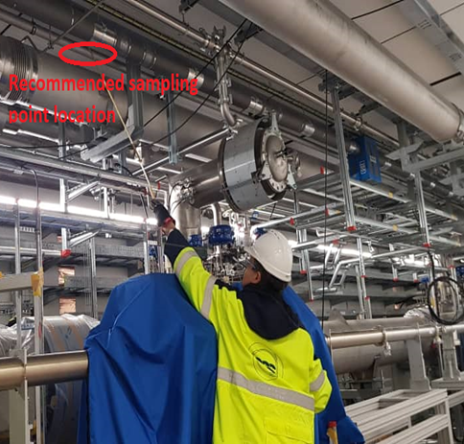
Site visit with cryo expert

Slide 7
Site visit with cryo expert

Slide 8
SAMPLING POINTS DISTRIBUTION IN THE TUNNEL
The distance from the end box to end of the last cryomodule is about 310m.
We covered this length by 13 sampling points.
If we divide 310 to 13 we reach 23.8m.
We tried to distribute the sampling point evenly in the tunnel, considering the location of the stubs and the leak points and length of the sampling pipes.
Based on our current design the distance between our sampling points in the tunnel are between 17~27m with the average of 24.6m.

Slide 9
SAMPLING POINTS DISTRIBUTION IN THE TUNNEL
Sampling point distribution relative to the location of the cryomodules and stub no.are as below table:
Stub no. | Nearest Cryomodule no. | Nearest cryomodule with sampling point | Distance (m)
120 | SPK2-SPK3 | SPK3 | 12.8
130 | SPK6-SPK7 | SPK7 | 17
140 | SPK10-SPK11 | -- | --
150 | SPK13-MBL1 | SPK13 | 25.7
160 | MBL2-MBL3 | MBL3 | 20.7
170 | MBL4-MBL5 | -- | --
180 | MBL6-MBL7 | MBL6 | 27.4
190 | MBL8-MBL9 | MBL9 | 23.7
200 | HBL1-HBL2 | -- | --
210 | HBL3-HBL4 | HBL3 | 27.4
Stub no. | Nearest Cryomodule no. | Nearest cryomodule with sampling point | Distance (m)
220 | HBL5-HBL6 | HBL6 | 24.5
230 | HBL7-HBL8 | -- | --
240 | HBL9-HBL10 | HBL9 | 26.6
250 | HBL11-HBL12 | HBL12 | 24.4
260 | HBL13-HBL14 | -- | --
270 | HBL15-HBL16 | HBL15 | 26.8
280 | HBL17-HBL18 | HBL18 | 24.2
290 | HBL19-HBL20 | -- | --
300 | HBL21 | HBL21 | 26.9

Slide 10
SPOKE CRYOMODULES
The Spoke Linac (SPK) is the first stage of the SCL.
It consists of the 13 spoke cryomodules.
There are in total three sampling points, which are positioned by:
Spoke 3
Spoke 7
Spoke 13
25.7m
17m
12.8m

Slide 11
MBL CRYOMODULES
It consists of the 9 elliptical cryomodules.
There are in total three sampling points, which are positioned by:
MBL 3
MBL 6
MBL 9
23.7m
27.4m
20.7m

Slide 12
HBL CRYOMODULES
It consists of the 21 elliptical cryomodules.
There are in total 7 sampling points, which are positioned by:
HBL 3, 6, 9, 12, 15, 18, 21
26.6m
24.5m
27.4m

Slide 13
HBL CRYOMODULES
24.2m
26.5m
24.4m

Slide 14
HBL CRYOMODULES
26.9m

Slide 15
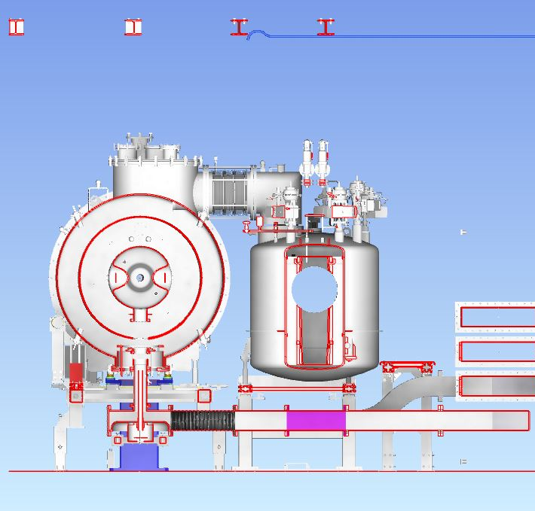
Section views

Slide 16
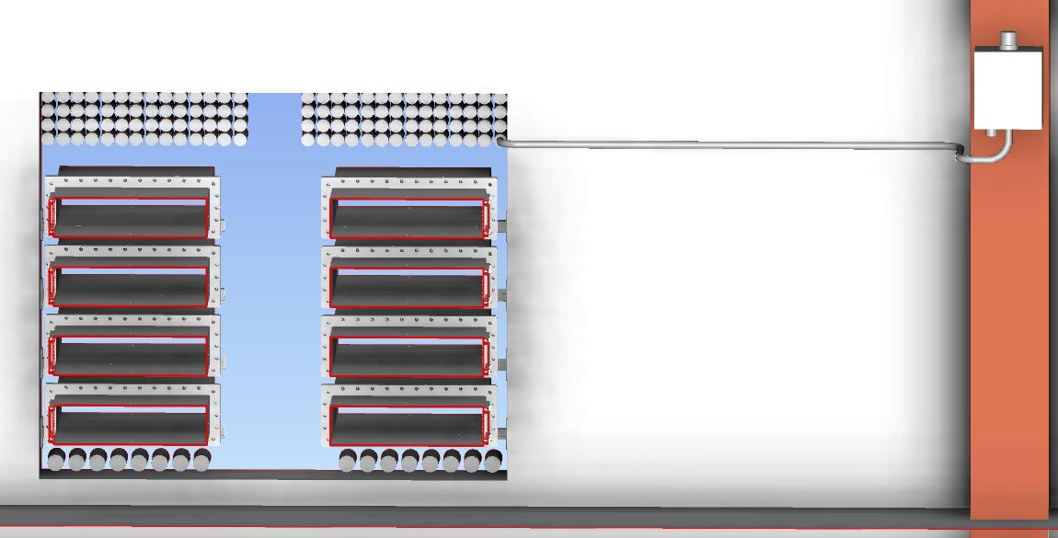
ODH monitor in G02

Slide 17
2
Typical installation of ODH sampling pipe

Slide 18
Typical installation for ODH sampling pipe
ODH sampling point

Slide 19
Typical installation for ODH sampling pipe
Pipe route on the wall in G01

Slide 20
Typical installation for ODH sampling pipe
Exhaust air pipe

Slide 21
Typical installation for ODH sampling pipe
Stub in G01

Slide 22
Typical installation for ODH sampling pipe
Pipe route on the roof in G01

Slide 23
Typical installation for ODH sampling pipe
ODH monitor in G02

Slide 24
Typical installation for ODH sampling pipe
Pipe route in G02

Slide 25
Typical installation for ODH sampling pipe
Stub in G02

Slide 26
3
Alarm activation matrix

Slide 27
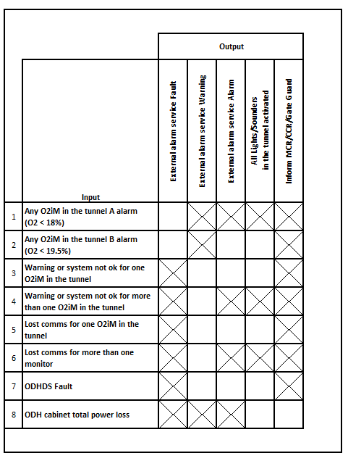
Alarm activation matrix

Slide 28
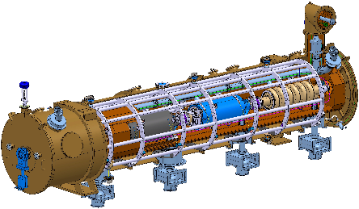
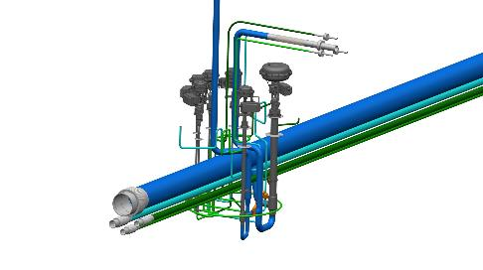
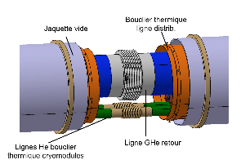
4
Reviewing the data extracted from CFD

Slide 29
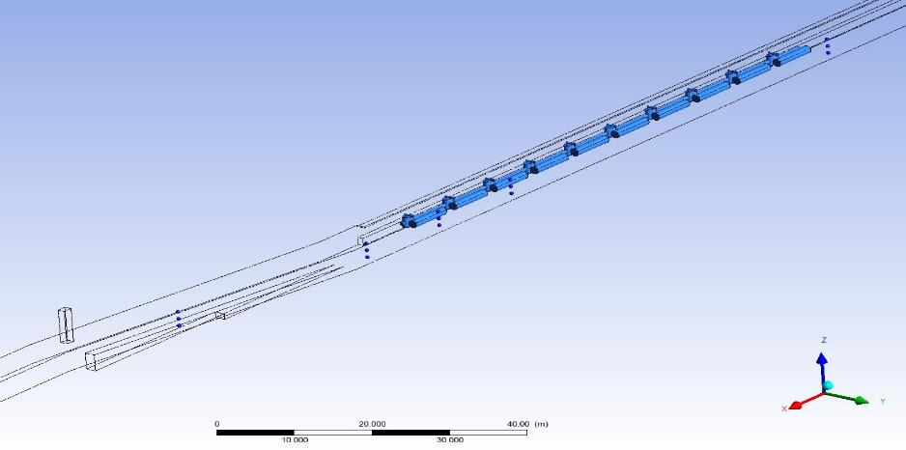
Accelerator tunnel
CFD simulations
Scenario 2 (2.4 kg.s⁻¹ during 2 s) – rupture of the vacuum vessel of a High-β
Ventilation ON
25 200 m³/h
Discharge point
B
Nearest exit from the A2T
A
C
Acknowledgement : E.LUNDH

Slide 30
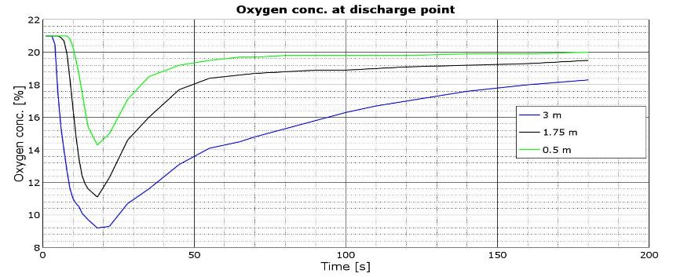
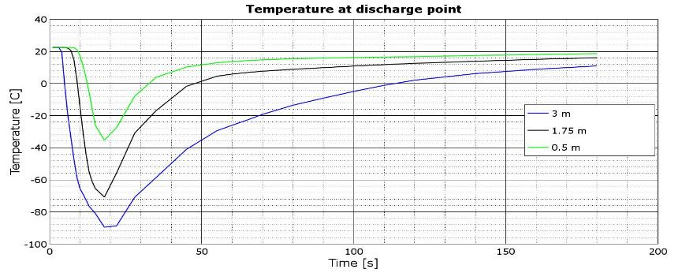
A
Ventilation ON
25 200 m³/h
Acknowledgement : E.LUNDH

Slide 31
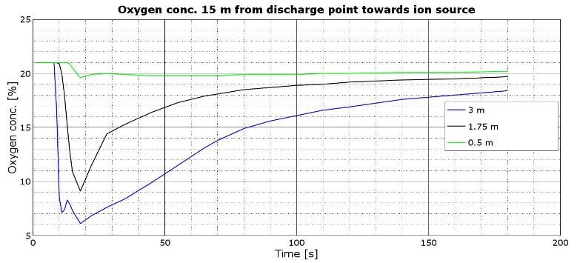
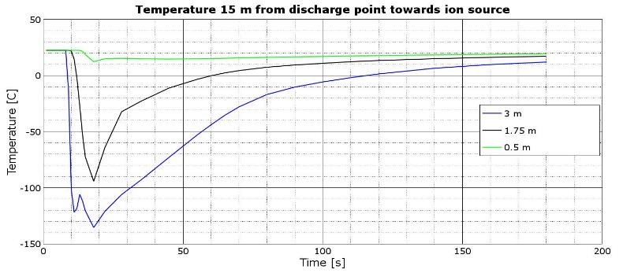
18%
Propagation time
10s
B
Ventilation ON
25 200 m³/h
Acknowledgement : E.LUNDH

Slide 32
5
Propagation, detection and alarm time

Slide 33
Propagation, detection and alarm time
Review committee recommendation 2016
Rough estimation
~10s
~7s
~ 18 s
<1 s

Slide 34
Finish presentation

Slide 35
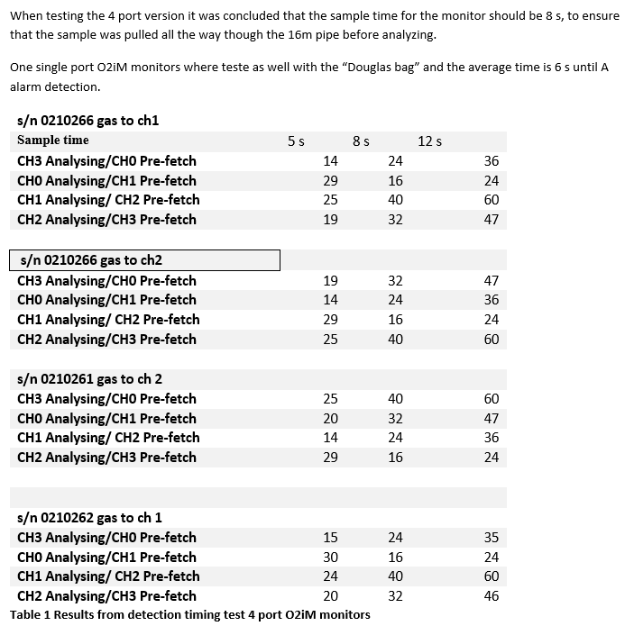

Slide 36
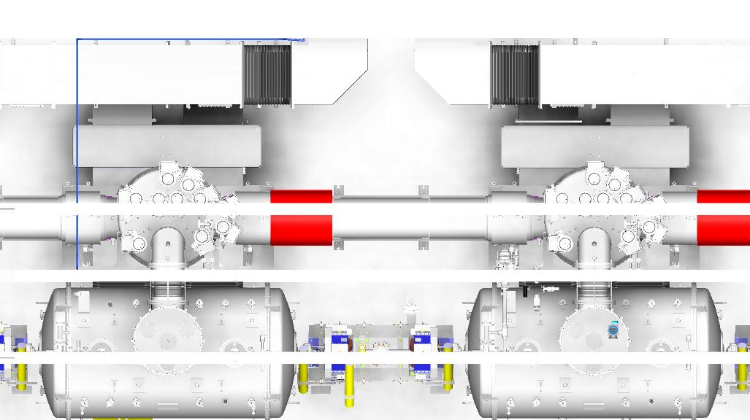
Spoke 3 sampling point layout

Slide 37
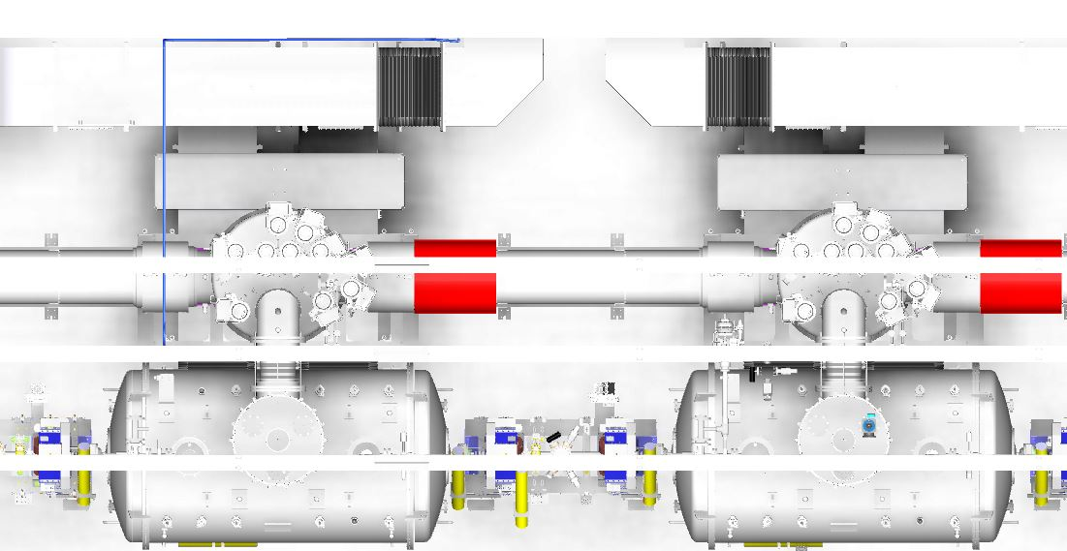
Spoke 7 sampling point layout

Slide 38
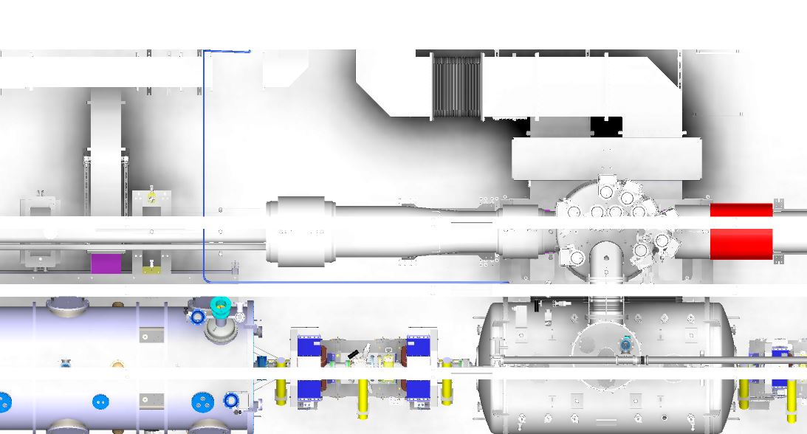
Spoke 13 sampling point layout

Slide 39
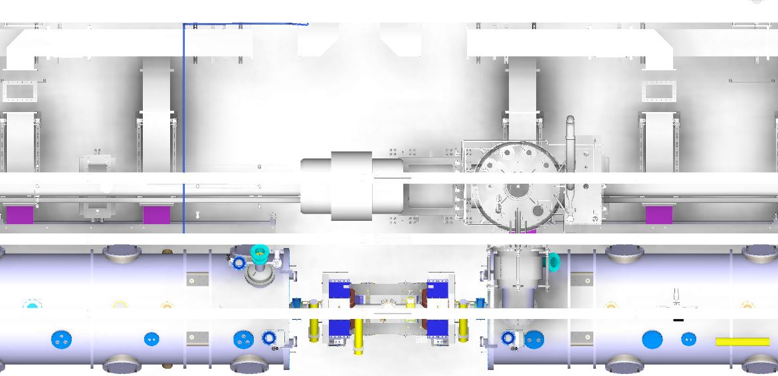
MBL 3 sampling point layout

Slide 40
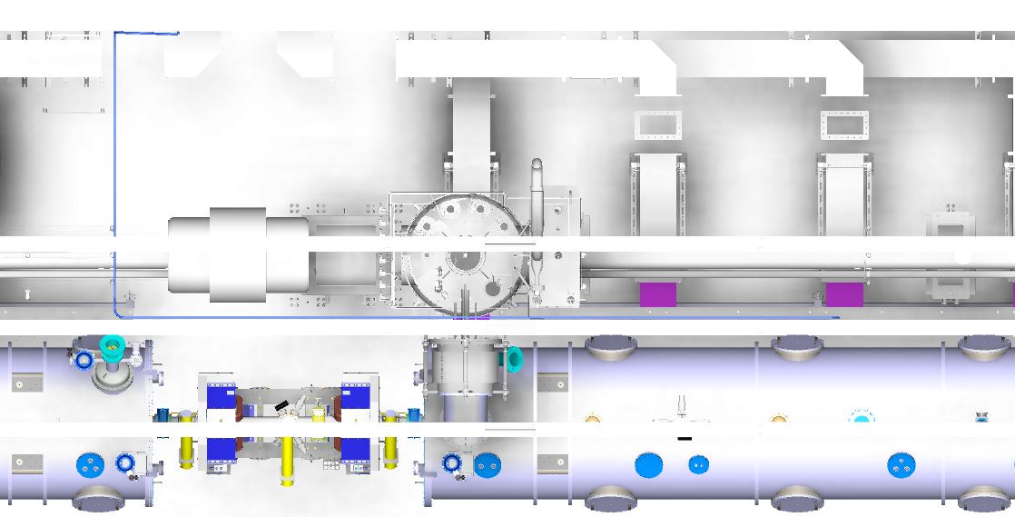
MBL 6 sampling point layout

Slide 41
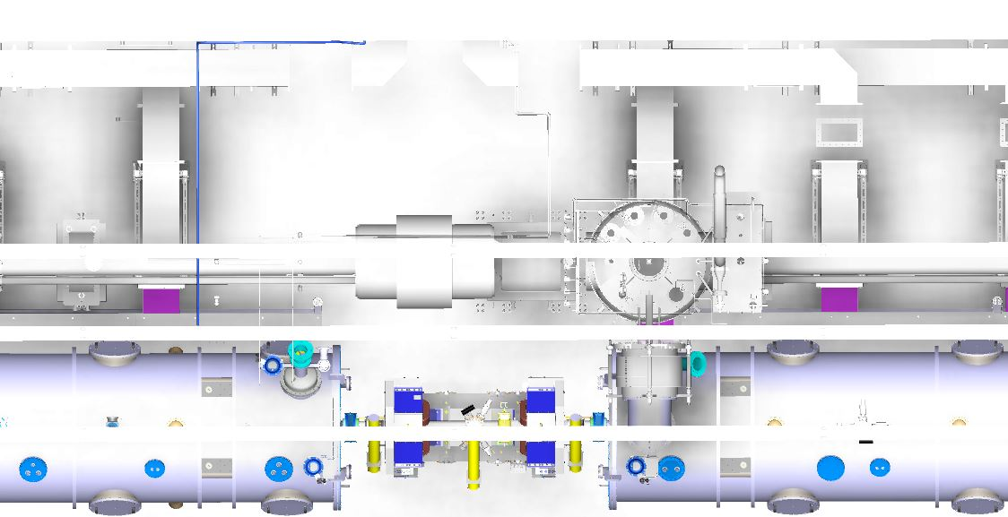
MBL 9 sampling point layout

Slide 42
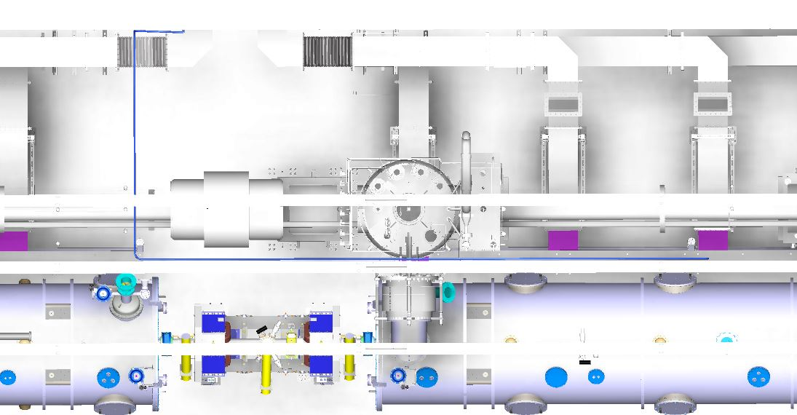
HBL 3 sampling point layout

Slide 43
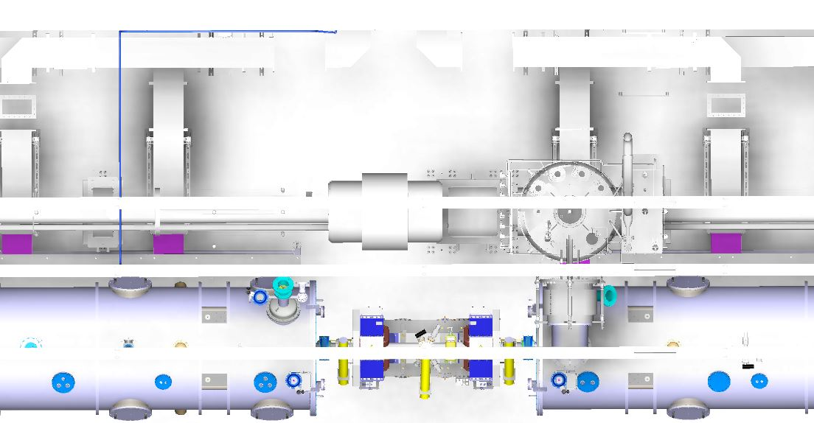
HBL 6 sampling point layout

Slide 44
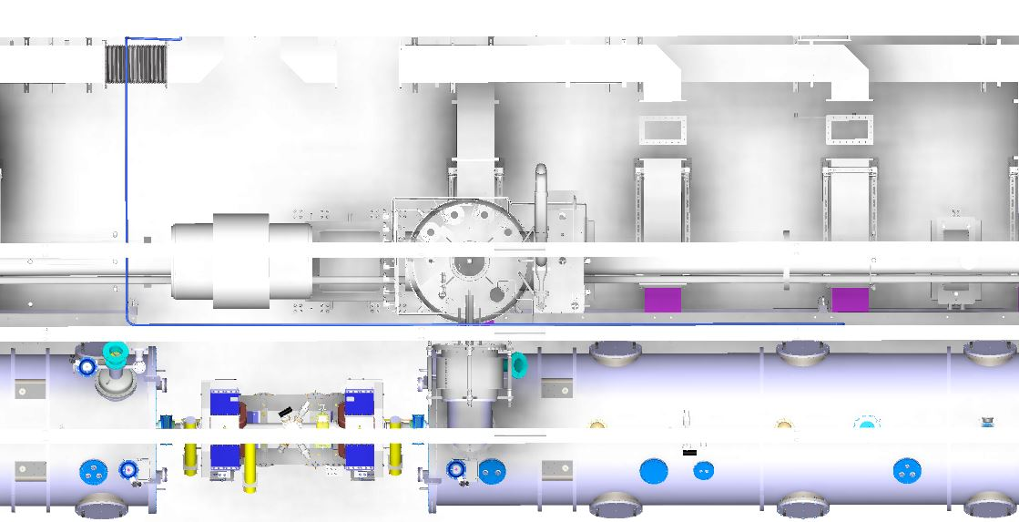
HBL 9 sampling point layout

Slide 45
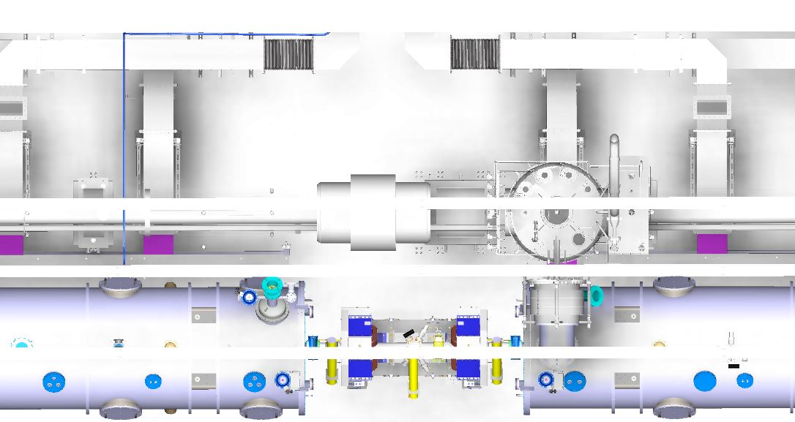
HBL 12 sampling point layout

Slide 46
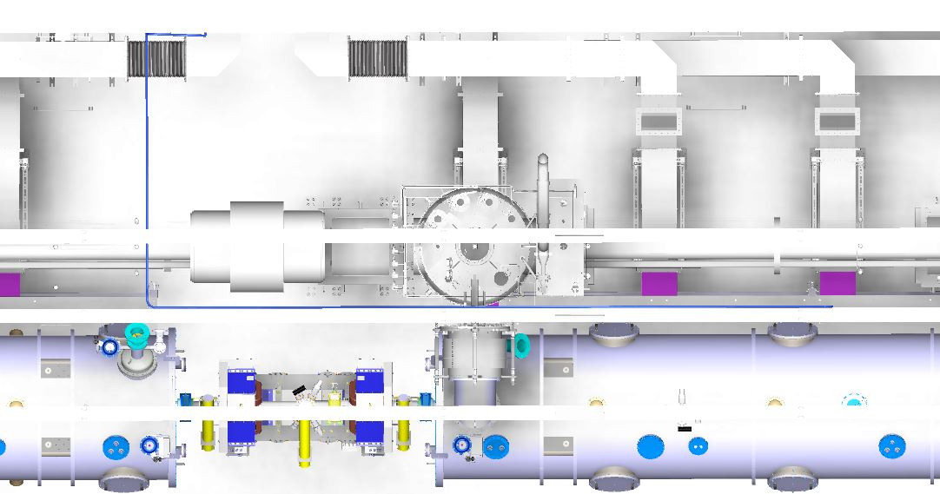
HBL 15 sampling point layout

Slide 47
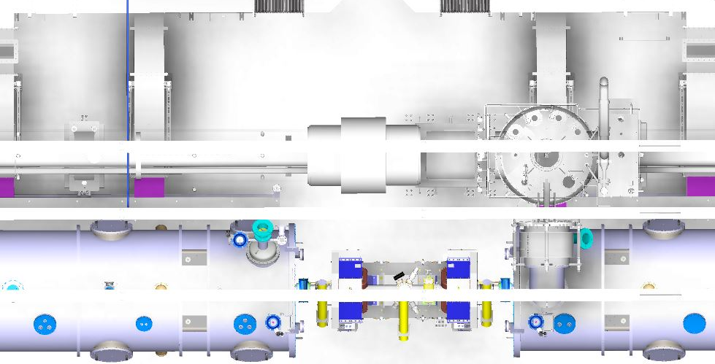
HBL 18 sampling point layout

Slide 48
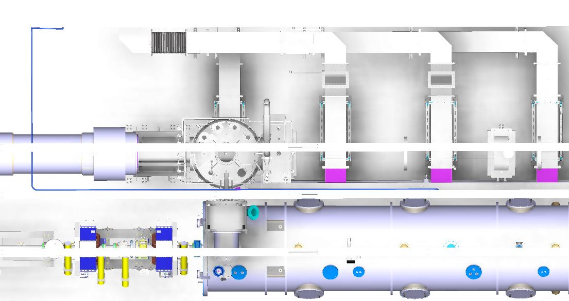
HBL 21 sampling point layout

