Slide 1
ODH incidents
Optional subtitle
PRESENTED BY Helen boyer

Slide 2
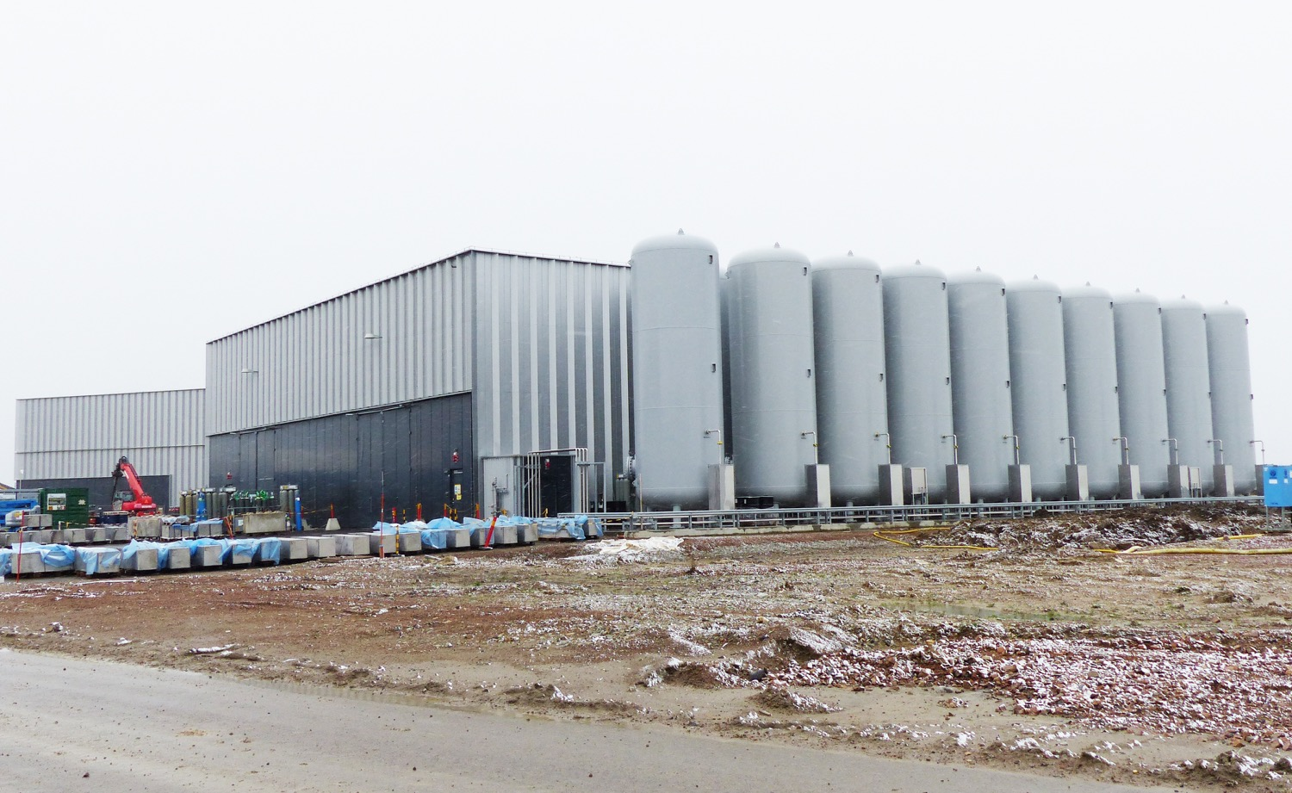
Oxygen Deficiency Hazard (ODH) incidents - Nitrogen ingress into ’dogshed’
The incident occurred at G04, in an area known as the dogshed. This area is where the regulators for the helium gas system are located.
As part of commissioning nitrogen was being exhausted outside building.
Poor sealing of pipework into the dogshed building then allowed the nitrogen that had built up in this ’box’ to enter the dogshed.
Oxygen deficiency alarm for the area activated and the person left the area.

Slide 3
Oxygen Deficiency Hazard (ODH) incidents - Nitrogen ingress into dogshed(2)
Recommendations from incident investigation included:
Redesign of exhaust pipework
ODH alarm outside dogshed area
Repositioning of alarm detection
Improved sealing of pipework
Ensure that modifications to design are considered by all parties

Slide 4
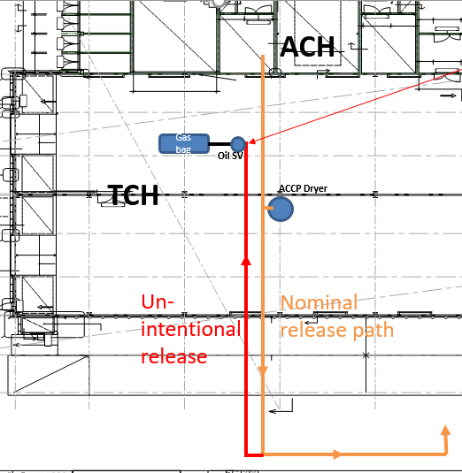
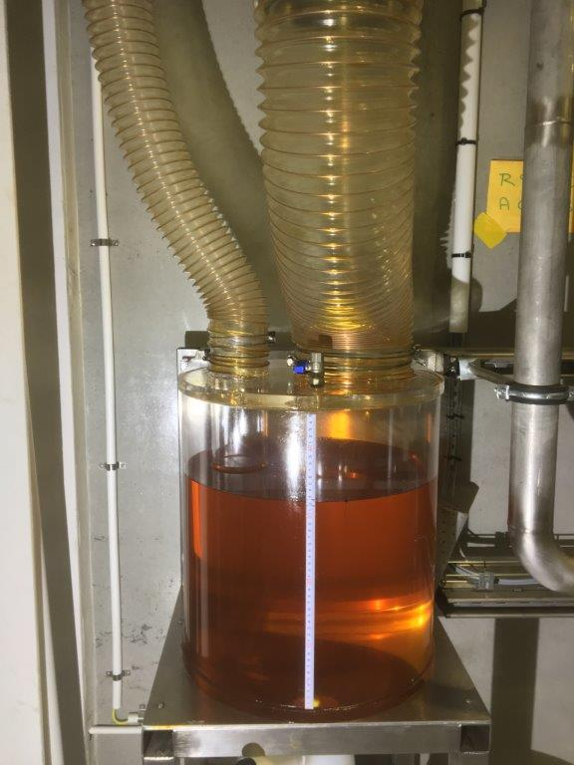
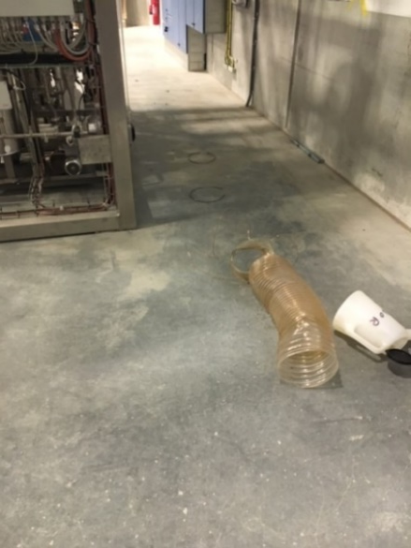
ODH Incidents – incorrrect dryer depressurisation (1)
Incorrectly performed dryer depressurisation (in <1 second instead ~15 minutes) caused pipe disconnection,
serious pressure relief incident
ODH Warning (sensor position 6 < 19.5 % for ~40-50 seconds) and
Fire alarm (presumably caused by oil vapour cloud)

Slide 5
ODH Incidents – incorrrect dryer depressurisation (2)
Recommendations from incident investigation included:
Immediate stop of commissioning and machinery
Removing root cause by putting a blind flange on the safety relief header
Check for further flow restrictions
Design of a separate safety relief line only for the gas bag relief
HAZOP of dryer system

Slide 6
Other incidents
Alarm triggered due to power loss – initially ODH data was not captured, by morning the ODH monitors in Cold box hall switched off (at that time the UPS was not supported by diesel generators) The ODH plc cabinet and alarms were then transferred to local UPS.
Since then the diesel generators have come on line providing back up power.

Slide 7
Finish presentation

