Slide 2
SE Integration and integration infrastructure
Solutions and labs
Experiment Control and Data Curation (ECDC)
Anders Pettersson

Slide 3
NICOS
All devices shall be available in NICOS
Instrument cabin
User and Expert interface
Qt based
Extensible and customizable
Scripting
Python CLI
Plotting live data

Slide 4
EPICS
Integrated Control Systems Division - ICS WP12
EPICS - Experimental Physics and Industrial Control System
EPICS is the signal layer backbone at ESS
Every remote controlled signal or data need to be available as an EPICS PV (Process Variable)
All SE hardware is integrated into EPICS
ICS WP12 provide integration working close with ECDC
ECDC priorities NSS integration tasks
All data will be timestamped in EPICS
Notes:
Open source facility control system/Scada system used at large research facilities (radio telescope array, telescopes, synchrotrons, Xfel etc).

Slide 5
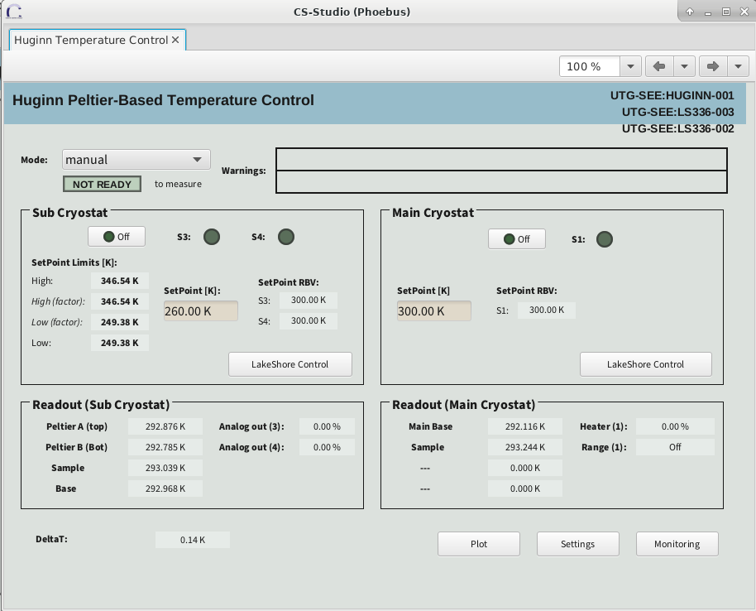
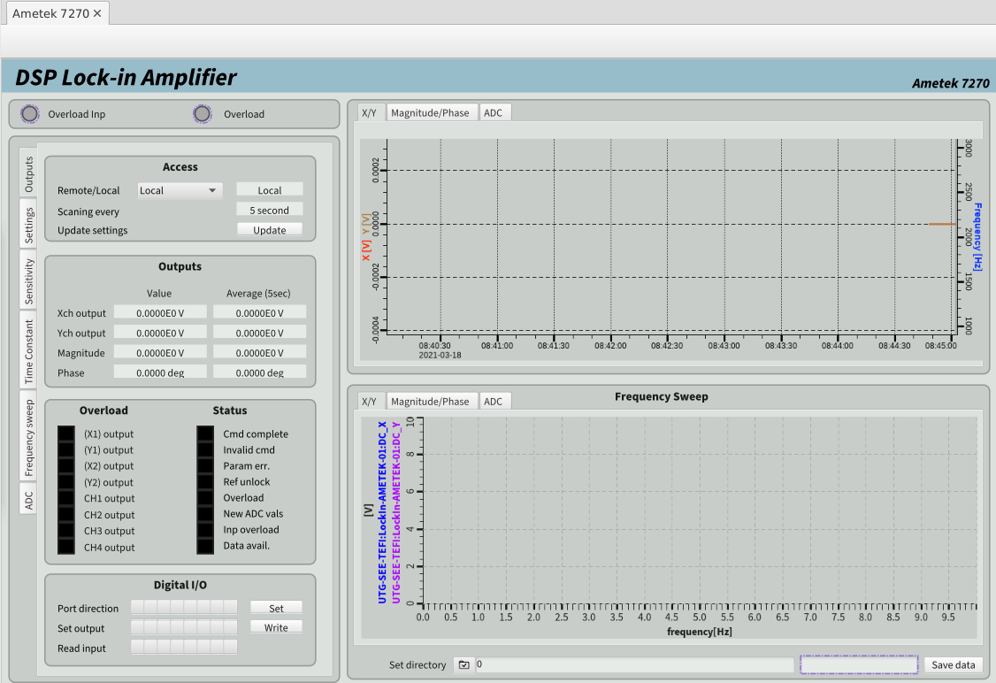
EPICS
CS-Studio Phoebus GUI, Archiver
From SE perspective
CS-Studio Phoebus -> Engineering Interface (mainly SE team)
Troubleshooting/development interface
Archiver –> long term SE monitoring
Not the interface for the User
Potentially providing device hardware configuration parameters not exposed to User.
Will not provide scripting

Slide 6
Overview SE integration
From hardware to User interface
SE System
User interface
Local IPC
EPICS
Octopy
EPICS Process Variables (PV)
Technical Network
NICOS
SEE
SEE
ESS Timing network
EPICS
forwarder
Filewriter
NeXus/HDF5
Kafka
Notes:
Exposeing signals on EPICS enable access on ESS controls infrastructure

Slide 7
2
(mention octopy..)
Different solutions
Same User Experience

Slide 8
Different solutions Same User Experience
Use case: EPICS for standard systems
EPICS
Standard devices are straightforward in EPICS
Robust
GUI, Archiver, Save and Restore
Some community integrations available

Slide 9
Different solutions Same User Experience
Use case: Octopy for device requiring a DLL (potentiostat)
Not straightforward with EPICS
Labview not supported by ICS
Labview ”EPICS” not ”adviced” by ICS
ICS only supports Linux machines (win required)
”Normal” complexity with Octopy
Octopy python based, runnable on most systems
Notes:
Octopy provide a solution where EPICS is limited

Slide 10
Different solutions Same User Experience
Use case: Octopy Development systems Orange Cryostat, Rig1, LS336 Tctrl calib
Octopy provide SE with a toolbox for SE low level complexity
Configurations can be changed dynamically enabling modularity
Python libraries can be used
Python scripts can be added in a modular way
SE staff can code (low threshold)

Slide 11
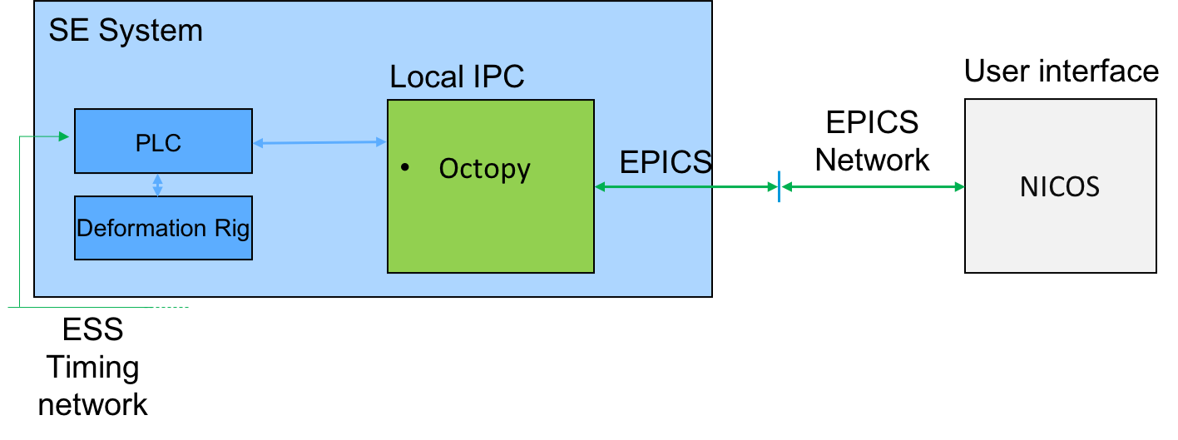
Different solutions Same User Experience
Use case: Higher timestamping resolution
Timestamping for SE (”raw” signals)
PLC (Beckhoff) synchronize to ESS time through PTP
Standard MQTT library is used for PLC to push data to Octopy -> EPICS
The Provides solution for timeresolution 10-100us and sample rate 1-10ks/s

Slide 12
Different solutions Same User Experience
Use case: Octopy for SECoP Devices
Translate a SECoP device to EPICS
Develop a ESS SE system for SECoP
Network

Slide 13
Integrated devices
LakeShore 224 T Monitor
LakeShore 336 T Controller
Vinci HP syringe pump
GE Pace 5000 P Calibration system
Huginn Peltier-Based T Control
Julabo F25 HL
NE1002x Syringe Pump
NE1600 Syringe Pump
NE9000 Peristaltic Pump
Camera Alignment System (CAS)
Beckhoff as toolbox
Knauer Azura P 6.1L HPLC
Lakeshore 155 I-V Source
Lesker kjlc392 vaacuum gauge
Schlumberger Freq Resp Analyzer
AMI 1700 LN2/LHE Level Instrument
Burster Resistance Decade 1427
ESI Pressure Gauge monitor
Flir camera
Kepco BOP50-2m Power Supply

Slide 14
Thoughts on integration
Good things and challenges..
An available SE ”expert” is essential for the integration
Some basic devices integrated
Octopy completes integration toolbox for SE
(current) Infrastructure mostly in place (finally) in SE labs
YMIR will allow closer to ”real deal” testing
Too few SE systems to integrate. Essential for develop modularity, logic, complexity
Too few ongoing projects, ICS resources very limited but still underutilised by SE
Still some struggles with infrastructure

Slide 15
.
B02 Controls lab
YMIR instrument

Slide 16
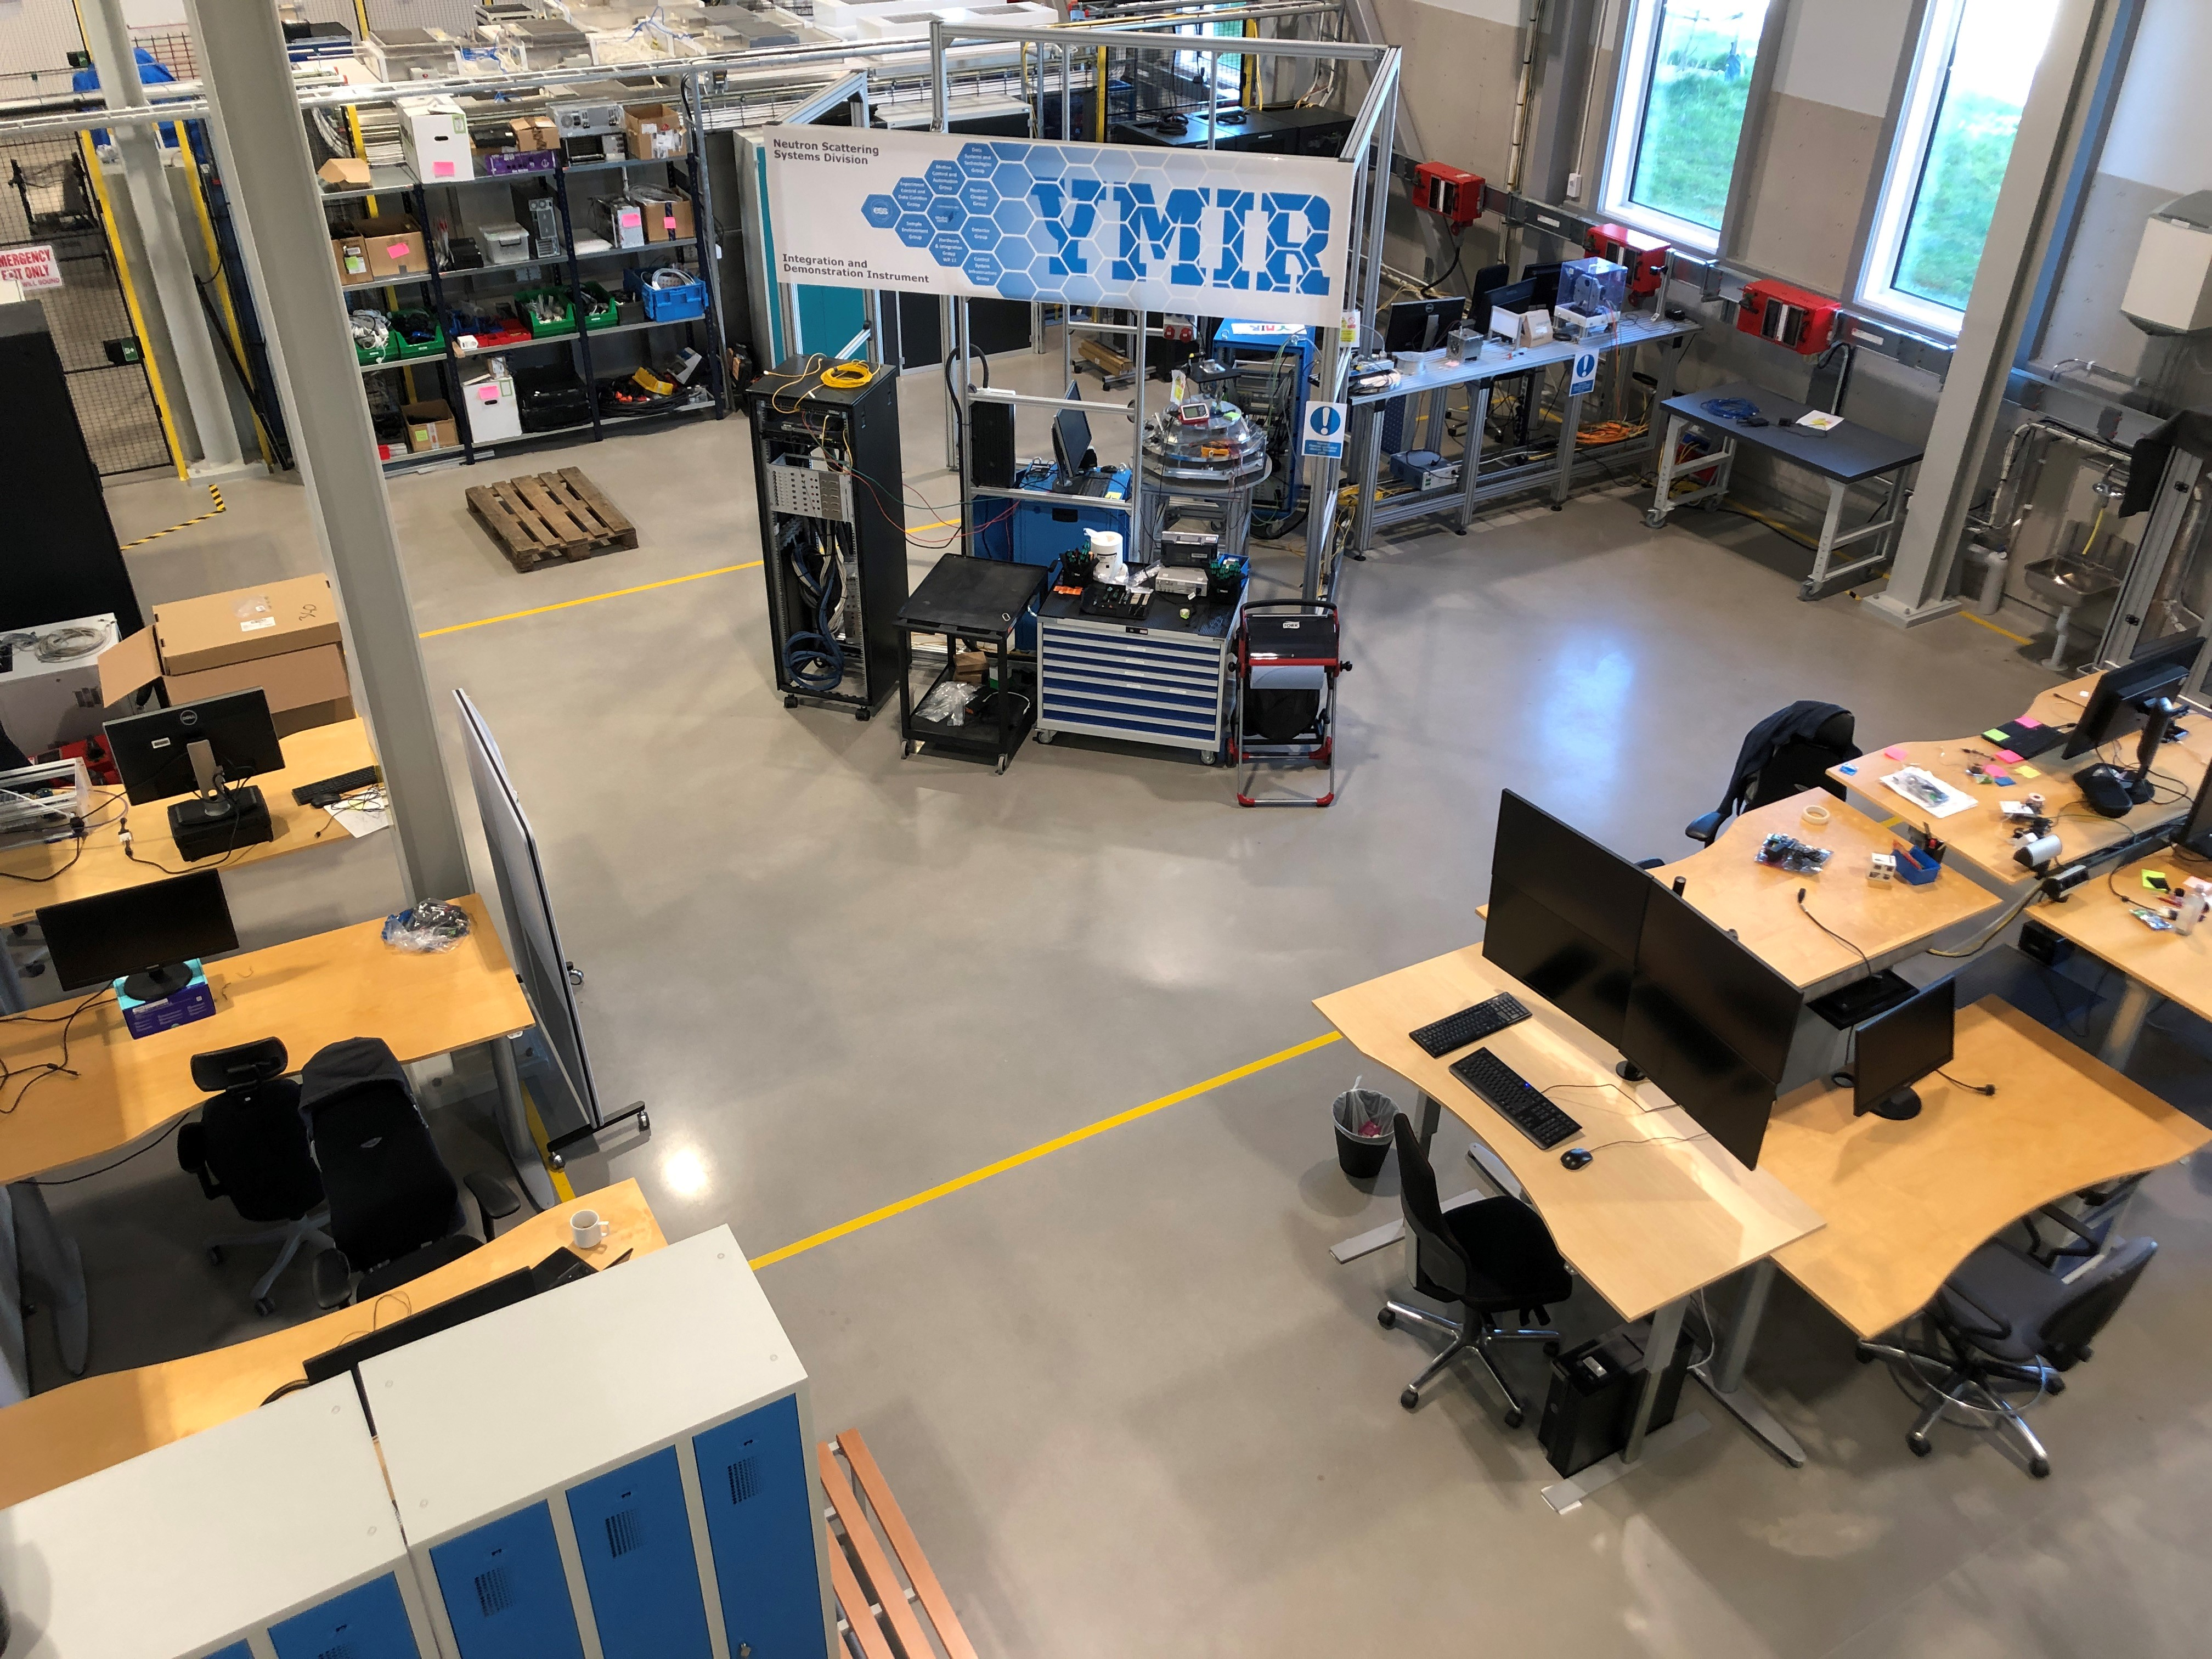

Slide 17
YMIR beamline in ESS B02 Facility
Collaborative lab space for SE, ECDC, MC&A, Chopper, instr etc
YMIR:
Physical Instrument without neutrons
Provide latest instrument control system
Planned Instrument network infrastructure
Utilities for SE
Soldering station
Cross group collaboration workplace
Easy access promoting interactions with instrument teams, tech teams,
Demonstrator

Slide 18
YMIR beamline
Current devices
Laser beam + detector readout
Running Mini-chopper
SE XYZ scanning system
Timestamping system (SE, ICS, MC&A)
Non-magnetic floor
SE K-mount
Light tomography

Slide 19
YMIR beamline
For Sample Environment
Testrun equipment as a SAT, integration SAT
Test new developments ”offline”
Test arriving equipment in non supervised zone
Demonstrate/test complete control chain for SE
Strengthen collaboration cross teams
SE comtrols infrastructure development
SE plug and play
Timestamping
TTL synch
….

Slide 20
Summary
Complementary integration solutions
One user interface
EPICS/NICOS UI available for SE
Octopy used by SE to build complex SES
Octopy provide local flexibility
YMIR help drive SE controls development
B02+E03 etc big step towards final SE controls structure
Beckhoff PLC + Octopy provide standard for raw signals, hi-res timestamping and motion

Slide 21
Thank You for listening!

