Slide 2
Soft Matter Support
Rheometer and Stopped Flow status
PRESENTED BY Anders Pettersson/caroline Curfs

Slide 3
Soft matter support
A lack of resources
“FLUCO” have been split into Soft matter and Electrochemistry (Alice C)
Lost our only resource in soft matter (H Schneider)
No additional resources on the horizon
Communication not optimal…

Slide 4
Soft matter support
AP (ECDC) Supporting SE on 2 projects
Currently working in ECDC mainly with SE controls and integration support
Will support SE on Rheometer and Stopped Flow system
Have experience from rheology and from food/refinery analytical labs
Plan
Understand equipment
Define use cases
-> support integration process

Slide 5
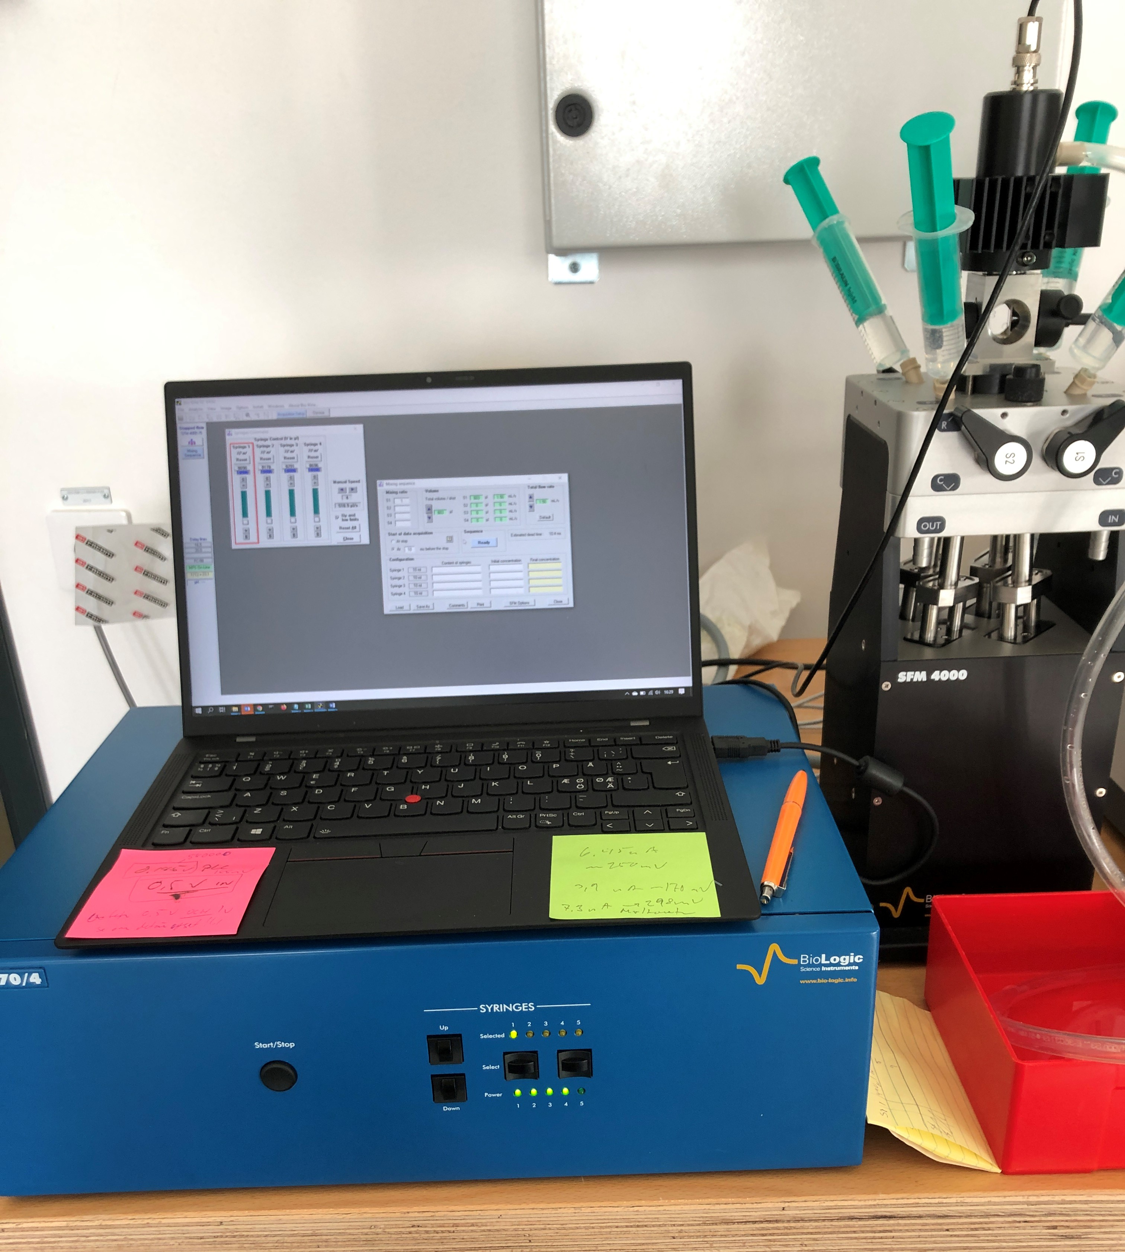
Soft matter support
Stopped Flow System BioLogic SFM400 MPS70
Status:
Moved to SE E03 lab
Running using BioKine software
Protocol not released by manufacturer (!)
TTL pulse synchronization used at other facilities
Plans:
Spend some time to backwards engineer protocol (First signals sniffed)
Instrument scientist involved (JH)

Slide 6
Soft matter support
Anton-Paar MCR702 Rheometer
Status:
Moving to E03 SE labs Thursday
Plans:
Anton-Paar visit for startup support
Starting with just learning the device
Define use case and start integration (protocol supposed to be available)
Instrument scientist involved (JH)

Slide 7
Soft matter support
JASCO LC-4000 HPLC
Status:
RS232 Com card on my desk today
Moving to E03 SE labs Thursday
Plans:
Start with basic integration based on ISIS EPICS (low hanging fruit)
Instrument scientist involved (JH LOKI, AL ESTIA)
“device expert” resource discussion still not fully resolved..

