Slide 1
Yeast lipid deuteration at DEMAX
Workflow and case studies
PRESENTED BY HanNA Wacklin-KNECHT

Slide 2
1
Yeast lipid production at DEMAX

Slide 3
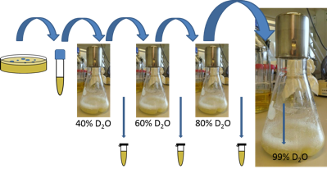
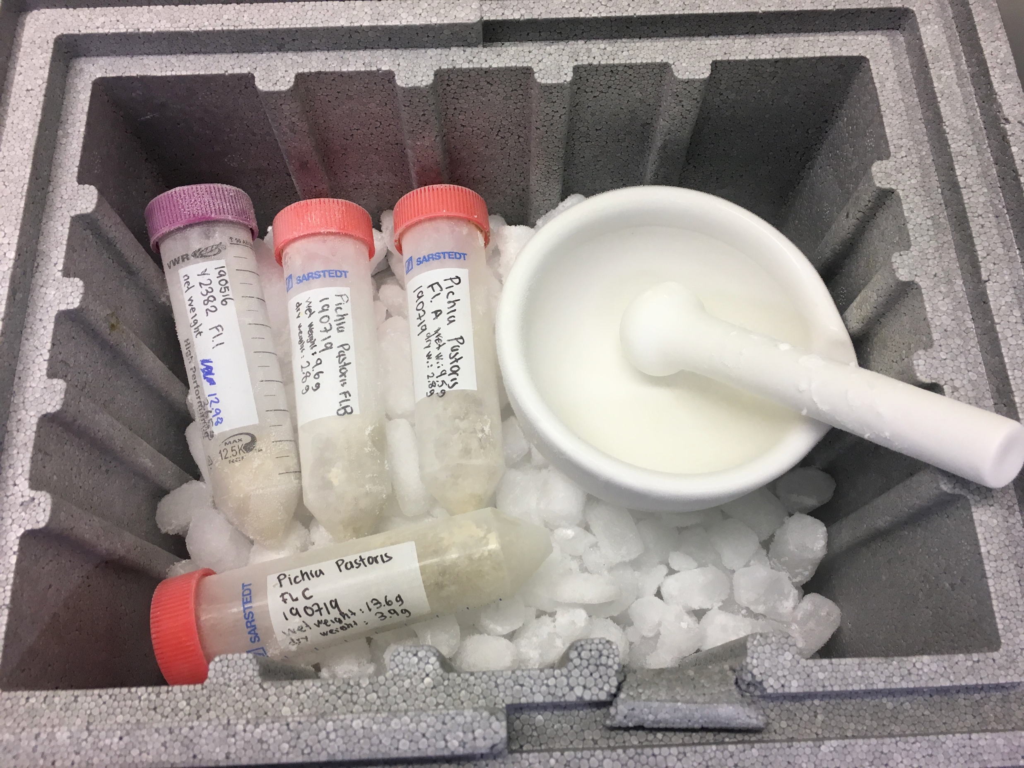
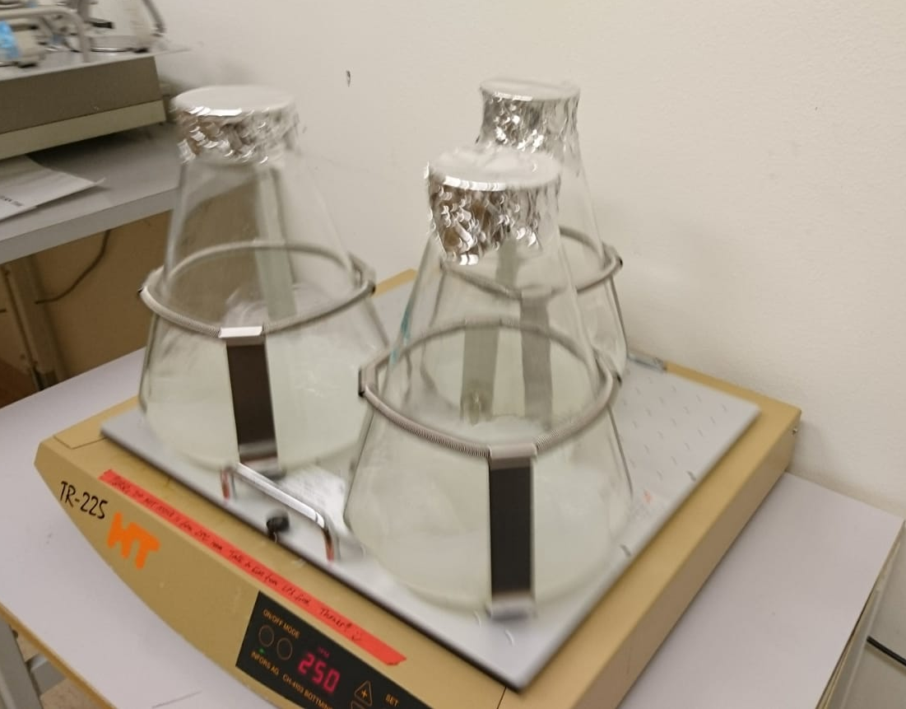
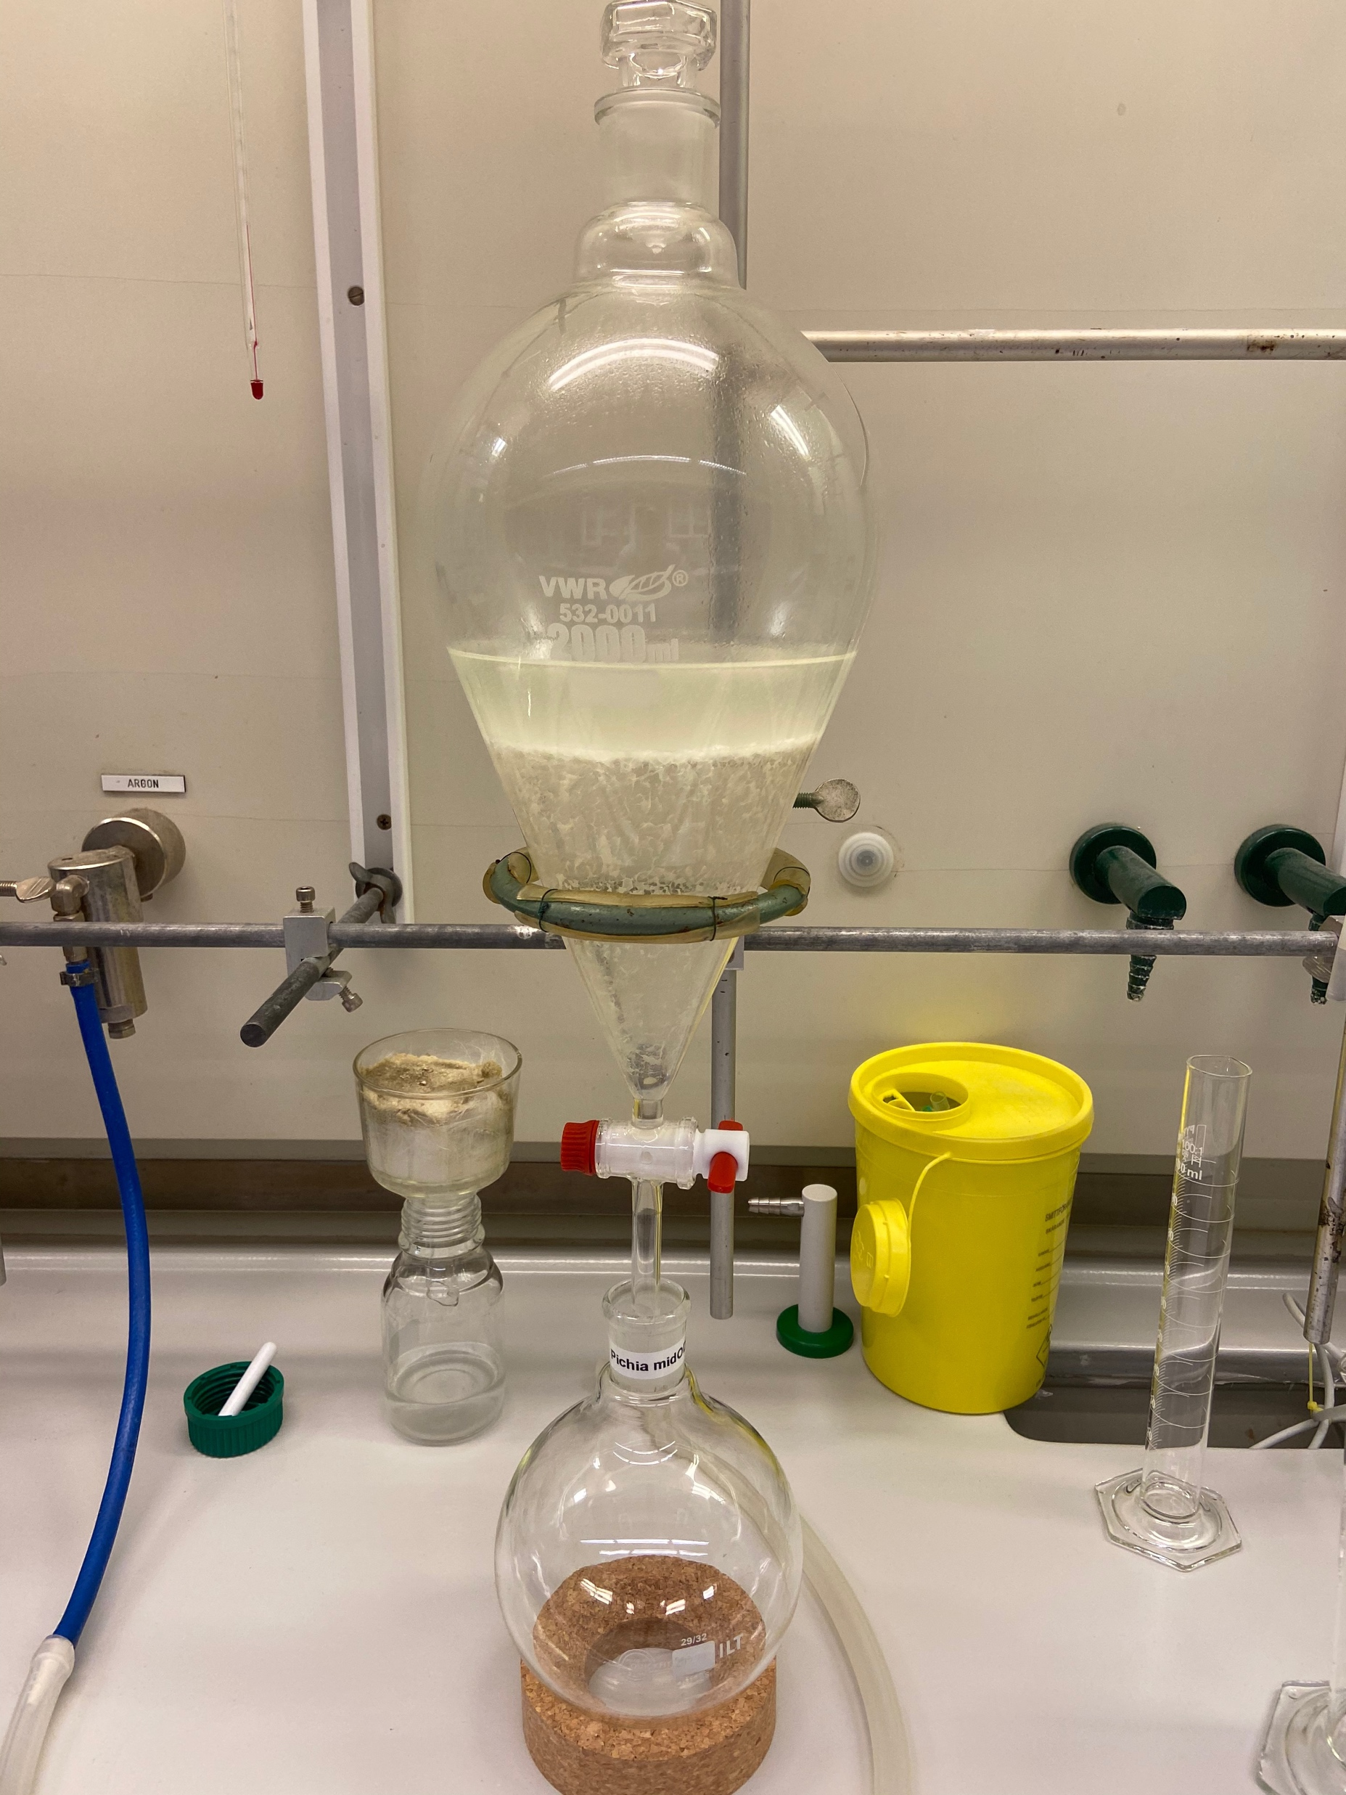
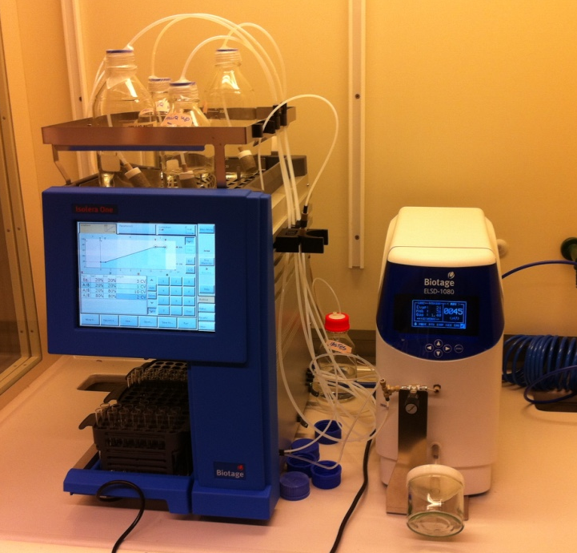
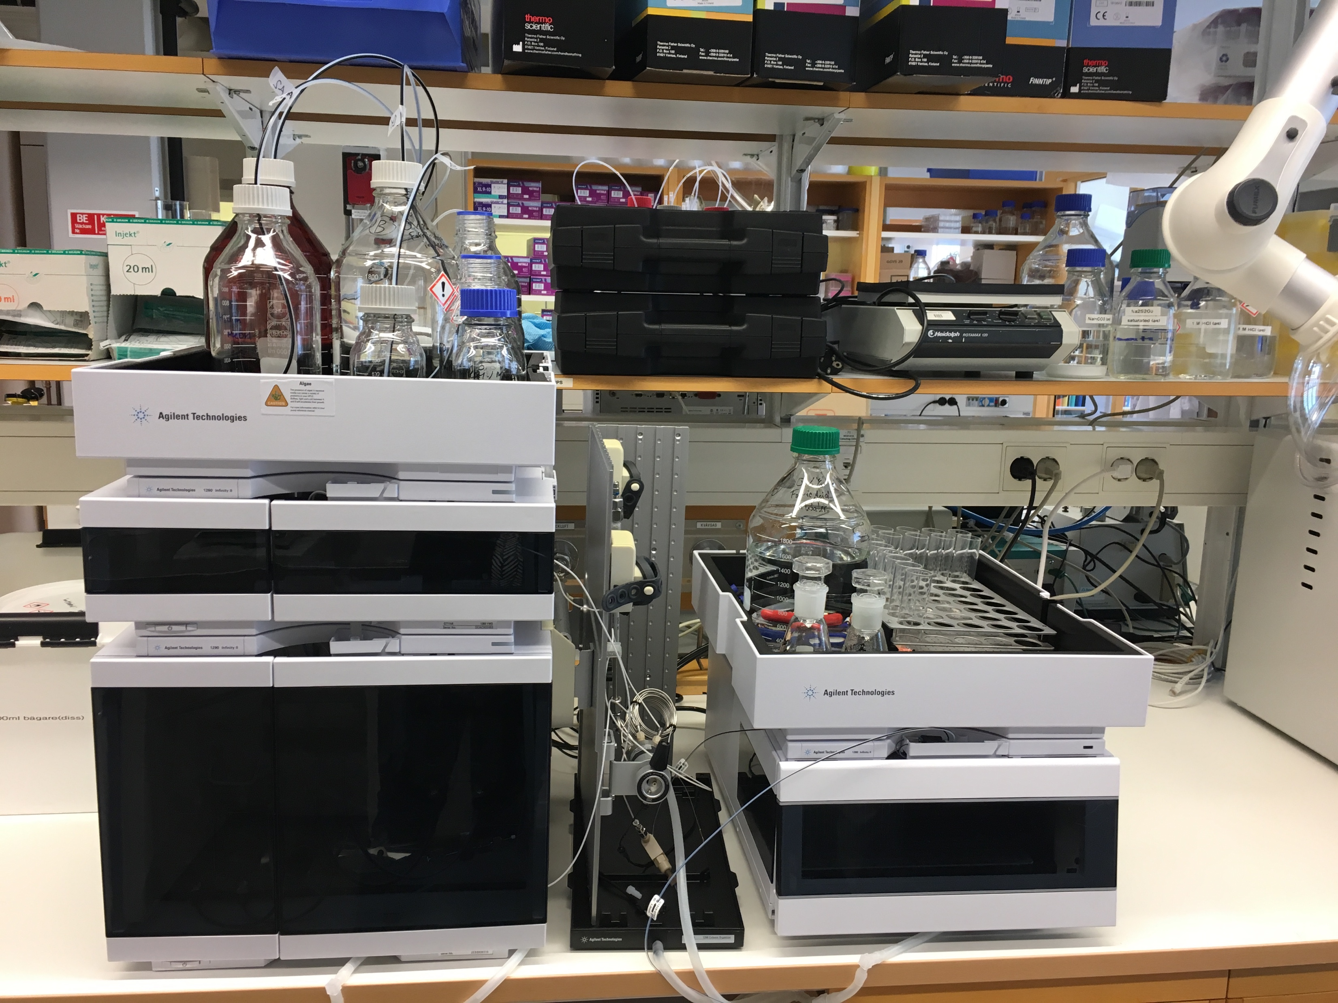
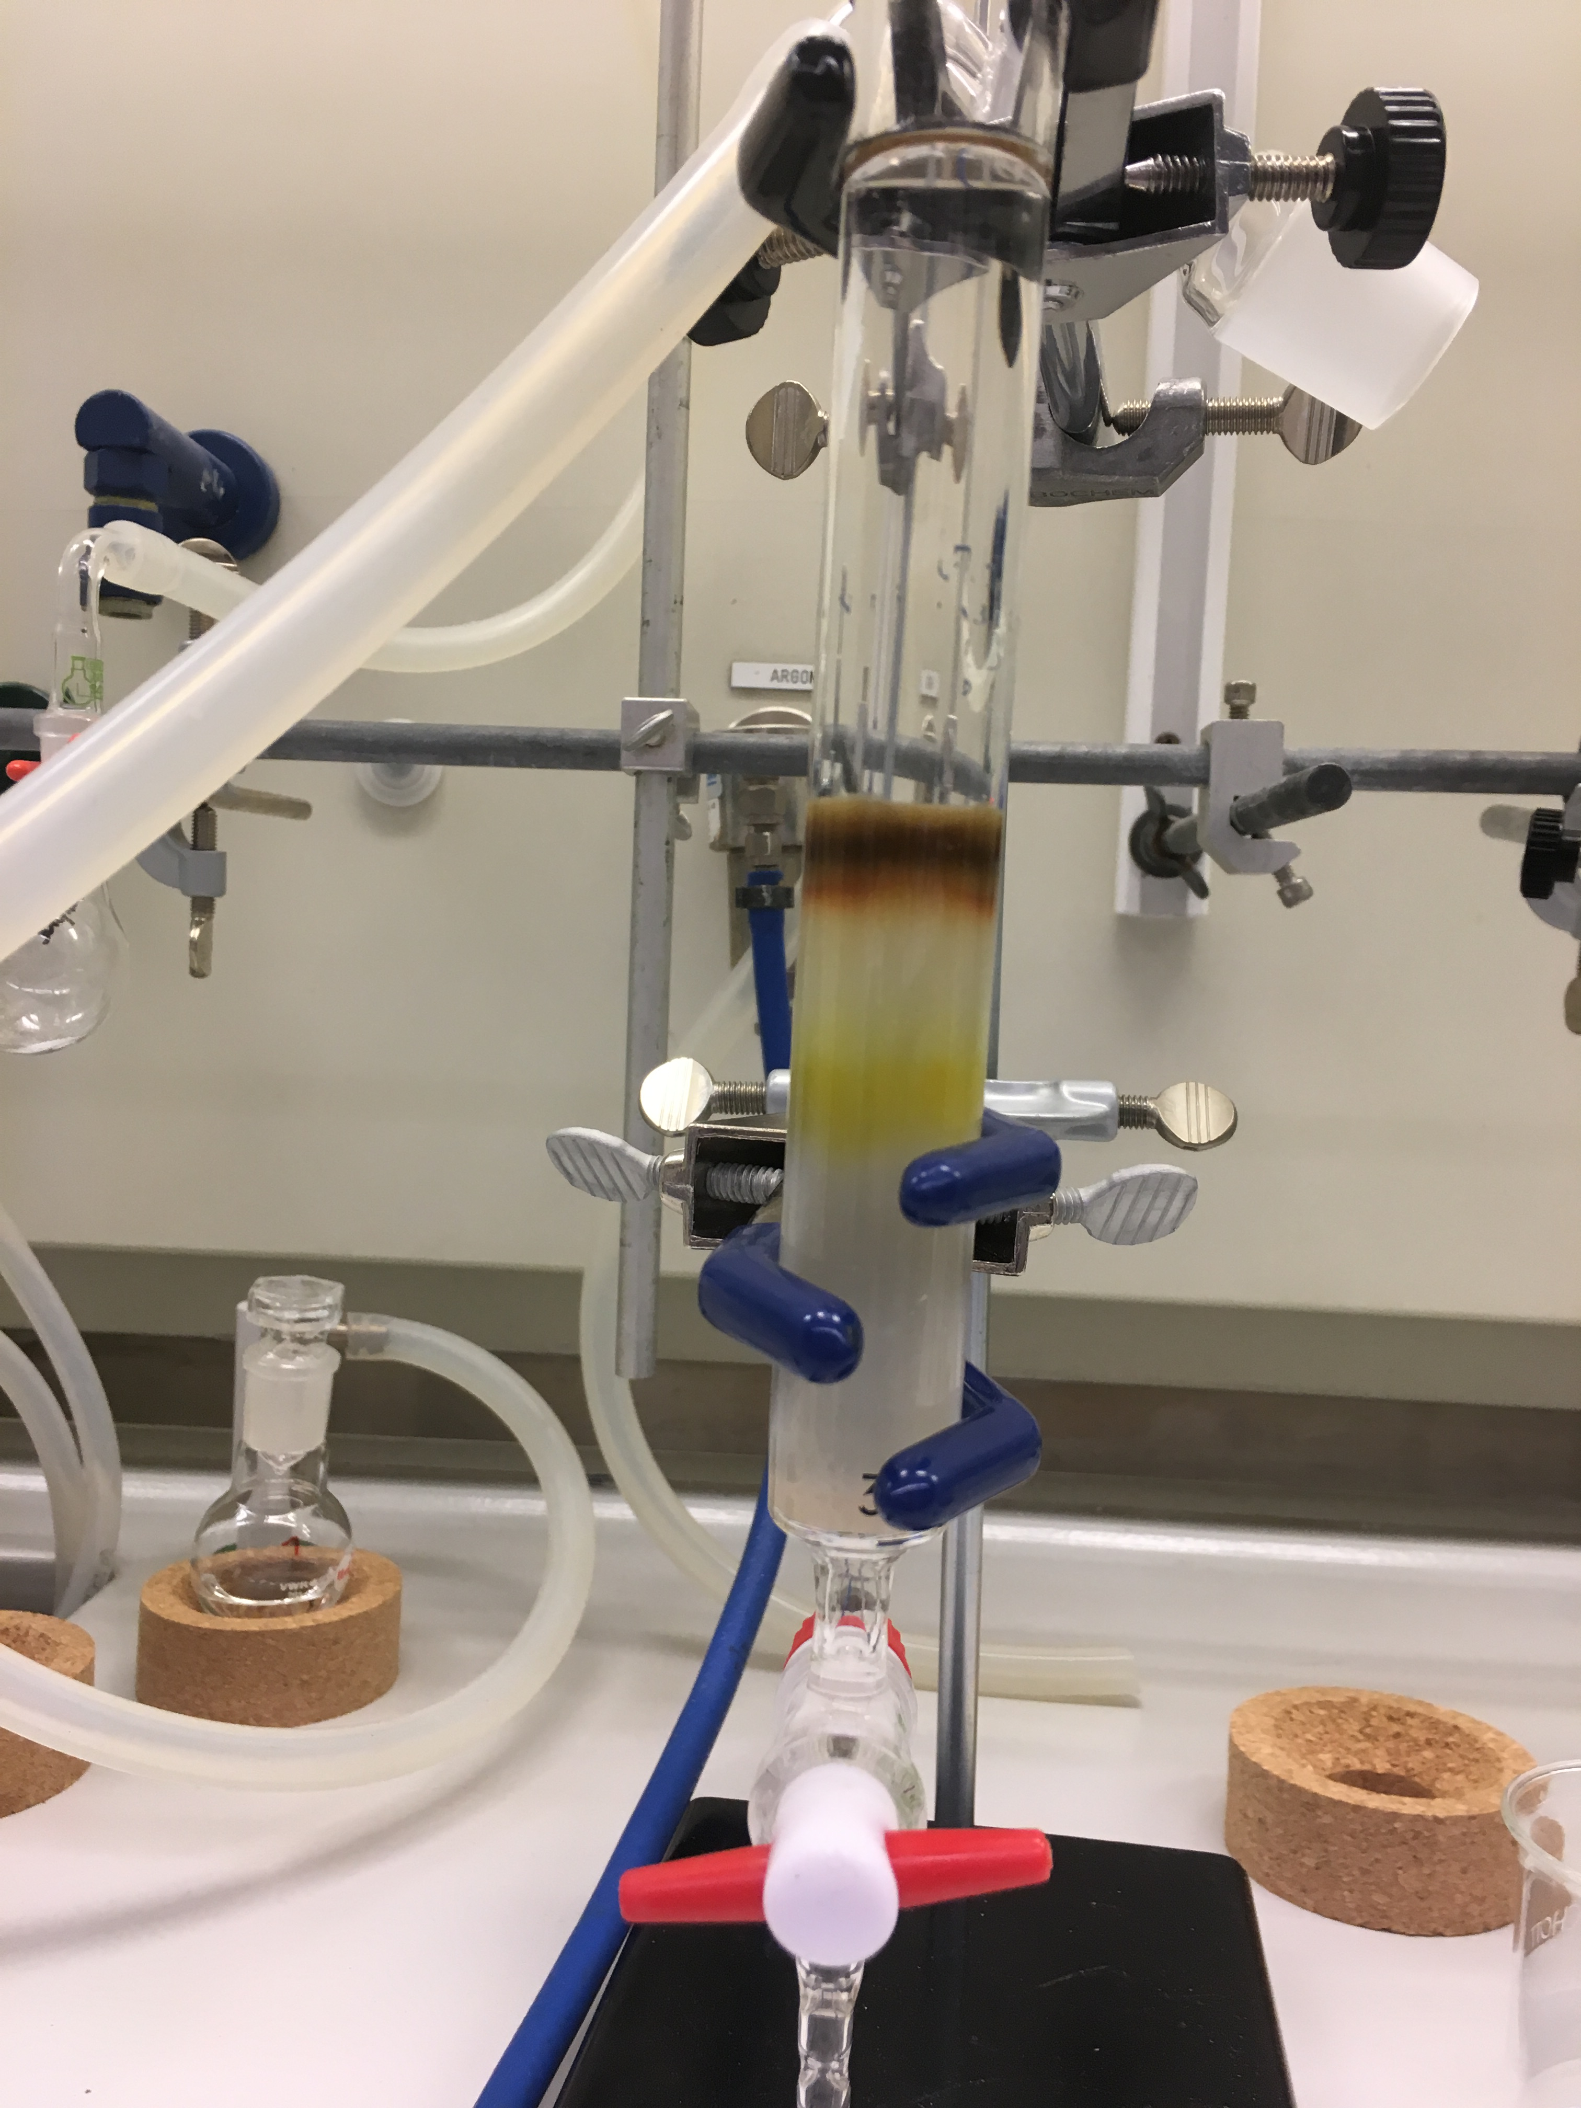
Workflow for purification
From cell culture to phospholipid extracts ~ 4 PW
~15-25g dry cell paste
Shaker flasks (4-6L)
Freeze-dry
Solvent
Extraction (25g, 2L)
Adaptation to D2O
2 weeks (LP3)
phospholipid classes (10-100mg each)
PC, PE, PS, PI, CL, PG
Flash chromatography
preparative HPLC or LC
phospholipid extract ~250mg
total lipid extract
600-800mg

Slide 4
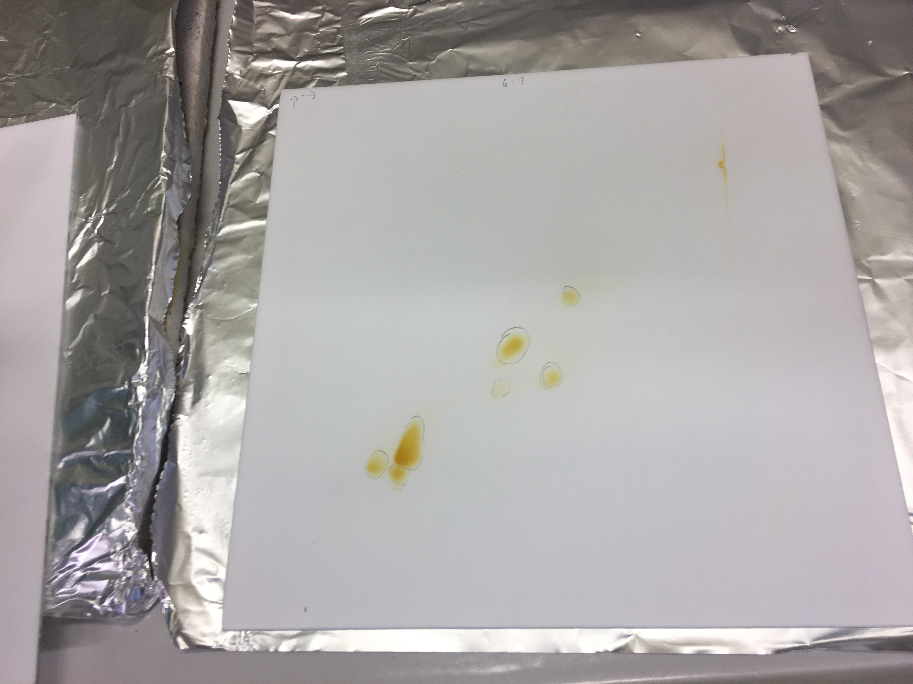
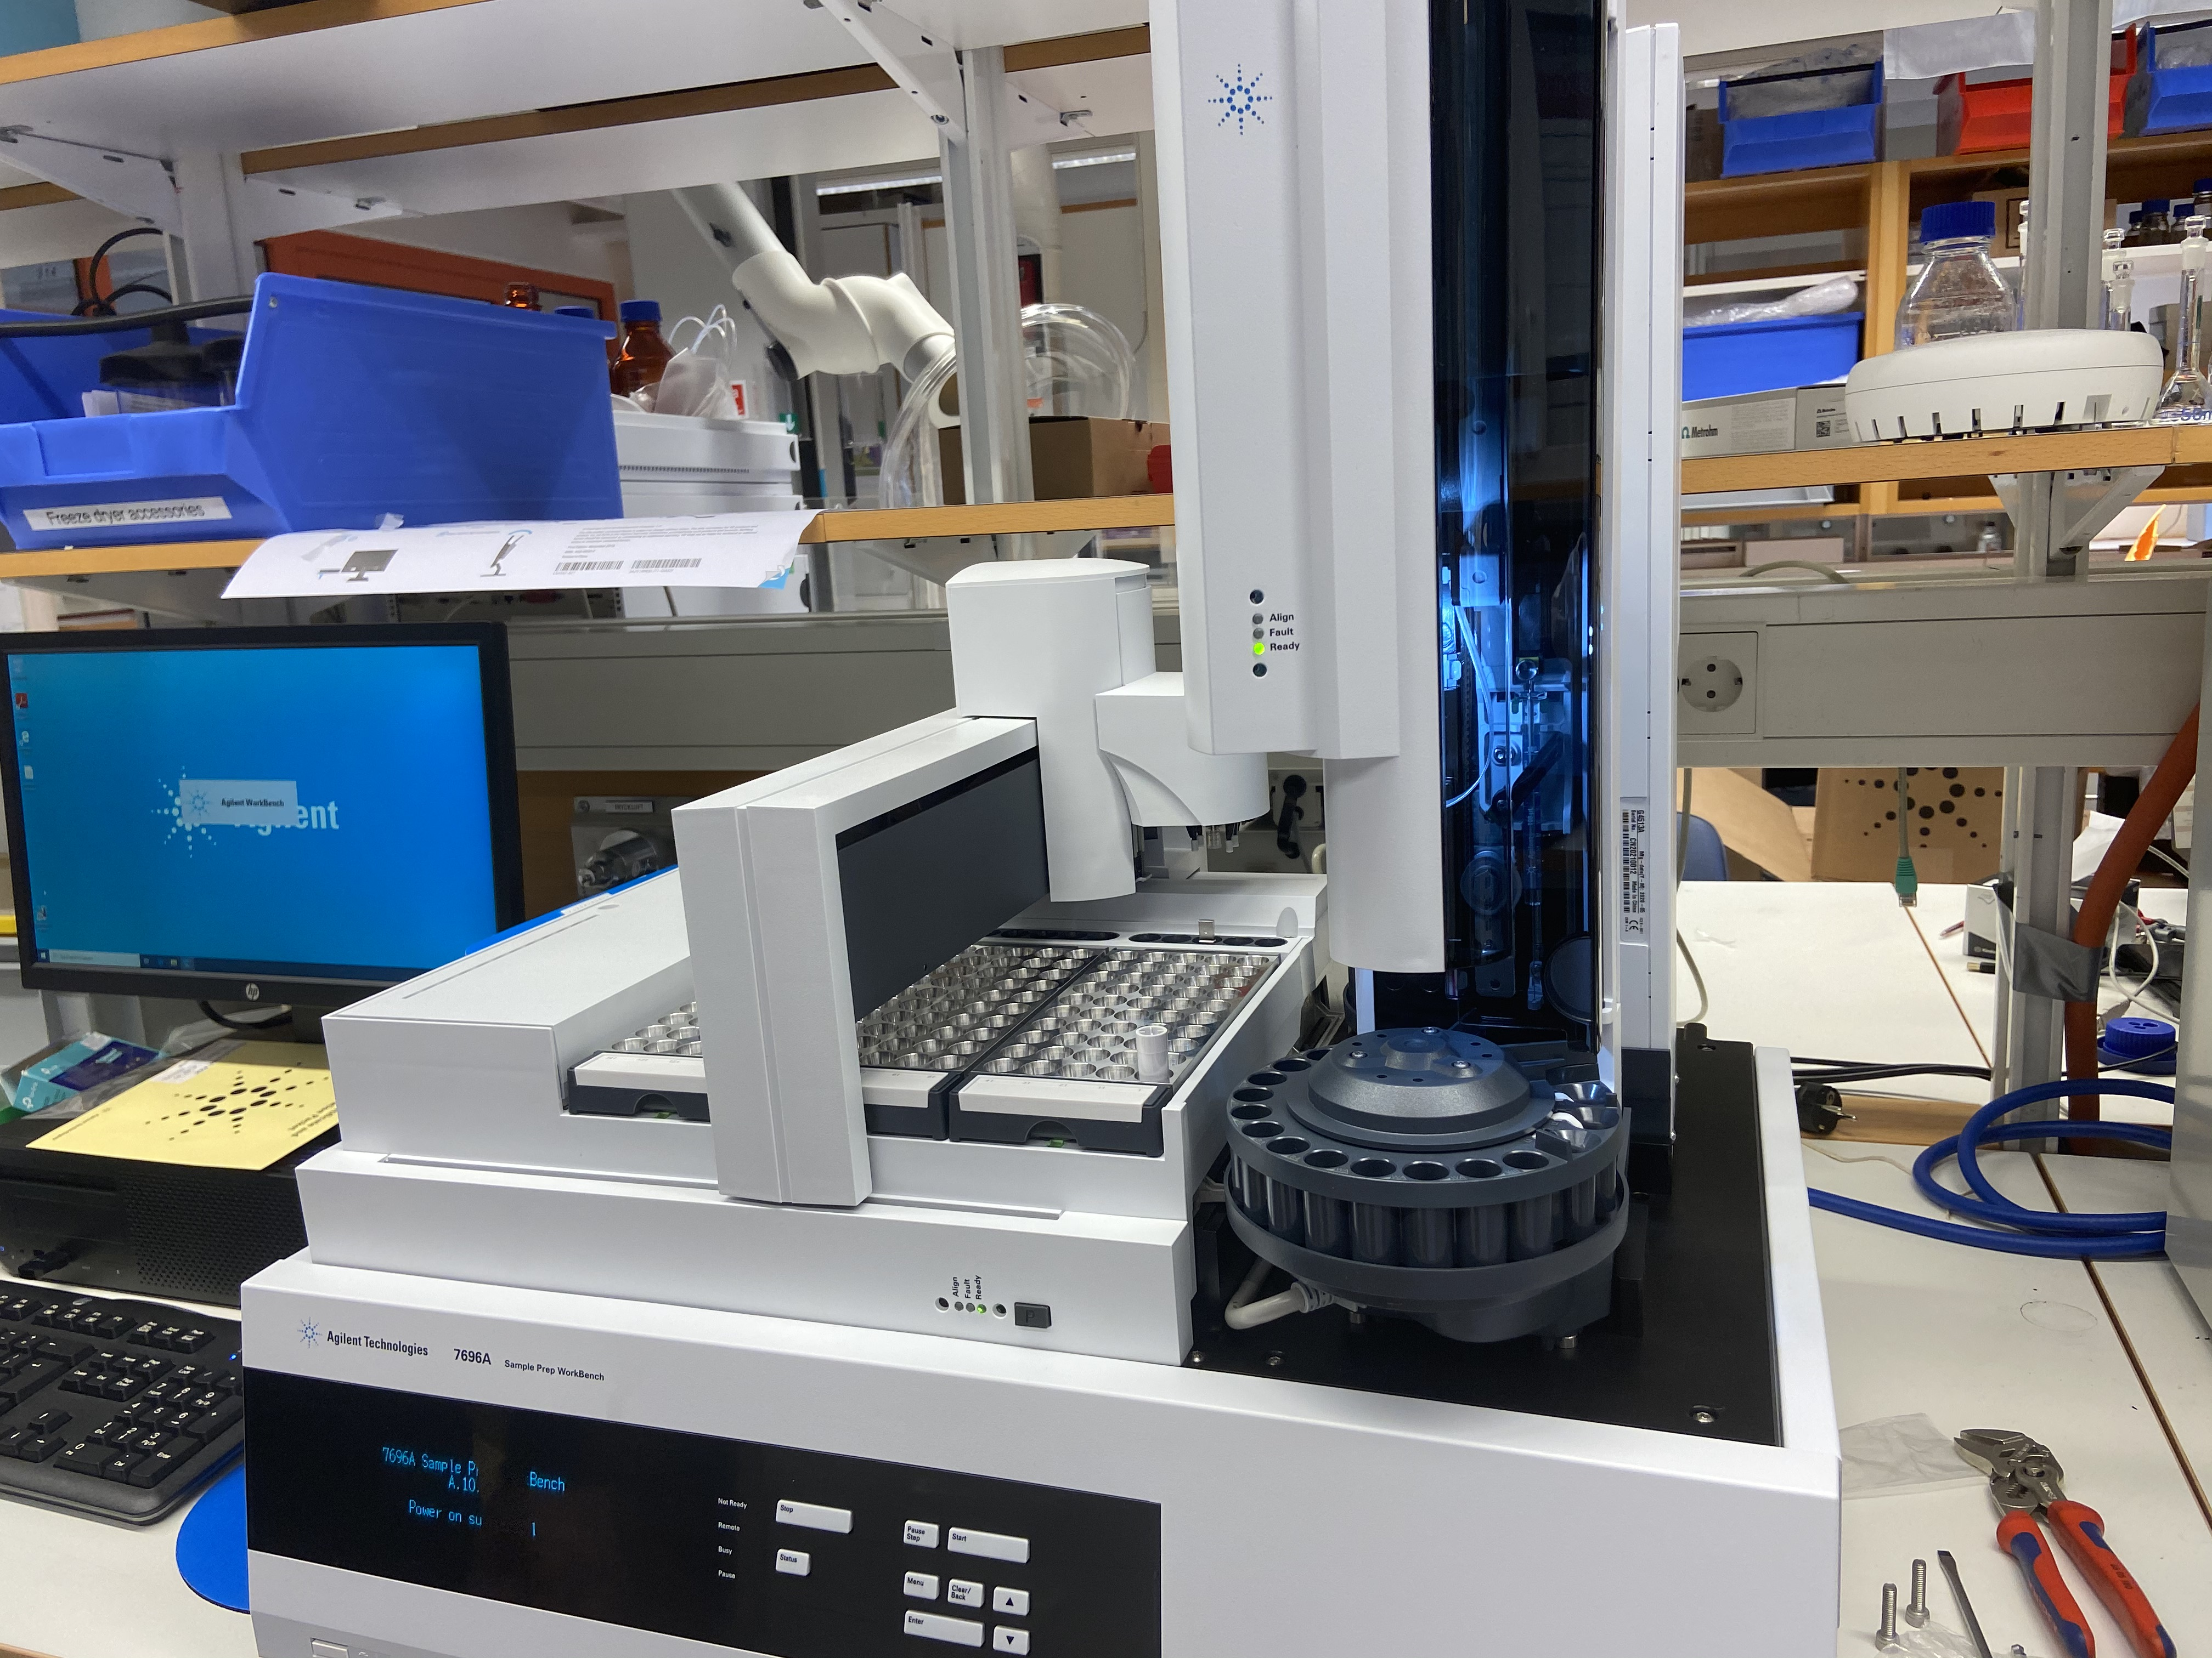
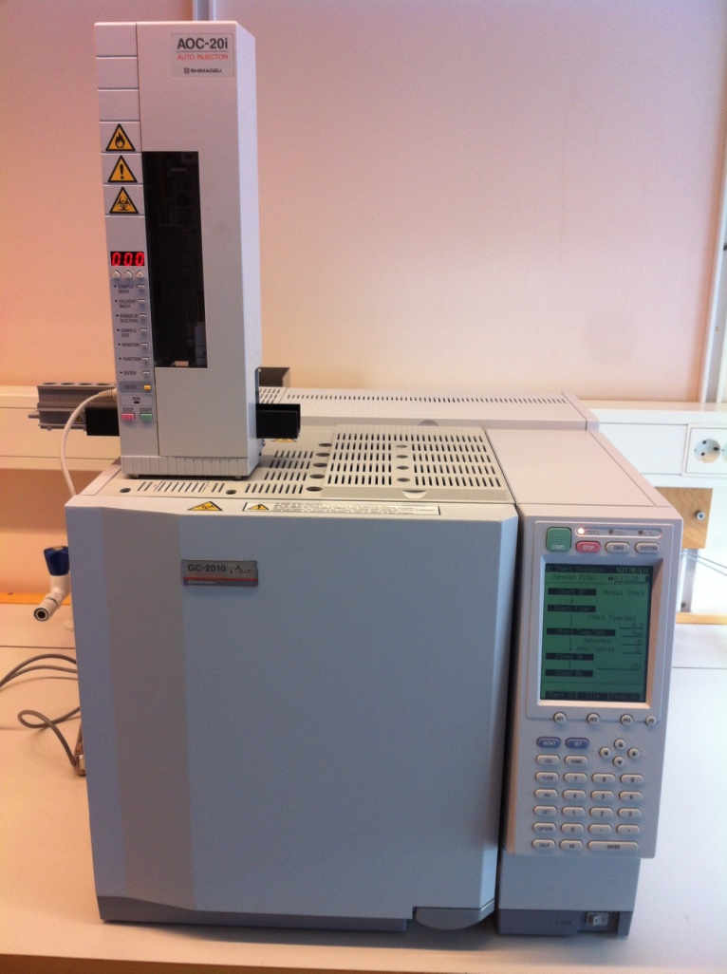
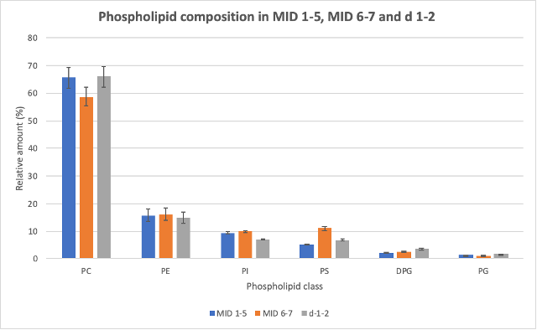
Workflow for lipid analysis
% deuteration:
FTIR check internal (1 day)
GC/LC-MS external (availability)
Lipid composition ~1 PW per TLC plate/ batch
Preparative TLC
Automated GC sample preparation
GC-FID
total PL extract
each PL class
analysis in triplicate for errors in composition
reusability good after neutrons:
Phospholipid composition
Lipid chain composition in each PL class

Slide 5
Logistics/cost
6 PW per batch (~10k€)
D materials ~50€ per 1mg phospholipid
Large batch purification most efficient
CELL GROWTH AT LP3
  2 weeks D/ 1 week H
  2 staff members need to be available for 2 consecutive weeks without public holidays
  service not available mid June – mid August
  cell harvesting time (OD) determines phospholipid content and composition
  can combine batches
EXTRACTION/PURIFICATION
  2 weeks per batch
  250mg (total phospholipids) per batch
  scaling up to 500mg -1g purification of several extractions saves time
2-3 growth campaigns per year at LP3
500mg -1g phospholipid batches for separation and analysis
store @ -80°C
-> distribute to proposals
ANALYSIS (composition)
  2 weeks per batch (TLC plate)
  can combine all same OD batches to save time.
  routine checks on %D with FTIR for consistency
  GC-MS of LC-MS for %D verification is external and requires planning
Not well suited to per beamtime applications or 6 monthtly proposal calls

Slide 6
User requests for biological lipids
Typical requests for 10-100mg phospholipid per beamtime
  total phospholipid extracts or individual classes requested
  most applicants use NR or SANS (10-100mg range)
  exceptions include: QENS and NSE experiments (>500mg range)
  requests for both H and D lipids since no similar commercial material is available
  requests for long term collaborations for 2-3 years (4-5 beam times per year) to ensure consistency of material (and access to it) = 500mg – 1.5g requests!
  external grant funded postdocs/students can hosted at DEMAX for purification/analysis but this involves additional PW for training/supervision.
  1st pilot call (2019): two proposals (350mg d-PL + 1g of h-PL)
  2nd pilot call (2020): one large proposals (500mg d-PL + 1.5g h-PL)
  Call 2b (2022): two large proposals (1g of d-PL + 2.5g of h-PL, separated into PL classes) were submitted

Slide 7
2
User CASE study: long term collaborations

Slide 8
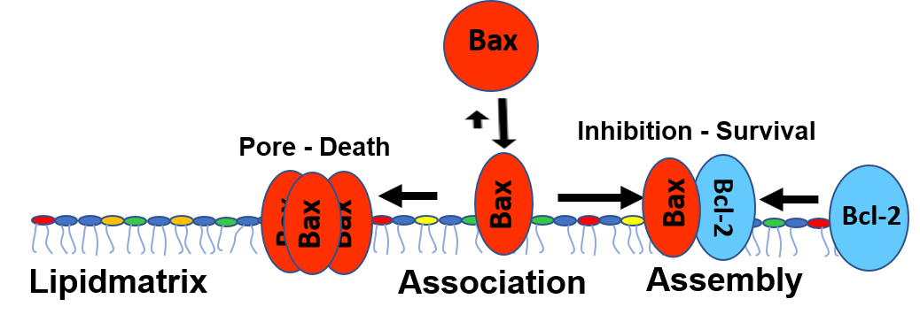

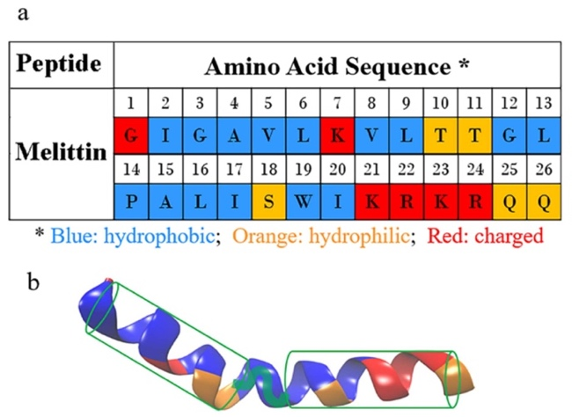

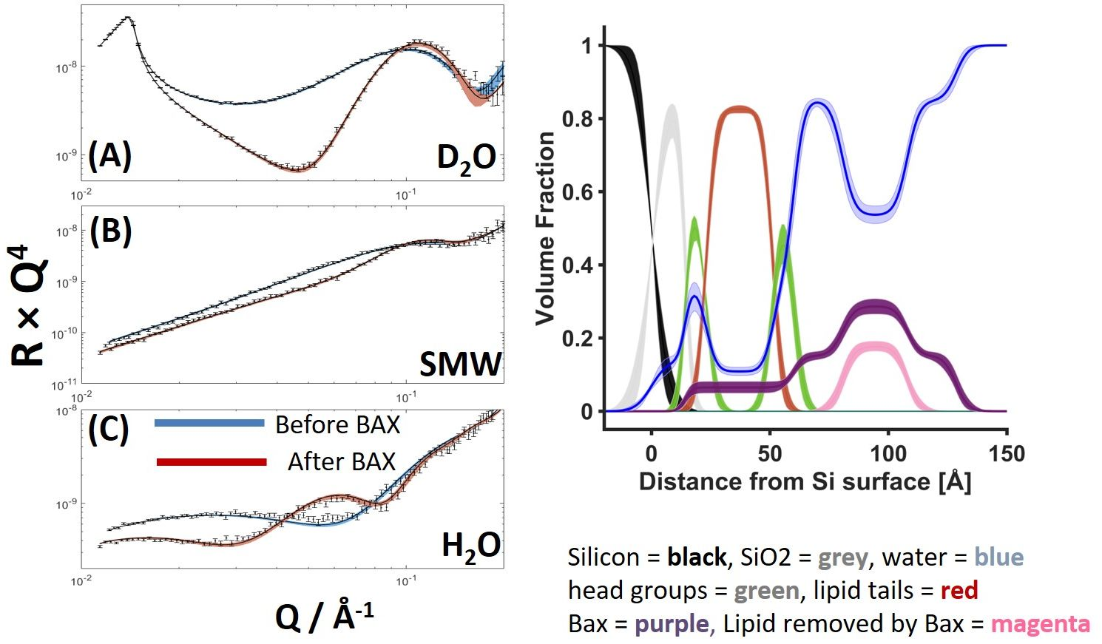
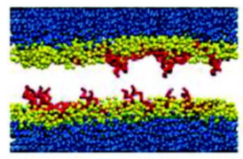





Collaborations – Biological Lipids
CANBEES - Can Bees Help to treat cancer? (2yr)
Melittin targets many types of tumor cells & helps treat resistant cancer cells
Investigate effect of lipid alterations in cancer cells on Melittin specificity with NR and MD simulations
Reconstitution of cancer cell membranes
MedCAN – Methodology for Deuteration, Contrast variation and Analysis of Neutrons in Cancer (4yr)
Mechanism of cell death regulating proteins (Bax + Bcl-2)
NR + NMR to elucidate protein-lipid and protein-protein interactions and membrane structure
Reconstitution of outer mitochondrial membranes
Each project aims for 4-5 beamtimes per year and separation of 0.5g/1g d/h lipids
Reconstitution of membranes from H/D phospholipids purified from yeast
Long term proposals submitted to ensure consistency and optimise methods/effort
Lipid extraction/purification/analysis and method development is done by two postocs funded from the grants
Design more ”realistic” cell membranes
Tumour cells vs ”Healthy” cells
Gerhard Gröbner
+postdoc
Luke Clifton
Jenny Andersson (75% DEMAX)
Neutron reflectometry
+ 3yr postdoc at LU
50% at DEMAX
(Nov 2022->)
Computer simulations
Marie Skepö

Slide 9
Conclusions and outlook
How to meet future demand on yeast lipid deuteration? – large scale cultures and extractions for stock of cell paste/lipid extracts for purification to meet proposal requests – annual budget review?
Timescale involved in full lipid production cycle (min. 3 months) is ill suited to 6 monthly proposal calls and LP3 scheduling – this work would be better served by 2-3 annual growth campaigns + rolling access in combination with an annual call for lipid purification.
PhD and postdoc projects often require same material over 2-4 years – can we implement a long term proposal type for this?
Analysis of biological lipid % deuteration – MS is external to ESS and not always available. Investigating LC-MS-MS @ LU Biotechnology but this needs 2D HPLC method development.
FTIR investigated at ESS (SULF) for routine checks, not sure about accuracy.
Possible MS collaboration with ILL threatened by staffing issues there.
Cost effectiveness – investigate reusing D₂O (once), alternative carbon sources, developing use of bioreactors at LP3 is manpower/skills limited at the moment
Staffing of lipid biodeuteration for user program – could be up to 50% of current research contract with LP3 (cell growth), currently most purification/analysis carried out by externally postdocs = not sustainable.

Slide 10




Acknowledgements
Funding and collaborations
WG3 Deuteration Technologies
Horizon 2020 grant 65400

