Slide 2
Acc Tunnel ODHDS CDR Presentation – ACC ODHDS architecture, ODH monitors, sampling points and ODH alarms placement
PRESENTED BY anton andersson

Slide 3
Agenda
System Netw. architecture and opt. fiber ring
ODH monitor and sampling point placements
Alarm unit placements

Slide 4
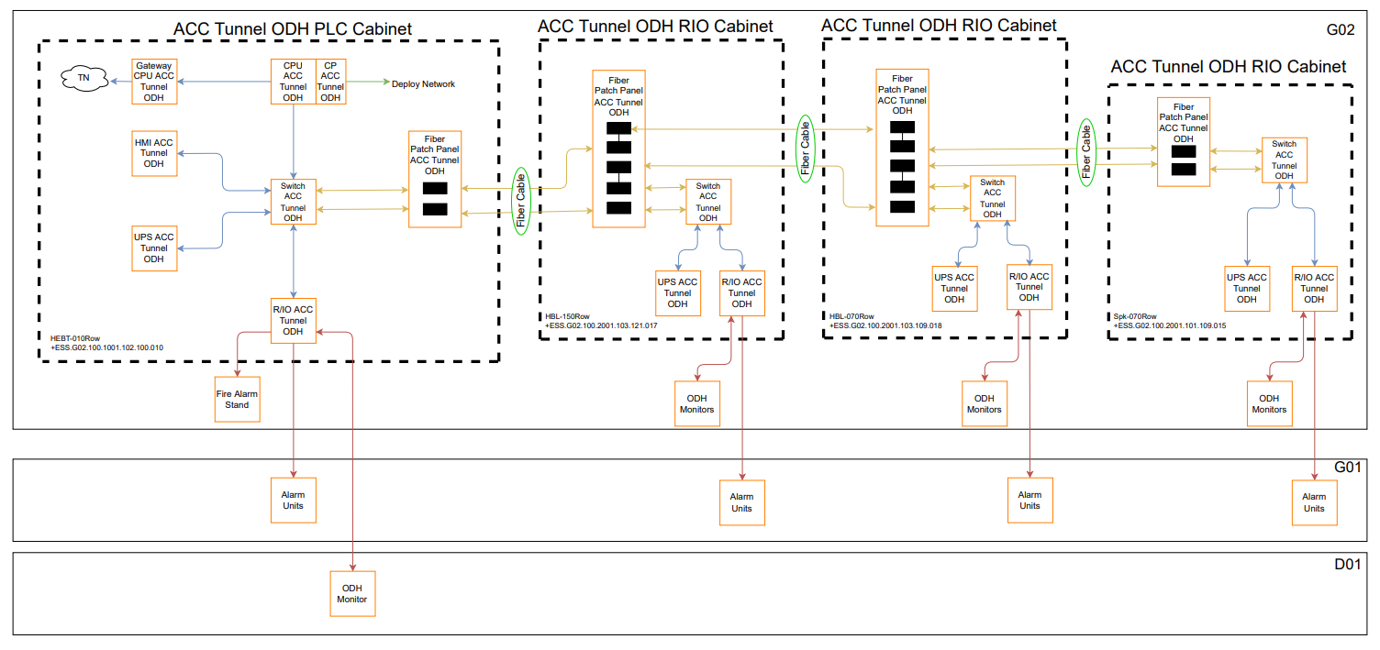
System Netw. architecture and opt. fiber ring

Slide 5
System Netw. architecture and opt. fiber ring
The Network architecture for the Acc ODHDS consist of a multi-mode opt. fiber ring which connect to the Scalance switches in the control cabinets.
The purpose of the ring is to achieve redundancy in case one of the opt. fiber cables is damaged or accidentally disconnected.
The CPU and HMI connects to the switch in the PLC cabinet.
The interface modules for the IO configurations and the UPS units connect to the switch is each cabinet. It was concluded that these RJ45 connections do not need to be part of the ring since they are internal connections inside locked control cabinets.
All the opt. fiber cables are protected by cable trunks and conduits.
For more information on the ODHDS system architecture for all buildings, see ESS ODH Detection Systems Architecture [1].

Slide 6
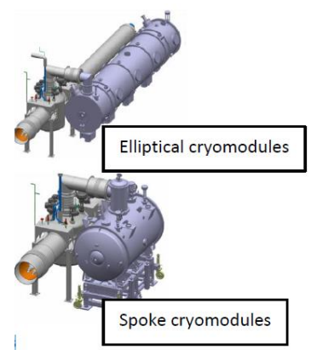
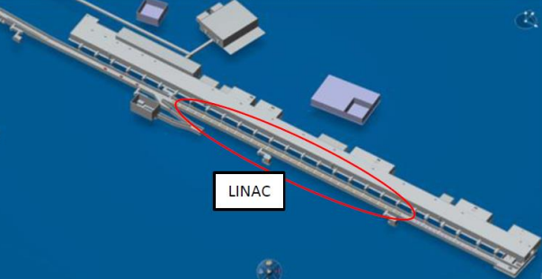
ODH monitor and sampling point placements
The Super Conducting Linac (SCL) part of the tunnel contains 30 elliptical cryomodules; 9 mediumbeta,21 high-beta, and 13 spoke cryomodules.
Following the investigation of possible cold helium propagations in the tunnel for several credible failure scenarios, a Safety Helium Collector (SHC) system is installed in the tunnel to evacuate cold helium vapor from cryomodules. The SHC reduces the risk of ODH and cold burns. The SHC valves will be closed before access to the tunnel is granted to personnel. Therefore, in case of a failure in a cryomodule that results in the release of helium, the released He is vented outside the tunnel through the SHC without causing an ODH in the tunnel. Moreover, the Accelerator ODH Detection System (ODHDS) is designed to detect ODH that may be caused by leakage of suffocating gas from the cryogenic systems in the accelerator tunnel.

Slide 7
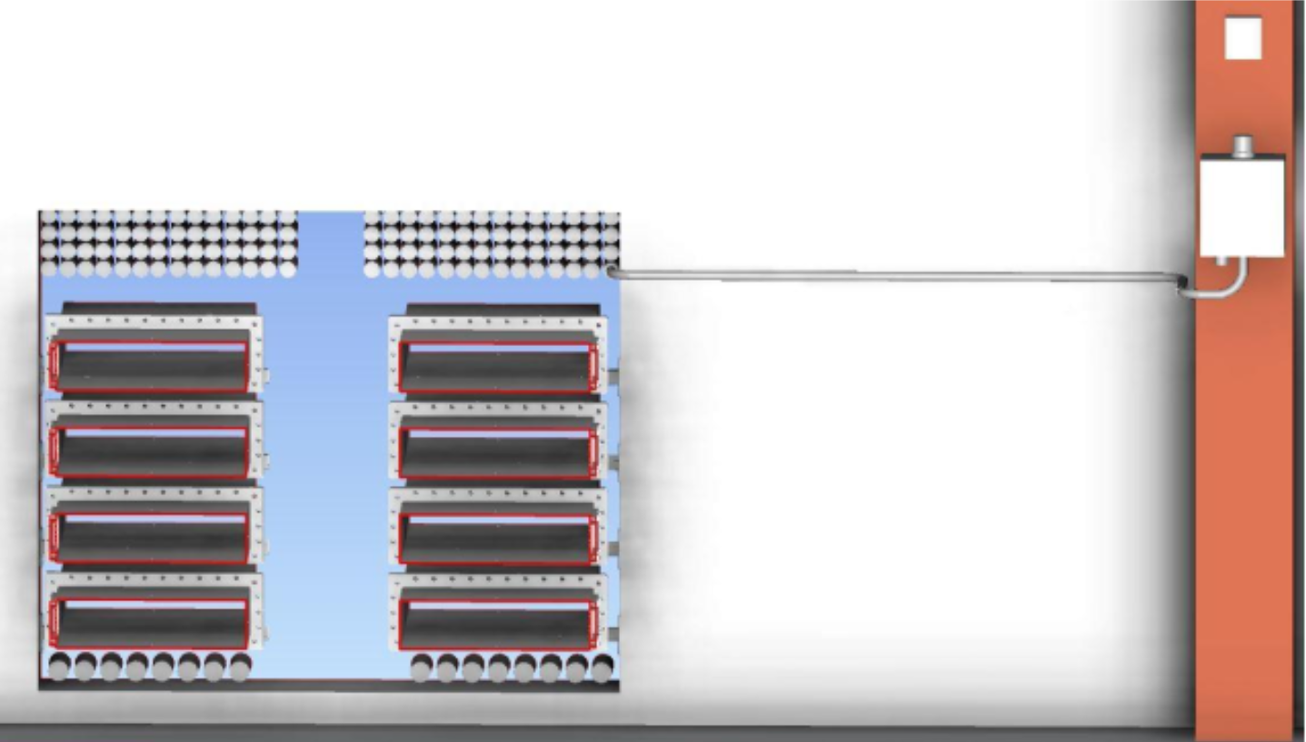
ODH monitor and sampling point placements
ODH monitor placement
13 ODH monitors are located in the klystron gallery (G02) and 1 ODH monitor is located in the GSA (D02). The reason is to protect the electronics in the ODH monitors from effects of radiation in the acc tunnel (G01).
Sampling pipes go from the ODH monitor, through the stubs and to the sampling point in the acc tunnel (G01)
In order to prevent the propagation of activated air from the acc tunnel (G01) to the klystron gallery/GSA, the sampled air is exhausted back to the acc tunnel (G01) after being analyzed by the ODH monitors.
For more information on the ODH monitor and sampling point placements, see [2] [3].

Slide 8
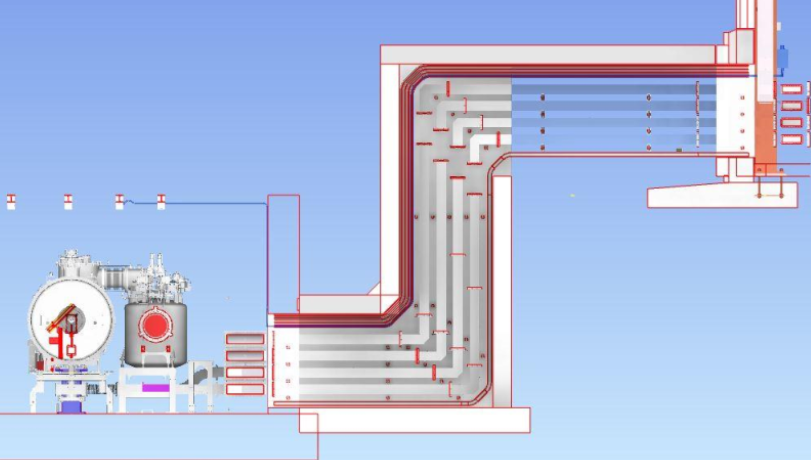
ODH monitor and sampling point placements
The rationale for determining the optimum location for sampling points:
Tunnel hight
The ACC ODHDS sampling points are located at ceiling height (~120 mm below the ceiling) because helium is lighter than air.
Tunnel width
There are pressure safety devices on the CDS and cryomodules, which are the potential leak points and can cause ODH for personnel during access to the tunnel. These pressure safety devices are located:
on the valve boxes and on the cryomodule for the Spoke section.
on the CDS near the cryomodule and on the cryomodule for the elliptical linac (MBL and HBL).
on the end box.
For this reason, the ACC ODHDS sampling points are located in the area between the CDS and the cryomodules.

Slide 9
ODH monitor and sampling point placements
The rationale for determining the optimum location for sampling points:
Tunnel length
The SCL is stretched for about 310 meters from the end box at the first Spoke cryomodule to the last high-beta cryomodule. The following factors has determined to location of the sampling point:
Even distribution of the sampling points along the tunnel.
Location of the stubs where the sampling points enter the tunnel from the klystron gallery.
Location of the potential helium leak points (pressure safety devices).
Minimizing the length of the pipes between the ODH monitor in the klystron gallery and the sampling point since the longer the pipe, the more time it takes to detect the ODH.
Conclusion: Considering these factors, 13 sampling points are considered in the SCL and one sampling point in the A2T area, which is the far end of the tunnel before the exhaust ventilation hatches, where an accumulation of helium might occur. The distance between 2 sample point vary from 17->27 meters, with an average of 24.6 meters.
We will show more in detail on the upcoming slides

Slide 10
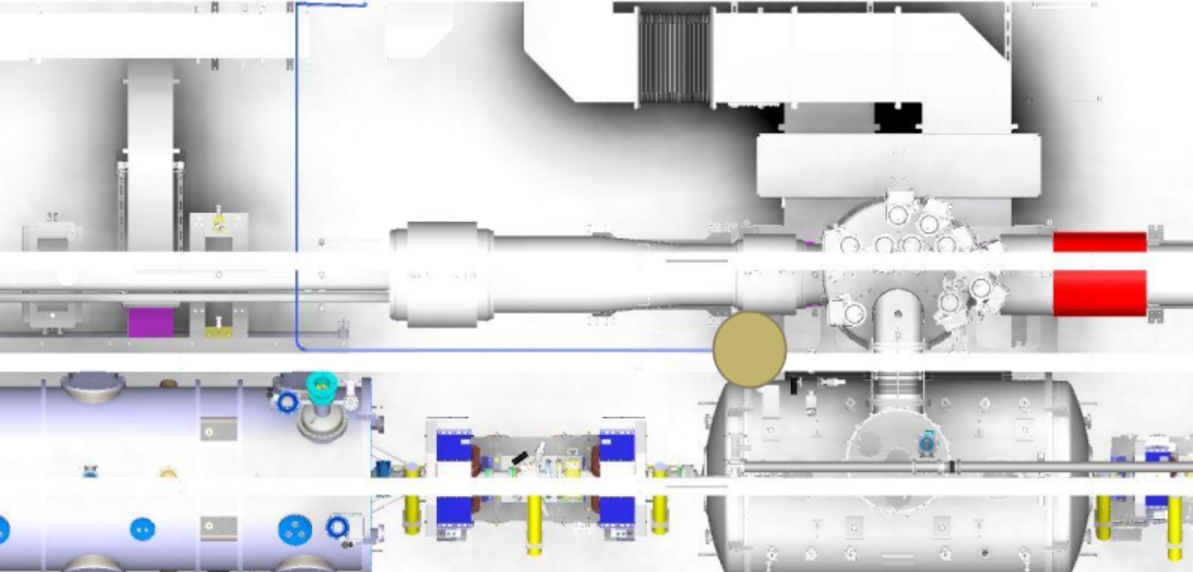
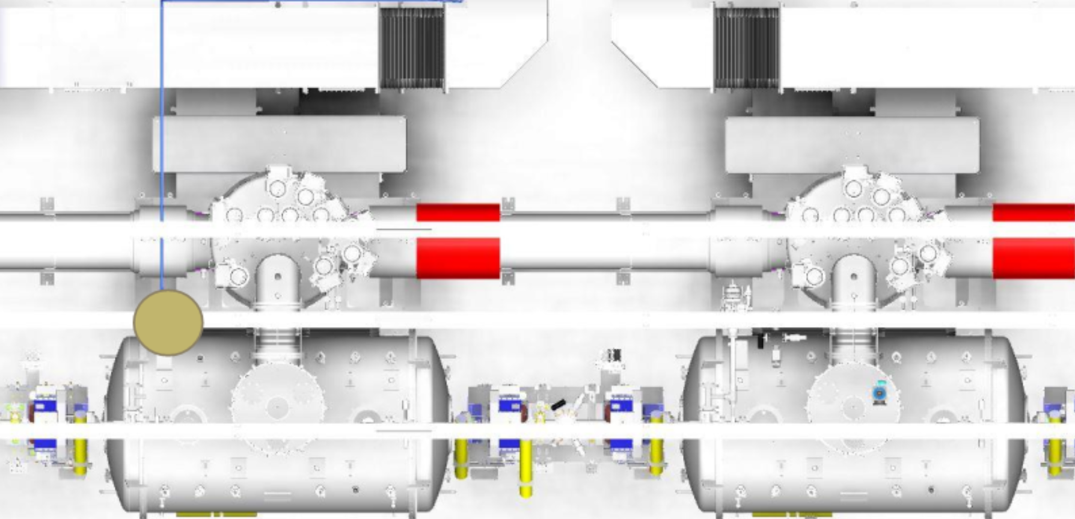
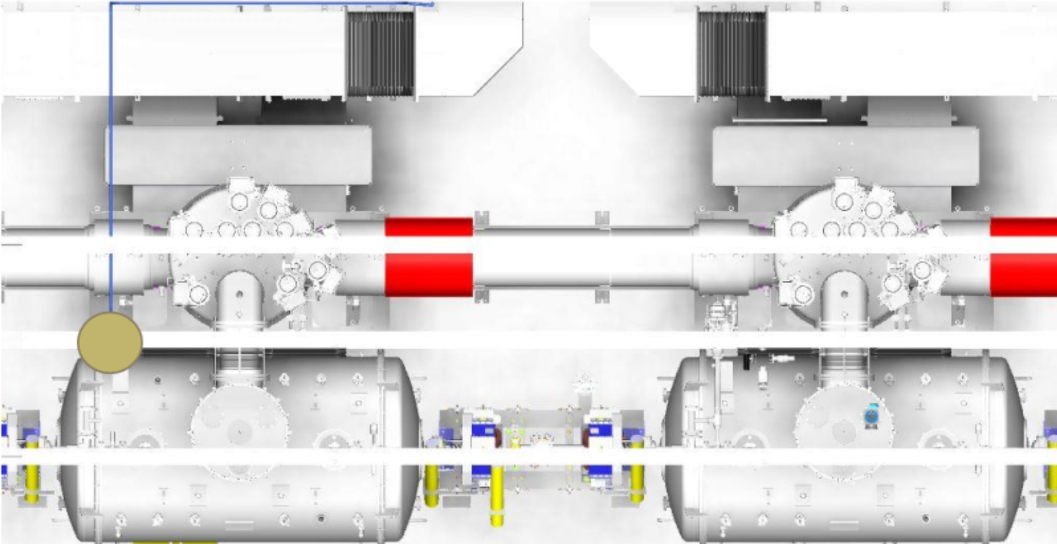
ODH monitor and sampling point placements
Sample point placement in Spoke (13 cryomodules)
Spoke 13
Spoke 7
Spoke 3
Spoke 13
Spoke 1

Slide 11
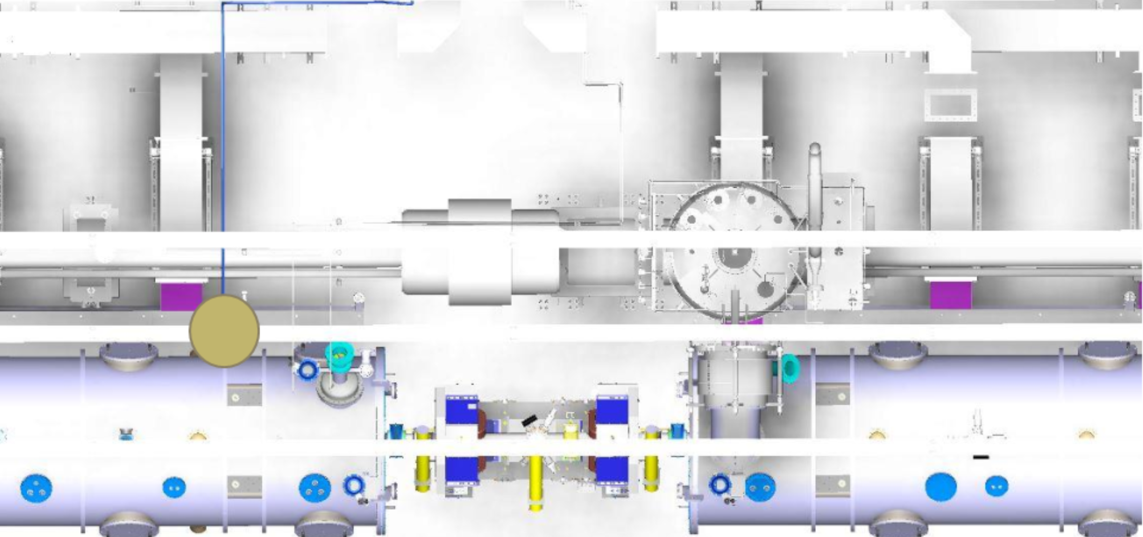
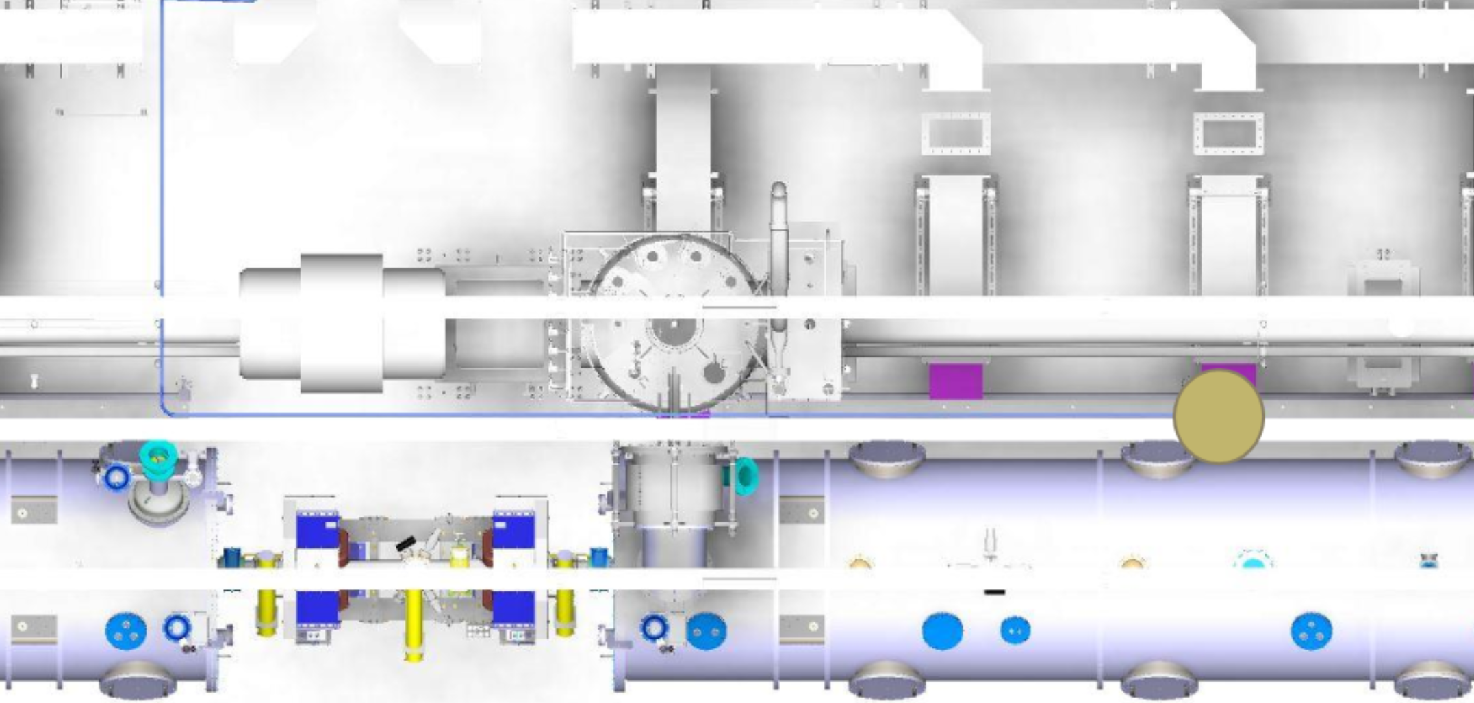
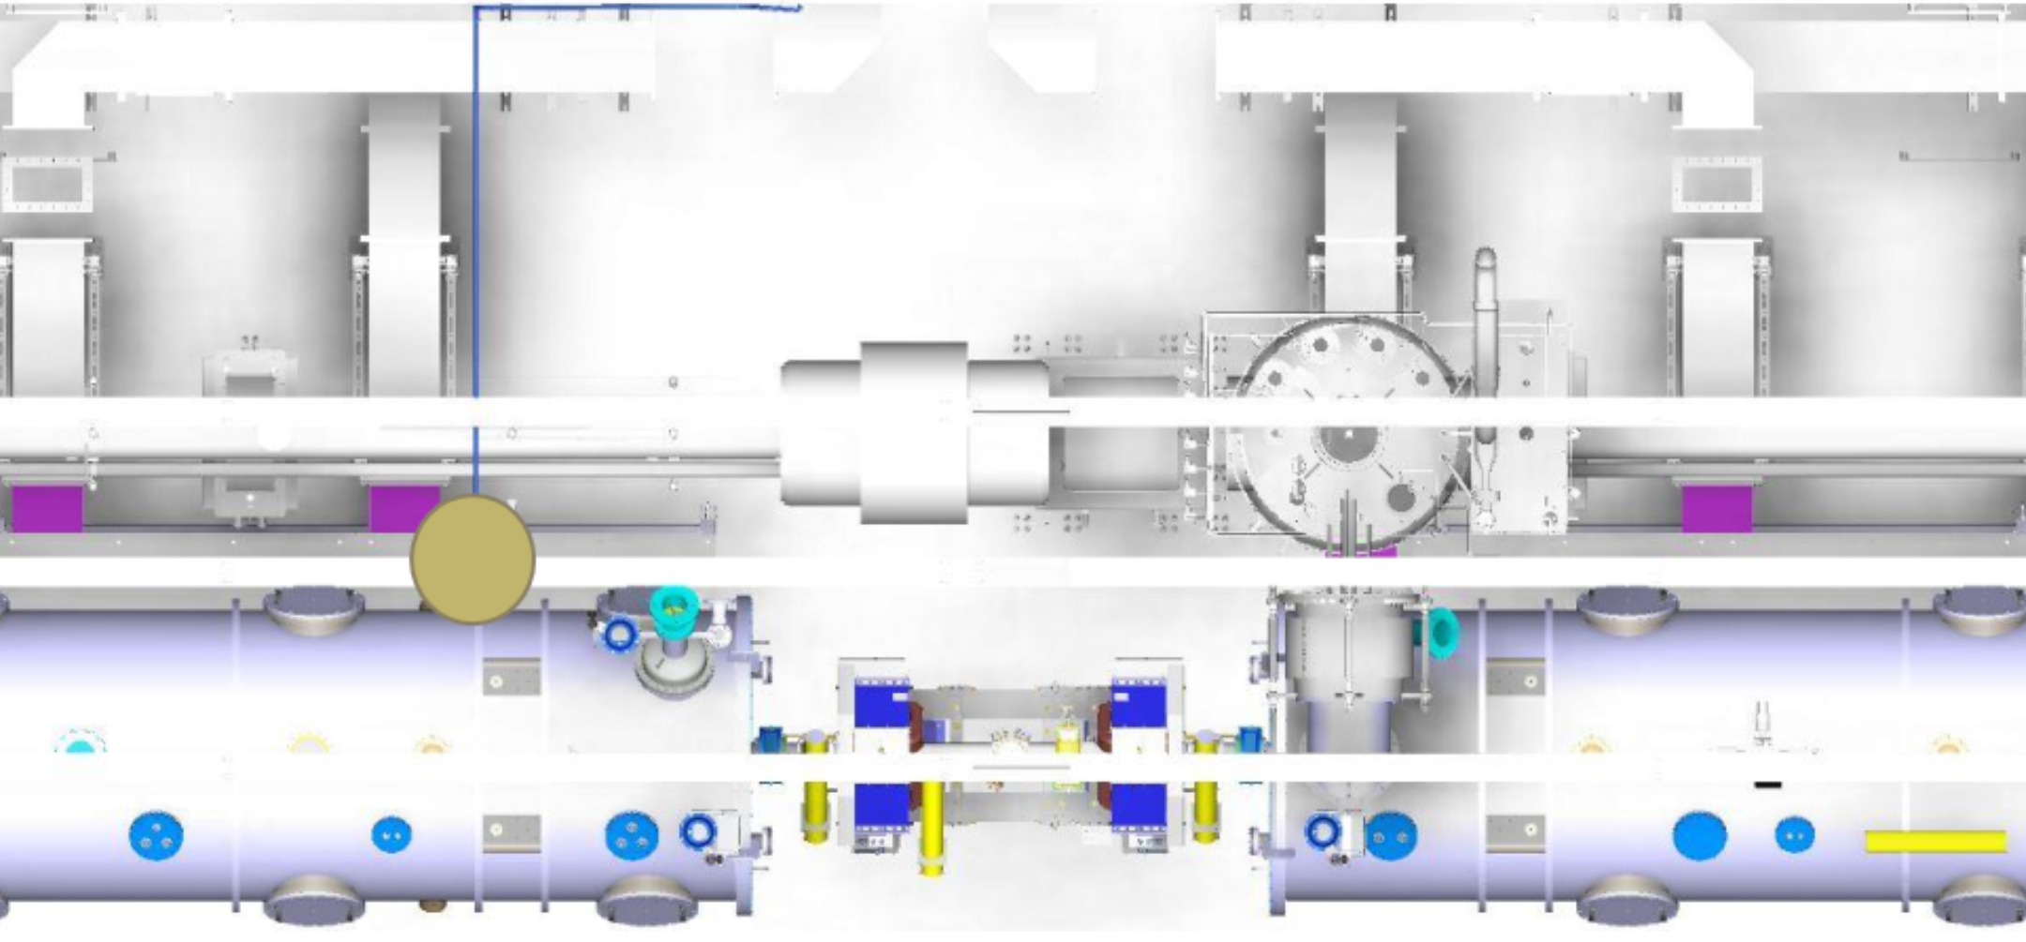
ODH monitor and sampling point placements
Sample point placement in MBL (9 cryomodules)
MBL 9
MBL 6
MBL 3
MBL 9
MBL 1

Slide 12
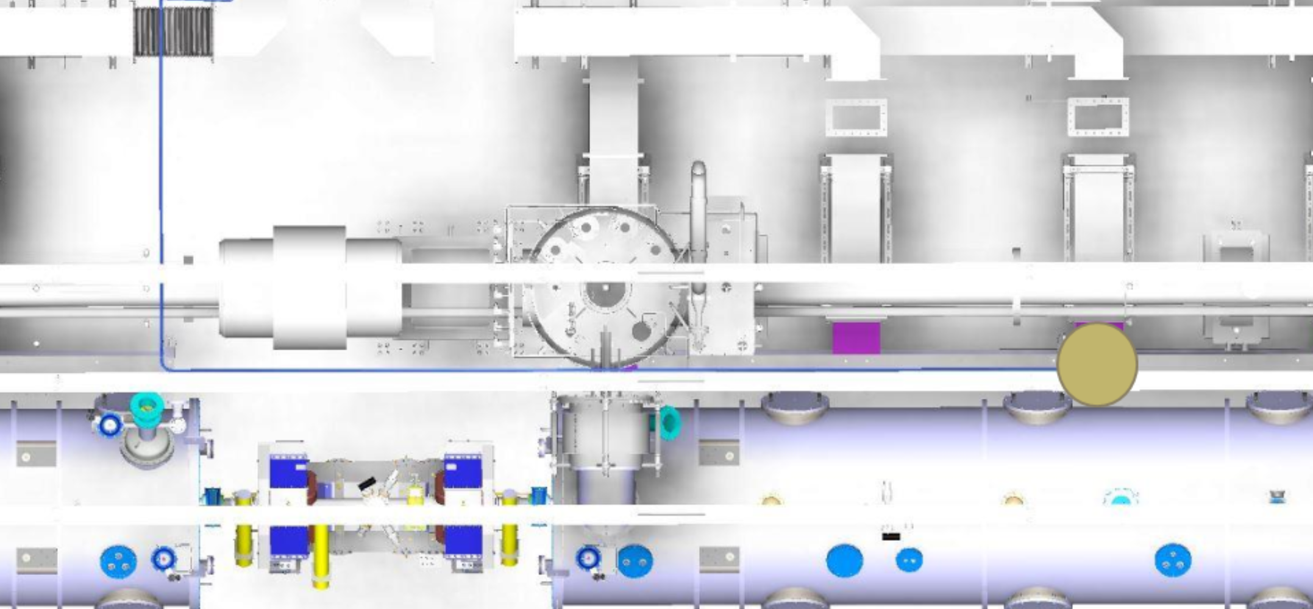
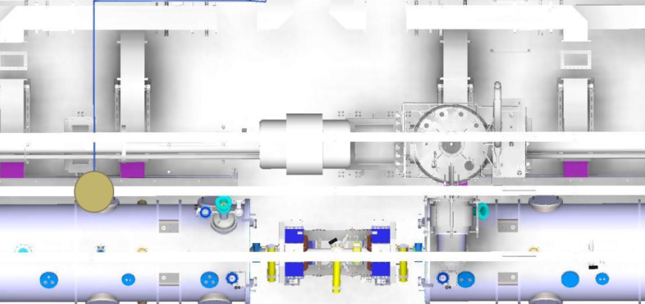
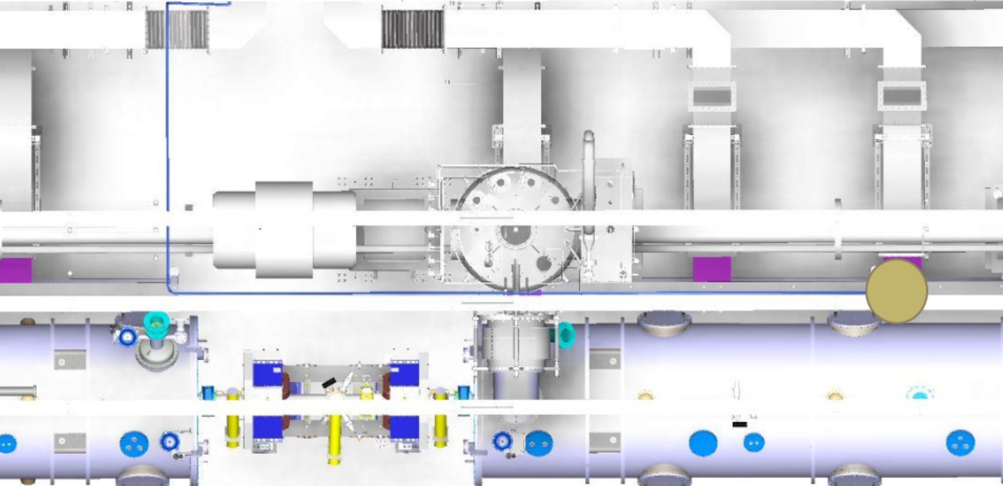
ODH monitor and sampling point placements
Sample point placement in HBL (21 cryomodules)
Cryomodule 1-9
HBL 9
HBL 6
HBL 3
HBL 9
HBL 1

Slide 13
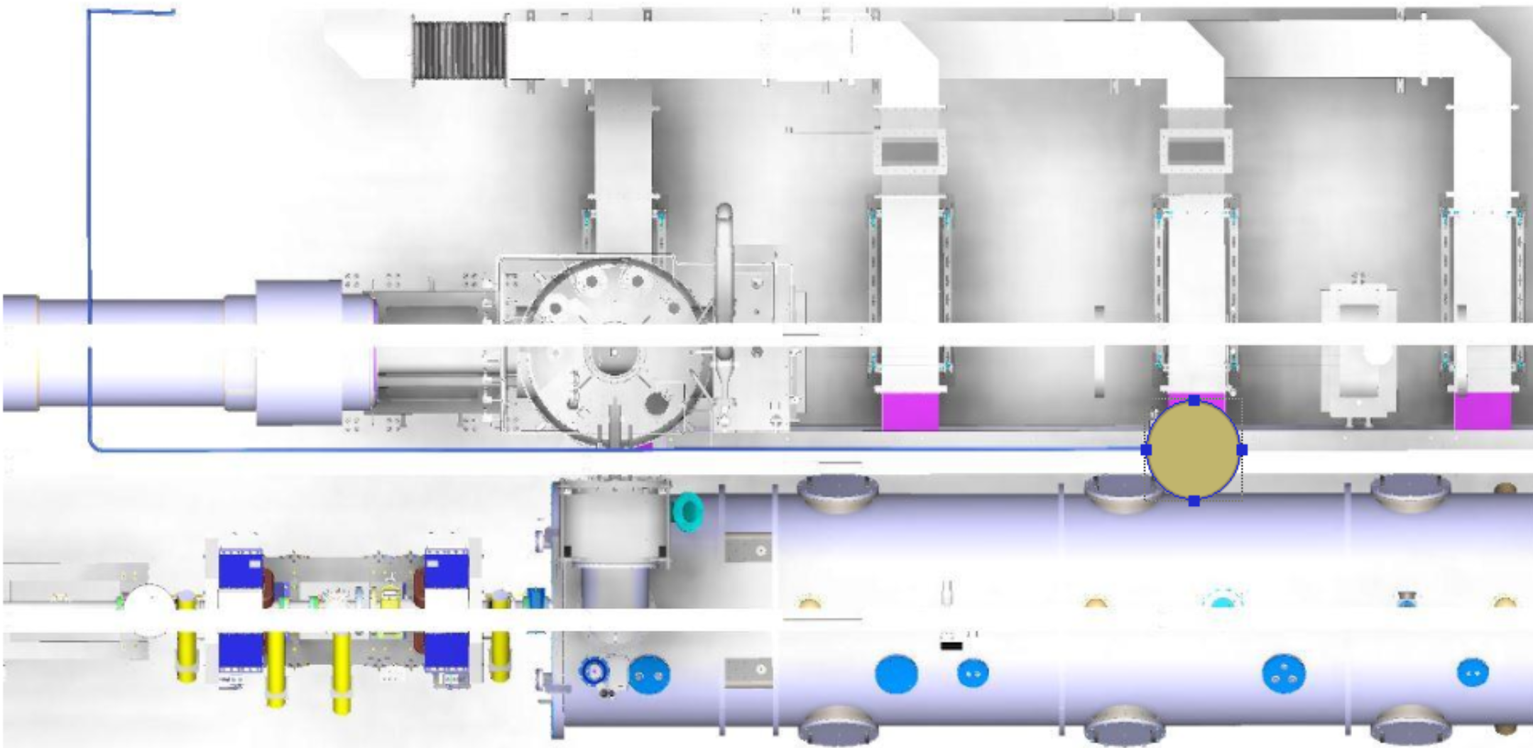
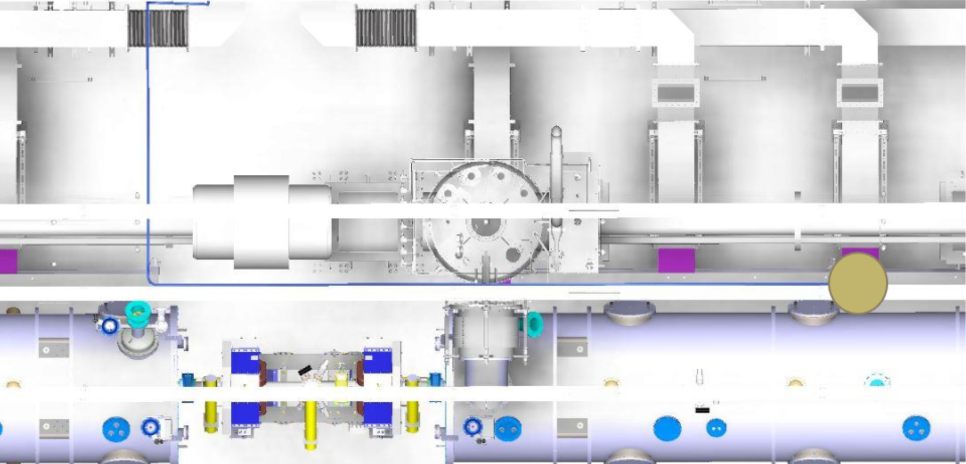
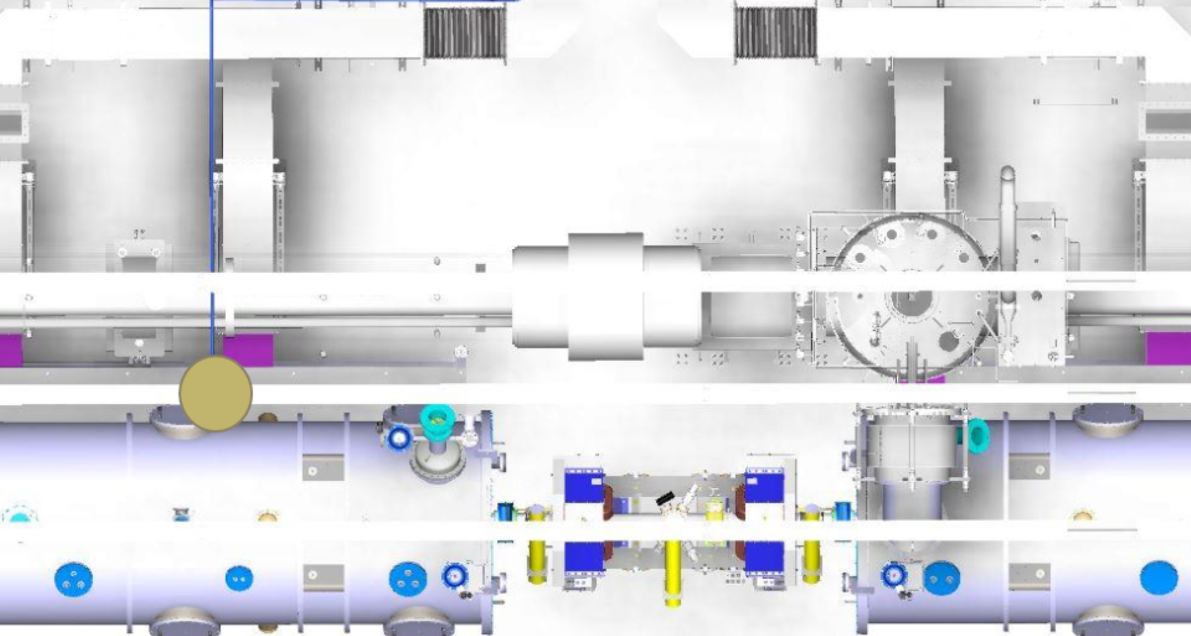
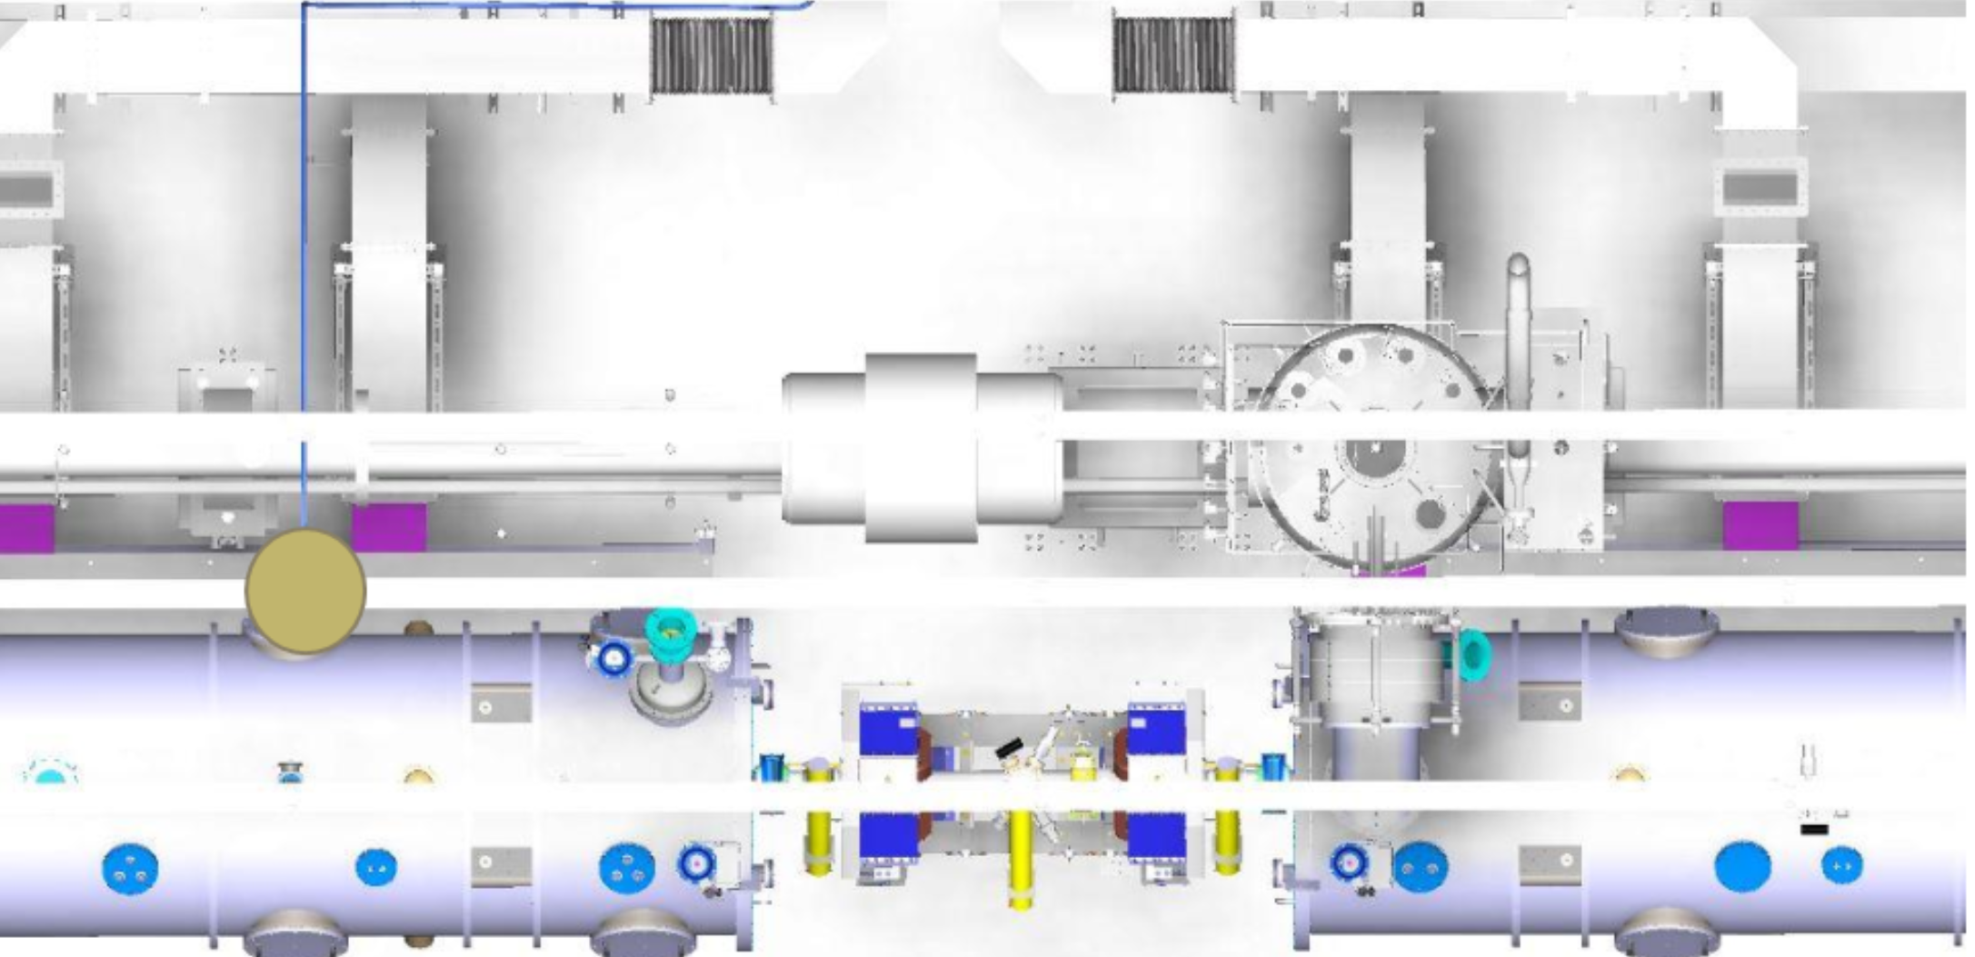
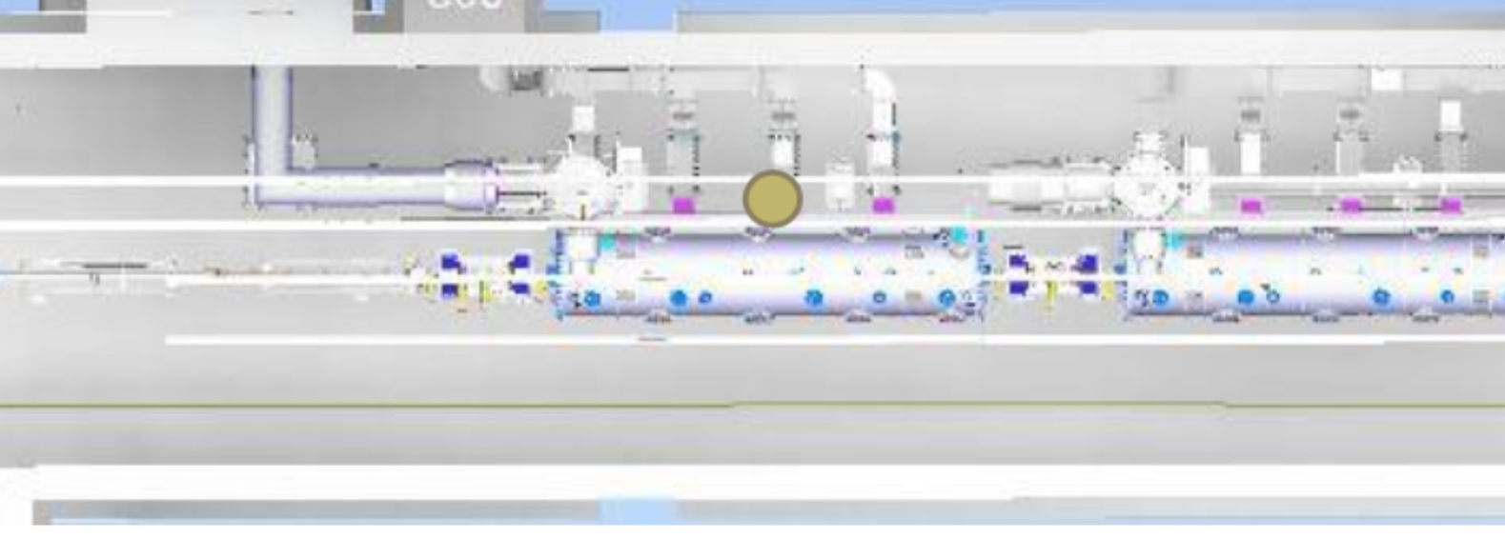
ODH monitor and sampling point placements
Sample point placement in HBL (21 cryomodules)
Cryomodule 11-21
HBL 21
HBL 15
HBL 18
HBL 12
HBL 21
HBL 11

Slide 14
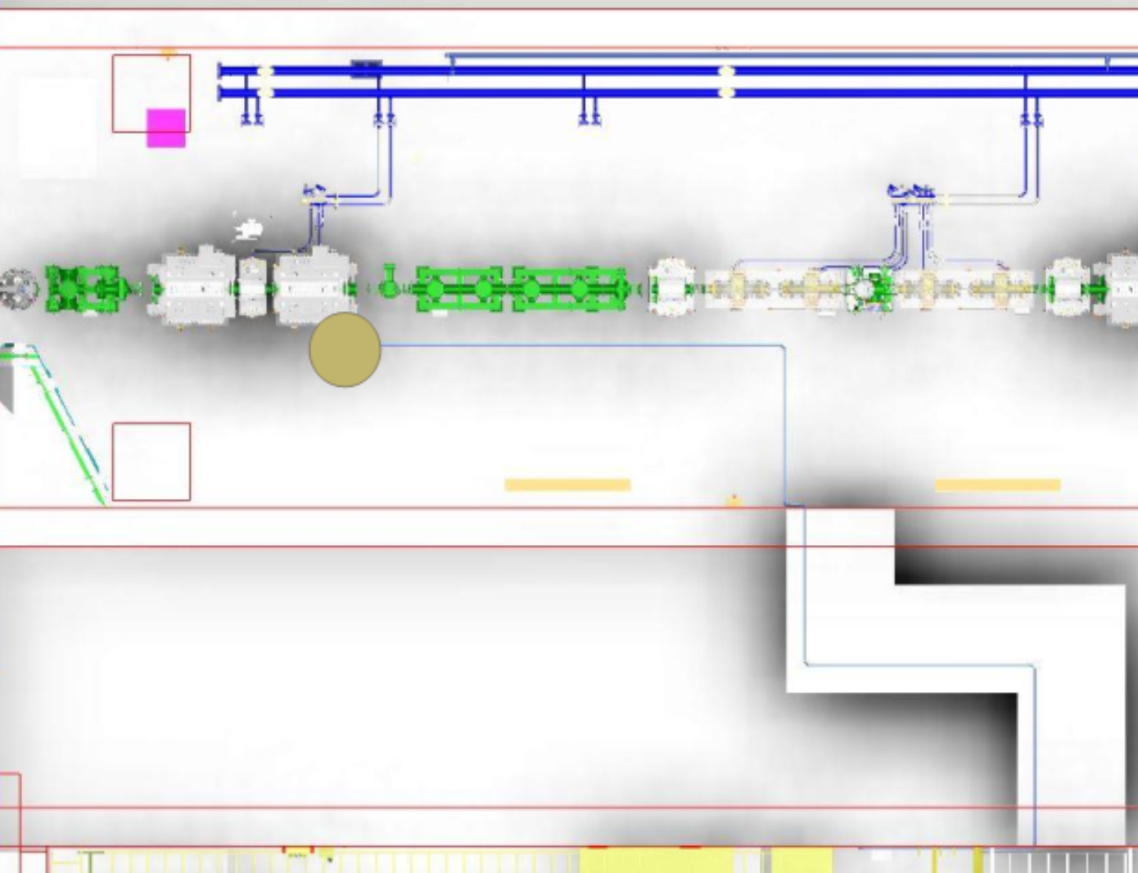
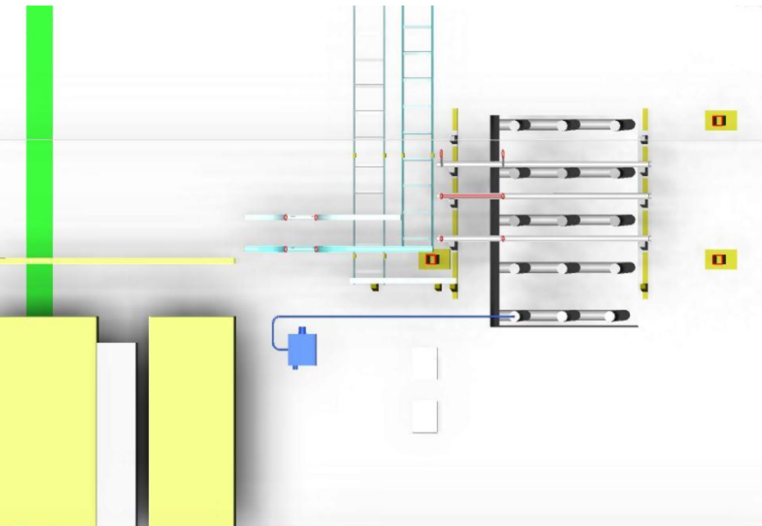
ODH monitor and sampling point placements
Sample point placement in A2T
Note: This ODH monitor in GSA (and its sample point in A2T) has been added due to PDR committee comments
Sample point A2T
ODH monitor GSA
Sample Point A2T

Slide 15
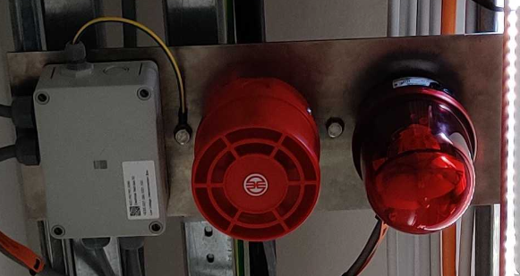
Alarm unit placements
Alarm units are placed on alarm unit plates, that consist of one rotating light and one sounder.
These alarm unit plates are placed in a way so that the rotating light can be seen from any reasonable location and with maximum 30-meter distance in the accelerator tunnel. This is consistent with the distance between the fire alarm units.
Alarm unit plates are also located in the emergency exits and on each entry point to the acc tunnel.
The sound-level of the sounders should be at least 10 dB(A) over the ambient normal highest level of background noise, but not more than 115 dB(A) at a distance of one meter from the sounder.
Typically, it is required that the sound level of sounders is higher than 65 dB(A) in permanently occupied places. [4]
For TODHDS the sounders were placed on every other alarm unit plate and the sound was clear enough.
However, for this design, the sounders are prepared for every alarm unit plate since we do not yet know the final background noice in the area. During commissioning, the sounders that are not needed can be tuned down or disconnected to fulfill the above-mentioned requirement.
For more information on alarm unit placements, see [3].
Placements will be shown more in detail on the upcoming slides

Slide 16
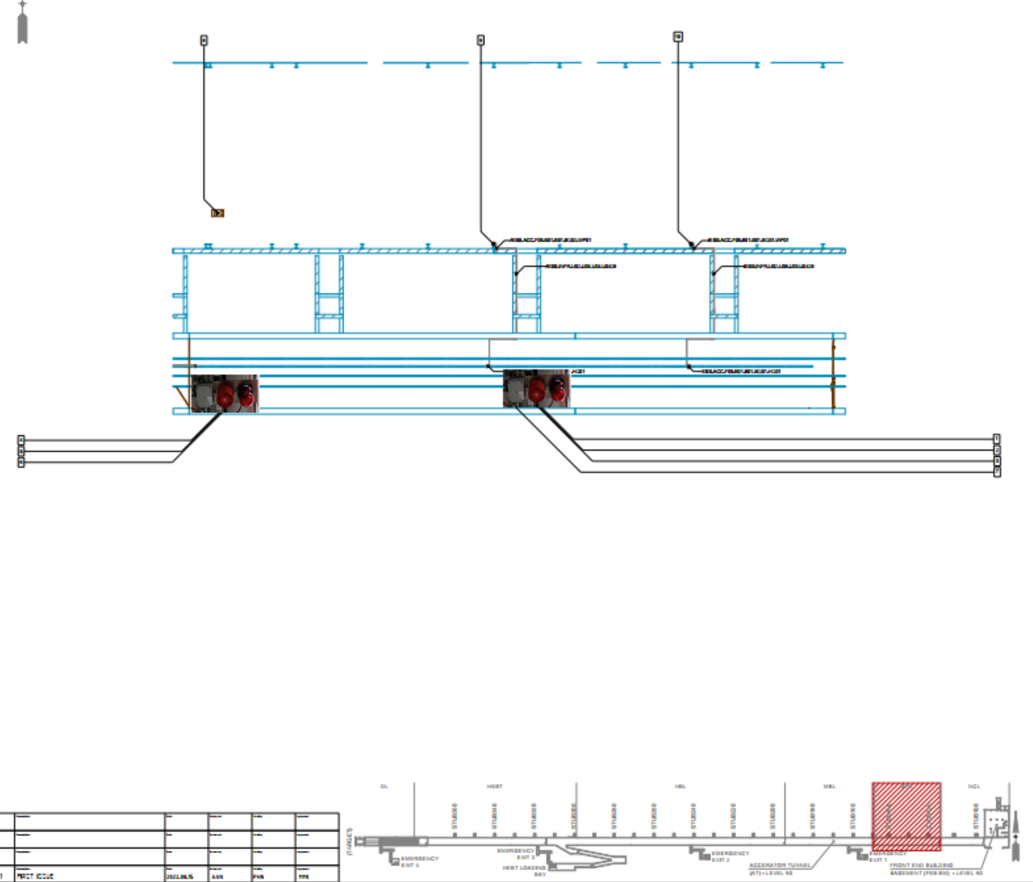
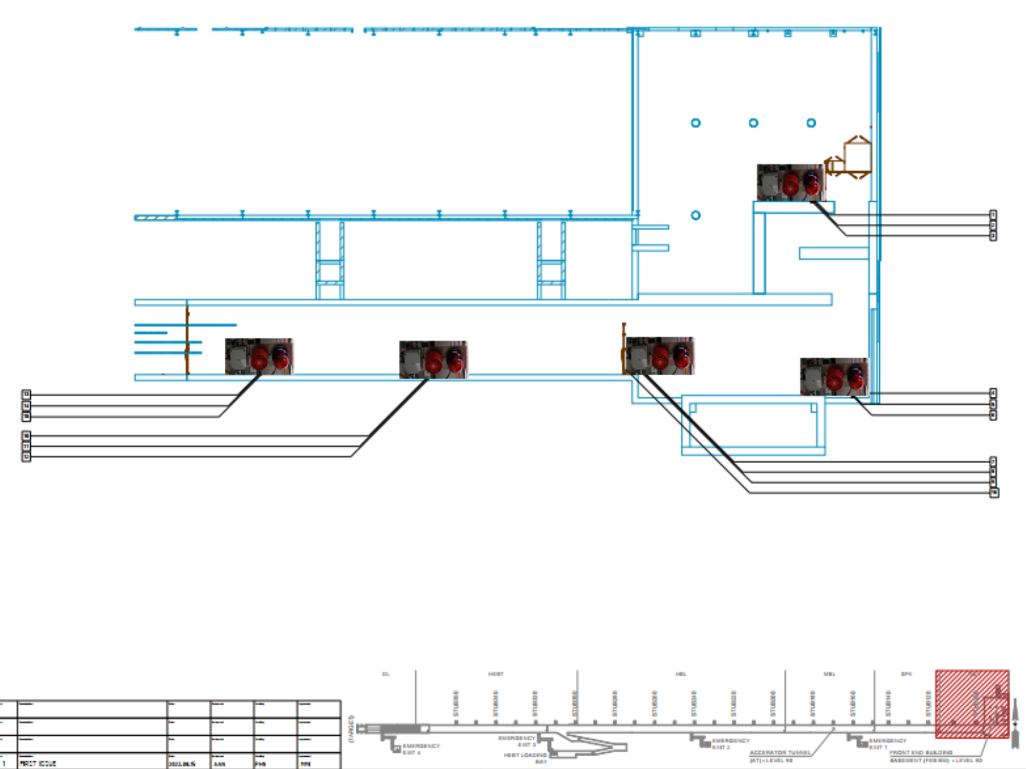
Alarm unit placements
Alarm units Spk
Alarm units NCL

Slide 17
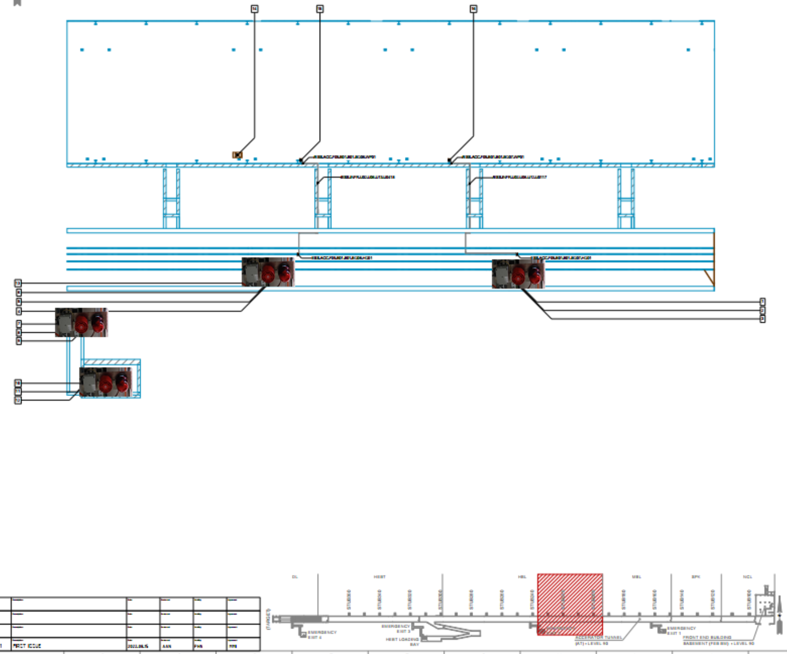
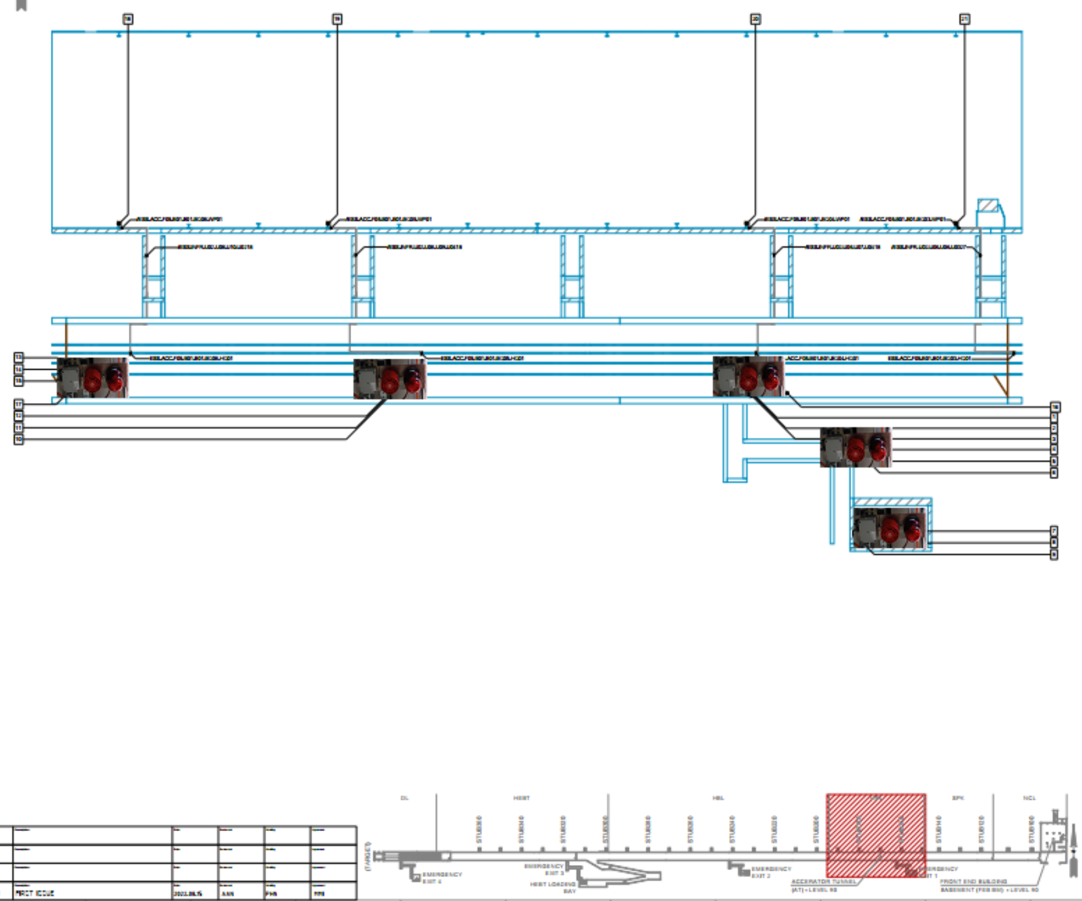
Alarm unit placements
Alarm units HBL (1/3)
Alarm units MBL

Slide 18
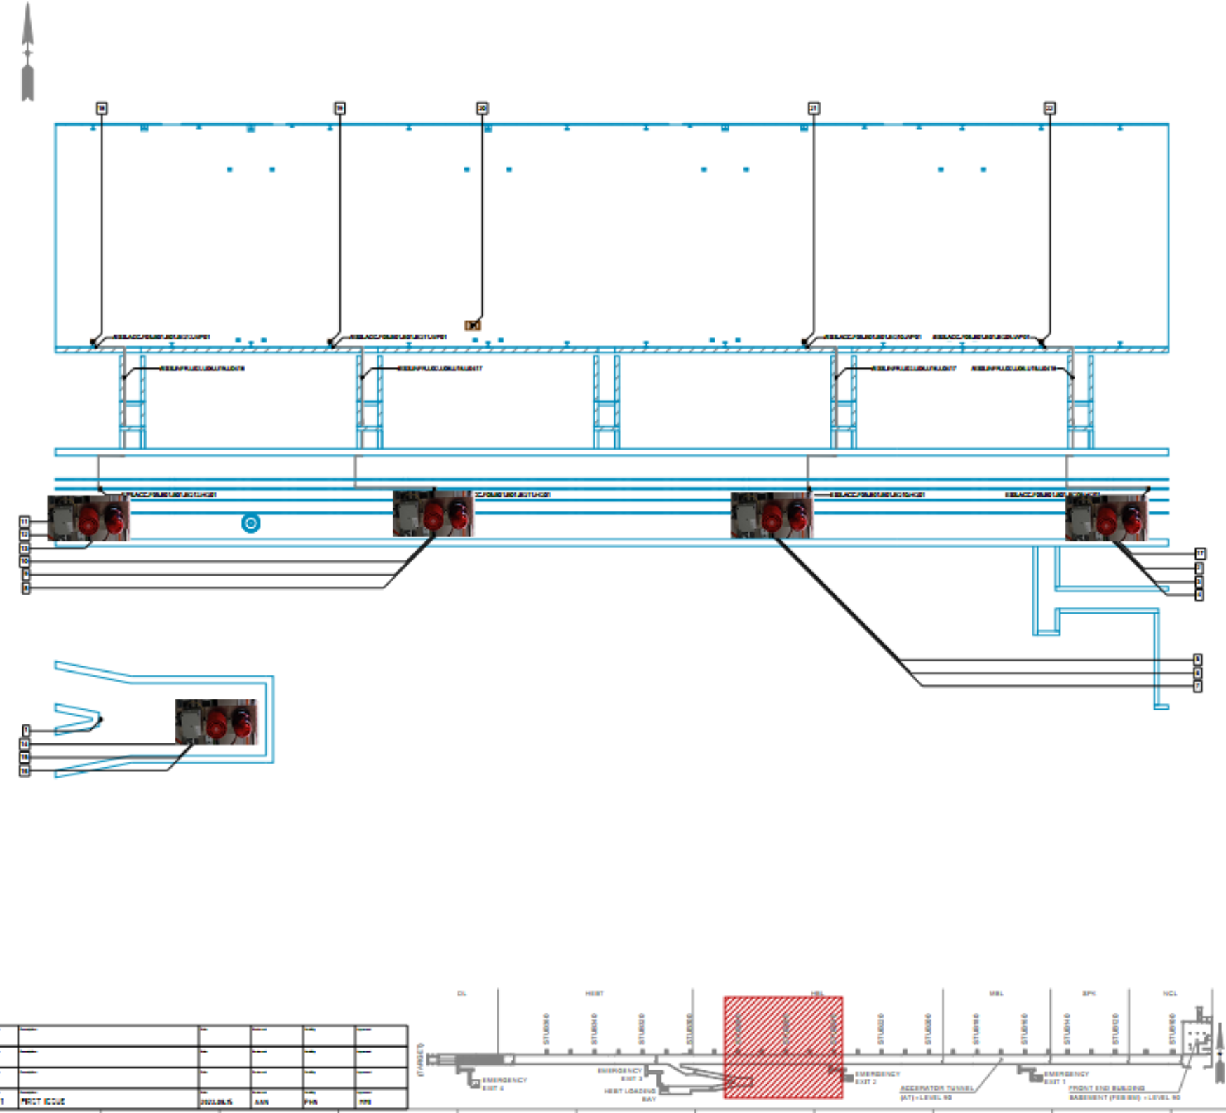
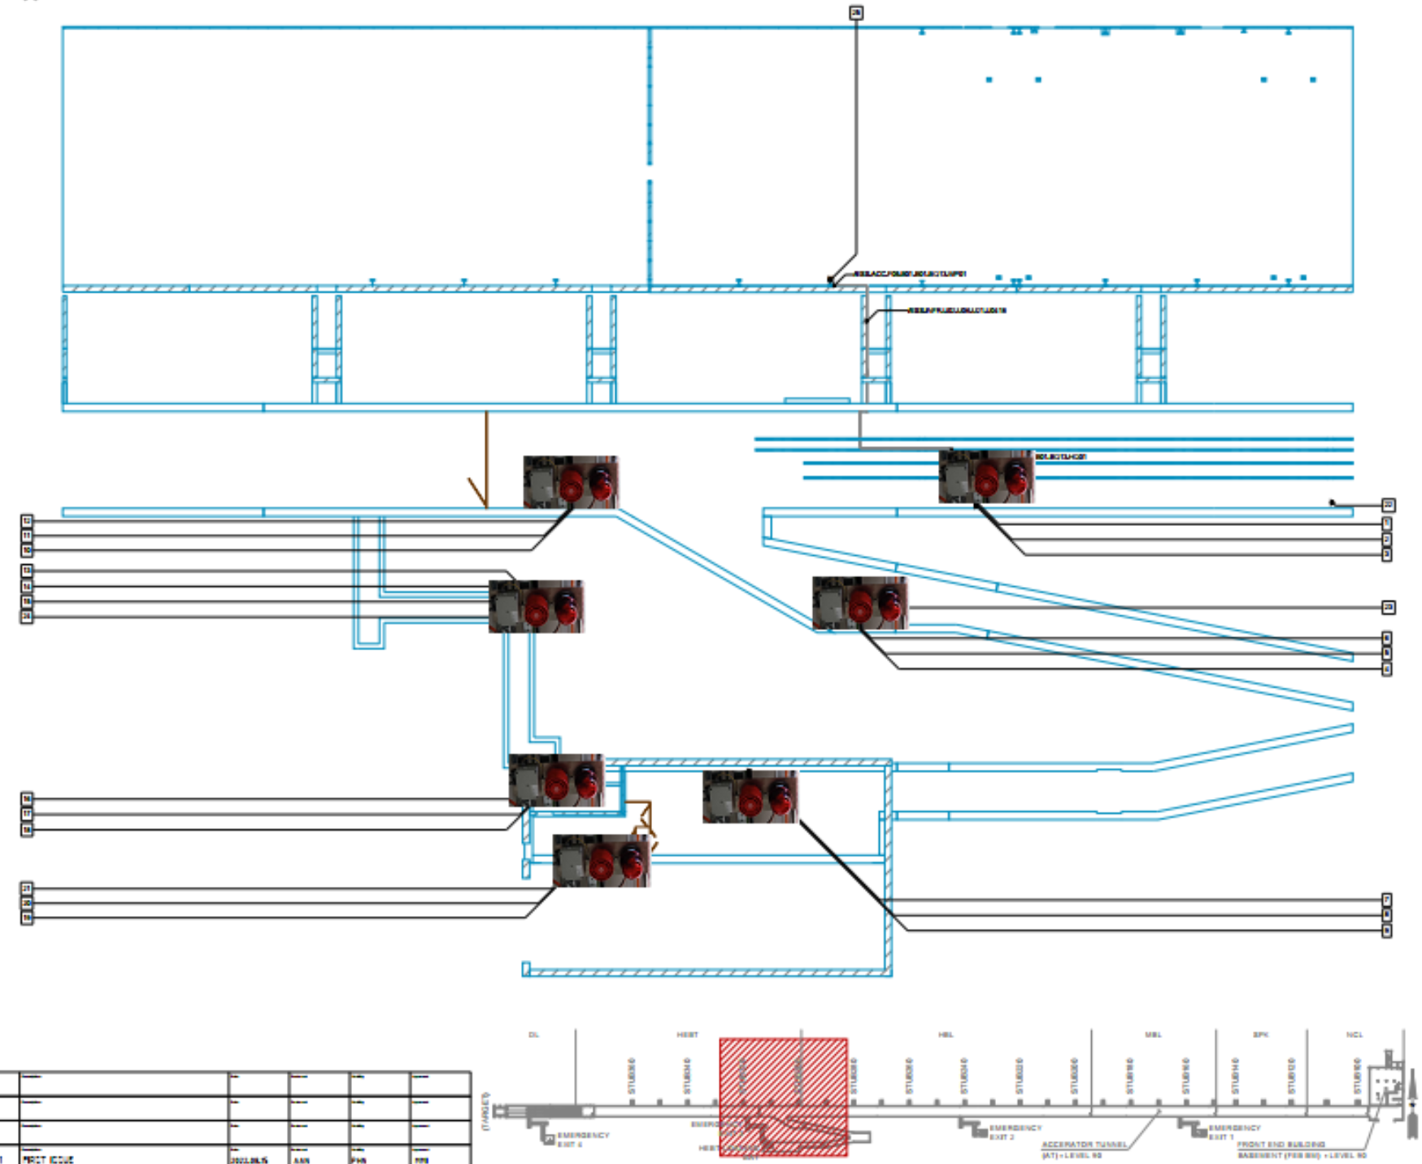
Alarm unit placements
Alarm units HBL (3/3)
HEBT (1/2)
HEBT loading bay
Alarm units HBL (2/3)

Slide 19
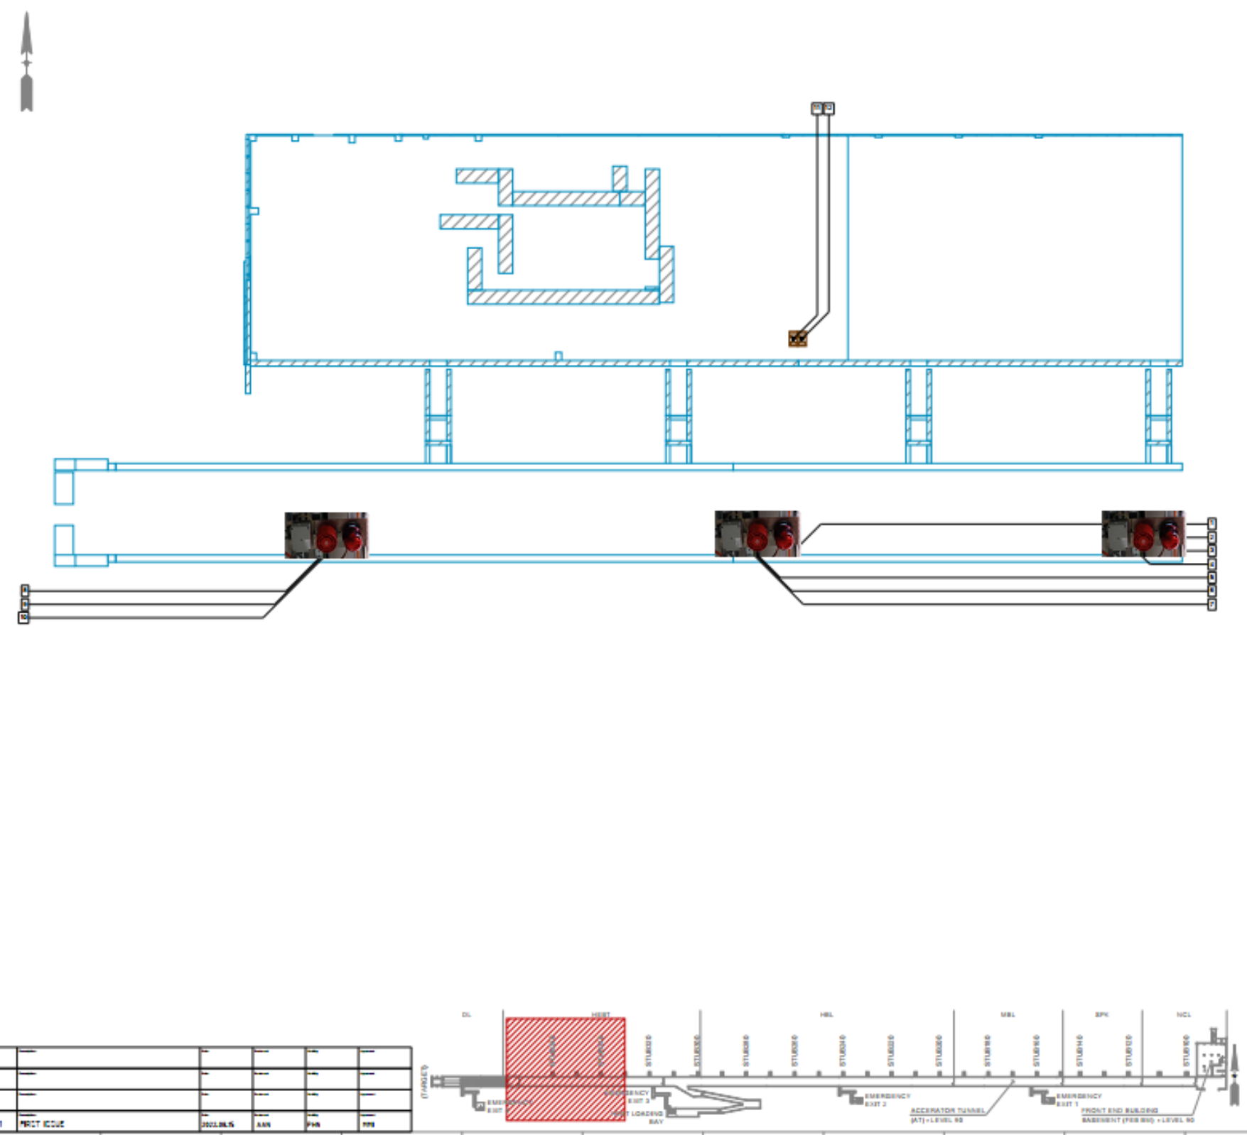
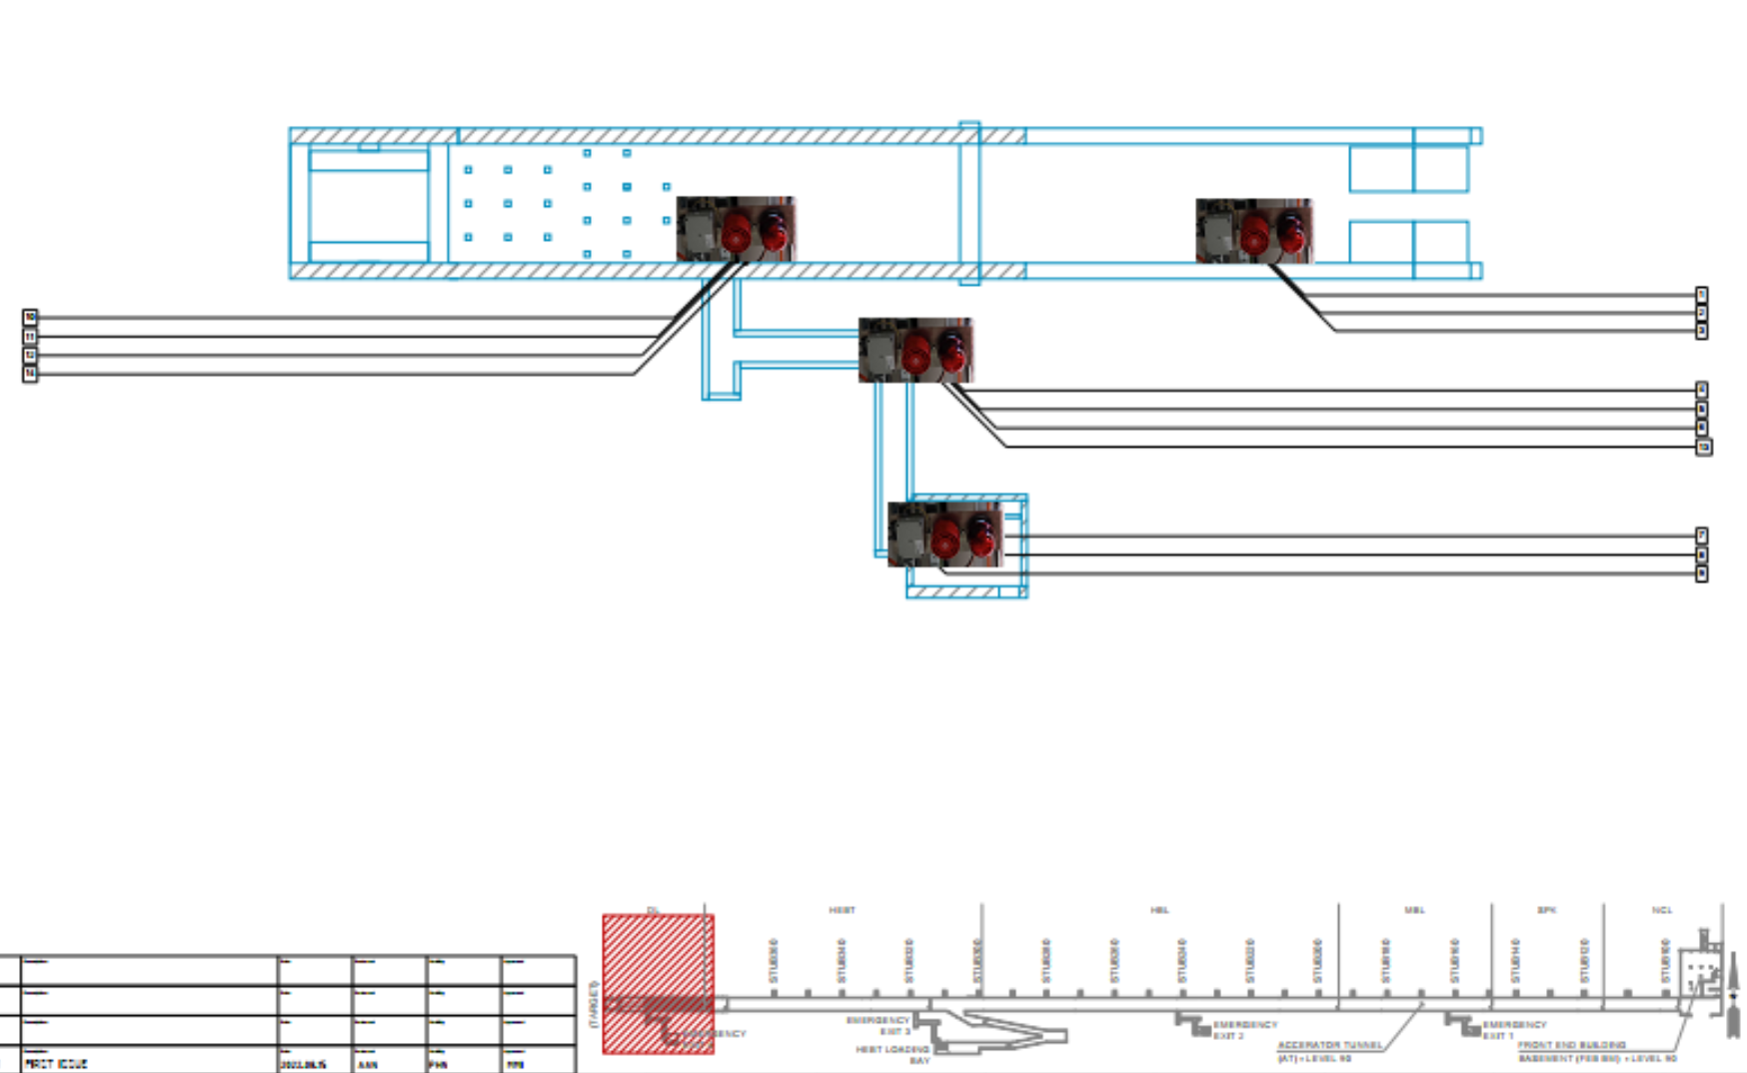
Alarm unit placements
Alarm units DL
Alarm units HEBT (2/2)

Slide 20
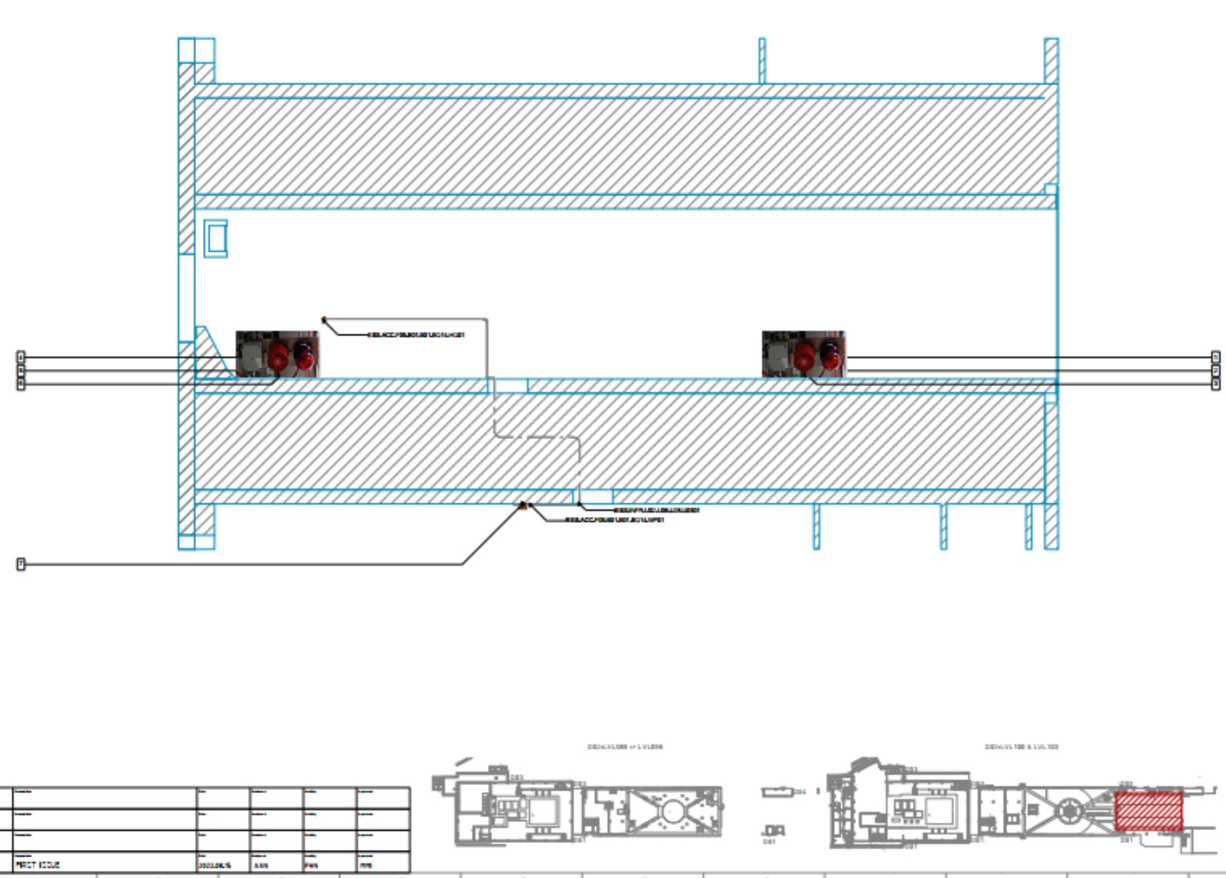
Alarm unit placements
Alarm units A2T

Slide 21
Finish presentation

Slide 22
Reference Documents
[1] ESS-3739365 - ESS ODH Detection Systems Architecture
[2] ESS-3836683 - The layout of ODH monitors sampling points for the accelerator tunnel
[3] ESS-4096073 - ACC TUNNEL ODHDS EQUIPMENT LAYOUT
[4] ESS-3236032 - High Level Requirement Specification for ODH Detection Systems

