Slide 2
Acc Tunnel ODHDS CDR Presentation - ACC ODHDS Electrical and Mechanical Design
PRESENTED BY anton andersson

Slide 3
Agenda
Input documentation and relevant standards
Performed electrical design tasks for this CDR
Control cabinet design
Power distribution and UPS
Control Equipment
Alarm Units
ODH monitors
Environmental conditions
Electrical design updates CryoB ODHDS

Slide 4
Input documentation and relevant standards
Internal Input Documentation:
High Level Requirement Specification for ODH Detection Systems [1]
Technical Description of ESS ODH Detection Systems [2]
Electrical Design Guidelines for PSS and ODHDS [3]
Appendix for Electrical Design Guidelines for PSS and ODHDS [4]
High level design documentation
ESS Rules for electrical design [5]
PSG High Level Design Requirements [6]
ESS Generic Requirements for Naming and Tagging [7]
ESS Generic Requirements for Marking and Labelling [8]
Relevant Standards
SS-EN_60204-1 - Safety of machinery – Electrical equipment of machines [9]
SS4364000 – Rules for design and erection of electrical installations [10]
AFS2020:1 - The Swedish Work Environment Authority regulations [11]
SBF110 - Swedish Fire Protection Association's publications [12]

Slide 5
Performed electrical design tasks for this CDR
The following electrical design tasks has been prepared for this CDR and some of the documentation will be used only for installation purposes, and some will be updated to As-built after finalized installation and used for operation/maintenance purposes.
All documents are released in CHESS.
Electrical design specification (ESS-4041812)
Create FBS, ESS-names and CDB-names
Component Selection
Aveva 3D modelling
Aveva 2D Equipment Layout Drawings (ESS-4096073)
Aveva Cable Routing
Cable Pulling Sheets (ESS-4096074)
Create IO-list (ESS-4041788)
ePlan electrical and mechanical drawings (ESS-4041290)
List of Labels (ESS-4041789)
Electrical Design Verification Report (ESS-4041790)

Slide 6
Performed electrical design tasks for this CDR
See on the image below the electrical design workflow, for the detailed design phase.

Slide 7
Performed electrical design tasks for this CDR
Electrical design specification
Created to support electrical design and to make sure that all the electrical requirements for the system are summarized in one document.
Create FBS, ESS-names and CDB-names
Functional tags are created for the system according to the ESS rules for naming and tagging.
All sub-systems and components for the Acc ODHDS have been assigned with a functional tag in the FBS.
All components which is connected to the control system have been assigned with an ESS-name.
All cables has been assigned with a cable database name to enable cable routing in Aveva E3D.
Aveva 3D modelling
All control cabinets and field devices are been modelled in Aveva E3D and clash checks has been performed.
Aveva 2D Equipment Layout Drawings
The equipment Layout drawings are derived from the Aveva 3D modeling. This document allows us to see the location of all control cabinets and field devices without having to access the 3D model. This document will be used both for installation and operation/maintenance purposes.

Slide 8
Performed electrical design tasks for this CDR
Aveva Cable Routing
Cable routing are performed in Aveva E3D. This is needed to create the cable pull sheets which are needed for installation and to be able to see the route of cables for operation/maintenance.
Cable Pulling Sheets
Cable pulling sheets are derived from the Aveva E3D model and is used for installation purposes. It defines the start and endpoint of all cables, which cable containments to use for all cables and total lengths of cables.
Create IO-list
An IO-list is created for the system and is mainly used for software development purposes. All IOs together with its signal tags and addresses are defined in this document.
ePlan electrical and mechanical drawings
The electrical and mechanical drawings contains:
Multi-Line diagrams for all electrical connections.
Network connections.
Control cabinet layout drawings, used for populating the control cabinets.
Parts Lists.
This document will be used both for installation and operation/maintenance purposes.

Slide 9
Performed electrical design tasks for this CDR
List of Labels
This document contains a list of all labels needed for the system:
FBS Labels
Asset Labels
Control Cabinet manufacturing labels
Warning Signs
This document is created to simplify printing/procuring of labels and to simplify labelling for installation.
The Acc ODHDS labelling fulfills he requirements in the ESS rules for marking and labelling.
Electrical Design Verification Report We will go through an example in the electrical design verification report (ESS-4041790)
The electrical design verification report is created to verify:
Appropriate settings on selectivity modules based on loads.
Selection of power supplies.
Selection of UPS unit and battery capacity (derived from TIA selection tool).
Control cabinet power dissipation to determine the need for a fan or cooling system.
Current carrying capacity of selected cables.
Automatic disconnection of supply in case of short-circuit which is based on cable types, cable lengths and protection device.
Voltage drop to ODH monitors and alarm units which is based on cable types, cable lengths and load. This is performed to ensure that the ODH monitors, and Alarm units can handle the voltage level caused by the voltage drop.

Slide 10
Control cabinet design
4 Control cabinets are used for the design of the Acc ODHDS:
1 PLC cabinet which is located in the GTA.
3 RIO cabinets that are distributed along the klystron gallery.
The loads from each control cabinet are designed as evenly as possible to avoid the need for a large number of batteries in a single control cabinet.

Slide 11
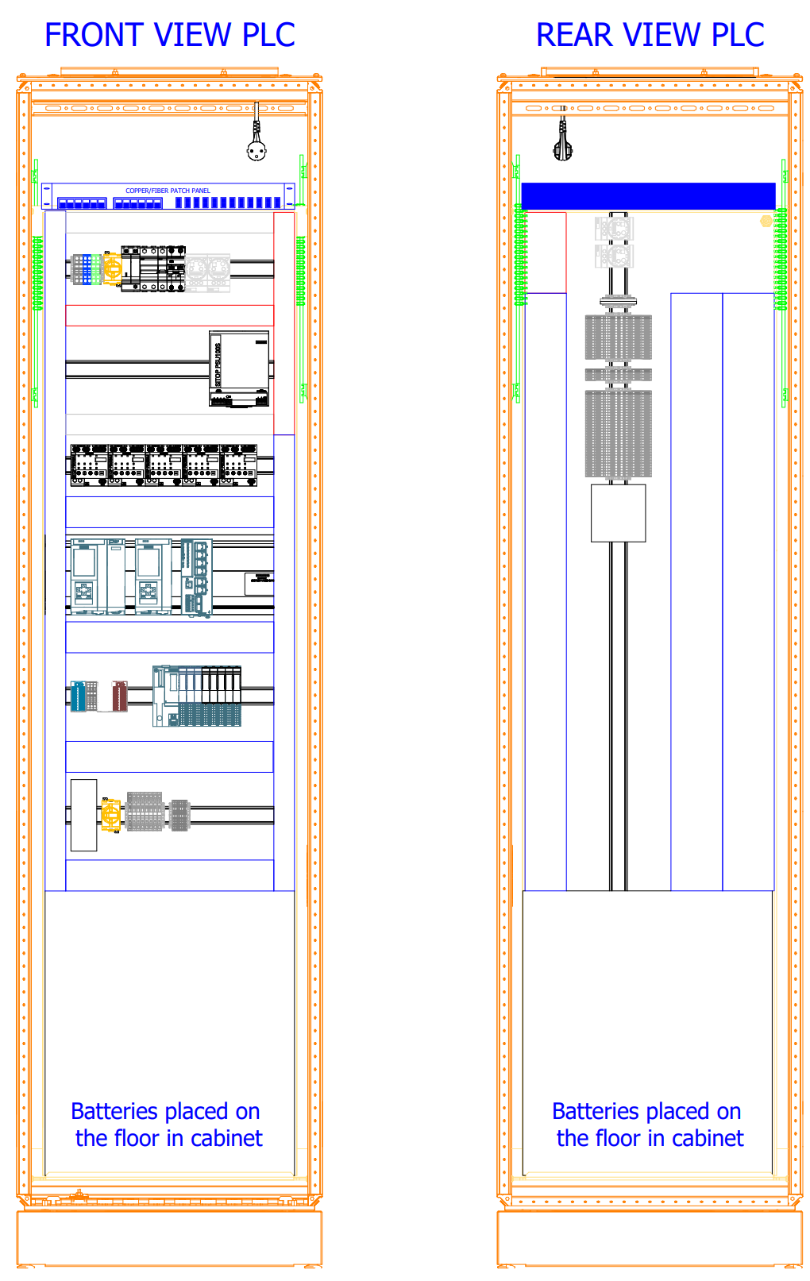
Control cabinet design
All the control cabinets are designed with two doors, one on the front of the cabinets, and one on the rear of the cabinet.
All the active components are placed on the front of the cabinet and all the terminals to outgoing cables are placed on the rear of the cabinet.
This also means that there is a clear boarder on the rear side of the cabinet, of which conductors that are internal (left of terminals) and the outgoing cables (right of terminals).
230VAC conductors and 24VDC conductors are seperated in the control cabinet to avoid disturbances on the 24VDC circuits.
RED = Reserved for 230VAC conductors
BLUE = Reserved for 24VDC conductors
The need for cooling in the cabinet is calculated through the Rittal Therm software, and we found a need for a fan in the cabinets to dissipate the heat.
We have a filter on the bottom half of front door to let air into the cabinet,
and a fan on the ceiling of the cabinet (towards the rear side) which suck the air out of the cabinet. This means that the air will pass through all active components on the front mounting plate. A thermostat will be installed to keep the temperature of the cabinet to <30 °C.

Slide 12
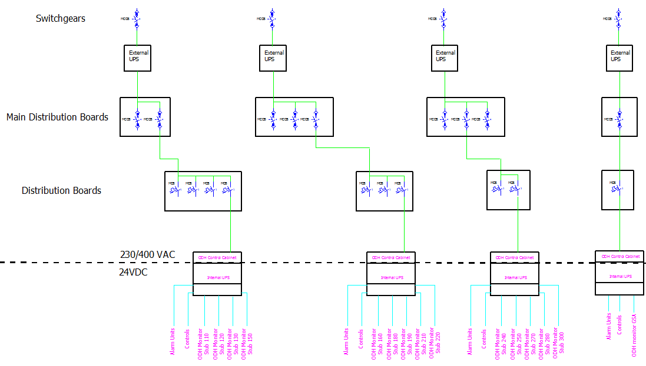
Power Distribution and UPS
If there is a power failure outside of the ESS facility, the diesel generators would start (with help of the external UPS) and our internal UPS would still be powered by our incomming power supply.
However, if there is a power failure within the ESS facility downstream of the Diesel Generators, the internal UPS will go to battery mode and we have at least 5 hours back-up in normal operation state, and then we have at least 30 minutes for alarm state.

Slide 13
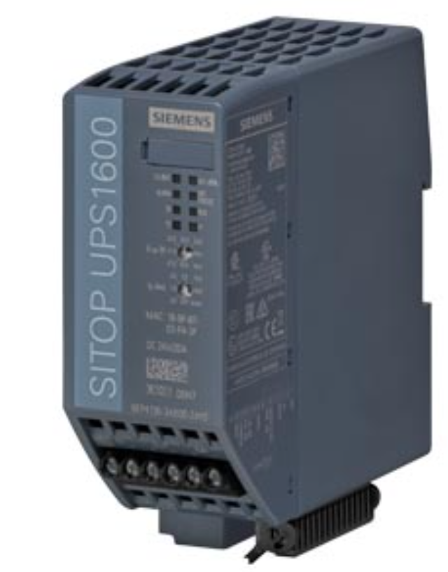
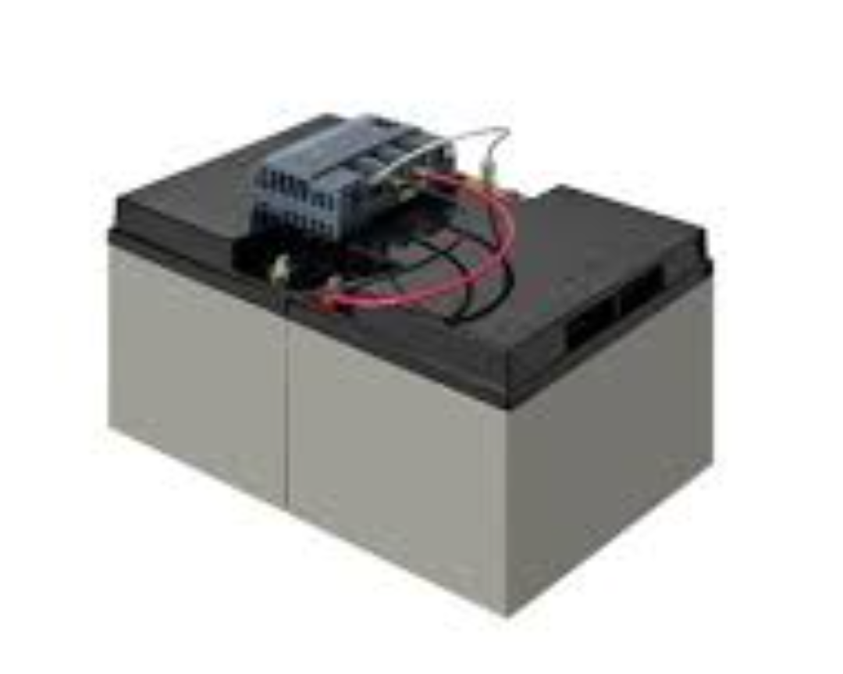
Power Distribution and UPS
UPS design:
The UPS unit is providing back-up power to both the ODH monitors, Alarm Units and the Control System.
The Siemens UPS-Units SITOP UPS1600 together with battery modules SITOP BAT1600 has been selected in the design.
4 pc of battery modules SITOP BAT1600 is required in each control cabinet based on calculation in the TIA selection tool.
The UPS batteries is designed to deliver >=24VDC for the full 5.5h. 25% spare capacity has been considered. A lifetime of >8 years is expected from the batteries. If the UPS did not deliver >=24VDC, we could not ensure that the ODH monitors would be running for the full 5.5H, because of the voltage drop.
The Battery modules are designed so that they can be replaced individually during operation.
Siemens specifies that the UPS units and battery modules are maintenance-free until end of life.
We have not added a component to be able to by-pass the UPS Units. The reason is that the selected UPS Unit has a very long MTBF (Mean Time Between Failure) of almost 40 years. It was concluded that, if we add component(s) for the by-pass function (Relay/position switch), the likelyhood of that component failing, is just as great or greater then the UPS unit failing.

Slide 14
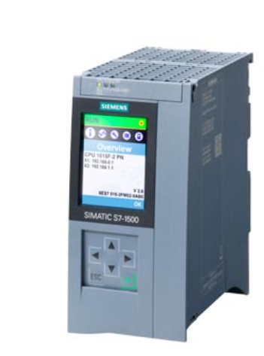
Control Equipment
The SIMATIC S7-1500 controllers from Siemens are used in the design together with ET 200SP distributed IOs.
The CPU, Gateway CPU and HMI is located in the PLC cabinet.
All control cabinets contains an IO configuration.
A Communication processor is used for the CPU for network deployment purposes.
The control equipment are connected to the internal UPS.
The following components are selected:
SIMATIC S7-1500F, CPU 1515F-2 PN
SIMATIC S7-1500, CPU 1515-2 PN
CP 1543-1
MTP1500, Unified Comfort Panel
SCALANCE XC206-2SFP
ET 200SP IM 155-6PN/2 High Feature
ET 200SP DI 16x 24V DC
ET 200SP AI 4XU/I 2-WIRE
DQ 8x 24VDC/0.5A High Feature
High Feature DQ modules are used so that we can detect wire break to the alarm unit devices. If std DQ modules were used, we would not be informed if there is a lost connection to any of the alarm devices.

Slide 15
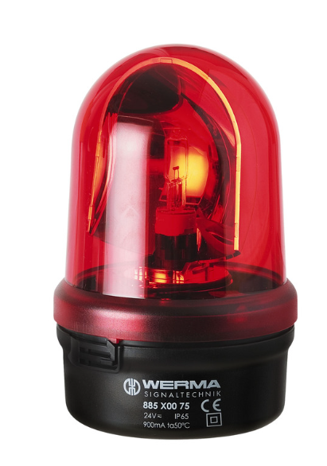
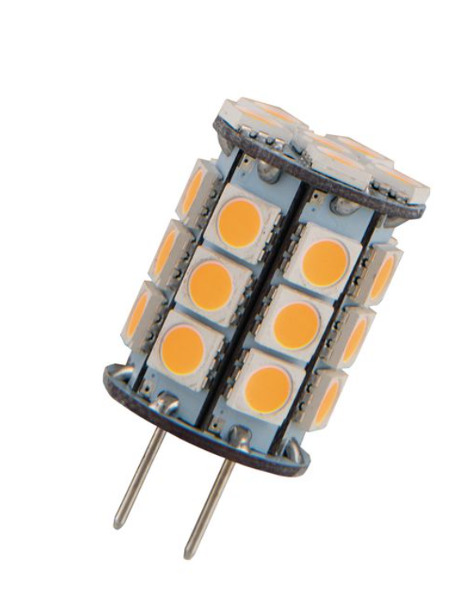
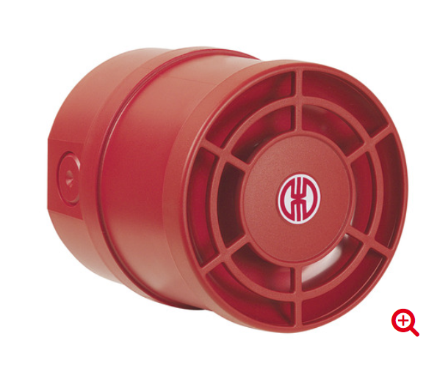
Alarm Units
The following alarm units are selected:
Rotating Mirror Beacon BM 24VAC/DC RD from Werma (with LED bulb LED Compact G6.35).
Multi-t.sounder WM 32 tne 9-28VDC RD.
Since most alarm units are located in the Acc tunnel, Radiation resistant cables are selected.
The cables to alarm units are protected by cable trunks/conduits.
The alarm units are connected to the internal UPS.

Slide 16
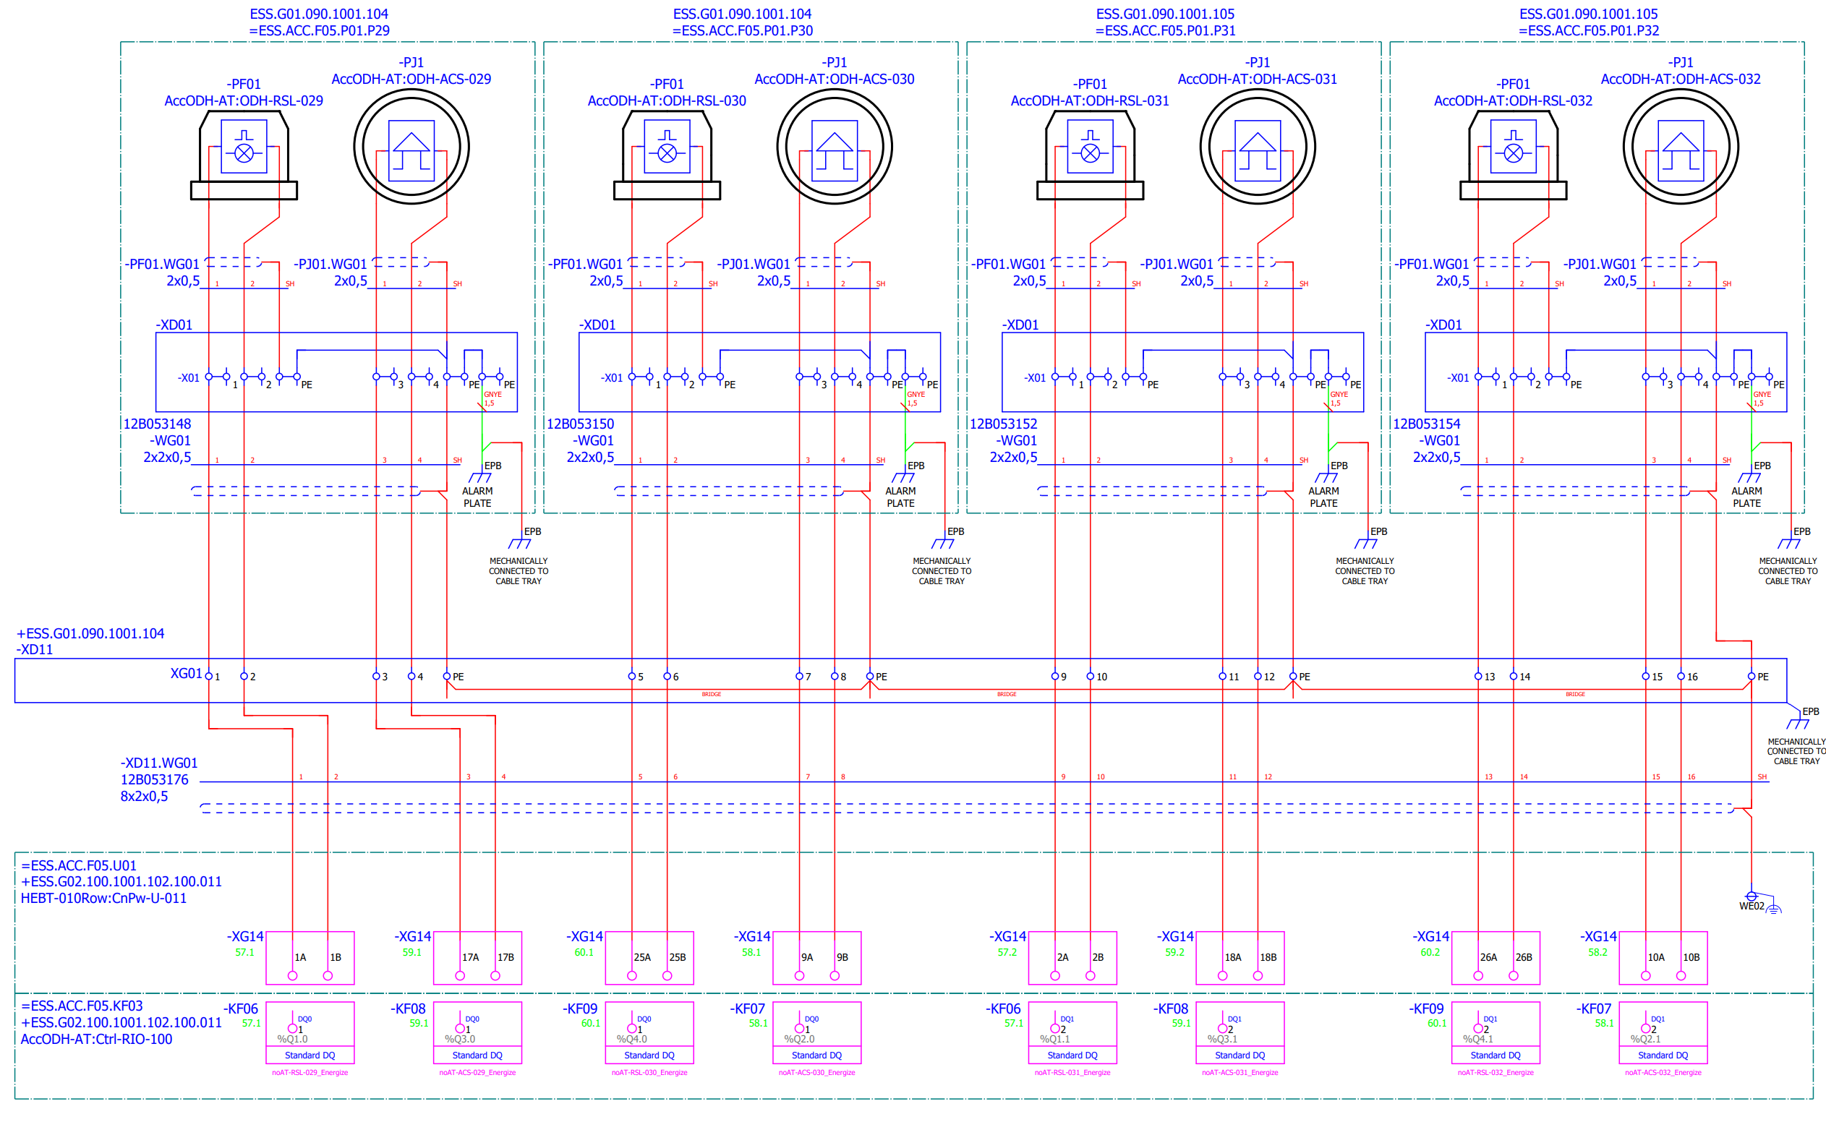
Alarm Units
To be able to monitor wire break of the alarm unit circuits, each alarm unit is connected to its own HF DQ module output.
Also, to achieve redundancy, adjacent alarm units are connected to seperate HF DQ modules , which are protected by seperate selectivity module outputs.

Slide 17
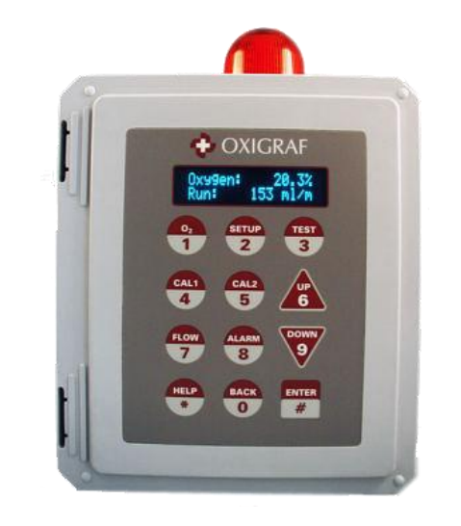
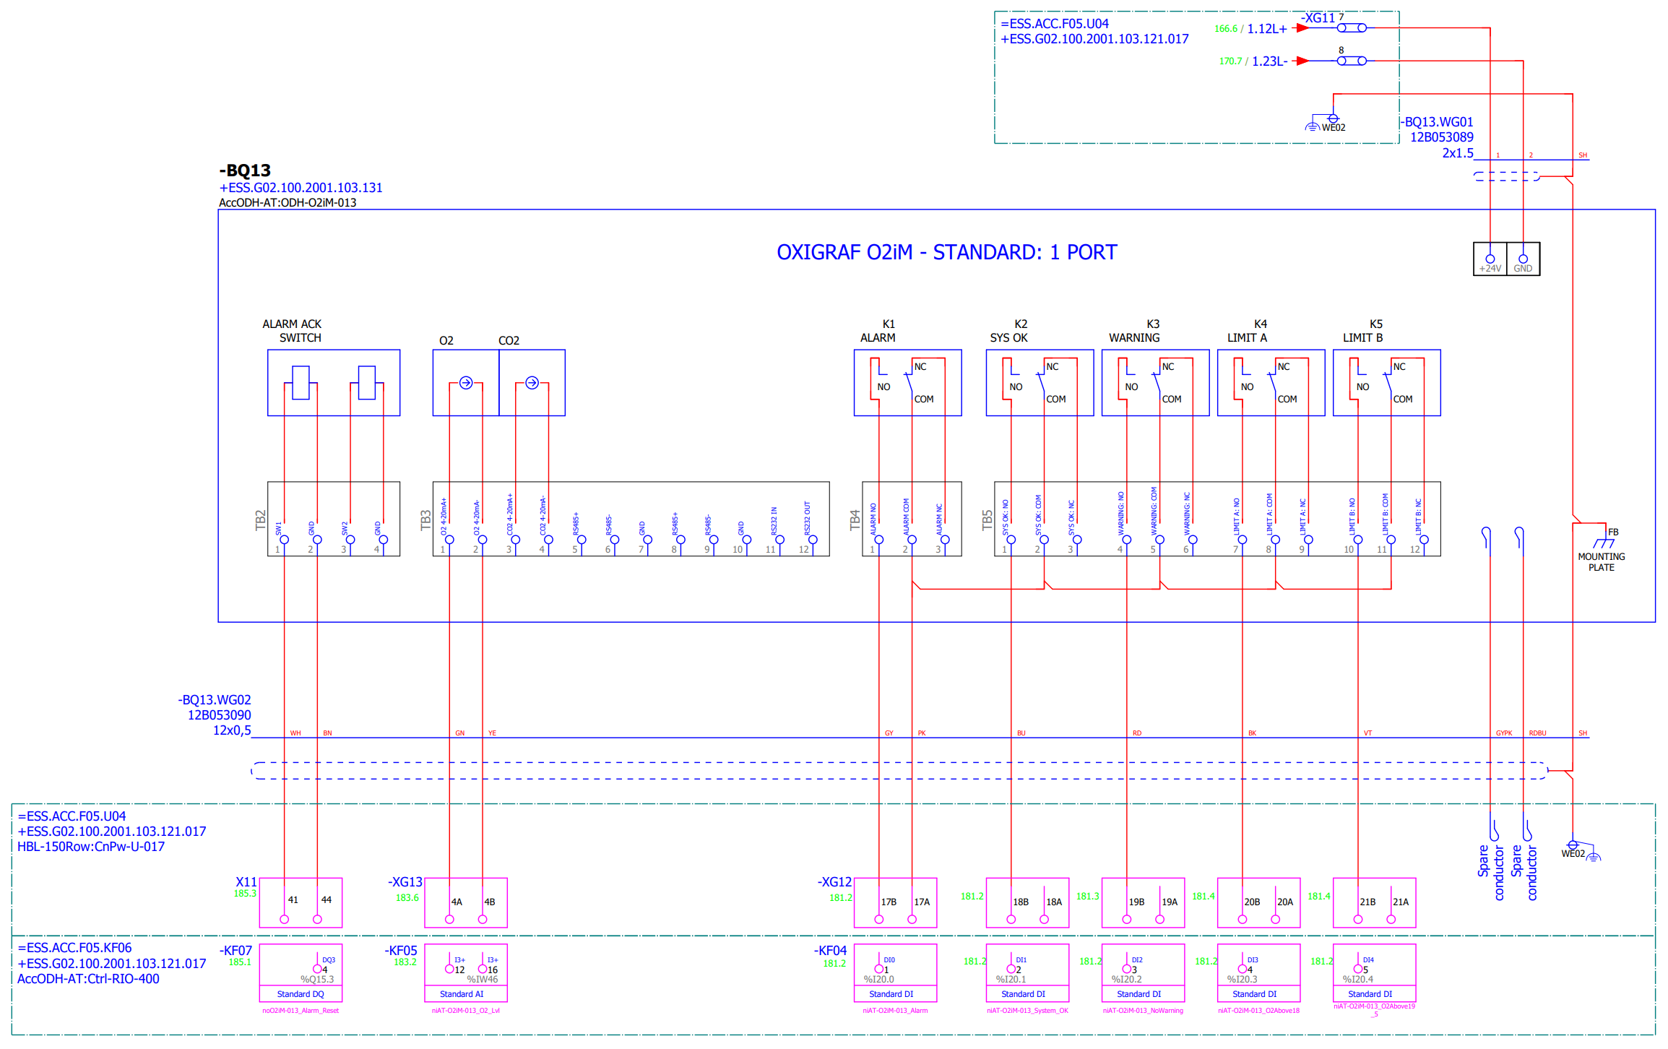
ODH monitors
ODH monitor O2iM from Oxigraf is selected, which is a 1-port ODH monitor.
Each ODH monitor is provided with a 24VDC feed from the control cabinet, individually protected by a selectivity module output, to be able to turn off one monitor individually. Each ODH monitor is also provided with a signal cable, for communication to the PLC.
13 of the 14 monitors are located in G02, where radiation resistant cables are not selected. 1 monitor is located in the GSA, which means the 24VDC cable and the signal cable has to be routed through the Acc Tunnel, and therefor radiation resistant cables are selected.
The cables to the ODH monitors are protected by cable trunks/conduits.
The ODH monitors are connected to the internal UPS.

Slide 18
Environmental conditions
The components used in the design, have been checked to ensure they can sustain the environmental conditions where they are to be installed, see Appendix for Electrical Design Guidelines for PSS and ODHDS [4]
We have checked:
Radiation resistance
IP-rating
Temperature rating
Relative humidity rating

Slide 19
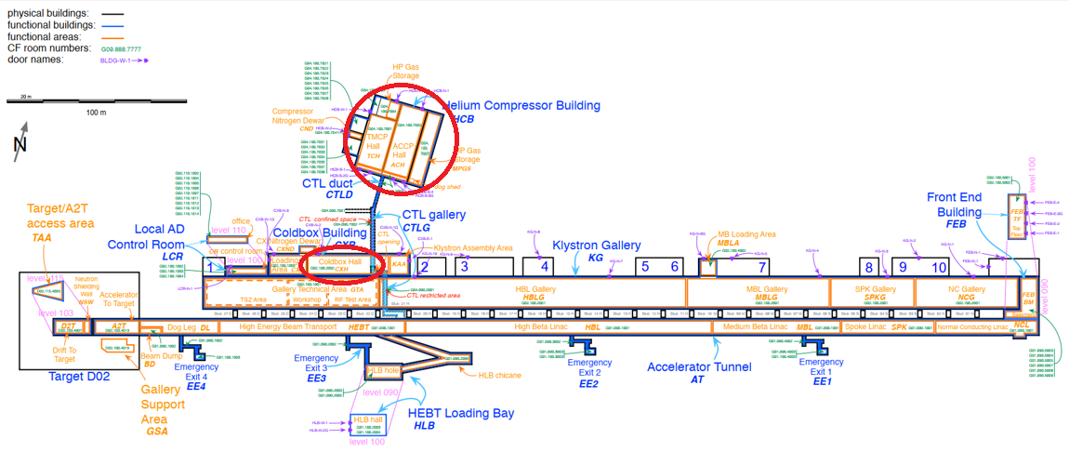
Electrical design updates CryoB ODHDS
The CryoB ODHDS covers the G04 helium compressor building and the Coldbox Hall in G02.

Slide 20
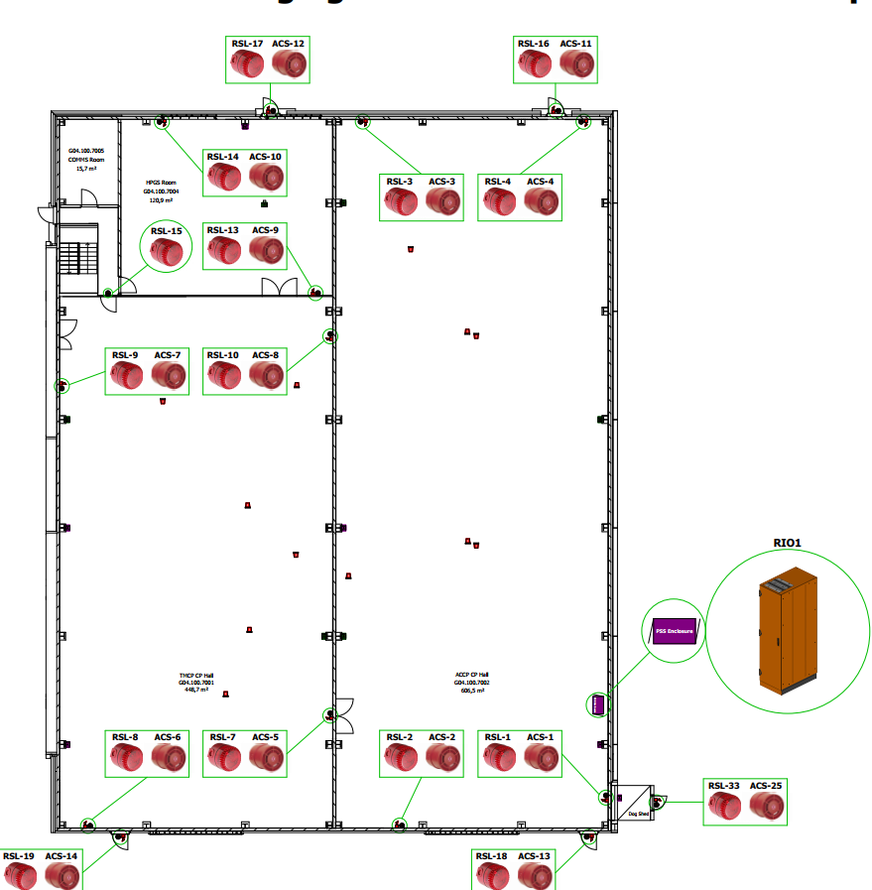
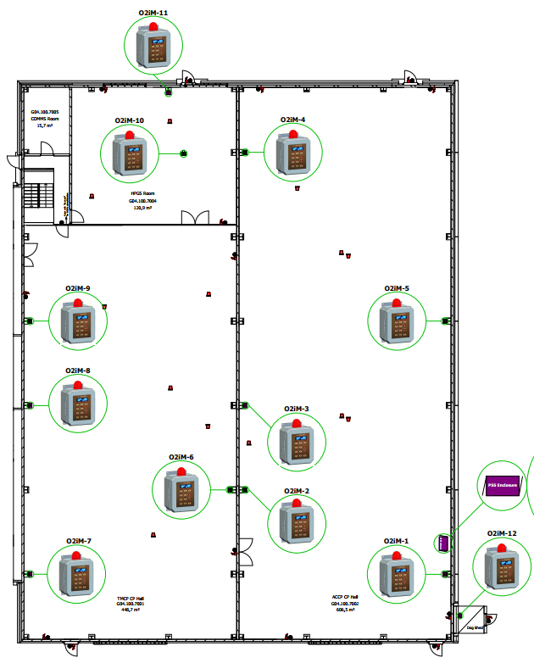
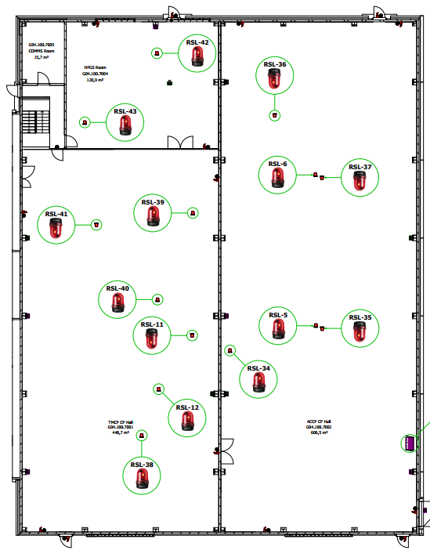
Electrical design updates CryoB ODHDS
An overview of the alarm unit placement and ODH monitor placements in the helium compressor building G04

Slide 21
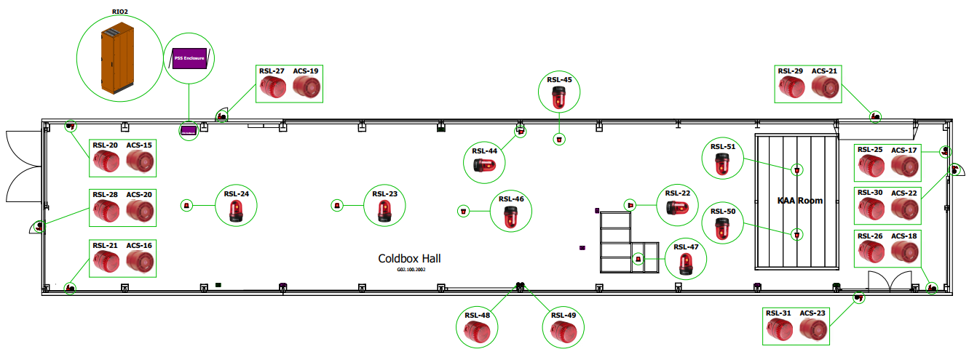
Electrical design updates CryoB ODHDS
An overview of the alarm unit placement and ODH monitor placements in the Coldbox hall in G02.

Slide 22
Electrical design updates CryoB ODHDS
The attached updates could be made to the CryoB ODHDS, to fulfill the same design principles as defined for the Acc Tunnel ODHDS, see our conclusions below and please provide feedback to our conclusions.
# | Possible design changes | Conclusion
1 | Perform an update to achieve redundancy for Opt. fiber connection. Connect a fiber ring between the control cabinets. No need for new fiber cable since we have spare strands. | This will be implemented to achieve redundancy of the Netw. communication between the control cabinets. This is easy to implement since we have spare strands in the fiber cables. So, we only need to patch in the control cabinets.
2 | Update to follow the same naming structure as for Acc tunnel ODHDS. Update FBS tags, ESS-names This would also cause re-labling. | We will not do this update. This CryoB ODH design and the TS2 PSS will not follow the generic guideline we have for functional tags. Since these systems are operational systems, and the FBS tags/ESS-names do not improve the functionality of the system itself, we will prioritize other task.
3 | Update for Asset IDs | This will be implemented. We can quite easially look through the Asset IDs for this system and see that it follows our electrical design guideline for assigning Asset IDs.
4 | Update to allow for additional UPS information to the CPU. Connect the UPS units to profinet. Network switches are already in all control cabinets. | We will do this update. Since we have Nets. switches in the control cabinets, this is just a matter of patching in the UPS unit.
5 | Updates to enable the monitoring of cable break to alarm units. Change to HF DQ modules. Remove relays from DQ module outputs and instead connect directly to outgoing terminals. Distribute 1 DQ output directly to 1 alarm unit. Re-pull cables to alarm units. | We will not use the HF DQ modules, we keep the relays, and we keep the old cabling. The reasons is that the system is already installed, and these upgrades are challenging to implement from an installation perspective. And we still have short-circuit protection directly from the selec. modules. Some mitigations could be: -We might want to test these alarm unit circuits more frequently, to ensure we do not have any wire break (since this could not otherwise be detected). These selec. Module outputs to be upgraded to major alarms.
6 | Update to fulfill the same UPS design principle as defined for Acc tunnel ODHDS. Update battery size/number of batteries. Feed the ODH monitors with 24VDC from the ODHDS control cabinets. One more cable from the control cabinet to each ODH monitor required for this. | We will not do this update The reason is that we in this case would need to pull new 24VDC power cables from the control cabinets to the ODH monitors for the 5h + 30 min battery back-up time to make any sense. To keep it the way it is, is not a problem from a safety perspective since we would trigger the alarms if the main power is lost. However, it does affect availability, for the same reason. With the current design, we at least ensure 30 minutes of alarm time on the UPS. This has been confirmed by the TIA selection tool. According to TIA selection tool: - Our UPS/Battery can handle 1h and 6 minutes in alarm mode when it is brand new - It can handle 36 minutes in alarm mode after 4 years. - It is at end of life after 5 years.

Slide 23
Finish presentation

Slide 24
Reference Documents
[1] ESS-3236032 - High Level Requirement Specification for ODH Detection Systems
[2] ESS-3137044 - Technical Description of ESS ODH Detection Systems
[3] ESS-4077615 - Electrical Design Guidelines for PSS and ODHDS
[4] ESS-4226262 - Appendix for Electrical Design Guidelines for PSS and ODHDS
[5] ESS-0015433 - ESS Rules for electrical design
[6] ESS-2029560 – PSG High Level Design Requirements
[7] ESS-0094090 - ESS Generic Requirements for Naming and Tagging
[8] ESS-0094091 - ESS Generic Requirements for Marking and Labelling
[9] SS-EN_60204-1 - Safety of machinery – Electrical equipment of machines
[10] SS4364000 – Rules for design and erection of electrical installations
[11] AFS2020:1 - The Swedish Work Environment Authority regulations
[12] SBF110 - Swedish Fire Protection Association's publications

