Slide 2
Installation and commissioning plan/status for the ACC ODHDS¶
PRESENTED BY Mattias Eriksson/Donya daryadel

Slide 3
Agenda
Accelerator ODHDS Installation Current Status/Remained Activities
Accelerator ODHDS Installation/Commissioning Plan

Slide 4
1
Accelerator ODHDS Installation Current Status/Remained Activities

Slide 5
Accelerator ODHDS Installation
Current status
All 14 monitors were installed in klystron gallery and GSA.
Installation of sampling and exhaust micropipes and filters for all 14 sampling points along the SCL and A2T area were done .
All the sampling and exhaust micropipes are connected to the monitors.

Slide 6
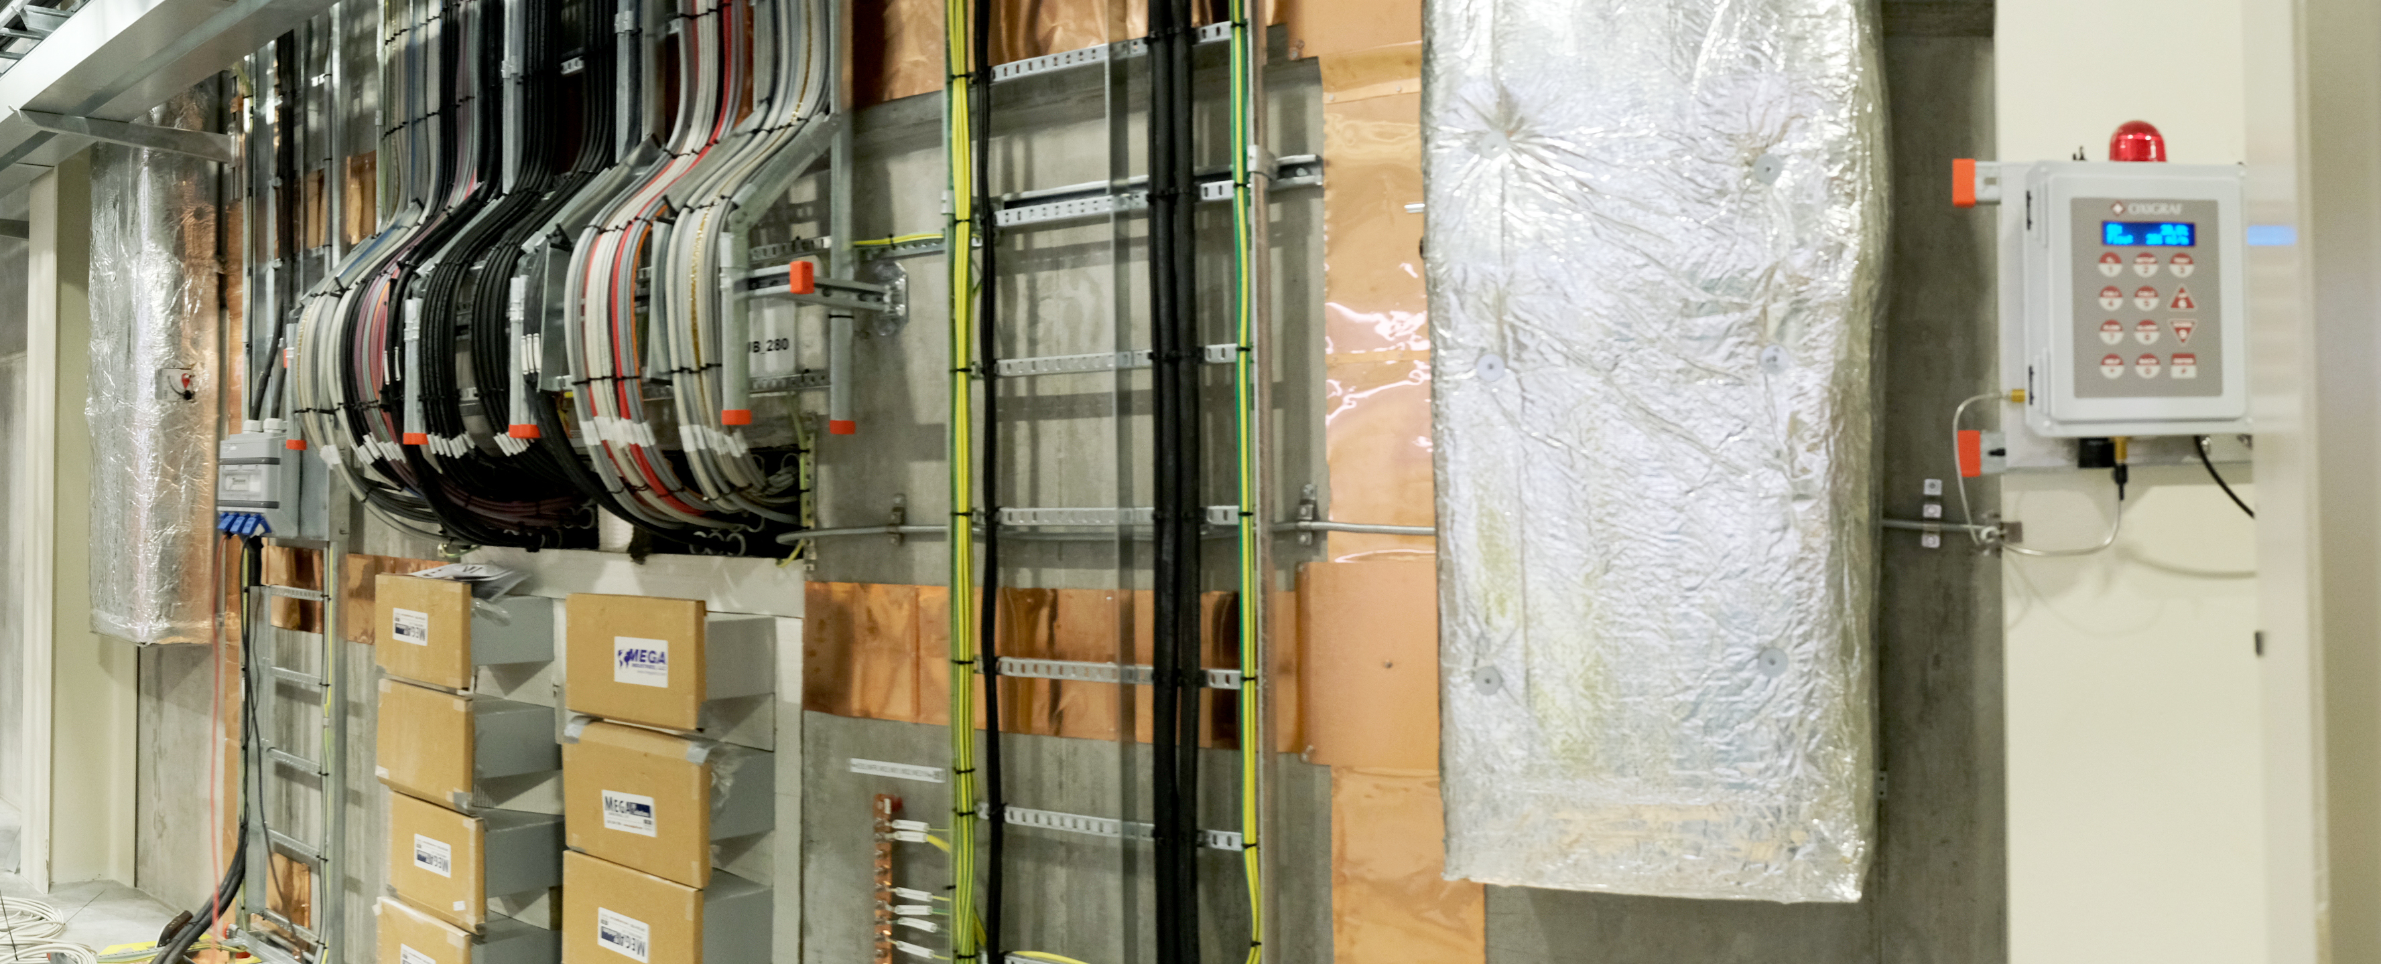
Accelerator ODHDS Installation
Current status

Slide 7
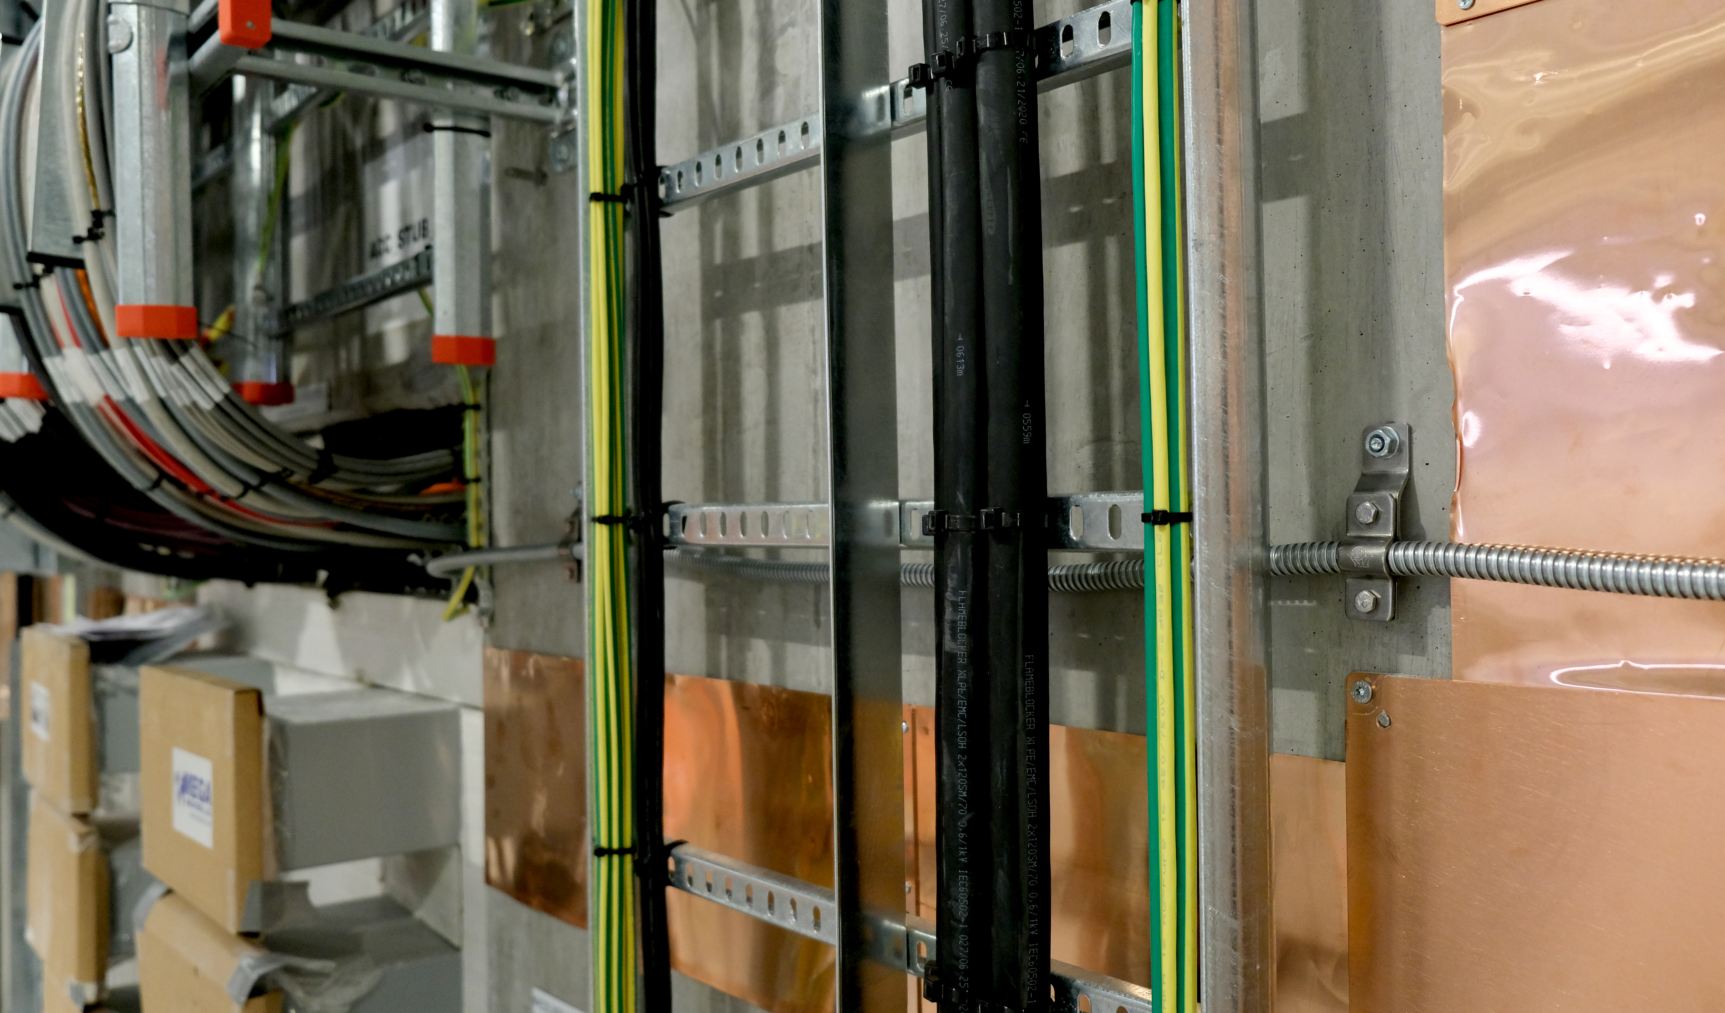
Accelerator ODHDS Installation
Current status

Slide 8
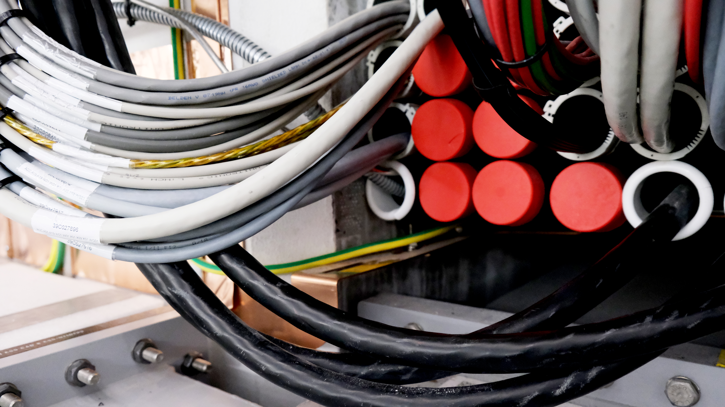
Accelerator ODHDS Installation
Current status

Slide 9
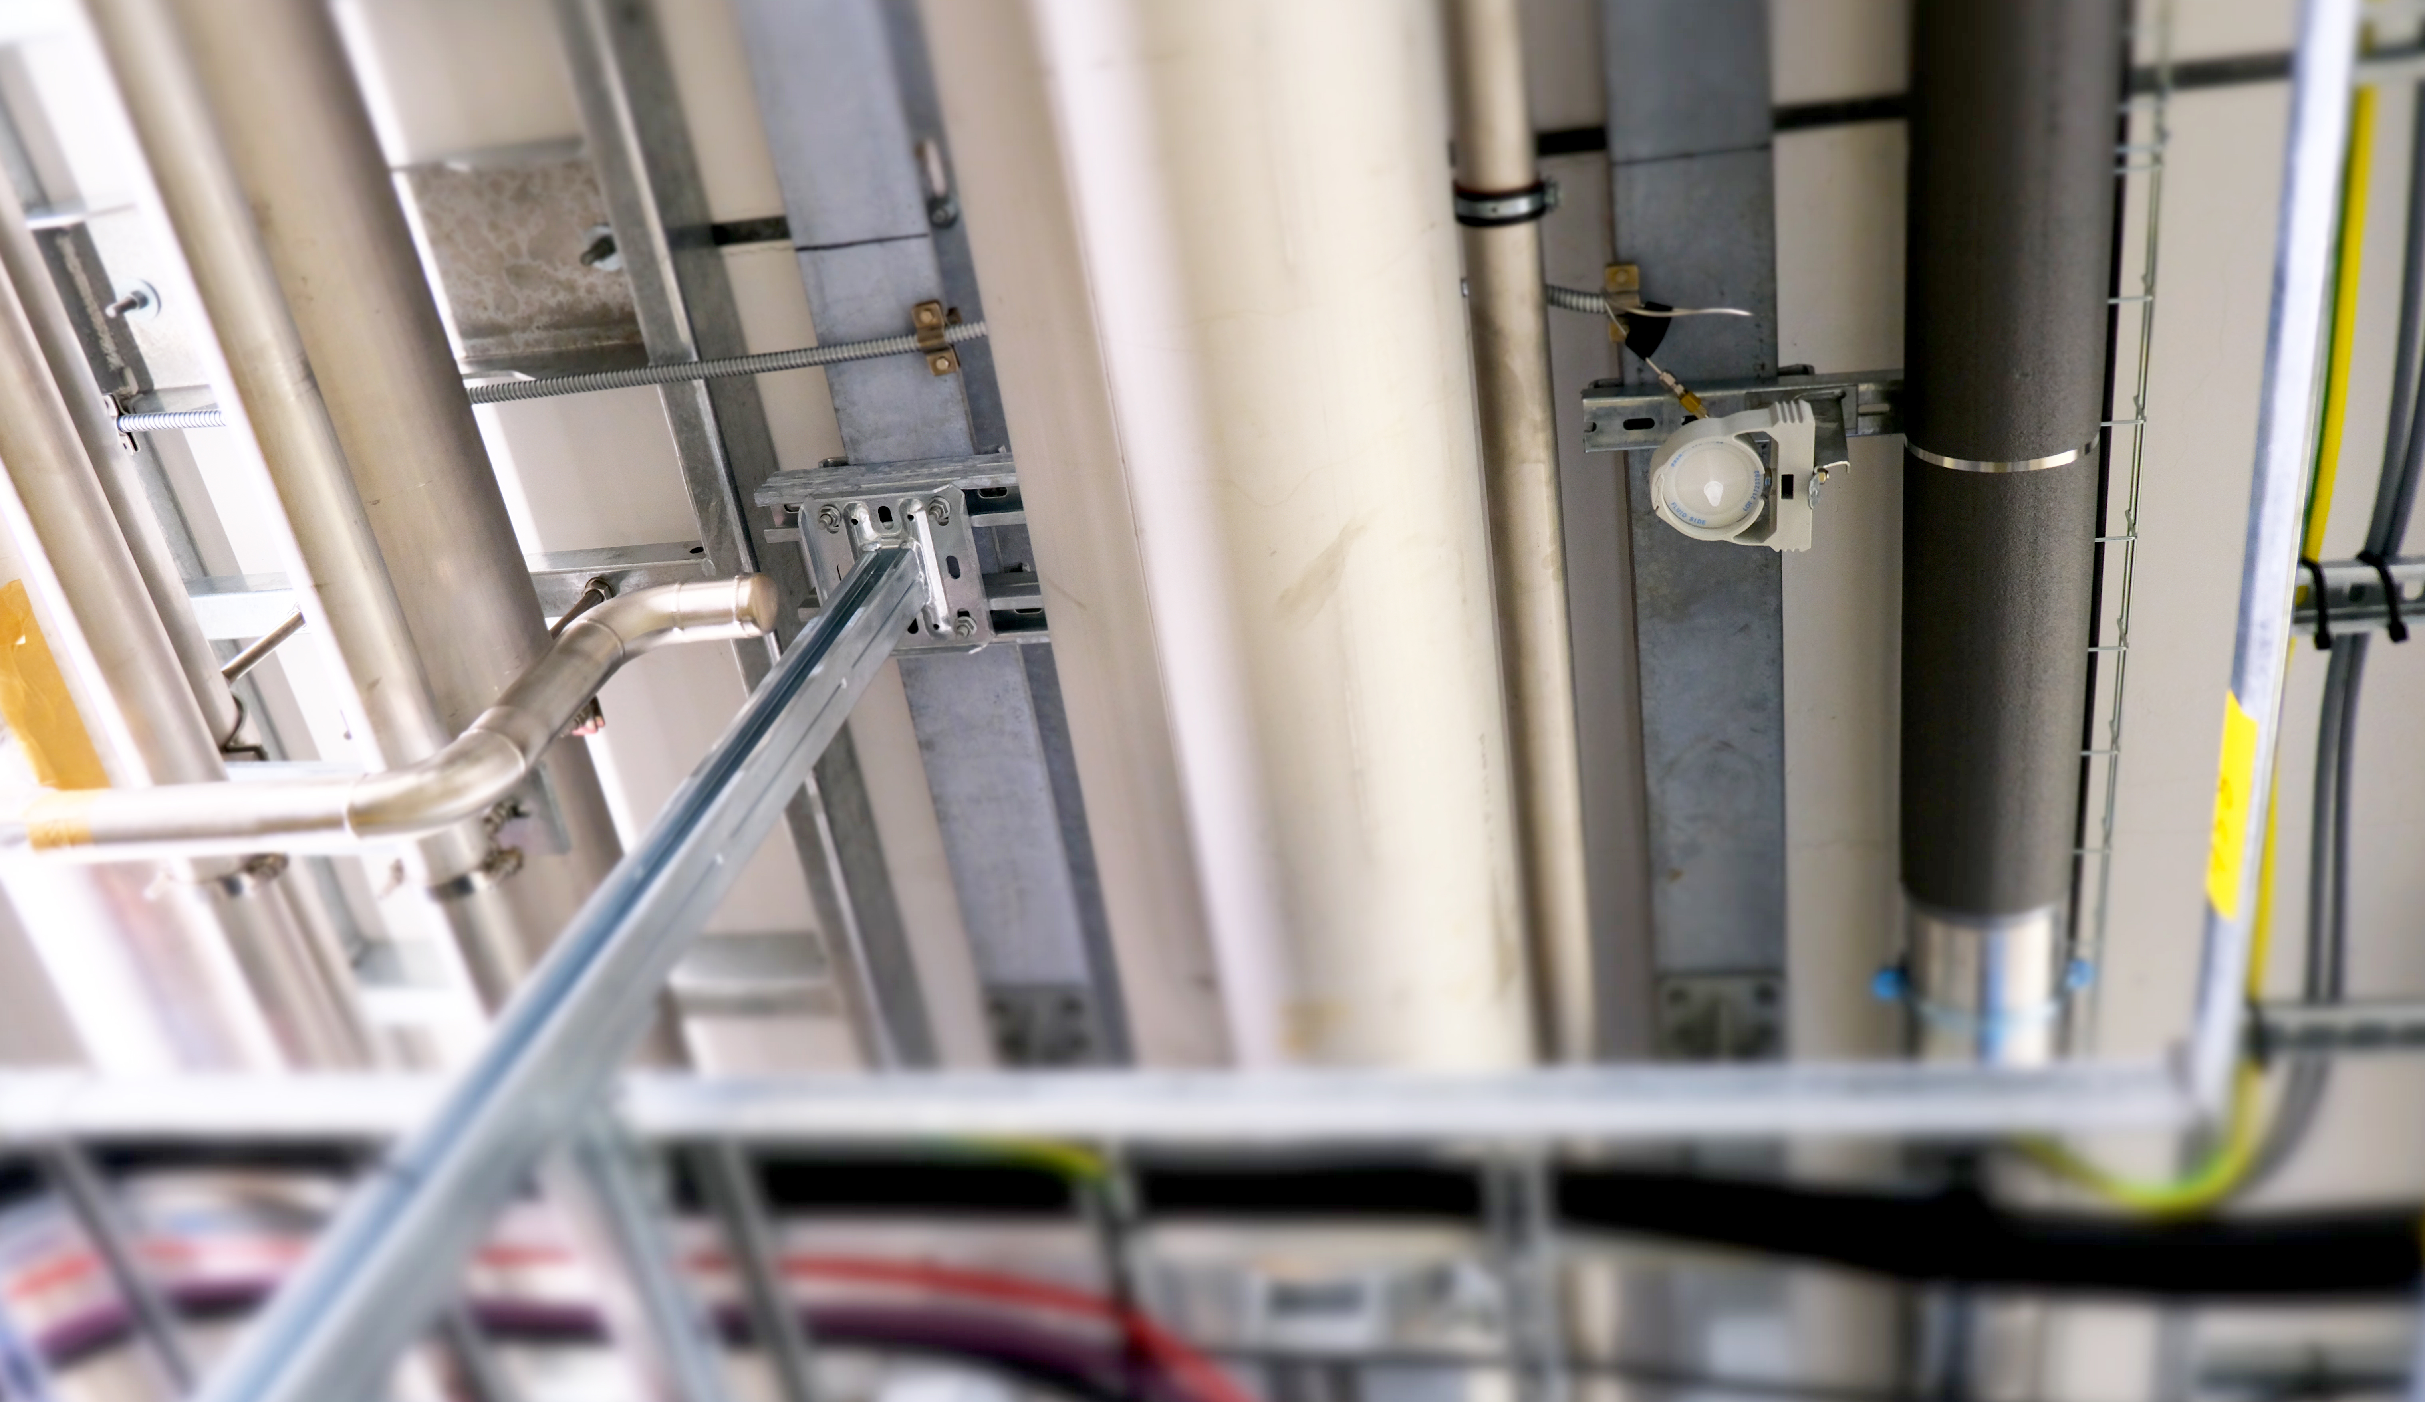
Accelerator ODHDS Installation
Current status

Slide 10
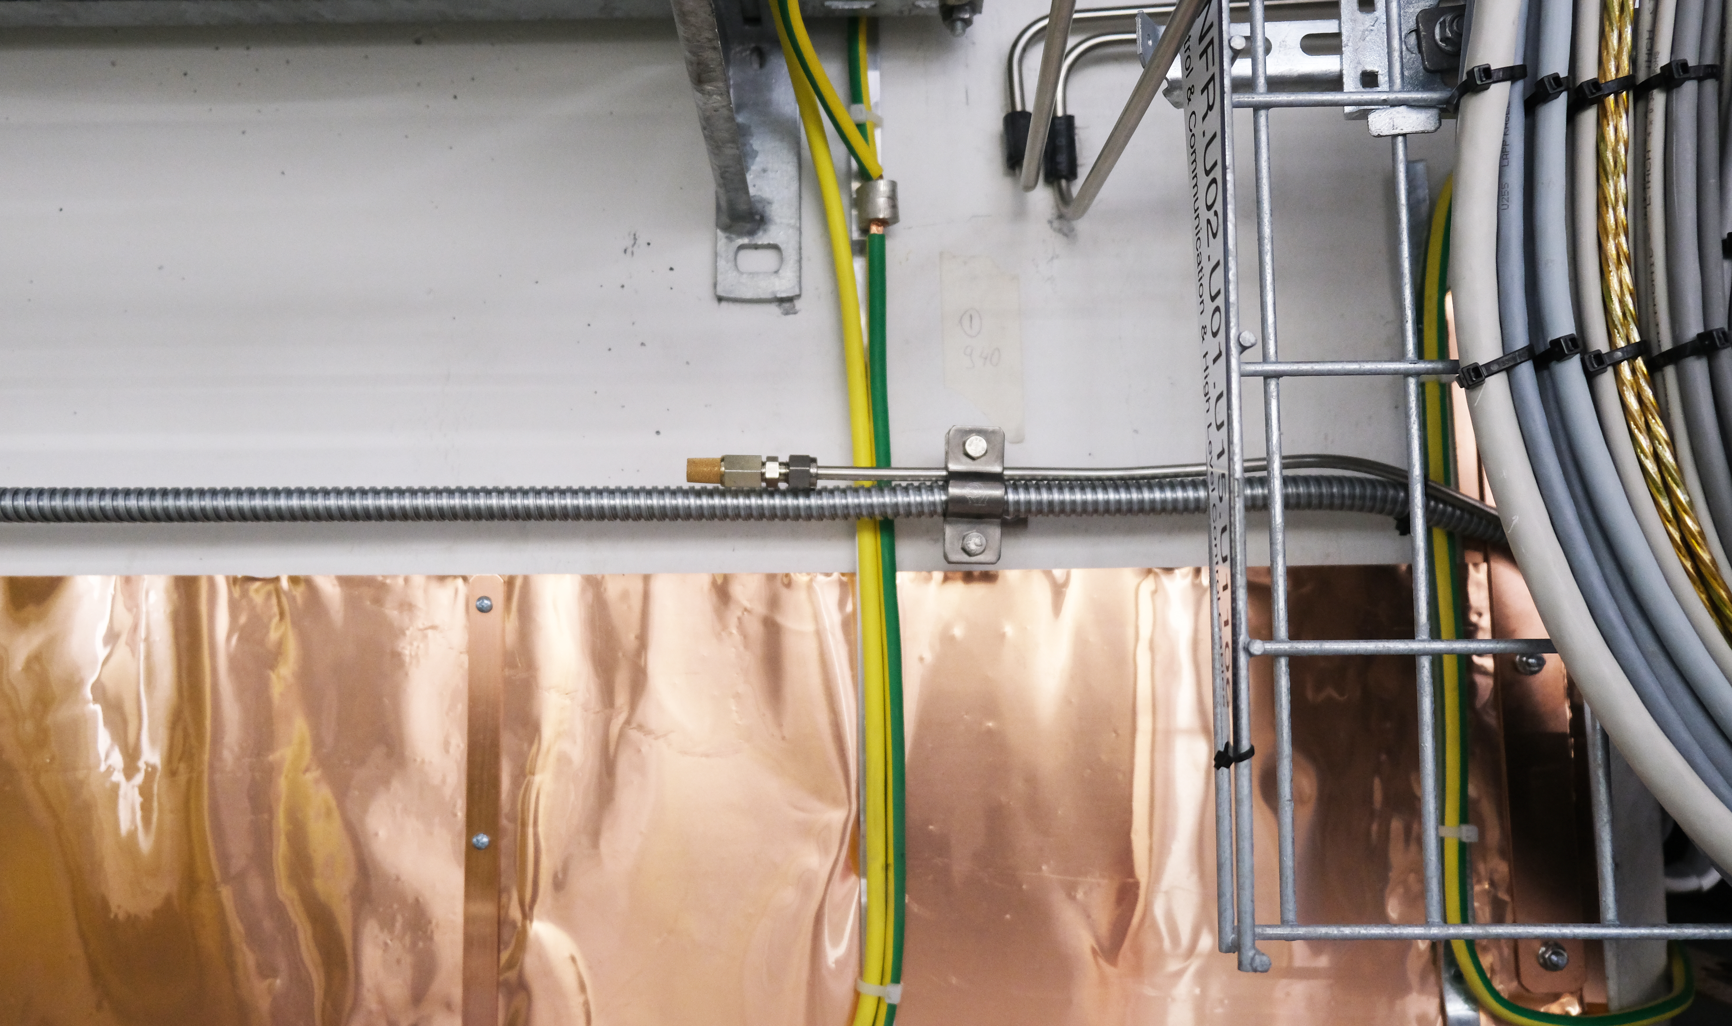
Accelerator ODHDS Installation
Current status

Slide 11
Accelerator ODHDS Installation
Current status

Slide 12
Accelerator ODHDS Installation
Remained activities and their pre-requisites
ODH monitors cabling
Procurement of required cables
Conduit installation
Alarm device Installation
Procurement of extra alarm plates and boxes
Switching off TODHDS
Alarm device cabling
Procurement of junction boxes
Conduit installation
Cabinets installation after FAT
Delivery of all the components inside the cabinet
Manufacturing of the cabinet.
Hardware FAT of the cabinet.
Connecting cables to the cabinets
Cabinets installation

Slide 13
2
Accelerator ODHDS Installation/
Commissioning Plan

Slide 14
Accelerator ODHDS Installation/ Commissioning Plan
ODHDS Development lifecycle

Slide 15
Accelerator ODHDS Installation/ Commissioning Plan
FEB 22
SEP 22
OCT 22
NOV 22
DEC 22
JAN 23
FEB 23
MAR 23
APR 23
MAY 23
26th
MAY 23
ODH monitors/Sampling pipes installation
FEB22 – SEP22
This activity was started in parallel with PDR and finished before this CDR.
ODH monitors/
Alarm device cabling
SEP22 – DEC22
This activity can be finished after delivery of all required cables, boxes, and conduits
Cabinet manufacturing
NOV22-FEB23
This activity can be finished after the delivery
of all the cabinet’s components.
Hardware FAT
This activity can be started after cabinet manufacturing. The planned end date for it is on 15th MAR.
Alarm device installation
Starting this activity needs delivery of extra alarm plates, boxes and switching off TODHDS.
MAR23
Cable termination
This activity can be started after Hardware FAT. The planned end date for it is on 31th MAR 23.
Hardware SAT
This activity can be started after cabinet installation and cable termination. The planned end date for it is on 20th APR 23.
Soft. Dev./Peer review/Pre-FAT
SEP22-20th APR23
The planned end date
for it is 20th APR 23.
SIT
This activity can be started after soft. Pre-FAT and Hardware SAT. The planned end date for it is on 8th MAY 23.
Punch removal &
Put into operation
The planned end date for it is on 26th MAY 23.

Slide 16
THANK YOU

