Slide 2
Accelerator ODHDS Activation Matrix, Software Requirements and Software Design
Accelerator ODHDS CDR
Denis Paulic and DMITRII Plotnikov

Slide 3
Agenda
Software Documentation
2 Information Security Risk Assessment
3 Activation Matrix
4 Zone States
5 Software Structure
6 ODHDS Library Functions
7 Operator Screens
8 CryoB ODHDS Updates
9 Test Environment for ODHDS

Slide 4

Software Documentation – ODHDS
Requirements
Design Details
ESS ODHDS
HLR
HfEM
TD
Activation Matrix for system’s zones
System Requirements Specification
Software Design Description
Software
Summary
System Specific
Supporting Docs
ICD
ISRA
EMD
IO
SDP
HMI/OPI
VDog
EMD = Electrical and Mechanical Design
ICD = Interface Control Document
IO = Inputs / Outputs List
ISRA = Information Security Risk Assessment
HfEM = ESS Handbook for Engineering Management
HLR = High Level Requirements
HMI/OPI = Guide for HMI and OPI Development
SDP = Software Development Plan
TD = Technical Description
Vdog = Guide for Versiondog and Networks

Slide 5
Software Development and Deployment Flow
Procedures for preparing the system for code deployment
FIT = Final Integration Test
FAT = Factory Acceptance Test
SIT = Site Integration Test

Slide 6

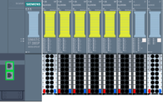
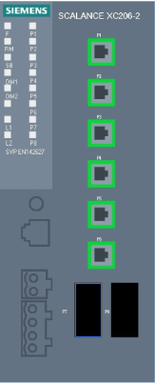

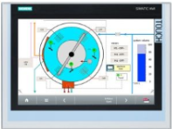


Production Network – Accelerator ODHDS
Transfer Workstation
VM
ODHDS-XFER
For each RIO cabinet (3x)
Remote IO Station
Network
Switch
UPS Module
Main PLC
Remote IO Station
ODHDS HMI
Network
Switch
UPS Module
ODHDS
Midzone
PROFINET TCP/IP
To show the data on the OPIs,
To provide operators with alarm notification through alarm annunciator service,
To provide users with reset and temporary mute functions
To archive data on EPICS archiver.
Gateway PLC
ODHDS Supervision Station (MCR)
ODHDS Supervision Stations (SMR)
Deployment workstation for Gateway PLC
VM
Technical Network
EPICS = Experimental Physics and Industrial Control System
HMI = Human Machine Interface
IO = Input / Output
MCR = Main Control Room
PLC = Programmable Logic Controller
SMR = Security Monitoring Room
UPS = Uninterruptible Power Supply

Slide 7
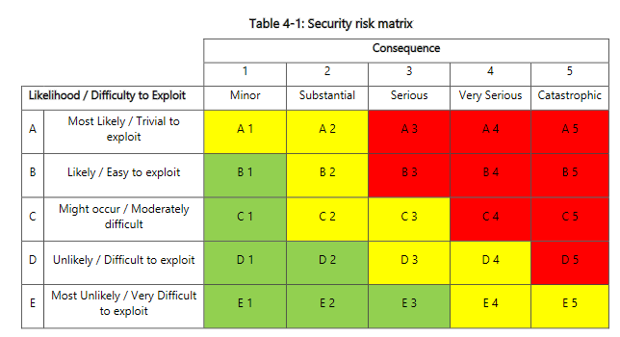
Information Security Risk Assessment (ISRA) for ODHDS
30 August 2022 – full day workshop
ISRA Worksheets and Report are treated as confidential
ODHDS Production Zone, ODHDS/PSS Development Zone and interfaces with Control Network Zone were analysed
Preliminary findings: 8 recommendations

Slide 8
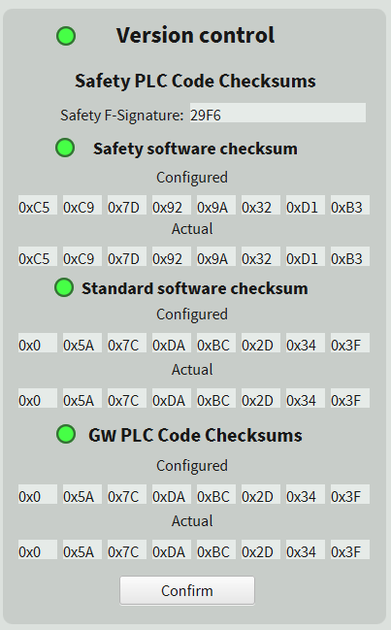
ISRA Recommendations / Countermeasures
Verification of ODH alarm thresholds
  Diagnostic function to compare the analogue O2 reading (percentage) and status of Limit A and Limit B relays.
Checksum control
  Diagnostic function to monitor the production code checksums and
Heartbeat between the PLCs and OPIs
  Diagnostic function to monitor the status of communication with the OPI and trigger the annunciator alarm in case it is detected frozen/non-responsive.
Checksum control
This will be implemented on the EPICS IOC side (separate PV for each) and alarms will be linked to these PVs.
Global checksum status
Safety software checksum status
Standard software checksum status
Gateway standard software checksum status
Copy actual values to configured (restricted)

Slide 9
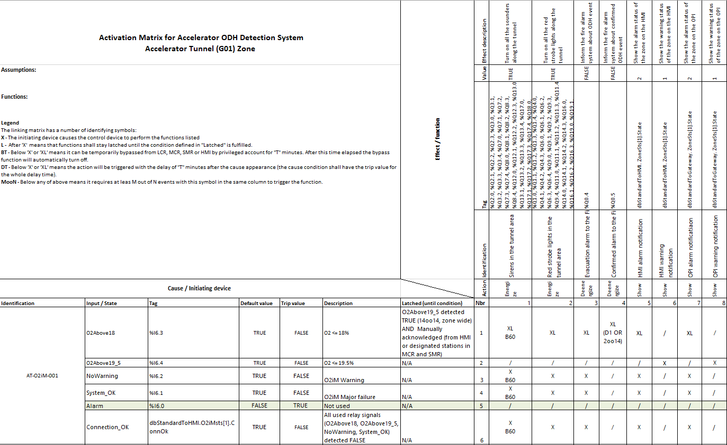
Activation Matrix for Accelerator ODHDS – Intro
Assumptions:
All monitors are warmed up.
The designated monitor in a row is not in maintenance mode.
Connection_OK := O2Above18 OR O2Above19_5 OR System_OK OR NoWarning
Each ODH monitor will trigger its local light and sounder to notify the low O2 level has been detected.
Legend
The linking matrix has a number of identifying symbols:
X - The initiating device causes the control device to perform the functions listed
L - After 'X' means that functions shall stay latched until the condition defined in "Latched" is fulfilled.
BT - Below 'X' or 'XL' means it can be temporarily bypassed for "T" minutes. After this time elapsed the bypass function will automatically turn off.
DT - Below 'X' or 'XL' means the action will be triggered with the delay of "T" minutes after the cause appearance (the cause condition shall have the trip value for the whole delay time).
MooN - Below any of above means it requires at leas M out of N events with this symbol in the same column to trigger the function.

Slide 10
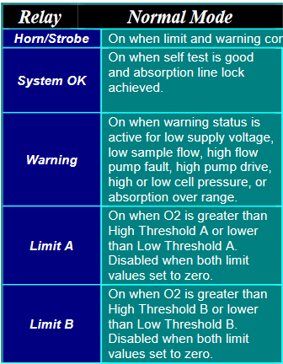
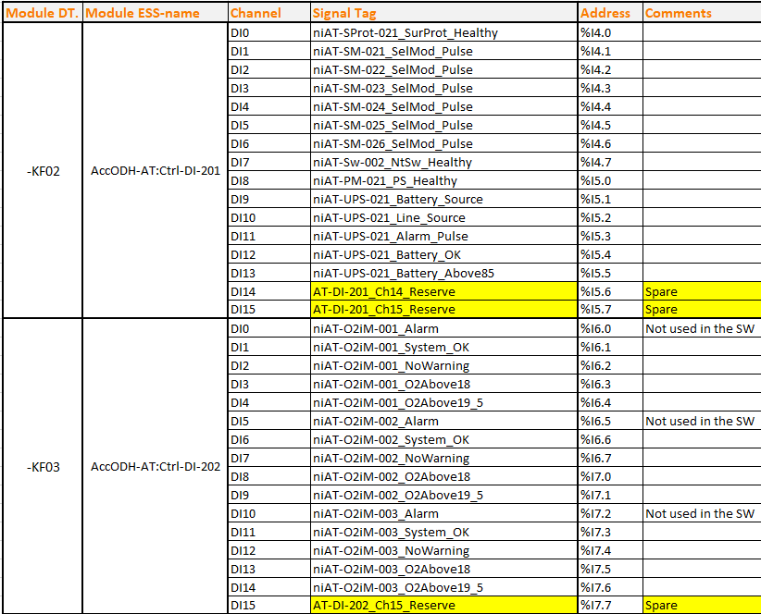
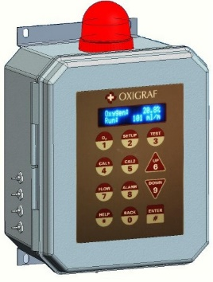
Activation Matrix for Accelerator ODHDS – Cause
Latching requirements for the affected functions once the signal is tripped.
Description of signal when tripped.

Slide 11
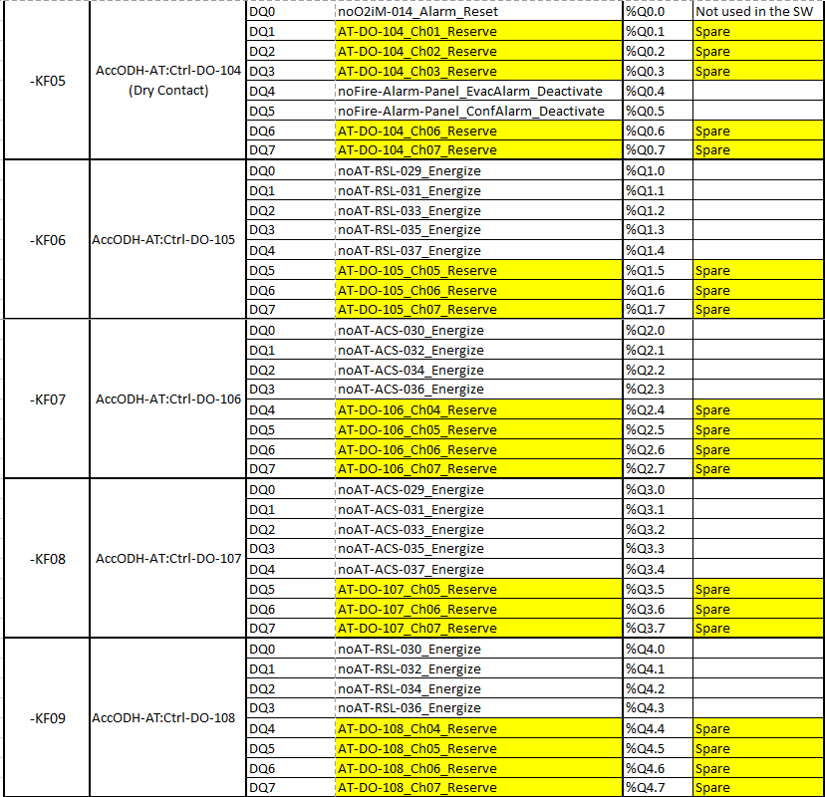
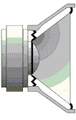



Activation Matrix for Accelerator ODHDS – Effect
B60 → The sounders can be muted for 60 minutes (once they have been streaming for at least 5 minutes).
ODH confirmed alarm signal
If the O2 level is detected less or equal to 18% from at least two monitors placed in that area at the same time or one monitor detects the O2 level being less or equal to 18% for more than 1 minutes.
ODH evacuation alarm
If the alarm devices are triggered, it is sent to the fire alarm system for evacuation purposes in each evacuation zone

Slide 12
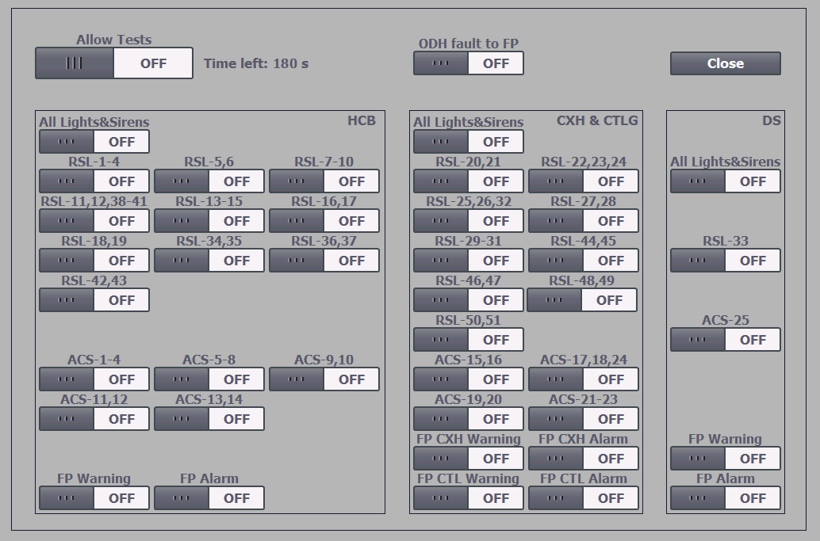
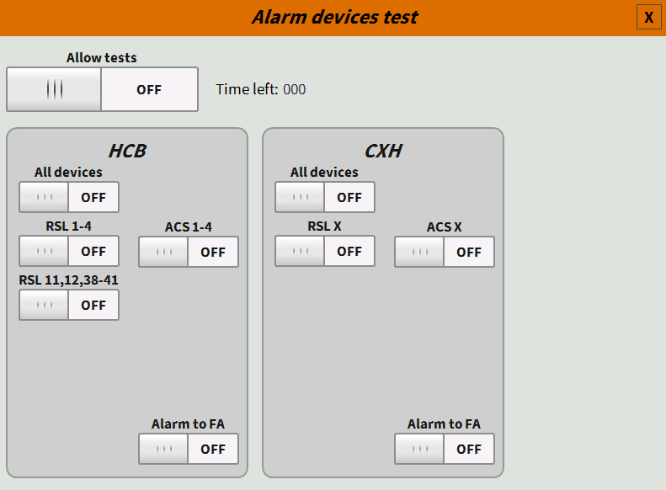
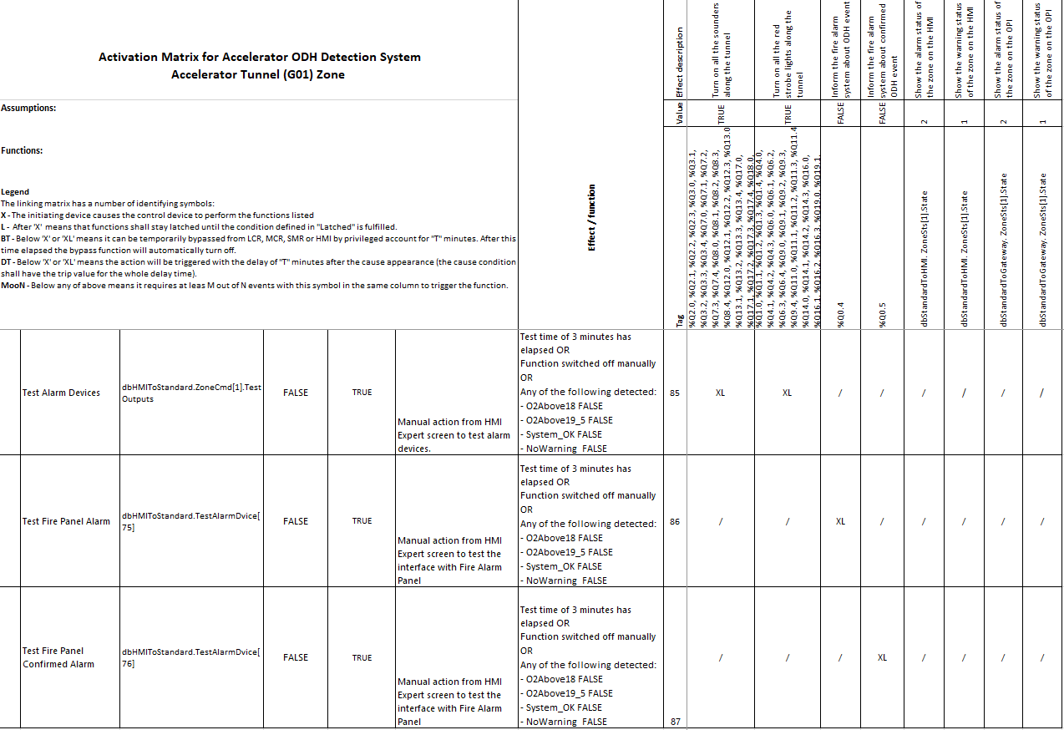
Activation Matrix for Accelerator ODHDS – Test Functions

Slide 13
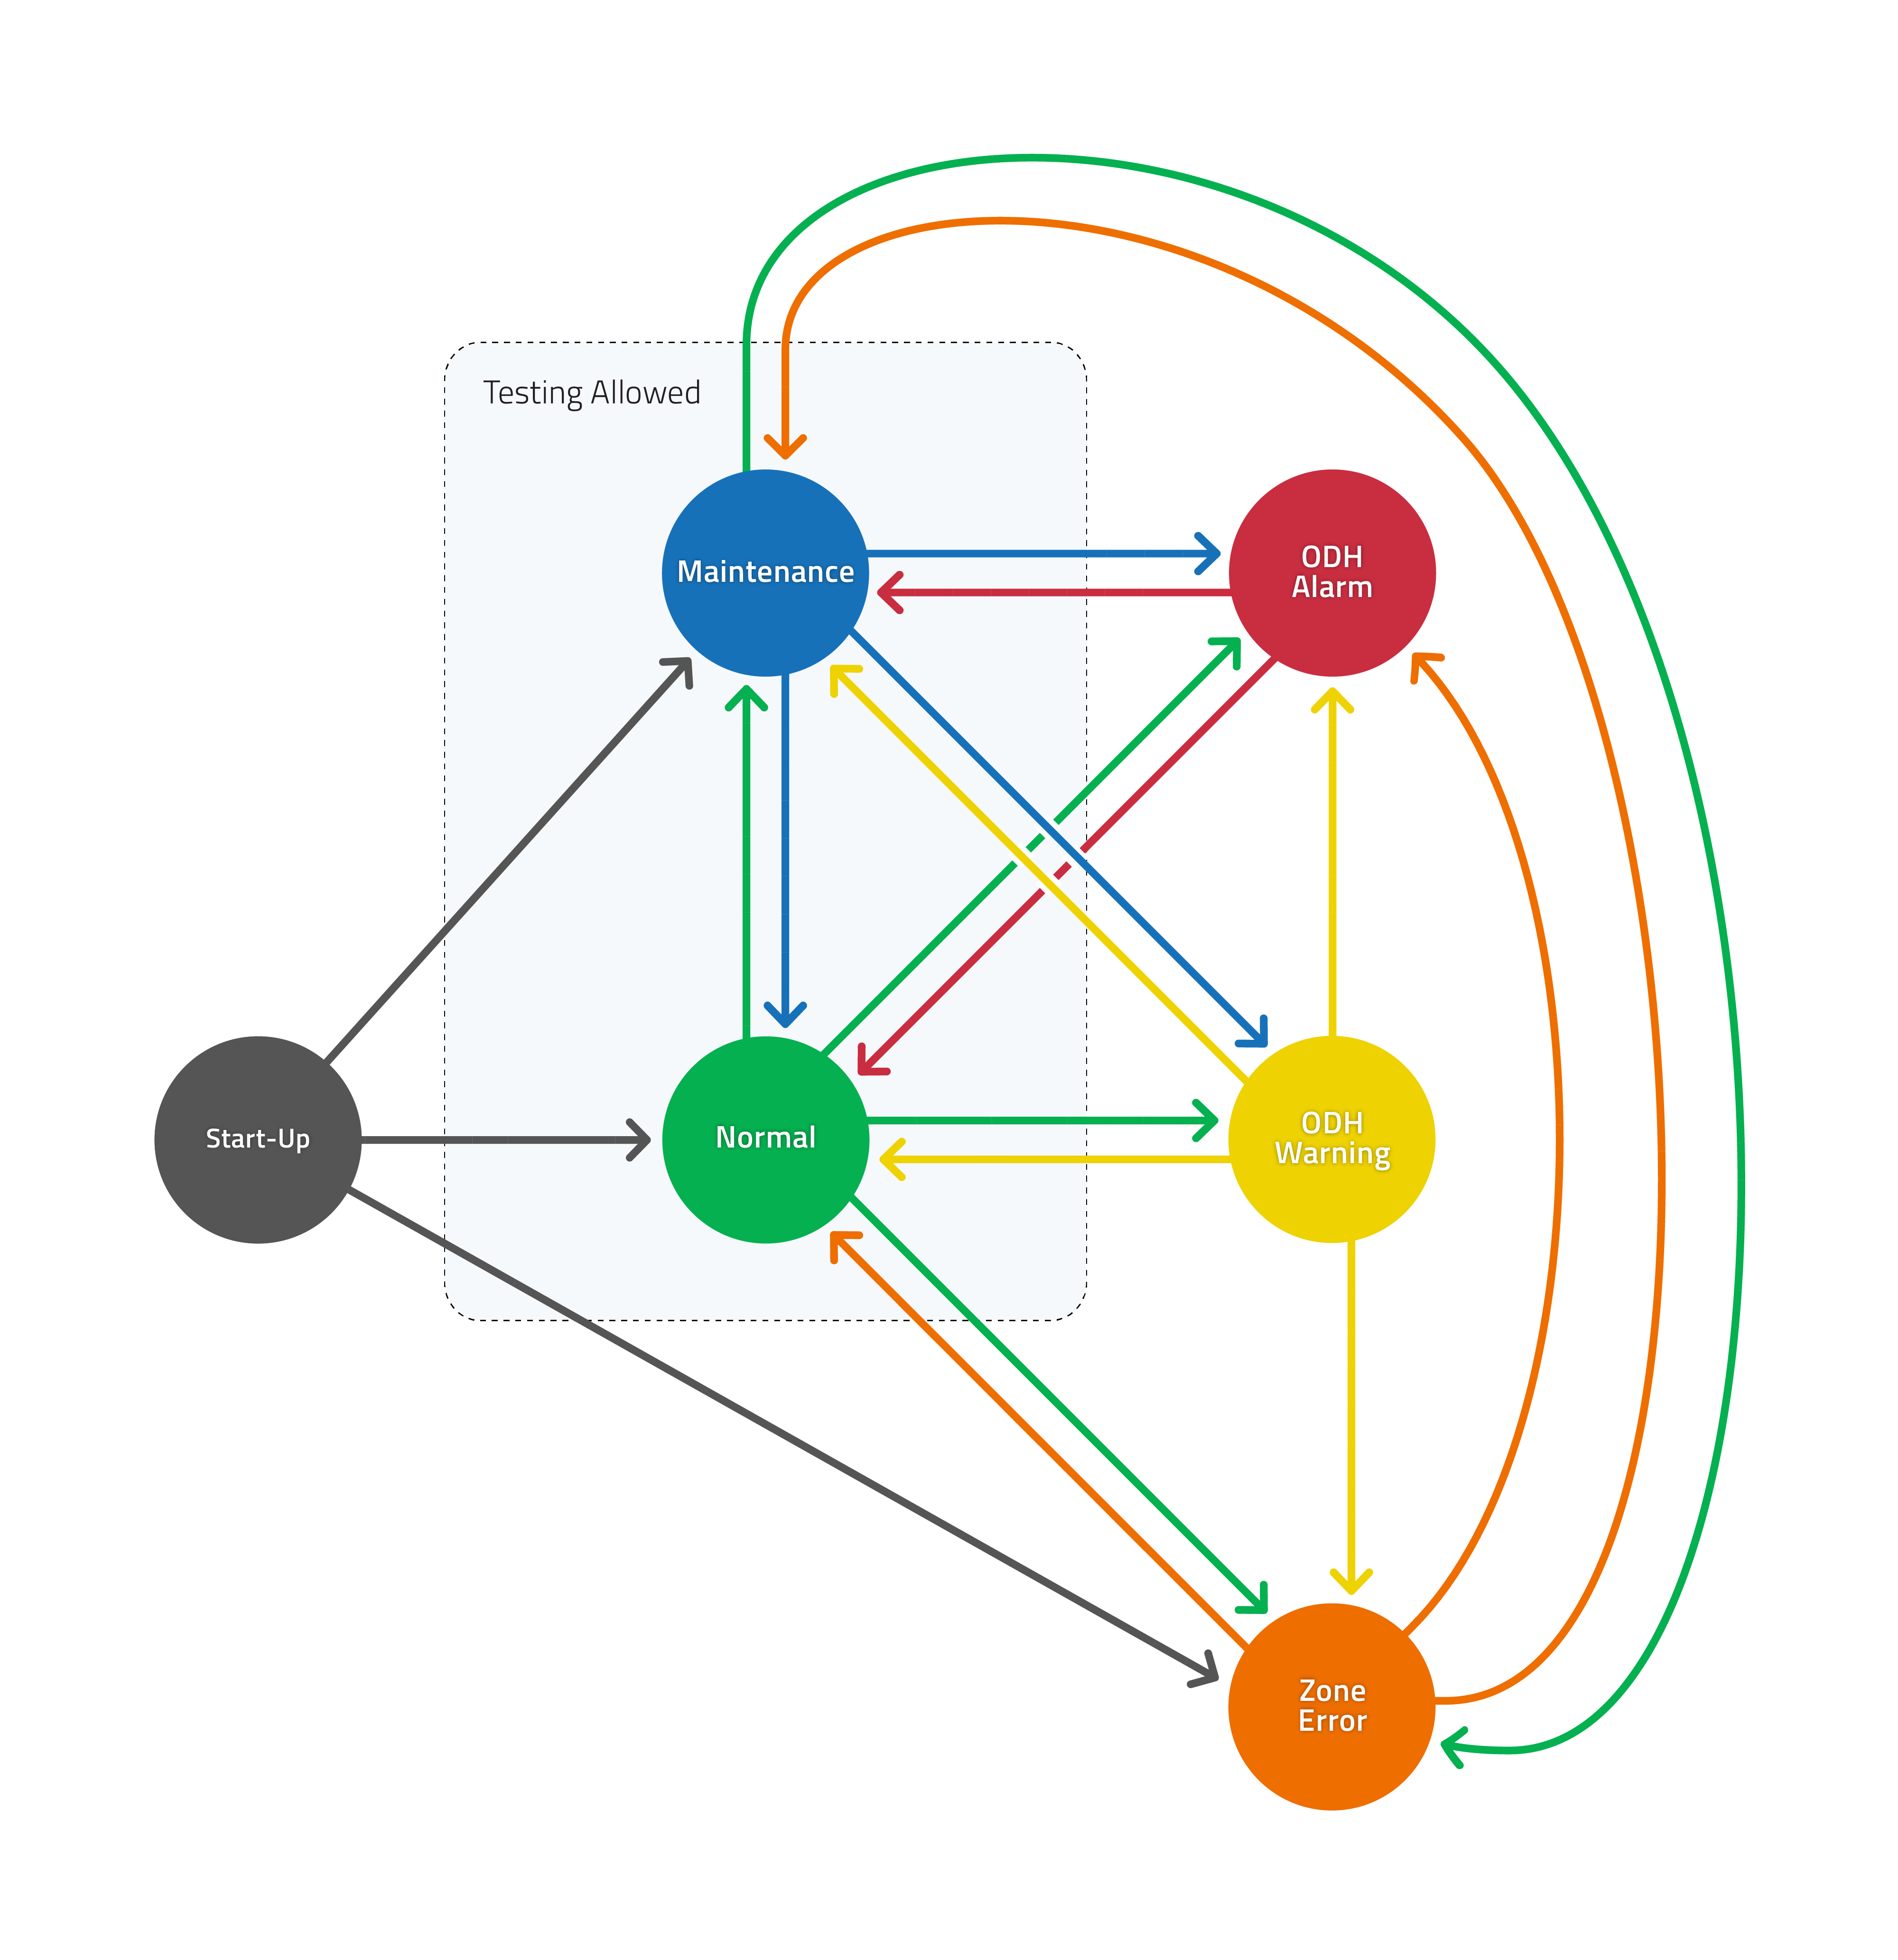
Accelerator Tunnel Zone States

Slide 14
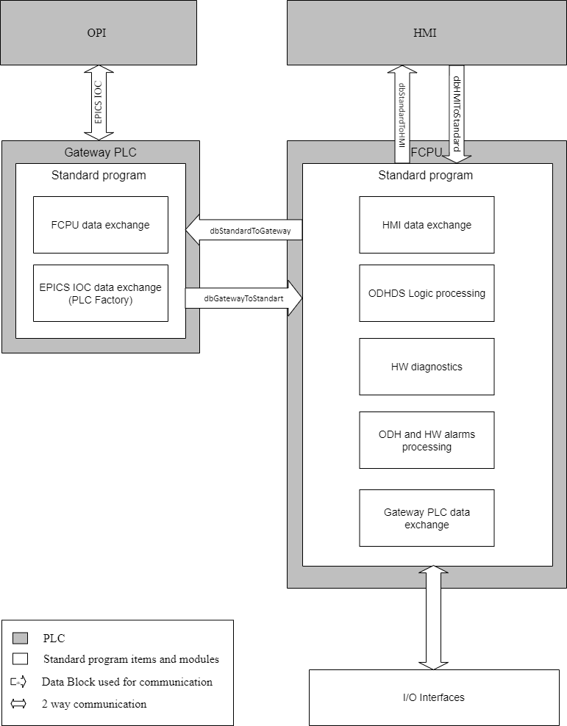
ODHDS
Software Structure

Slide 15
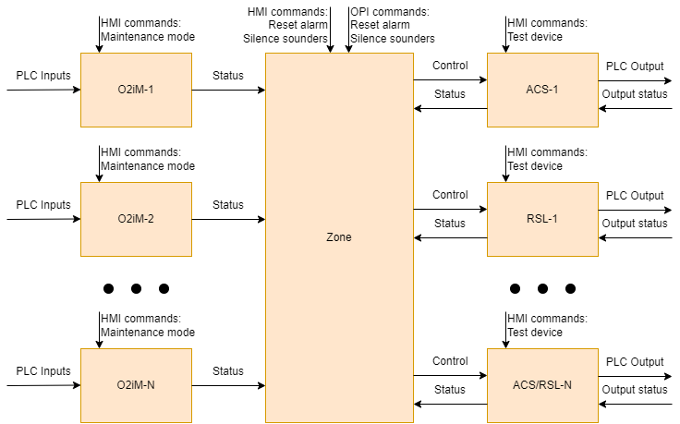
ODHDS
Logic
Structure

Slide 16
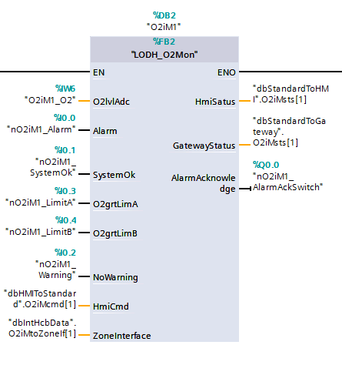
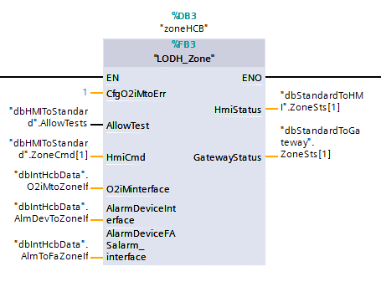
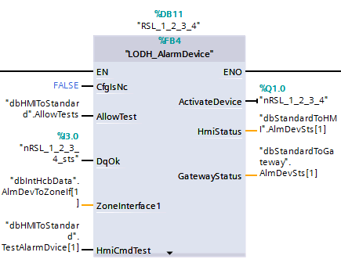
ODHDS Library - Function Blocks
ODH monitor
ODHDS Zone
ODH Alarm Devices

Slide 17
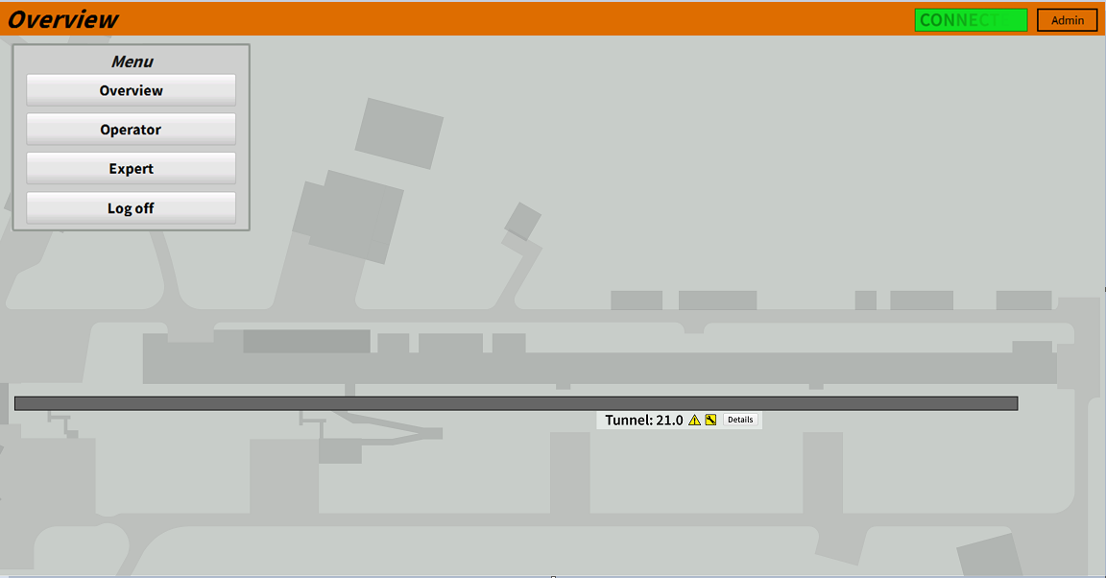
Accelerator ODHDS HMI
Status of Accelerator tunnel ODH zone.
Status of each ODH monitor and alarm device.
ODH warning notifications in case of decreased O2 levels (≤19.5%) detected by any of the ODH monitors.
ODH alarm in case of detecting the low O2 level (≤18%) by any ODH monitor.
Real-time O2 percentage value from ODH monitors.
Diagnostics (PLC alarms and errors, etc.).
Important timers for manually triggered procedures.
At least two user groups:
  Operator – can perform alarm resetting and view alarm history.
  Admin – full access, can perform maintenance actions.

Slide 18
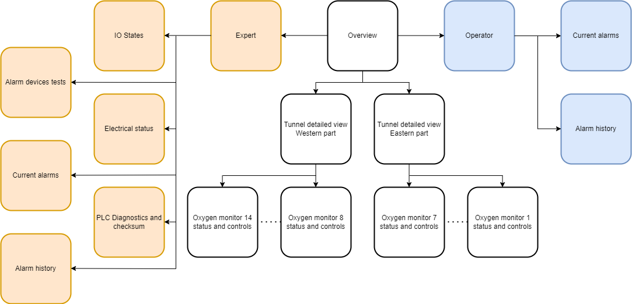
Accelerator ODHDS HMI – Screens

Slide 19
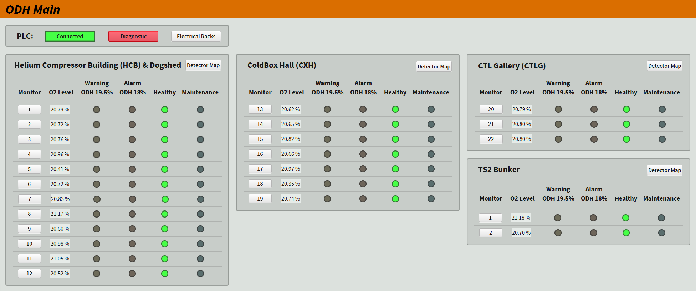
ODHDS Main OPI Screen
Today

Slide 20
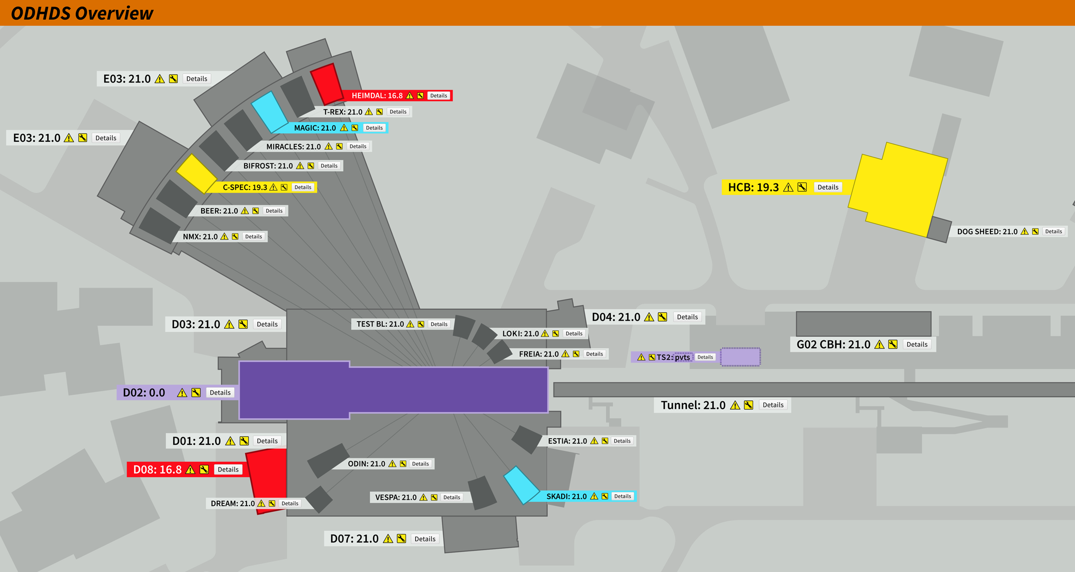
Overview OPI for ESS ODHDS
Zone colors:
Grey – OK
Yellow – Zone is in the ODH warning state (at least 1 monitor measures O2 level < 19,5%)
Red – Zone is in the ODH alarm or zone error state (monitor fault or O2 level < 18%)
Blue – Zone is in the maintenance state (at least 1 monitor is in the maintenance mode)
Violet – Zone data is not available (ODHDS is off)
Doted borders – lost communication between GCPU and IOC
- Attention mark. Non-critical issue in the zone
- Zone ODHDS has a hardware failure
- The lowest O2 level measured in the zone

Slide 21
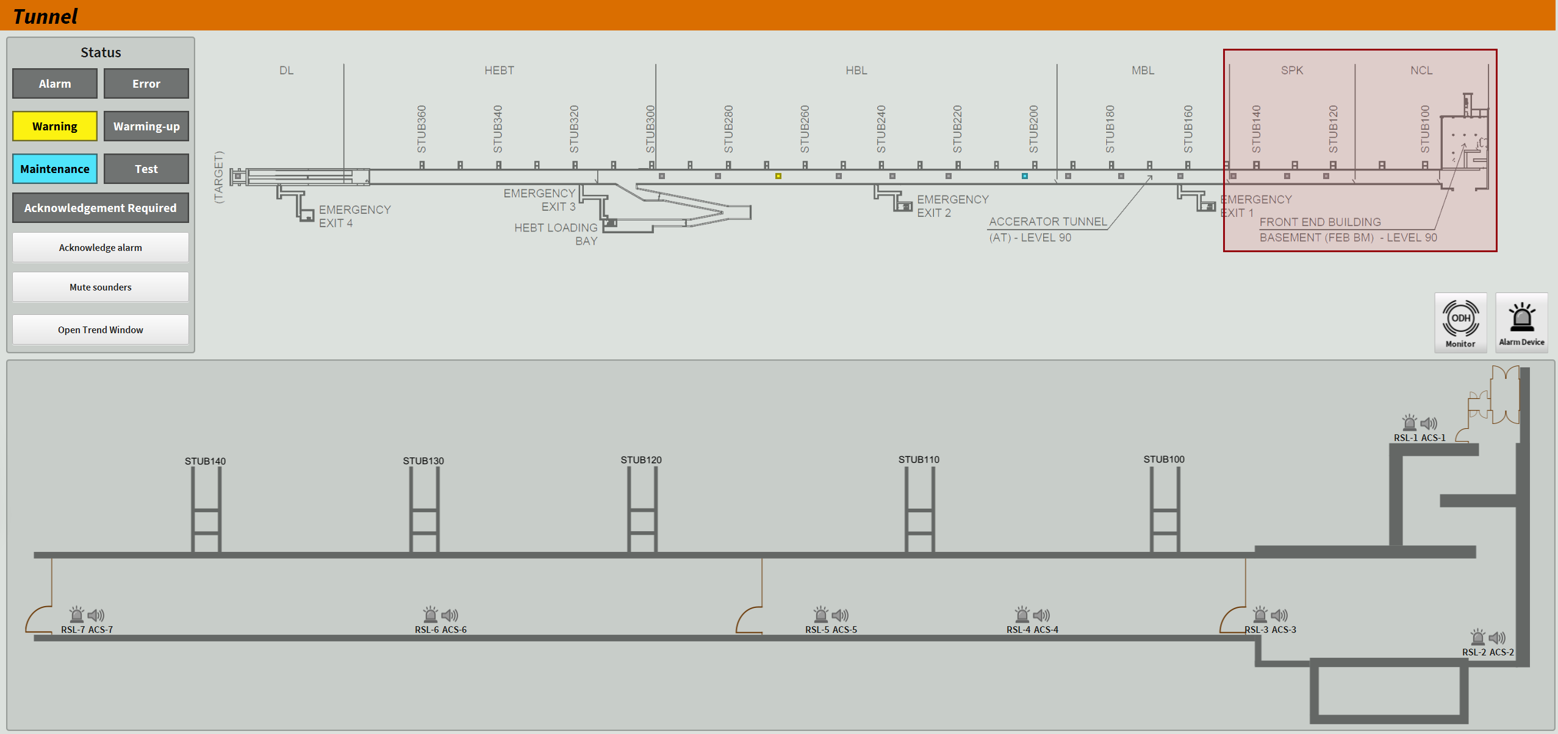
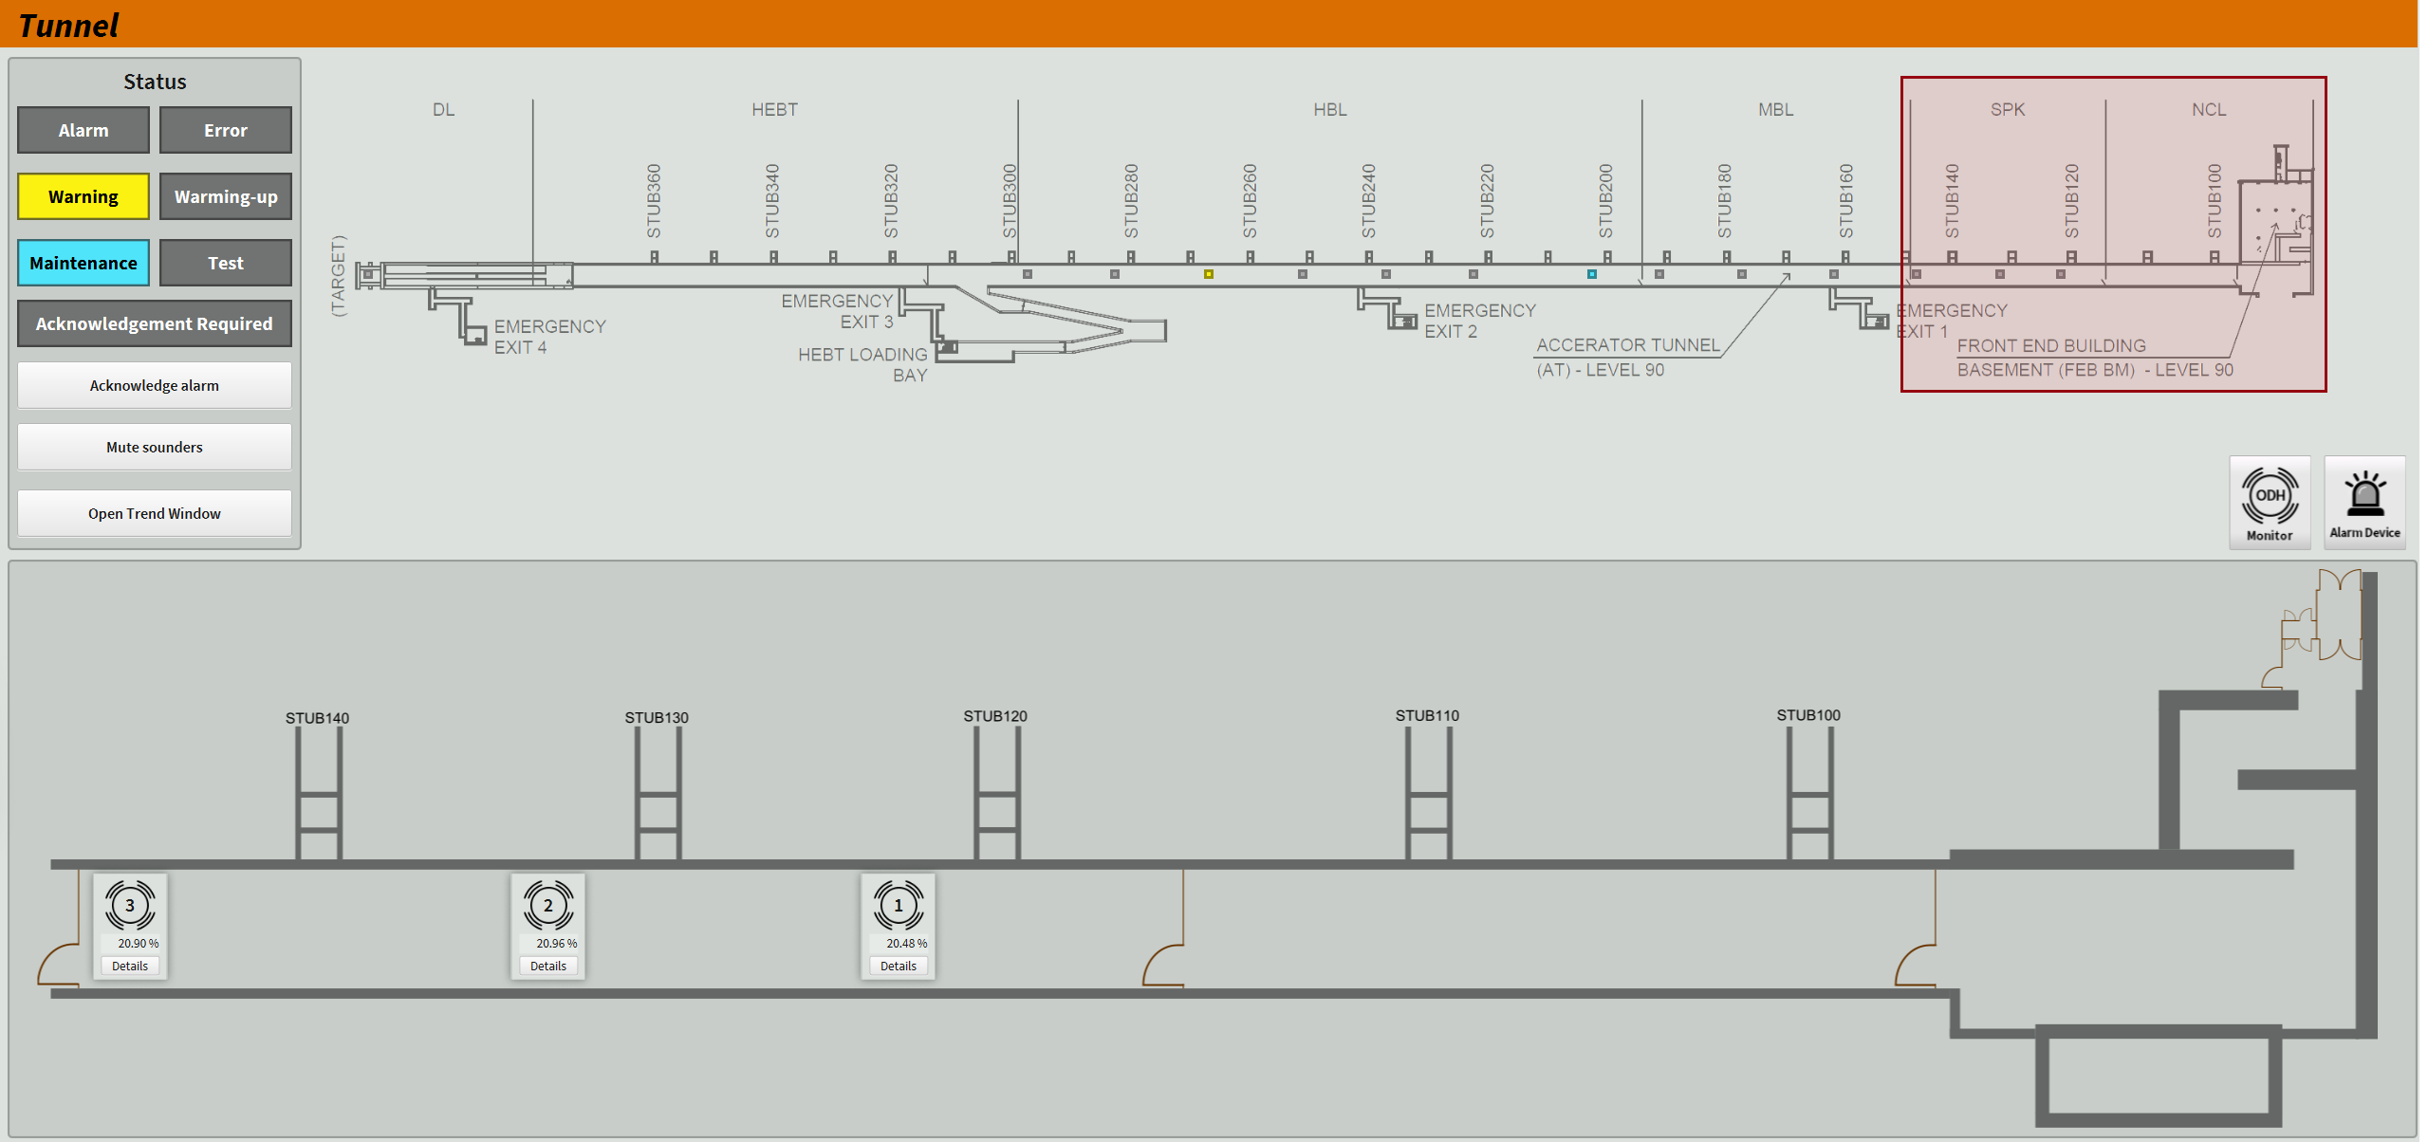
Accelerator ODHDS OPI

Slide 22
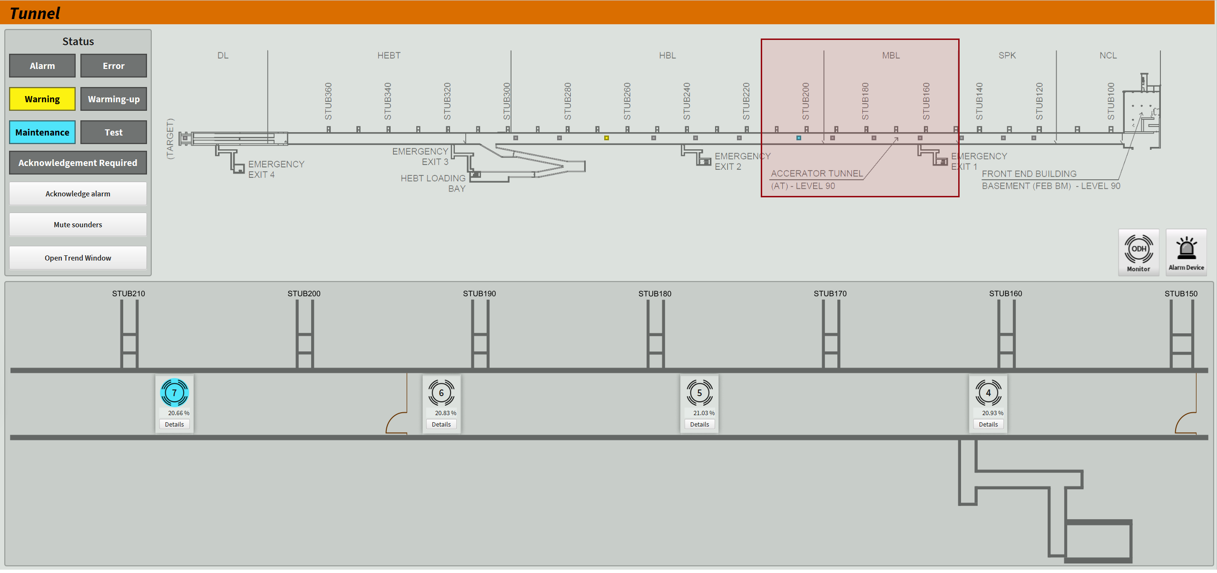
Operator Interfaces – ACC ODHDS OPI

Slide 23
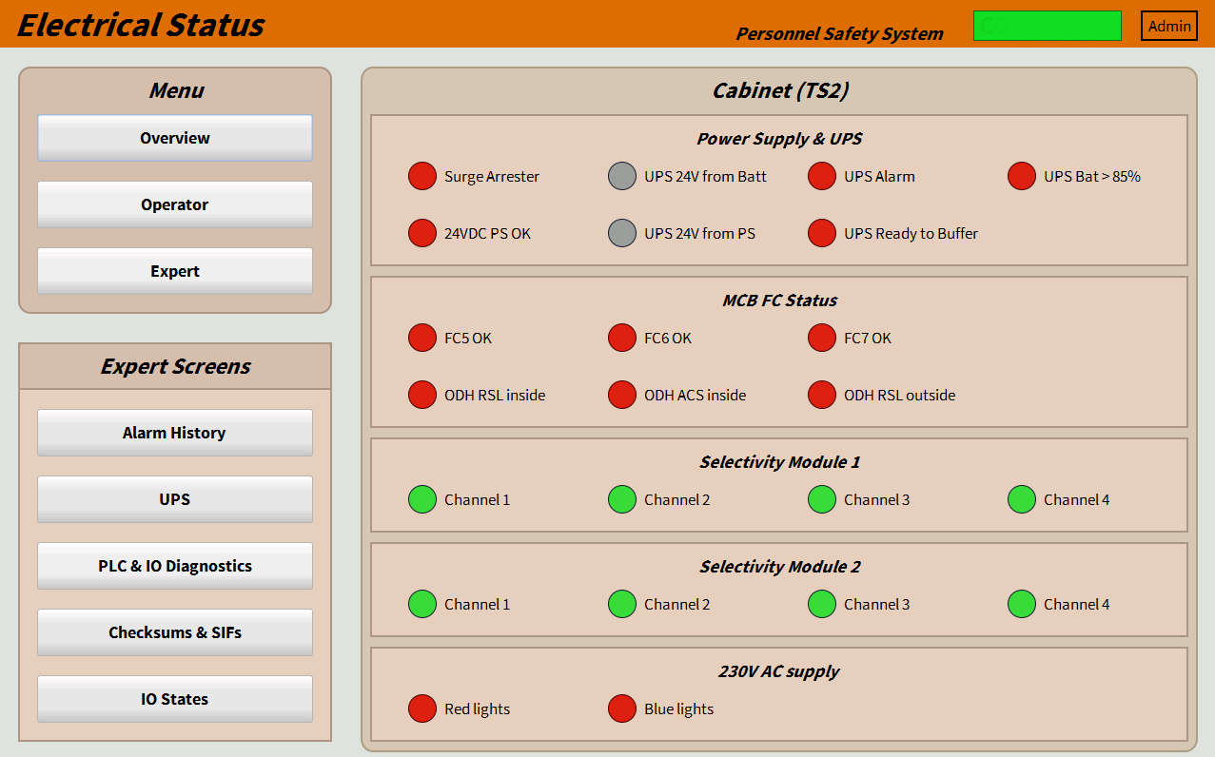
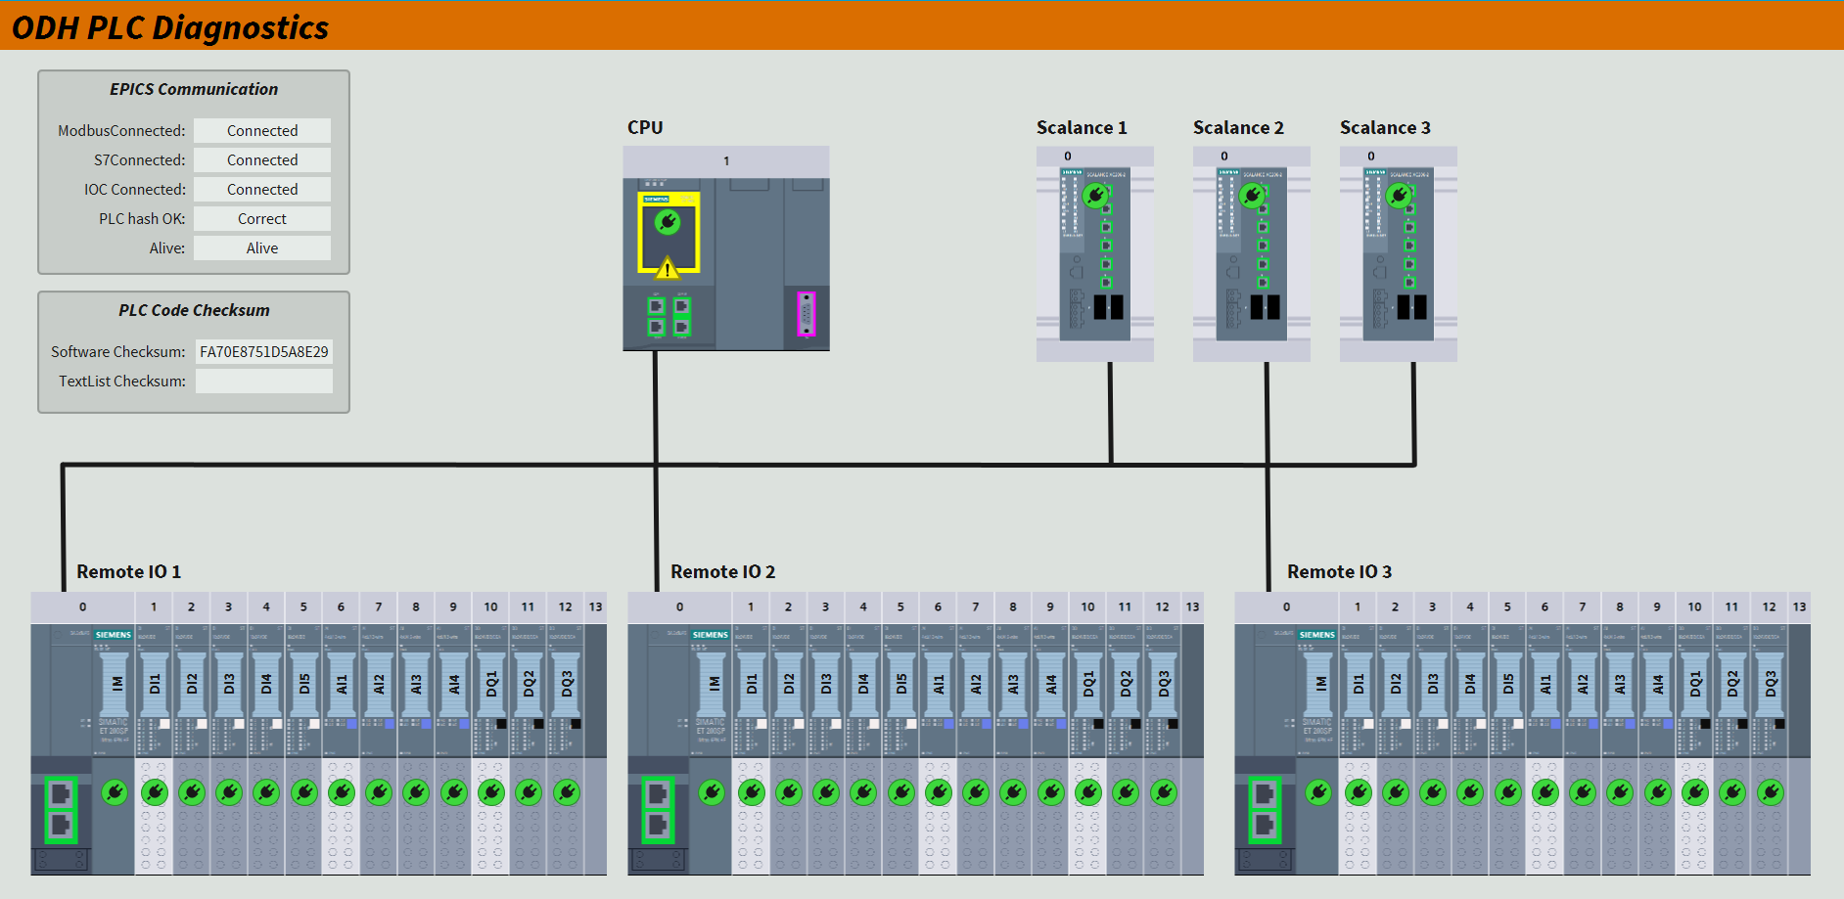
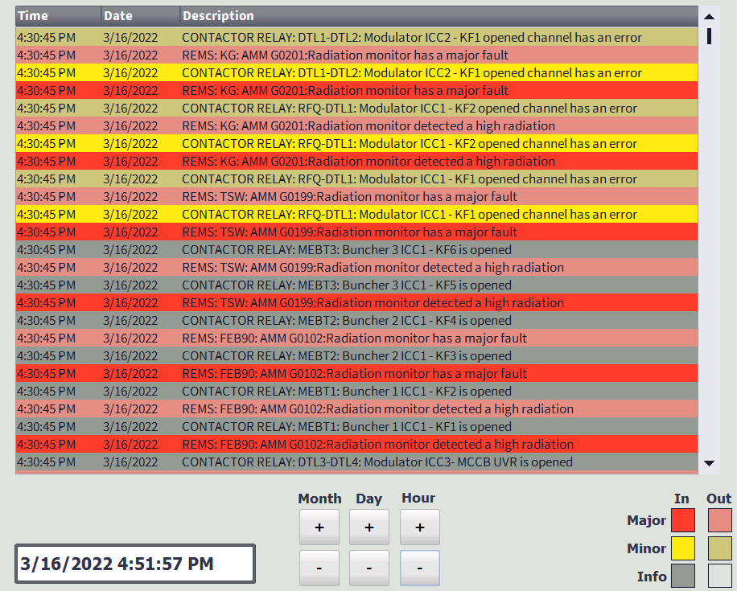
Diagnostics
Example from TS2 PSS
Component errors and failures will be detected by the PLC and shown on the operator interfaces.
This includes, but is not limited to:
    Missing or defective modules,
    Open circuits for alarm units,
    Short circuits for alarm units,
    Power supply errors,
    Communication lost
      between the PLC and remote IOs,
      Between the main and gateway PLC,
      Between the gateway PLC and OPI.
Example from PSS1

Slide 24
Cryo-buildings ODHDS
Software Updates
Logic updates:
  Modified ODH monitor fault tolerance for the zone
  Implemented silencing function for audible alarms
  Updated logic for data exchange with Gateway PLC
  Implemented logic to allow commands to reset alarms and silence audible alarms from OPIs (through Gateway PLC)
Operator screens:
  OPIs
    Complete rework of the Overview screen
    Update of detailed zone screens to align with fire alarm system
    Added a layer to display status of alarm devices
    Implemented a side-panel to show a status of each zone
  HMIs
    Planned transition to a new family of Siemens HMIs (WinCC Unified)
    Complete rework of the screens

Slide 25
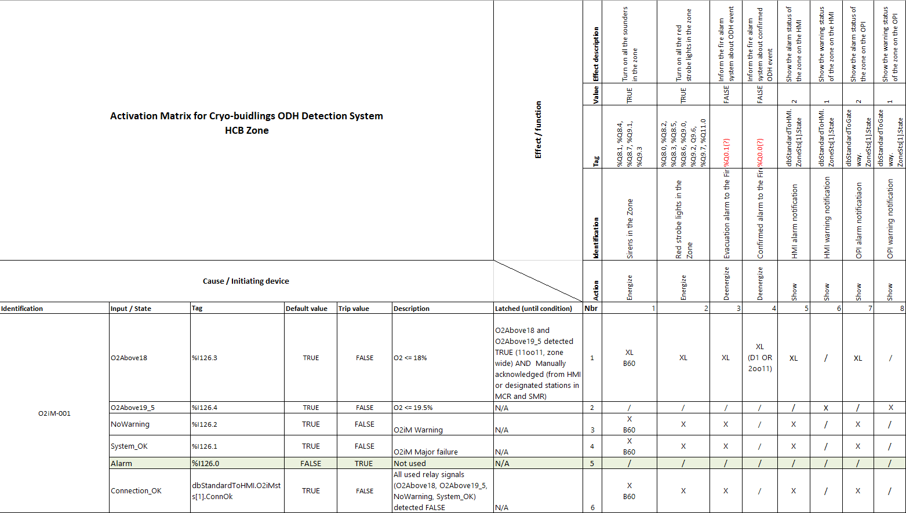
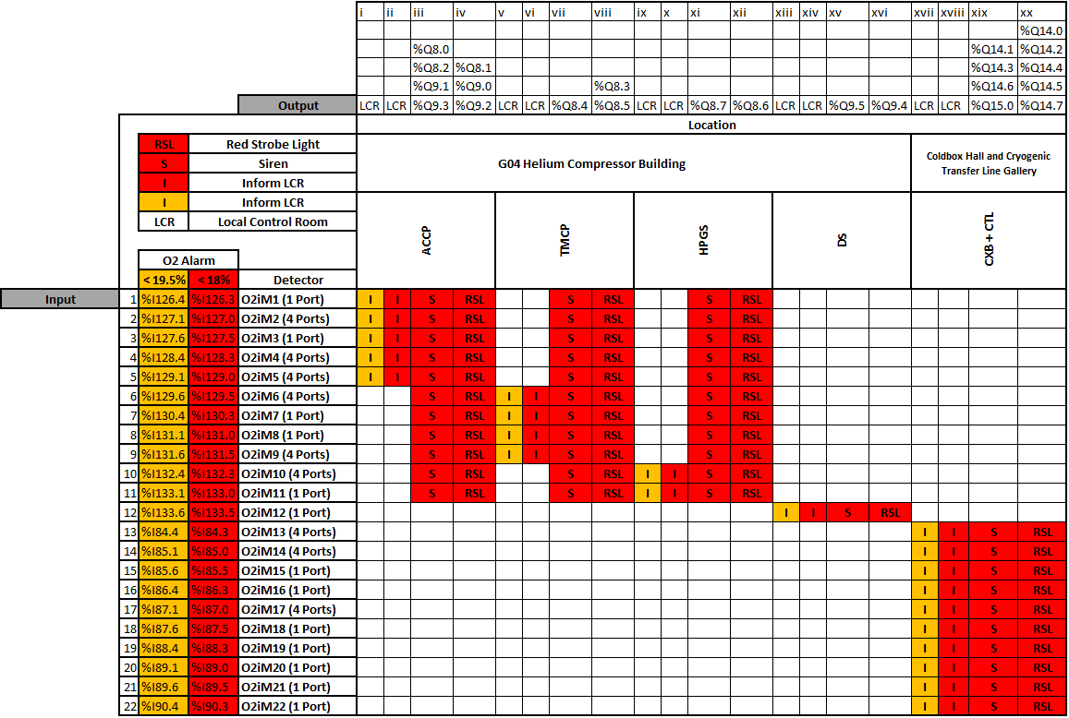
CryoB ODHDS Activation Matrix

Slide 26
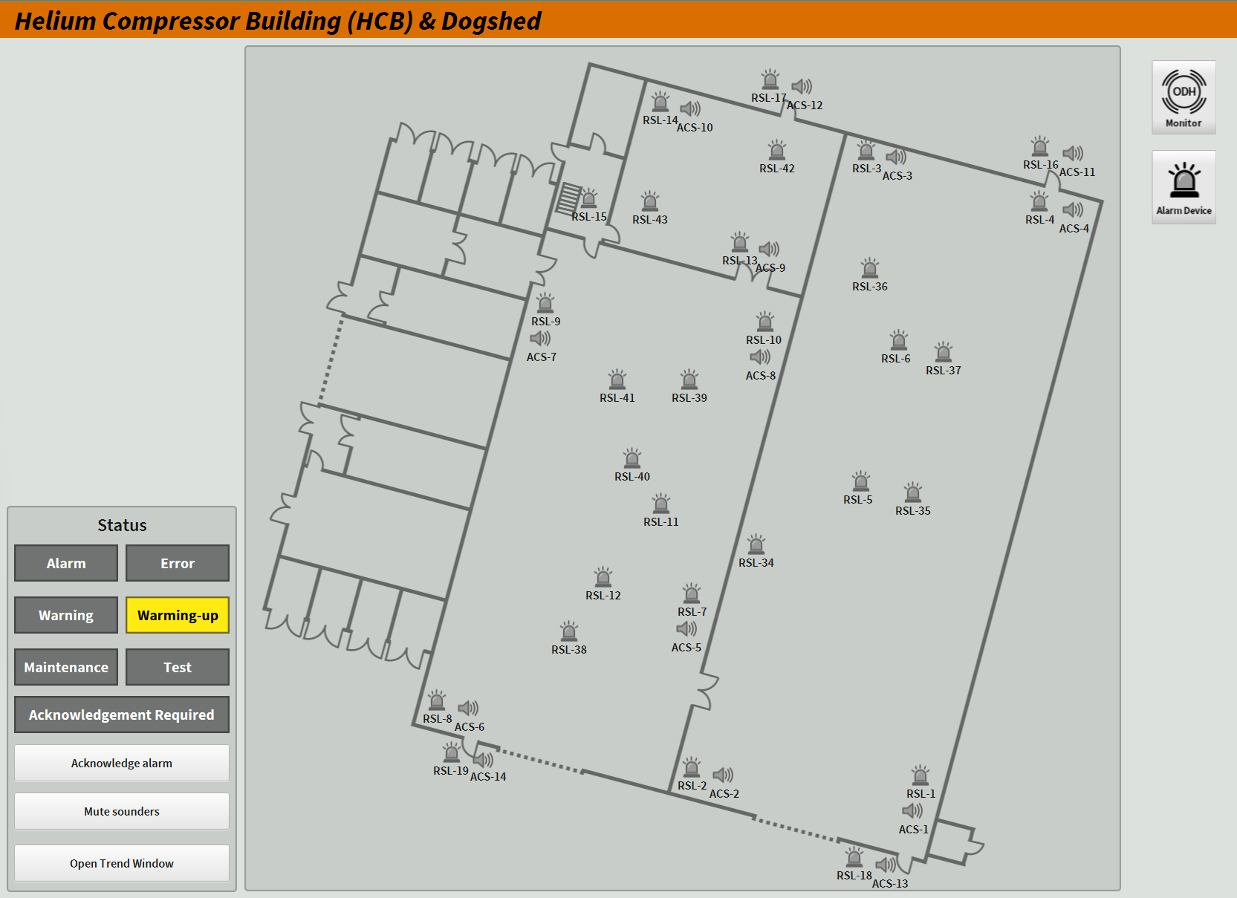
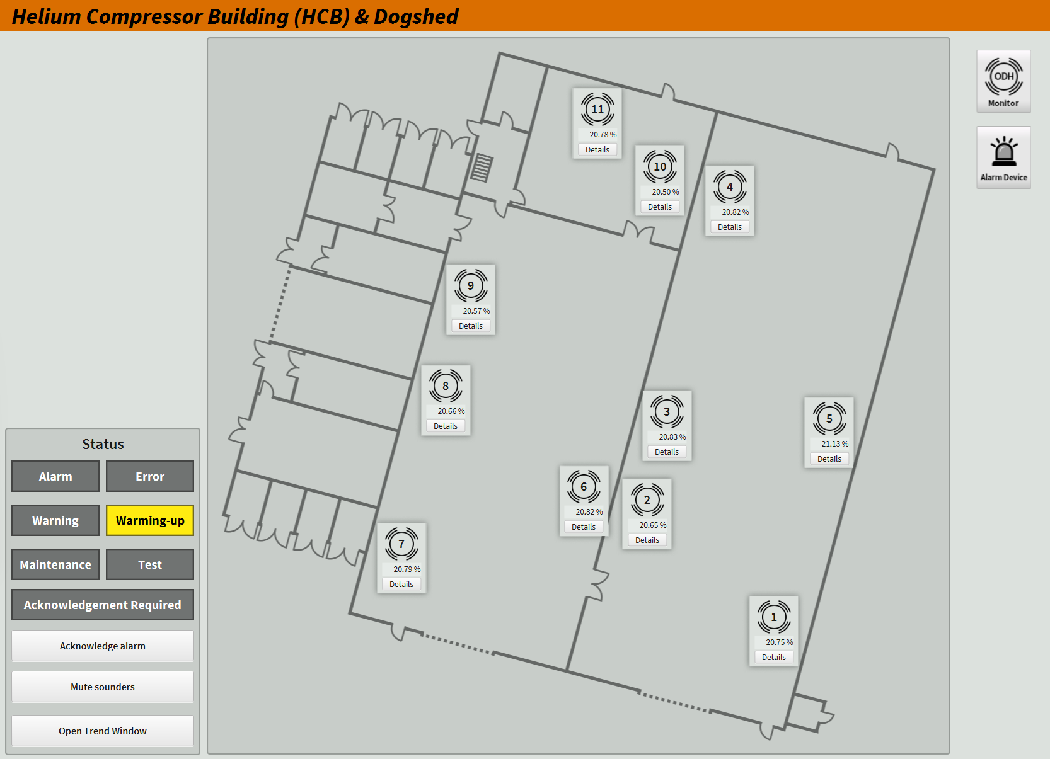
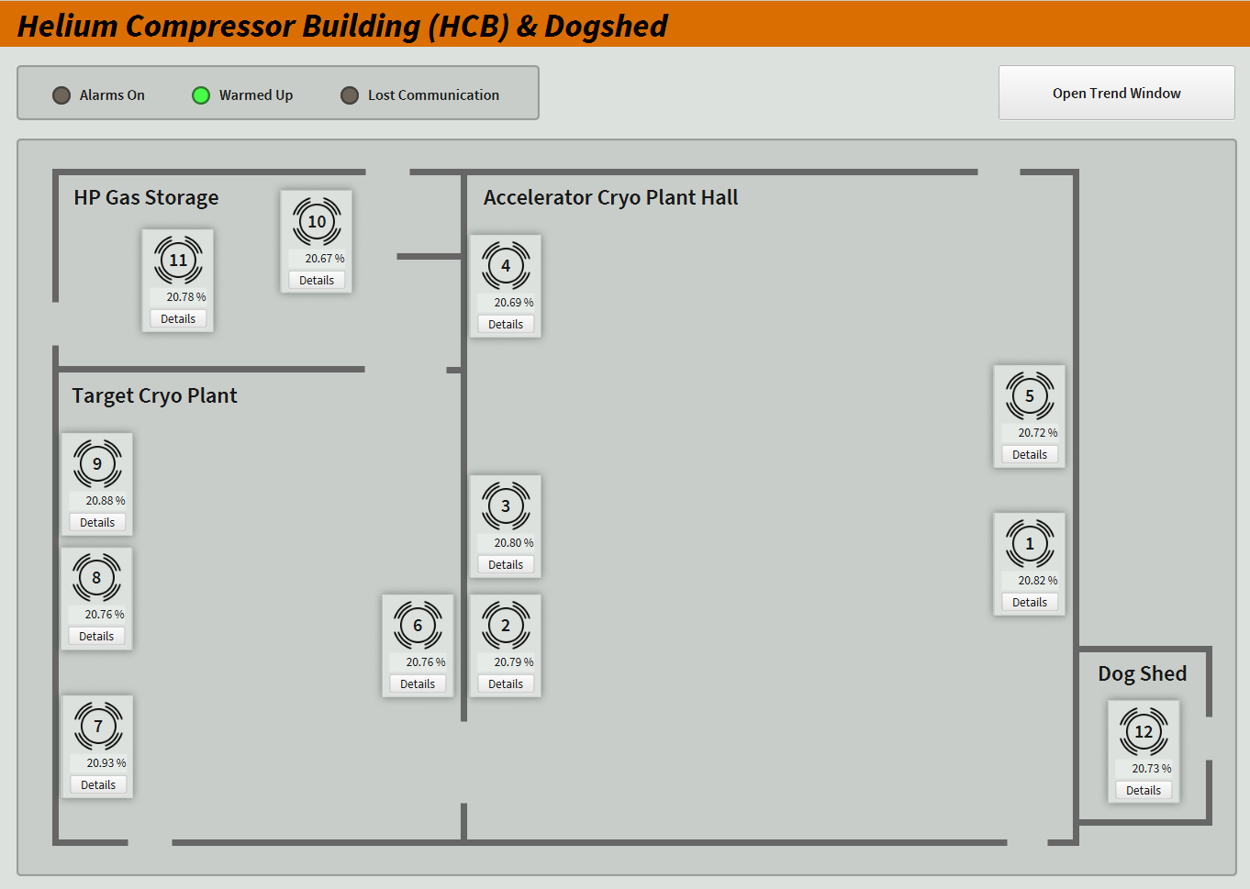
CryoB ODHDS - Detailed Zone OPI

Slide 27
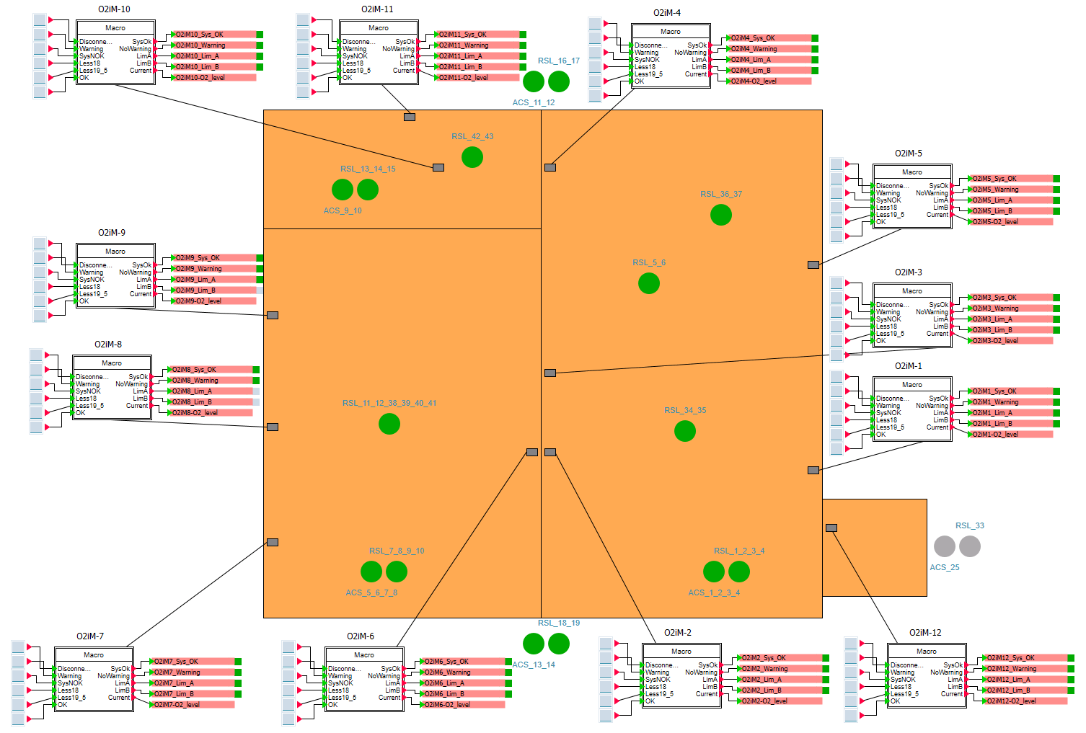
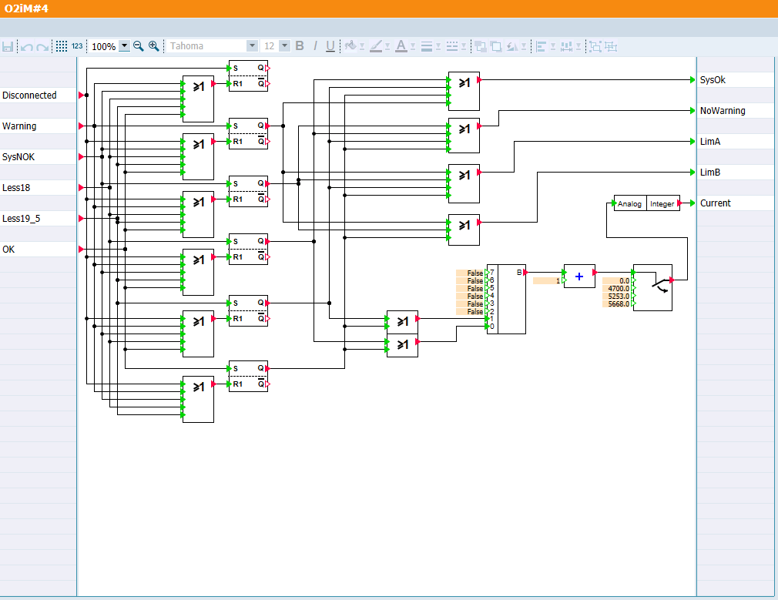
ODH Simulation Software (Simit)

Slide 28
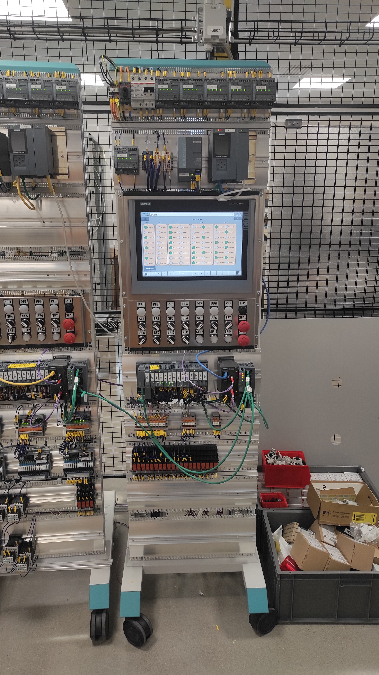
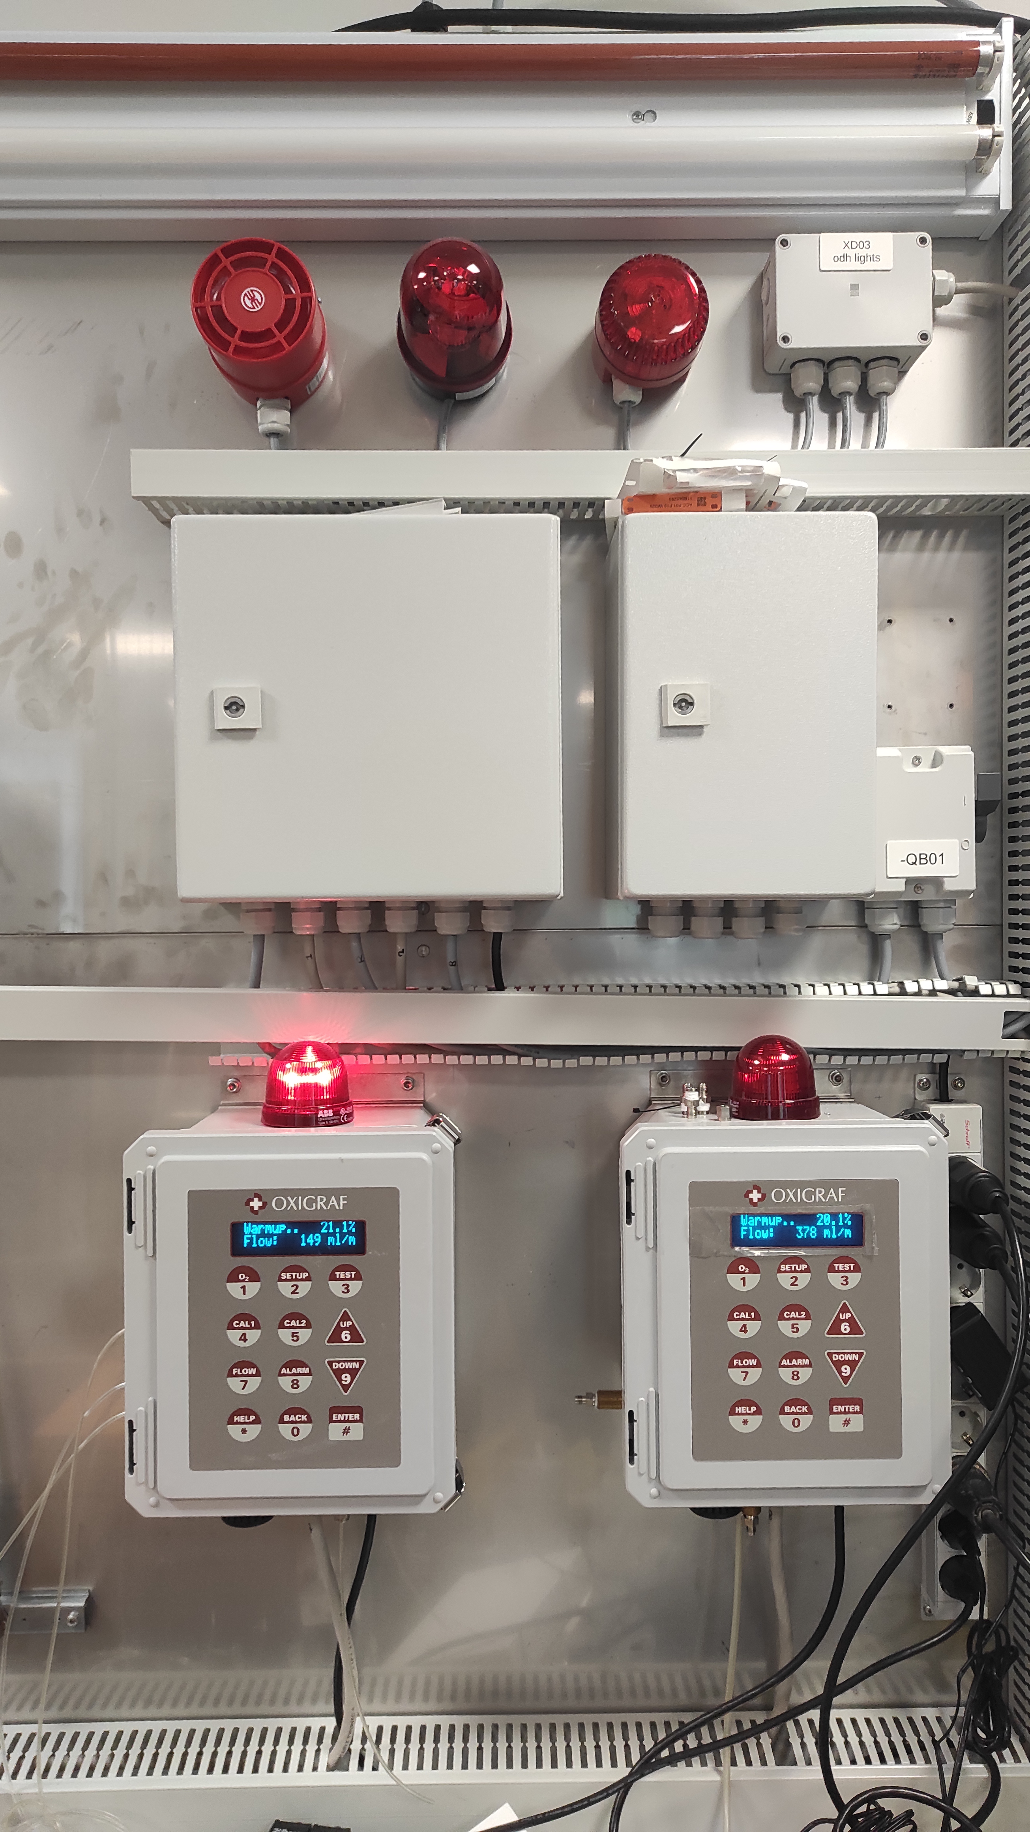
Test Environment for ODHDS

Slide 29
Thank you!
Questions?

Slide 30
Back-up slides

Slide 31
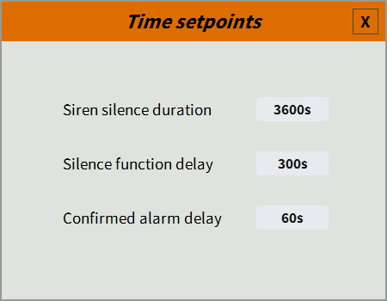
Soft-coded Timers – Input from HMI

Slide 32

Development Setup Network - Simplified
Safety Environment
Development Workstations
Shared Resources
CSLab
PSS Thin-clients
PSS Transfer Workstations
Bastions (Wallix)
ODHDS Transfer Workstations
Safety Firewall
DC Firewall
TN-DC Network
TN Firewall
Technical Network
AD = Active Directory
DHCP = Dynamic Host Configuration Protocol
DNS = Domain Name System
iDMZ = internal Demilitarized Zone
LDAP = Lightweight Directory Access Protocol
TN = Technical Network

Slide 33
Development setup
PLC Programming
The environment host a dedicated Versiondog server
Project are centralized to this server and synchronised to the workstations
Versiondog provides backup and version control
PLC programming can be achieved using a special workstation (XFER)
  For PSS: a user need to use a dedicated thinclient (locked in the PSS rack)
  Explicit Approval, real time monitoring and session recording are enable on the bastion
The programming workstation download the code from Versiondog
  This workstation is deployed using the workstation template

Slide 34
Development setup
BASTION
Based on Wallix Privileged Access Management
  Filter users, source and destinations hosts
  2 factor authentication → to be implemented
  Procedure to allow access to a workstation:
      User shall be authorised to use a Thinclient
      User shall be declared on the bastion and linked to dedicated Thinclient/s
      User shall be a member of a LDAP group to be allowed to use the bastion
      User shall be a member of a local domain AD group to be able to connect (via RDP) to the workstations
      The workstation shall be listed in a specific device group to link bastion users to their devices

Slide 35
Code Development
Virtualised Environment
  Disposable Windows Virtual Workstations
    Workstation re-deploy by updating the template
    Users backup to a dedicated NAS (personal files) and Versiondog (Projects)
    Backup of the entire environment (no access to the developers’ VMs)
  No direct access from the Office networks
    Wallix Bastion (Privileged Access Management software)
  Remote desktop ONLY through dedicated Thinclients
    Hardened Linux machines with user filtering and local firewall policies
  Enforced access control, session recording and approval work flow for critical access to critical workstations
NAS = Network-Attached Storage
VM = Virtual Machine

Slide 36
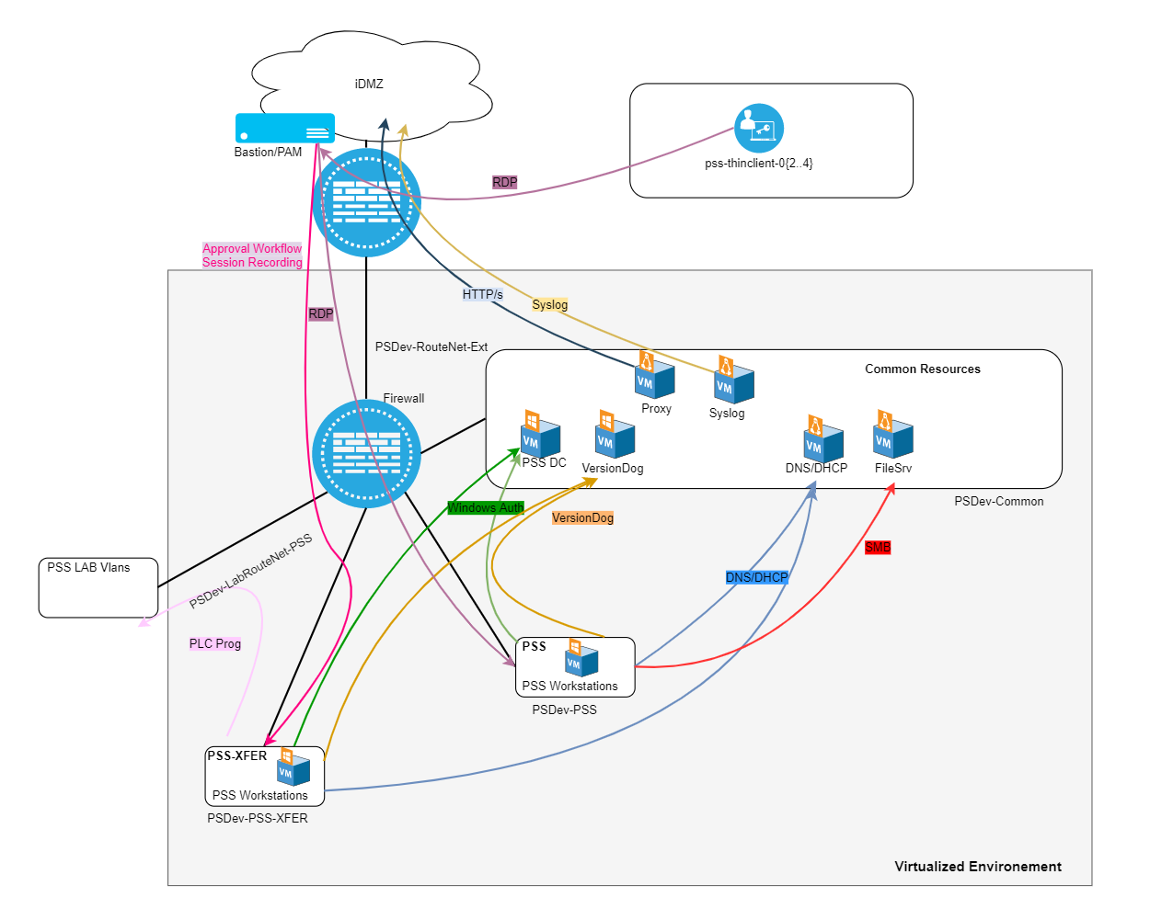
Development Environment – Detailed View
Drawing courtesy of S. Armanet (INFRA)

Slide 37
OPI Alarm Tree
PSS1
System
PLC Cabinet
External Devices
Critical alarm
Alarm mode
AMM
ESOS
Safety PLC
Gateway PLC
HMI
Power supply
IM155
Slot 1.. Slot 18
RIO 1..RIO3
High radiation
Monitor Failure
Button pushed
Hardware error
Switch
IO Interface
Slot 1..Slot 21
Status
Connected
Status
Connected…
UPS
24 VDC
Battery status
RTB
Alarm
Status
Status
Status
Connected
24 VDC
Surge arrester
Switch

