Slide 1
Delivering LOKI scientific computing infrastructure for Hot Commissioning
WojCIECH Potrzebowski (SANS Instrument data scientist)

Slide 2
DMSC-LOKI project on JIRA (from previous meeting)

Slide 3
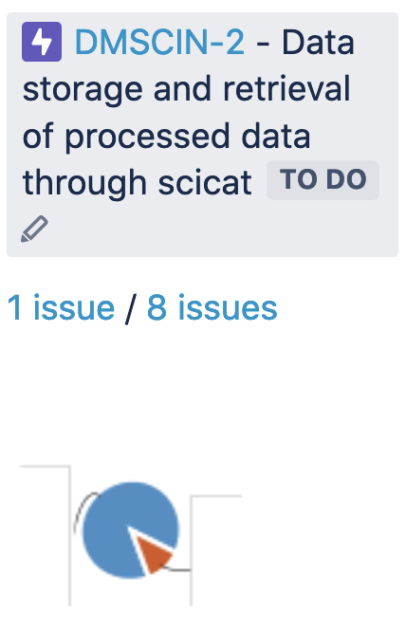
What is missing? (from previous meeting)
Underlying user stories
Milestones
Undone/done metrics
Validation and acceptance tests
Continuous integration
Signing off and ownership transfer
Deployment procedures
Extension to other instruments

Slide 4
Big Picture board
User stories

Slide 5
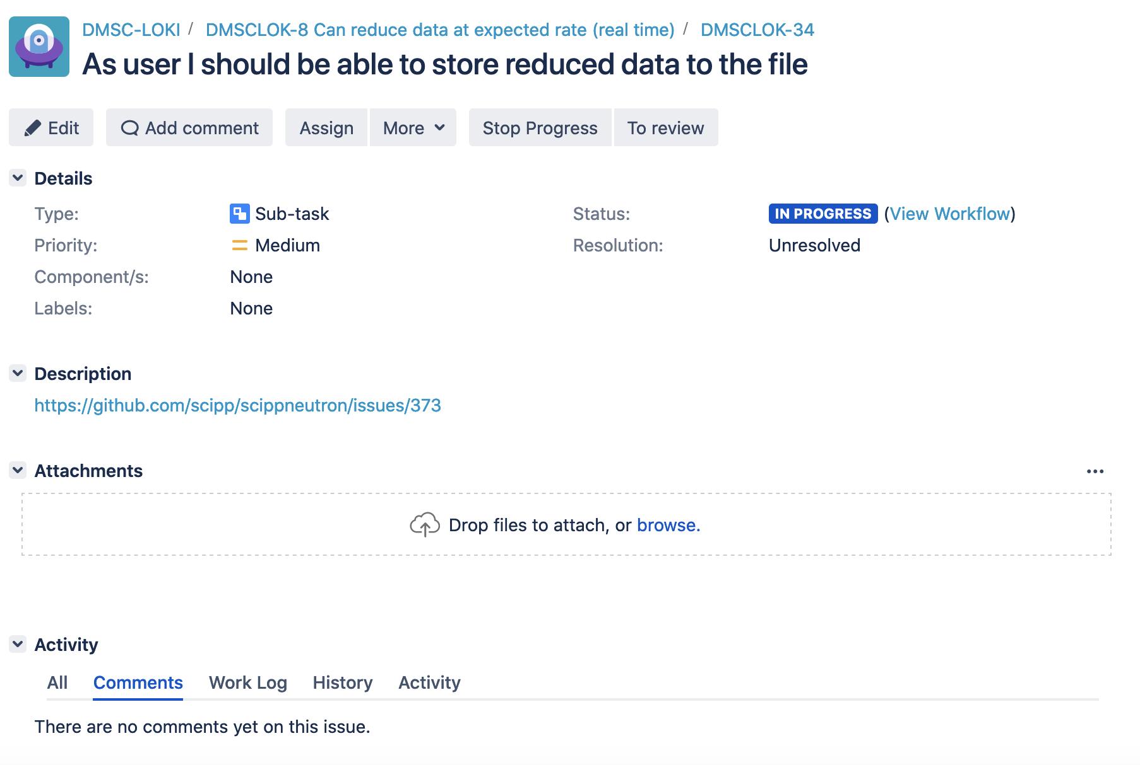
Saving reduced data to file

Slide 6
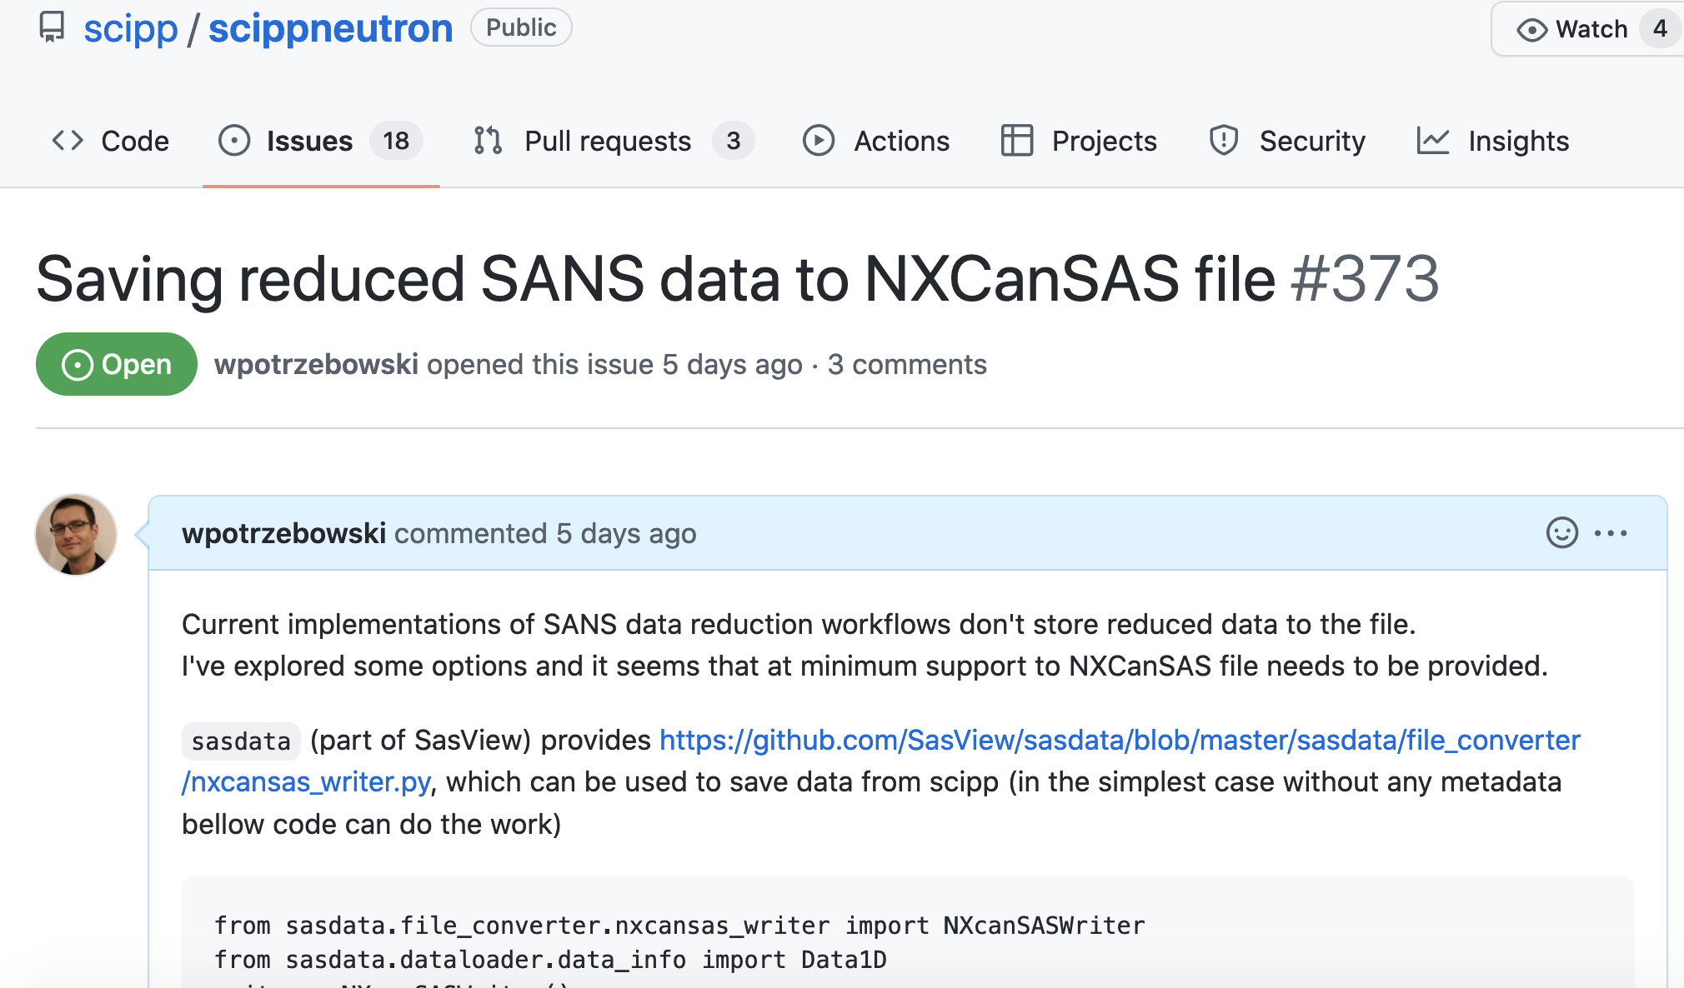
Saving reduced data to file

Slide 7
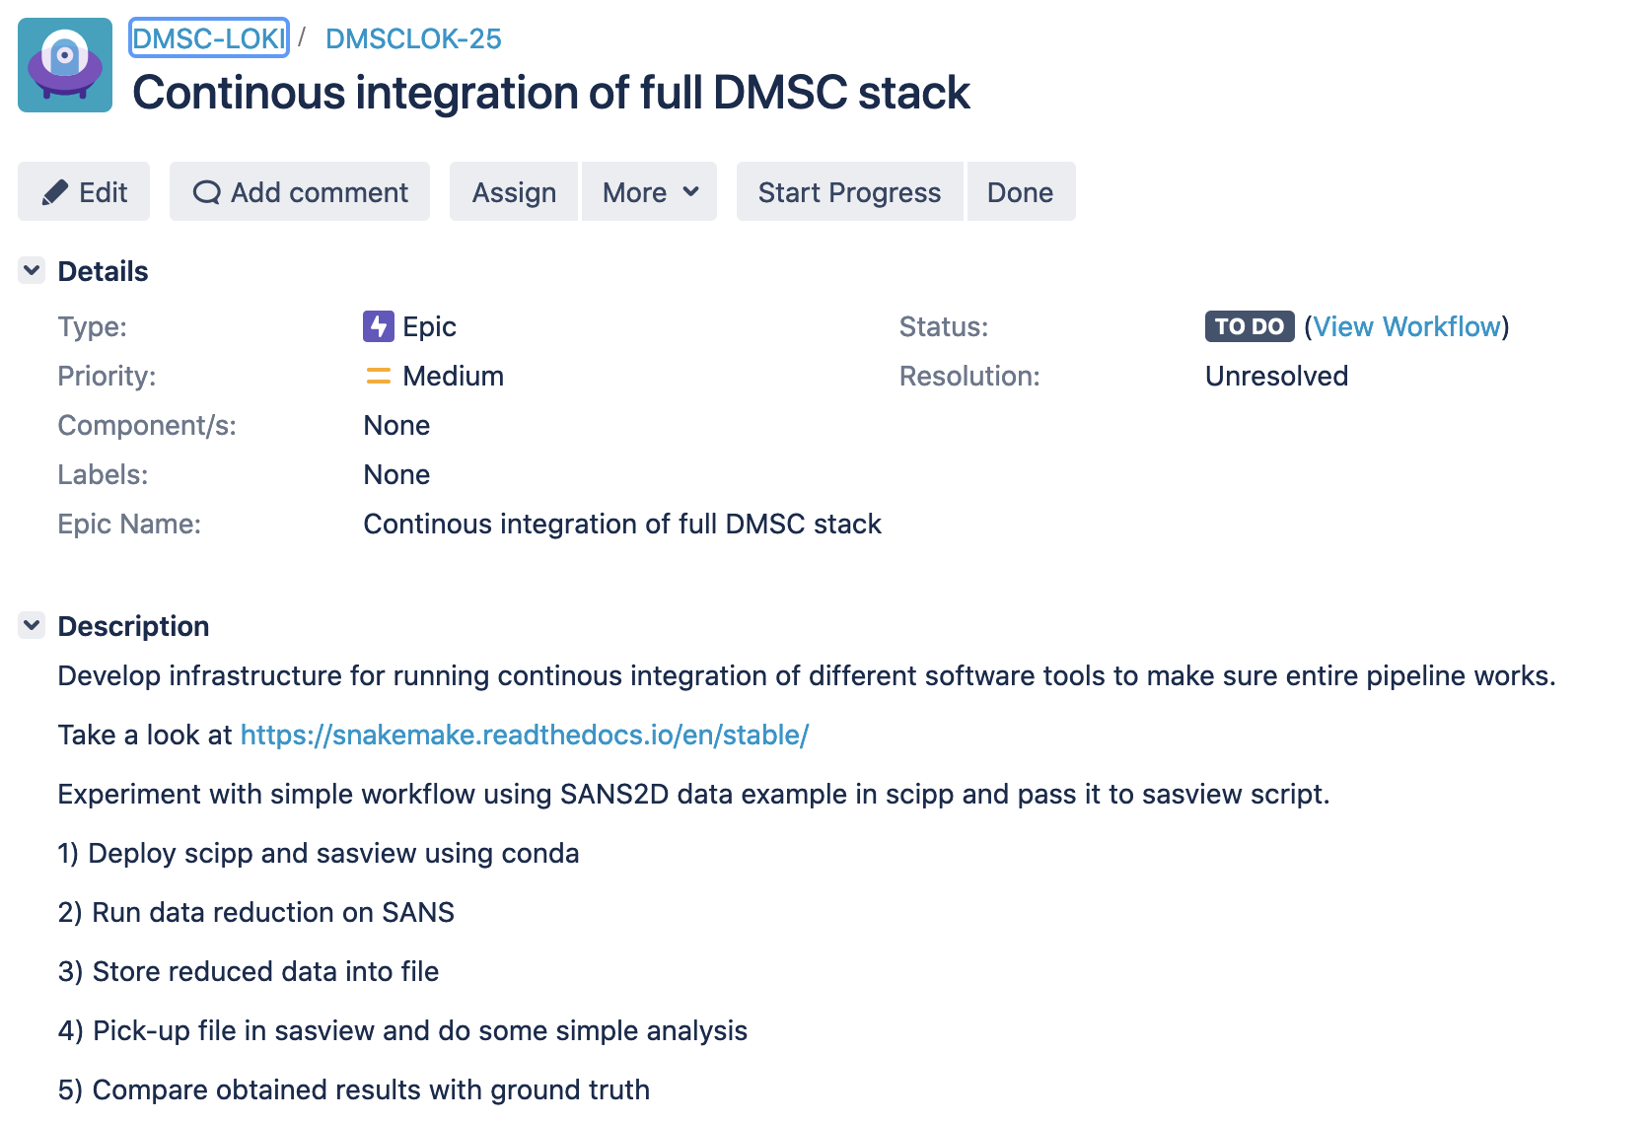
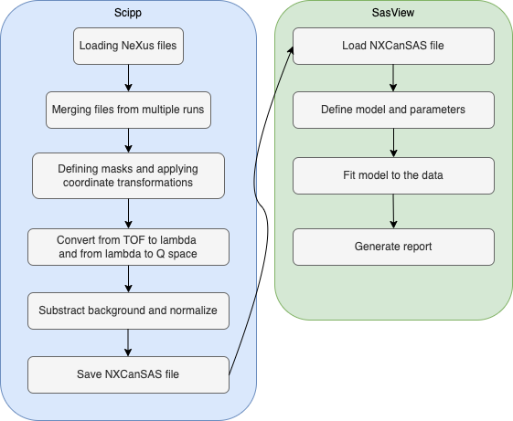

Slide 8
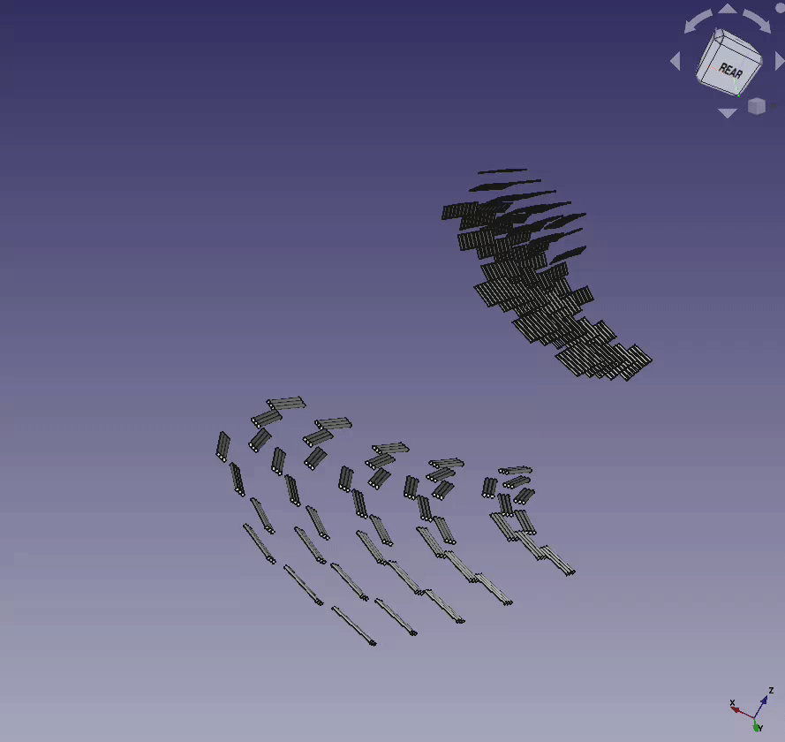
Other Instrument Updates
From: https://confluence.esss.lu.se/display/DMSC/09-2022
ODIN: Established monthly meetings on polarized imaging with Hal (part of weekly ODIN-IDS meetings).
YMIR: Planned next milestones for YMIR/Light-tomography (by ultimo Jan 2023).
ESTIA: Beginning work on Selene guide alignment software (with Artur Glavic)
DREAM: demonstration of VISA for instrument team
BIFROST: secondary flight-path model in STEP format
Easy science workshop at ISIS (diffraction, reflectometry, spectroscopy)

Slide 9
Proposals and potential collaborations
VR proposals:
SEC-SANS
SANS for crowded solutions
Simulations for spectroscopy
AI/AR developed by RISE (imaging)
Beam times:
ESRF (diffraction on magnetostrictive materials)
MAXIV (diffraction magnetic field induced self-assembly of iron oxide nanoparticles in solution)
ILL (SANS virus self-assembly under pressure)
Commissioning:
Possibility to participate in commissioning of instruments at ISIS and ILL
Collaborations:
Easy science
KU student projects (meeting in November)
Autonomous experiments as part of SasView (with NIST and ISIS)
Potential collaboration on data reduction (scipp) with ISIS and MaxIV (CoSAXS)

Slide 10
Considerations, issues, improvements
Discussed format and input to this meeting -> other IDS may follow or come instead
Detailed tracking of progress with all DMSC is challenging/not feasible -> taking pragmatic approach
Similar efforts from DRAM group on tracking data analysis -> need to coordinate
Lack of instrument scientist for ESTIA

Slide 11
Thank you for listening!

