Slide 2
Bunker PSS Overview and Concepts of Operations
ESS PSS PDR (2022-12-01)
PRESENTED BY Yaser Takzare
Notes:
The Bunker PSS ConOps provides a high-level description of Bunker PSS and its expected operation.
And in this presentation, we will review the principle of Bunker PSS operation.

Slide 3
Agenda
Bunker
Bunker PSS concepts of operation
Bunker PSS key exchange system
Granting Access to the Bunker PSS Controlled Area
Preparing the Bunker PSS Controlled Area for Operation and Permits
Transition to Alarm mode
Bunker PSS Interfaces
Bunker PSS Questions

Slide 4
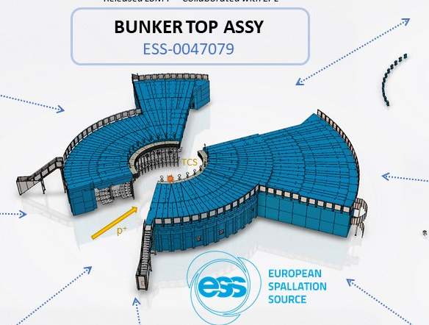
1
Bunker

Slide 5
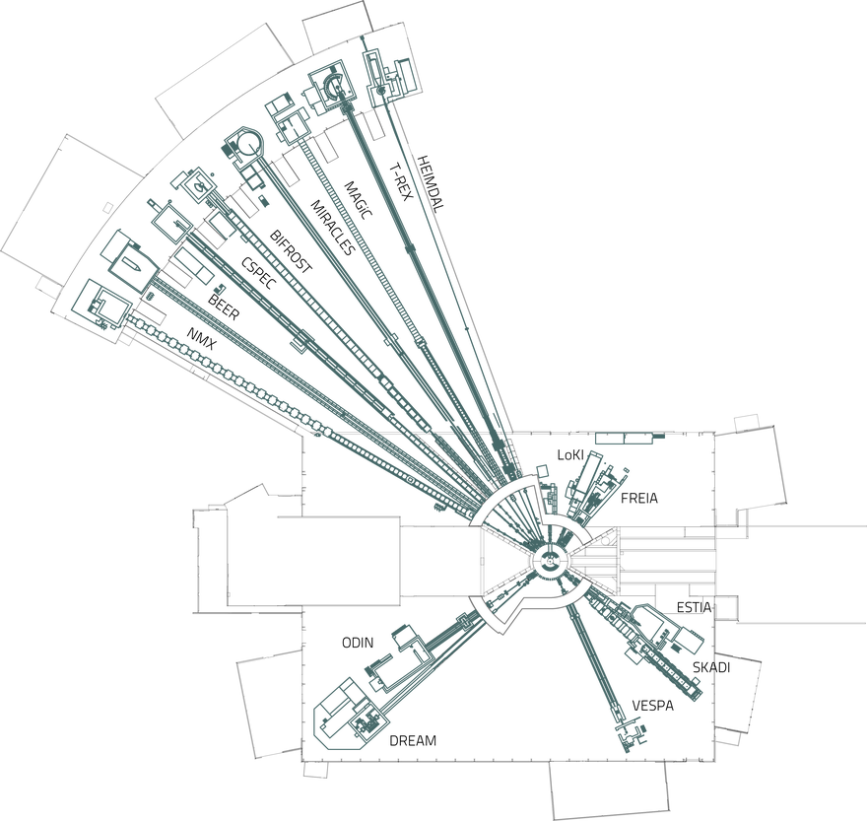
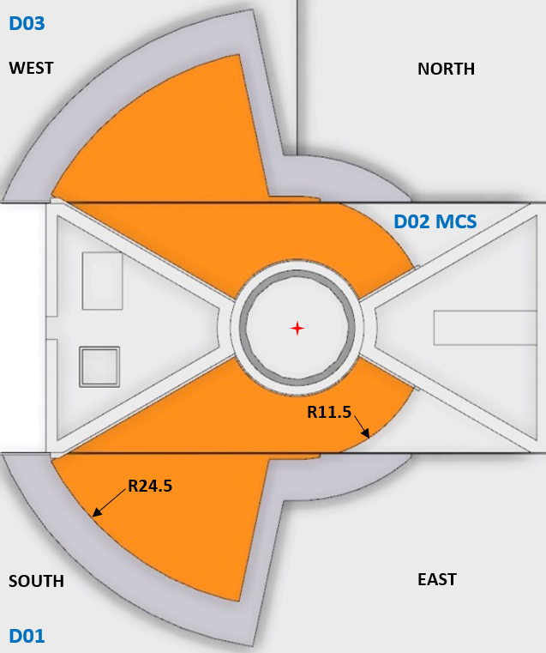
Bunker
North-West Bunker: Located in D03 building.
South-East Bunker: Located in D01 building.

Slide 6
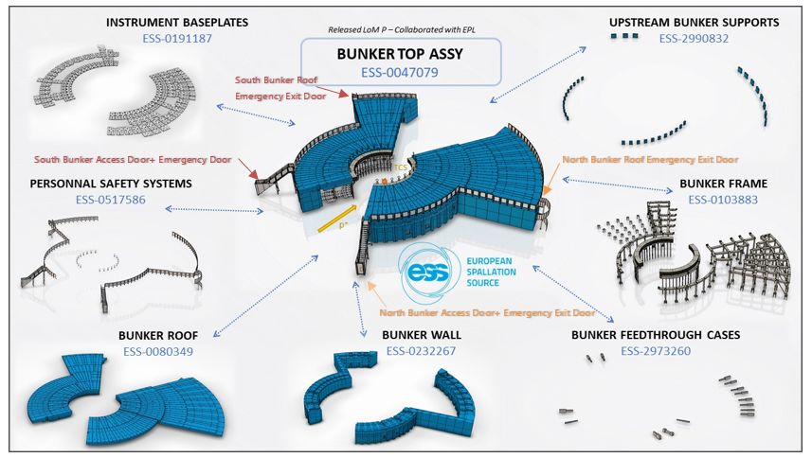
Bunker

Slide 7
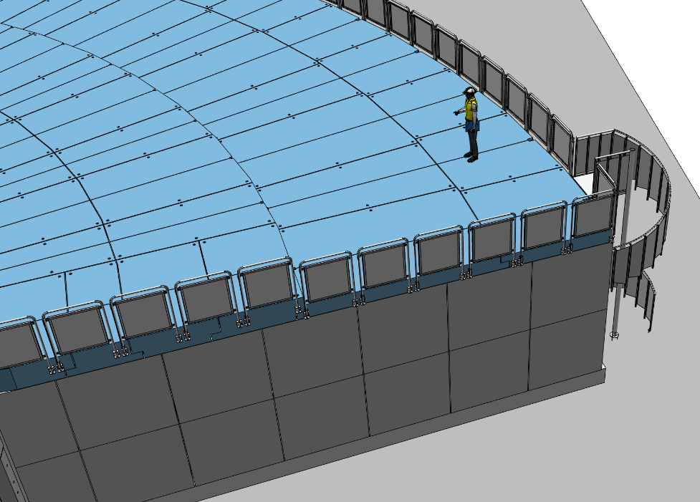
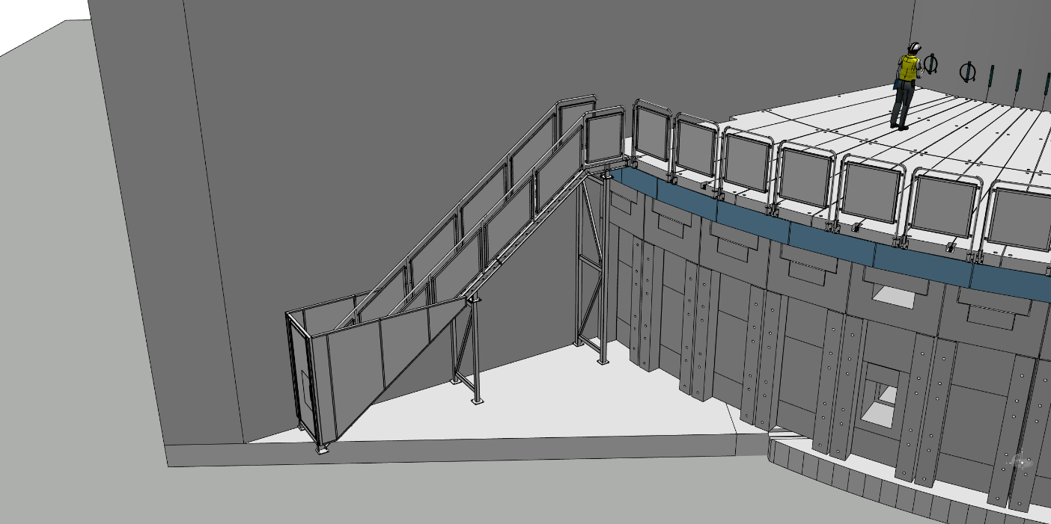
Access to the Bunker Area
To prevent unauthorized access onto the bunker roof, a fence and stairs with controlled access will be installed.

Slide 8
In Bunker Access case example
Bunker’s Roofs
To create full access to LOKI:
  21 roof blocks (11+6+4)
  4 bolts
  1 beam
  must be removed.

Slide 9
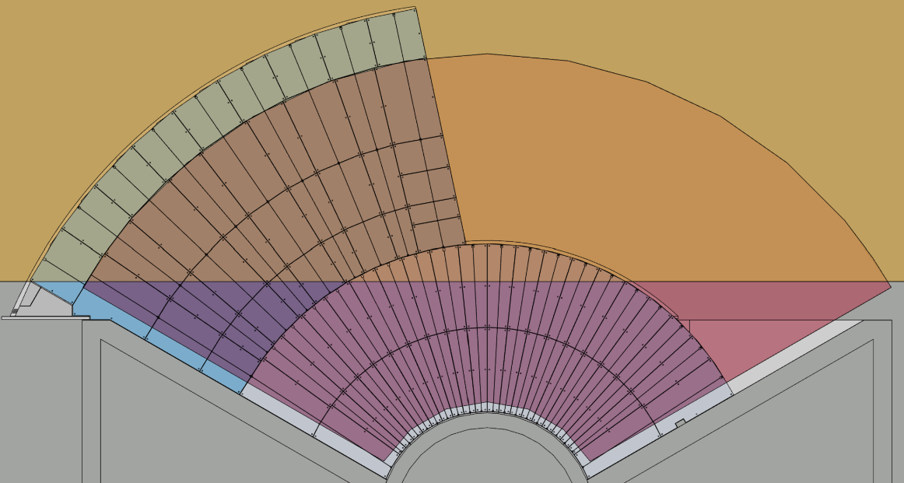
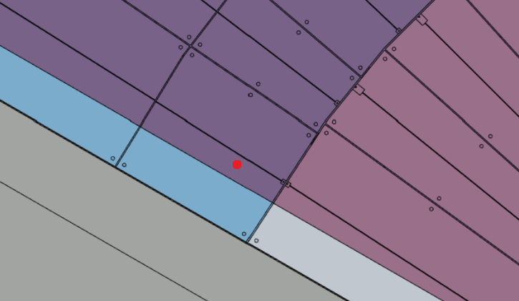
How to remove the Shielding Blocks
Bunker’s Roofs
Experimental Hall crane coverage area
Cranes crossover (load interchange) area
Bunker crane coverage area
Third level block and its CoG

Slide 10
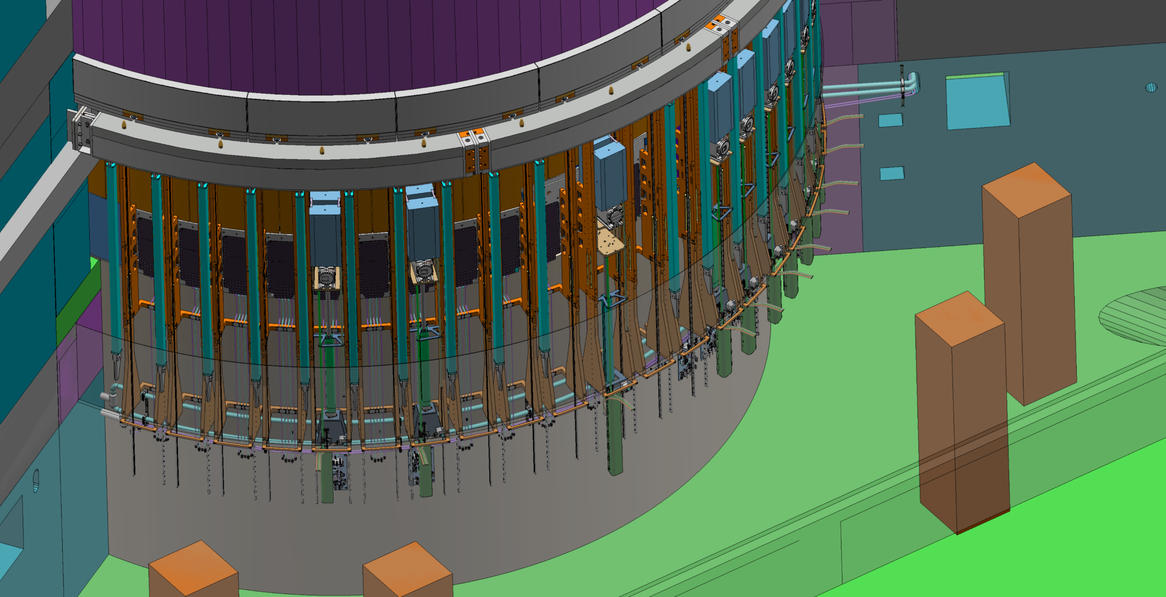
In Bunker gamma radiation hazard from the monolith
Light shutter system

Slide 11
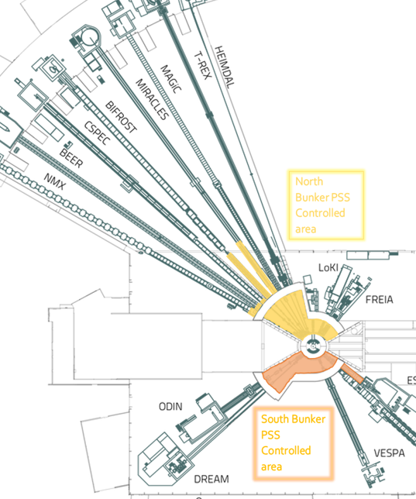
2
Bunker PSS concepts of operations

Slide 12
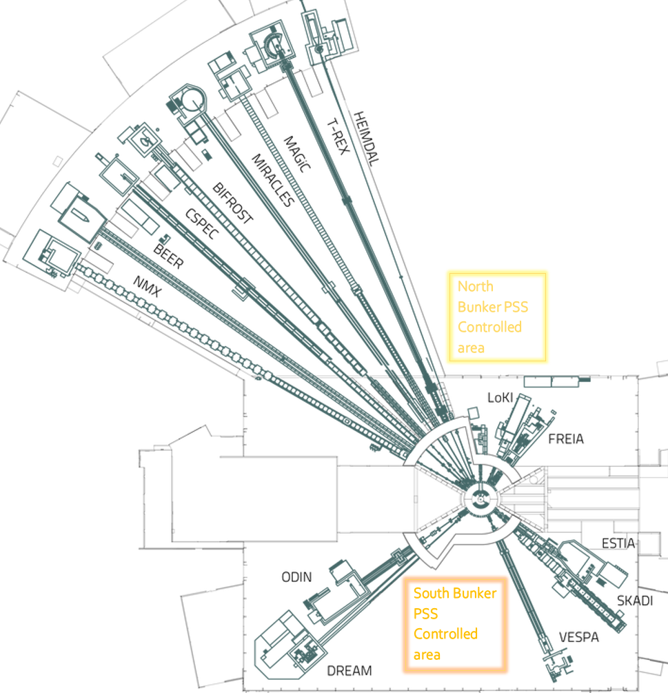
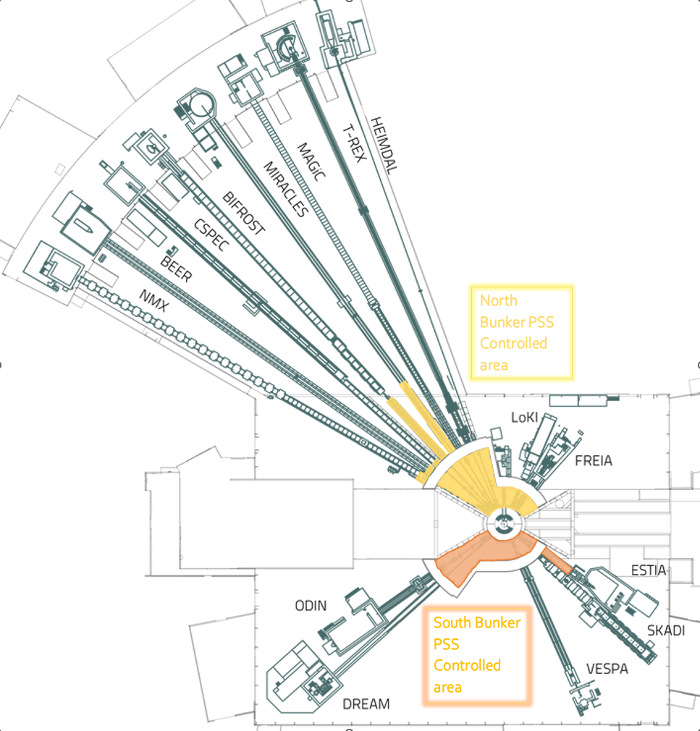
The Bunker PSS
The Bunker PSS is the personnel safety system that ensures safe access to the Bunker . It is composed of two independent systems:
North Bunker PSS for North-West Bunker
South Bunker PSS for South-East Bunker
Bunker PSS controlled area
Area inside of the Bunker
Some parts of the instrument beamlines up to instrument shutter
The Bunker PSS provides two main functionalities:
Safety Interlock System
Access Control System

Slide 13
Bunker PSS Main Functions
Safety Interlock System
The purpose of the Safety Interlock System of Bunker PSS is to mitigate hazards in the Bunker PSS controlled area.
Mitigate prompt ionizing radiation from proton Beam to Target.
The Bunker PSS prevents access to the Bunker PSS controlled area, if there is proton Beam to Target.
Mitigate gamma radiation hazard from the monolith.
Preventing access to the Bunker PSS controlled area if the light shutters are not closed.
The Bunker PSS prevents inadvertent energization of the bending magnets, if the Bunker PSS controlled area is not closed and locked.
Preventing inadvertent opening of the light shutters, if the Bunker PSS controlled area is not closed and locked.

Slide 14
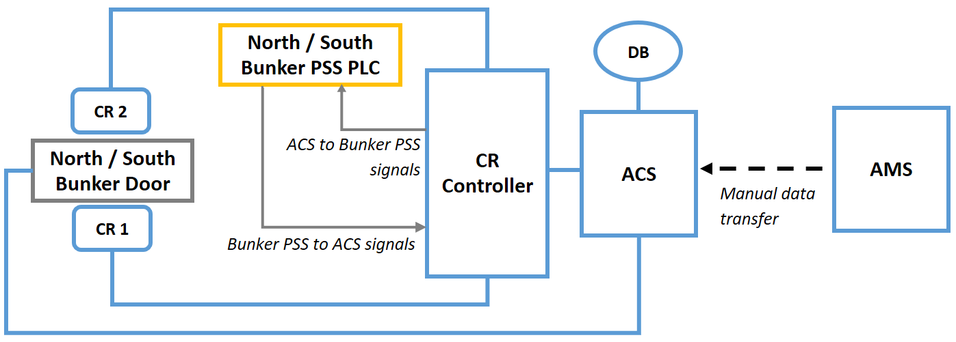
Bunker PSS Main Functions
Access Control System
A key exchange unit with Safety Tokens (ST), which is part of the Bunker PSS Key Exchange System
PSS has an interface with Electronic Personal Dosimeter (EPD) reader to allow access only if the person is carrying an active EPD.
An intercom system is used for communication between the access door and the Main Control Room (MCR).
A video surveillance system, which are installed at the access doors for supervising the access from the MCR.
Q: Do we need to have single entry control in Bunker PSS Access control?

Slide 15
Principles of operation
The Bunker PSS ensures that no one is left inside Bunker PSS controlled area
The Bunker PSS ensures that the shielding blocks for Bunker PSS controlled area are in place.
The Bunker PSS ensures that the bunker crane and fence is locked.
Prior to enabling Bunker
PSS permit to allow
the Beam on Target :
The operator changes the beam destination out of Target through the control system
The operators close the Light Shutters through the control system,
Upon initiating access to Bunker PSS controlled area, Bunker PSS interlocks the bending magnets and light shutters
The bending magnets and light shutters are secured against re-energisation until the Bunker PSS controlled area is closed and locked.
Prior to granting access to Bunker PSS controlled area:

Slide 16
Bunker PSS Modes of Operation
The Bunker PSS operates in four operational modes in order to:
Ensure safe access to the Bunker PSS controlled area.
Ensure safe initiation of Beam to Target
BoT ON Mode
Transition
Mode
Access
Mode
Alarm Mode
Notes:
In BoT ON mode the Bunker PSS issues all permits necessary to allow Beam on Target.
The Transition mode is mainly used as a transition between BoT ON and Access modes and vice versa.
The Bunker PSS is in Access mode when access to the Bunker PSS controlled area is considered safe, and access is permitted.

Slide 17
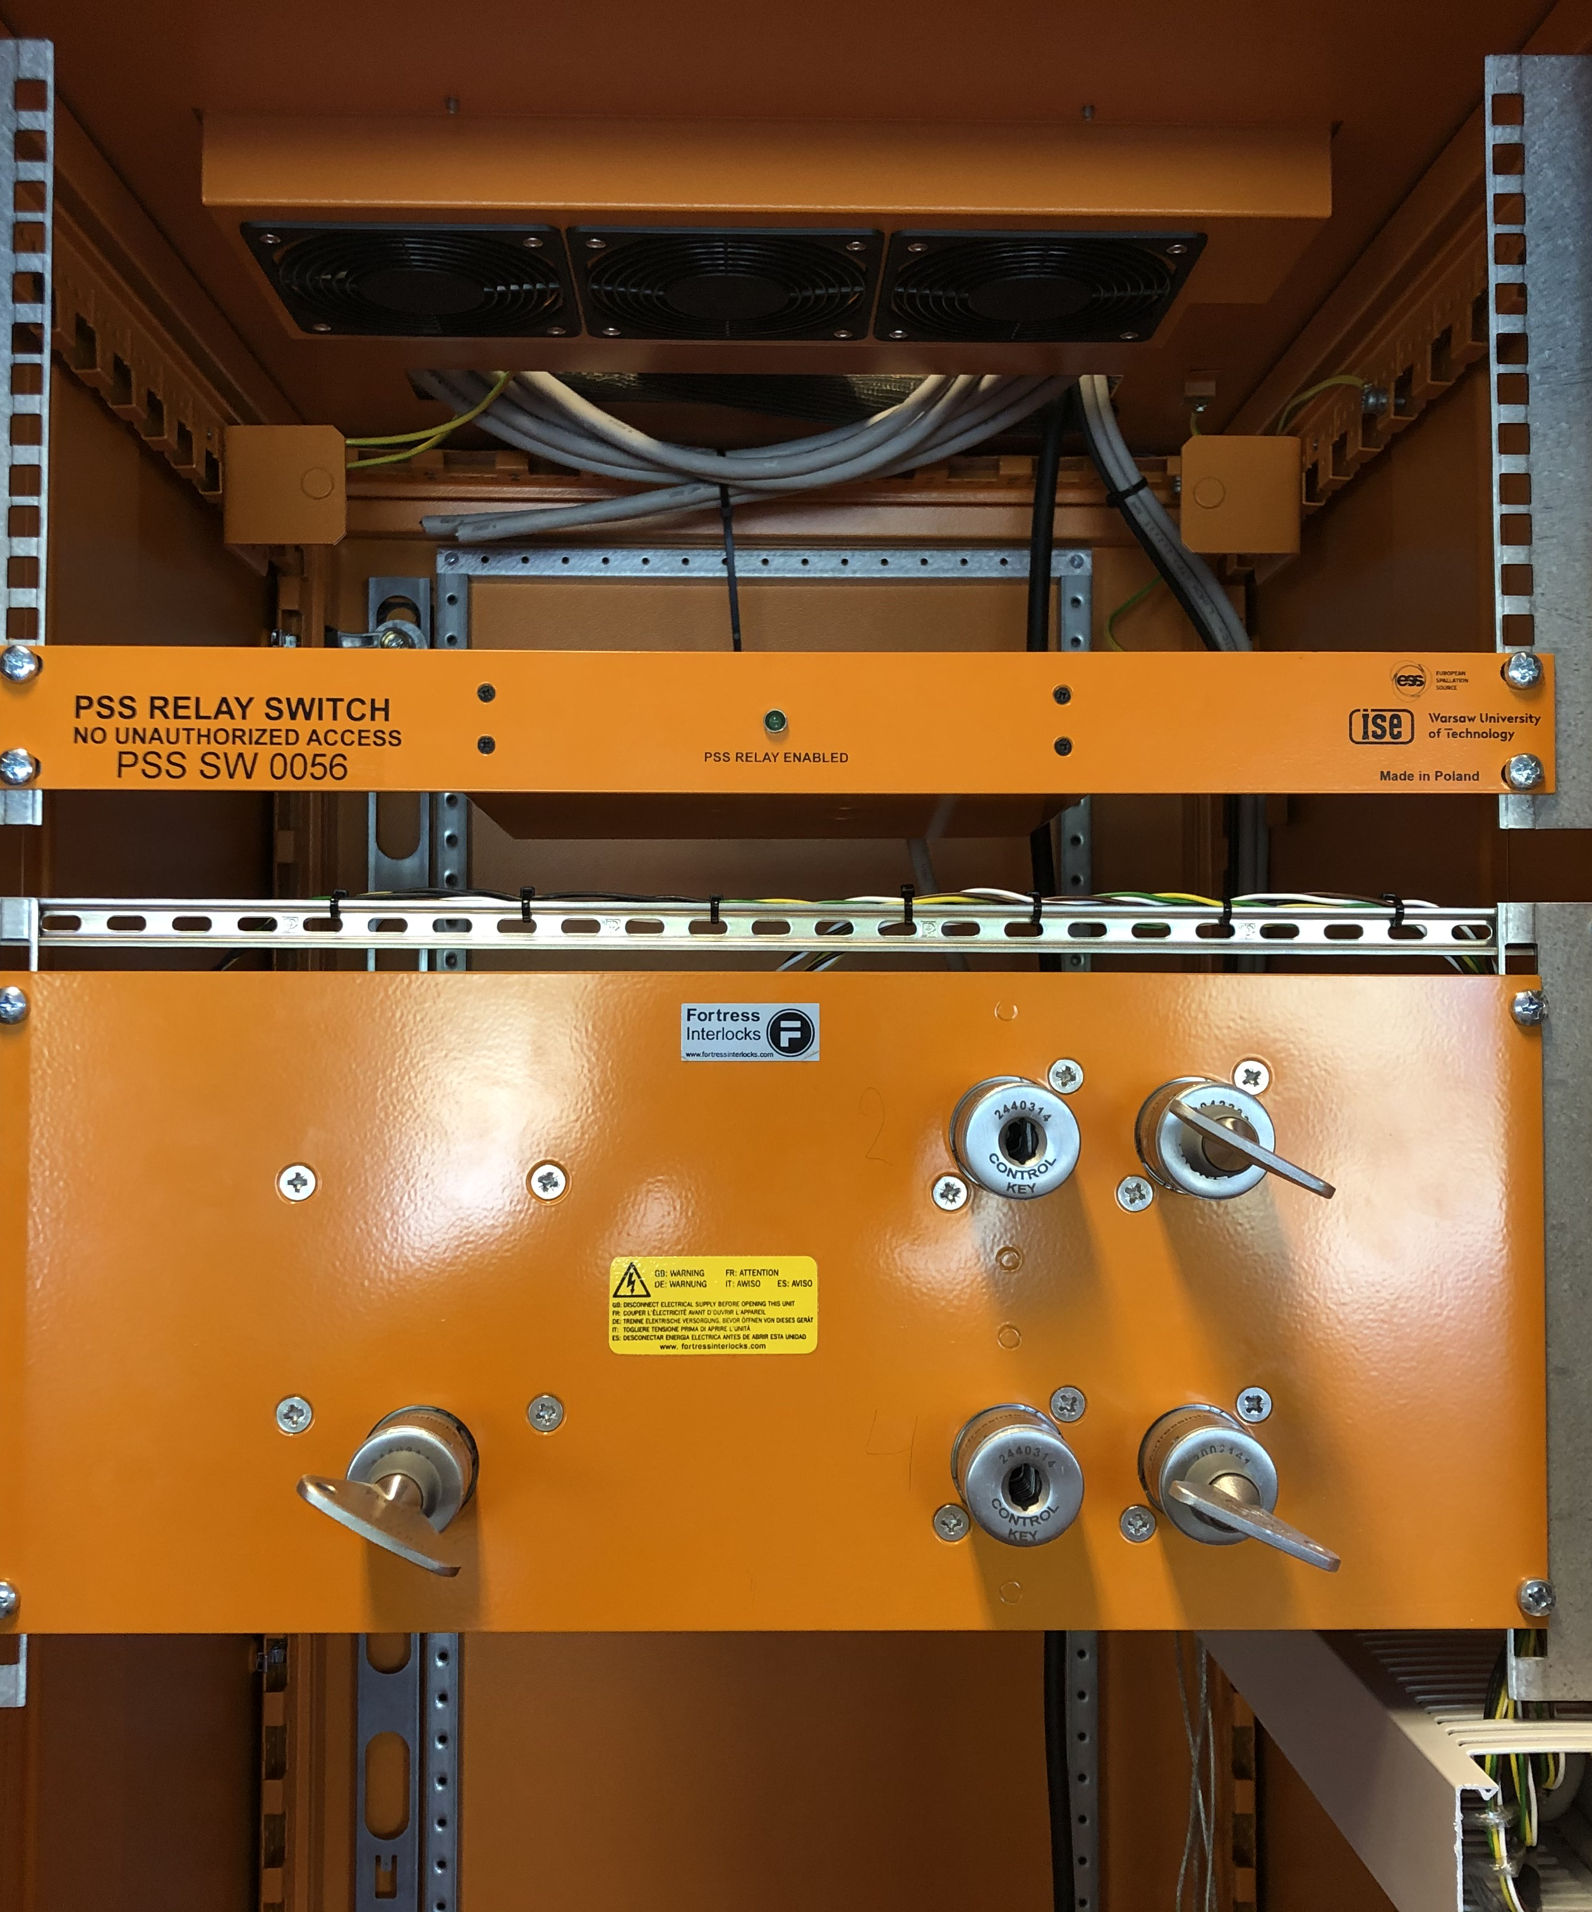
3
Bunker PSS key exchange system

Slide 18
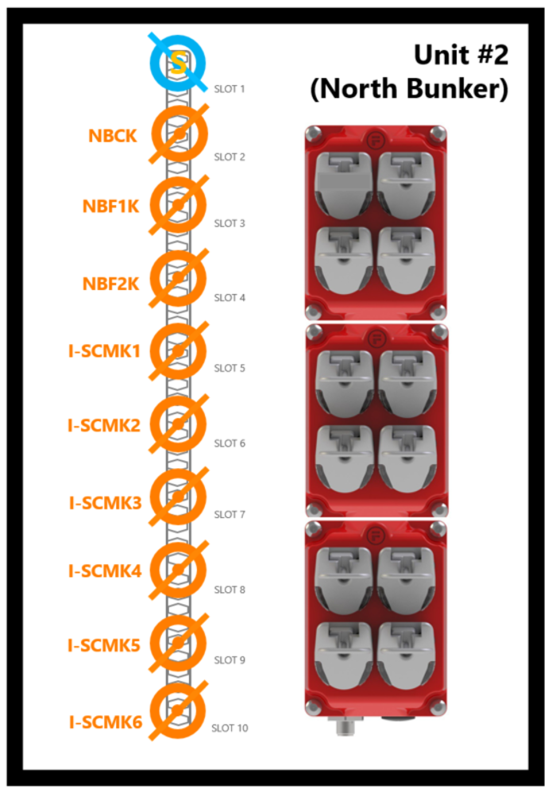
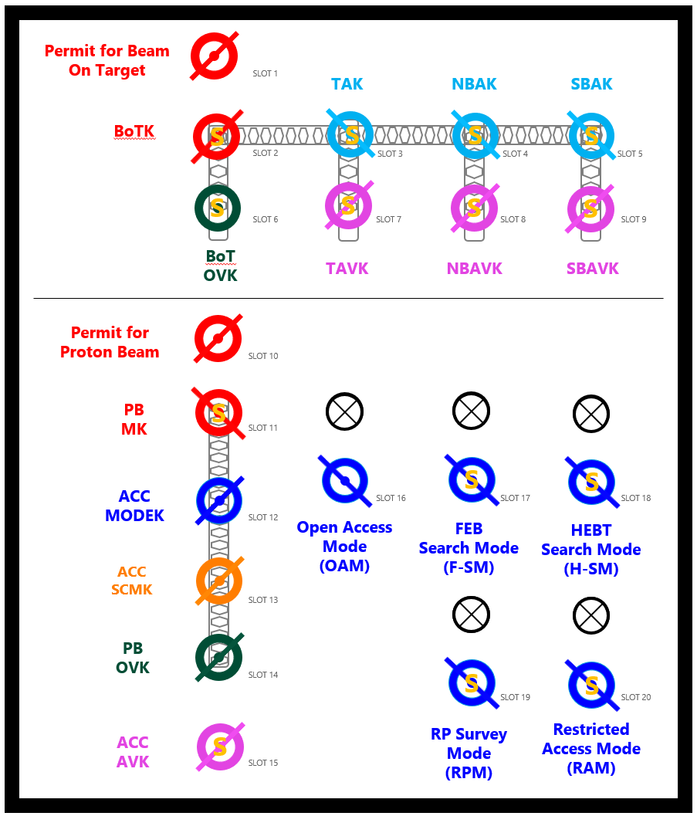
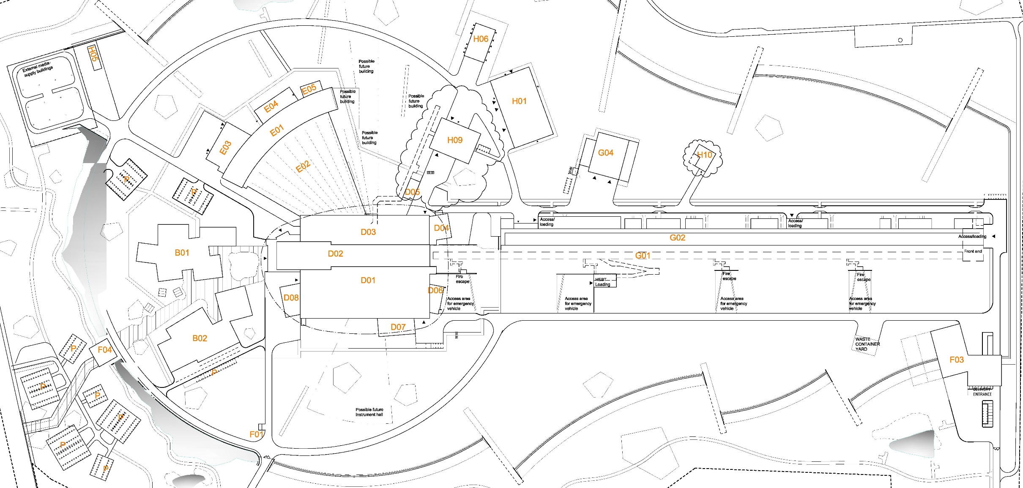
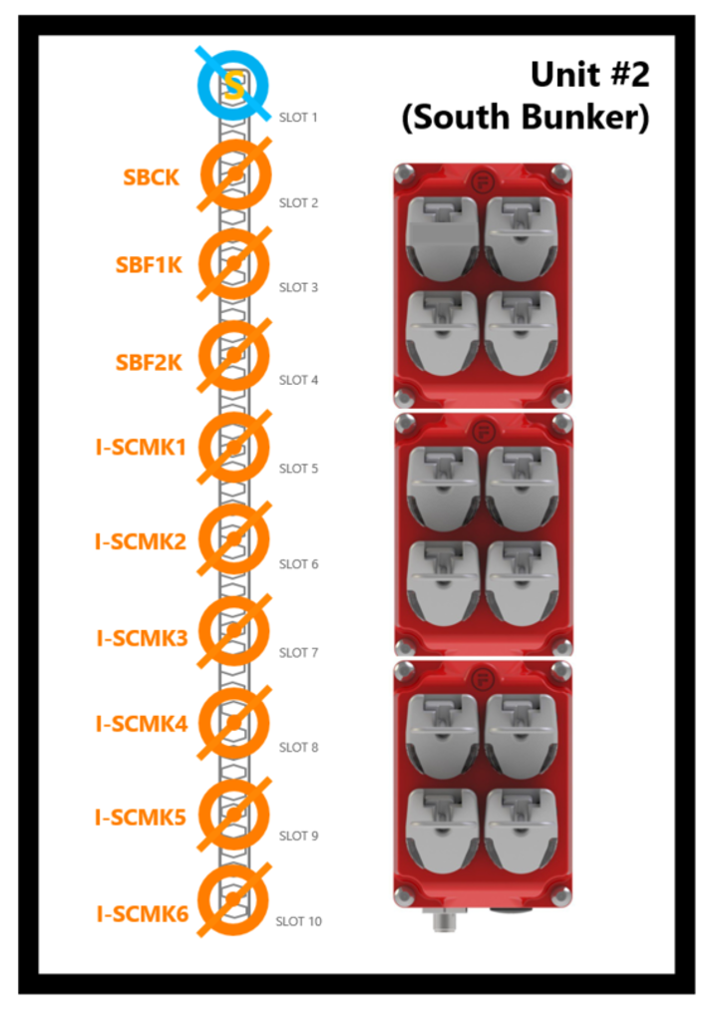
Bunker PSS key exchange system
North Bunker PSS key exchange unit #2
Integrated ACC – Target - Bunker PSS key exchange unit #1 (MCR)
South Bunker PSS key exchange unit #2

Slide 19
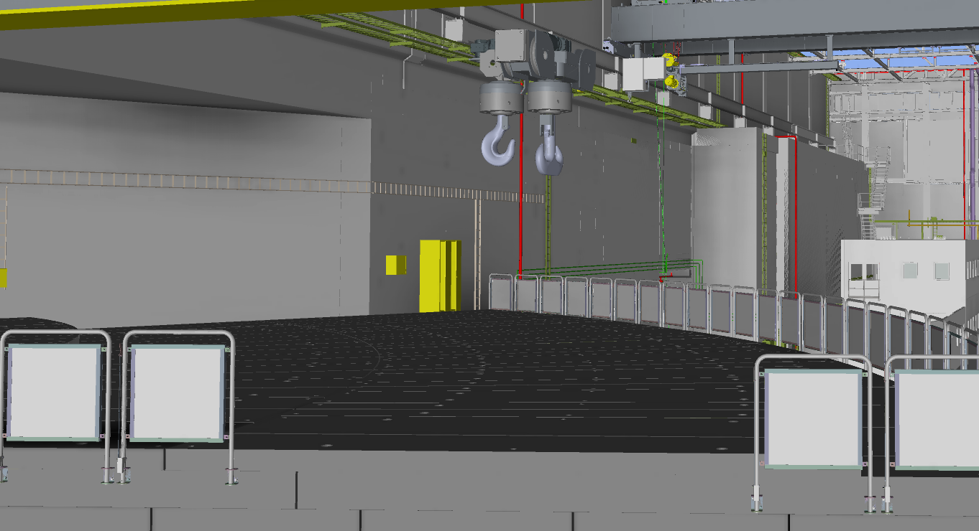
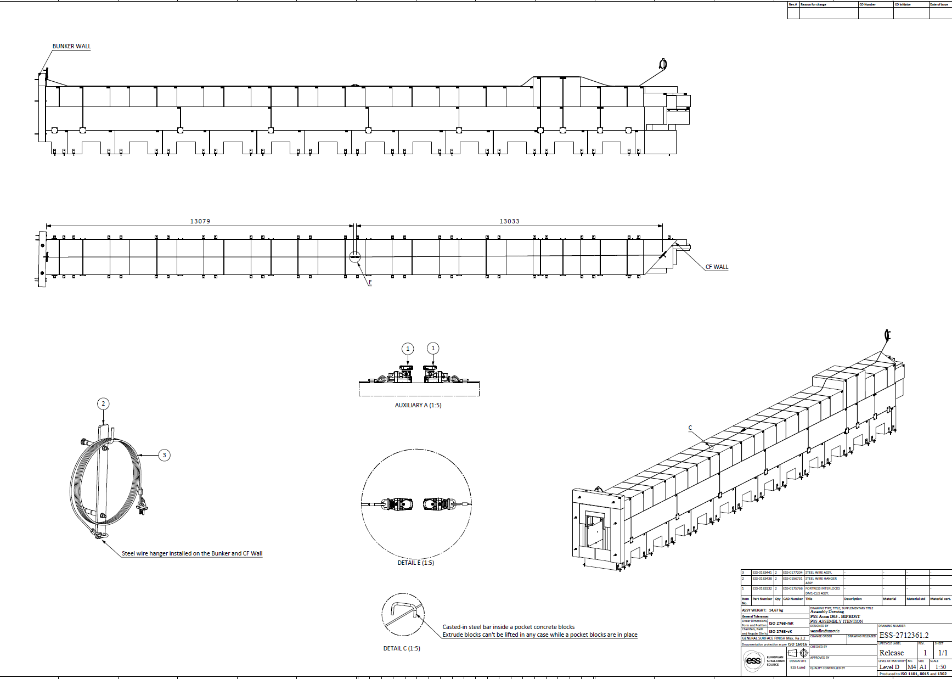
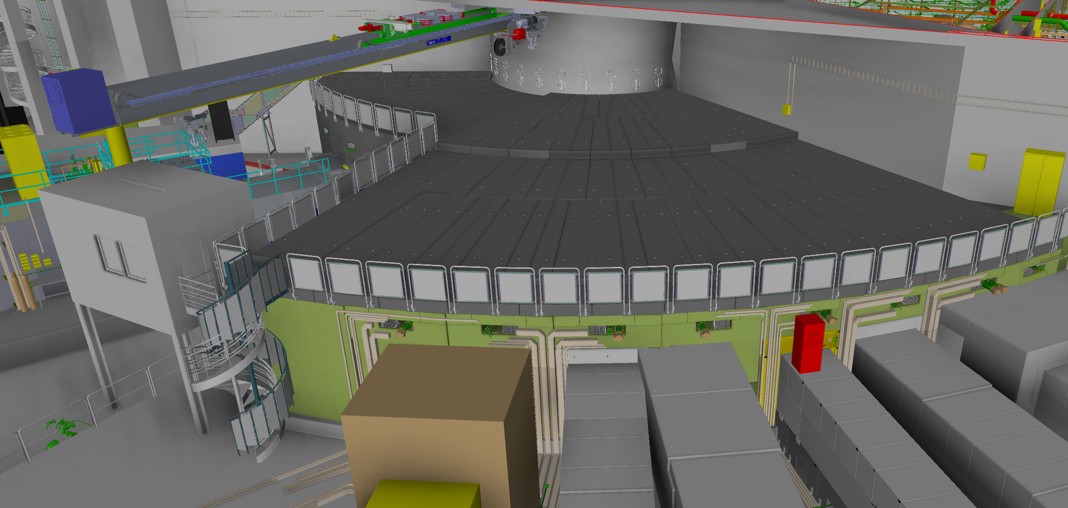
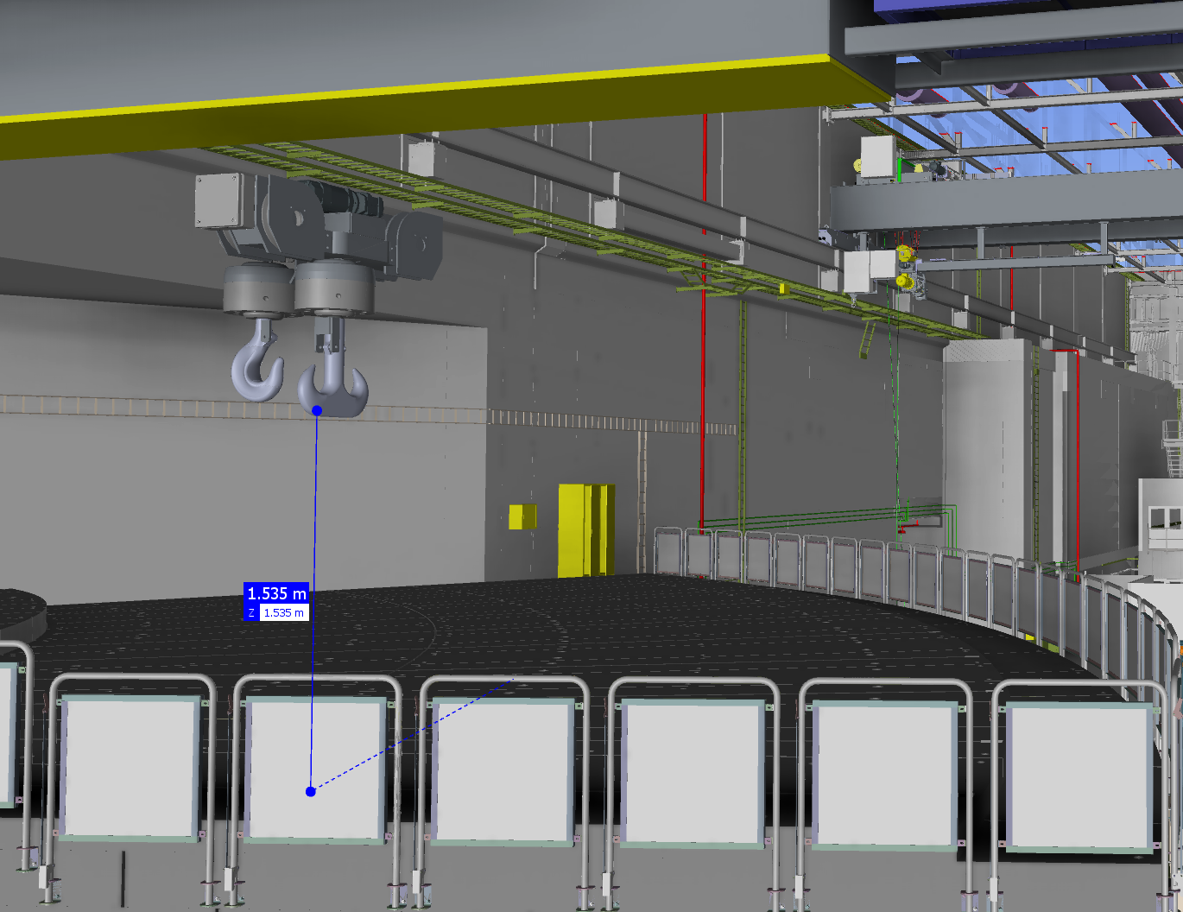
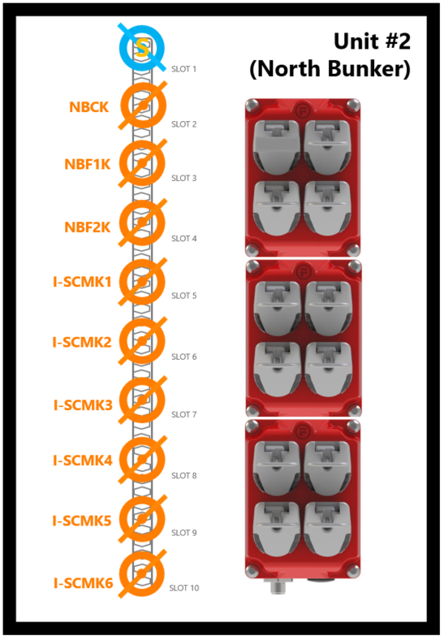
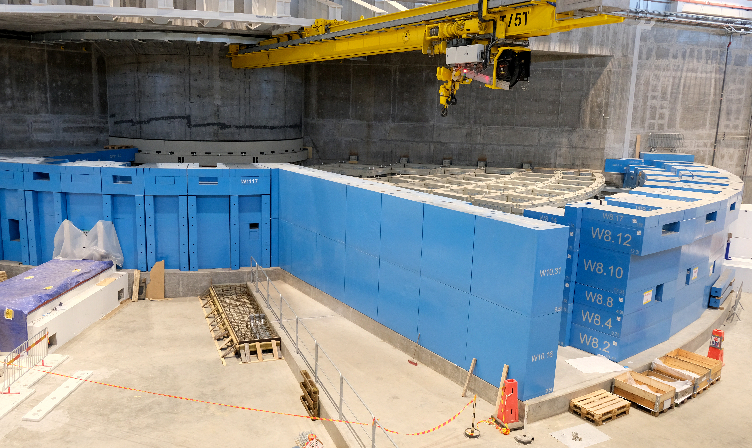


Bunker PSS key exchange system
You should swipe your card with active EPD and take ST to the door open
Bunker is in Access Mode I have a task there
North Bunker PSS key exchange unit #2 schematic
We counting the persons with Safety Tokens.
The Integrity of access control to the Bunker PSS area could be lost by opening the roof fence.
QR: Is it acceptable to open the fence under the supervision of the rigging team?

Slide 20

4
Granting Access to the Bunker PSS Controlled Area

Slide 21

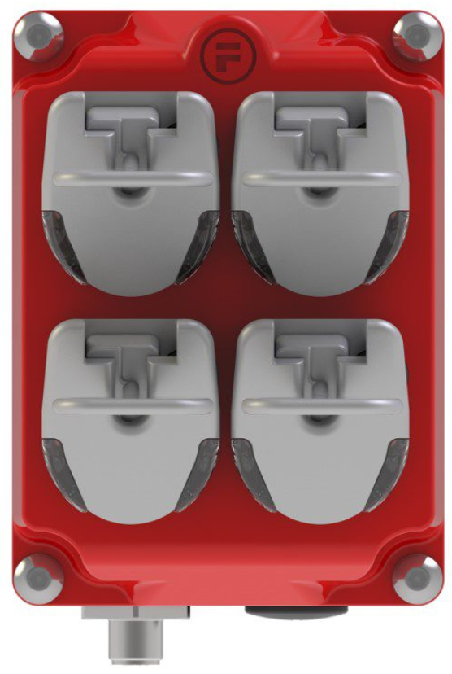
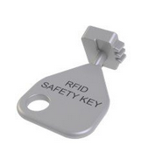
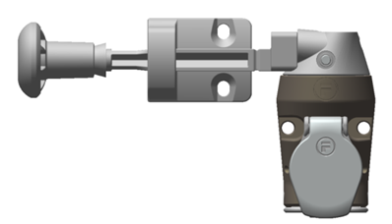
Granting Access to the Bunker PSS Controlled Area
Run slideshow on this slide
BoTK is locked in slot 2 until BoT is permitted
BoTK not in Slot 1 = Bending Magnets are interlocked
NBAK and SBAK can be released if all Light Shutters are closed and AMS = 0
The NBAK is locked by solenoid upon removing of any RFID keys and unlocked when all RFID keys are in home position and AMS = 0
Permit for Beam On Target
Unit #1
(Target – Bunker Scope)
S
Unit #2
(North Bunker)
SLOT 1
SLOT 1
BoTK
TAK
NBAK
SBAK
NBCK
SLOT 2
BoTK
S
S
S
S
NBCK
NBF1K
SLOT 2
SLOT 3
SLOT 4
SLOT 5
SLOT 3
NBAK
S
S
S
S
NBF2K
SLOT 6
SLOT 7
SLOT 8
SLOT 9
SLOT 4
BoT
OVK
TAVK
NBAVK
SBAVK
I-SCMK1
SLOT 5
If needed to considering a delay for access,
Access to Target basement by closing the Light shutters
LSS maintenance
NBAVK and SBAVK are managed by RP team. The solenoid is removed through HMI with RP credentials
I-SCMK2
Interlock module for Bunker crane, Instrument beamline shielding, Bunker fence
SLOT 6
I-SCMK3
SLOT 7
BoT ON
Mode
Transition
Mode
Access
Mode
I-SCMK4
SLOT 8
I-SCMK5
SLOT 9
I-SCMK6
SLOT 10

Slide 22

5
Preparing the Bunker PSS Controlled Area for Operation and Permits

Slide 23
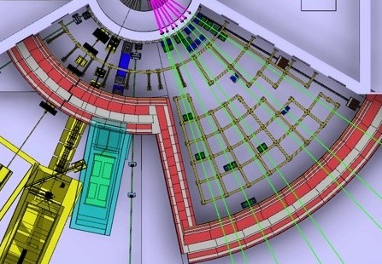
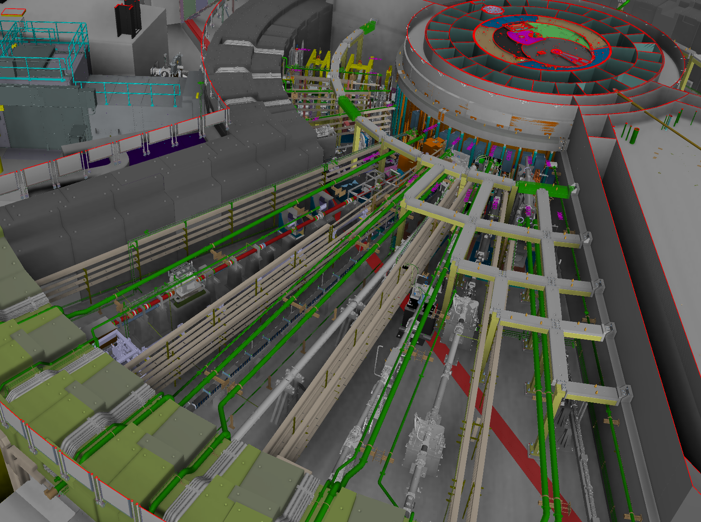
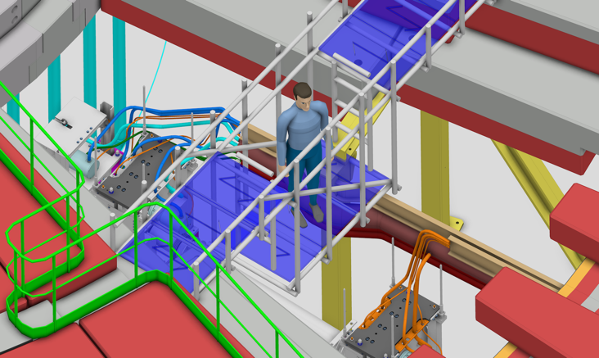
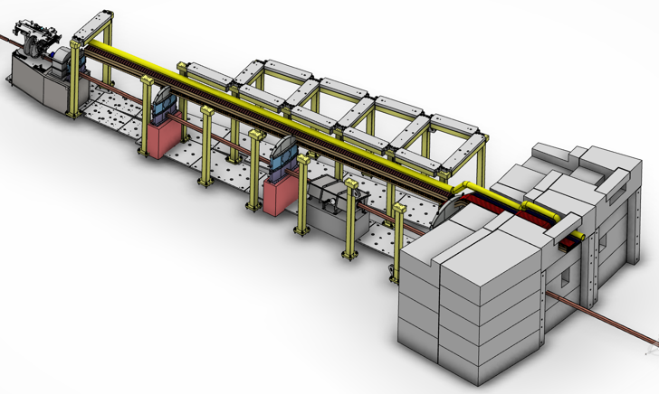
Preparing the Bunker PSS Controlled Area for Operation
Formalized Search inside the Bunker is not applicable
high radiation zones
Complex area with instruments beamlines, choppers, pipping, and equipment

Slide 24

Preparing the Bunker PSS Controlled Area for Operation
How be sure nobody left inside the Bunker before closing the area?
In Access mode Bunker PSS counts/controls the persons by Safety Token
Q: Are emergency stop buttons required in the Bunker area?

Slide 25

Preparing the Bunker PSS Controlled Area for Operation
The Rigging team requests everybody to leave the area except those who are responsible for closing the roof and placing the shielding blocks.

Slide 26

Preparing the Bunker PSS Controlled Area for Operation
Check with MCR, How many persons registered in AMS

Slide 27
Preparing the Bunker PSS Controlled Area for Operation

Slide 28
Preparing the Bunker PSS Controlled Area for Operation
The NBAK is locked by solenoid upon removing of any RFID keys and unlocked when all RFID keys are in home position and AMS = 0
S
Unit #2
(North Bunker)
NBAK
SLOT 1
NBCK
SLOT 2
NBF1K
SLOT 3
NBF2K
SLOT 4
NBCK
I-SCMK1
SLOT 5
I-SCMK2
SLOT 6
I-SCMK3
SLOT 7
I-SCMK4
SLOT 8
I-SCMK5
SLOT 9
I-SCMK6
SLOT 10

Slide 29
Permit to energizing the Bending Magnet for sending the Proton Beam to Target
BoTK not in Slot 1 = Bending Magnets are interlocked
LSS of North Bunker are still interlocked up to receiving permission from Target PSS
LSS of South Bunker are still interlocked up to receiving permission from Target PSS
Permit for Beam On Target
Unit #1
(Target – Bunker Scope)
SLOT 1
NBAK
SBAK
NBAK
TAK
BoTK
S
S
S
S
BoTK
SLOT 2
SLOT 3
SLOT 4
SLOT 5
S
S
S
S
SLOT 6
SLOT 7
SLOT 8
SLOT 9
BoT
OVK
Once BoTK is moved to Slot 1 ACC PSS enables the permit to BoT after a predefined beam imminent time . Now North and South Bunker PSS transitions to BoT ON mode.
TAVK
NBAVK
SBAVK
BoTK is locked in slot 2 until BoT is permitted
BoT OVK is managed by RP team. The solenoid is removed through HMI with RP credentials
(North–Bunker Modes of Operation)
(South–Bunker Modes of Operation)
BoT ON
Mode
Transition
Mode
Access
Mode
BoT ON
Mode
Transition
Mode
Access
Mode

Slide 30

6
Transition to Alarm mode

Slide 31
Transition to Alarm mode and Procedure to Transition to Access Mode
For Transition to Access mode the NBAK shall be off, NBAK can be released if all Light Shutters are closed and AMS = 0
If Light shutters are open it needed to close by LSS Control system
(North–Bunker Modes of Operation)
From the Alarm mode it is only possible to transition to Access mode after the anomaly is addressed.
Key Exchange configuration shall be same as Access Mode
BoT ON
Mode
Transition
Mode
Access
Mode
Permit for Beam On Target
Unit #1
(Target – Bunker Scope)
SLOT 1
BoTK
Internal error in Bunker PSS PLC system
Any critical key in the key exchange box– position lost
TAK
NBAK
SBAK
BoTK
S
S
S
S
SLOT 2
SLOT 3
SLOT 4
SLOT 5
S
S
S
S
Alarm
Mode
SLOT 6
SLOT 7
SLOT 8
SLOT 9
BoT
OVK
TAVK
NBAVK
SBAVK
Bunker PSS permit to the Light shutters is disabled
Bunker PSS permit to Nexus PSS as “Ready to BoT” is disabled

Slide 32
Transition to Alarm mode and Procedure to Transition to Access Mode
(North–Bunker Modes of Operation)
BoT ON
Mode
It is needed to everybody leave the area,
All safety tokens returned to the key exchange system,
Searching the area procedurally and closing the emergency doors.
Transition
Mode
Access
Mode
Internal error in Bunker PSS PLC system
Any critical key in the key exchange box
Internal error in Bunker PSS PLC system
Any critical key in the key exchange box
If the e-exit door is detected open during Access mode, the integrity of access control to the Bunker PSS area is lost.
Alarm
Mode
Bunker PSS permit to the Light shutters is disabled
Bunker PSS permit to Nexus PSS as “Ready to BoT” is disabled

Slide 33

7
Bunker PSS Interfaces

Slide 34
Bunker PSS Interfaces
Actuators to Interlock Bending Magnets
  Through the BoT Key
Physical Protection System
Electronic Personal Dosimeter
Bunker Roof Fence
Bunker Crane
Instrument Shielding Blocks
Equipment Under Control
  Actuators to Interlock Proton Beam
  Actuators to Interlock Light Shutters

Slide 35
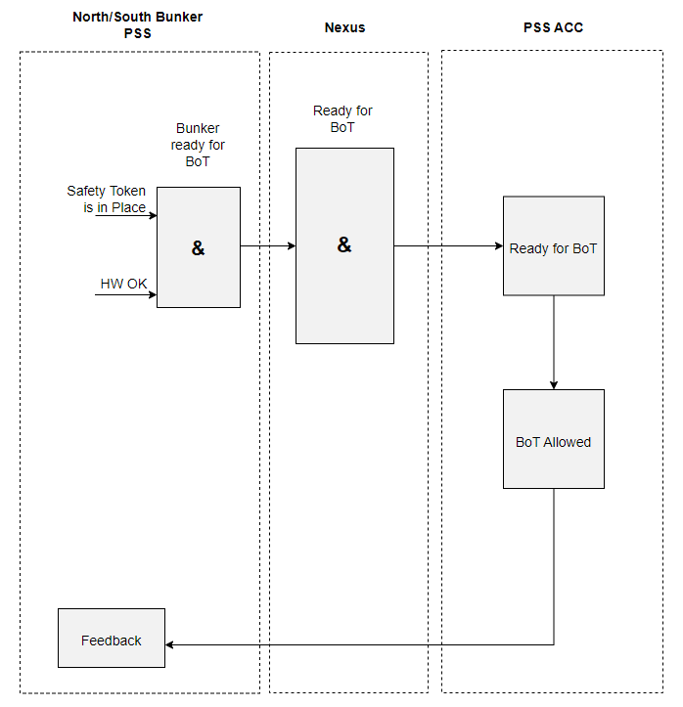
Interfaces: Actuators to Interlock Proton Beam

Slide 36
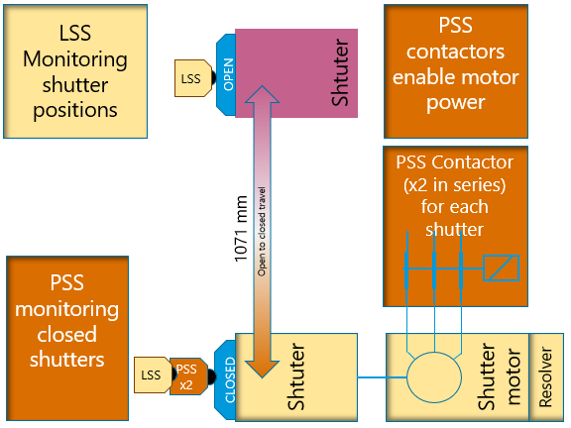
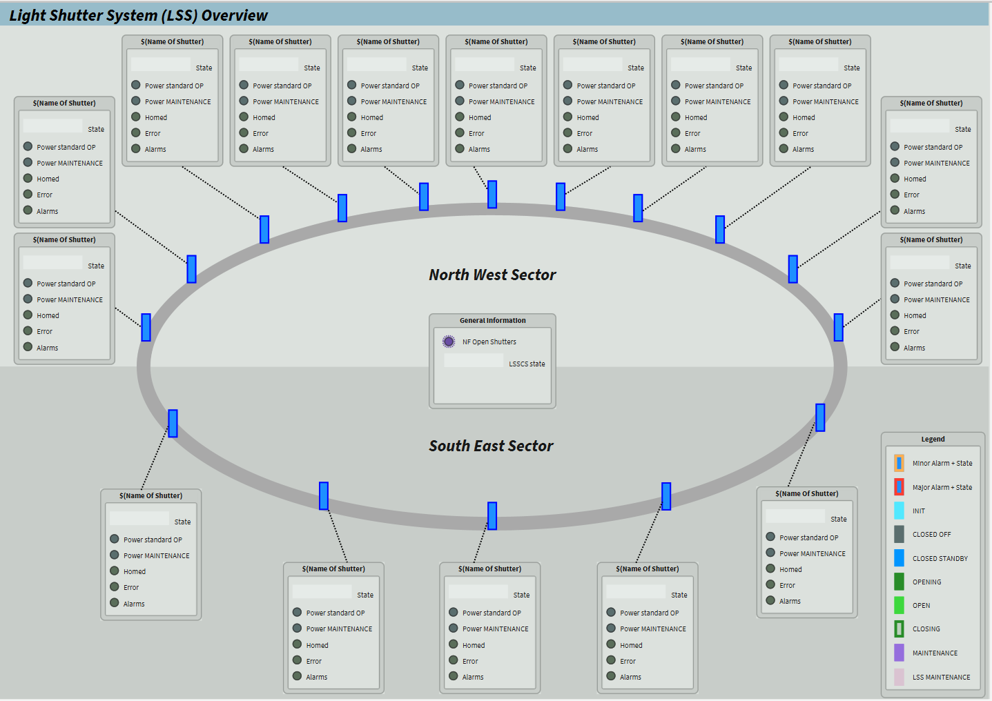
Interfaces: Actuators to Interlock light shutters
Bypass in Bunker PSS: Maintenance for light Shutter
Two redundant PSS limit switches indicating closed position of each Light Shutter.
PSS Contactors for each Light Shutter.
Bunker PSS enables the permit to that specific light shutter and the status of the PSS position switches on the light shutter is ignored in Bunker PSS System
The Bunker PSS interfaces with the Target Station PSS (TS PSS) through Nexus PSS in order to:
Inform TS PSS on the position of the light shutters
Receive requests from TS PSS to interlock the light shutters
Maintenance of the Light shutter as an indication for the Target PSS

Slide 37

8
Bunker PSS Questions

Slide 38
Bunker PSS Questions
Do we need to have single entry control in Bunker PSS Access control?
How many safety tokens is recommended for counting the persons in Access mode?
  Based on preliminary discussion with owner, 12 ST considered in this stage.
Is it acceptable to open the fence under the supervision in access mode?
  We counting the persons with Safety Tokens.
  The Integrity of access control to the Bunker PSS area could be lost by opening the roof fence. (e.g. Some one enter the bunker area from the fence opening)
Are emergency stop buttons and blue lights required in the Bunker area?
  The bunker area is a confined space area
  We don’t have normal lighting inside the bunker

Slide 39
Thank you

Slide 40
Back-up slides

Slide 41
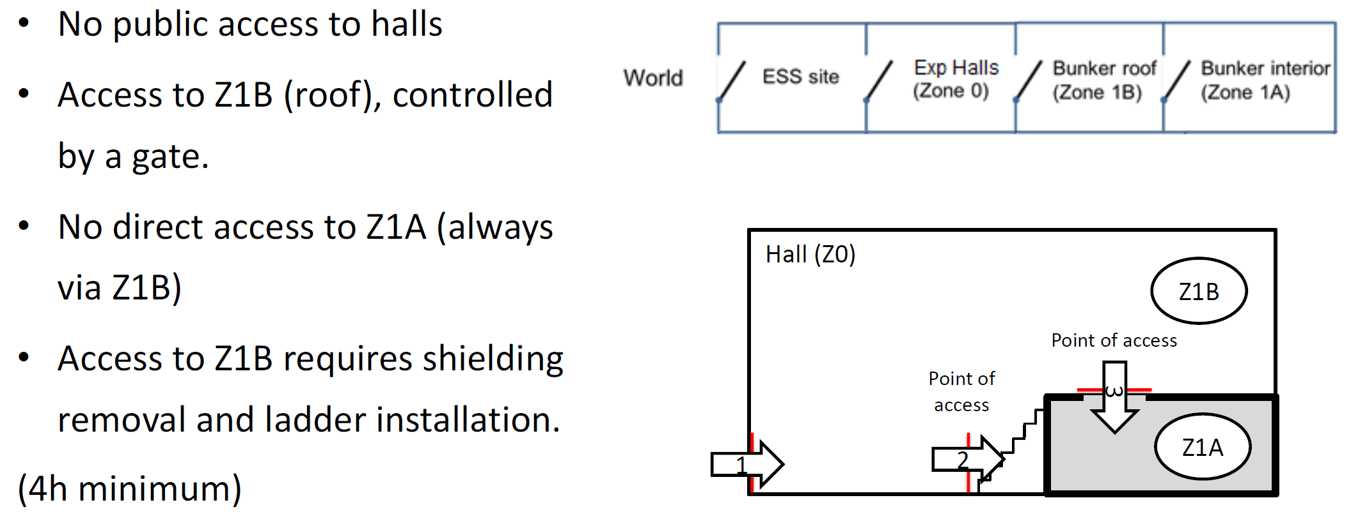
In Bunker Access case example

Slide 42
Blocks’ integrity
Bunker’s Safety
The interlock design uses steel line, propagated from the Monolith skirt shield wall through the blocks in the top level, up to the interlocks which are placed on the outer perimeter of the roof.

Slide 43
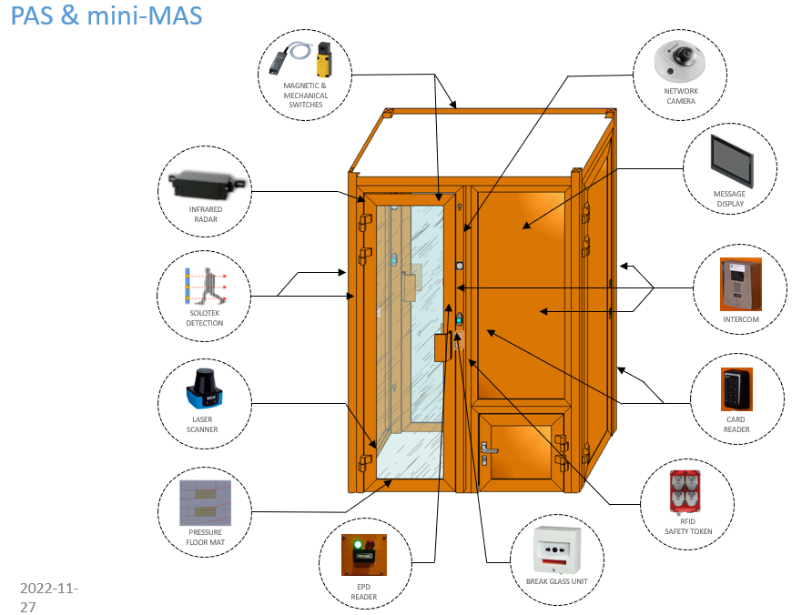
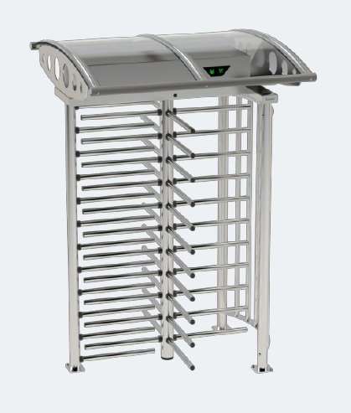
Access Control System

Slide 44
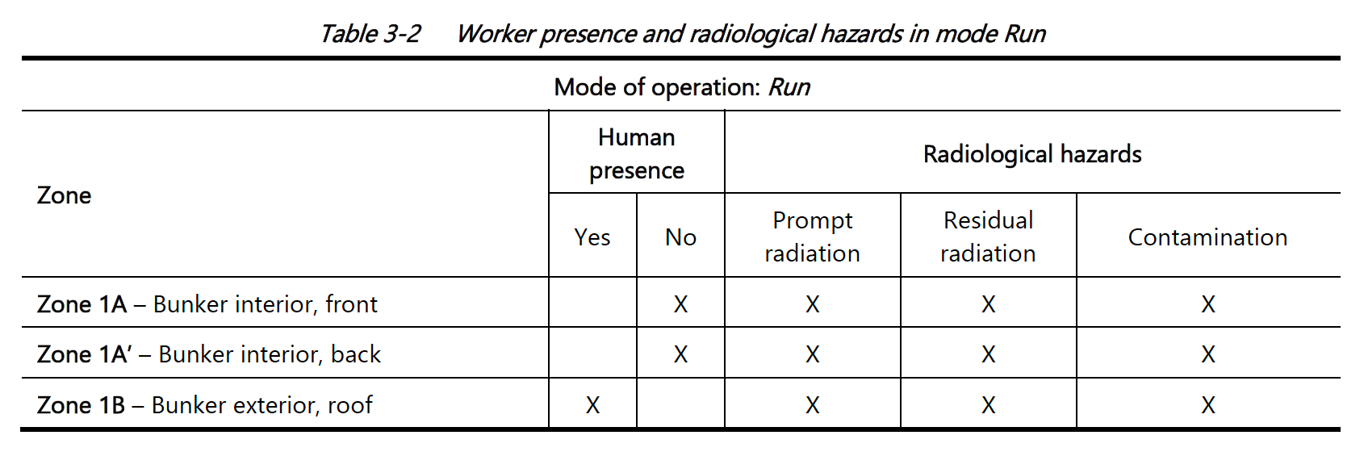
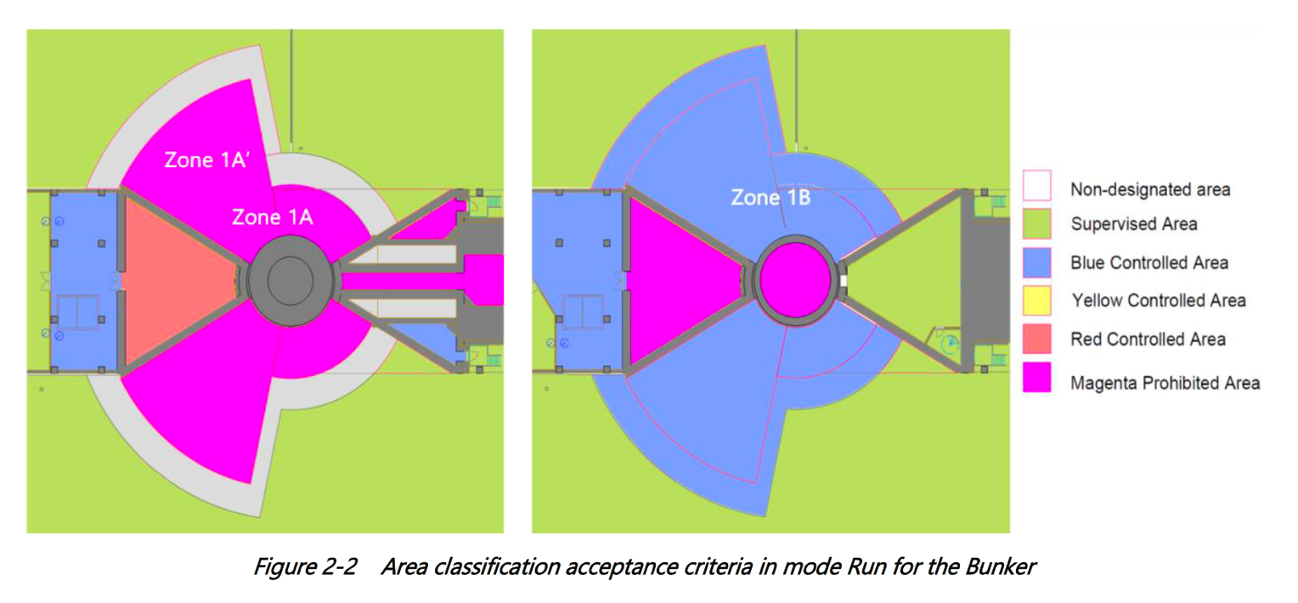
Planned human presence
MODE: RUN (source operating)

Slide 45
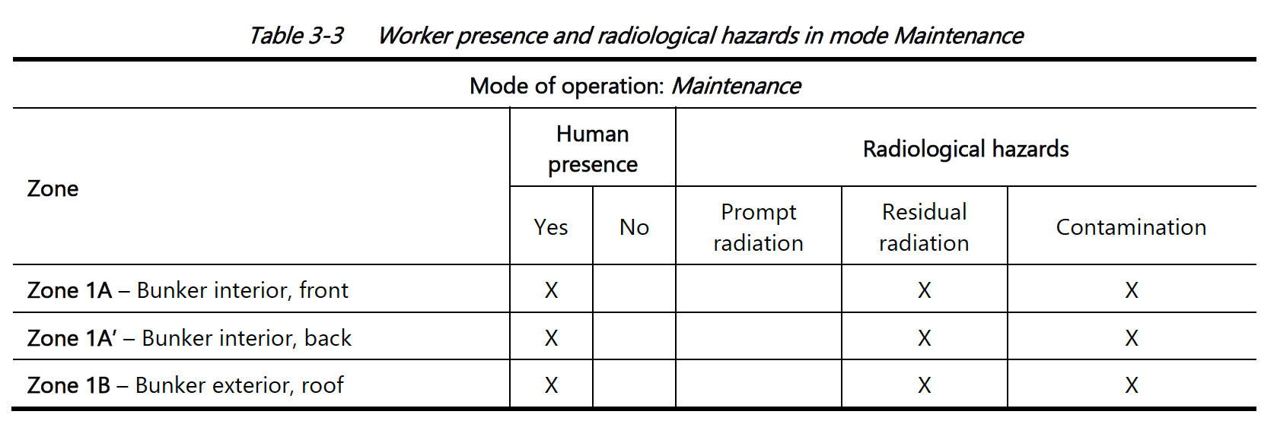
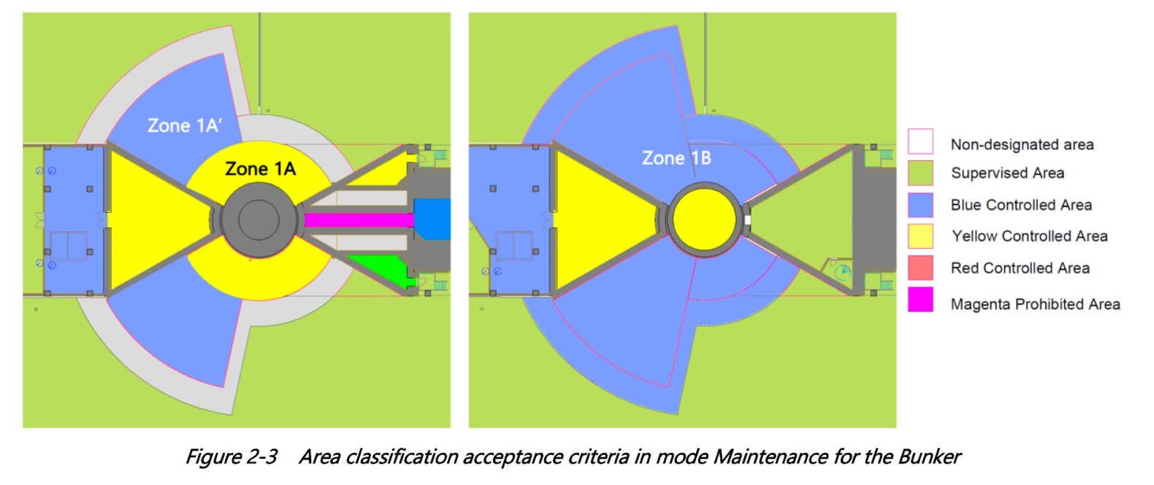
Planned human presence
MODE: Maintenance (source shutdown)

