Slide 2
ESS PSS Architecture.
General solutions, components, networks and technologies
PRESENTED BY Artem Petrushenko

Slide 3
Agenda
General solutions (Equipment, networks, technologies)
2 Nexus PSS Functional Architecture / System Architecture
3 Accelerator PSS Functional Architecture
4 Interface between Nexus PSS and ESS PSS Systems
5 Reaction times
6 Time Syncronization
7 Functional Architecture tests overview
8
9

Slide 4
ESS PSS Architecture
General solutions:
Networks,
Technologies

Slide 5

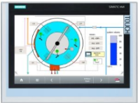
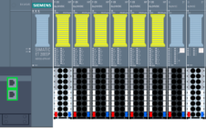
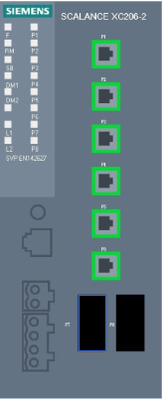





ESS PSS Architecture
General solutions
Transfer Workstation
PSS-XFER
VM
Main PLC
Remote IO Station
PSS HMI
Network
Switch
UPS Module
NTP
PROFINET TCP/IP
To show the data on the OPIs,
To provide operators with alarm notification through alarm annunciator service,
To archive data on EPICS archiver.
Gateway PLC
PSS Supervision Station (MCR)
Deployment workstation for Gateway PLC
VM
Technical Network
EPICS = Experimental Physics and Industrial Control System
HMI = Human Machine Interface
IO = Input / Output
MCR = Main Control Room
PLC = Programmable Logic Controller
UPS = Uninterruptible Power Supply

Slide 6

ESS PSS Architecture
General solutions: Network technologies
Main PLC
Remote IO Station
PSS HMI
Network
Switch
UPS Module
PROFINET TCP/IP
Features:
Fast device replacement – because the I/O controller automatically detects the new device and assigns its name
Flexible topologies – with linear, star, tree, and ring topologies
Large quantity structures – up to 1,024 devices can be managed per network. Simple configuration of hierarchical controller structures via mechanisms like I-Device
High transmission rates – fast and efficient data throughput for large volumes of data without affecting I/O data transfer
And more..

Slide 7
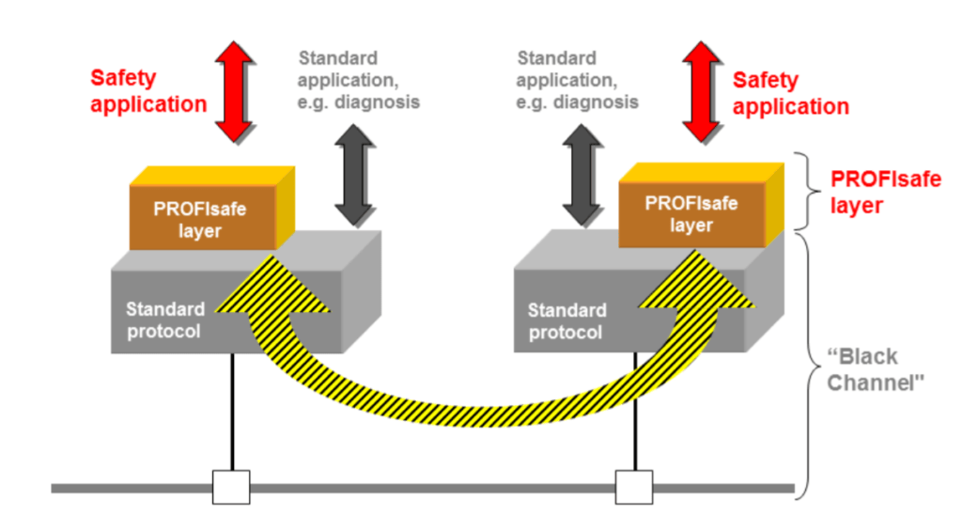
ESS PSS Architecture
General solutions: Network technologies
Fail-Safe (F) is the ability of a system to safely protect against hazards or reduce the risk to an acceptable level through the use of appropriate technical and organizational measures.
PROFIsafe is defined in IEC61784-3-3 as the protocol for implementing functional safety (failsafe), and is recognized by IFA (industrial safety institute of the DGUV, German Social Accident Insurance) and TÜV.
Safety measures:
Consecutive numbering of F messages (“sign-of-life”)
Expected time with acknowledgement (“watchdog”)
An ID between the sender and receiver (“F address”)
Data integrity check (CRC = cyclic redundancy check)
*
*PROFIsafe is designed to be independent of the base transmission channel; whether that channel is copper wire, fiber optics, wireless or a back-plane. The transmission rate and any built-in error detection mechanisms of the transmission protocol are considered “Black Channels” (like a black box where we don’t know what’s inside), they play no role in safety considerations. This approach frees PROFIsafe users from having to worry about the safety assessment of the individual system communication paths.

Slide 8
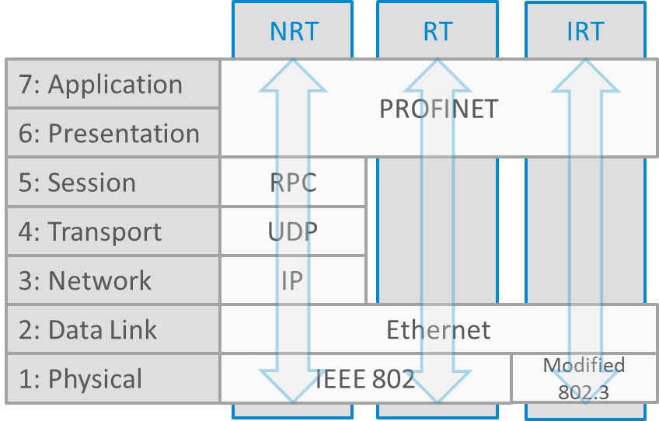
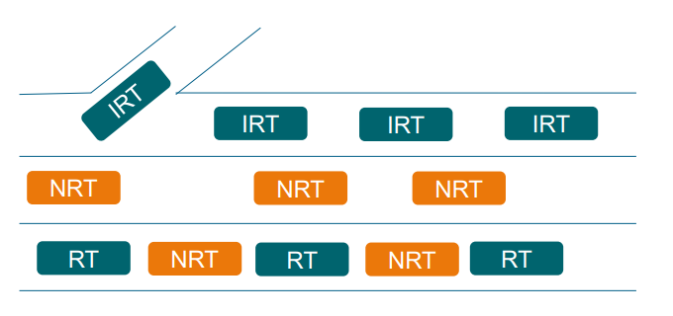
ESS PSS Architecture
General solutions: Network technologies
OSI model:
None Real Time (NRT) <100ms cycle:
Acyclic
Uses TCP/IP
Real Time (RT) <10ms cycle:
Cyclic
Skips the TCP/IP Layers
Isochronous Real Time (IRT) <1 ms cycle:
Cyclic
Reserved Bus lane
NRT communication are used for communication between Main and Gateway PLCs
RT communications are used for IO networks
IRT communications are used for networks with high redundancy capabilities (Nexus PSS)

Slide 9
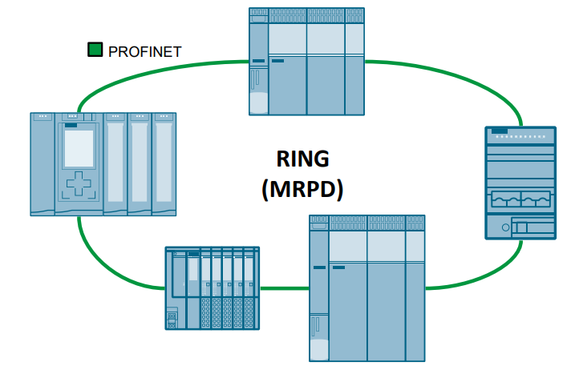
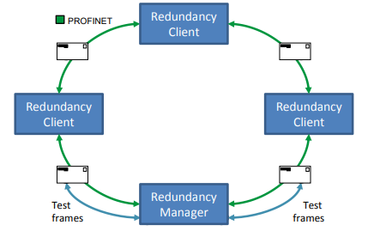
ESS PSS Architecture
General solutions: Network redundancy (MRPD)
MRPD offers the following advantages:
Short update times due to IRT;
During a device or line failure in the ring, all other devices continue to be supplied with IO data without interruption and reconfiguration time;
Comprehensive diagnostics via PROFINET;
Realizable without the use of additional external Ethernet Switches.

Slide 10
ESS PSS Architecture
General solutions: Equipment

Slide 11
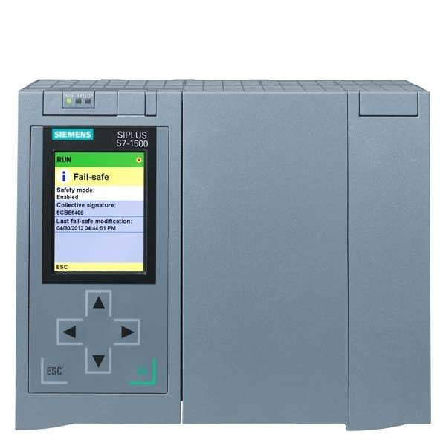
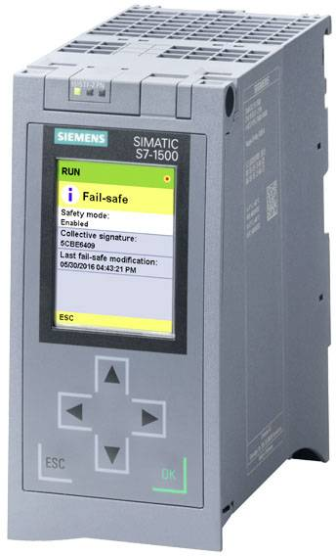
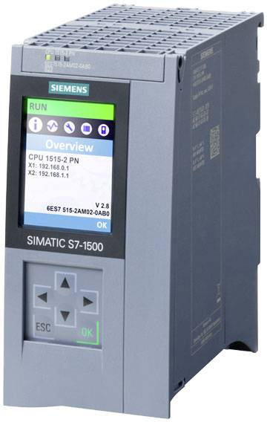
ESS PSS Architecture
Solutions & Technologies: PLCs
Failsafe application, large scope:
Failsafe application, regular scope:
Standard application (GCPU):
CPU 1518F-4 PN/DP
CPU 1515F-2 PN
CPU 1515-2 PN
Highest safety class achievable in safety mode: SIL3 (acc. to IEC61508)

Slide 12
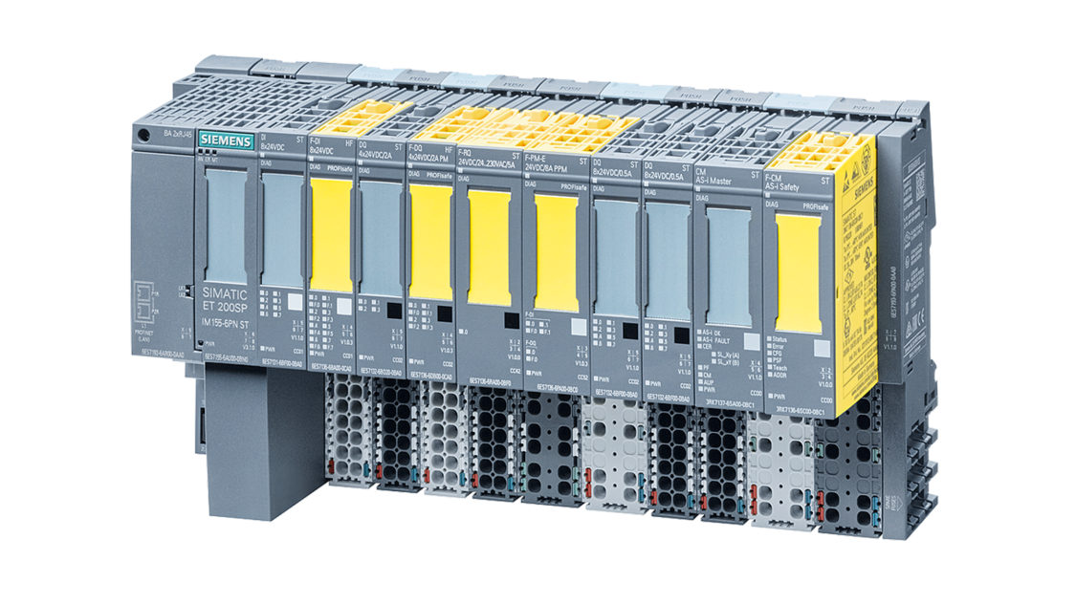
ESS PSS Architecture
Solutions & Technologies: Remote IO
SIMATIC ET 200SP
Failsafe IO:
Module | Description | Achievable SIL (acc. to IEC61508)
F-DI 8x24V DC HF | 8 failsafe inputs, High Feature Module | SIL3
F-DQ 4x24V DC/2A PM HF | 4 failsafe outputs, P/M-switching High Feature Module | SIL3
F-DQ 8x24VDC/0.5A PP HF | 8 failsafe outputs, P/P switching High Feature Module | SIL3
F-RQ 1x 24VDC/24..230VAC/5A ST | 1 failsafe relay output, Standard Module | SIL3
Standard IO:
Module | Description
DI 8xDC 24V HF | 8 High Feature inputs, channel wise diagnostics, Isochronous mode
DQ 8x DC 24V/0.5A HF | 8x 0.5A digital outputs, High Feature module, channel wise diagnostics, isochronous operation

Slide 13
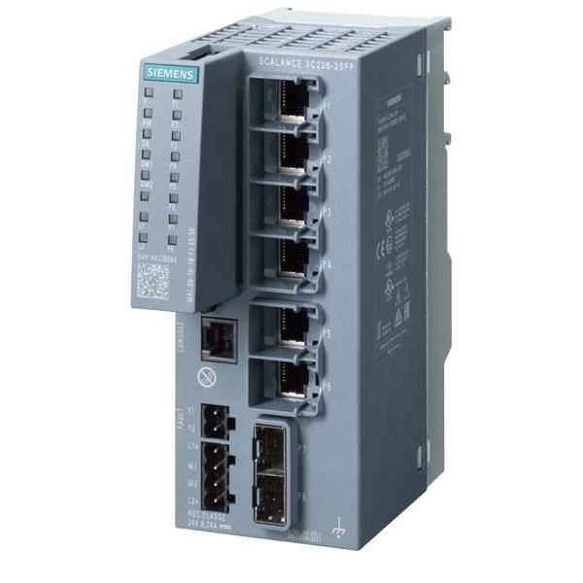
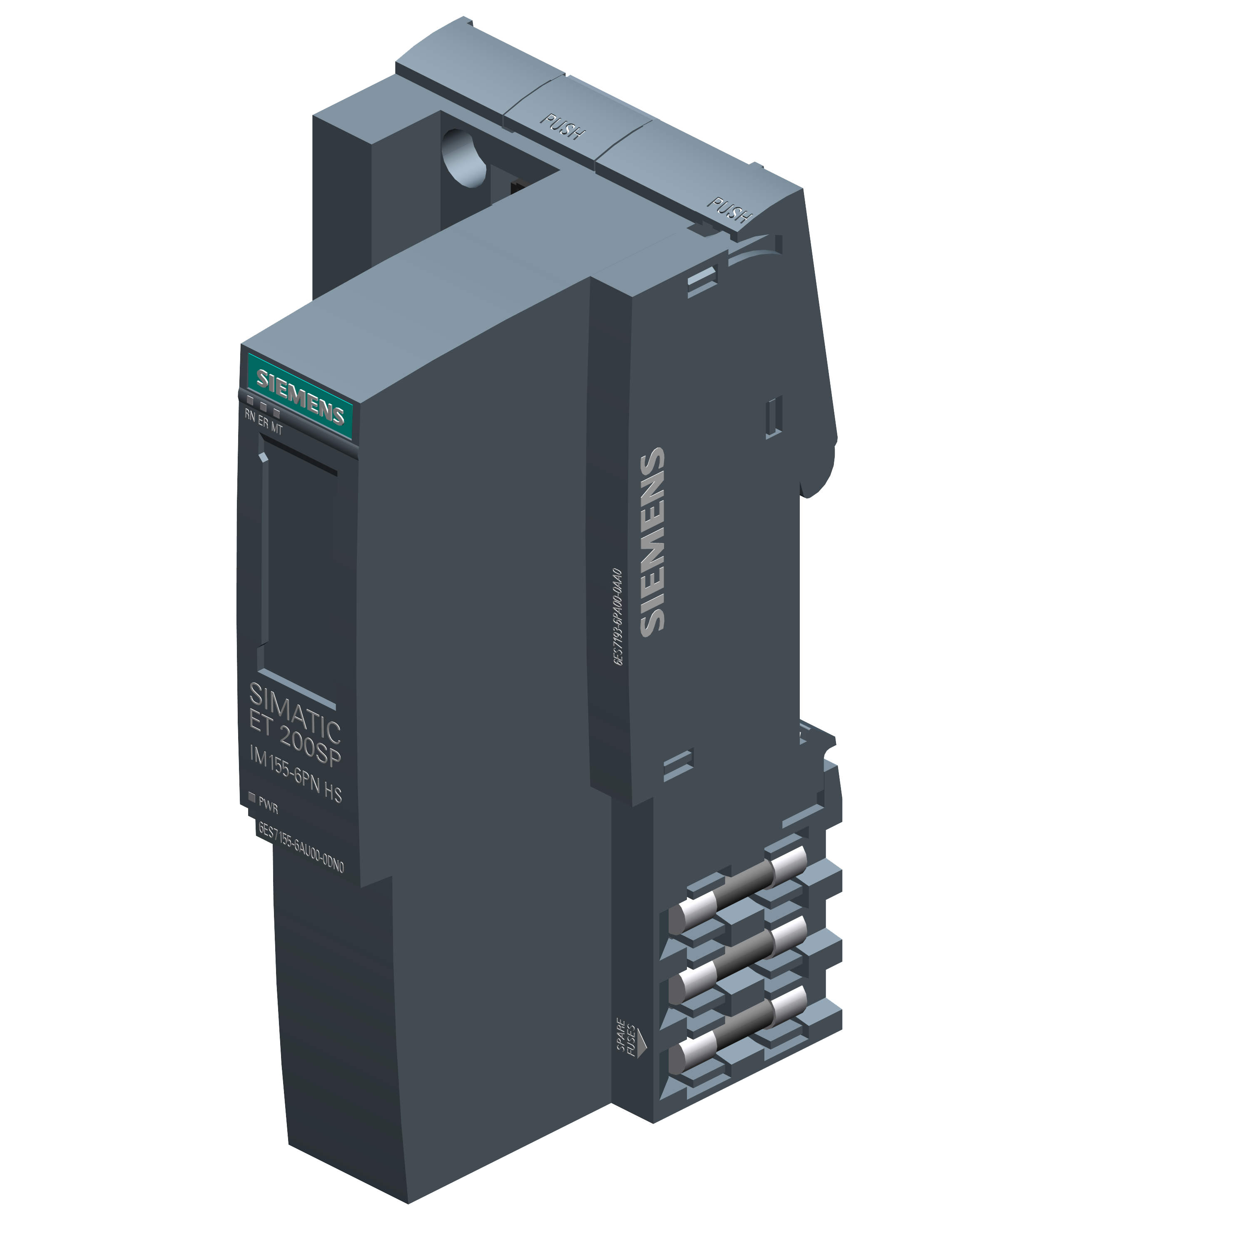
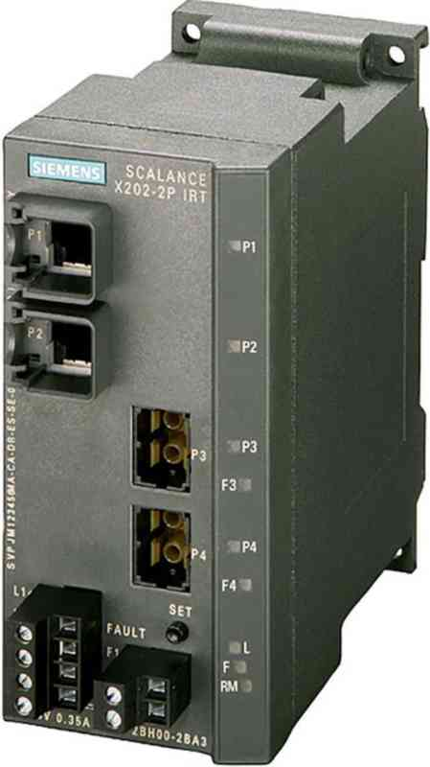
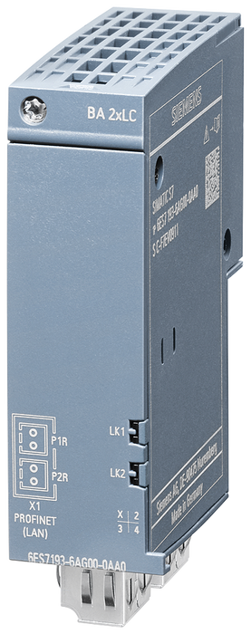
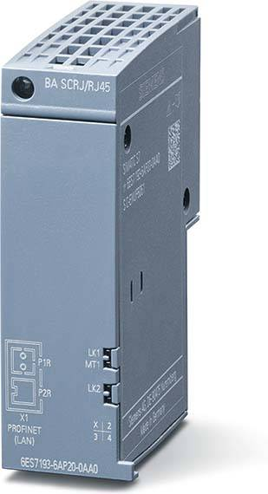
ESS PSS Architecture
Solutions & Technologies: Network equipment
Scalance XC206-2SFP
Scalance X202-2P IRT
Scalance IM155-6 PN HS/HF
BA 2xLC
BA 2xRJ45

Slide 14
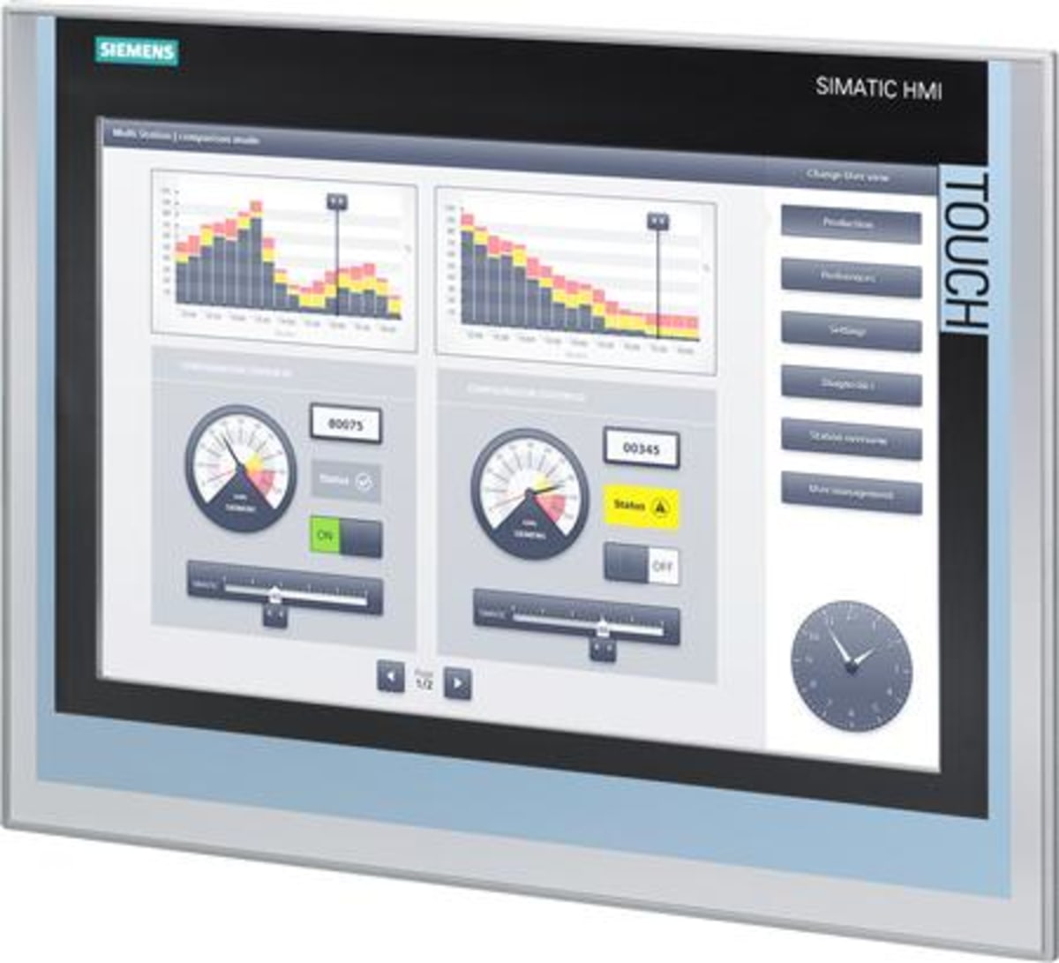

ESS PSS Architecture
Solutions & Technologies: HMIs
Simatic HMI comfort Panel
Simatic HMI Unified comfort Panel
Phase-out has been announced

Slide 15
ESS PSS Architecture
Solutions & Technologies: EPICS integration
Transfer Workstation
(PSS-XFER)
VM
Remote IO Station
PROFINET TCP/IP
Technical Network
Safety PLC
Gateway PLC
Unidirectional data transfer – No is traffic allowed from the technical network side

Slide 16
ESS PSS Architecture
Nexus PSS
Functional Architecture
System Arhitecture

Slide 17
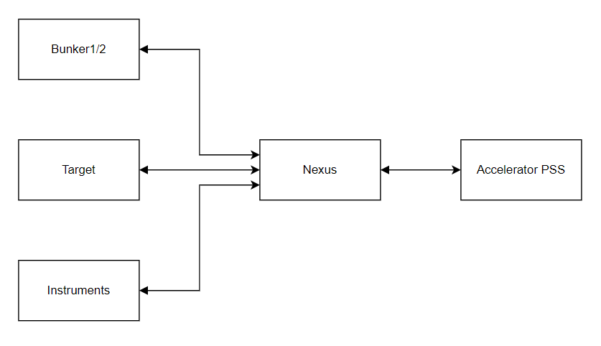
Nexus PSS Architecture
In certain hazardous scenarios, TS PSS, Bunker PSS and each Instrument PSS need to request ACC PSS to prevent proton beam to Target. In order to ensure a robust and reliable interlink between different PSS Systems, destributed PSS system called Nexus PSS. It is a PLC-based system with remote Input/Output modules that collects “Ready” status from each PSS distributed across the facility, to evaluate readiness for Beam on Target, and communicates it to the ACC PSS.

Slide 18
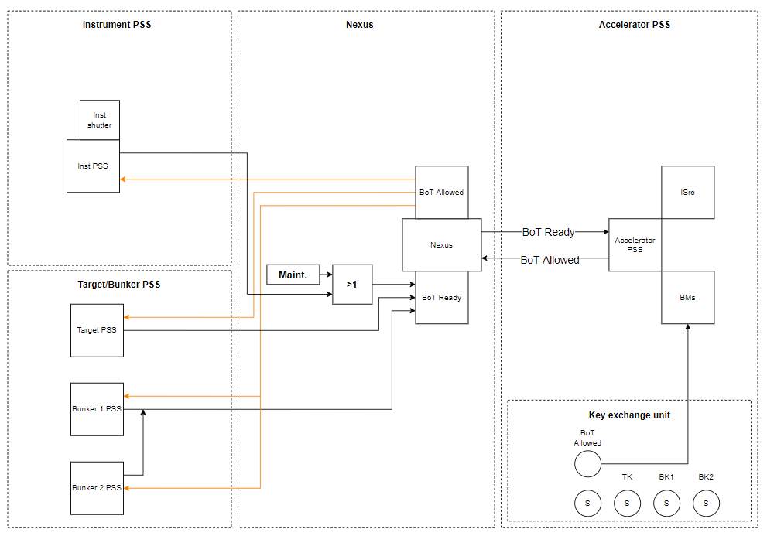
ESS PSS Software
ESS PSS Software preliminary design

Slide 19
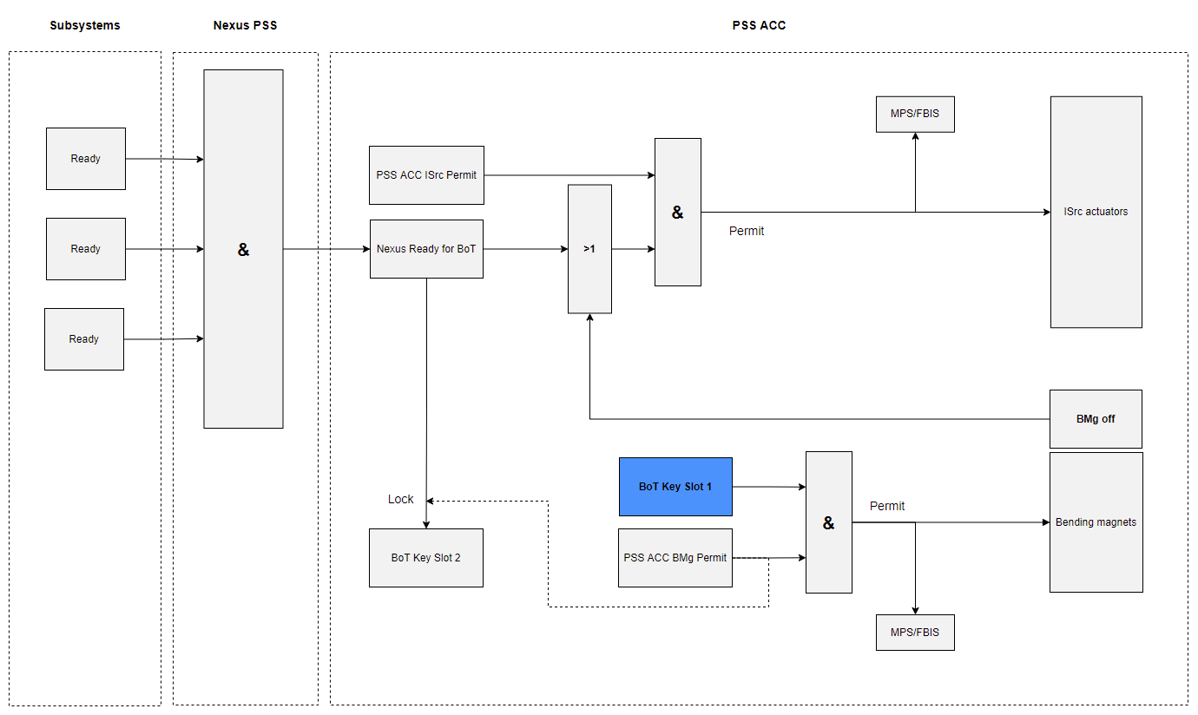
ESS PSS Software
ESS PSS Software preliminary design (from PSS Accelerator perspective)

Slide 20
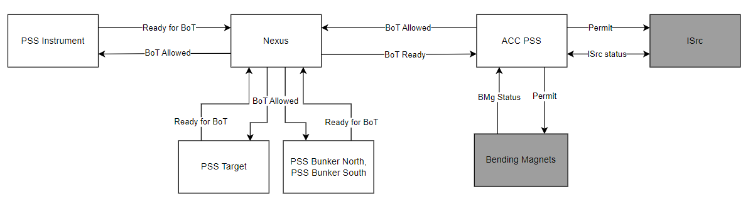
ESS PSS Software
ESS PSS Software preliminary design, use cases
BoT Key

Slide 21



ESS PSS Software
ESS PSS Software preliminary design: Beam on TBD
N / A
BoT Key
BoT Key locked in S2 until Nexus is Ready for BoT

Slide 22
ESS PSS Software
ESS PSS Software preliminary design: Beam On Target
BoT Key

Slide 23

ESS PSS Software
ESS PSS Software preliminary design: Beam on Target, Instrument ESTOP
BoT Key
Check BMs status
ESTOP pressed
+
Heavy Shutter not closed in 500ms

Slide 24
ESS PSS Software
ESS PSS Software preliminary design: Beam on Target, ISrc actuators failure
BoT Key

Slide 25
ESS PSS Software
ESS PSS Software preliminary design: Beam On Target, Loss of comms with instrument PSS
BoT Key
Check BMs status

Slide 26
ESS PSS Architecture
Nexus PSS
System Architecture

Slide 27
Nexus PSS Architecture
Limitations:
Maximum number of devices: 32
Maximum segment length for Fiber optic cable (between 2 active components): 2000m
Maximum segment length for copper cable (between 2 active components): 100m
Only IRT-enabled devices are allowed in the ring

Slide 28
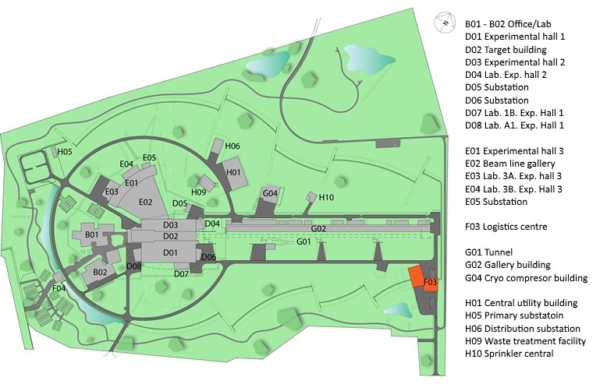
Nexus PSS Architecture
Network ring: Plant overview

Slide 29
Nexus PSS Architecture

Slide 30

Nexus PSS Architecture
Nexus PLC cabinet
Transfer Workstation
(PSS-XFER)
VM
Nexus Remote IO Station
…
Nexus PLC Cabinet
Nexus Remote IO Station
…
Technical Network
Nexus Remote IO Station
Safety PLC
Gateway PLC
NTP

Slide 31

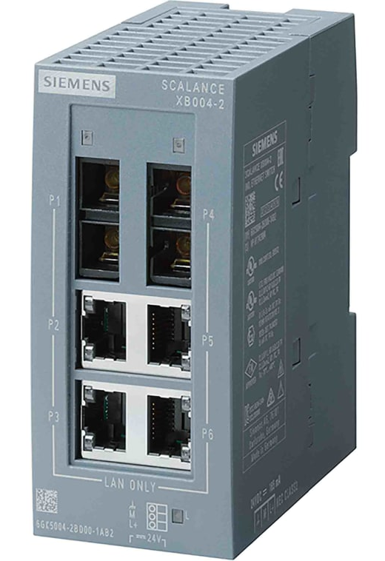
Nexus PSS Architecture
PSS Setup per building
D01 Network cabinet
Legend:
D01
Fiber-optic
Copper
Deploy network (copper)
NTP
Hardwired connection
Estia PSS PLC Cabinet
Nexus RIO
Estia PSS PLC Cabinet
Nexus RIO
Deploy network
RIO
Deploy network
RIO
Skadi PSS PLC Cabinet
Nexus RIO
Skadi PSS PLC Cabinet
Nexus RIO
Deploy network
RIO
Deploy network
RIO
Vespa PSS PLC Cabinet
Nexus RIO
Bunker PSS PLC Cabinet
Nexus RIO
Deploy network
RIO
Deploy network
RIO

Slide 32
ESS PSS Architecture
Interface between
Nexus PSS and
ESS PSS Systems

Slide 33
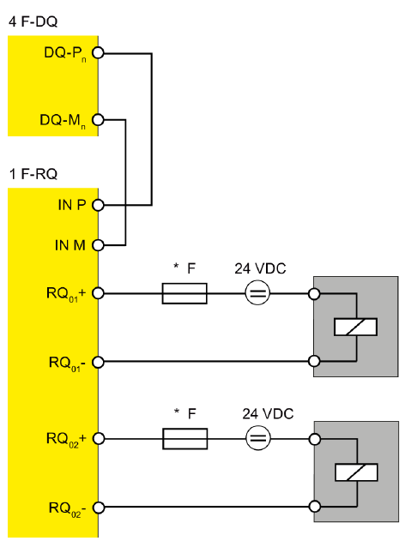
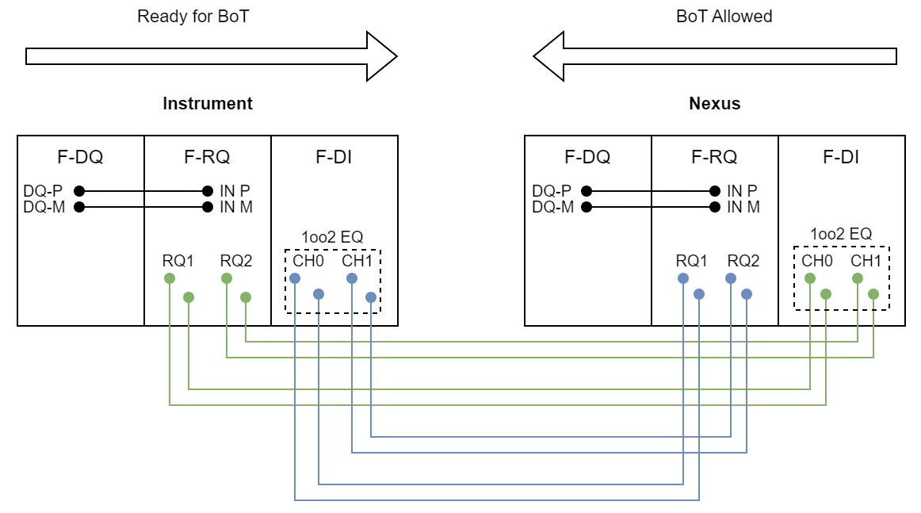
Nexus PSS Architecture
Interface between Nexus and Subsystems
F-RQ + F-DQ setup

Slide 34
ESS PSS Architecture
Accelerator PSS:
System Architecture

Slide 35
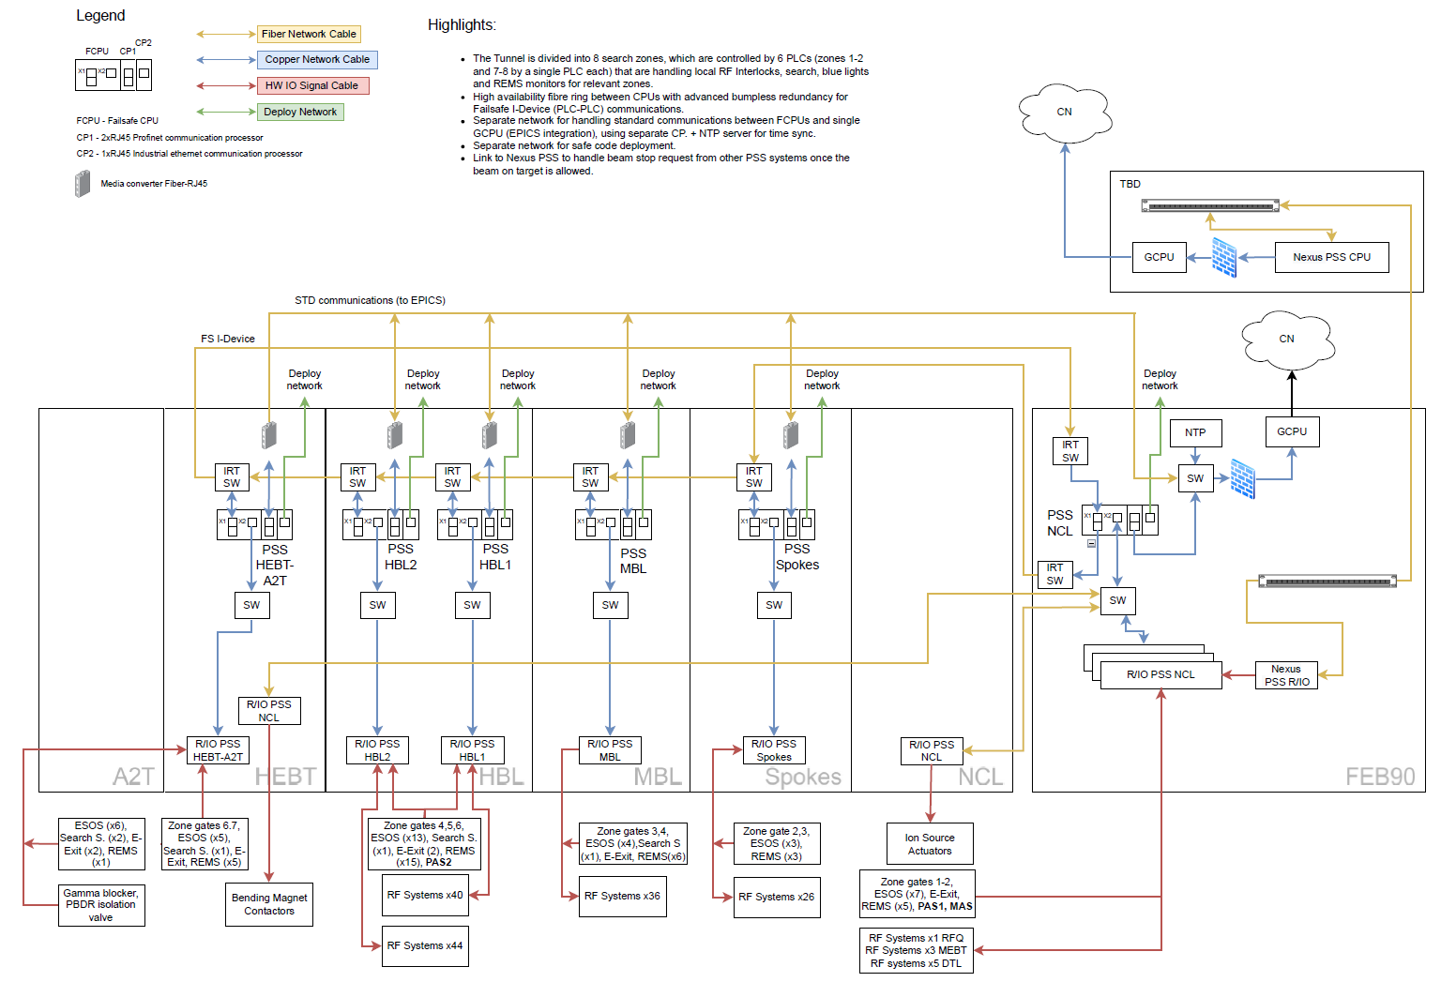
Accelerator PSS Architecture

Slide 36
ESS PSS Architecture
Reaction Times

Slide 37
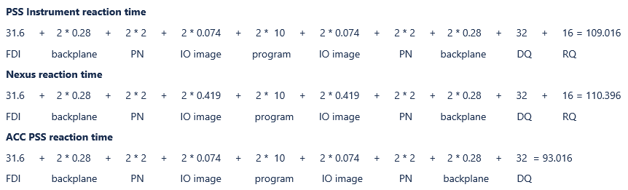

ESS PSS Architecture
ESS PSS reaction times
Interlock condition from any of the instruments to shut off ISrc, worst case:
~109 ms
~110 ms
~93 ms

Slide 38
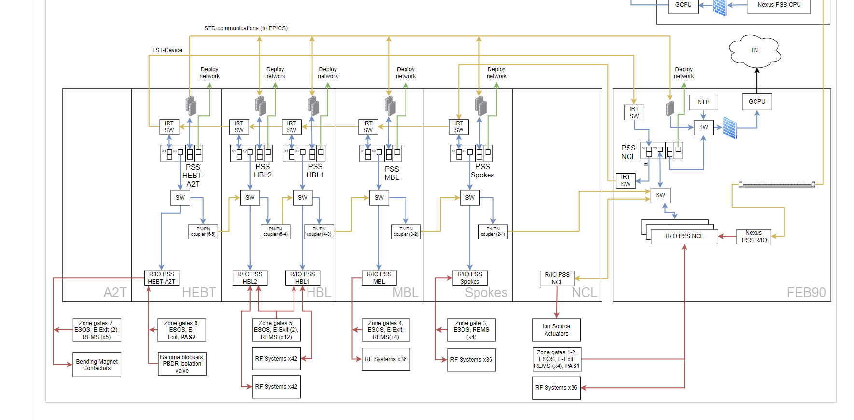
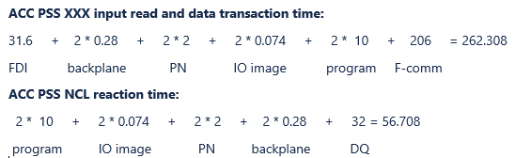

ESS PSS Architecture
ESS PSS reaction times
Interlock condition from any of the ACCPSS subsystems to shut off ISrc, worst case:
200 ms
62ms
56 ms

Slide 39
ESS PSS Architecture
Time syncronization

Slide 40
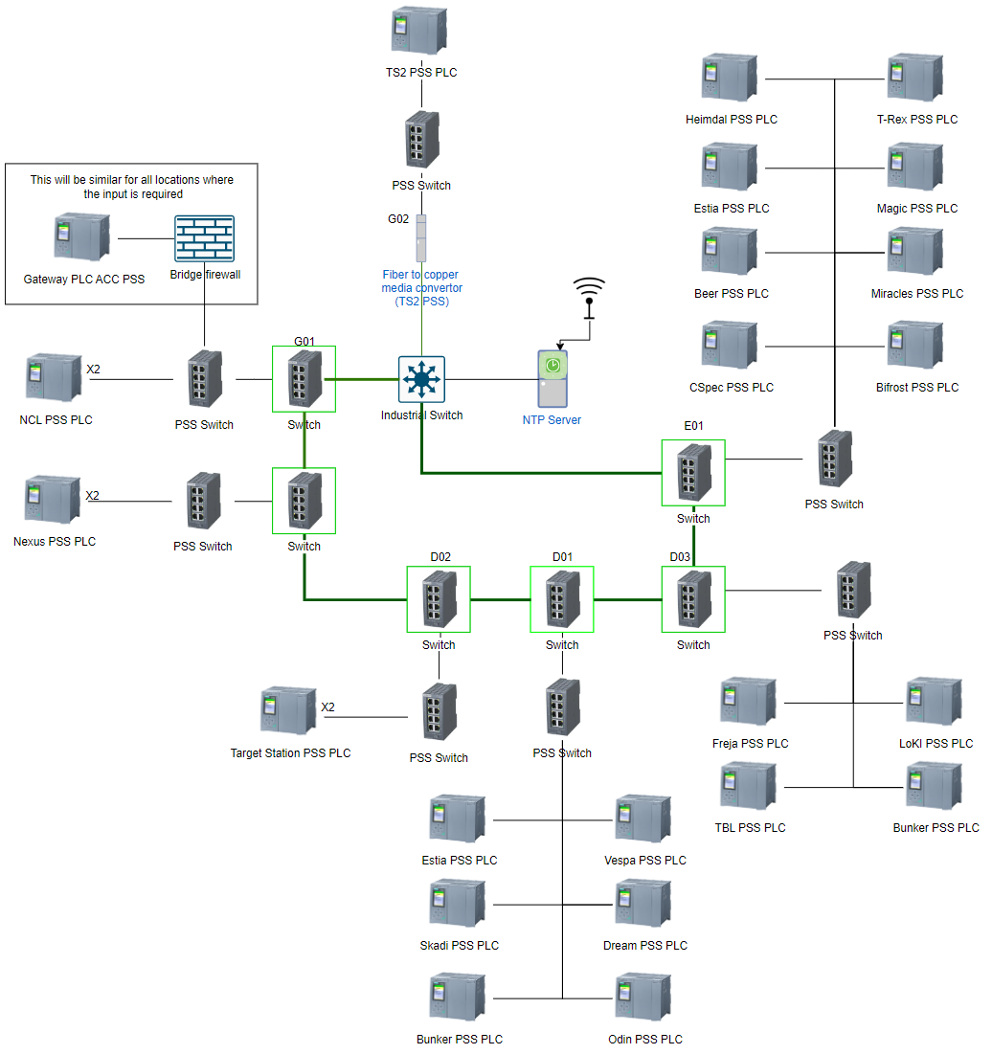
ESS PSS Architecture
Solutions & Technologies: NTP Solution

Slide 41
ESS PSS Architecture
Lab Tests overview

Slide 42
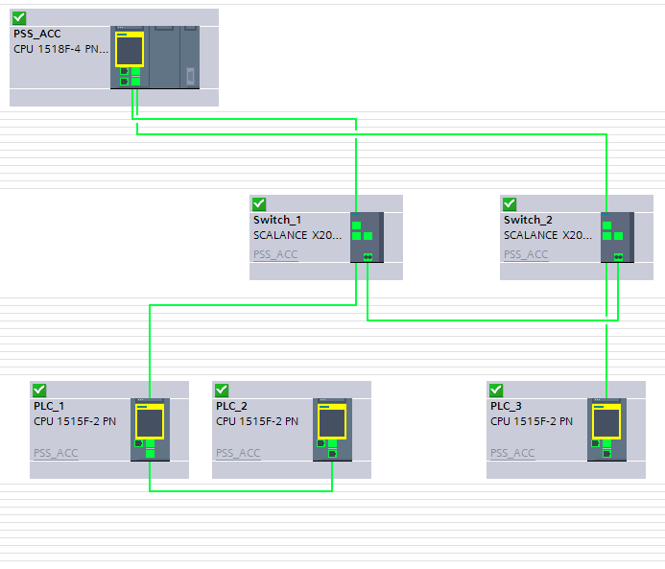
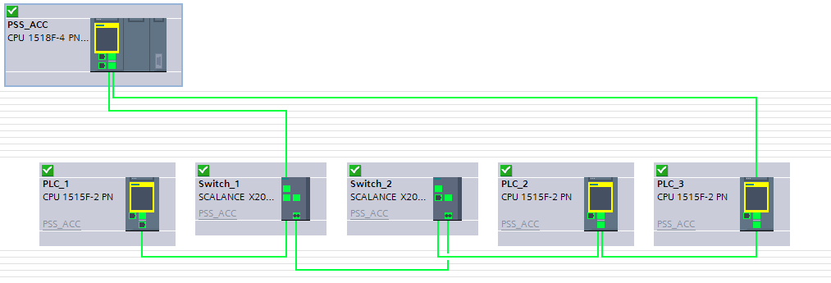
ESS PSS Architecture
Tests in the lab: Failsafe cross-PLC data exchange
Configuration 1:
Configuration 2:
Mixed configuration: PSS_ACC acts as a redundancy manager and
Sync master. PLC_2, PLC_3 included in the ring, PLC_1 not part of the ring.
Alternative configuration: LPSS_ACC acts as a redundancy manager and
Sync master. Other PLCs are excluded from the ring.

Slide 43
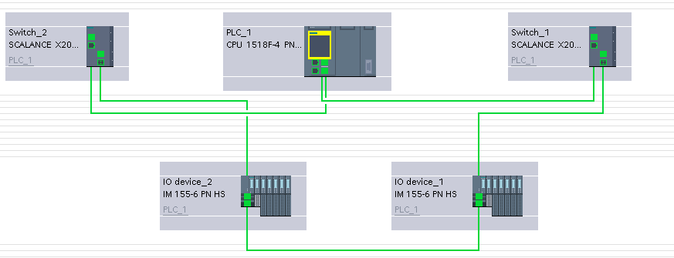
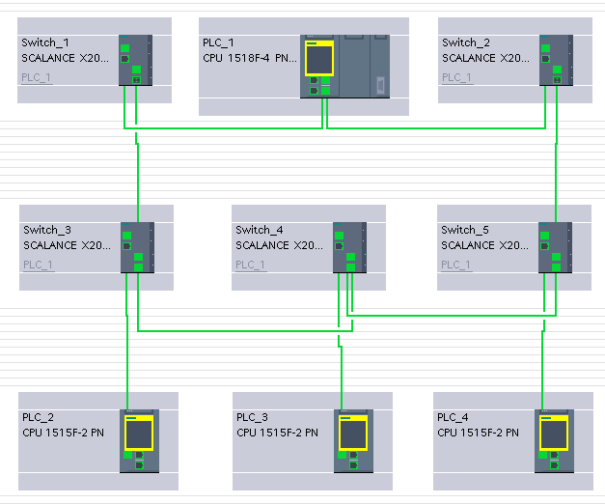
ESS PSS Architecture
Tests in the lab: MRPD (Profinet media redundancy)
Configuration 1:
Configuration 2:
Devices are connected to the redundant network in the ring, PLC_1 is the redundancy and synchronization master.
This setup is based on the main ring that includes a number of IRT switches + main PLC in the loop. Other PLCs are connected to the copper ports of the IRT switches.

Slide 44
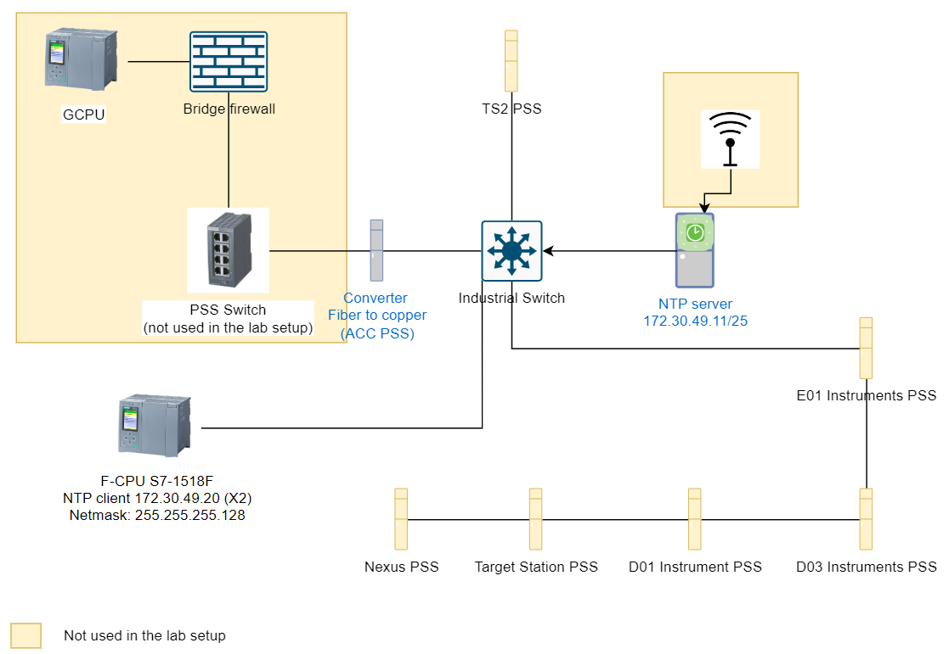
ESS PSS Architecture
Tests in the lab: NTP time sync concept

Slide 45


ESS PSS Architecture
Tests in the lab: Results & Conclusions
# | Test | Result | Remark
1. | Software
1.1 | Failsafe cross-PLC data exchange
1.2 | Profinet media redundancy via MRPD
2 | Hardware
2.1 | IM155-6 PN HS Interface Module
2.2 | 2xLC Bus Adapter for IM155 (ET200SP)
2.3 | Scalance X202-2PIRT IE IRT Switch
2.4 | Scalance X101-1 BFOC-to-RJ45 MC |  | Not passing MR packets*
2.5 | Scalance XB004-2 unmanaged IE switch
2.6 | Unified comfort panels
2.7 | NTP time sync. concept
* It was discovered that this component not working properly with media redundancy frames, so we had to replace it

Slide 46
Thank you!

Slide 47
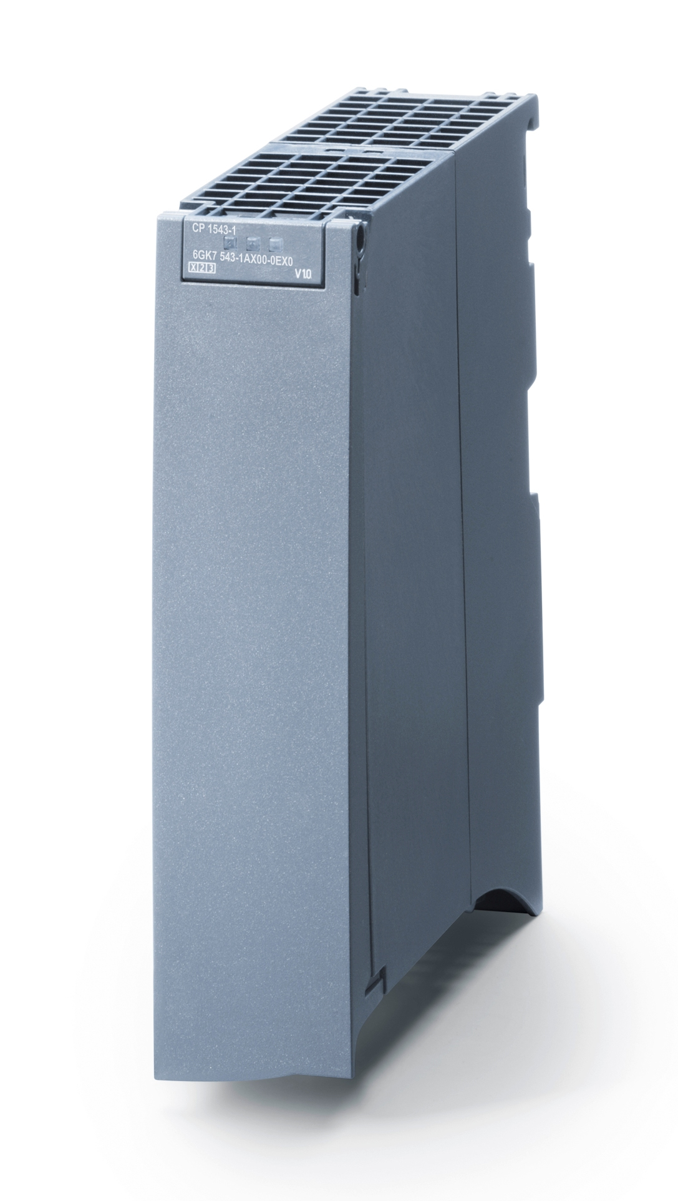
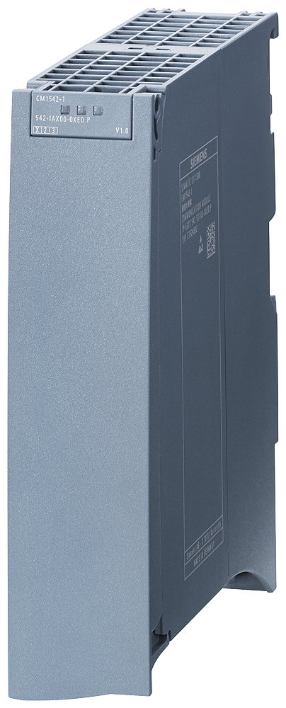
ESS PSS Architecture
Solutions & Technologies: Network equipment
CP 1543-1 – Industrial Ethernet Communications
CP 1542-1 – Standard profinet Communications
CP 1543-1

