Slide 1
Monitoring for Application Performance, Data Center, Networks and Security Events
Controls Infrastructure
PRESENTED BY Stephane Armanet

Slide 2
Introduction
Observability
Observability , its importance for monitoring and maintaining Controls infrastructure
Scope of the presentation:
User applications
Compute, Storage and under-pinning infrastructure
Server Applications
Network devices
Firewalls
Information Security events

Slide 3
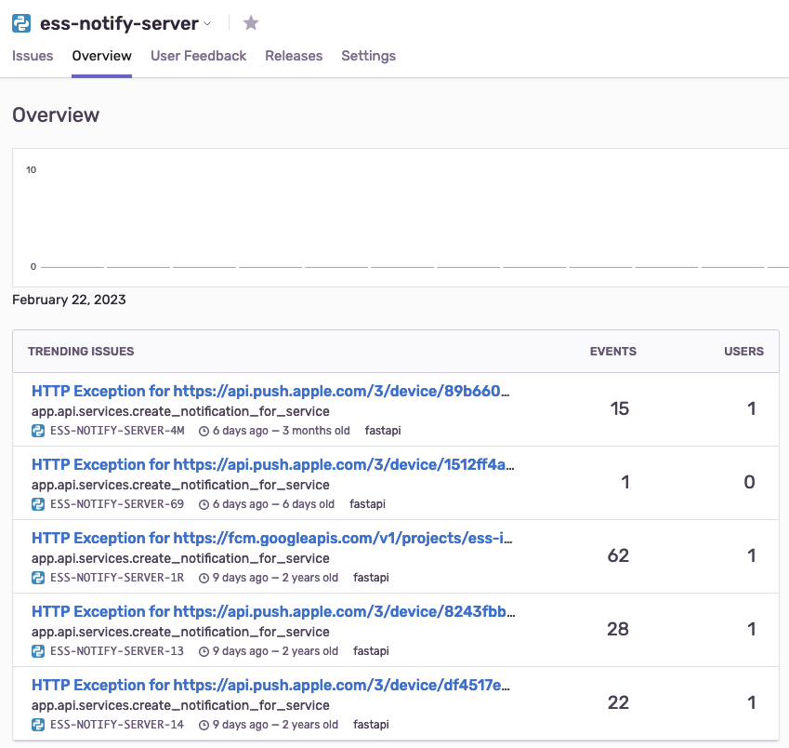
Metrics 1 of 3
Collecting and analyzing
Sentry: Application performance monitoring & error tracking
Reducing risks in deployment of code that may have bugs
Provides developers with error tracking, monitoring and application crashes
Integration
Logging application events to Sentry.io
Integration: through an SDK, JIRA, Slack, Grafana
Events = Exceptions and application oops/crashes, anomalous behavior
Platform support https://sentry.io/platforms/
https://sentry.esss.lu.se/sentry/

Slide 4
Metrics 2 of 3
Collecting and analyzing
Prometheus (60 seconds):
Physical and virtual hosts (node exporter)*
Includes EPICS IOCs
Virtualisation Platforms
Application (JMX and HTTP)
Custom (SSH and SNMP)
Exported to Zabbix
Integration with:
Alerta, CE-Deploy and Grafana
* node_exporter deployed at post-install
Single source of truth (CMDB -> CSEntry -> NetBox)
https://prometheus-01.tn.esss.lu.se/graph
https://prometheus-02.tn.esss.lu.se/graph
https://alerta.tn.esss.lu.se/
https://zabbix.tn.esss.lu.se/
https://ce-deploy.esss.lu.se/
https://grafana.tn.esss.lu.se/
Example dashboards:
Alert dashboard: link
NXBastion usage: link
Archiver that include last week issue: link
Storage: prediction on consumed in 1 year: link
Jupyterhub: link

Slide 5
Metrics 3 of 3
Collecting and analyzing
Elastiflow
Netflow (sessions):
Palo Alto Firewalls
sFlow (sampled polling ~ 60 seconds):
Network switches and routers
Virtualisation platforms (Proxmox)
hsflow
Virtualisation platform (VMWare)
Virtual switch
https://elastiflow.tn.esss.lu.se/
https://elastiflow-02.tn.esss.lu.se/

Slide 6
Logs
Collecting and analyzing
Graylog
De-coupled from Graylog and stored on file (JSON - > GELF and syslog formatted files)
Syslog and Gelf
Allows integration with other applications that can read from a filesystem (reduced effort with integration through API)
Available even when there are issues with the UI
Grafana LOKI is promising

Slide 7
Information Security Events
Collecting and analyzing
https://wazuh-01.esss.lu.se/
Brief demo
Wazuh - Security information and event management
Vulnerability scanning, Security posture and dashboards
Decoder and rules for events
Various integration and example of input:
Addrwatch (MAC address duplicate detection)
Suricata (network analysis and threat detection software)
Syslog
Zeek (network security monitoring - heuristic analysis and pattern matching)
Allows integration with other applications that can read from a filesystem (reduced effort with integration through API)
Available even when there are issues with the UI

Slide 8
Additional tools and
The need for visibility into status, health and historical trends
Future (TBA/TBD)
Dedicated cluster for monitoring (near-term)
Elasticsearch/Splunk
Malcolm/Arkime
SuzieQ
Standard - OpenTelemetry (collector/exporter)

Slide 9
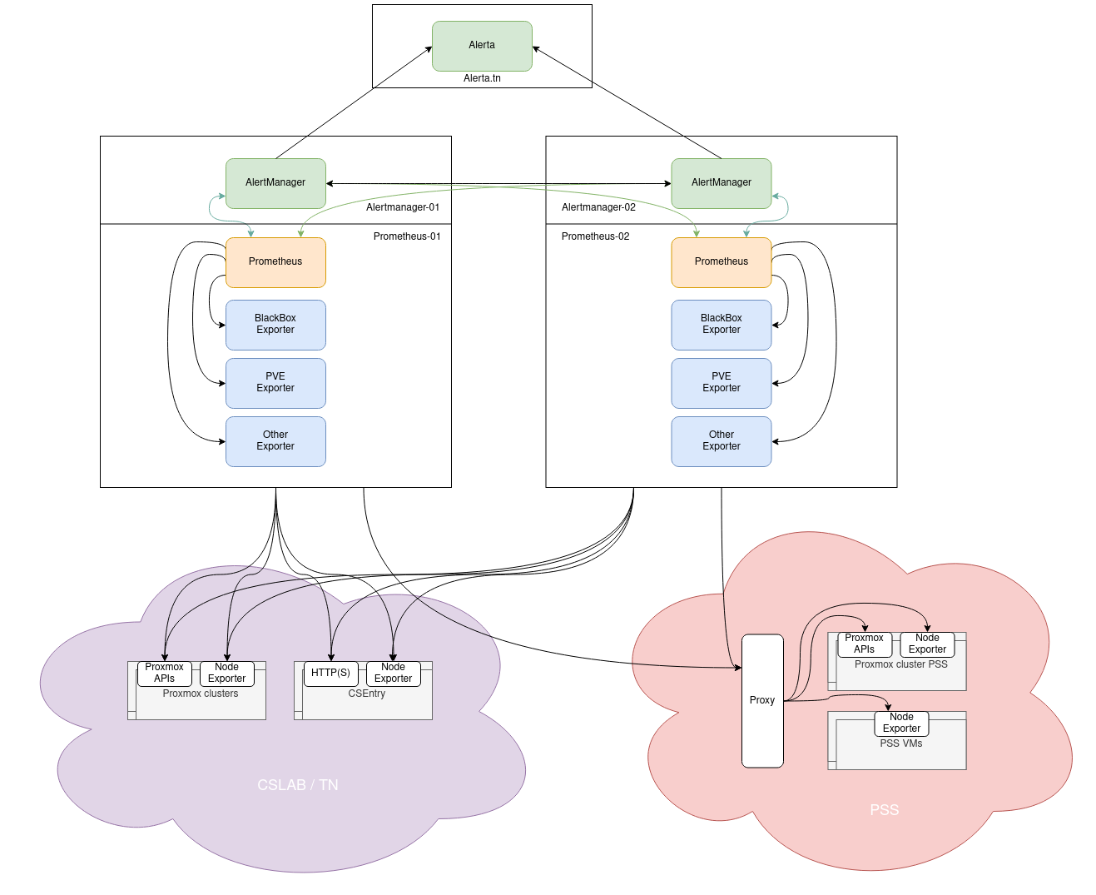
Backup

Slide 10
Finish presentation

