Slide 1

Towards very cold neutrons
Oliver Zimmer
LENS moderator meeting; Garching, 24 March 2023

Slide 2
Contents:
Why very cold neutrons (VCN)?
Moderation to the VCN range - local excitations
Clathrate hydrates as VCN moderator and CN reflector
HighNESS: studies of moderator material properties
Collaboration on VCN moderator prototype with ILL?

Slide 3
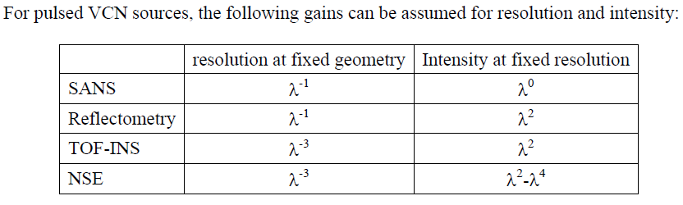
Why Very Cold Neutrons?
Neutron scattering community:
From proceedings of workshop on application of a VCN source at Argonne, 2005
Revisited during recent ESS workshop on CN, VCN and UCN sources
Particle physics community:
  Sensitivity improvements:
    neutron-antineutron oscillation experiment (∝ λ²)
    in-beam neutron EDM experiments (∝ λ)

Slide 4
How to get cool neutrons?
 | λ (Å) | T_{n} (K)
thermal | 1.8 | 300
cold | 5 | 30-100
very cold | > 15 | < 4
ultra cold | > 500 | “0.002”
Moderation:
slowdown with many inelastic interactions
→ thermal equilibrium with cold medium
needs weakly absorbing cold medium with
good scattering cross sections
Moderation: compression
of full neutron spectrum

Slide 5
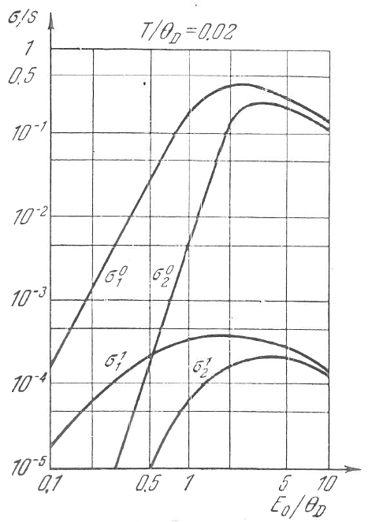
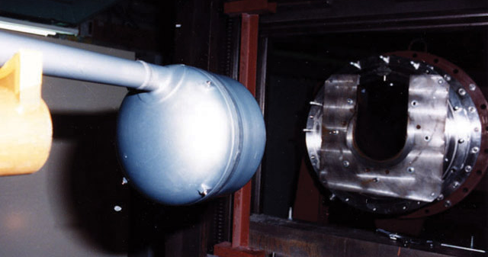
thermal → cold:
liquid H₂ and D₂ cold sources
(quasi-elastic scattering)
solid methane
(molecular rotations)
 | λ (Å) | T_{n} (K)
thermal | 1.8 | 300
cold | 5 | 30-100
very cold | > 15 | < 4
ultra cold | > 500 | “0.002”
thermal/cold → very cold?
phonons ?
kinematic restriction due to dispersion
T < T_{D} & E < k_{B}T_{D} : σ_{1-phonon-emission} ∝ E ⁻³
Gurevich and Tarasov,
Slow Neutrons

Slide 6
better use incoherent scattering by local modes:
(1) molecular rotations
(2) librational (Einstein) modes of confined molecules

Slide 7
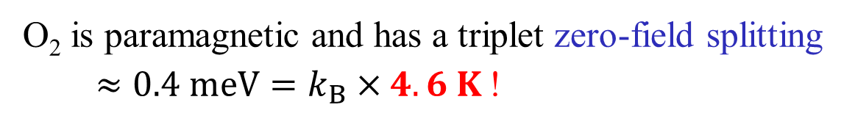
better use incoherent scattering by local modes:
(1) molecular rotations
(2) librational (Einstein) modes of confined molecules
(3) weakly absorbing paramagnetic species:
O₂ is paramagnetic and has a triplet zero-field splitting
$≈0.4 meV=k_{B}×4.6 K$!
E_{m}
m = ±1
m = 0
… no magnetic field needed !

Slide 8
Neutron slowdown in medium at k_{B}T < E *,
(E * ≅ 4.6 K for zero-field splitting in molecular O₂)
see Phys. Rev. C 93, 035503 (2016) for analysis of slowdown in infinite medium
Einstein modes can short-circuit a long paramagnetic cascade

Slide 9
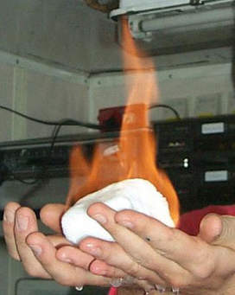
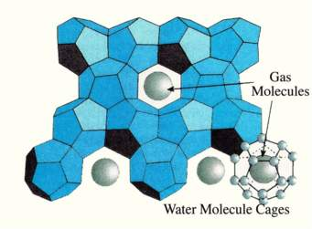
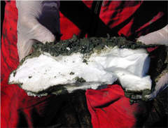
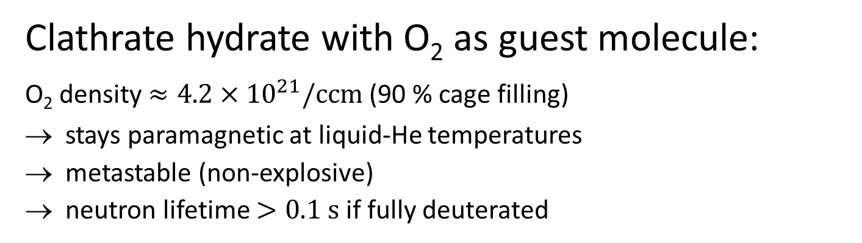
Solid oxygen is antiferromagnetic at low T (dispersion and dangerous), but:
Clathrate hydrate with O₂ as guest molecule:
O₂ density $≈4.2×{10}^{21}/ccm$ (90 % cage filling)
stays paramagnetic at liquid-He temperatures
metastable (non-explosive)
neutron lifetime $>0.1 s$ if fully deuterated
Methane hydrate clathrate

Slide 10
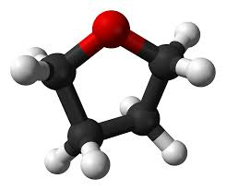
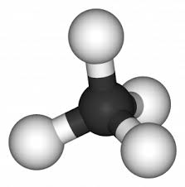
Clathrate hydrates
Exemplary
guests:
 | Clathrate type I | Clathrate type II
structure | cubic, a = 12 Å | fcc, a = 17.1 Å
# H₂O per unit cell | 46 | 136
Cages per unit cell | 6 large + 2 small | 8 large + 16 small
Bragg cut-off wavelength | 24 Å | 20 Å
Guest molecules, e.g., | CH₄ | O₂ , C₄H₈O (THF)
THF
CH₄
Large choice of weakly absorbing molecules made of D, O and C
non-dangerous materials
Gas hydrates meta-stable up to 140 K (O₂, CH₄); not so easy to produce
THF-d clathrate stable up to 7⁰ Celsius; very easy to produce
Huge lattice constants → large Bragg cut-off → albedo in whole CN λ-range

Slide 11
Tetrahydrofuran (THF) clathrate hydrate
Stoichiometric compound: 17H₂0:THF
Can be annealed by re-melting and re-freezing
(forms polycrystalline clathrate structure)
THF
 | Clathrate type I | Clathrate type II
structure | cubic, a = 12 Å | fcc, a = 17.1 Å
# H₂O per unit cell | 46 | 136
Cages per unit cell | 6 large + 2 small | 8 large + 16 small
Bragg cut-off wavelength | 24 Å | 20 Å
Guest molecules, e.g., | CH₄ | O₂ , C₄H₈O (THF)
Neutron scattering measurements done at ILL in 2021 and 2022 on:
  17D₂0:THF-d 17H₂0:THF-d 17D₂0:THF 17H₂0:THF
main goal within WP3 of HighNESS: S(q,ω) in absolute units

Slide 12
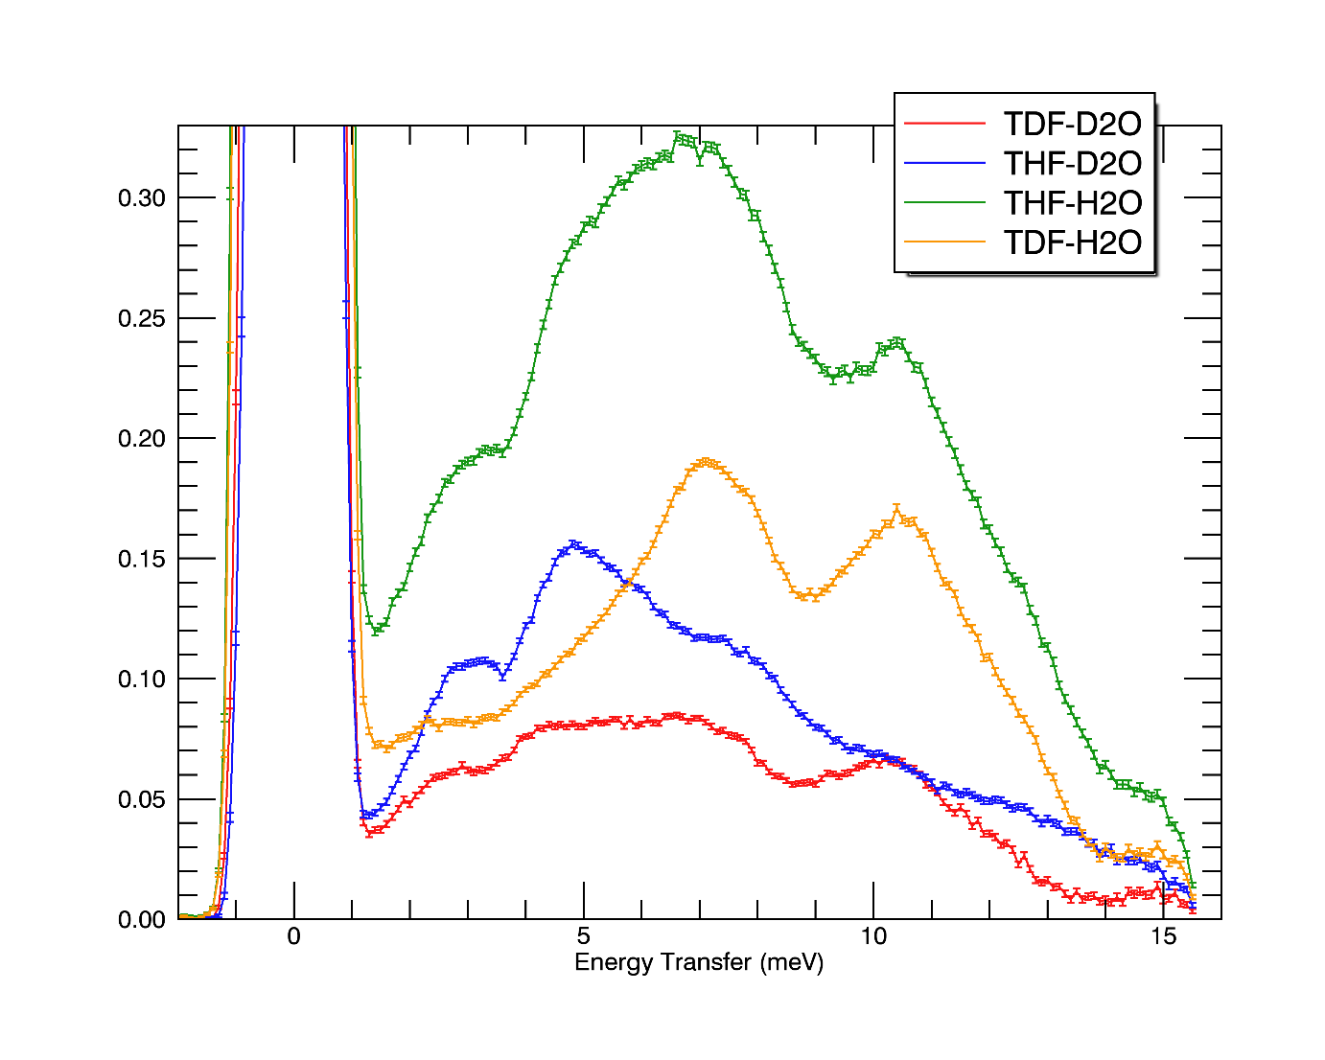
Tetrahydrofuran (THF) clathrate hydrate
Richard Wagner (HighNESS postdoc)
Valentin Czamler (HighNESS PhD stud.)
exemplary IN5 data:
Neutron scattering measurements done in 2021 and 2022 on:
  17D₂0:THF-d 17H₂0:THF-d 17D₂0:THF 17H₂0:THF
main goal within WP3 of HighNESS: S(q,ω) in absolute units

Slide 13
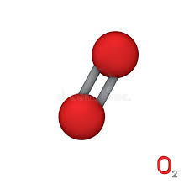
THF + O2 binary clathrate hydrate
THF
 | Clathrate type I | Clathrate type II
structure | cubic, a = 12 Å | fcc, a = 17.1 Å
# H₂O per unit cell | 46 | 136
Cages per unit cell | 6 large + 2 small | 8 large + 16 small
Bragg cut-off wavelength | 24 Å | 20 Å
Guest molecules, e.g., | CH₄ | O₂ , C₄H₈O (THF)
O₂
Combines strong motional modes of THF-d with paramagnetic cooling by O₂
Should improve moderation w.r.t. the simple 17D₂0:THF-d
+ : simpler to prepare than a pure gas hydrate, but:
– : cannot be simply annealed → likely applicable only for weaker sources

Slide 14
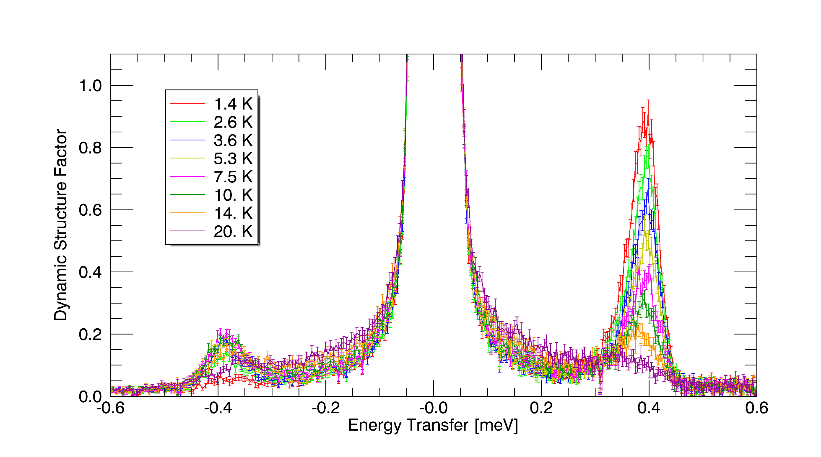
First experiments on O2 clathrate done at D20, IN4, IN6 and D7
(exp. Team: A. Falenty, T. Hansen, M. Koza, W. Kuhs, OZ)
Magnetic intensity seems in agreement with theoretical prediction

Slide 15
Possibility at ILL: PF1B cold neutron beam facility
(instrument scientists: Torsten Soldner & Valery Nesvizhevsky)

Slide 16
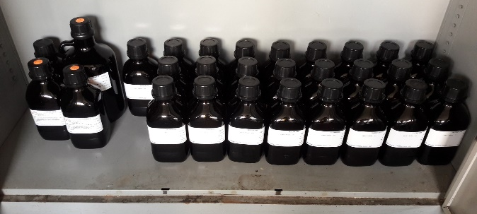
Invitation for collaboration with ILL
Common grant application?
As a next step after HighNESS:
Construction and characterization of VCN moderator prototype
30 liters of 17D2O.THF-d, cooled to 1.3 K, cryogenics from EURIZON
Monochromatic beam at PF1B with velocity selector
ToF analysis of moderated neutrons (λ, T_{mod} and position)
without/with nanodiamond reflector
Comparison of exp. results with simulations, tests of radiation hardness, other materials, test in neutron field at Budapest reactor? …
Velocity selector
ToF analysis
VCN moderator
ToF analysis
ToF analysis
ToF analysis

