Slide 1
Scientific Activities Division (SAD) providing Sample Environment,
Sample and User Services
Based on SAD 2.0 Group Structure with SCUO, MPS, CLS incl. polarisation and guide characterisation function
PRESENTED BY Arno Hiess

Slide 2
SAD Implementation Strategy
From SAC meeting May 2022
Ensure delivering Scientific Operation
provide efficiency by avoiding duplication of functions and realising budget leverage:
  provide ‘holistic’ service e.g. supporting (today & tomorrow) internal ESS stakeholders and (future) users
  support and implement to ESS standards / guidelines / admin. measures e.g. mech.+ ctrl integration, supplies + infrastructure, safety + licensing
  profit from (additional) partner commitments, collaborative projects and 2nd hand equipment
  commission instrumentation towards future operational needs but supporting today’s needs already
ensure sustainability by lean and competent core team:
  enable collaborations, ensure partner delivery (to SD and NSS), take operational ownership
  staff ramp up towards ops considering training needs and cross competences (no single point failure and / or acknowledging known gaps )
  extend capabilities by attracting additional resources by third-party funding
Notes:
First starting with a general strategy

Slide 3
new SAD 2.0 groups and functions
Reason/s for change
Background to change / Considerations
Operational needs from users and instrument teams as well as technical functions and scientific topics.
  Staff competences, work environment, career development, organizational balance (group size, less hierarchy) and minimize line management overhead
  Internal interfaces and synergies to minimize project management overhead
  Synergies between research engineers
  for polarization and high magnetic fields (compatibility to be considered in chorus)
  for neutron optics and materials chemistry
Desired outcome / Results:
Organisational structure with distinct advantages consistent with SD implementation strategy for operation
New SAD 2.0 group structure emphasizes support functions over techniques
Consolidated group structure within the Scientific Activities Division to deliver scientific operation and scientific support most efficiently with (i) reduction of number of groups and (ii) delayering of manager.

Slide 4











Scientific Activities Division
providing ESS Sample Environment, Sample and User Services for all scientific topics
Scientific Activities Division within the ESS Science Directorate
SCUO
Scientific Coordination
and User Office
C-L-S
Chemistry & Life Science Support
M-P-S
Materials & Physics Support
enables user access, supports its communities, encourages colla-borative scientific activities
• manage (initial) user program
• oversee scientific coord. (SFT) and in-house scientific activities
• provide community interaction
• scientific outreach incl. industry and scientific visits
• prepare SFT Newsletter
• scient. KPI incl. publication data
• participate in “welcome function’
• ensure library function
ensures Chemistry, Life Science, Soft Matter and Biology support
• provide deuteration, chemistry, life science, crystallisation services
• install, operate, calibrate, maintain sample env. for phys. chemistry, fluid control, surfaces, interfaces
• ensure sample management e.g. receive, handle, ship, characterise, synthesize, condition, mount, orient, align samples)
• operate deuteration, chemistry, LS labs & workshops
• develop, procure, refurbish, integrate and commission new equipment
• ensure method development.
• provide neutron guide characterisation & simulations.
ensures Materials Engineering and Solid State Physics support
• provide services for materials engineering, quantum materials and physics
• install, operate, calibrate maintain sample env. for low-T, high-T, high-p, fields B E; mech. Processing
• ensure liquid helium cycle for user programme as well as mechanical and control integration of sample environment systems
• operate materials eng. lab and T-B-p SE workshops
• develop, procure, refurbish, integrate and commission new equipment
• ensure method development.
• ensure the neutron polarisation function.

Slide 5



















Scientific Activities Division
providing ESS Sample Environment, Sample and User Services for all scientific topics
Scientific Activities Division within the ESS Science Directorate
SCUO
Scientific Coordination
and User Office
C-L-S
Chemistry & Life Science Support
M-P-S
Materials & Physics Support
DP
23
LIB
HB
23
23
OZ
23
CTA
LAB
ENG
enables user access, supports its communities, encourages colla-borative scientific activities
• manage (initial) user program
• oversee scientific coord. (SFT) and in-house scientific activities
• provide community interaction
• scientific outreach incl. industry and scientific visits
• prepare SFT Newsletter
• scient. KPI incl. publication data
• participate in “welcome function’
• ensure library function
ensures Chemistry, Life Science, Soft Matter and Biology support
• provide deuteration, chemistry, life science, crystallisation services
• install, operate, calibrate, maintain sample env. for phys. chemistry, fluid control, surfaces, interfaces
• ensure sample management e.g. receive, handle, ship, characterise, synthesize, condition, mount, orient, align samples)
• operate deuteration, chemistry, LS labs & workshops
• develop, procure, refurbish, integrate and commission new equipment
• ensure method development
• provide neutron guide characterisation & simulations
ensures Materials Engineering and Solid State Physics support
• provide services for materials engineering, quantum materials and physics
• install, operate, calibrate maintain sample env. for low-T, high-T, high-p, fields B E; mech. Processing
• ensure liquid helium cycle for user programme as well as mechanical and control integration of sample environment systems
• operate materials eng. lab and T-B-p SE workshops
• develop, procure, refurbish, integrate and commission new equipment
• ensure method development
• ensure the neutron polarisation function

Slide 6
SAD 2.0 – Advantages and Opportunities
Ensure delivering scientific operation and support efficiently
Advantages
Groups with well-matched team sizes and similar competences / subject matter experts ensure well-balanced topical scientific operational support and avoids single points of failure.
Avoids duplication-of-effort and eases consistent ways-of-working as well as integration by matching laboratories / workshops, lab instrumentation and sample environment by scientific topic.
Polarization: profits from already well-established collaboration with MPS.
Guide characterization: methodological synergies exist with CLS.
Opportunities
More multi-faceted links to external partners by dissolving (well-known) technical functions e.g. continue exchange with (new / existing) networks (ISSE, DEUNET)
(Potentially) increased technical interfaces e.g. keep / strengthen excellent links to (new) ESS central services: facility management (lab fit-out, operation, maintenance), EHS&Q (samples), ICS/ECDC/MCA/DMSC (control integration, fair data), NSS/EIS (mechanical integration), AD/TD (material analysis, cryogenics, vacuum).
Notes:
First starting with a general strategy

Slide 7



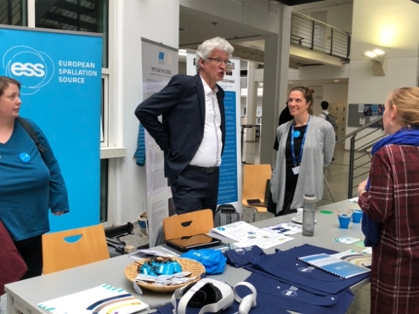




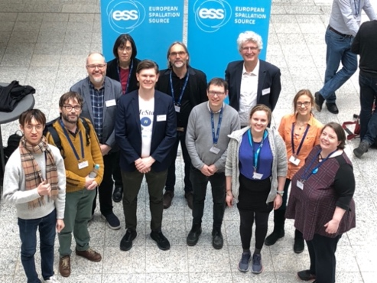


Scientific Coordination and User Office
Ensuring administrative support for science division activities
ESS successfully hosted a booth with the ILL at ECNS 2023
A collaboration between ESS and our neighbouring universities have won the bid to host ICNS 2025 in Copenhagen and Lund
SCUO are working with IT to implement an e-library to provide journal access for ESS scientists
Also on-going is the recruitment of a librarian to drive this work
Notes:
First starting with a general strategy

Slide 8
Chemistry and Life Science Support - CLS
Structure of CLS with functional leads
DEMAX (Zoe Fisher)
Zoe Fisher, Anna Leung
Jia-Fei Poon, Hanna Wacklin-Knecht
Deuteration Service
SULF (Monika Hartl)
Monika Hartl, Katrin Michel, Melissa Sharp, NN(Q2/23), Ghazaleh Roosteai (installation), Damian Martin Rodriguez (Spallation Chemistry)
Support laboratories
Installation / Spallation Chemistry
Group Leader : Monika Hartl
SCSE (acting: Monika Hartl)
Alice Corani, Harald Schneider, NN (Q2/23)
Sample Environment
Interaction to Science (Hanna Wacklin Knecht)
Hanna Wacklin-Knecht, Melissa Sharp, Alice Corani, Monika Hartl
  Interact with instrument teams on needs for DEMAX, SULF, SCSE

Slide 9
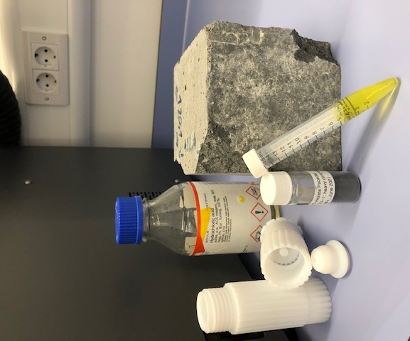
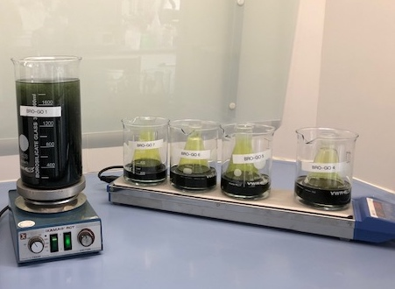
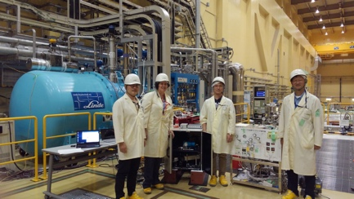
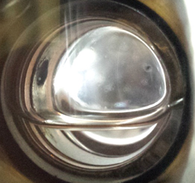
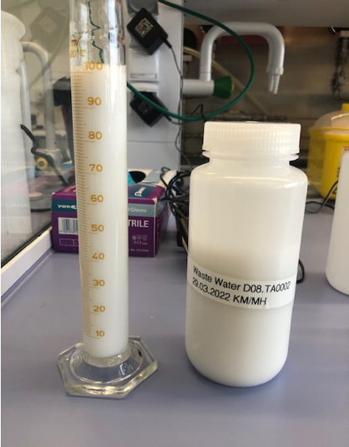
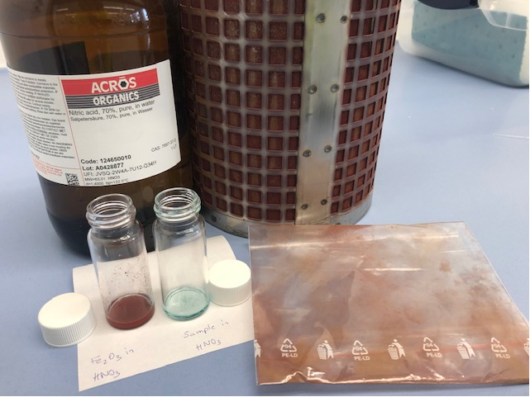
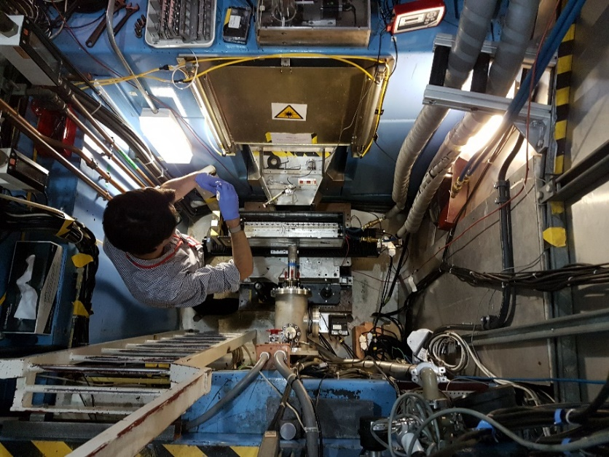
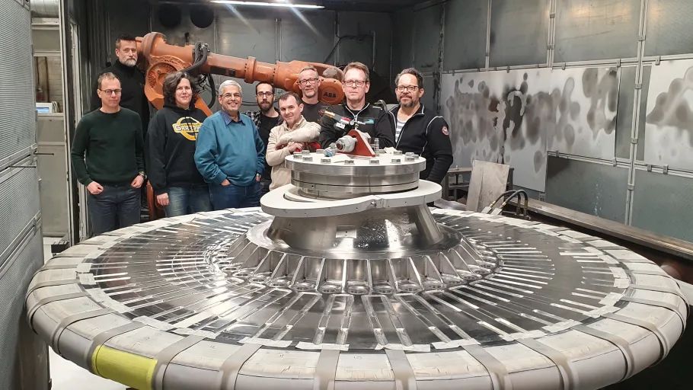
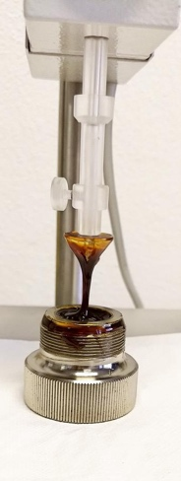
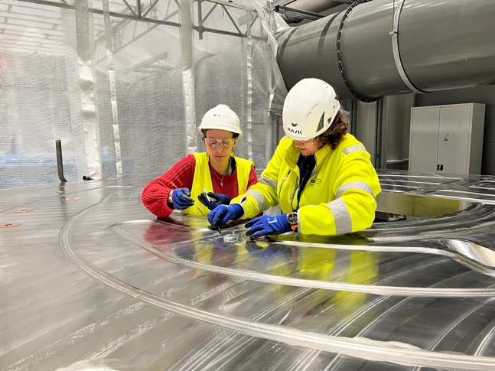
ESS project support
Shielding material
analysis
…frequently turns into science
BrightnESS – development
reflector materials
O/p-H2 research
for moderator
(collab. ESS/JPARC/SNS)
Cooling water issues
(accelerator)
Waste water
analysis
Luminescence coating for Target
Radiation Hardness of Grease (LoQ, ISIS)
“goo” on the CW blocks

Slide 10
Materials and Physics Support - MPS
The people of MPS and their scope
Project leads for sample environment systems (SES)
Holmes (Low temp. and magnets)
C. Curfs (High temp., high pressure and mechanical processing)
Define, design and procure SES
Manage projects within time and budgets
Test SES and lead the integration
Group Leader : Caroline Curfs
Control electronics and control integration
N. Ekström & A. Hagelberg
Design and fabrication of control electronics
Control integration of systems, which cannot use EPICS directly
Mechanical integration and technical support
R. Ammer & L. Saxtrup
Provide mechanical alignment and integration of SES
Mechanical workshop
Technical work
  Design, develop and provide hardware for polarization
  Provide software for control of hardware
  Scientific support
Polarization
W. T. Lee & J. Hagman

Slide 11
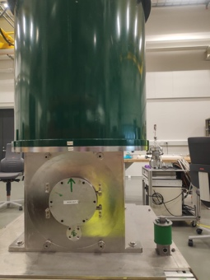
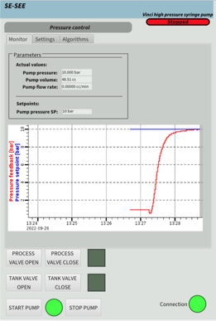
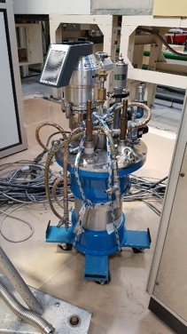
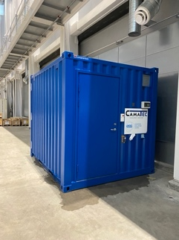
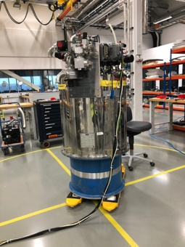
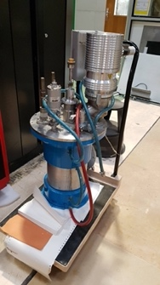
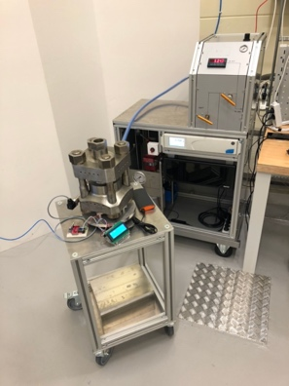
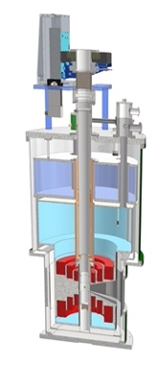
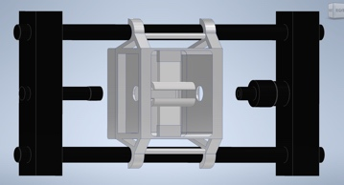
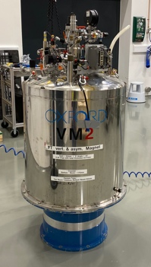
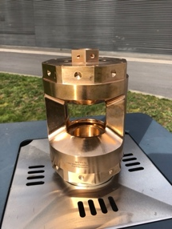
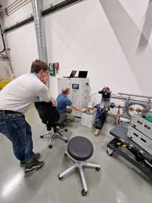
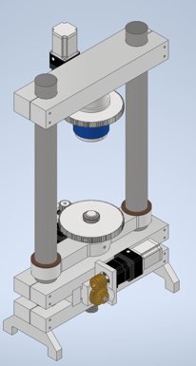
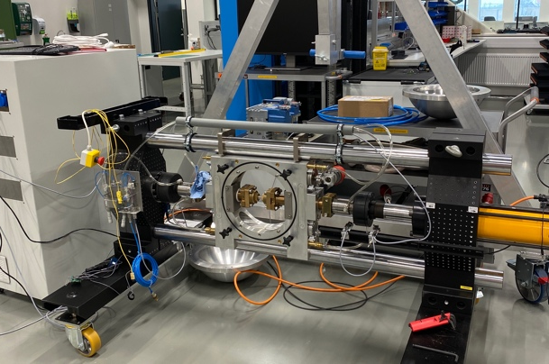
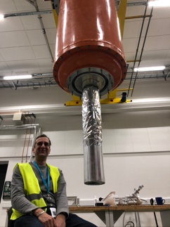
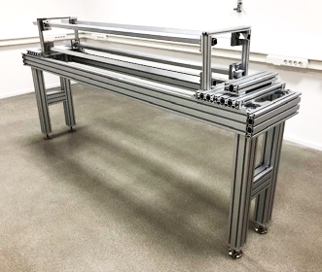
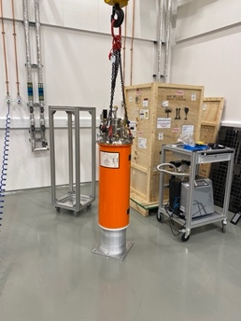
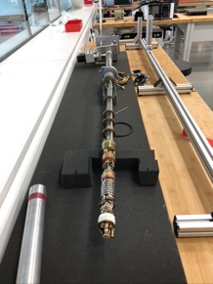
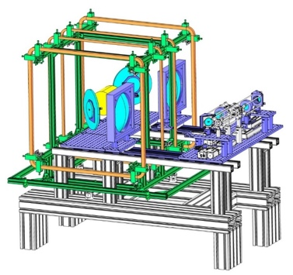
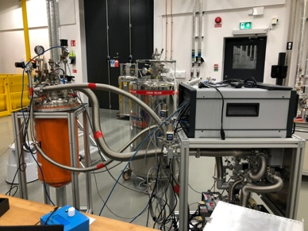
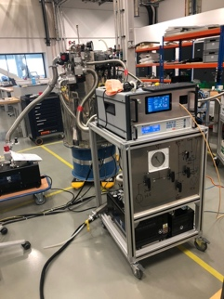
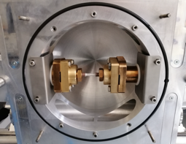
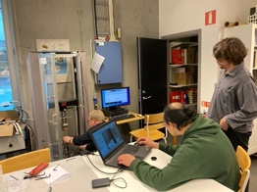
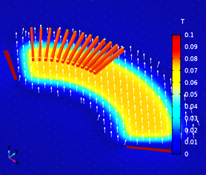
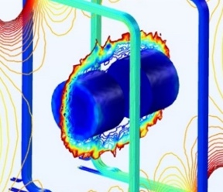
Sample environment systems
Magnets
High
Pressure
High
temperature
Low temperature
Polarization
Mechanical processing

Slide 12
CLS + MPS STAP meeting – April 2023
STAP Members
CLS STAP
Luke Daemen [new chair]
Andy Church
Jeremy Lakey
Tamim Darwish
Gavin Stenning
Thom Shea
Anne Martel (new member)
MPS STAP
Stefan Carlson [chair]
Michael Hofmann
Bianca Haberl
Klaus Kiefer
Richard Down
Robert Pederson (new member)
Notes:
First starting with a general strategy

Slide 13
CLS + MPS STAP meeting – April 2023
Charge – Common Topics
Considering the new organisational structure and our sustained path to Hot Commissioning, First Science and the User Programme, how do we
Best deliver the remaining scope related to sample services and sample environment for all scientific areas?
Make best use of our available scientific support functions today and during the different future phases?
Maintain scientific expertise and keep user and collaborators engaged in ESS and interest in using our services (deuteration, chemistry, life science, materials)?
Shape a line organisation with capabilities to tackle the operational challenges?
Ensure method development and (cross-) training of staff?
Best attract and execute externally funded collaborative projects and how to sustain the resulting capabilities?
Notes:
First starting with a general strategy

Slide 14
CLS + MPS STAP meeting – April 2023
Charge - Chemistry and Life Science Support
Is the new structure in CLS sustainable? How do we minimize time spend on managing and maximize time spend on delivering the scope?
There is no time left in the SULF team to go out and participate in funding calls nor in joint research proposals. How can we still (find time to) stay on top of ongoing science?
Supporting the ESS project is both beneficial to ESS and to SULF. How do we cope with the larger demand and the necessity to supply written reports?
The service contracts with Lund University (LU) and Lund Protein Production Platform (LP3) end in 2025. Should these contracts be extended beyond 2025 or would it make sense to build up these capabilities closer to or at ESS now that the other parts of DEMAX are at ESS?
How should DEMAX balance the core user support with R&D activities?
The costs for off-the-shelf sample environment components has increased significantly – how do we still deliver what the instruments need?
How do the SCSE team members find the time to test the equipment in the neutron beam?
Is the I2S function sufficiently defined? Are there aspects we are missing?
Notes:
First starting with a general strategy

Slide 15
CLS + MPS STAP meeting – April 2023
Charge - Materials and Physics Support
The responsibility of the SLIME lab (Sample Lab for Imaging and Mechanical Engineering) has been transferred from CLS to MPS with limited and inadequate furniture, no budget and no resources, but the same scope. How should the SLIME lab be equipped to help deliver needed equipment to support ODIN and DREAM for first science. What are the minimum resources needed to do this?
With the moving of soft-matter and physical-chemistry sample environment scope from MPS to CLS, how can we avoid duplicating pieces of equipment and competences between the 2 teams and maximize the use of resources?
Some sample environment systems require competences from the CLS/SCSE and MPS groups. How should we share budget, responsibilities and priorities?
When using prototypes or old pieces of equipment, which are not CE marked, we must define workable procedures that ensure safety and are accepted by our safety and quality departments if general approvals are not feasible. What experience does the STAP have on how this is done at their facilities, to be allowed to use them in the labs and on the instruments.
One of the scopes of the MPS group is to support users in the fields of materials engineering, quantum materials and high pressure. What should MPS do to start building a community, ready for first science?
Notes:
First starting with a general strategy

Slide 16
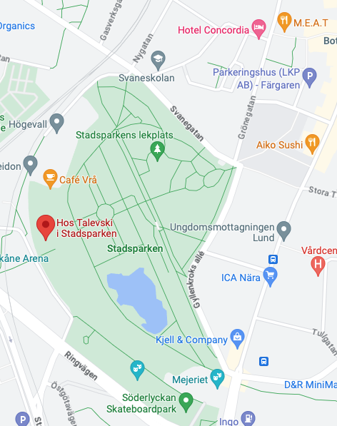
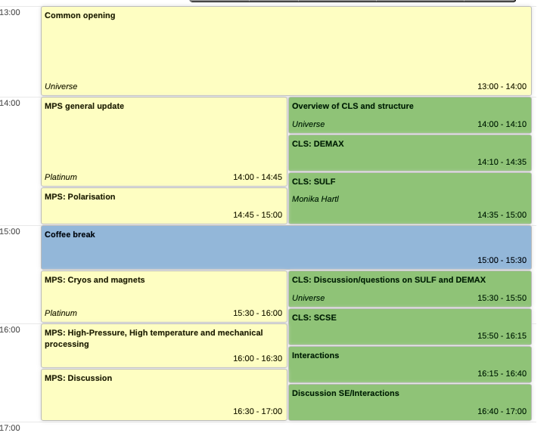
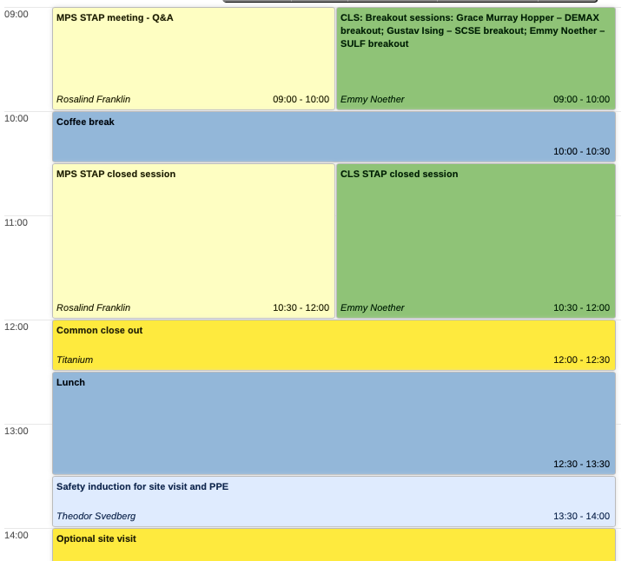
CLS + MPS STAP meeting – April 2023
Agenda and practical information
Detailed information (agenda, rooms) is on our indico page: https://indico.esss.lu.se/event/3213/
Due to space constraints, we have a second room and zoom link for common session and close out.
Dinner start on Monday at 18:30 at Hos Talevski i Stadsparken (City Park Café)
Notes:
First starting with a general strategy

Slide 17
Questions?

