Slide 2
Materials and Physics Support Group
General update
Organisation
Labs & workshops
PRESENTED BY caroline curfs

Slide 3
MPS specific charges
  SLIME lab : The responsibility of the SLIME lab (Sample Lab for Imaging and Mechanical Engineering) has been transferred from CLS to MPS with limited and inadequate furniture, no budget and no resources, but the same scope. How should the SLIME lab be equipped to help deliver needed equipment to support ODIN and BEER for first science. What are the minimum resources needed to do this?
  With the moving of soft-matter and physical-chemistry sample environment scope from MPS to CLS, how can we avoid duplicating pieces of equipment and competences between the 2 teams and maximize the use of resources?
  Some sample environment systems require competences from the CLS/SCSE and MPS groups. How should we share budget, responsibilities and priorities?
  When using prototypes or old pieces of equipment, which are not CE marked, we must define workable procedures that ensure safety and are accepted by our safety and quality departments if general approvals are not feasible. What experience does the STAP have on how this is done at their facilities, to be allowed to use them in the labs and on the instruments.
  One of the scopes of the MPS group is to support users in the fields of materials engineering, quantum materials and high pressure. What should MPS do to start building a community, ready for first science?

Slide 4
Agenda
1 Scope
2 Team
3 Updated plan
5 Way of working and Way forward operation
4 Labs and Workshops
5 Conclusions

Slide 5
1
Scope

Slide 6
Scope
  Provide services for materials engineering, quantum materials and physics
  Provide and maintain sample environment systems in the fields of:
    Low and ultra low temperatures
    High temperature
    Electrical and magnetic fields
    High pressure
    Mechanical processing
  Provide mechanical integration for all SES (including CLS projects)
  Provide control integration for complex SES (including CLS projects)
  Coordinate the He management
  Provide hardware and scientific support for polarization

Slide 7
2
Team

Slide 8









Team until 31.12.2022
2 technicians
2 control engineers
2.5 research engineers
1 mechanical design engineer form NSS
0.5 control integration engineer from ECDC
0.5 group leader

Slide 9

Team from 01.01.2023
2 technicians
2 control engineers
2.5 research engineers
1 mechanical design engineer form NSS
0.5 control integration engineer from ECDC
0.5 group leader
2 technicians
2 control engineers
1.5 research engineers
1 mechanical design engineer form NSS
0.5 control integration engineer from ECDC
0.5 group leader
2 technicians
2 control engineers
1.5 research engineers
0.5 control integration engineer from ECDC
0.5 group leader
0.X cryogenic engineer for He management from Accelerator

Slide 10
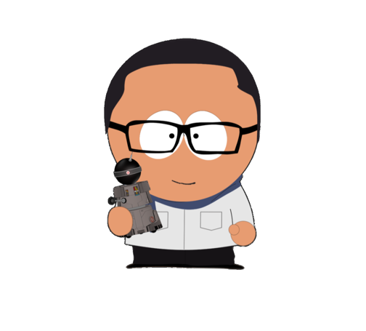

Team from 01.04.2023
2 technicians
2 control engineers
1.5 research engineers
0.5 control integration engineer from ECDC
0.5 group leader
0.X cryogenic engineer for He management from Accelerator
1 scientist and 1 technician for polarization

Slide 11

Team after 01.05.2023
3 technicians
2 control engineers
1.5 research engineers
0.5 control integration engineer from ECDC
0.5 group leader
0.X cryogenic engineer for He management from Accelerator
1 scientist
3 technicians
2 control engineers
3.5 research engineers
0.5 control integration engineer from ECDC
0.5 group leader
0.X cryogenic engineer for He management from Accelerator
1 scientist
3 technicians
2 control engineers
4.5 research engineers
0.5 control integration engineer from ECDC
0.5 group leader
0.X cryogenic engineer for He management from Accelerator
1 scientist
4 technicians
2 control engineers
4.5 research engineers
0.5 control integration engineer from ECDC
0.5 group leader
0.X cryogenic engineer for He management from Accelerator
1 scientist
0.X mechanical designer

Slide 12
Team in 2027
7 technicians
2 control engineers
4.5 research engineers
0.5 control integration engineer from ECDC
0.5 group leader
0.X cryogenic engineer for He management from Accelerator
1 scientist
0.X mechanical designer

Slide 13
3
Updated plan

Slide 14
MPS Sample Environment Systems
Systems to be delivered by MPS before 12.2027
  8 magnets from 2.5 T to 15 T
  Low temperature : 6 cryofurnaces and 10 cryostats (7 wet and 3 dry)
  Ultra low temperature: 3 dilution fridges and 1 He3 insert
  High temperature: 2 ILL-type furnaces, 1 induction furnace, 1 lamp furnace and 1 hot air blower
  High pressure: 10 high pressure cells (5 gas, 4 liquid and 1 clamp), 1 compressor, 3 Paris Edinburgh presses with gas loading
  Mechanical processing : 2 stress rigs (uniaxial and torsion/rotation), 1 thermo-mechanical instrument (dilatometer)
  Provided by instruments : 1 He3 insert, 1 cryofurnace with sample changer and 4 cryostats

Slide 15
Status of SES by end of 2022
Planned
Magnets | 2.5 T WBM | 8 T magnet | 15 T magnet | Spectro magnet
Cryo Instr. & IK | Fow cryostat ESTIA | Wet cryostat BIFROST | Cryofurnace CSPEC | Sample changer CSPEC | He3 insert CSPEC | HP cryostat
Cryo pool | Sample rot sticks | Dry Cryo DIFF EC
High Pressure | Clamps | Gas cells | PE | Gas loading for PE
Mechanical processing | Rig 60 kN | Tortion/rot. rig | Dilatometer
High temperature | ILL-type furnace
Soft matter | SANS SC therm. | SANS SC tumbler | Stopped flow cells | Rheometer
Surface interfaces | Solid/liquid cells
In situ | Laser P&P
Physical chemistry | Electrochem. cell | Gas handling | Humidity
Preparation CFT
Design
CFT
Construction
Procurement
Tests
Control and mechanical
integration
Specifications

Slide 16
Status of SES by end of 2022
Reality
Magnets | 2.5 T WBM | 8 T magnet | 15 T magnet | Spectro magnet
Cryo Instr. & IK | Flow cryostat ESTIA | Wet cryostat BIFROST | Cryofurnace CSPEC | Sample changer CSPEC | He3 insert CSPEC | HP cryostat
Cryo pool | Sample rot sticks | Dry Cryo DIFF EC
High Pressure | Clamps | Gas cells | PE | Gas loading for PE
Mechanical processing | Rig 60 kN | Tortion/rot. rig | Dilatometer
High temperature | ILL-type furnace
Soft matter | SANS SC therm. | SANS SC tumbler | Stopped flow cells | Rheometer
Surface interfaces | Solid/liquid cells
In situ | Laser P&P
Physical chemistry | Electrochem. cell | Gas handling | Humidity
Preparation CFT
Design
CFT
Construction
Procurement
Tests
Control and mechanical
integration
Specifications

Slide 17
Status of SES by end of 2023
Expected
Magnets | 2.5 T WBM | 8 T magnet | 15 T magnet | Spectro magnet | 15T magnet | 6.5T magnet
Cryo Instr. & IK | Flow cryostat ESTIA | Wet cryostat BIFROST | Cryofurnace CSPEC | Sample changer CSPEC | He3 insert CSPEC | HP cryostat
Cryo pool | Sample rot sticks | Dry Cryo DIFF EC | Cryofurnace DIFF 2nd hand | Dil. Fridge 2nd hand | Dil. Fridge | Dry cryo spectro
 | Dry Cryo Heimdal
High Pressure | Clamps | Gas cells | PE | Gas loading for PE
Mechanical processing | Rig 60 kN | Tortion/rot. rig | Dilatometer
High temperature | ILL-type furnace | Induction furnace | Cryostream/gas blower
Preparation CFT
Design
CFT
Construction
Procurement
Tests
Control and mechanical
integration
Specifications

Slide 18
4
Way of working and way forward to operations

Slide 19
Way of working
  Project oriented
    each SES is a project with a customer, a leader, a cross-organization team supporting the leader and a project plan with budget and timeline.
  Working together :
    Team work = each MPS team member brings his competence to each project - No groups within the group
    Cross-functional teams for each project from all parts of ESS
    Improved communication with instrument teams by
      Offering lab/workshop space and technical support to students and scientists for research projects
      Participating to experiments at other large facilities with instrument scientists
      Co applying to grants and actively participating in research projects involving sample environment systems

Slide 20
Way of working
Each SES= project
Customer
Instrument or external users
Requirements
MPS group leader
Support for project plan
Prioritisation
Project leader
MPS expert
Detailed specifications
Feasibility
Coordination
SES = Project plan
Budget
Timeline
Resources
Technical support
MPS
Design : EIS
Motion Control
Vacuum group
Safety EH&S
Procurement
Procurement office
In Kind
Manufacturer
Mechanical workshop
Integration
Mechanical: MPS & EIS
Control: MPS & ECDC
Documentation
Safety & Compliance
EH&S
Quality : electrical, CE marking
Tests
Customer + MPS

Slide 21
Way forward to operation
  Users Operation in 2027
    MPS group = 15. 5 FTE (1 scientist + 5.5 engineers/scientists + 2 control integration engineers + 6 technicians) to support 15 instruments for low and high temperatures, magnetic and electrical fields, high pressure and polarisation
  Preparing for operation:
    Continuous support: Increase interchangeability by training each MPS team member on all SES
    Increase competences by training at other facilities, participating in workshops and meetings (e.g. ISSE), inviting technicians and scientists at ESS (exchange program through LENS?)
    Creating strong links between instruments and MPS :
      providing custom made electronics, mechanical components, general help
      supporting instruments for the procurement of SES within their scope

Slide 22
5
Labs and workshops

Slide 23
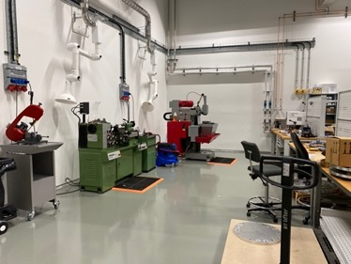
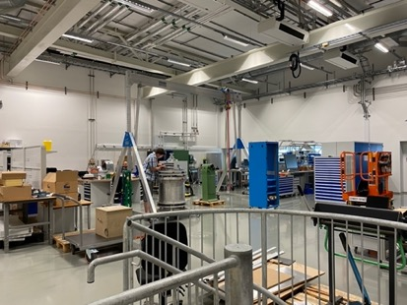
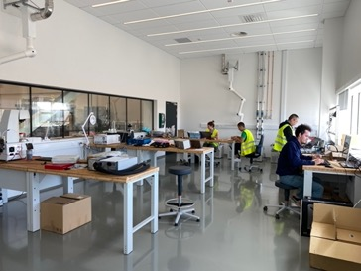
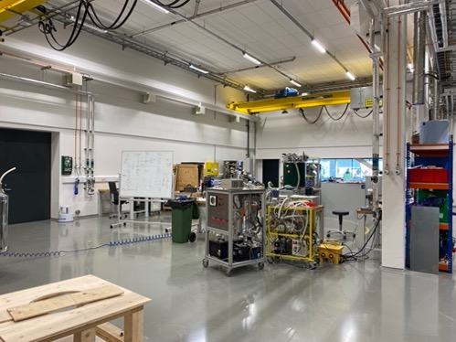
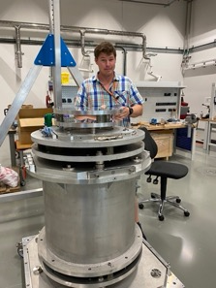
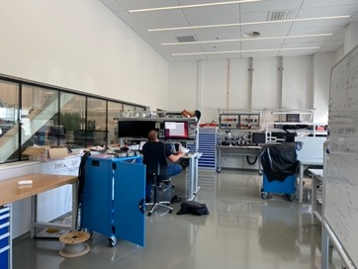
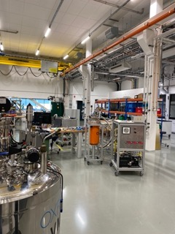
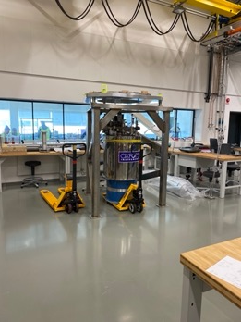
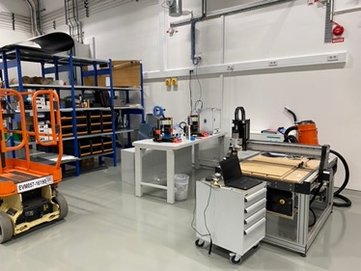
Main workshop used
E03
Ground floor: 65 m² (quiet area) + 257 m² (labs and workshops)
1st floor: 65 m² (quiet area) + 267 m² (labs and workshops)
Non-magnetic floor
Dedicated to mechanical and control integration, low/high temperature, magnets, high-pressure and mechanical processing
Includes a mechanical workshop

Slide 24
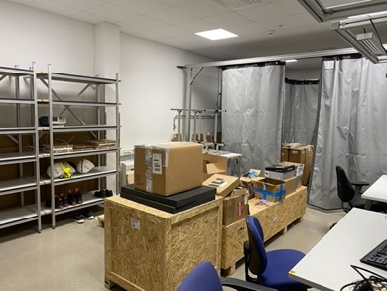
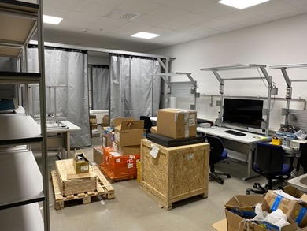
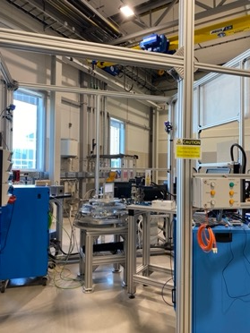
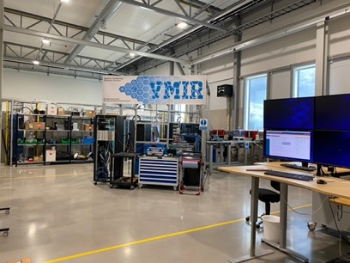
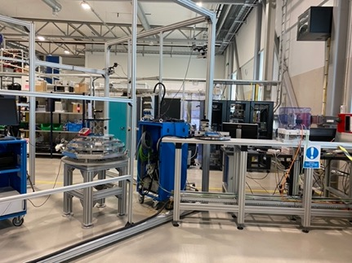
Labs and workshops
B02
Sample environment
165 m²
Outside the restricted zone
After BOT: to test and integrate SES on arrival at ESS
Currently shared with ECDC, MCA, Chopper and detectors for collaborative projects (YMIR)
Non-magnetic floor
Polarisation lab
51 m²
Dedicated to polarisation research
Laser curtain installed

Slide 25
Labs & workshops to install
D08
First floor
Sample environment
Maintenance and storage of cryos, magnets, furnaces for ODIN, DREAM, ESTIA,…
Polarization
High pressure
DAC
Ground floor

Slide 26
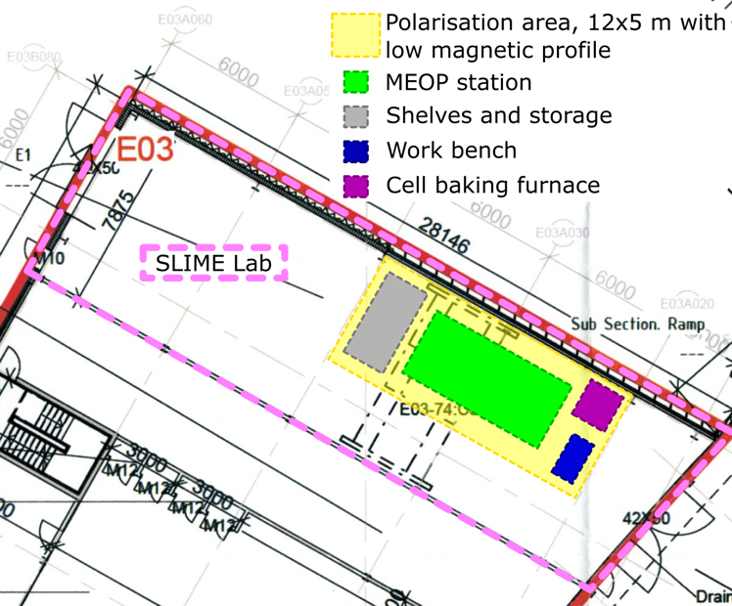
Labs & workshops to install
E03 SLIME lab
210 m²
Gate doors to experimental hall and outside
Crane, water, gas, electricity installed
Primarily planned to support BEER and ODIN users for mechanical engineering
  Deformation rigs
  Furnaces
  And?
Potentially: host the MEOP station for polarisation

Slide 27
4
Conclusions

Slide 28
Conclusions
Opportunities & Challenges
Opportunities
New tasks and responsibilities
  Polarization (hardware, software and labs)
  Mechanical engineering lab (SLIME)
New people (MPS and collaborators)
  End 22: Jaroslaw Fydrych for He management (Accelerator)
  01.04 : Wai Tung Lee for polarization
  01.04: Joel Hagman for polarization
  02.05 : Damian Paliwoda for high pressure
  29.05 : Oleksiy Zadorozhko for cryo
  Q3.23: Mechanical design engineer (EIS)
Possibilities to attract future users and scientific collaborators by giving access to available SES outside beam time
Challenges
Project delays due to :
  Lack of resources (experts and support)
  Complexity of ESS requirements (electrical, design, documentation)
  Long lead time for raw materials and electronics
Restructuration
  Redistribution of tasks CLS/MPS
  Responsibilities, budget and prioritization of cross-organizational projects
Distractions
  Installation of new labs with no additional resources and budget (grant application?)
  Management of more new and complex projects
  Repeated discussion of past choices

Slide 29
Finish presentation

