Slide 2
Introduction and ESS PSS overview
PDR for TBL PSS, ODIN PSS and BIFROST PSS
(2023-06-15)
PRESENTED BY Morteza Mansouri
2023-06-14

Slide 3
Welcome!
Concepts of operations and general overview of how ESS PSS and its sub-systems function.
Concepts of operations and overview of PSS for ODIN, BIFRSOT, TBL and their sub-systems functions.
Detailed analysis of safety functions per instrument PSS
Visit to instrument halls, if time allows.

Slide 4
A few notes
The attendees (other than the committee members) are encouraged to ask questions or provide comments in the Zoom chat.
If the questions/comments are not discussed during the sessions, they will be collected (by the Zoom host) and answered at the end of day.
The attendees via Zoom, please keep your microphones muted during presentations.
Looking forward to a critical and constructive review!

Slide 5
Agenda
1 PSS scope and requirements management
2 ACC PSS, TS PSS & Bunker PSS
3 Instrument PSS
4 PSS main functions and interfaces
5 PSS stakeholders
6 Bypass PSS

Slide 6
1
PSS Scope and requirements management

Slide 7
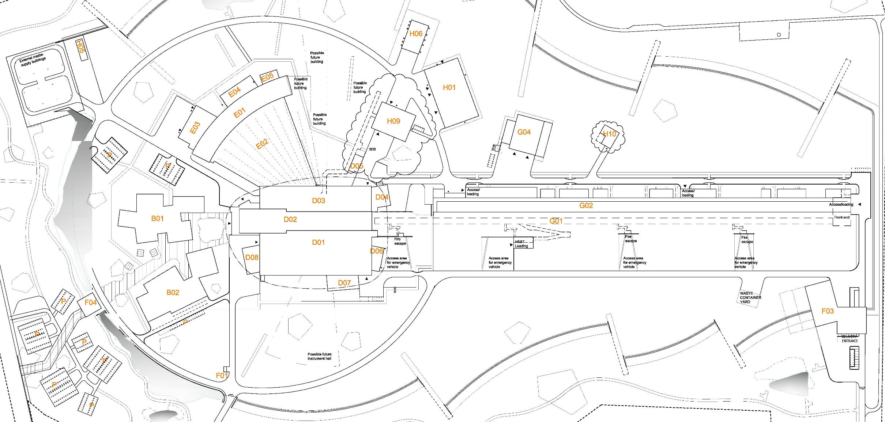
Personnel Safety Systems at ESS
Instrument 1 PSS
Instrument 2 PSS
Instrument 16 PSS
TS2 PSS
Bunker PSS
Target PSS
Accelerator PSS

Slide 8
ESS PSS
Personnel Safety Systems at ESS (ESS PSS) can be considered as an integrated system that is composed of several PSS systems across the facility; ACC PSS, TS PSS, Bunker PSS an PSS systems for instruments.
The purpose of ESS PSS is to contribute to the overall personnel safety at ESS in order to enable safe commissioning and operation of the Linear Accelerator (Linac), Target, Bunker and Neutron Instruments.
Terminologies:
Parent system: The system hierarchically above a PSS in the ESS Facility Breakdown Structure (FBS). For examples the Accelerator (=ESS.ACC) as the parent system for Accelerator PSS (=ESS.ACC.F01).
PSS controlled area: An area within which a PSS mitigates designated hazards or the PSS contributes to access control.
EUC: Equipment that the PSS interlocks, in order to mitigate designated hazards associated with equipment and/or processes.

Slide 9
General functionalities of a PSS
Safety interlock system: This is the core of a PSS and implements the safety instrumented functions, and search, interaction with key exchange system, etc.
Access control system: The access control system contributes to ensuring ‘registered access’ to a PSS controlled area, in cooperation with physical protection system. For this purpose double-door access stations are installed at entry points to a PSS controlled area.
Notes:
So far, ACC PSS includes both functionalities of safety interlock system and access control system. The rest of PSS systems at ESS only include a safety interlock system.
Both functionalities can be implemented through one PLC-based system.

Slide 10
How are the requirements to PSS captured?
PSS mitigates the risk of designated hazards as defined in the parent system risk assessment document, including designated Worker Radiation Safety Functions (WRSF), when required.
Requirements on how the PSS procedures work, how operator, user, etc. is involved, etc. are listed in the respective PSS ConOps. For example see ESS-3540345 for ODIN PSS ConOps. The designated PSS ConOps is reviewed and approved by all relevant stakeholders.

Slide 11
Risk assessments
Performing the hazard analysis and risk assessment is in the scope of the parent system owner.
The risk assessment document is owned and approved by the parent system owner.
ES&H (OHS +RP) review the risk assessment to ensure their consistency, an integration into overall ESS saftey concepts and policies.
PSS team is involved in the risk assessment process (and also one the reviewers of the RA document) in order to:
Contribute to the overall risk assessment effort
Ensure the mitigations assigned to PSS can be feasibly realized by PSS.

Slide 12
Risk assessments (format)
The RA documents contain both conventional and radiation hazards.
Hazard identification
Risk estimation and mitigation
Post implementation review

Slide 13
Risk assessments (risk matrix)

Slide 14
2
ACC PSS, TS PSS & Bunker PSS

Slide 15
Accelerator PSS
Overview
Slide courtesy of Vincent Harahap

Slide 16
Accelerator PSS
Main hazards to be mitigated by ACC PSS:
Prompt ionizing radiation from proton beam,
Prompt ionizing radiation from RF-powered cavities,
Ionizing radiation (gamma) from target,
High voltage from the Ion Source (ISrc) platform.
The basic functions realized by ACC PSS:
Ensure no one is in the tunnel and access is prevented when the above-mentioned hazards exist.
Ensure the above-mentioned hazards are mitigated prior to permitting access to the tunnel.

Slide 17
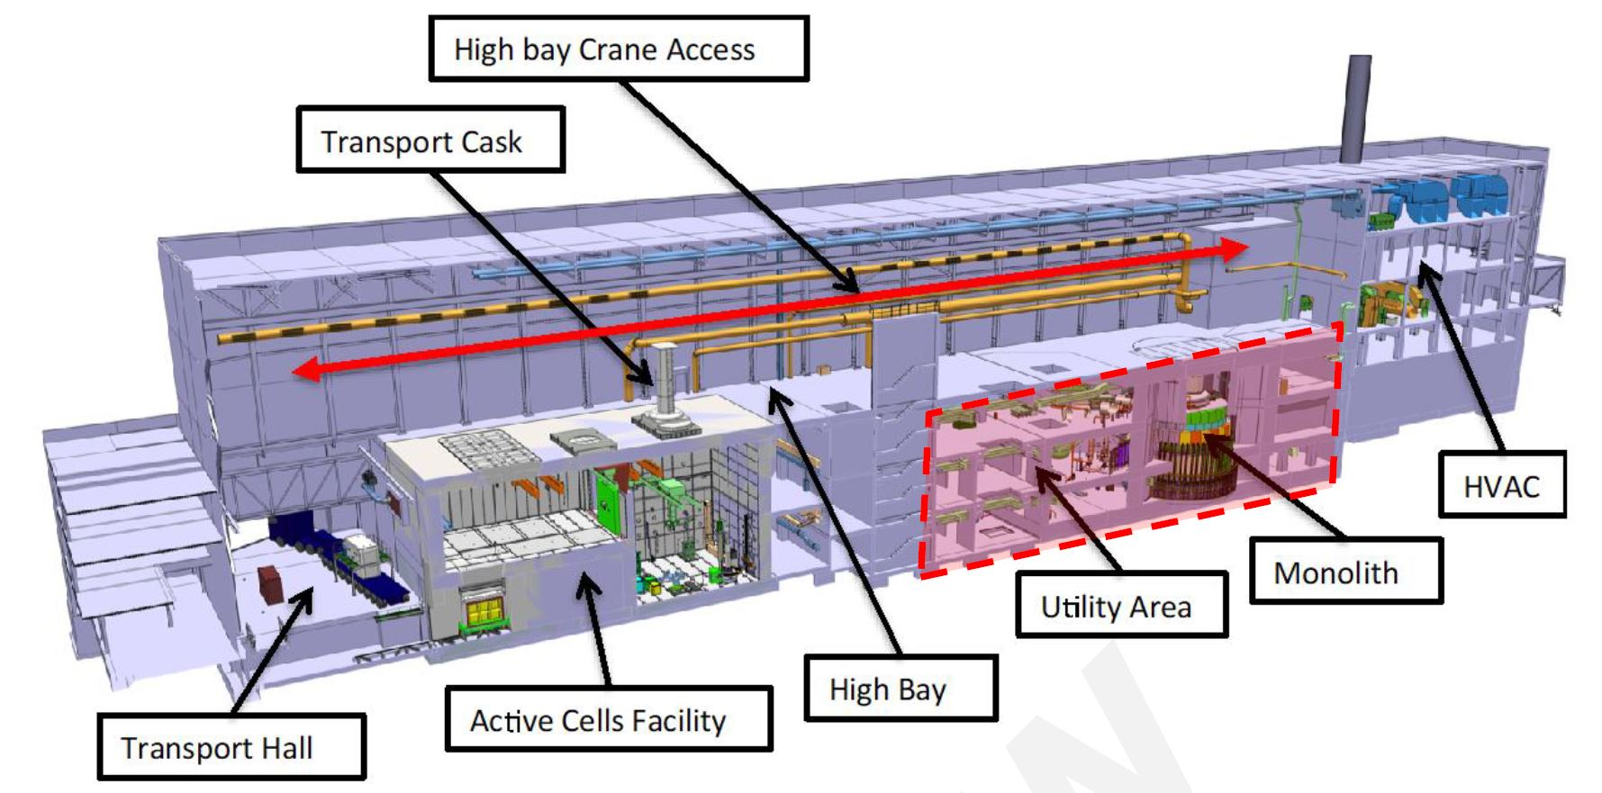
Target station

Slide 18
TS PSS
Main hazards to be mitigated by TS PSS:
Prompt ionizing radiation due to sending proton beam to target,
Ionizing radiation (gamma) from target monolith.
The basic functions realized by TS PSS:
Ensure no one is in designated areas and access is prevented when the above-mentioned hazard exist.
Ensure the above-mentioned hazards are mitigated prior to permitting access to the designated areas.

Slide 19
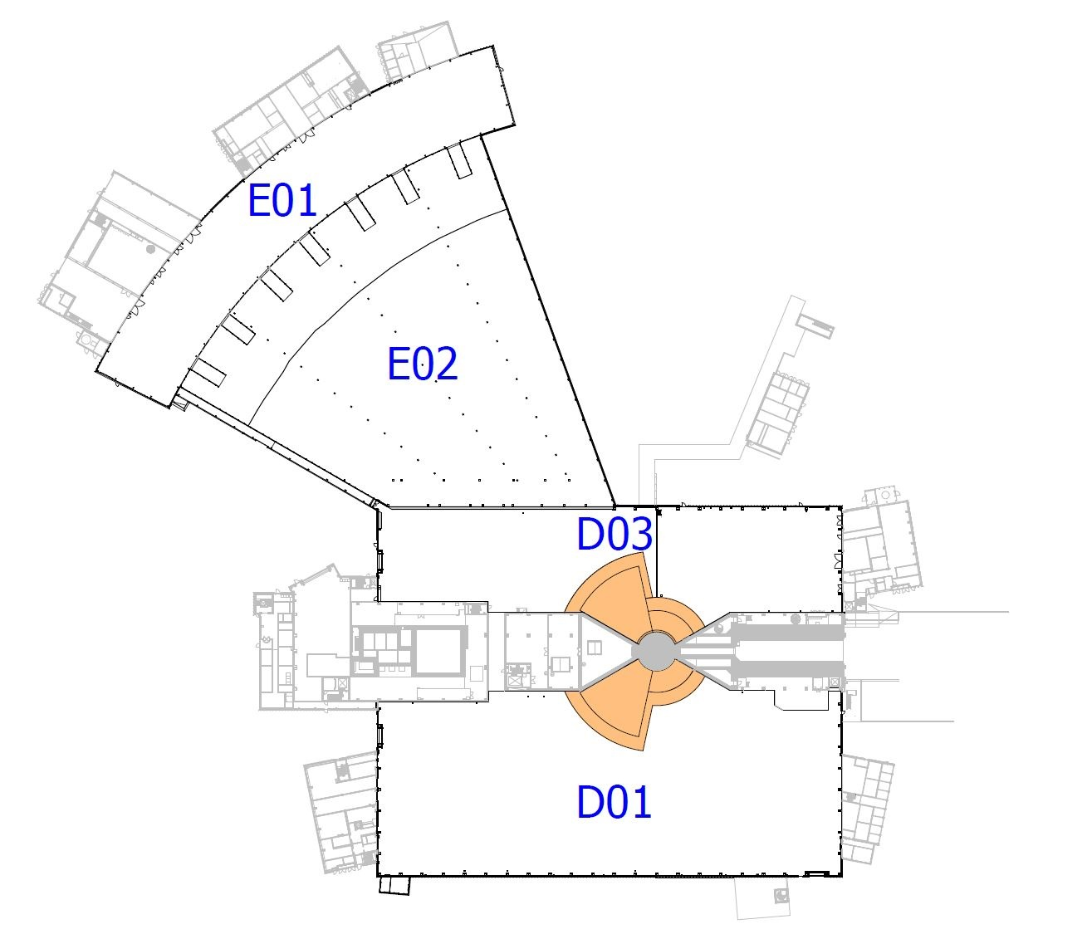
Bunker
Plan view of the NSS buildings, with the Bunker PSS controlled area marked in orange.

Slide 20
Bunker PSS
Main hazards to be mitigated by Bunker PSS:
Prompt ionizing radiation due sending proton beam to target,
Ionizing radiation (gamma) from target monolith.
The basic functions realized by Bunker PSS:
Ensure no one is in inside the bunker when the above-mentioned hazards exist.
Ensure the above-mentioned hazards are mitigated prior to permitting access to inside the bunker, and designated parts of neutron guides.

Slide 21
3
Instrument PSS

Slide 22
Instruments
BIFROST PSS
TBL PSS
ODIN PSS

Slide 23
Instrument PSS
Main hazards to be mitigated by any Instrument PSS:
Prompt ionizing radiation from Neutron beam,
The basic functions realized by Instrument PSS:
Ensure no one is in inside the cave and removal of shielding blocks is prevented when the above-mentioned hazards exist.
Ensure the above-mentioned hazards are mitigated prior to permitting access to the instrument cave.
Instrument PSS may contribute to mitigating other hazards such as vacuum, laser or motion.

Slide 24
Instrument Hazard Analysis
See examples from ODIN Instrument Hazard Analysis (ESS-1075652)

Slide 25
4
PSS main functions and interfaces

Slide 26
Main Instrument PSS functions
Prevent access to the Instrument PSS controlled area, if hazardous equipment is energised.
Prevent energization of hazardous equipment, if the Instrument PSS controlled area is not searched and locked.
Switch OFF the hazardous equipment, if an intrusion to the Instrument PSS controlled area is detected.
Switch OFF hazardous equipment, if an Emergency Switch-OFF Button (ESOB) is pressed in the Instrument PSS controlled area.
Switch OFF proton beam to target, if the Instrument PSS receives a high radiation alarm or fault signal from the radiation monitor downstream the shutter.

Slide 27
Other Instrument PSS functions
Provide procedures and means to ensure no one is left in the Instrument PSS controlled area (e.g. formalized search) prior to start of operation.
Provide personnel and operators with the information of the Instrument PSS controlled area, and PSS permits to EUC, locally and remotely.
Provide intercom system (in each instrument hall) to communicate to Main Control Room (MCR), where applicable.

Slide 28
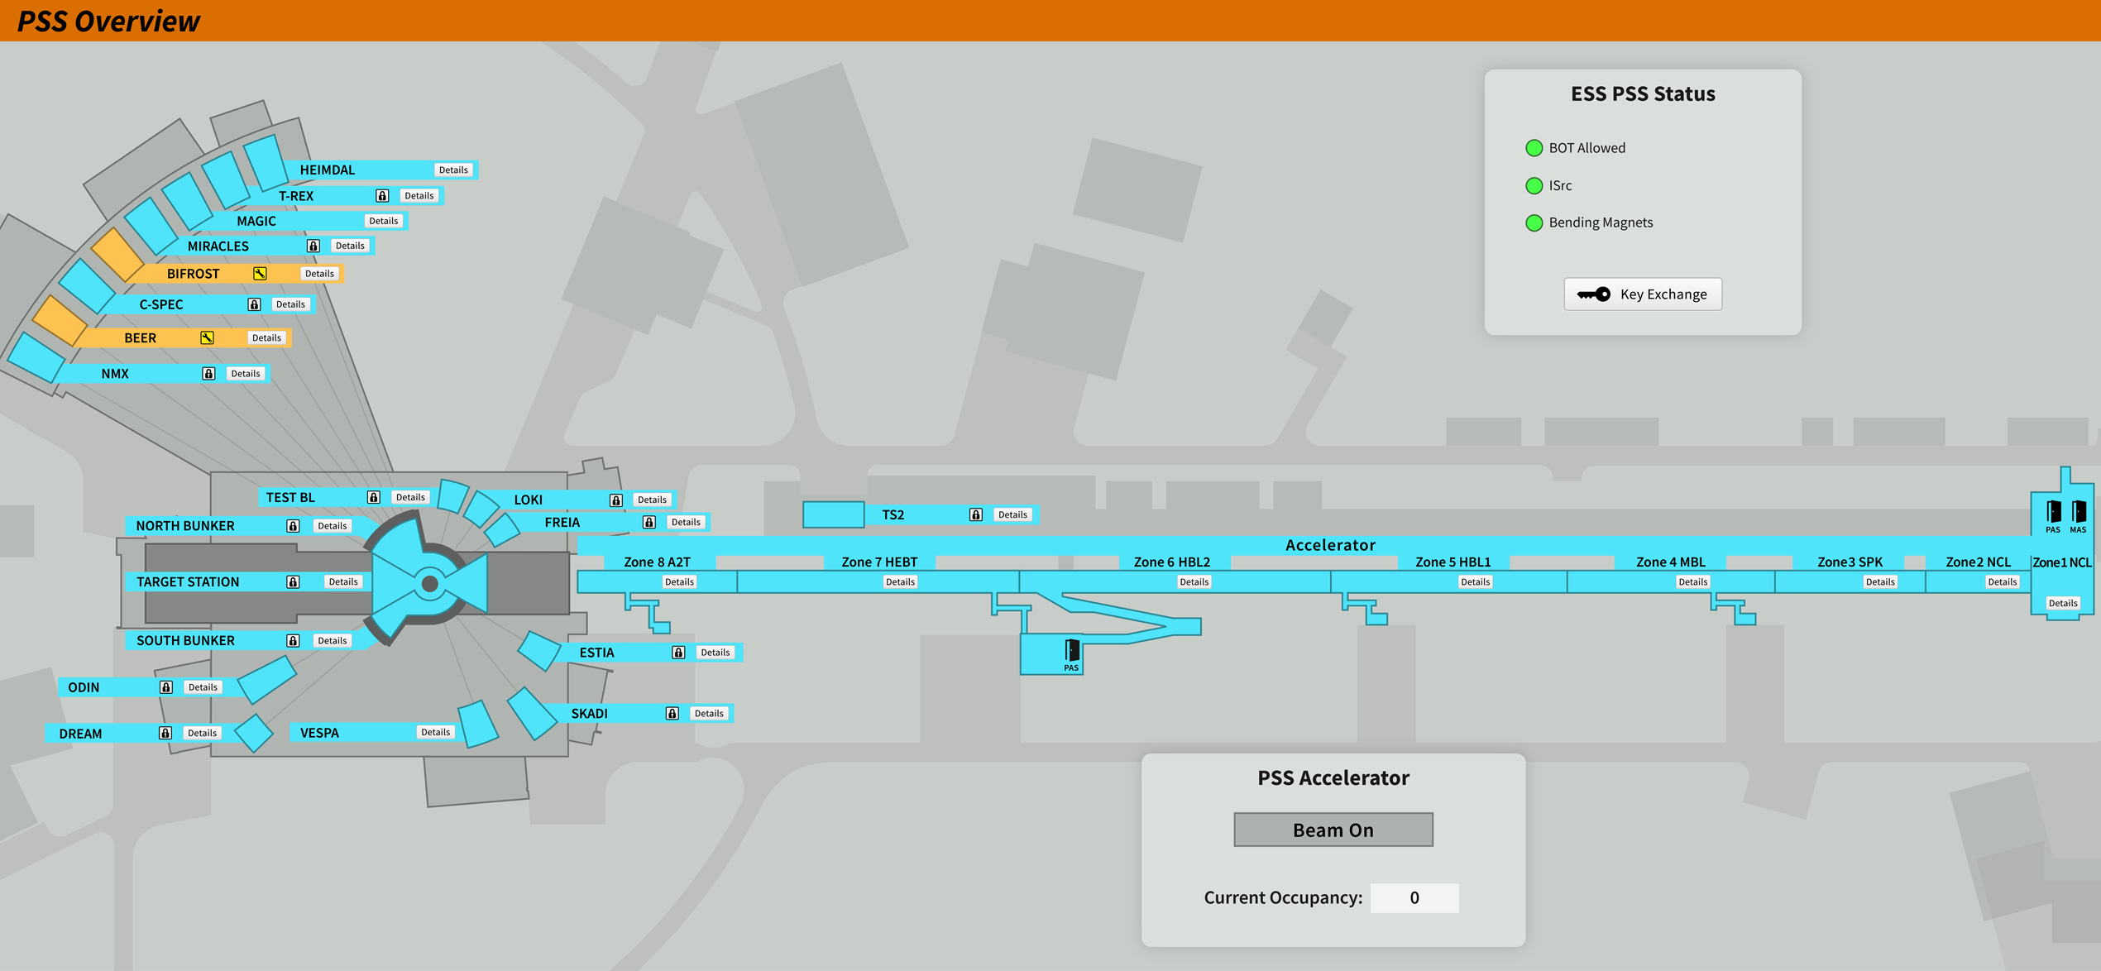
Overview OPI for ESS PSS

Slide 29
System specific OPI

Slide 30
Nexus PSS
In certain hazardous scenarios, TS PSS, Bunker PSS and each Instrument PSS need to request ACC PSS to prevent proton beam to Target. In order to ensure a robust and reliable interlink between different PSS Systems, a centralised system called Nexus PSS, which interfaces all other PSS systems, is used for this purpose.
System Requirements Specification for Nexus Personnel Safety System (ESS-4758307)

Slide 31
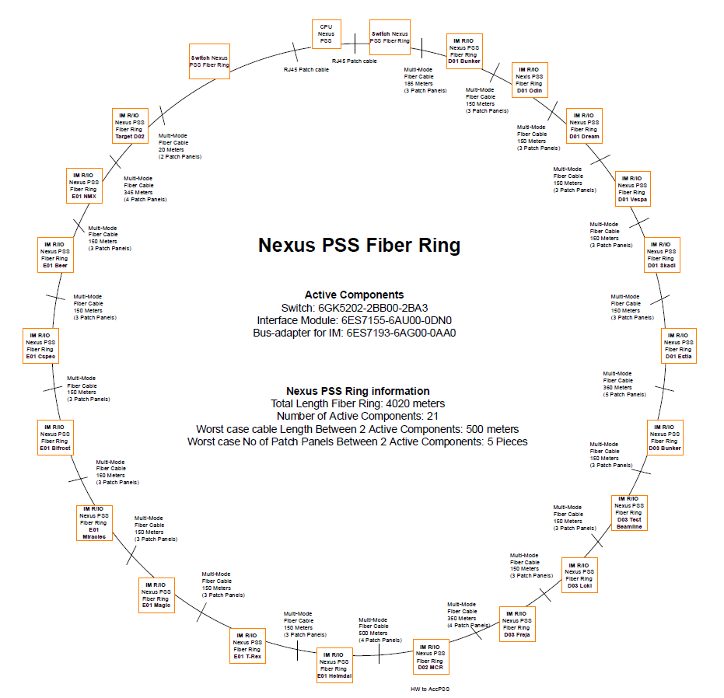
ESS PSS architecture
Architecture Specification for Personnel Safety Systems (ESS-3739363) provides the functional and physical architectures for PSS.
It depicts how various PSS (ACC PSS, TS PSS, Bunker PSS, Instruments PSS) are structured and how they are interlinked.
The PSS architecture is designed in a scalable fashion, and the adopted technologies have the capacity to support full accelerator power and energy, and 22 neutron instruments.

Slide 32
PSS Interfaces
Interfacing system | Purpose
Data archiving service | To record PSS data (e.g. alarms, PLC diagnostics, etc.) during operation to allow for event reconstruction and analysis.
Alarm Service | ESS uses the EPICS alarm service to realise the provision of automated notifications for PSS related events (e.g. when PSS SIFs have been triggered, or PSS equipment failure). These alarms can be categorised based on their severity and provide operators with an instruction.
Technical Network | A routing instance of the Technical Network, the Controls Network (CN), is used for EPICS-based control systems. The CN enables all data transfers between the PSS and EPICS IOC, the data archiving service, and alarm service.
Radiation monitors | Radiation monitors are installed at the perimeters of designated PSS controlled areas to maintain the area classification with legal dose limits and dose rates set by the Operational Radiation Protection team, and alarm if those are exceeded. The ESS PSS interface with these radiation monitors through the Radiological & Environmental Monitoring System (REMS) (=ESS.INFR.B01) to mitigate radiation hazards in certain hazardous scenarios. In case of Instruments, PSS interfaces with radiation monitor downstream the instrument shutter, in order to mitigate the radiation hazard within the cave upon shutter failure.
Electronic Personal Dosimeter | Designated PSS (e.g. ACC PSS) need to interface with the Electronic Personal Dosimeter (EPD) System to ensure personnel carry an EPD upon access to PSS controlled area. The EPDs are used for direct reading of radiation dose and alarming capabilities in areas with higher radiation risk.

Slide 33
PSS Interfaces
Interfacing system | Purpose
Physical Protection System | The Physical Protection System (=ESS.INFR.R01) is a system in place to protect people, information and facility assets against antagonistic threats, e.g. unauthorised intrusion or sabotage. Designated PSS (e.g. ACC PSS) need to interface with the Physical Protection System to utilize card readers on the access stations for management of registered access.
Gas detection system | A gas detection system monitors oxygen level, release of Hydrogen or toxic gases in designated areas. It creates notifications and triggers evacuation alarms if the pre-defined thresholds are reached. PSS may need to interface some of the gas detection systems in order to prevent access to the PSS controlled area in case of a gas alarm.

Slide 34
PSS Interfaces
Interfacing system | Purpose
ISrc | Mitigate prompt ionizing radiation hazard from proton beam
RF systems | Mitigate prompt ionizing radiation hazard from RF-powered equipment
Instrument shutter | Mitigate prompt ionizing radiation hazard from Neutron beam
Bending magnets | Prevent proton beam to Target
Gamma blocker Light shutters | Mitigate gamma radiation hazard from target
PBDR isolation valve | Confine the radioactive inventory within monolith in case of failure in the monolith vessel
Access doors | Prevent access to hazardous area
ISrc HV PS Vacuum pumps, protective windows on detector vessels | Mitigate conventional hazards: high voltage, vacuum

Slide 35
5
PSS stakeholders

Slide 36
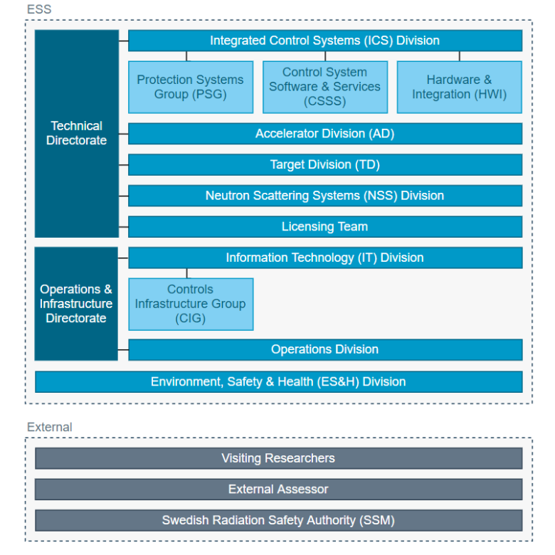
PSS stakeholders & interaction roles
A stakeholder is defined as a person, or group of people, linked to the system in any fashion. The concept includes everyone with an interest (or stake) in the system. These stakeholders interact with the PSS in different roles, called system interaction roles (owner, provider, operator (normal and expert), client.

Slide 37
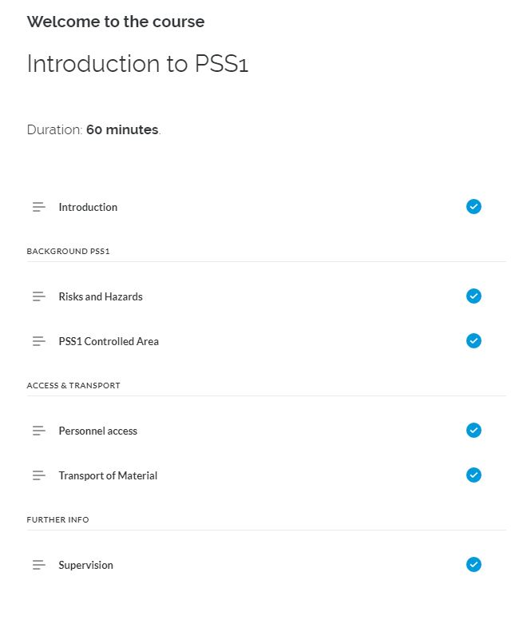
PSS training
Clients and operators receive training on how to interact with the designated PSS in the area. Operators receive additional training on how to manage mode transitions and acknowledge alarms using the HMI.
Trainings are developed by the PSS team in cooperation with the ESS Learning Management System (LMS) team. An operations manual is also provided for each PSS.
PSS1 online training course in ESS learning lounge
Hands on training to clients (e.g. how to use access stations), and to operators (e.g. how to perform the formalized search) is also provided by PSS team.

Slide 38
6
Bypass PSS

Slide 39
PSS bypass
The ESS PSS are designed to minimize the need to bypass the system while hazards are
present. However, in certain circumstances, such as during testing or performing maintenance of the EUC, a SIF (or parts of a SIF) may need to be temporarily disabled or bypassed.
Prior to bypassing the designated SIFs, written operational procedures shall be developed documenting how and when a SIF bypass may be used, by whom, and for how long. This procedure shall include a re-verification of the SIF, after the task is completed and the bypass is removed.
Moreover, a risk assessment shall be carried out to evaluate and determine the compensating measures that ensure continued safety, while the SIFs are disabled or degraded due to bypass.

Slide 40
Measures during PSS bypass
The following measures can be considered for providing bypass means for the ESS PSS:
A means of ensuring the hazard related to the SIF is removed shall be implemented such as a LOTO or Physical barrier installed.
When a bypass function is enabled, alarms and emergency switch-off SIFs shall not be disabled.
Bypass functions shall be removed, and bypass means returned to their normal position prior to the start of normal operations.
The bypass means are managed by an Expert Operator to prevent unauthorized use.
Where possible, time limits on bypass functions are enforced.
Where possible, limiting the number of bypasses that can be active at the same time is enforced.

Slide 41
Examples of PSS bypass
Below are a few examples of required bypass functions in PSS:
ACC PSS :
Bypass the PSS interlock on RF power actuators to enable warm coupler conditioning while access to the ACC PSS controlled area is permitted.
Bypass the PSS interlock on the gamma blocker to allow access to the ACC PSS controlled area in order to repair a failed (in open position) gamma blocker.
Bunker PSS & TS PSS:
Bypass the PSS interlock on a light shutter to allow access to the Bunker PSS controlled area in order to perform maintenance on a neutron beam port.
Bypass the PSS interlock on a light shutter to allow access to the TS PSS controlled area in order to repair a failed (in open position) light shutter
Instrument PSS:
Bypass the Instrument PSS interlock on proton beam actuators, when an instrument is offline.

Slide 42
Thank you!

Slide 43
Back-up slides

Slide 44
Finish presentation

