Slide 2
ODIN Personal Safety System
Presented by Afshin Farshidfar

Slide 3
Agenda
1 ODIN and ODIN PSS Controlled Area
2 ODIN PSS Main Functions
3 ODIN PSS Interfaces
4 ODIN PSS Operational Activities
ODIN PSS Mode of Operations
Key Exchange System
Operational Procedures

Slide 4
1.
ODIN and ODIN PSS Controlled Areas

Slide 5
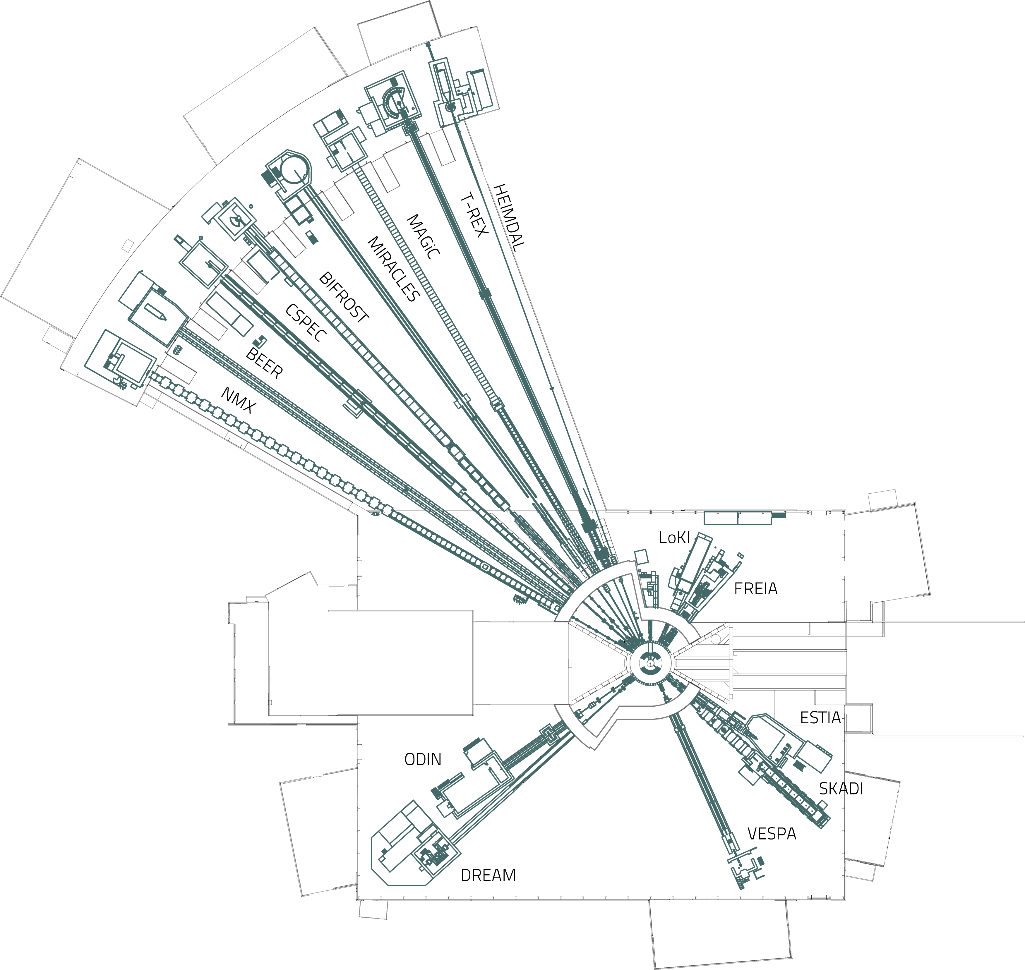
ODIN
The Instrument
Notes:
Add the plan view Yaser used.

Slide 6
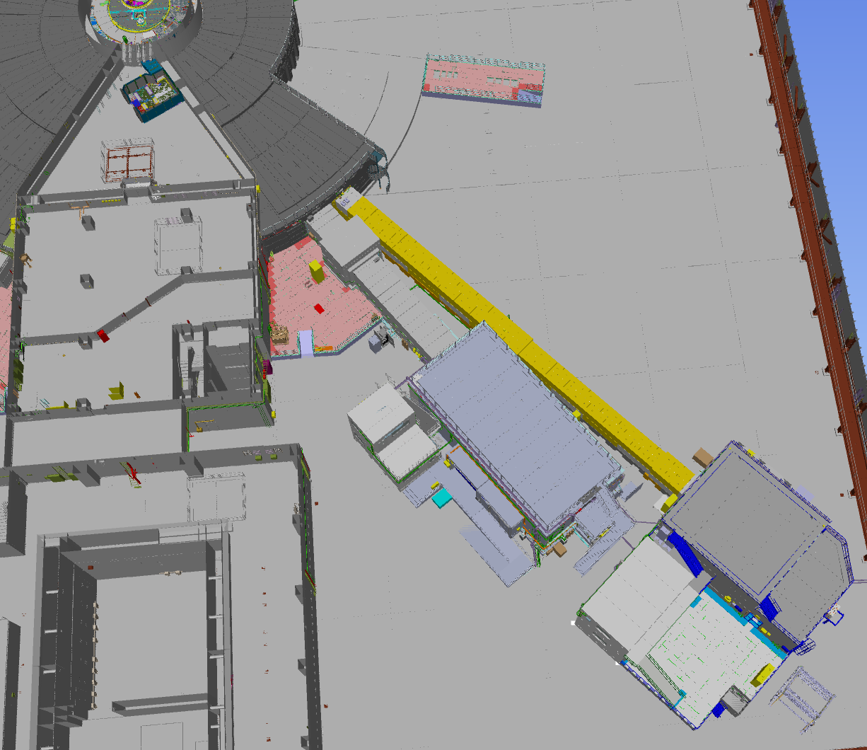
ODIN
The Instrument
ODIN
DREAM

Slide 7
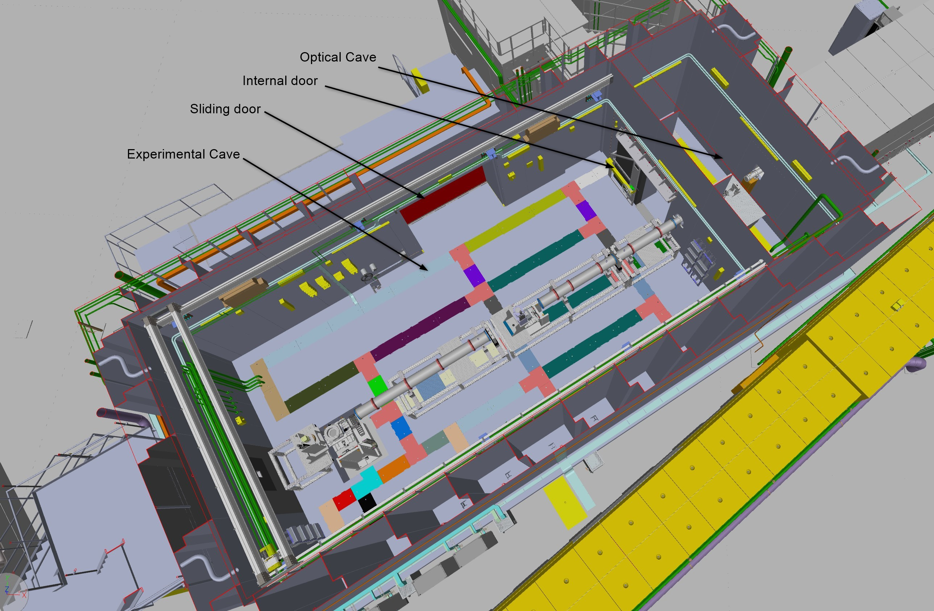
ODIN
The Instrument

Slide 8
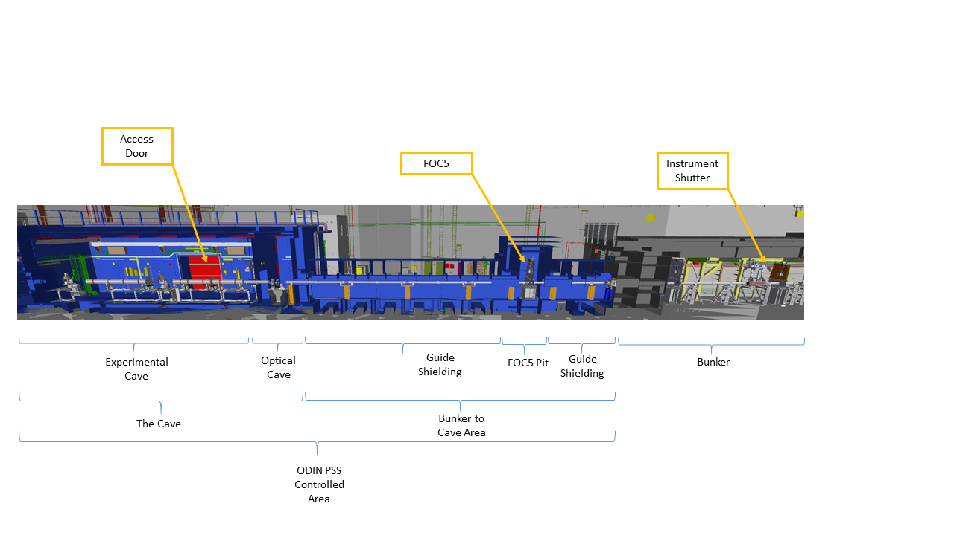
ODIN
PSS Controlled Area

Slide 9
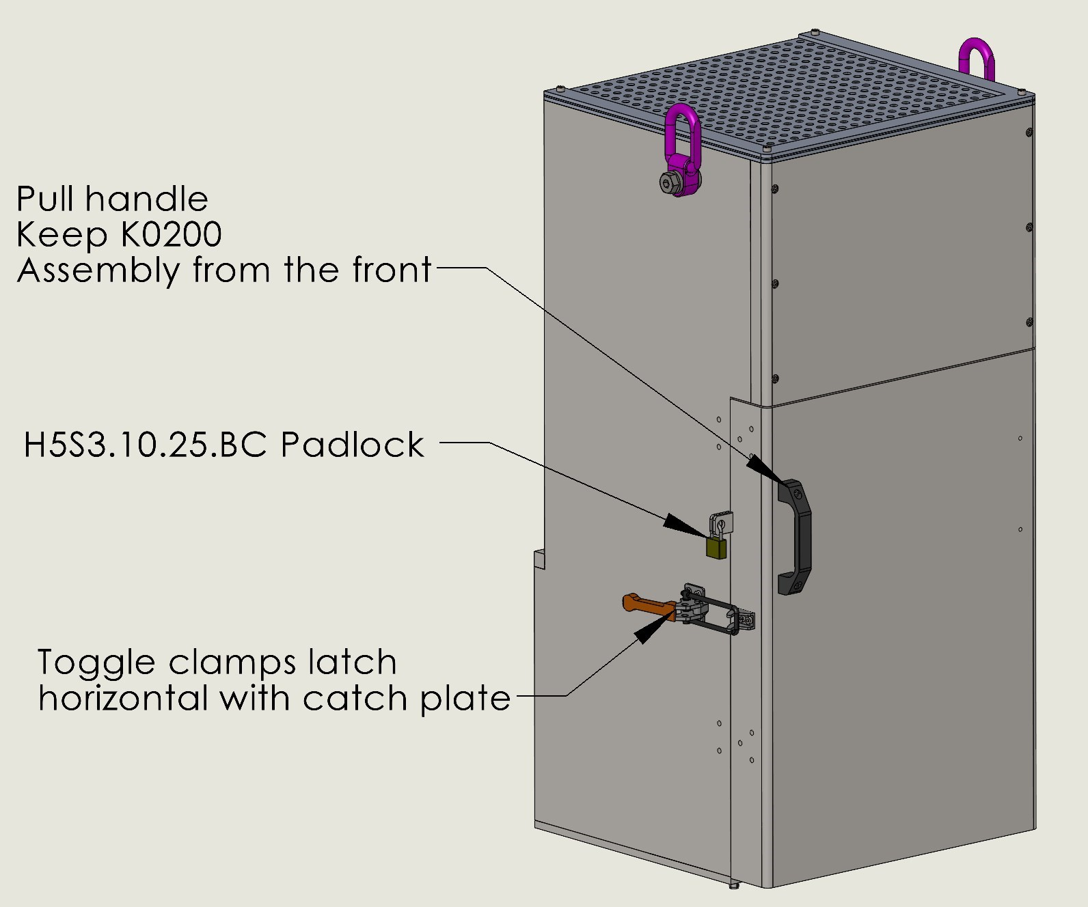
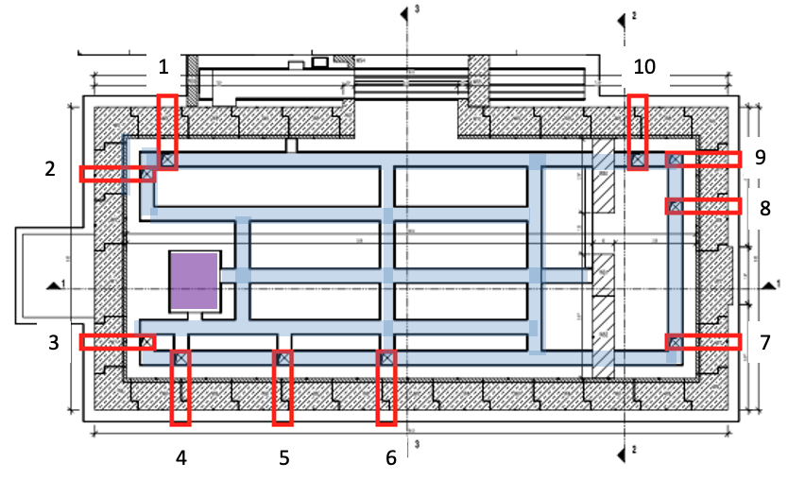
ODIN
RP Controlled Locks

Slide 10
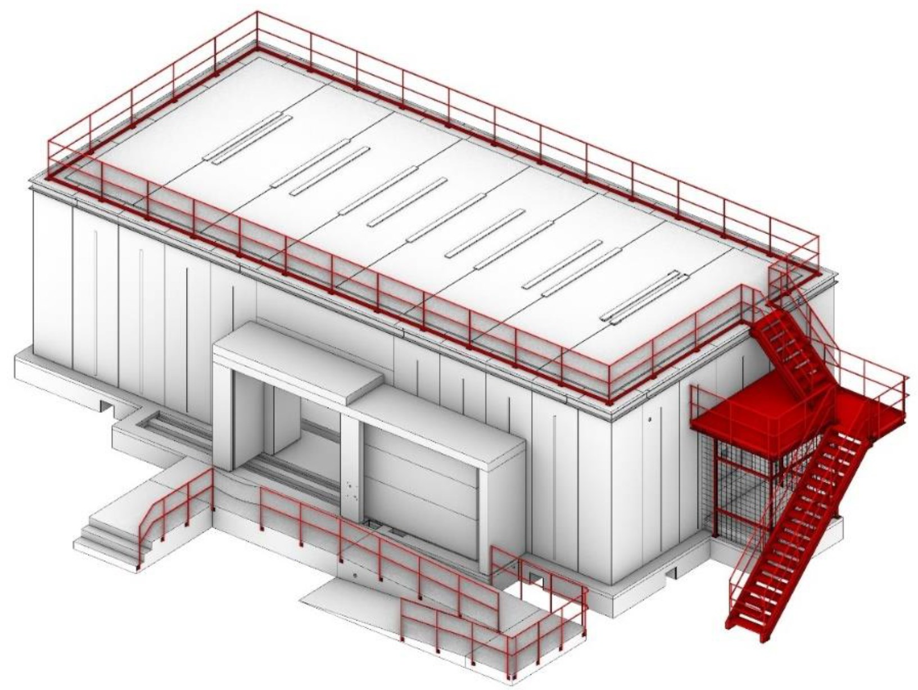
ODIN
RP Controlled Locks

Slide 11
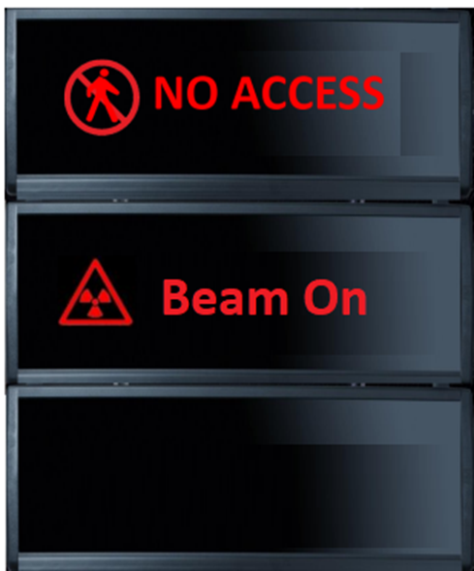
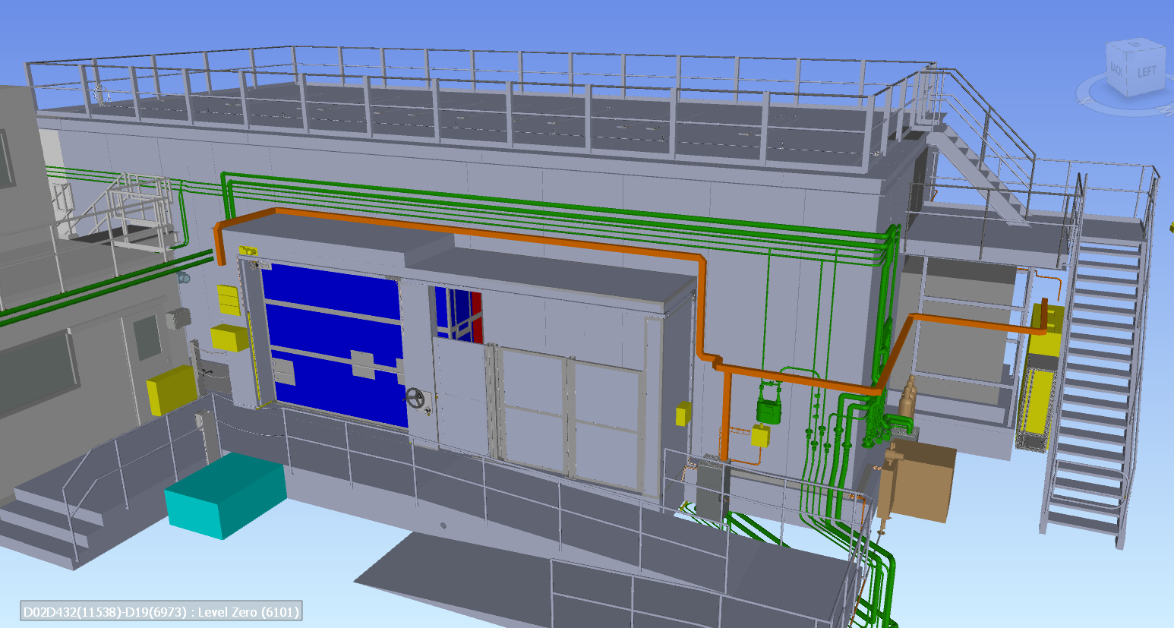
ODIN
Arrangement of PSS Equipment Around the Cave
Searching
PSS Key Exchange Unit
PSS OPI Inside the Hutch

Slide 12
2.
ODIN PSS Main Functions

Slide 13
ODIN PSS Main Functions
Mitigate Prompt Ionizing Radiation Hazards
Prevent access to the controlled area when the instrument shutter is open
Prevent inadvertent opening of the instrument shutter when the controlled area is not searched and locked
Interlock the instrument shutter in case of intrusion and request ACC PSS to turn off the beam to Target if the shutter is not closed
Request ACC PSS to switch off the proton beam to Target if an Emergency Switch Off Button (ESOB) is pressed when the instrument shutter is open
Request ACC PSS to switch off the proton beam to Target if a high radiation alarm from the radiation monitor downstream the instrument shutter is received when the instrument shutter is closed and access to the ODIN PSS controlled area is permitted

Slide 14
3.
ODIN PSS Interfaces

Slide 15
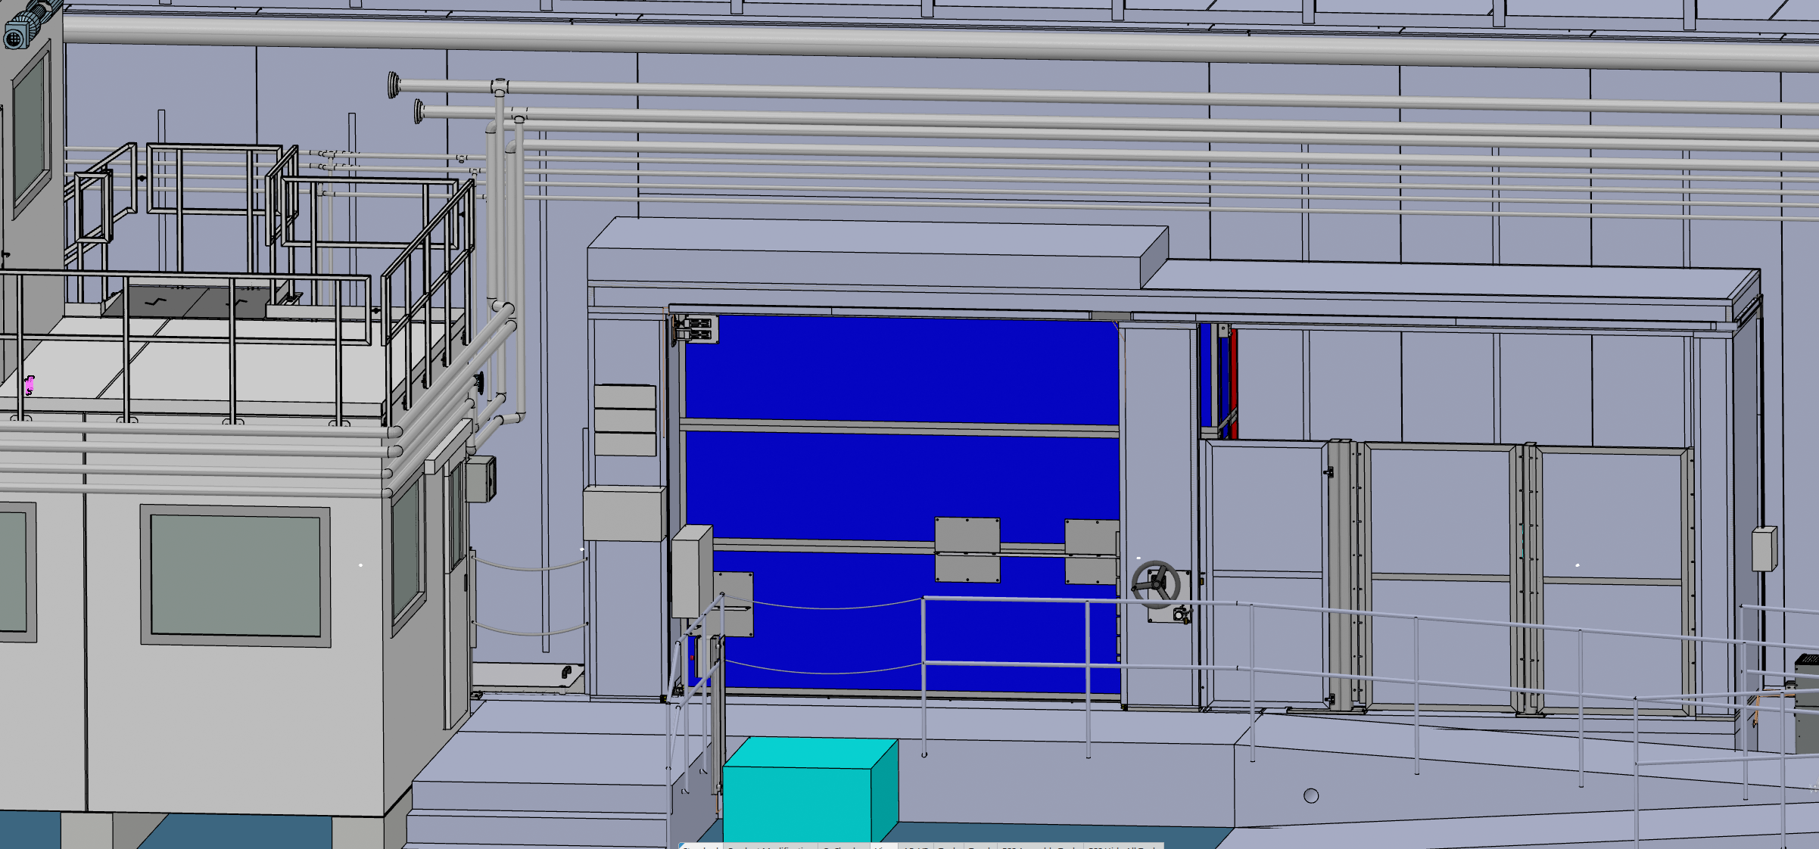
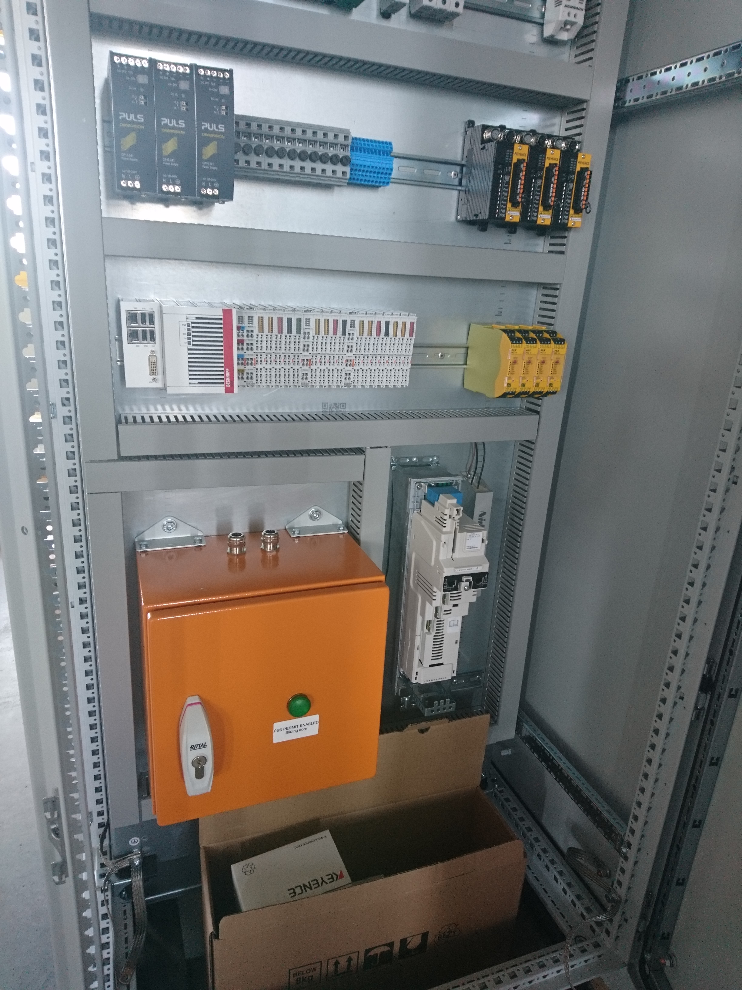
ODIN PSS Interfaces
The Access Door
The Access Door PSS ICC
Notes:
The cave access door is an ODIN PSS EUC
Explain the main function that is related to this interface

Slide 16
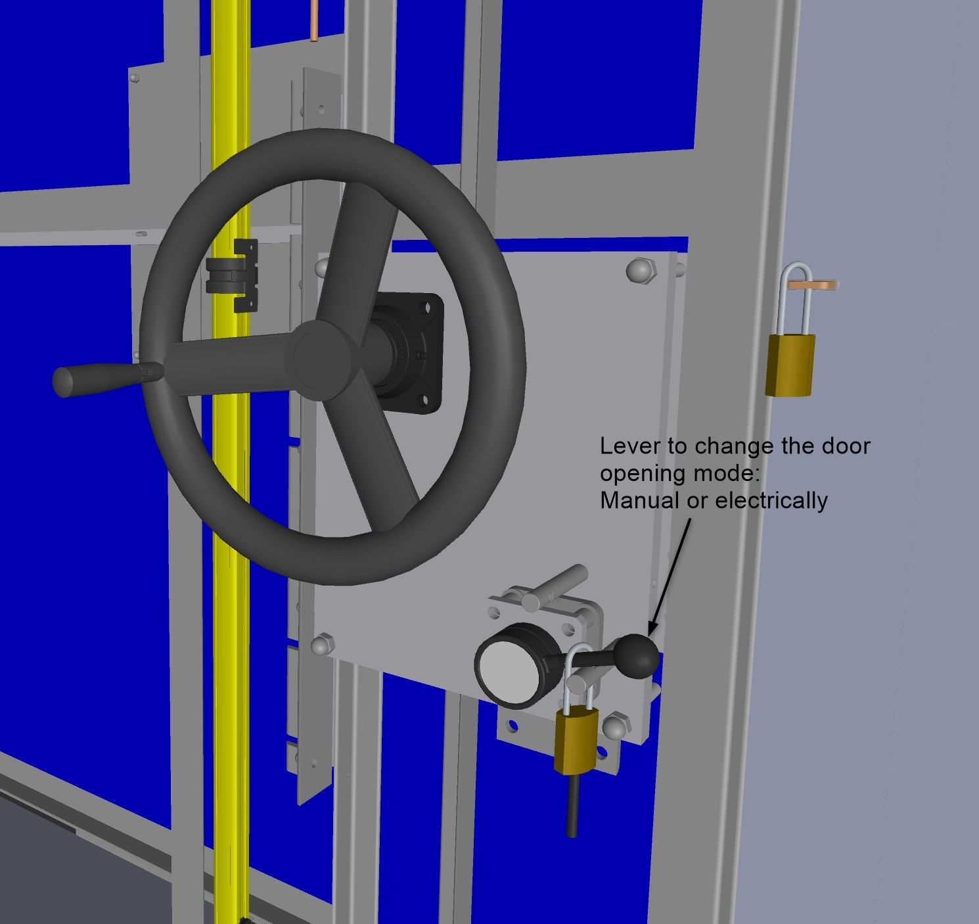
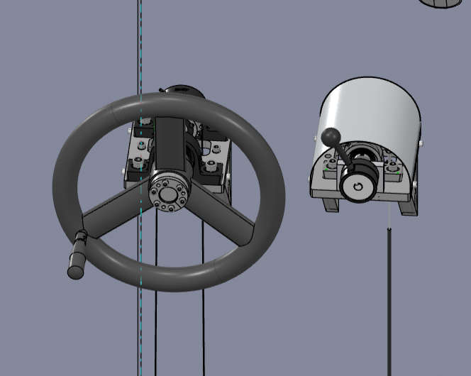
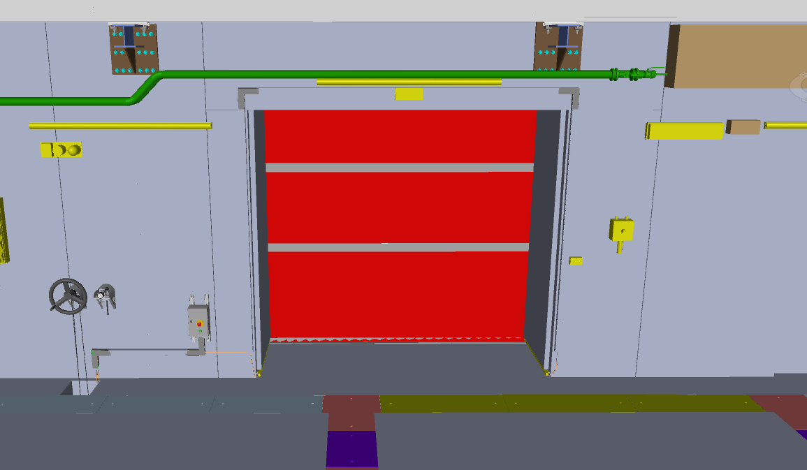
ODIN PSS Interfaces
The Access Door Motor Mechanical Override
Inside of the cave
Outside of the cave

Slide 17
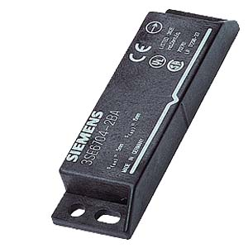
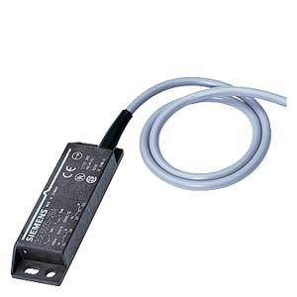
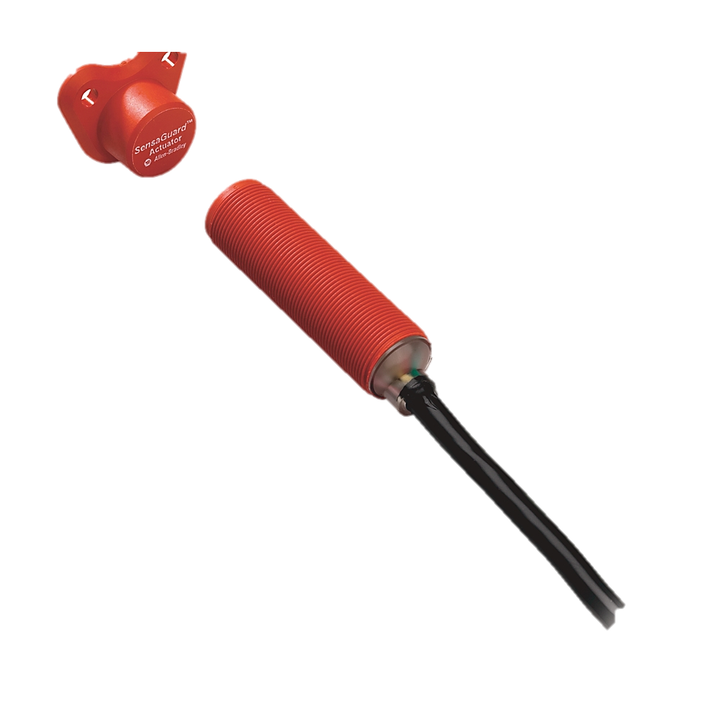
ODIN PSS Interfaces
The Access Door

Slide 18
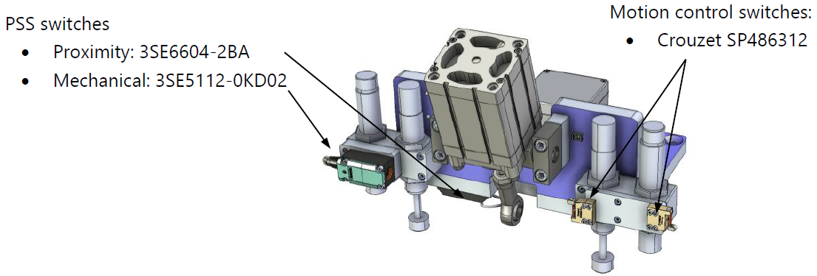
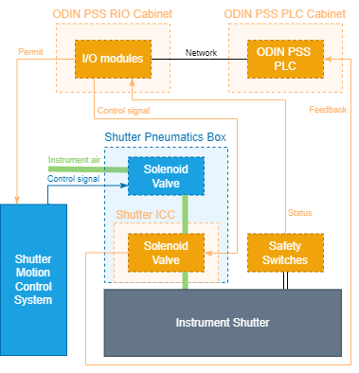
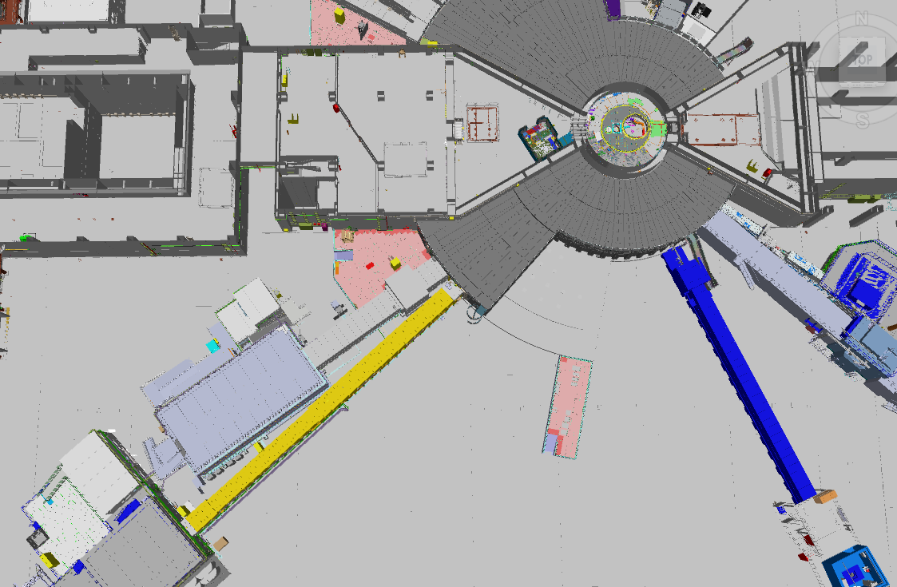
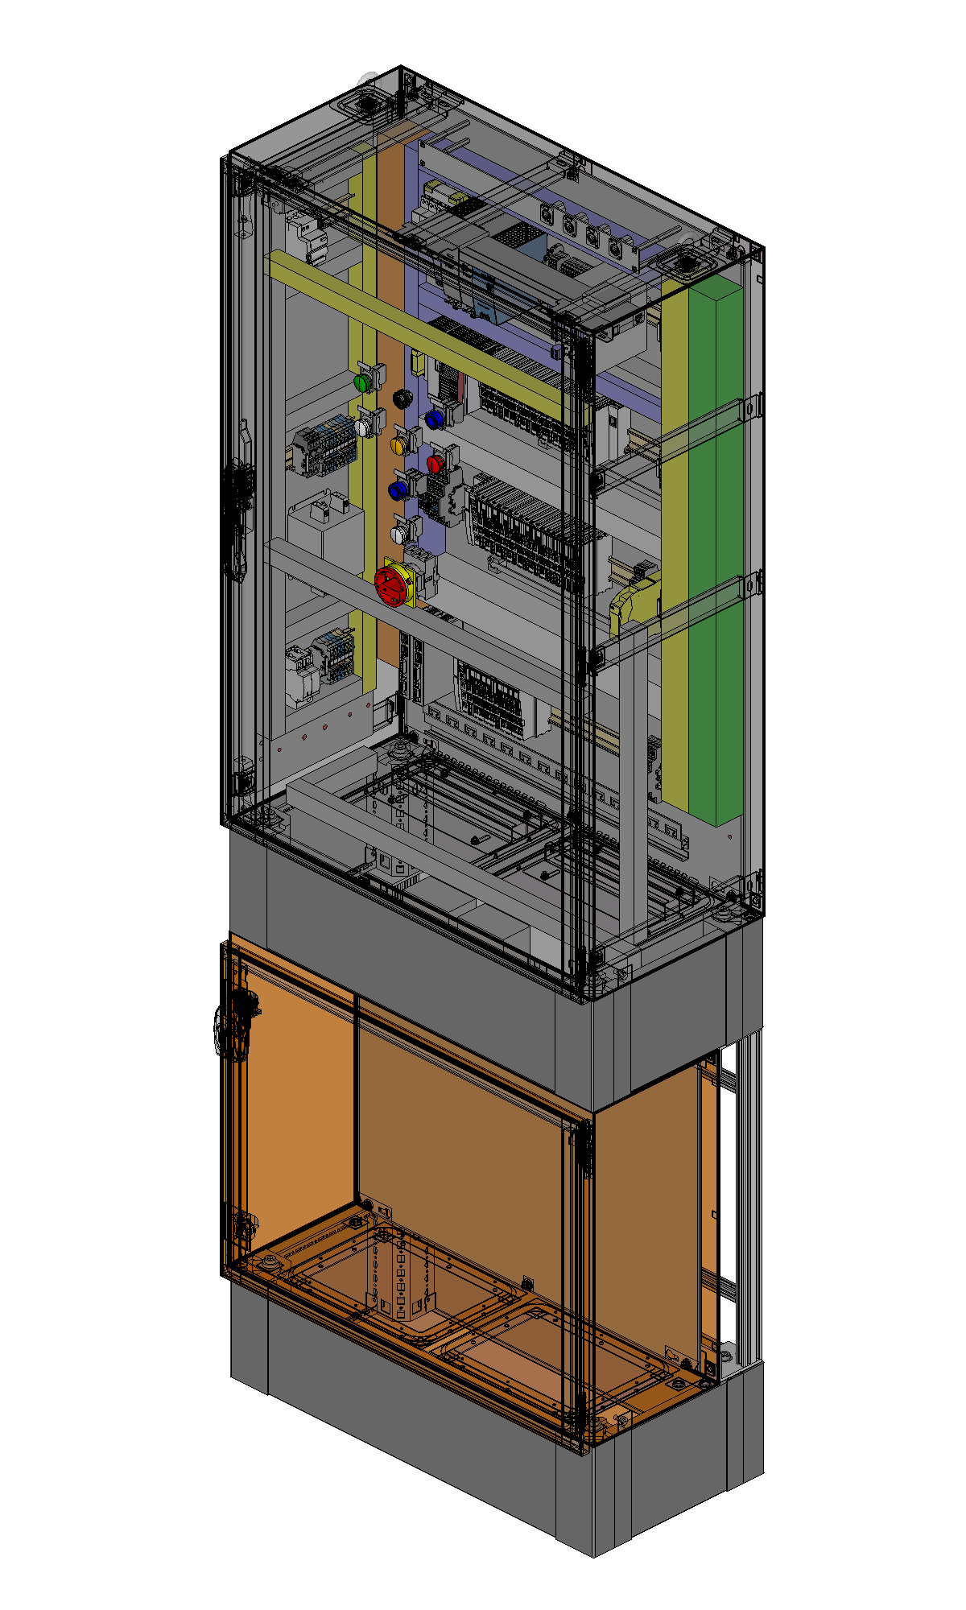
ODIN PSS Interfaces
Instrument Shutter
ODIN Cave
Notes:
The ODIN instrument shutter is a pneumatically actuated shutter which is fail safe.
In case of power failure or failure in instrument air, the instrument shutter is pulled by gravity to its normally shut state
The ODIN PSS interlocks the power to a safety solenoid valve provided by PSS on the instrument shutter. The solenoid valve in turn, interlocks the instrument air to the instrument shutter. The function of the safety solenoid valve is to prevent inadvertent opening of the instrument shutter when access to the ODIN PSS controlled area is permitted.

Slide 19
ODIN PSS Interfaces
Proton Beam Actuator
- Request ACC PSS to switch off the proton beam to Target if an Emergency Switch Off Button (ESOB) is pressed or an intrusion is detected or there is an HW failure in ODIN PSS when the instrument shutter is open
Request ACC PSS to switch off the proton beam to Target if a high radiation alarm from the radiation monitor downstream the instrument shutter is received when the instrument shutter is closed and access to the ODIN PSS controlled area is permitted
Notes:
Nexus PSS is a centralised interlink system for all PSS across ESS.

Slide 20
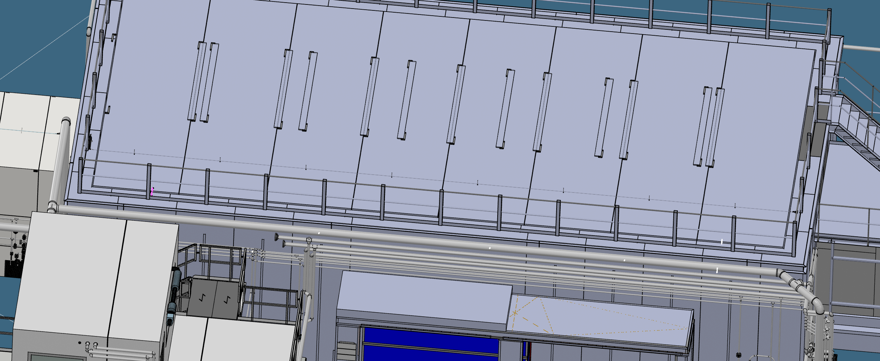
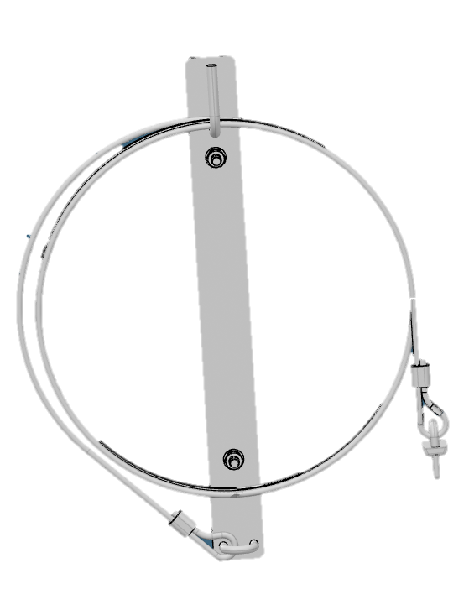
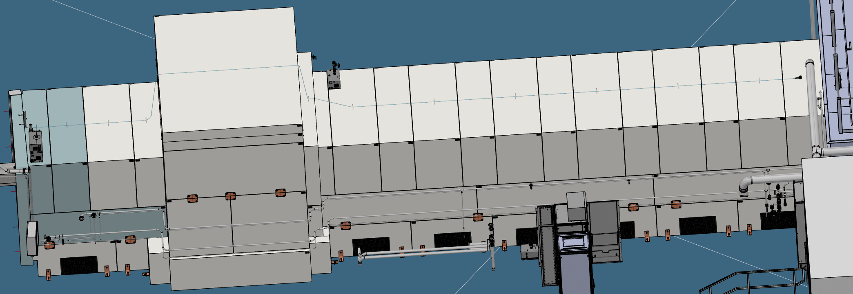
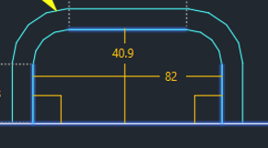
ODIN PSS Interfaces
The Cave Roof and Beam Guide Shielding
Notes:
Fortress DM modules

Slide 21
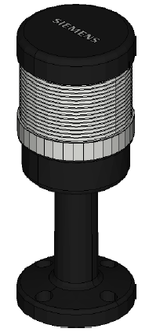
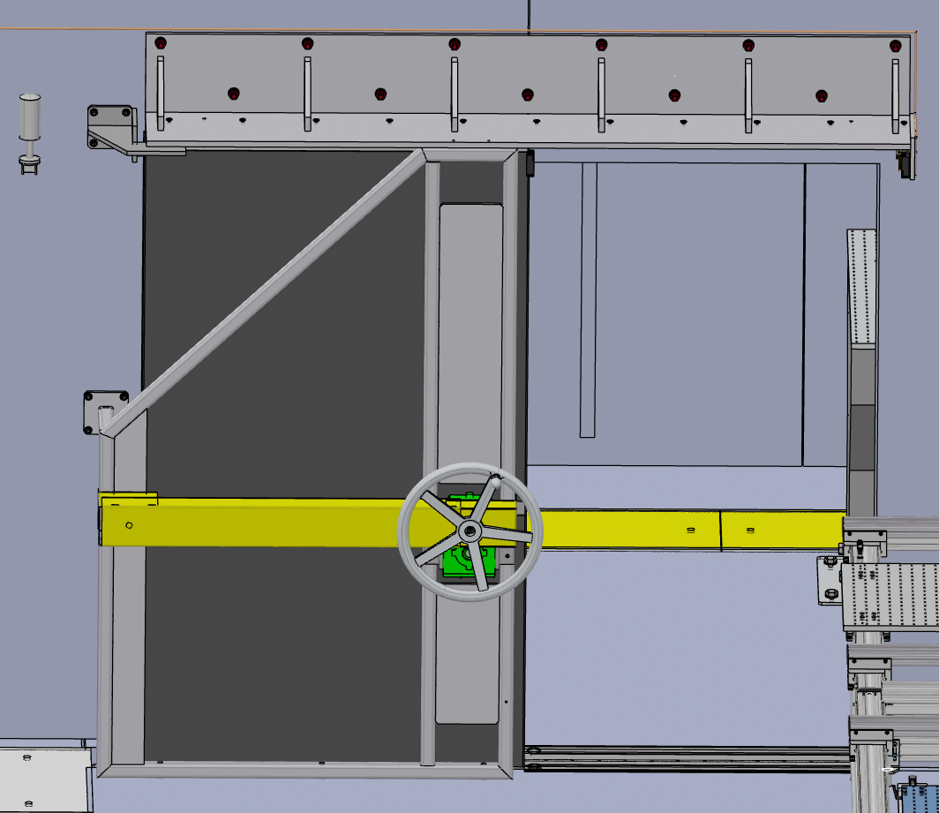
ODIN PSS Interfaces
The Internal Door
Notes:
Another function of ODIN PSS is to facilitate searching the PSS controlled area before enabling the permit to open the shutter which will be described in detail later on.
Inside the ODIN’s cave there is an optical cave is separated from the rest of the cave with a door which opens rarely. In order to avoid searching the optical cave while that internal door is kept closed, PSS monitors the door with a set of magnetic switches and also turn on an annunciator light showing the status of the search of the optical cave.

Slide 22
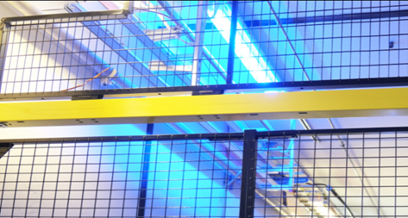
ODIN PSS Interfaces
Blue Lights
Blue lights are to warn personnel that an ionizing radiation hazard is imminent
ODIN blue lights are OFF when the beam is ON

Slide 23
ODIN PSS Interfaces
ODH Detection System
An Oxygen Deficiency Hazard (ODH) detection system is a system that monitors the oxygen level in designated areas, and triggers notifications, and evacuation alarms if the oxygen level in the area drops below pre-defined thresholds.
The ODIN PSS may need to interface with the ODH detection system in D01 to prevent access to the cave in case of ODH or display access limitations due to ODH on the ODIN PSS message display.

Slide 24
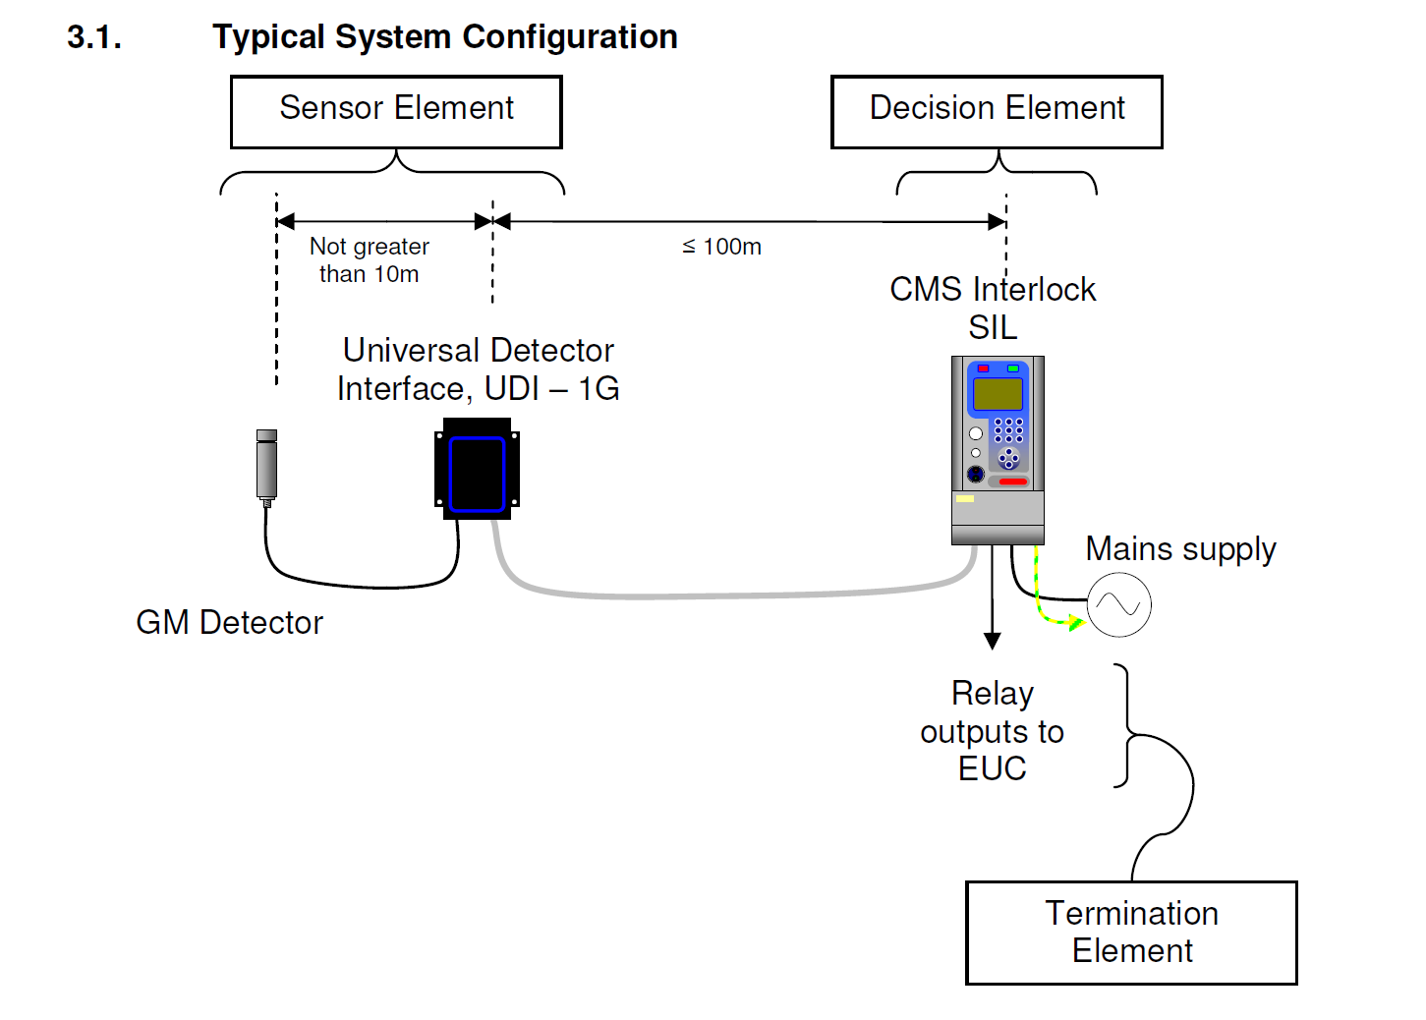
ODIN PSS Interfaces
Radiation Monitors
In case of failure in the instrument shutter, i.e. the instrument shutter is detected closed by PSS but the radiation monitor downstream the shutter detects a high level of radiation, ODIN PSS requests the Accelerator PSS to switch OFF the proton beam to Target, if access to the ODIN PSS is permitted

Slide 25
4.
ODIN PSS Operational Activities

Slide 26
ODIN PSS Operational Activities
Principles of Operation
Prior to enabling ODIN PSS permit to open the instrument shutter:
Trained operators carry out a formalised search in ODIN PSS controlled area,
ODIN PSS locks the access points to ODIN PSS controlled area.
Notes:
ODIN PSS protects workers by ensuring a safe state of ODIN PSS controlled area when it is accessible, as well as ensuring that no one is left inside the ODIN PSS controlled area when it is unsafe

Slide 27
ODIN PSS Operational Activities
Principles of Operation
Prior to granting access to ODIN PSS controlled area:
The operator closes the instrument shutter through the instrument shutter control system.
Upon initiating access to the ODIN PSS controlled area, the ODIN PSS interlocks the instrument shutter to prevent its inadvertent opening.
The instrument shutter is secured against re-energisation until the ODIN PSS controlled area is searched and locked.

Slide 28
4.1.
ODIN PSS Modes of Operation

Slide 29
ODIN PSS Modes of Operations
Access
Mode
Beam ON Mode
Transition
Mode
The ODIN PSS permit to the access door is enabled,
The ODIN PSS cave’s search is broken upon first access,
The ODIN PSS permit to the instrument shutter is disabled,
The ODIN PSS permit to the access door is disabled,
The ODIN PSS cave’s search is complete,
The ODIN PSS permit to the instrument shutter is disabled,
The ODIN PSS permit to the access door is disabled,
The ODIN PSS cave’s search is complete,
The ODIN PSS permit to the instrument shutter is enabled,
Alarm Mode
Notes:
Add more details on this slides for each modes, the status of permits and other status
Add message display modes.

Slide 30
ODIN PSS Modes of Operations
Alarm Mode
The ODIN PSS permits to the EUC are disabled according to the triggered Safety Instrumented Functions (SIF)
In any ODIN PSS Mode
ESOB
HW Failure
Any ESOB inside ODIN PSS controlled area is pressed: The search of the zone where the ESOB is pressed is broken,
Intrusion into ODIN PSS controlled area: The search of the zones where the intrusion is detected is broken,
Internal error in the ODIN PSS PLC system: The search of the whole ODIN PSS controlled area is broken.
Alarm Mode
In Beam ON or Transition Mode
Intrusion
In ACCESS or Transition Mode
REMS

Slide 31
4.2.
Target PSS Key Exchange System

Slide 32
ODIN PSS key exchange system
Notes:
Each PSS includes a key exchange which is a mechanically trapped key interlock system
where one key is exchanged for a number of other keys. It is to ensure that operating procedures are performed as a predetermined sequence of events and that procedural steps cannot be circumvented
Main functions:
To make sure PSS controlled area is safe to access
To make sure that PSS controlled area searched and locked before going to beam ON

Slide 33
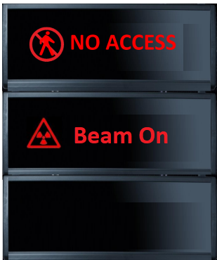
ODIN PSS Key Exchange System
Access Procedure
The operator closes the instrument shutter through the Motion Control System.
Shutter opening
is disabled.
AK1
AK gets trapped in slot 6 upon detection of opening of the cave door or removing any of the keys in slots 7 and 8
MK
MK
OVK
AK
Slot 4
S
S
S
MK
Slot 1
Slot 2
Slot 3
ODIN PSS detects the instrument shutter in the closed position, and releases MK from slot 1.
AVK is trapped in slot 5
AVK
S
S
AK
Slot 5
Slot 6
SCMK1
SCMK1
Slot 7
Cave’s Roof interlock module
SCMK2
SCMK2
Slot 8
Guide shielding interlock module
Beam ON Mode
Transition
Mode
Access
Mode

Slide 34
ODIN PSS Key Exchange System
Access Veto Procedure
Access to the cave and guide
is vetoed by the RP. AK can’t be moved to slot 6
Solenoid on slot 5 can be released via HMI using RP credential.
AVK can be removed from slot 5 if AK is in slot 4
RP Team
MK
MK
OVK
AK
Slot 4
S
S
Slot 1
Slot 2
Slot 3
AVK
S
Slot 5
AK
Slot 6
AVK
SCMK1
Slot 7
SCMK2
Slot 8

Slide 35
4.3.
Formalised Search in ODIN PSS Controlled Area

Slide 36
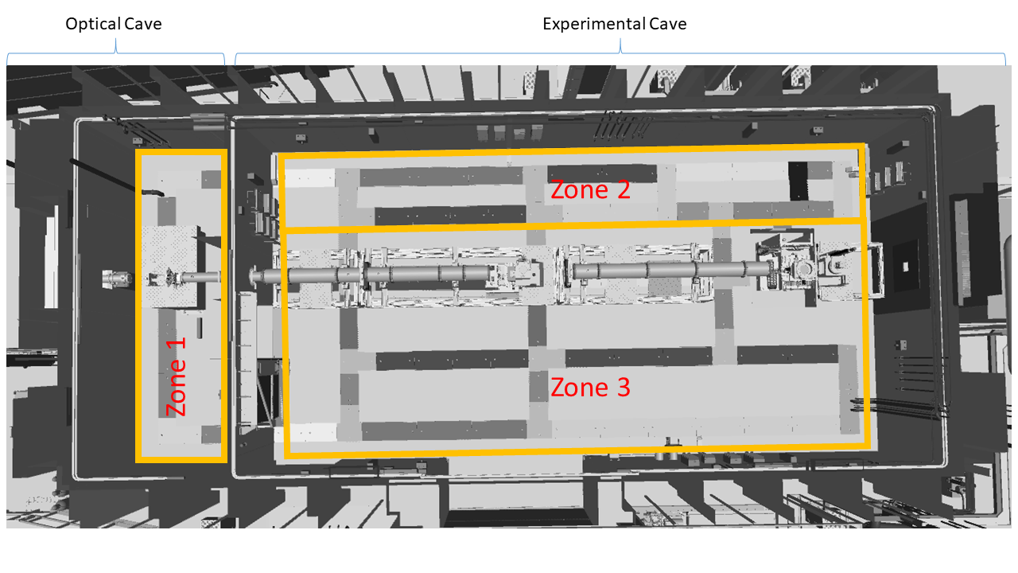
Formalised Search
ODIN PSS Search Zones
Prior to enabling the ODIN PSS permit to open the instrument shutter, a trained operator needs to perform a formalised search in the ODIN cave
A Formalised Search is carried out by pressing search buttons which are distributed in a way that requires the search team to inspect all corners of the search area
The search buttons are to be pressed in a predetermined sequence, with a time delay between pressing two buttons.
Access Door

Slide 37
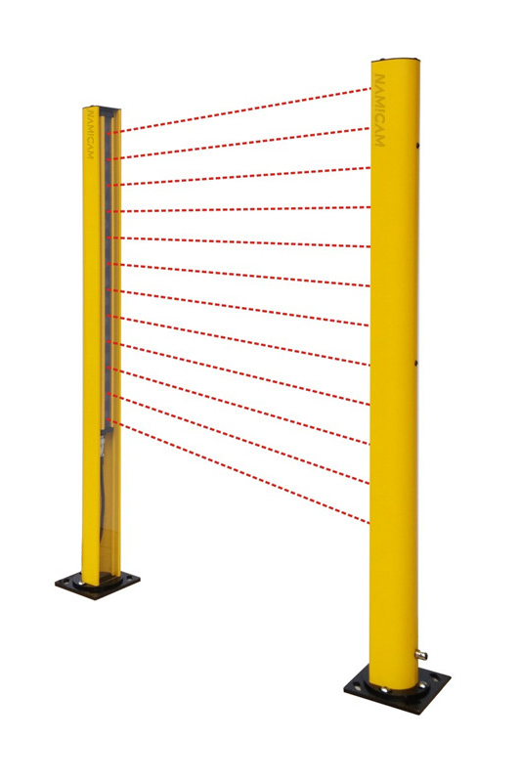
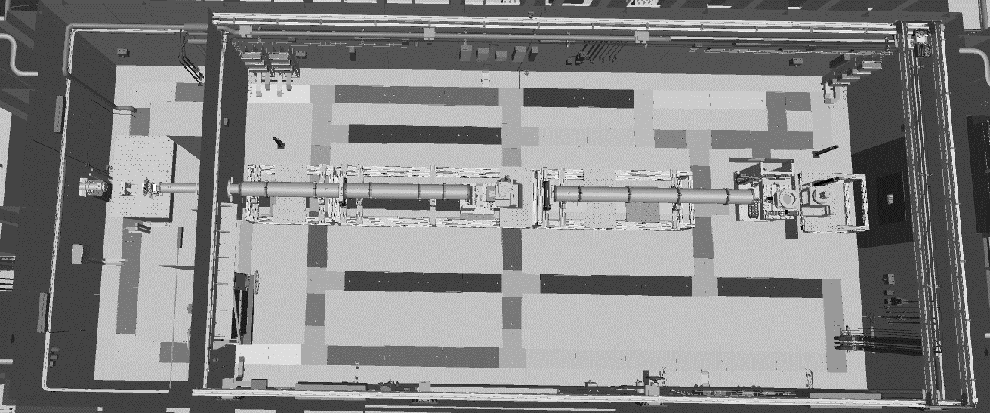
Formalised Search
Light Curtain Setup Alternative I
The light curtain is used to define the other side of the beamline as a separate search zone
The first setup alternative covers the whole beam line in the experimental hall (~12m space between the light curtain transmitter and receiver)
Notes:
Around 12m between transmitter and receiver of the light curtain in this option

Slide 38
Formalised Search
Light Curtain Setup Alternative II
The second alternative covers only the small passage
The need to install physical barriers along the beamline (to separate zone 2 and zone 3) will be evaluated after the equipment on and around the beam line is installed
The passage
Notes:
Block the other part of the optical bench if there is a way to

Slide 39
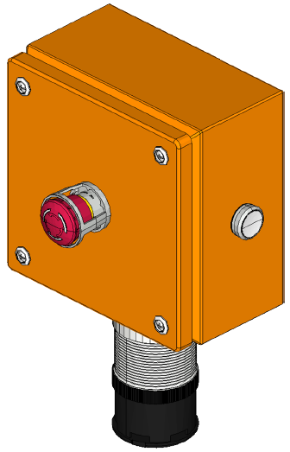
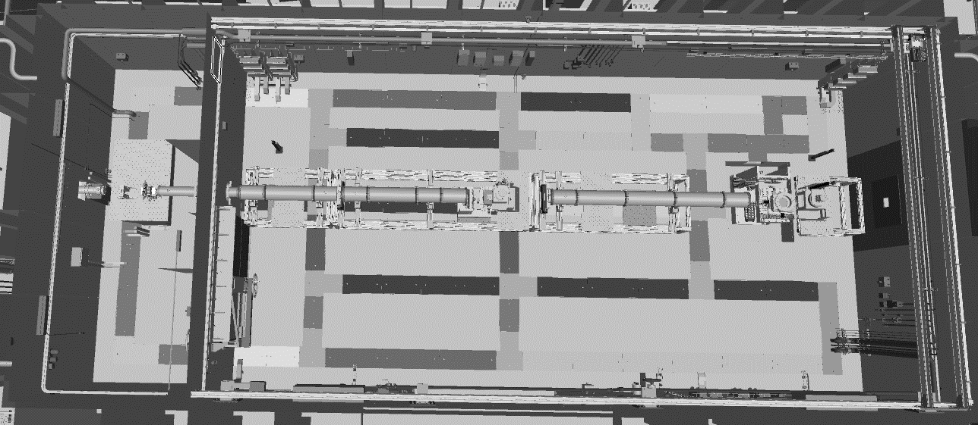
Formalised Search
ODIN Cave Formalised Search
ODIN PSS must be in ACCESS mode
The operator ensures that the roof shielding blocks are in place, and SCMK1 is in Slot 7 of the key exchange
If the optical cave search is broken, the search shall always start from there
The access door shall be closed within a certain time limit
SEARCHING
SEARCHED

Slide 40
4.4.
Enabling the Permit to Open the Instrument Shutter

Slide 41
Steps to Enable the Instrument Shutter to Open
The solenoid releases the MK from slot 2 if the PSS controlled area is searched, and locked and all SIFs are cleared.
The solenoid locks the MK in slot 1 upon detection of the shutter opening
MK
MK
OVK
AK
Slot 4
S
S
S
Slot 1
MK
ODIN PSS controlled area is searched and locked. AK can be released from slot 6
Slot 2
Slot 3
AK
Solenoid on slot 3 can be released via HMI using RP credential.
MK gets trapped in slot 2 if OVK is removed
AVK
S
Slot 5
S
AK
Slot 6
SCMK1
SCMK1
Slot 7
Cave’s Roof interlock module
SCMK2
Slot 8
SCMK2
Guide shielding interlock module
Blue lights and the sounders turn on and the shutter opening
gets enabled after 60s
Access
Mode
Beam ON Mode
Transition
Mode

Slide 42
THANKS FOR YOUR TIME!

Slide 43
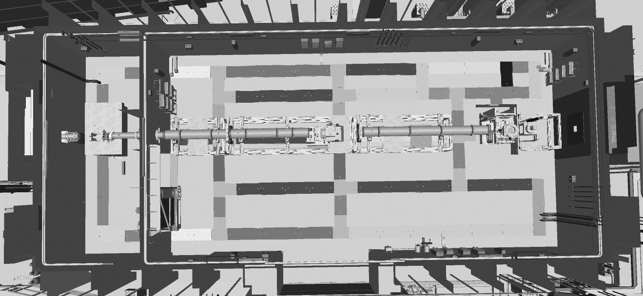
ODIN PSS ESOB
Emergency Switch OFF Stations
Access Door
Back to Mode definition Slide

