Slide 2
BIFROST PSS Overview and Concepts of Operations
BIFROST PSS PDR
PRESENTED BY YASER TAKZARE

Slide 3
Agenda
1 BIFROST Instrument and BIFROST PSS Controlled Area
2 BIFROST PSS Main Functions
3 BIFROST PSS Interfaces
4 BIFROST PSS Operational Activities
4.1 BIFROST PSS Modes of Operation
4.2 Key Exchange System
4.3 Formalised Search in BIFROST PSS Controlled Area
4.4 Enabling the Instrument Shutter to Open
5 Questions to the committee

Slide 4
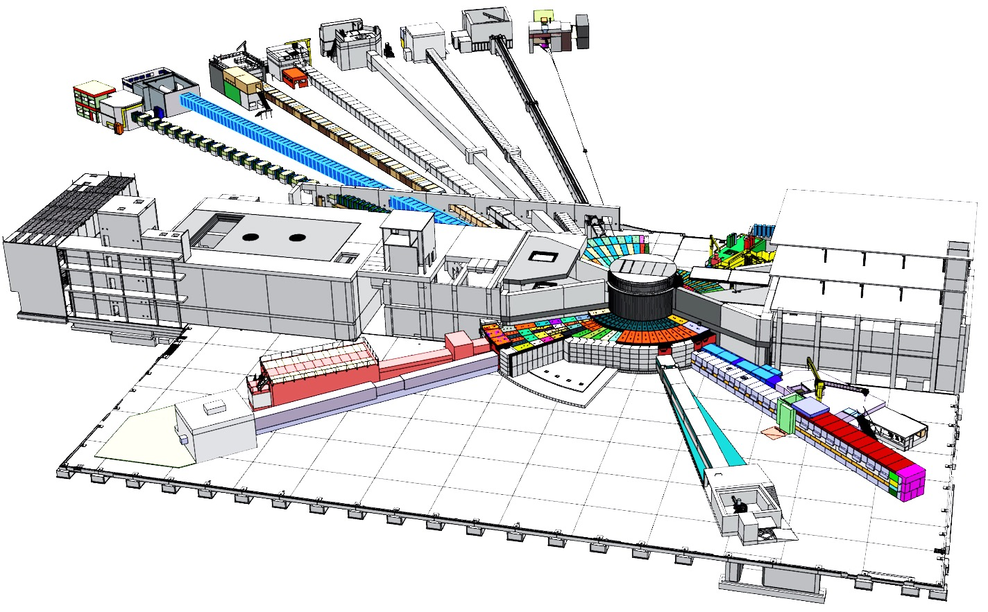
1
BIFROST Instrument and BIFROST PSS Controlled Area

Slide 5
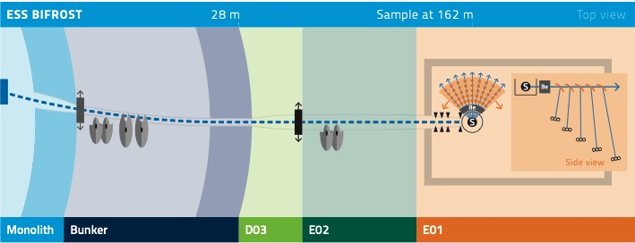
BIFROST

Slide 6
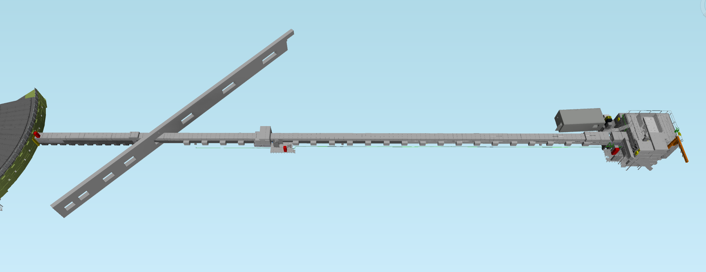
BIFROST
PLAN VIEW
D03: Experimental hall 2
E02: Beam line Galley
E01: Experimental hall 3
Control Hutch
Instrument Shutter Pit
Bunker Wall
Chopper Pit
Cave

Slide 7
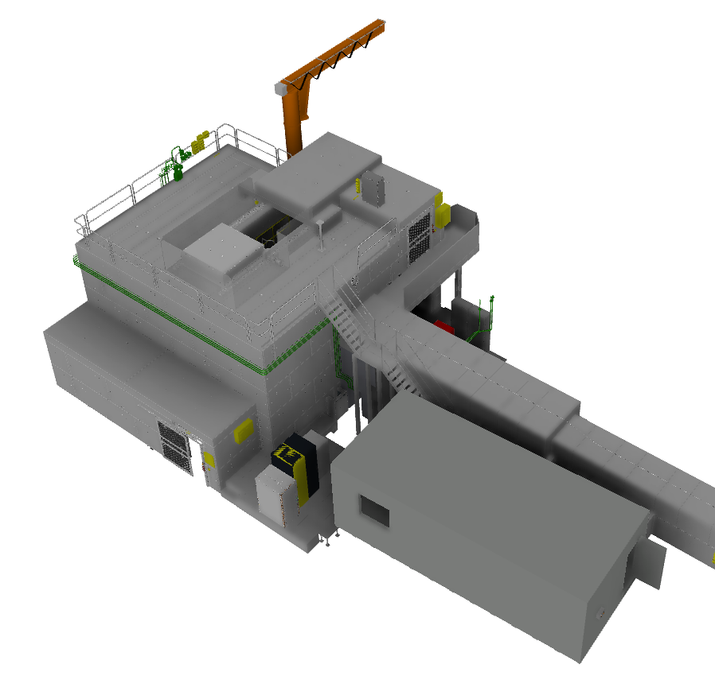
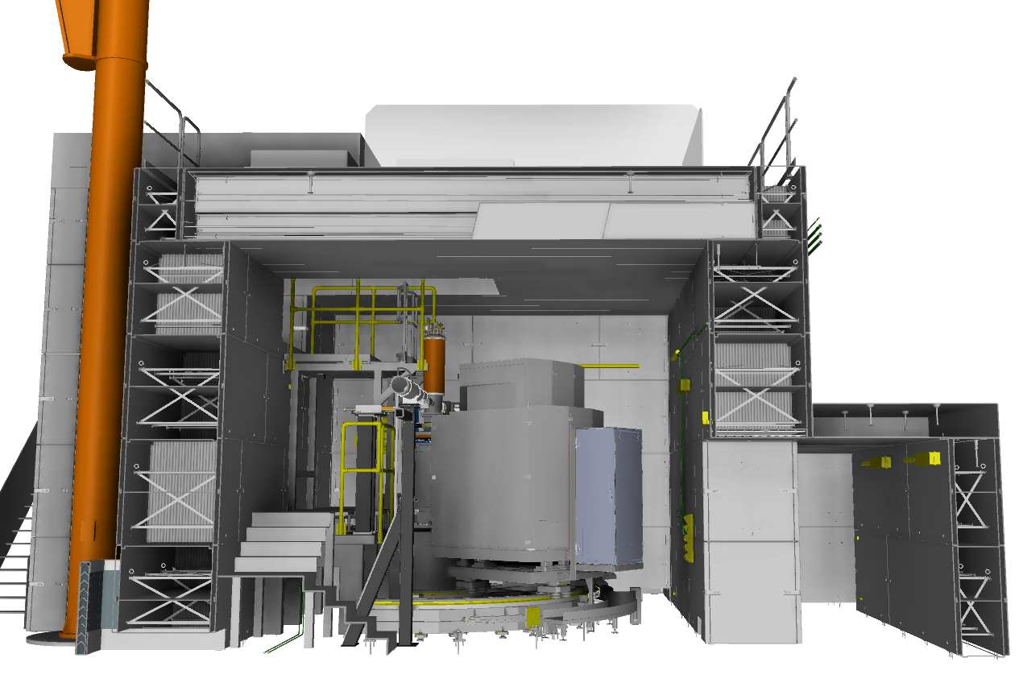
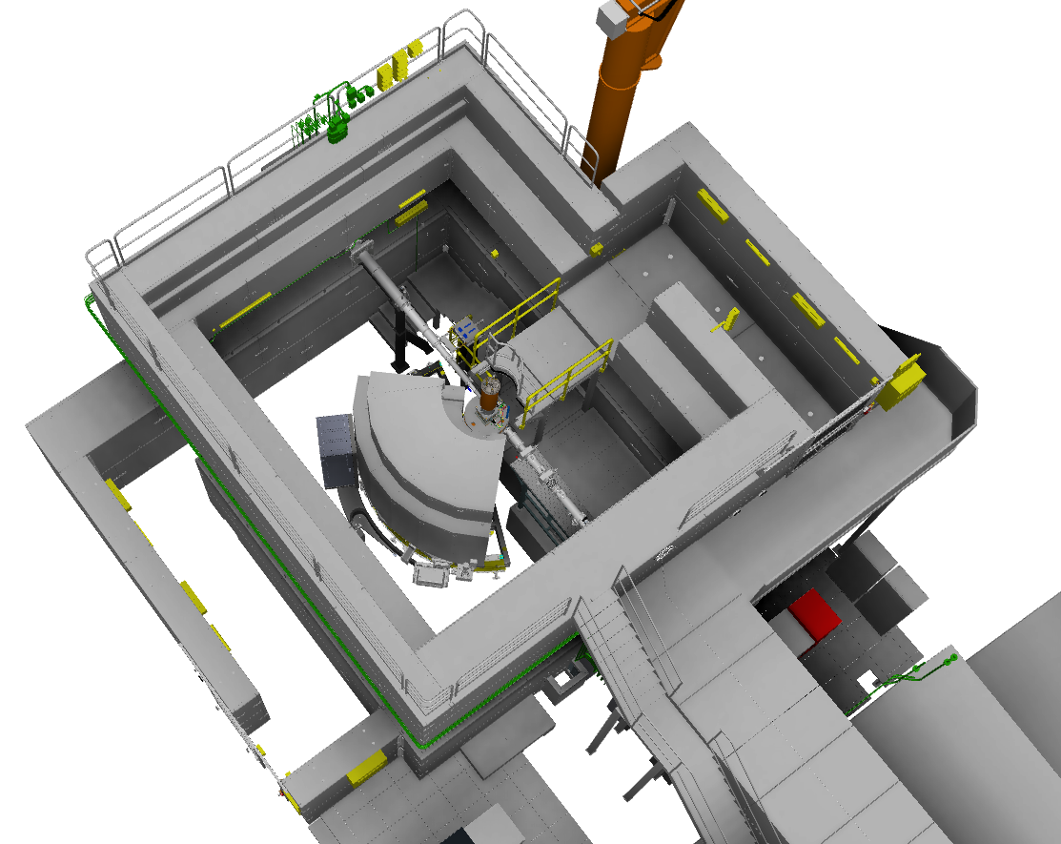
BIFROST Cave
Sliding shielding block
The roof hatch
Elevated Access door
Elevated access labyrinth
Cave Side View
Platform for direct access to the sample position
Ground Access door
Ground Access: will be used for maintenance and for direct access to the sample position. The access frequency is likely to be once per two weeks
Elevated Access: will be used for accessing sample environments, for sample changes, changing settings, fixing issues etc. This is the access path for daily operation and is expected to be used several times per day
Roof Hatch: will be used for accessing sample position, and allowing the transport of large-size equipment (e.g., cryomagnets) to be craned into place. The roof hatch is expected to be used roughly once per day or once every second day
Side View
Ground access labyrinths
Cave Top View

Slide 8
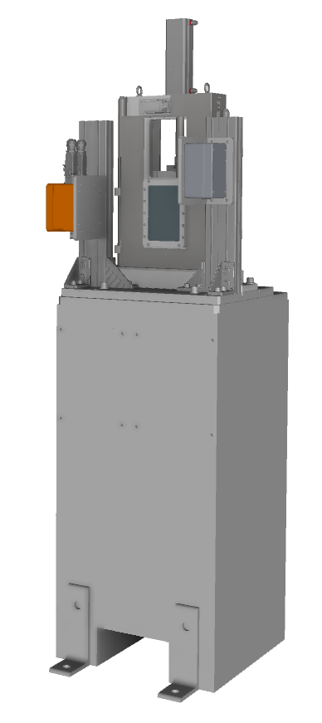
The BIFROST PSS Controlled Area
The BIFROST PSS is the safety interlock system that ensures safe access for personnel to the BIFROST PSS controlled area.
The BIFROST PSS mitigates the Radiation hazards (mainly prompt ionising radiation from the neutron beam)
Instrument Shutter Pit
Part of BUNKER PSS
controlled area
BIFROST PSS controlled area (inside the cave, chopper pit and guideline)
Safe when Proton Beam to Target is off
Safe when Neutron Beam is off (Instrument Shutter is closed)

Slide 9
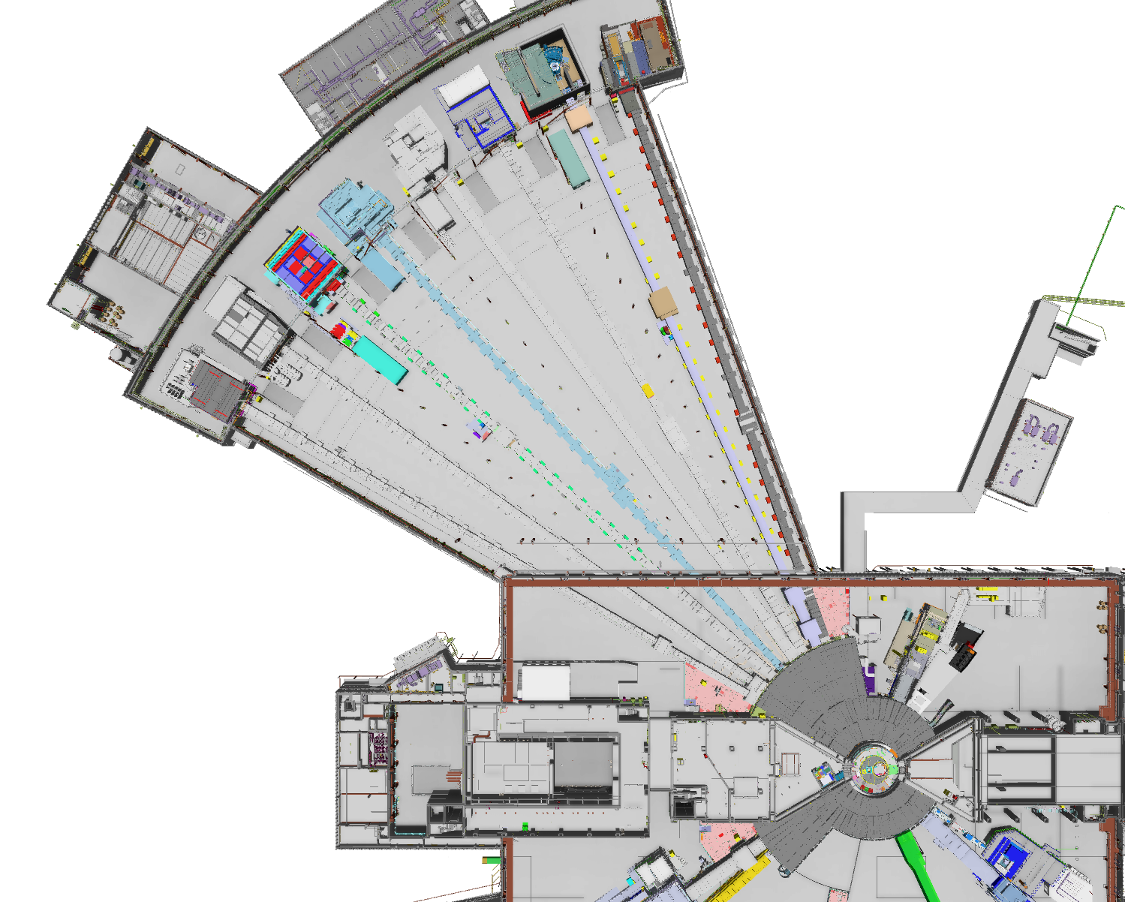
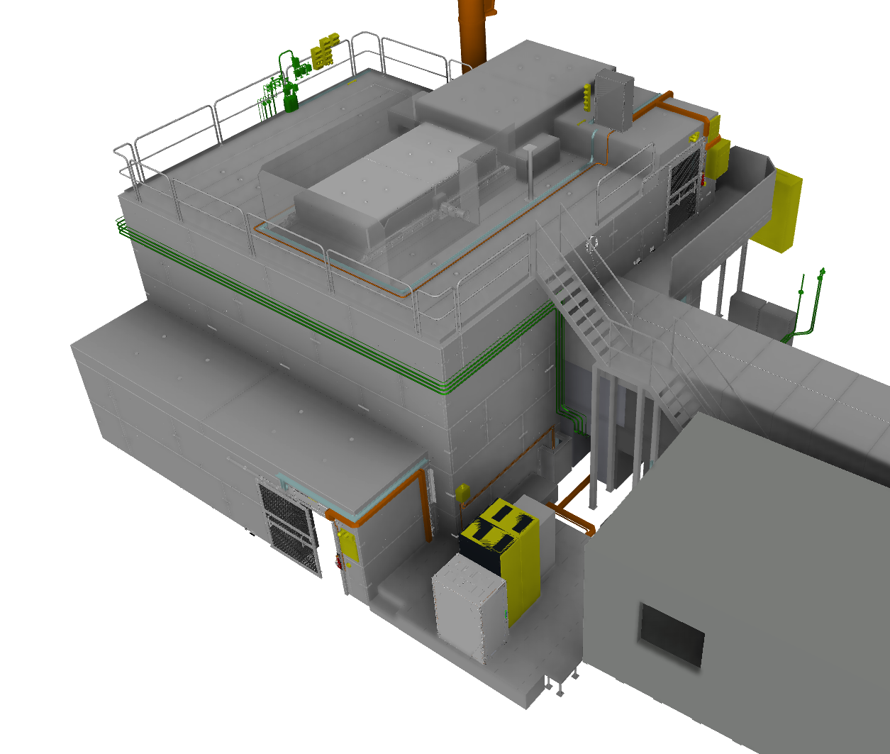
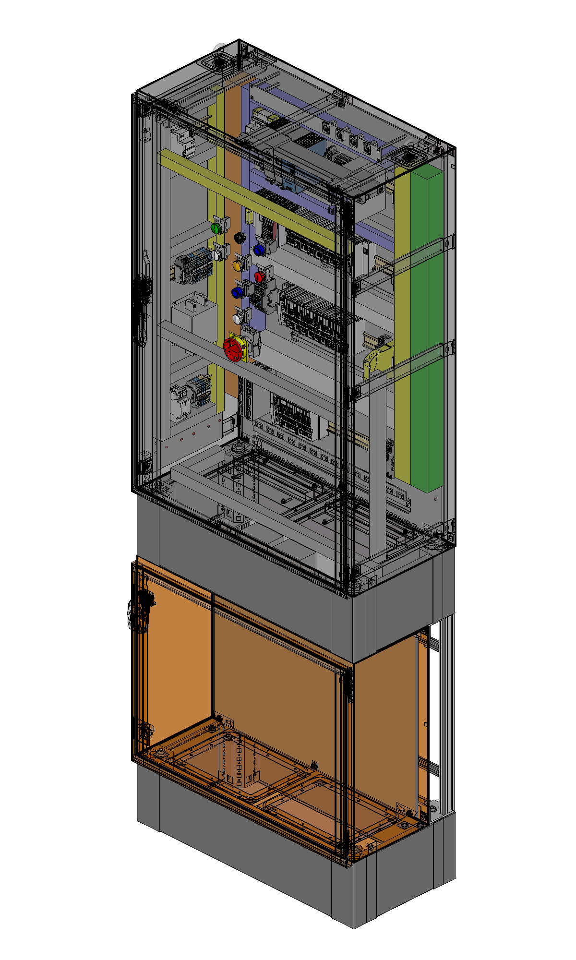
The BIFROST PSS
Shutter Pneumatics Box
PSS ICC for Instrument Shutter Solenoid Valve
BIFROST PSS Components Distribution
PSS OPI
in Control Hutch
PSS ICC for Roof Hatch
Message Display
BIFROST PSS RIO Cabinet
Key Exchange
& PSS HMI
Message Display
BIFROST PSS PLC Cabinet and ODH RIO Cabinet
PSS OPI
in Control Room

Slide 10
2
BIFROST PSS Main Functions

Slide 11
BIFROST PSS Main Functions
The BIFROST PSS prevents access to the BIFROST PSS controlled area by locking the access doors and interlocking the cave roof hatch drive system in the closed position, if the instrument shutter is open.
The BIFROST PSS prevents inadvertent opening of the instrument shutter by interlocking the instrument shutter drive system, if the BIFROST PSS controlled area is not searched and locked.
If an intrusion into the BIFROST PSS controlled area is detected by the safety position monitoring switches at any of the access points, the BIFROST PSS interlocks the instrument shutter. If the shutter is not closed after a certain amount of time, the BIFROST PSS also requests the ACC PSS (=ESS.ACC.F01) to switch off the proton beam to target,

Slide 12
BIFROST PSS Main Functions
If any Emergency Switch-OFF Button (ESOB) in the BIFROST PSS controlled area is pressed, the BIFROST PSS interlocks the instrument shutter. The BIFROST PSS also requests the ACC PSS to switch off the proton beam to target, if the shutter is not detected closed upon pressing the ESOB.
If the BIFROST PSS receives a high radiation alarm from the radiation monitor downstream the instrument shutter when the instrument shutter is closed, and access to the BIFROST PSS controlled area is permitted, it requests the Accelerator PSS to switch OFF the proton beam to target.
Complementary indications:
Message display
Blue light
Sounder on ESOS

Slide 13
3
BIFROST PSS Interfaces

Slide 14
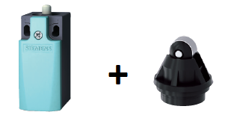
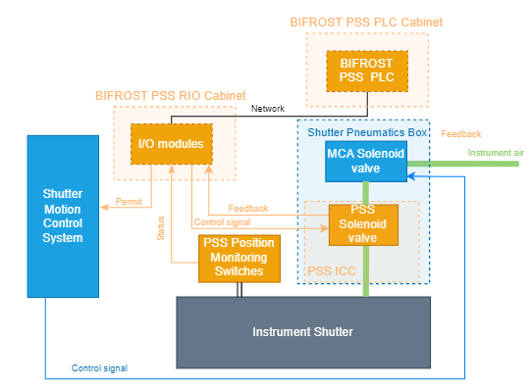
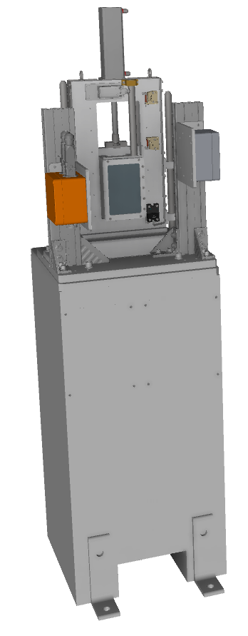
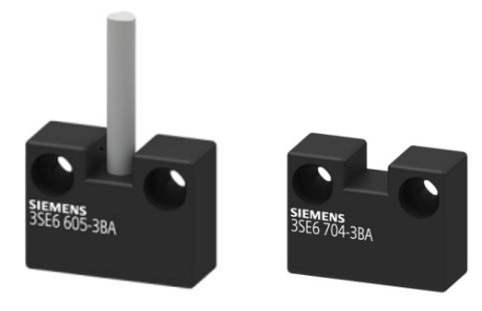
Interfaces: Motion Control System
Interface diagram for the instrument shutter
Two sets of mechanical and magnetic position monitoring switches are installed on the instrument shutter
Mechanical switch has two sets of NC safety contacts and the magnetic switch has one NC safety contact, which are closed when the shutter is closed.

Slide 15
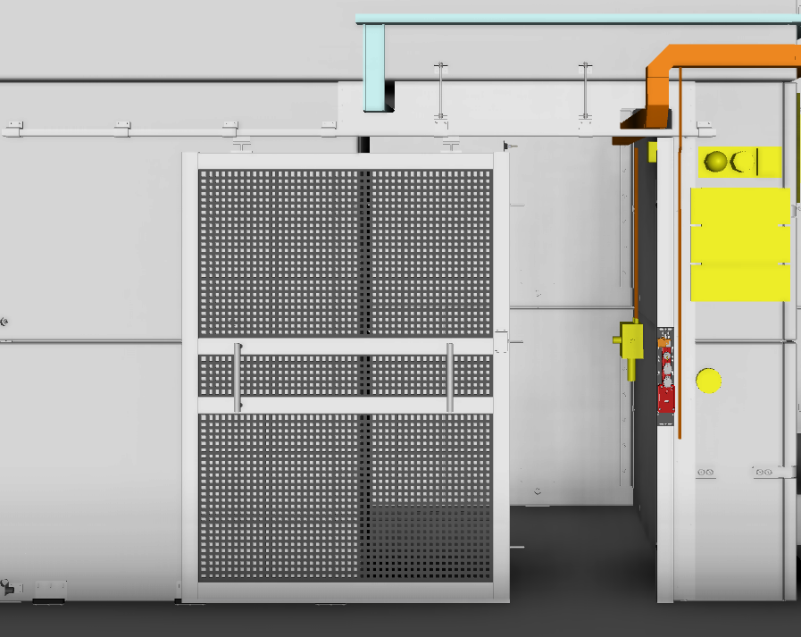
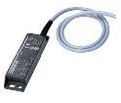
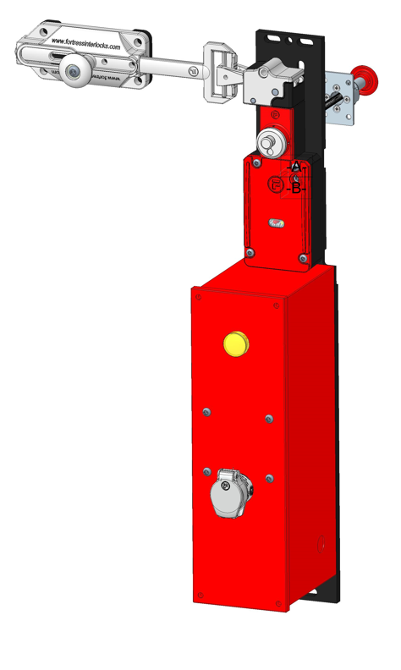
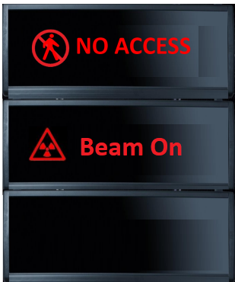
Interfaces: Access Doors
Ground and Elevated Access doors
The access doors are equipped with a solenoid controlled (energise to unlock) safety lock.
The access doors are locked by BIFROST PSS when the instrument shutter operation is permitted.
The locks have two NC safety circuits connected to the BIFROST PSS, which are closed when the door is closed and locked.
The lock has an escape release button from inside
Two sets of mechanical and magnetic position monitoring switches are also installed on each door.
Both switches have two sets of NC safety contacts which are closed when the door is closed.
The break glass unit contains a key that can override the access doors locking mechanism and open the door in case of an emergency.
Beside each access door, there is a message display unit which shows the PSS statues
HMI and Key exchange are beside the Elevated access door
SEARCHING

Slide 16
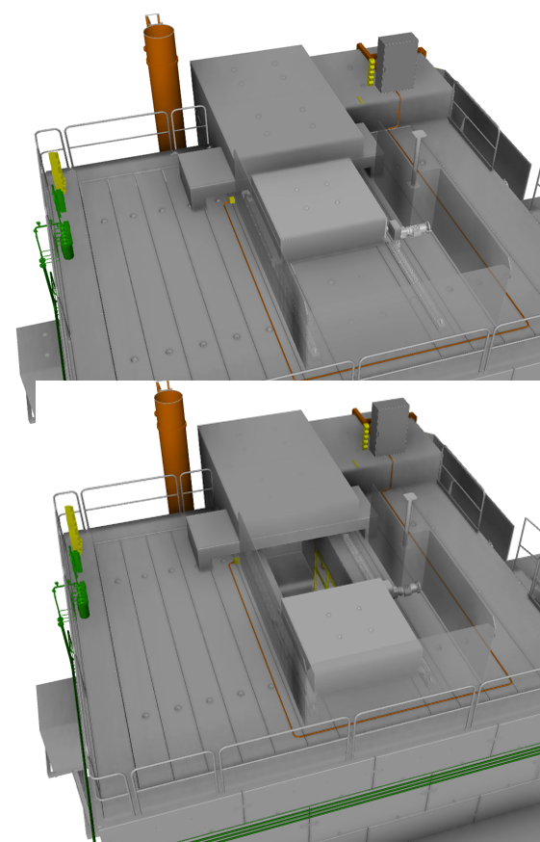
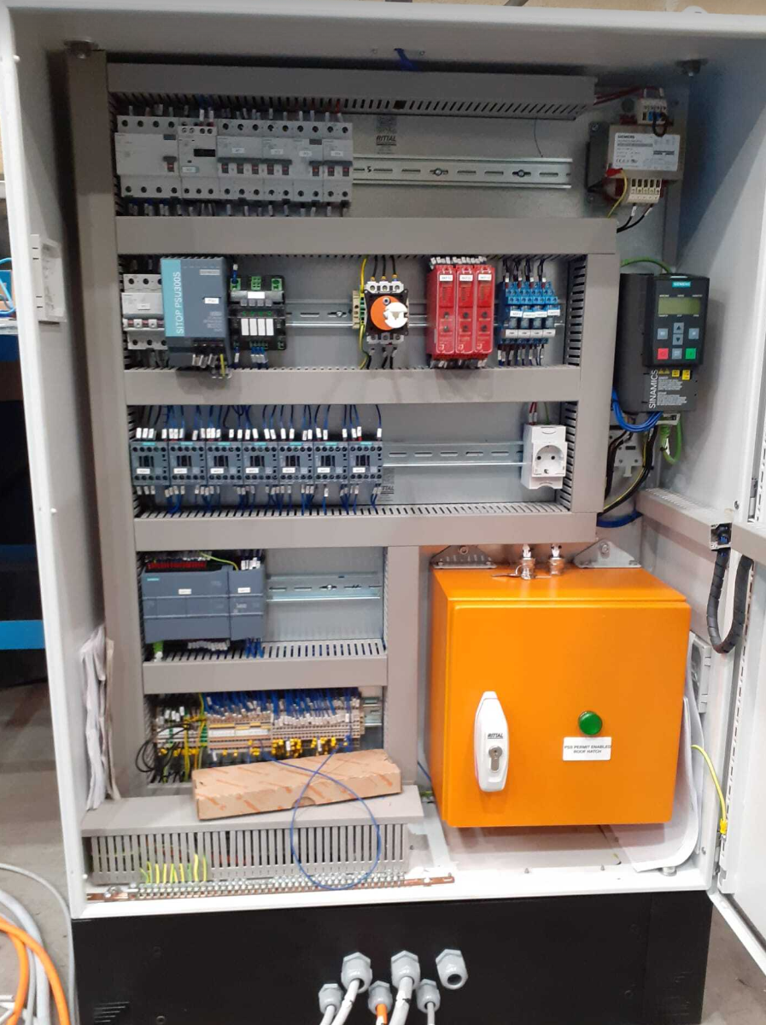
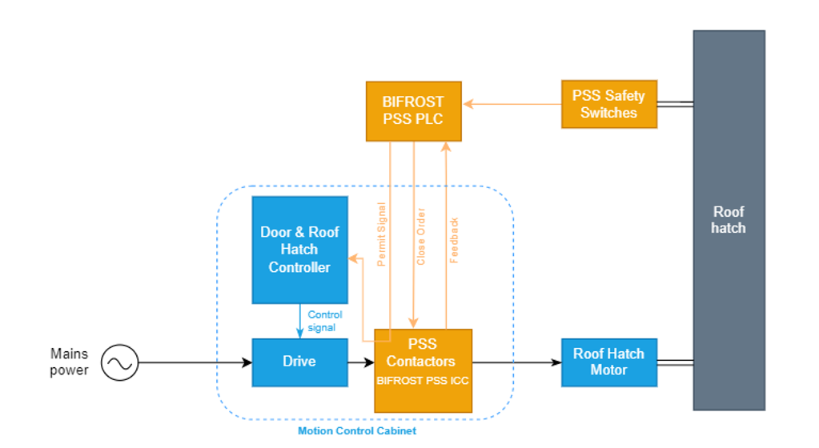
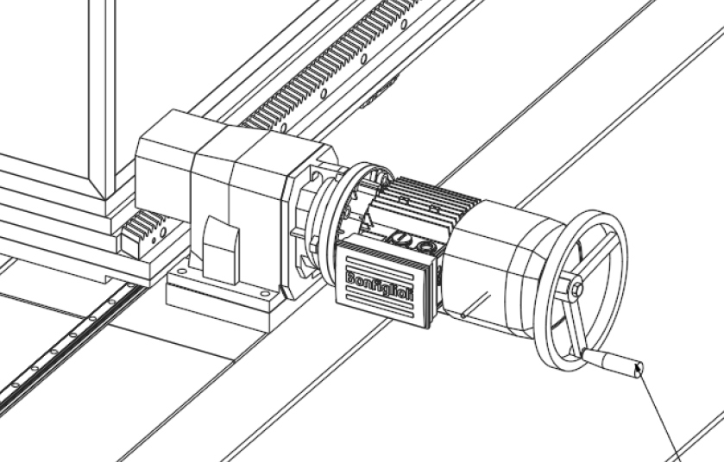
Interfaces: Access Doors
The roof hatch
The power of the roof hatch’s motor is interlocked by the BIFROST PSS through two series contactors. when the roof hatch is closed, and instrument shutter operation is permitted.
Two sets of mechanical and magnetic position monitoring switches are also installed on the roof hatch.
Both switches have two sets of NC safety contacts which are closed when the roof hatch is closed.
The roof hatch drive system includes a manual handle for maintenance operations, which is typically dismounted during normal use of the roof hatch.

Slide 17
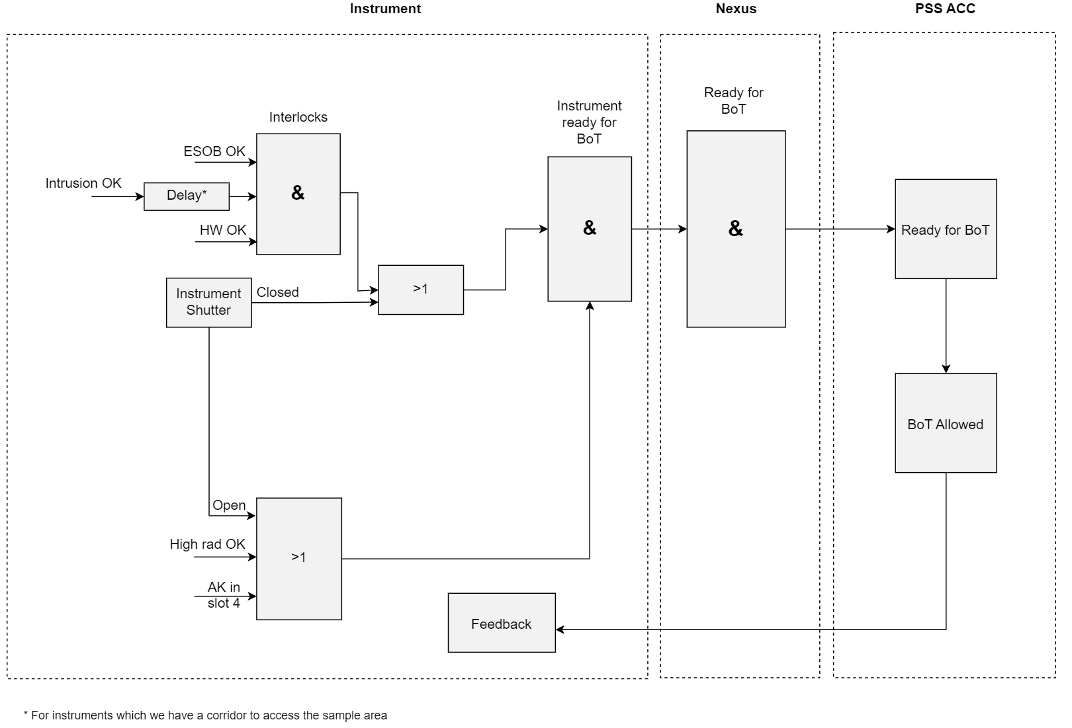
Interfaces: Actuators to Interlock Proton Beam
The BIFROST PSS sends “Ready for BoT” to ACC PSS.
The ACC PSS trips the Proton Beam Actuators if the BIFROST PSS is not “Ready for BoT” and the BoT is Allowed.
The BIFROST PSS also receives the Proton Beam on Target Allowed status from the Accelerator PSS.
The communication between Accelerator PSS, and BIFROST PSS is made through the Nexus PSS.

Slide 18
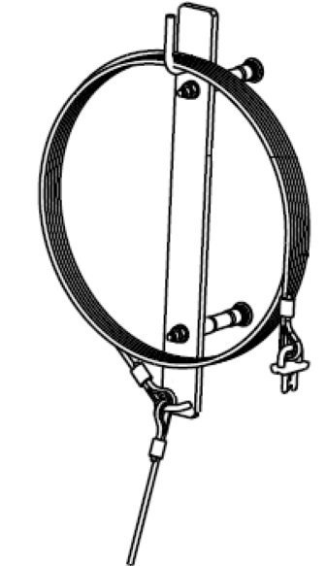
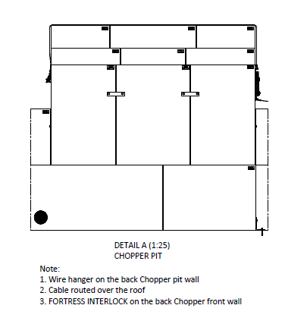
Interfaces: Removable shielding blocks
The BIFROST PSS interfaces with removable shielding blocks surrounding the chopper pit and the neutron guides, from the chopper pit to the cave.
The PSS mechanical interlock modules ensure that the shielding bocks are closed prior to allowing the instrument shutter to open.
One interlock module for the chopper pit’s shielding
Two interlock modules for the beamline’s shielding from the chopper pit to the cave

Slide 19
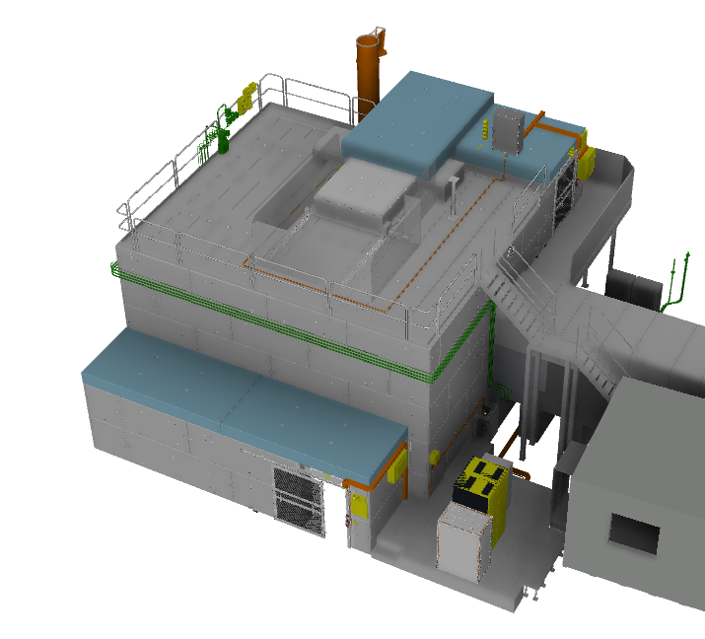
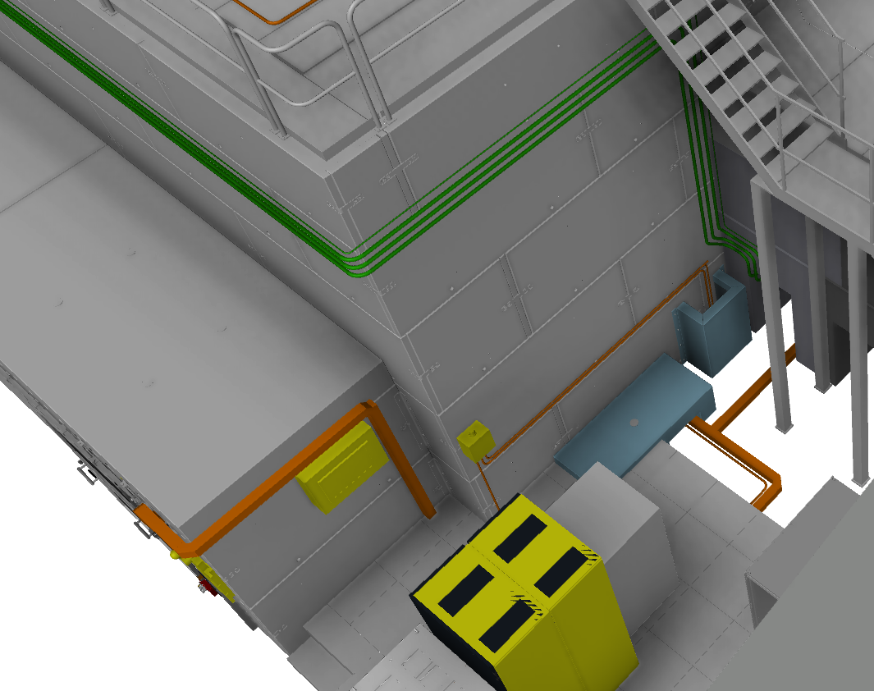
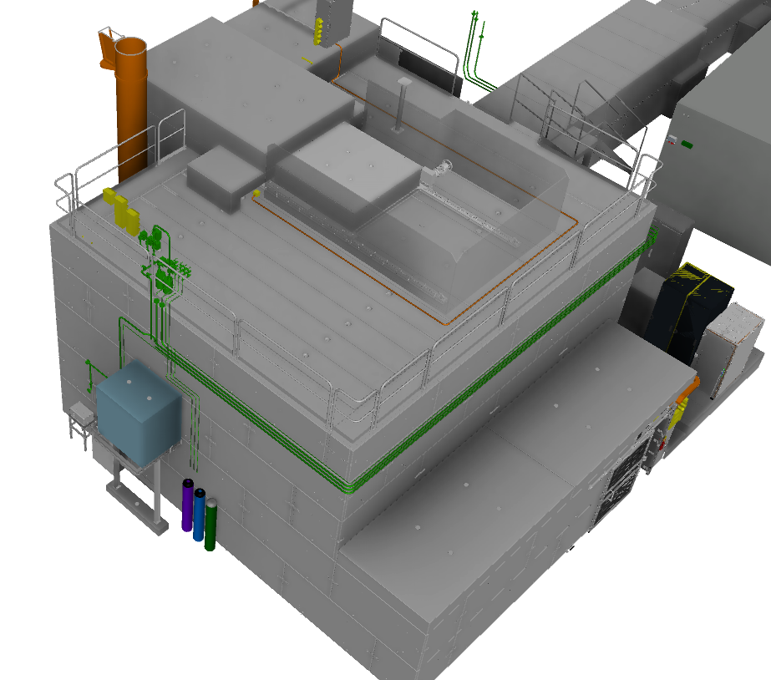
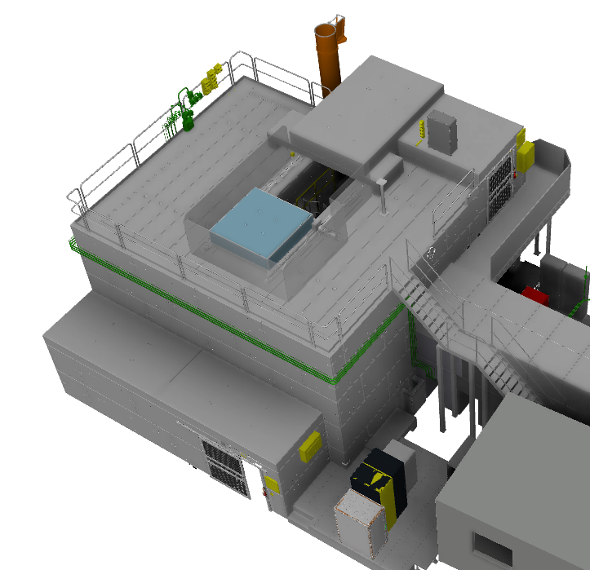
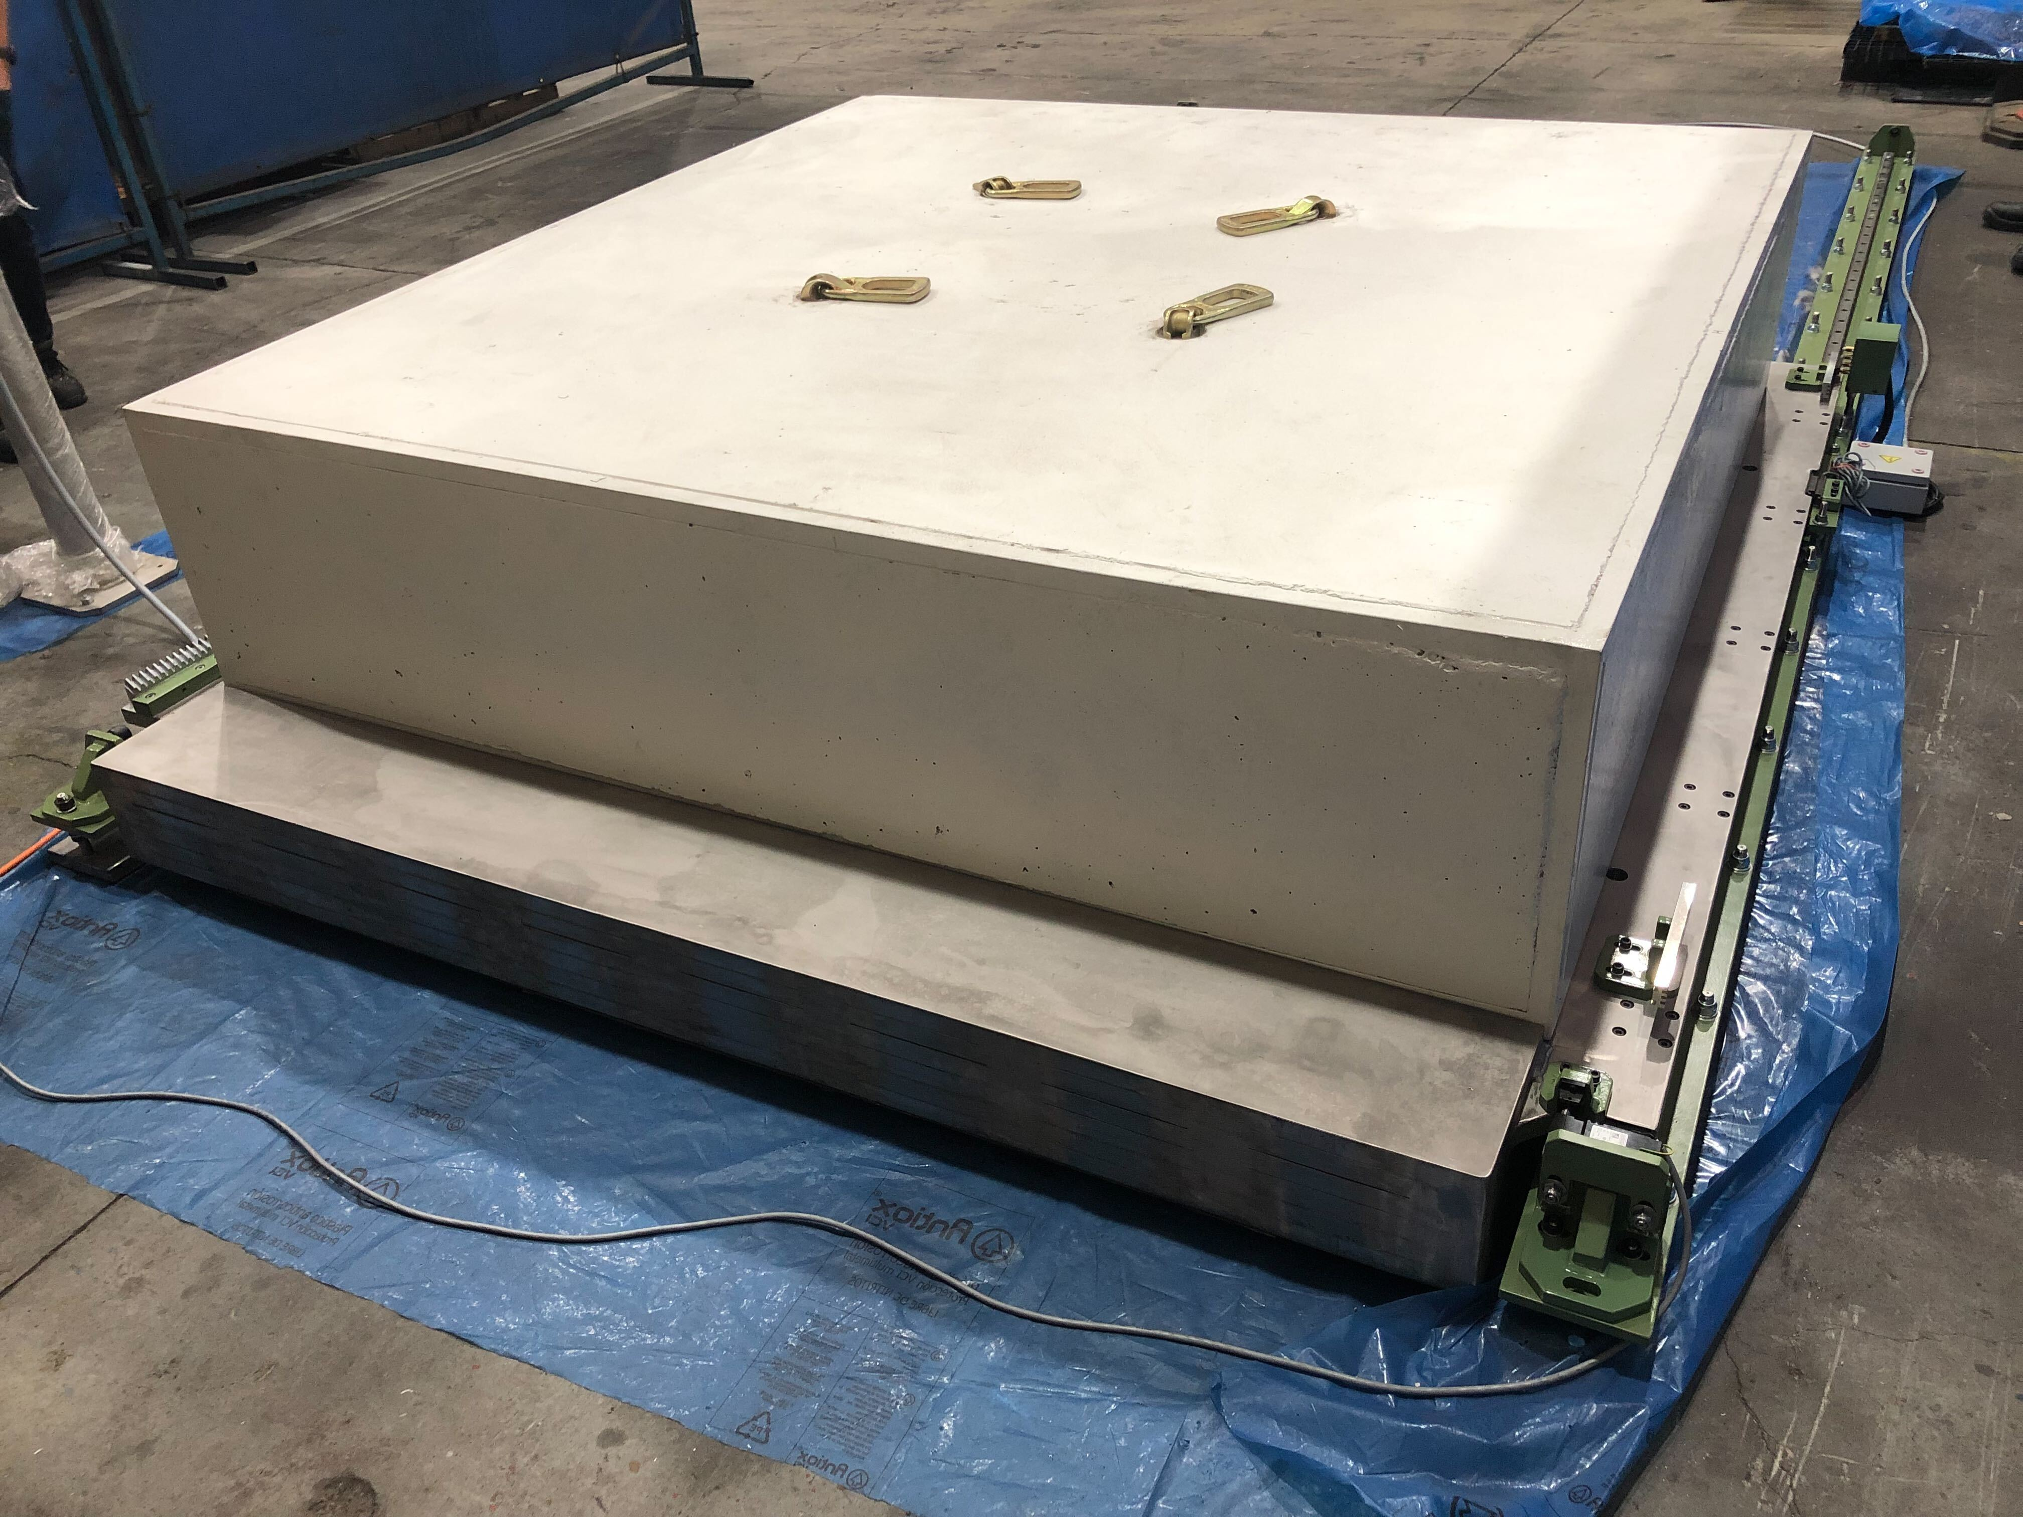
Removable shielding blocks-Not Interfaced with PSS

Slide 20
Interfaces: Blue lighting system
BIFROST cave is equipped with blue lights that turn on to warn personnel that an ionizing radiation hazard is imminent or exists.
The blue lights are turned on 60s before the drive system of the instrument shutter is enabled by the BIFROST PSS.
In order to blue lights to be more distinguishable PSS turns off a part of the white light via a contactor relay which will be installed inside NSS CEP lighting panel.

Slide 21
Interfaces: Radiation monitors
A group of radiation monitors is installed downstream of the instrument shutter to verify that the radiation has ceased when the instrument shutter is closed. In case of failure in instrument shutter, i.e. the instrument shutter is detected closed by PSS but the radiation monitor downstream the shutter detects high level of radiation, BIFROST PSS requests the Accelerator PSS to switch OFF the proton beam to target, if access to the BIFROST PSS is permitted.

Slide 22
Interfaces: ODH Detection System
An Oxygen Deficiency Hazard (ODH) detection system is a system that monitors the oxygen level in designated areas, and triggers notifications, and evacuation alarms if the oxygen level in the area drops below pre-defined thresholds.
The BIFROST PSS may need to interface with the ODH detection system in E01 to prevent access to the BIFROST cave in case of ODH or display access limitations due to ODH in the BIFROST sample area on the BFROST PSS message display.

Slide 23
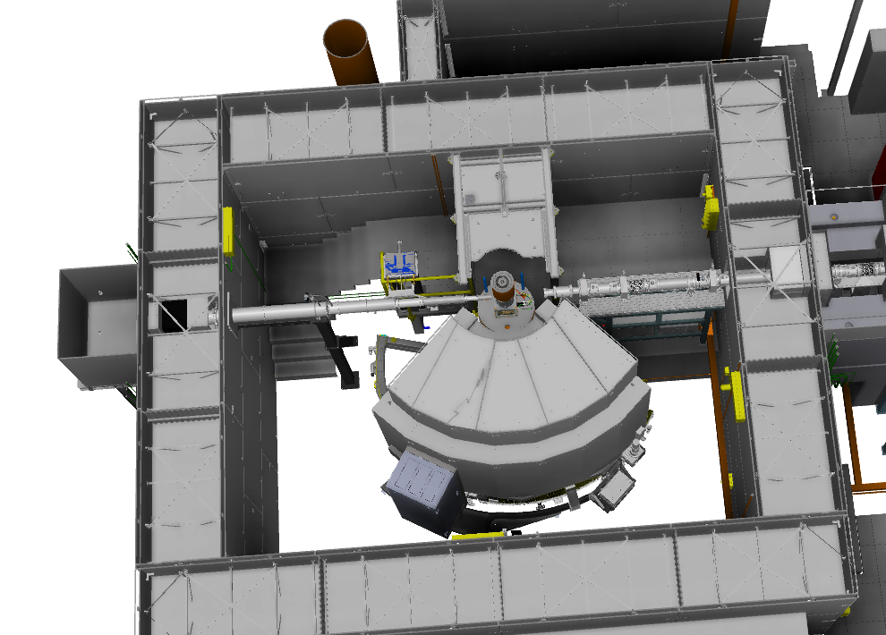
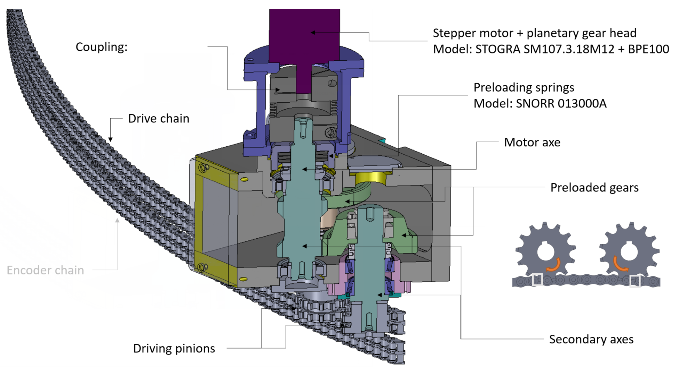
Interfaces: Motion Safety of Vacuum Vessel
BIFROST PSS contributes to motion control system of the vacuum vessel by providing the motion safety system with an area accessibility status signal (accessible vs. searched & locked). The motion safety system can use this signal to inhibit motion of the vacuum vessel when BIFROST PSS controlled area is accessible.

Slide 24
4
BIFROST PSS Operational Activities

Slide 25
Principles of operation
Prior to enabling the BIFROST PSS permit to open the instrument shutter:
The trained operators carry out a formalised search in the BIFROST cave.
The BIFROST PSS locks the access points to the BIFROST PSS controlled area.
Prior to granting access to the BIFROST PSS controlled area:
The operator closes the instrument shutter through the Motion Control System.
Upon initiating access to the BIFROST PSS controlled area, the BIFROST PSS interlocks the instrument shutter in order to prevent its inadvertent opening.
The instrument shutter is secured against re-energisation until the BIFROST PSS controlled area is searched, and locked.

Slide 26
4.1.
BIFROST PSS Modes of Operation

Slide 27
BIFROST PSS Modes of Operation
The BIFROST PSS operates in four operational modes in order to:
Ensure safe access to the BIFROST PSS controlled area.
Ensure safe energisation of the EUC.
Transition Mode:
Shutter Permit Disabled
Area Searched and Locked
Blue Lights OFF
BIFROST BoT READY
Beam ON Mode:
Shutter Permit Enabled After 60s
Area Searched and Locked
Blue Lights ON
BIFROST BoT READY
Access Mode:
Shutter Permit Disabled
Blue Lights OFF
Search is Broken upon Access
BIFROST BoT READY
Access
Mode
Transition
Mode
Beam ON Mode
SEARCHING
Alarm Mode
SEARCHED

Slide 28
BIFROST PSS Modes of Operation
Alarm Mode
Shutter Permit Disabled
ESOB pressed
The search of the zone where the ESOB was pressed is broken
BIFROST BoT Not READY if the shutter is detected open
Intrusion (during Beam ON, and Transition modes).
The search of the zones where the intrusion is detected is broken
BIFROST BoT Not READY if the shutter is detected open (after a delay).
Internal error in the BIFROST PSS PLC system
The search of all the zones is broken
BIFROST BoT Not READY if the shutter is detected open (after a delay).
High radiation alarm during the Access mode
BIFROST BoT Not READY
Beam ON Mode
Access
Mode
Transition
Mode
Alarm Mode

Slide 29
4.2.
BIFROST PSS Key Exchange System
Notes:
Each PSS includes a key exchange which is a mechanically trapped key interlock system
where one key is exchanged for a number of other keys.
Main functions:
To make sure PSS controlled area is safe to access
To make sure that PSS controlled area searched and locked before we go to beam on Target

Slide 30
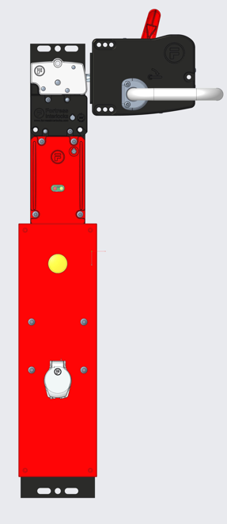
Steps to Access the BIFROST PSS Controlled Area
The operator closes the instrument shutter through the Motion Control System.
By turning off MK, Shutter opening
is disabled.
BIFROST PSS detects the instrument shutter in the closed position, and releases MK from slot 1.
OVK and AK are released from slots 3 & 4.
If AVK is in slot 5, AK could be released.
AK
MK
MK
OVK
AK
S
S
S
AK is trapped in slot 6 by removing any of the keys in slots 7~11 or opening roof hatch
PSS contactors for the roof hatch are closed.
MK
Slot 1
Slot 2
Slot 3
Slot 4
AK
AVK
S
Slot 6
Slot 5
S
First interlock module-Chopper Pit
SCMK1
SCMK1
Slot 7
Second interlock module-Beam Line
AVK is trapped in slot 5
SCMK2
SCMK2
Third interlock module-Beam Line
Slot 8
SCMK3
SCMK3
Slot 9
ACCESS
Mode
Transition Mode
Beam On Mode
EK1
EK1
Slot 10
First access door-Ground Level
EK2
EK2
Slot 11
Second access door-Elevated Level

Slide 31
Veto Access to the BIFROST PSS Controlled Area
The AK is in slot 4 and ON
Access to the cave and guide
is vetoed by the RP, AK can’t be released from slot 4.
MK
MK
OVK
AK
S
S
S
Slot 1
Slot 2
Slot 3
Slot 4
AK
AVK
S
Slot 6
Slot 5
AVK
First interlock module-Chopper Pit
SCMK1
The operator unlocks the AVK via the HMI.
Slot 7
Second interlock module-Beam Line
Beam On Mode
SCMK2
Third interlock module-Beam Line
Slot 8
SCMK3
Slot 9
EK1
Slot 10
First access door-Ground Level
EK2
Slot 11
Second access door-Elevated Level

Slide 32
Veto Access to the BIFROST PSS Controlled Area
The AK is in slot 4 and ON
Access to the cave and guide
is vetoed by the RP, AK can’t be released from slot 4.
MK
MK
OVK
AK
S
S
MK
Slot 1
Slot 2
Slot 3
Slot 4
AK
AVK
S
Slot 6
Slot 5
AVK
First interlock module-Chopper Pit
SCMK1
The operator unlocks the AVK via the HMI.
Slot 7
Second interlock module-Beam Line
Transition Mode
Beam On Mode
SCMK2
Third interlock module-Beam Line
Slot 8
SCMK3
Slot 9
EK1
Slot 10
First access door-Ground Level
Alarm
It is possible to Veto Access in Alarm Mode also which is triggered before Access
EK2
Slot 11
Second access door-Elevated Level

Slide 33
4.3.
Formalised Search in BIFROST PSS Controlled Area

Slide 34
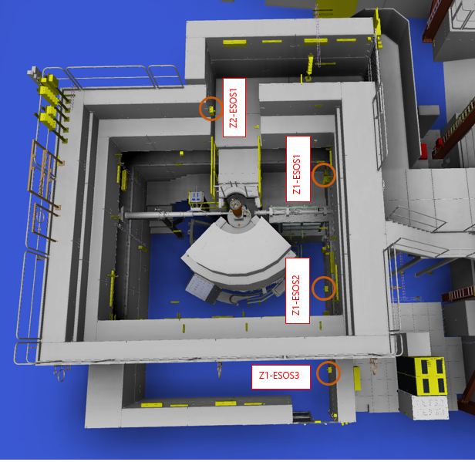
Formalised Search in the Cave
There are two independent search zones in BIFROST cave:
Zone 1- Ground access area
Zone 2- Elevated access area
There are 3 search buttons in the ground level area Zone 1.
The search in zone 1 is considered broken if any of the following conditions are true:
Any ESOB in this zone has been pressed.
BIFROST PSS goes to Alarm mode due to a PLC error.
The ground access door is detected open.
There is one search button in the elevated level area Zone 2.
The search in zone 2 is considered broken if any of the following conditions are true:
ESOB in this zone has been pressed.
BIFROST PSS goes to Alarm mode due to a PLC error.
The elevated access door is detected open.
The roof hatch is detected open.

Slide 35
Formalised Search in the Cave
Zone 1: Ground Level
The BIFROST PSS registers a successful search of the ground level (Zone 1) if the button has been pressed and the door is closed, within the correct time limit.
SEARCHING

Slide 36
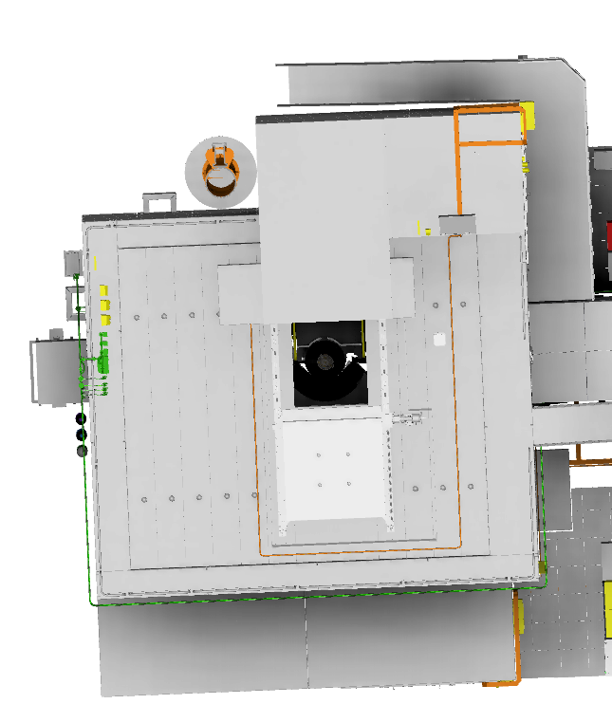
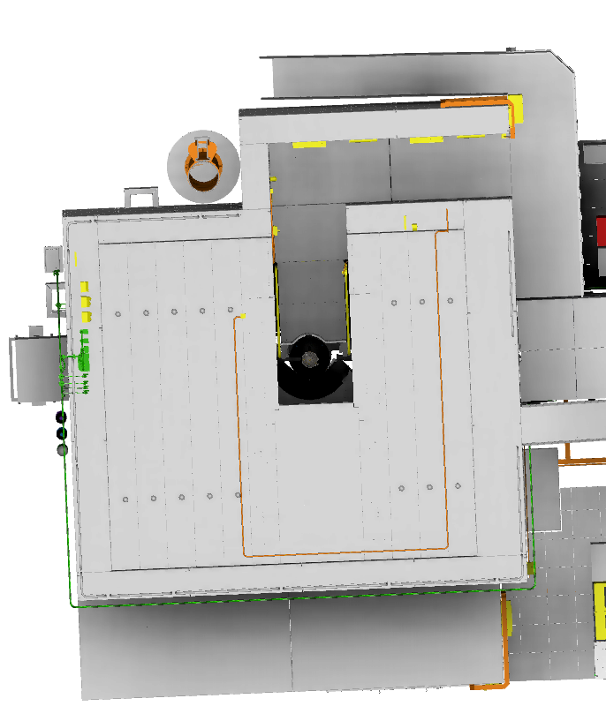
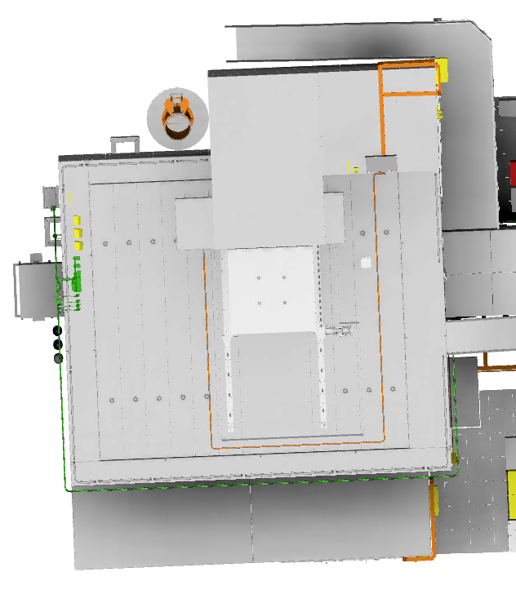
Formalised Search in the Cave
Zone 2: Elevated Level
The operator ensures that the roof hatch is closed.
SEARCHING
SEARCHED
The BIFROST PSS registers a successful search of the elevated area if the button has been pressed and the door is closed, within the correct time limit.

Slide 37
4.4.
Enabling the Instrument Shutter to Open

Slide 38
Steps to Enable the Instrument Shutter to Open
The operator open the instrument shutter through the Motion Control System.
By opening the shutter MK is locked.
MK
MK
OVK
AK
MK
S
S
S
AK is released from slot 6 by returning all of the keys in slots 7~11 and search completed
Slot 1
Slot 2
Slot 3
Slot 4
AK
AVK
S
Slot 6
The solenoid releases the MK from slot 2 if the PSS controlled area is searched, and locked and all SIFs are properly reset and acknowledged
Slot 5
S
AK
First interlock module-Chopper Pit
SCMK1
SCMK1
Slot 7
Second interlock module-Beam Line
ACCESS
Mode
Transition Mode
Beam On Mode
SCMK2
SCMK2
Slot 8
Third interlock module-Beam Line
SCMK3
SCMK3
Blue lights turn on and enables the sounders on ESOS (for short time), the shutter opening
gets enabled after 60s
Slot 9
EK1
EK1
Slot 10
First access door-Ground Level
EK2
Slot 11
EK2
Second access door-Elevated Level

Slide 39
Veto the Instrument Shutter Operation
The MK is in slot 2 and ON
Shutter opening
is vetoed by the RP and MK is trapped in slot 2
OVK
MK
MK
OVK
AK
S
S
Slot 1
Slot 2
Slot 3
Slot 4
AK
The operator unlocks the OVK via the HMI.
AVK
S
Slot 6
Slot 5
S
First interlock module-Chopper Pit
SCMK1
SCMK1
Slot 7
Second interlock module-Beam Line
ACCESS
Mode
Transition Mode
SCMK2
SCMK2
Third interlock module-Beam Line
Slot 8
SCMK3
SCMK3
Slot 9
EK1
EK1
Slot 10
First access door-Ground Level
Alarm
EK2
EK2
Slot 11
Second access door-Elevated Level

Slide 40
5
Questions

Slide 41
Questions to the committee
Is it necessary to consider the mechanical interlock module for the beamline, or RP control permissions and procedures by having operation veto keys is enough?

Slide 42
Thank you

