Slide 2
SIL Assessment for ESS Instruments PSS SIFs
ESS PSS PDR
PRESENTED BY Fan YE and Jonathan Gale

Slide 3
Agenda
1 Introduction to PSS SIL Assessment
2 ODIN PSS Safety Instrumented Functions (SIFs)
3 ODIN PSS SIL Assessment
4 TBL PSS, BIFROST PSS SIFs
5 TBL PSS, BIFROST PSS SIL assessment

Slide 4
1
Introduction to PSS SIL Assessment

Slide 5
PSS SIL Assessment
Risk Assessment
SIL Determination
  Inputs – Risk Assessments, ConOps
  Outputs – SIL targets for each SIF in terms of PFD/PFH and SIL
SIL Verification
  Inputs – SIL Determination, SIF configurations, Failure Data
  Method – Reliability Block Diagram (RBD), ProSET
  Outputs – SIL Verification results in terms of achieved PFD/PFH and SIL
SIL Determination
SRS
SIL Verification

Slide 6
SIL Determination and Verification
SIL Determination
  To determine the required SIL target (and reliability target PFD/PFH) for each SIF
  Layers of Protection Analysis (LOPA) used for SIL determination
  Guideline for SIL Assessment for Personnel Safety Systems (ESS-1408224)
SIL Verification
  To verify the proposed SIF design will meet the corresponding SIL (and PFD/PFH) target
  Reliability Block Diagram (RBD) used for SIL verification
  Event Tree Analysis (ETA) used to confirm frequency of individual hazardous scenarios meet the risk target
PFD = Probability of Failure on Demand
PFH = Average frequency of a dangerous failure per hour

Slide 7
2
ODIN PSS Safety Instrumented Functions

Slide 8
ID Pattern for SIFs
System_SIFNumber
System
  ODINPSS, TBLPSS, BIFROSTPSS, etc.
  Number
1 Emergency Switch-Off Button (ESOB) interlock
2 Main key interlock
3 Access Door interlock
4 Access Door lock
5 High radiation interlock
Notes:
There are several SIFs that are expected to be required in each PSS. These should always be numbered in the same order to facilitate cross-referencing between the systems, as shown below:

Slide 9
ODIN PSS SIFs
ODINPSS_SIF1
If any Emergency Switch-OFF Button (ESOB) in the ODIN PSS controlled area is pressed, close the instrument shutter and prevent its opening.
Additionally, if the instrument shutter is detected open after the ESOB is detected pressed, and the bending magnets are detected energised (BoT allowed), de-energise the following EUC:
Proton Beam Actuators:
  Ion Source (ISrc) High Voltage Power Supply (HVPS);
  Grounding relay
[Radhaz62]
....
d) Possibility to manually switch-off the neutron beam from inside the cave (safety interlock system).
ODINPSS_SIF1 is a manually activated SIF (requiring a person to press an E-Switch Off button). No SIL Determination is performed for this SIF, and the credit taken for this SIF is limited to 0.1. For the design purpose, ODINPSS_SIF1 is to be designed to meet the SIL 1 requirements.
Reset conditions:
ODIN PSS SIS shall be manually reset after a shutdown caused by pressing the emergency switch-off pushbutton, before allowing operation.
All buttons shall be unlatched prior to allowing manually reset.
Notes:
DP: It would be good to add at least one Radiation Hazard Number and Actions/ Risk Controls we listed in the SIL assessment, before showing the Reset conditions (similar to added above)
Also, we should mention this is a manually triggered SIF.

Slide 10
ODIN PSS SIFs
ODINPSS_SIF2
[Radhaz26]
PSS to interlock heavy shutter in closed position,
RP operations veto key provided by PSS (Re-evaluation of shielding by RP prior to start of operation)
[Radhaz62]
…
b) Safety interlock system preventing inadvertent request for opening the instrument shutter. PSS to prevent heavy shutter opens with any cave interlock open. Signage.
…
[Radhaz70]
PSS to interlock heavy shutter in closed position,
RP operations veto key provided by PSS (Re-evaluation of shielding by RP prior to start of operation)
If the ODIN main key is detected out of position ON in slot 1, close the instrument shutter and prevent its opening.
ODINPSS_SIF2 is a manually activated SIF that is not directly used in any hazardous scenarios, it is only used to support ODINPSS_SIF3. No SIL Determination is performed for this SIF, and the credit taken for this SIF is limited to 0.1. For the design purpose, ODINPSS_SIF2 is to be designed to meet the SIL 1 requirements.
Reset conditions:
A manual reset shall be required if ODINPSS_SIF2 is tripped, by returning the Main Key to ON position once the ODIN PSS controlled area is ready for operation prior to issuing the permit to energise EUC actuators.
Notes:
DP: Mention it’s a manually triggered SIF.

Slide 11
ODIN PSS SIFs
ODINPSS_SIF3
[RadHaz57, RadHaz58]
…
c) Monitoring cave access door by safety interlock system and interlock with heavy shutter and proton beam.
If the access door leading to ODIN PSS controlled area is detected open, close the instrument shutter and prevent its opening.
Additionally, if the instrument shutter is detected open and bending magnets are detected energised after the access door is detected open, de-energise the following EUC:
Proton Beam Actuators:
  ISrc HVPS;
  Grounding relay
Reset conditions:
A manual reset from the ODIN PSS HMI shall be required if ODINPSS_SIF3 is tripped:
once the ODIN PSS controlled area is ready for operation prior to issuing the permit to energise EUC actuators tripped by ODINPSS_SIF3.

Slide 12
ODIN PSS SIFs
ODINPSS_SIF4
Upon removal of the Access key from slot 6 disable opening of the motorized access door to the ODIN PSS controlled area.
[RadHaz57, RadHaz58]
…
b) Locking of cave access door by safety interlock system.
…
Reset conditions:
The ODIN PSS PLC shall prevent unlocking of the Access Door until a manual reset is carried out by the operator by putting the Access key in position ON.

Slide 13
ODIN PSS SIFs
ODINPSS_SIF5
If the radiation monitor downstream the ODIN instrument shutter shows high radiation when the shutter is closed and ODIN access key is detected in position ON in slot 6, and the bending magnets are detected energized (BoT allowed), de-energise the following EUC:
Proton Beam Actuators:
  ISrc HVPS;
  Grounding relay
[RadHaz19]
…
b) radiation monitor to detect radiation leakage through the closed shutter, interfaced by PSS
Reset conditions:
A manual reset from the ODIN PSS HMI shall be required if ODINPSS_SIF5 is tripped:
once the all radiation monitors are healthy and no high radiation is detected, prior to issuing the permit to energise the affected EUC.

Slide 14
3
ODIN PSS SIL Assessment

Slide 15
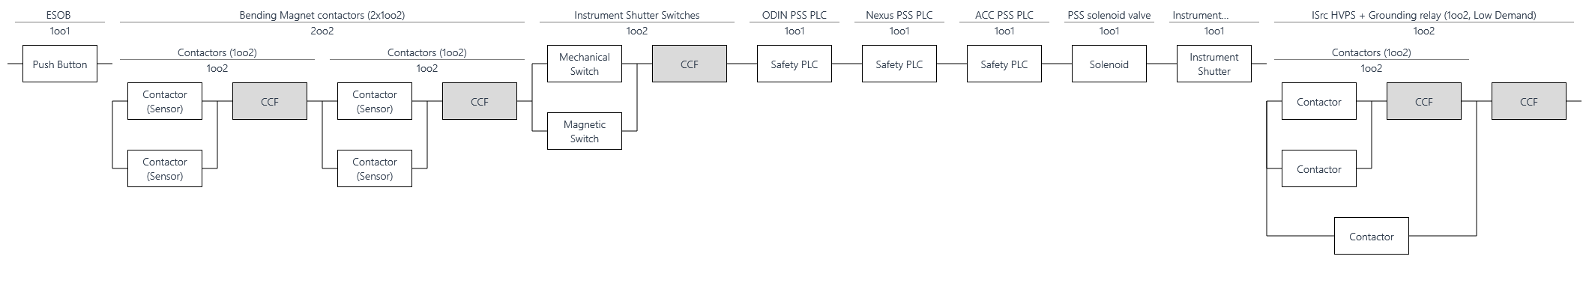
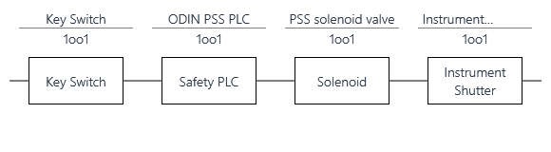
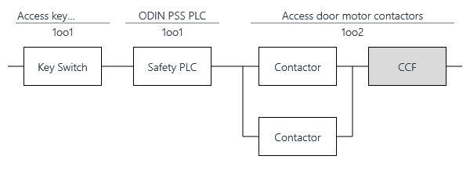
RBD for ODINPSS_SIF1, SIF2, SIF4

Slide 16
SIL Verification Results
ODIN PSS Low Demand SIFs
SIF Tag | Selected PFD Target | PFD Achieved | Selected SIL Target | Max Allowable SIL (Architectural Constraints) | Result
ODINPSS_SIF1 – Emergency Switch Off Button Interlock | N/A | 3.7E-2 | SIL 1 | SIL 1 | Passed
ODINPSS_SIF5 – High Radiation Interlock | 3.0E-2 | 4.6E-3 | SIL 1 | SIL 2 | Passed

Slide 17
SIL Verification Results
ODIN PSS High Demand SIFs
SIF Tag | Selected PFH Target (/hr) | PFH Achieved (/hr) | Selected SIL Target | Max Allowable SIL (Architectural Constraints) | Result
ODINPSS_SIF2 – Main Key Shutter Interlock | N/A | 3.1E-6 | SIL 1 | SIL 1 | Passed
ODINPSS_SIF3 – Access Doors Interlock | 1.7E-7 | 3.1E-6 | SIL 2 | SIL 1 | Failed
ODINPSS_SIF4 – Access Door Lock | 1.7E-7 | 2.7E-8 | SIL 2 | SIL 2 | Passed

Slide 18
Event Tree Analysis (ETA)
ETA01 – BoT operation started whilst personnel is present, Radiation hazard
Notes:
DP: It would be useful to mark the things people should notice on the ETAs, but not necessary if covered in the presentation.

Slide 19
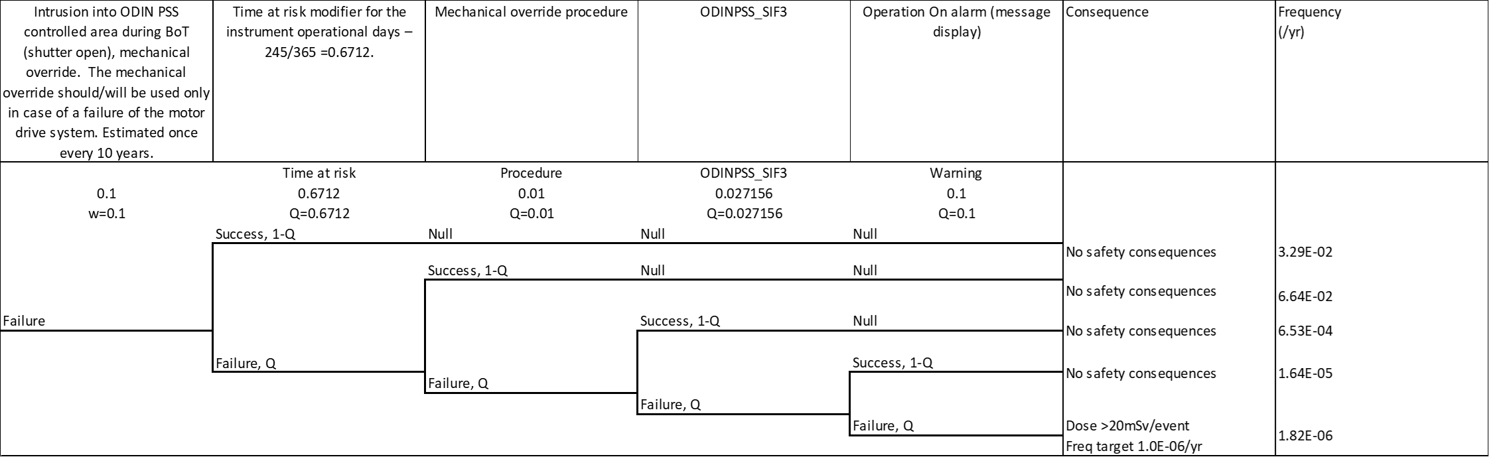
Event Tree Analysis (ETA)
ETA02a - Intrusion (via access door), Radiation hazard
ETA02b - Intrusion (via mechanical override), Radiation hazard

Slide 20
Event Tree Analysis (ETA)
ETA03 – Instrument shutter failure, Radiation hazard

Slide 21
Conclusions and Questions to the Committee
ODIN PSS
ODINPSS_SIF3 failed to meet the required SIL determined by the LOPA. Recommendations:
    Provide better reliability data for the instrument shutter. This will improve achieved PFH or PFD
    Provide EPD for ODIN controlled area as an IPL. This will reduce the SIL targets of ODINPSS_SIF3 and ODINPSS_SIF4.
The ETA for person missed by search scenario is only provided to demonstrate the controls currently in place. There is no independent search warning or EPD alarm, which brings the scenario to very high probability. This risk was accepted in the Loki PDR review. Is it acceptable for ODIN, TBL and BIFROST too?
Currently scenario ETA02b is above the acceptable level of risk for a 20mSv event. However, if there are cases where the dose will not go above 10mSv, we could introduce another conditional modifier where the risk target could be lowered (i.e. 1.0E-04 instead of 1.0E-06).

Slide 22
4
TBL PSS, BIFROST PSS SIFs

Slide 23
TBL PSS SIFs
TBLPSS_SIFs
TBLPSS_SIF1 – ESOB Interlock
If any Emergency Switch-OFF Button (ESOB) in the TBL PSS controlled area is pressed, close the instrument shutter and prevent its opening.
Additionally, if the instrument shutter is detected open after the ESOB is detected pressed, and the bending magnets are detected energised (BoT allowed), de-energise the following EUC:
    Proton Beam Actuators:
      ISrc HVPS;
      Grounding relay
TBLPSS_SIF2 – Main Key Shutter Interlock
If the TBL main key is detected out of position ON in slot 1, close the instrument shutter and prevent its opening.
TBLPSS_SIF3 – Access Door Interlock
If any access door leading to TBL PSS controlled area is detected open, close the instrument shutter and prevent its opening.
Additionally, if the instrument shutter is detected open and bending magnets are detected energised after access door is detected open, de-energise the following EUC :
    Proton Beam Actuators:
      ISrc HVPS;
      Grounding relay

Slide 24
TBL PSS SIFs
TBLPSS_SIFs
Note: this SIF does not include the logic solver. TBL PSS PLC will only monitor the safety circuits from the lock unit to ensure the door is locked.
TBLPSS_SIF4 – Access Door Lock
Upon removal of the entry key to Entry door to TBL cave from the door lock unit, lock the Entry door via solenoid.
TBLPSS_SIF5 – High Radiation Interlock
If the radiation monitor downstream the TBL instrument shutter shows high radiation when the shutter is closed and TBL access key is detected in position ON in slot 6, and the bending magnets are detected energized (BoT allowed), de-energise the following EUC:
      ISrc HVPS;
      Grounding relay

Slide 25
BIFROST PSS SIFs
BIFROSTPSS_SIFs
BIFROSTPSS_SIF1 – ESOB Interlock
If any Emergency Switch-OFF Button (ESOB) in the BIFROST PSS controlled area is pressed, close the instrument shutter and prevent its opening.
Additionally, if the instrument shutter is detected open after the ESOB is detected pressed, and the bending magnets are detected energised (BoT allowed), de-energise the following EUC:
    Proton Beam Actuators:
      ISrc HVPS;
      Grounding relay
BIFROSTPSS_SIF2 – Main Key Shutter Interlock
If the BIFROST main key is detected out of position ON in slot 1, close the instrument shutter and prevent its opening.
BIFROSTPSS_SIF3 – Access Door Interlock
If any access door leading to BIFROST PSS controlled area is detected open, close the instrument shutter and prevent its opening.
Additionally, if the instrument shutter is detected open and bending magnets are detected energised 5 seconds after access door is detected open, de-energise the following EUC :
    Proton Beam Actuators:
      ISrc HVPS;
      Grounding relay

Slide 26
BIFROST PSS SIFs
BIFROSTPSS_SIFs
BIFROSTPSS_SIF4_1 – Ground Access Door Lock
Upon removal of the entry key to the ground access door from its door lock unit, lock the ground access door via solenoid.
BIFROSTPSS_SIF4_2 – Elevated Access Door Lock
Upon removal of the entry key to the elevated access door from its door lock unit, lock the elevated access door via solenoid.
BIFROSTPSS_SIF4_3 – Roof Hatch Door Lock
Upon removal of the Access key from slot 6 disable opening of the roof hatch door.
BIFROSTPSS_SIF5 – High Radiation Interlock
If any radiation monitor connected to BIFROST PSS shows high radiation, close the instrument shutter and prevent its opening.
Additionally, if the instrument shutter is detected open and bending magnets are detected energised ? ms after the radiation monitor reported high radiation, de-energise the following EUC:
    Proton Beam Actuators:
      ISrc HVPS;
      Grounding relay
Similar to TBL PSS entry door
Similar to ODIN PSS access door

Slide 27
5
TBL PSS, BIFROST PSS SIL Assessment

Slide 28
SIL verification Results
Low Demand SIFs
SIF Tag | Selected PFD Target | PFD Achieved | Selected SIL Target | Max Allowable SIL (Architectural Constraints) | Result
TBLPSS_SIF1 - Emergency Switch Off Button Interlock | N/A | 3.7E-2 | SIL 1 | SIL 1 | Passed
TBLPSS_SIF5 – High Radiation Interlock | 3.0E-2 | 4.6E-3 | SIL 1 | SIL 2 | Passed
BIFROSTPSS_SIF1 – Emergency Switch Off Button Interlock | N/A | 3.7E-2 | SIL 1 | SIL 1 | Passed
BIFROSTPSS_SIF5 – High Radiation Interlock | 3.0E-2 | 4.3E-3 | SIL 1 | SIL 2 | Passed

Slide 29
SIL verification Results
High Demand SIFs
SIF Tag | Selected PFH Target | PFH Achieved (/hr) | Selected SIL Target | Max Allowable SIL (Architectural Constraints) | Result
TBLPSS_SIF2 – Main Key Shutter Interlock | N/A | 3.1E-6 | SIL 1 | SIL 1 | Passed
TBLPSS_SIF3 – Access Door Interlock | 1.7E-7 | 3.1E-6 | SIL 2 | SIL 1 | Failed
TBLPSS_SIF4 – Access Door Lock | 1.7E-7 | 1.1E-7 | SIL 2 | SIL 2 | Passed
BIFROSTPSS_SIF2 – Main Key Shutter Interlock | N/A | 3.1E-6 | SIL 1 | SIL 1 | Passed
BIFROSTPSS_SIF3 – Access Door Interlock | 1.7E-7 | 3.1E-6 | SIL 2 | SIL 1 | Failed
BIFROSTPSS_SIF4_1 – Ground Access Door Lock | 1.7E-7 | 1.1E-7 | SIL 2 | SIL 2 | Passed
BIFROSTPSS_SIF4_2 – Elevated Access Door Lock | 1.7E-7 | 1.1E-7 | SIL 2 | SIL 2 | Passed
BIFROSTPSS_SIF4_3 – Roof Hatch Door Lock | 1.7E-7 | 2.7E-8 | SIL 2 | SIL 2 | Passed

Slide 30
Event Tree Analysis (ETA)
Similar to ODIN PSS ETAs:
ETA01 – BoT operation started whilst personnel is present, Radiation hazard
ETA02a – Intrusion (via access door), Radiation hazard
ETA02b – Intrusion (via mechanical override), Radiation hazard
ETA03 – Instrument shutter failure, Radiation hazard

Slide 31
Thank you for your attention!

Slide 32
Backup slides

