Slide 1
NMX software status update
From events to a structural model
PRESENTED BY Justin Bergmann

Slide 2
Milestones
From now to Hot Comissoning
M1 = Spot integration
M2 = Scaling for multiple detector panels
M3 = Adaptation to actual NMX data format
M4 = position uncertainty acceptance criteria
M5 = Complete Data reduction ready and tested
M6 = User interface

Slide 3
From event data to a structural model
The data workflow
Data readout from detector
Simulating data to test following steps ✓
TOA to λ (TOA to λ ✓)
Spot finding ✓
Indexing ✓
Refine indexing ✓
Spot integration (✓)
Scaling 🕒
Merging
I to SFs
Phasing
Model completion
Refinement
Map calculation

Slide 4
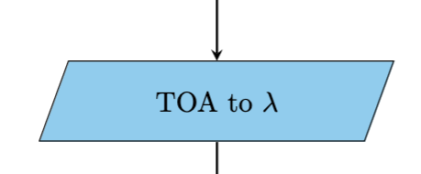
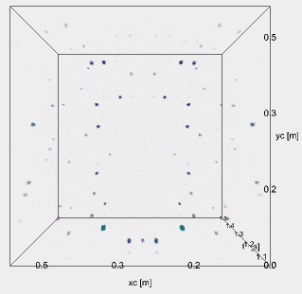
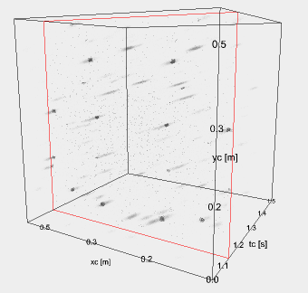
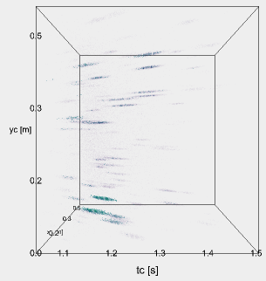
Data reduction
From event data to image like data
Binning of data to Time of flight (TOF) bins ✓
Avoid reflection overlap
Flexible adjustment of bin size
Processing in several seconds or a few minutes (multiple times faster than data collection)
TOA conversion to TOF in scipp and TOF to λ in DIALS (✓)
https://dials.github.io/projects.html

Slide 5
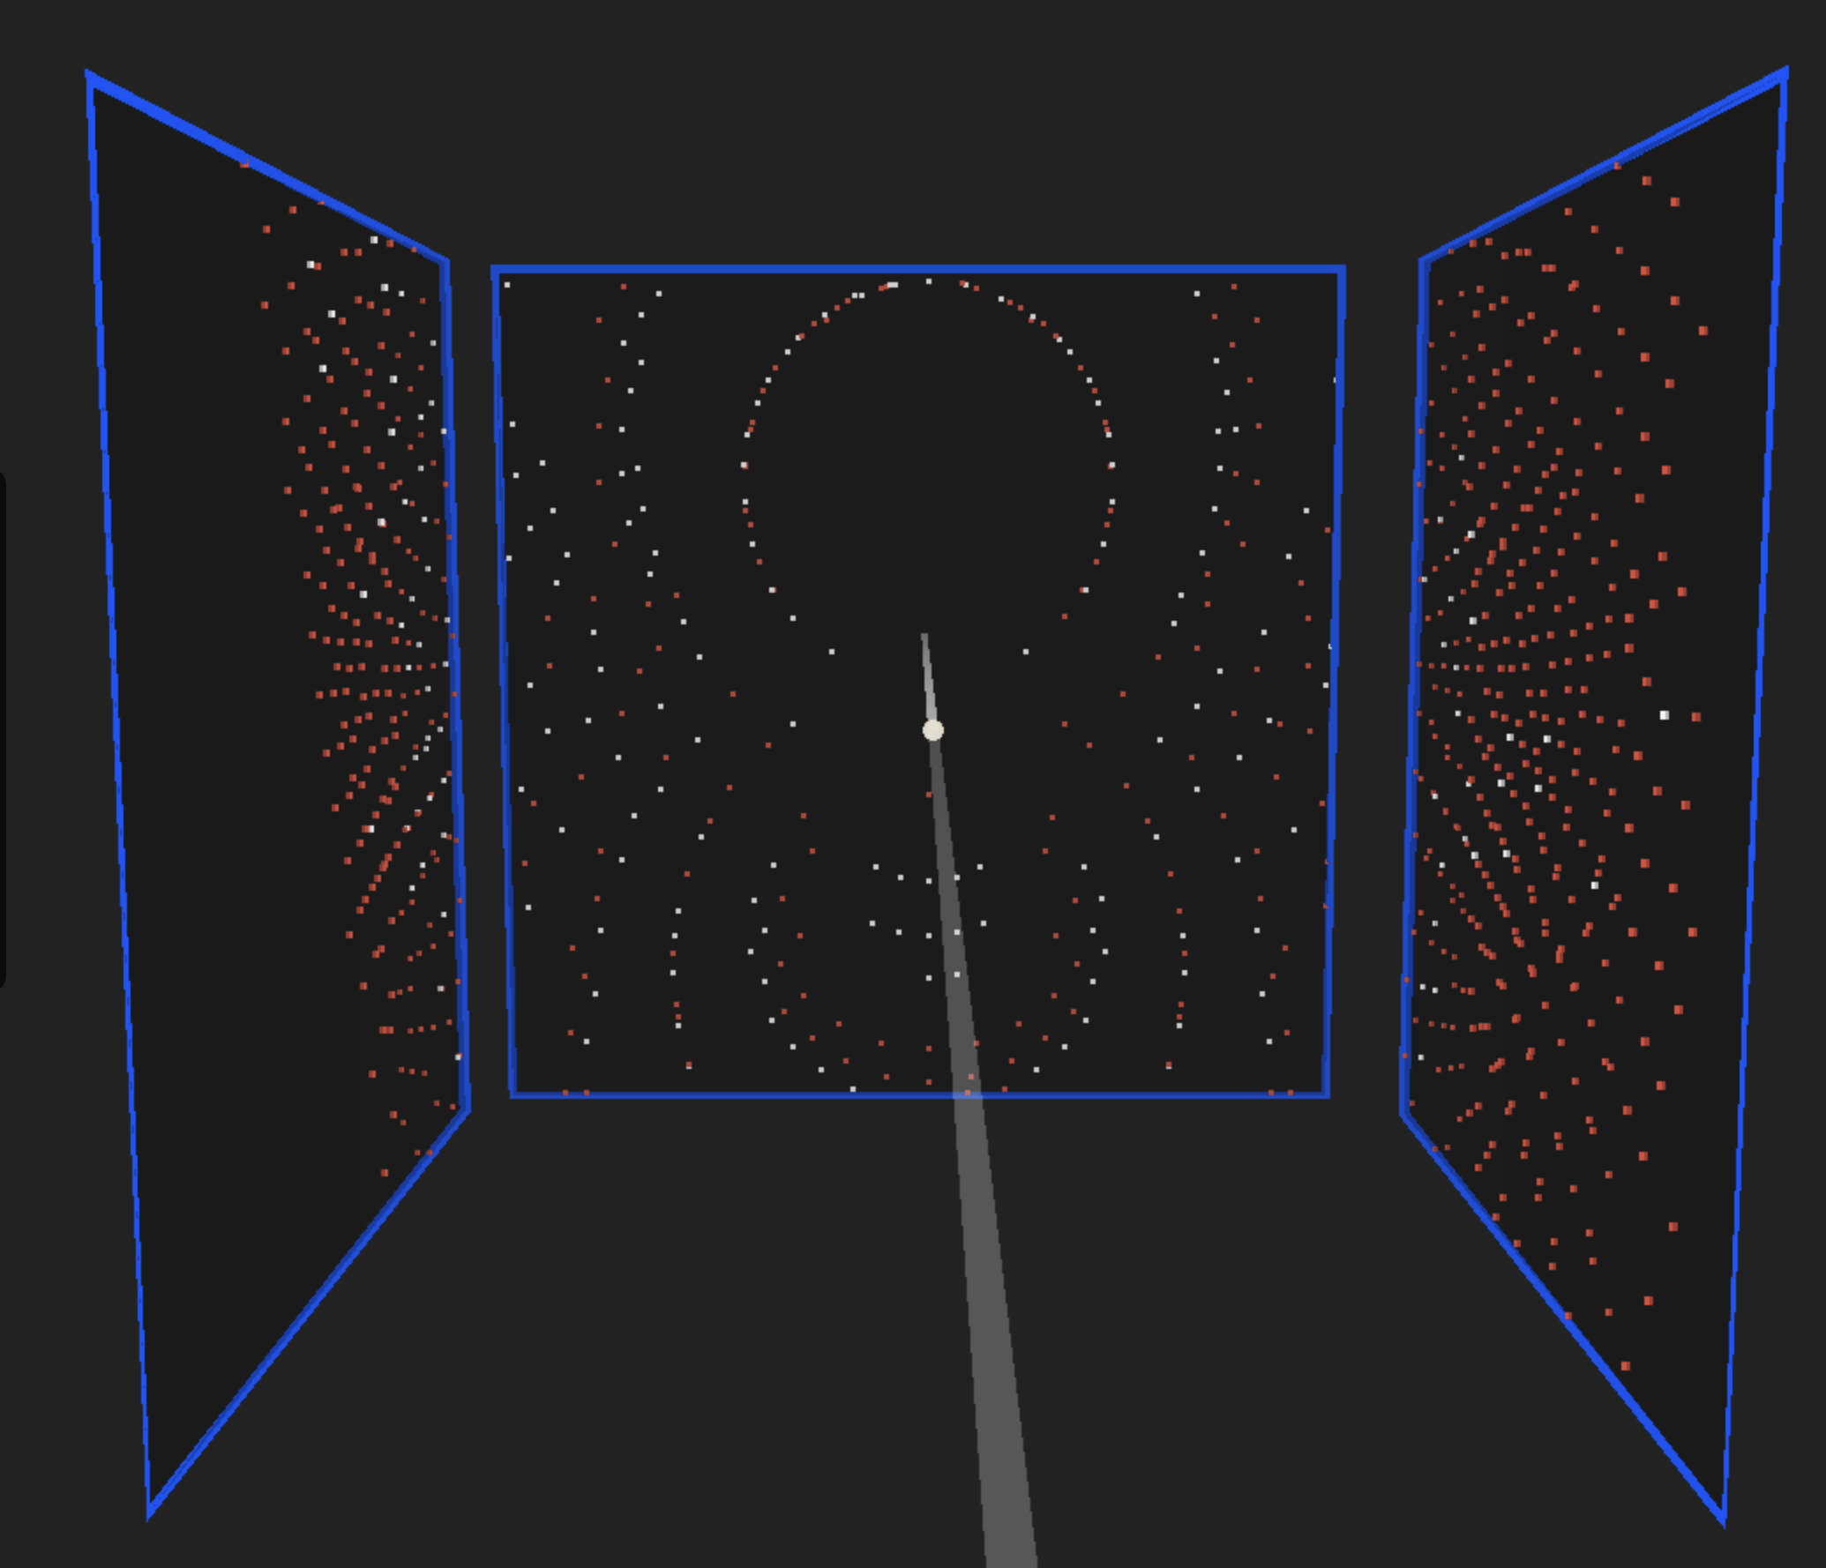
Datarecduction
From image data to reflexes
Spot finding ✓
pixel thresholding process followed by the determination of connected regions and size, centre of mass and total intensity estimation
Indexing ✓
Use orientation matrix is used to assign Miller indices to reciprocal-lattice points
Refine indexing ✓
Refining one general model of the instrument to use in the following processing
Spot integration (✓)
peak intensity is evaluated via summation integration or profile fitting

Slide 6
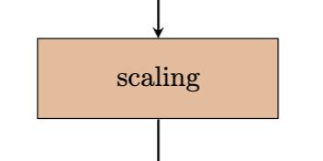
Scaling (work in progress)
LSCALE / PySCALE
Developing of a replacing python package mainly by Mikael Lund
scaling and normalization of Laue intensity data
yield fully corrected structure amplitudes
Program has to be rewritten to adjust for prosessing several detectors
LSCALE is runing in a Docker container on a modern computer
Pyscale is in development

Slide 7
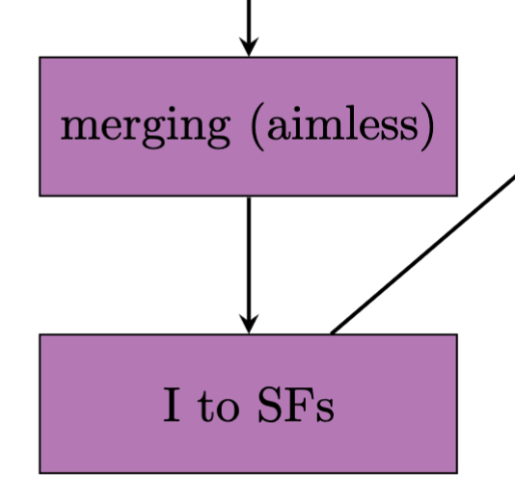
Finalysing data reduction
AIMLESS (CCP4)
Mergin
AIMLESS (CCP4) https://www.ccp4.ac.uk/html/aimless.html
scale refinement, using strong data for an initial scale
I to SFs
CTRUNCATE (CCP4) https://www.ccp4.ac.uk/html/ctruncate.htm
Conversion of measured intensities to structure factors

Slide 8
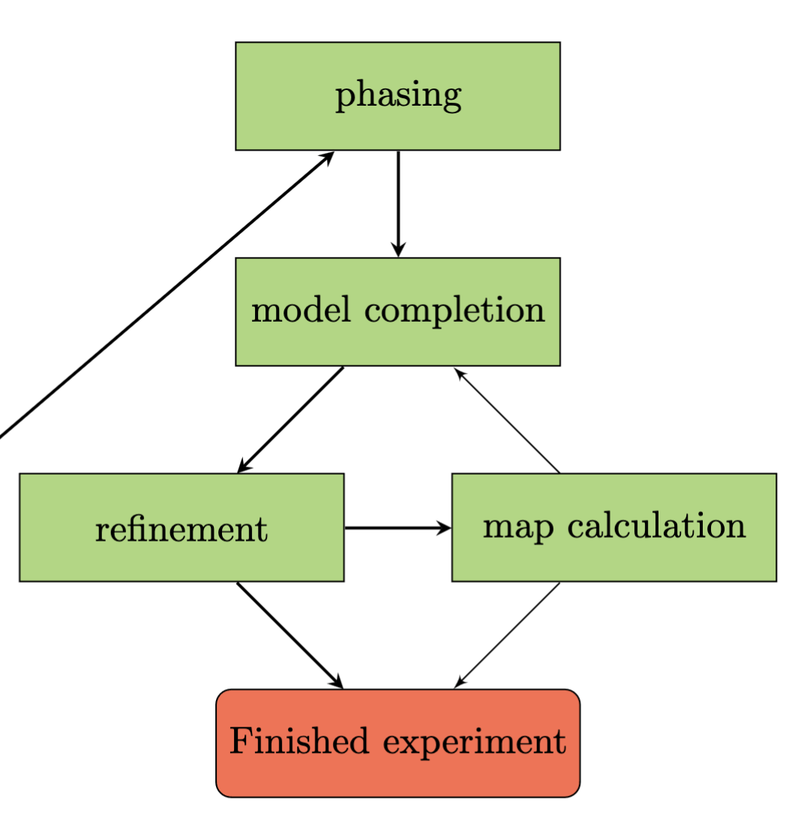
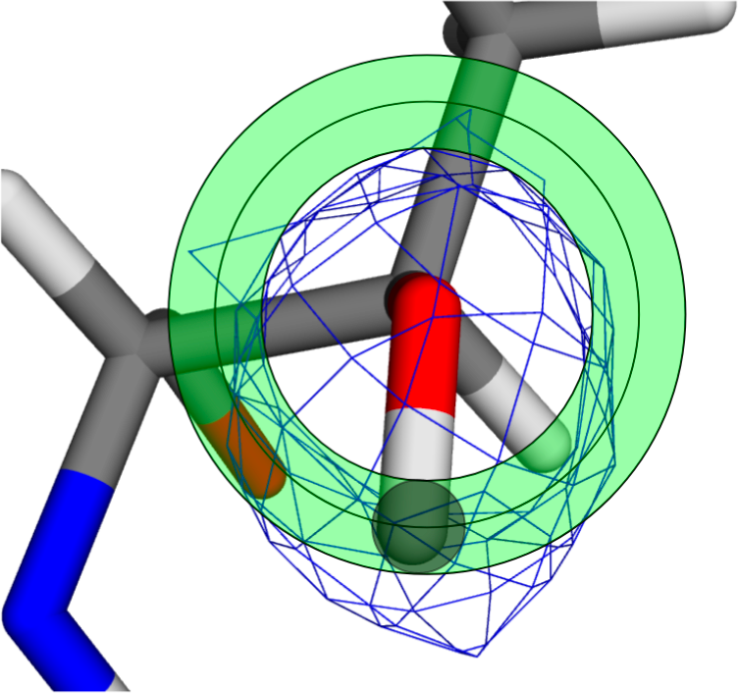
Model building and refinement
From intensities to a model
Phasing
Modelbuilding
Adding of hydrogen atoms to the model
Determination of protonation states for acidic and basic side chains
Hydrogen orientation for water
Refinement
Phenix
Refmac5
Solvent correction
Restraints and constraints
Validation

Slide 9
Open projects and Concerns
Strategy calculation
User interface
Scaling ready on time
Move of DMSC to DTU
Detachment of DMSC and ESS
Loss of personnel in ECDC and DMSC due to DMSC office move – eventually including NMX IDS

Slide 10
Questions and sugestions?

