Slide 1
SANS updates: LOKI + SKADI
WojCIECH Potrzebowski

Slide 2
SANS data processing pipeline
Current status for LOKI and SKADI
Experiment control
Stream events & meta data
Data reduction & visualization
Data analysis
Data management
LOKI | Baseline version Use case at Ymir NURF setup | Full chain tested Detector calibration scripts Meta data | Basic workflow Pipelining Direct beam TOF Resolution | Basic functionality TOF Resolution New release | Basic functionality Automation and integration Meta data
SKADI | Planning with ECDC | Planning with ECDC +DG | Will benefit from LOKI and DREAM (polarization) | Magnetic SANS workflows
Completed
Work in Progress
+ User office software, DST requirement (storage, VISA)

Slide 3
Milestones
From now to Hot Commissioning
M1 = LoKI detector test data reduced and analyzed – Approval by LoKI instrument team – December 15th 2023.
M2 = TOF resolution treatment available from data analysis and reduction software – approval by SANS instrument teams and SasView and scipp developers - March 2024
M3 = Coverage for reduction workflows for LoKI. Reduction workflows available on ess documentation webpages - Approval by SANS instrument scientists – March 2024
M4 = Delivery of complete data pipeline at the LOKI instrument – June 2024 - Approval by SANS instrument scientists
M5 = Interface testing for full DMSC software stack for LoKI available on dmsc-nightly - June 2024 – approval by DMSC stakeholders

Slide 4
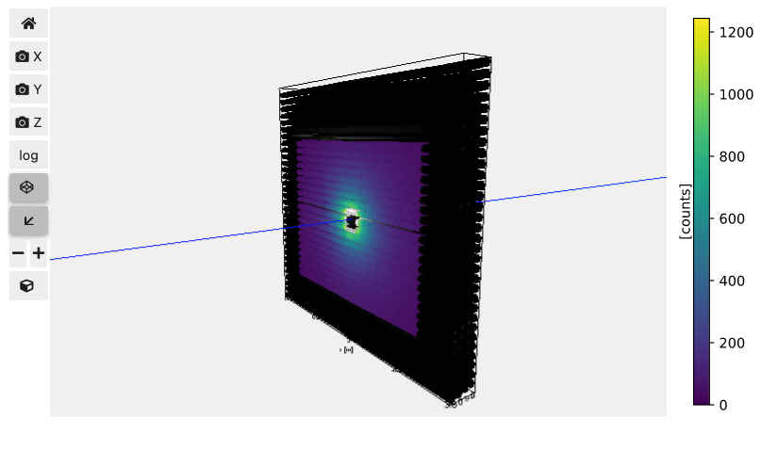
M1: Data reduction
Direct beam function
Development of direct beam iteration functionality in Scipp
Adapted data reduction pipeline in Scipp to use Mantid direct beam file
Benchmarking Scipp results with Mantid
Per layer-defined direct beam function
Step-by-step comparisons
Mask and monitors exactly as in Mantid

Slide 5
M1 and M3: Data reduction
High level Scipp developments
Framework for writing, testing, and maintaining complex data analysis workflows
Easier to develop code for repetitive tasks (e.g. wavelength slicing, meta-data filtering)
Easier integration with future GUI
Auto-generated workflow graphs
https://scipp.github.io/sciline/index.html
https://scipp.github.io/esssans/

Slide 6
M2: Data reduction (+ data analysis)
TOF resolution
Demonstrated that SasView can read and analyze arbitrary resolution function
Developed kernel convolution (aka GRASP) functionality in Python
Working on Scipp implementation
TODO:
Save to NXCanSAS format
Demo for CanSAS working group

Slide 7
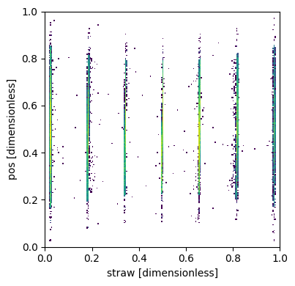
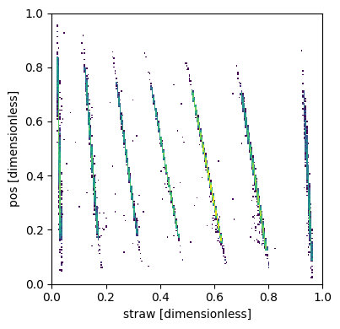
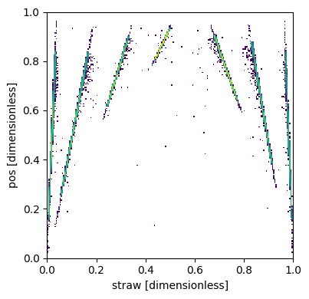
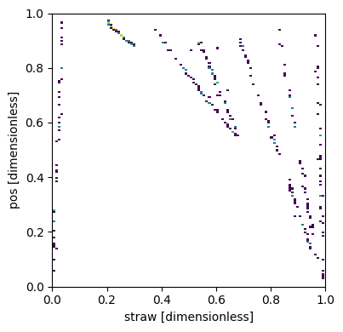
M4: Detector calibration
Data from LOKI detector test analyzed wrt straw and position determination
The majority of cases straightforward
Exploring procedures for identifying “doggy” straw/tubes
Possible masking and corrections discussed with ECDC
Work on proof of concept on DREAM (which likely can be adapted to LOKI)

Slide 8
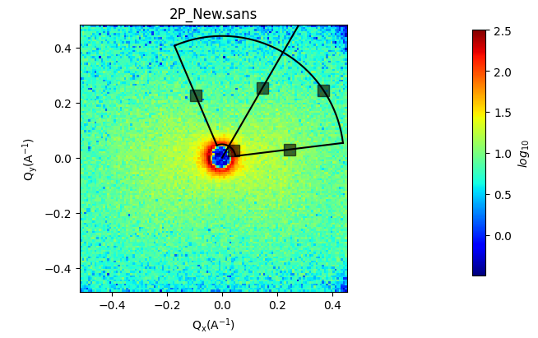
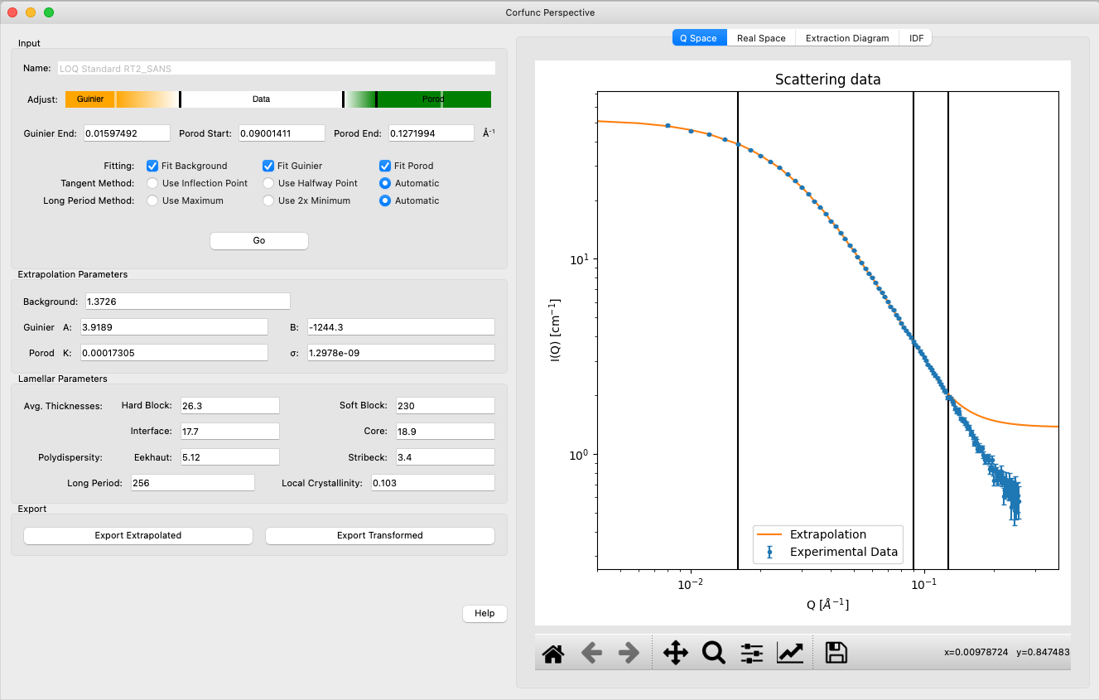
M4: Data analysis
SasView 6.0.0-alpha release
Orientation viewer available
Corfunc perspective refactored
Simultaneous fitting allows for a weighting scheme
Preferences panel with display and plotting options
Improved label handling on plots
Residuals plots refactored
PDB reader refactored
Wedge slicer added
Sasdata package separated
Custom Model writing tutorial

Slide 9
Other updates and concerns
Annika Stellhorn joined the SANS team (working on polarization analysis)
AoA Materials proposal on Shapespayer accepted – postdoc(s) will be recruited
Main concerns:
M1 is still on track but ran into some issues
New requirements for TollGate 5 and Safety Readiness Review (and their connection with already developed HC plans)
Getting Instrument Scientists on board with DMSC software and solutions
Uncertainty related to move to DTU
- IDS role
- connection to ECDC and instrument teams

