Slide 2
DMSC update
PRESENTED BY Thomas Holm Rod

Slide 3
Agenda
1 ESS Project Update
2 Science Directorate Updates
3 DMSC Division Updates

Slide 4
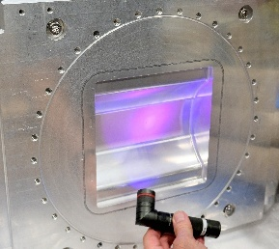
1
ESS Project

Slide 5
Courtesy: Andrew Kimber, ICB22

Slide 6
Courtesy: Andrew Kimber, ICB22

Slide 7
Presented at Instrument Collaboration Board last week
Courtesy: Rob Connatser, ICB22

Slide 8
Progress
"Plug and Play" Integration of Sample Environment Equipment Successfully Demonstrated
First Neutron Detectors Arrive at ESS

Slide 9
2
Science

Slide 10
Updated organigram
Strengthening Science Directorate
Science Directorate
Giovanna
Diffraction & Imaging Division
NN
Large Scale Structure and Dynamics Division
NN
Chemistry and Life-science Support Group
Monika Hartl
Materials Science and Physics Support Group
Caroline Curfs
Research Support Office Group
NN
Spectroscopy Division
NN
Management and Administration
DMSC
NN
Admin & Mng
Petra
Data Systems & Technologies
Jesper
Scientific Information Management Systems
Fredrik
Data Reduction, Analysis, and Modelling
Torben (A)
Instrument Data Scientists
NN

Slide 11
Data policy
A never ending story
SAC endorsed the ESS Data Policy 1 year ago
We have since then clarified some paragraphs based on the feedback from SAC
The material is uploaded to the indico page
It will not be the last update
Clarified questions related to Persistent Identifiers and citable Digital Object Identifiers:
Users can mint a DOI for a select set of data sets, which will generate a public and citeable webpage with links to the data sets
How to handle (retroactive) changes
It will be indicated which version of the Data Policy covers a specific data set
GDPR:
It is now specified that information uploaded by users should be GDPR compliant

Slide 12
3
DMSC

Slide 13
Relocation
Had to give way for a NATO and DK government supported initiative

Slide 14
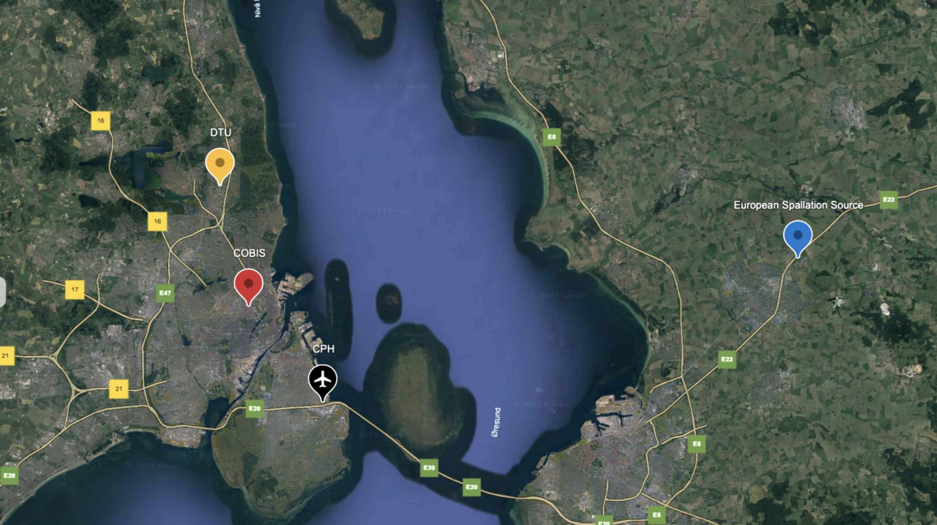
Relocation
DMSC will move to DTU April 1, 2023
Future office location
Backup system
Current office location
Cph data centre (HPC)
Lund data centre
Support for users, instruments, & Science

Slide 15
Staff changes since last STAP
Some resignations provoked by relocation
Group | #Resigned | #Recruited | #Vacant
ECDC | 1 | 1 | 1
SWAP | 0 | 2 | 0
DST | 0 | 1 | 3
DRAM | 1 | 2 | 2
IDS | 1 | 0 | 2
Admin | 0 | 0 | 0
Total | 3 | 6 | 8

Slide 16
Staffing for Analysis and Instrument Data Scientists
Instrument Data Scientists (½ IDS instrument)
Data analysis core development
Technique | Instruments | Who or When
Imag. & Eng. | ODIN & BEER | Søren
Reflectometry | ESTIA & FREIA | Andrew M
SANS | LoKI & SKADI | Wojtek
Diffraction | DREAM & MAGIC | Céline
Spectroscopy | BIFROST & CSPEC | Greg
Diffraction | NMX & HEIMDAL | Jan 20254
Spectroscopy | TREX & MIRACLES | Jul 2026
Technique | Who or When
Manager (Atomic sim) | Piotr
Diffraction | Andrew S
Spectroscopy | Simon W
Imaging (& Eng) | Nov 2023
Ensure right expertise
Able to collaborate on all techniques
IDS for reflectometry and SANS contribute significantly to data analysis
Data analysis developers to support IDSes during Hot Commissioning
Conservative when using ESS budget
More visionary / researchy when using external funding

Slide 17
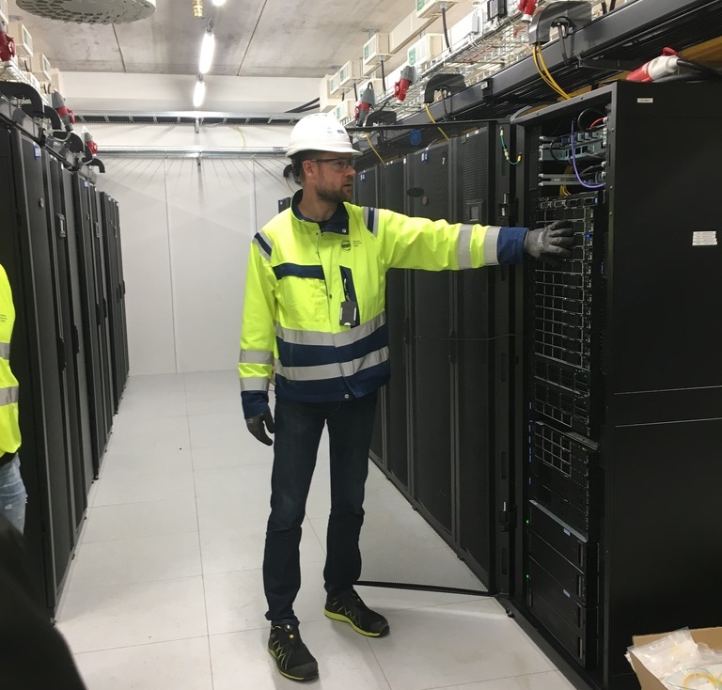
Relocation challenges
Risks to staff retention and data centre
Staff retention
Relocating to DTU is a challenge for some staff and some have already resigned
It is hard to recruit new staff
Several mitigations:
To keep staff on board
To compensate for lost staff
Data centre location
Our data centre also needs to relocate, but can stay in its current location until Sept 2025.
DTU cannot readily host it on their Lyngby campus (3-5 years lead time), so looking into:
Relocating data centre to ESS-Lund
Relocating data centre to commercial partner
Relocating to DTU-Risø, which is inconveniently located

Slide 18
Mitigating risks to staff retention
Action | Approved
Support for commuting for limited time
Support for relocating home
Bonuses for staying 0, 6, 12 months after relocation
Reduce need for commuting across Sound | Somewhat
Offering Swedish contracts for ECDC staff living in Sweden | Probably
Offering more DK/SE flexible working hours for DMSC-Science staff living in Sweden for two years | ESS Denmark
More flexible WfH policy for DK employees
Framework agreement for hiring freelancers
Student workers

Slide 19
Relocating Cph server room
Still need to decide on long-term solution
Action | Status
Locate to Risø | Try to avoid
Locate to DTU campus | Possible in 3-5 years
Locate to ESS Lund | Being investigated (but possible)
Locate to commercial provider | Being investigated (but possible)
Extend contracts with BII for two years

Slide 20
Planning & Milestones
Managed to get more attention from project organization
Visit to DMSC
Workshop with planner – restructured IDS activities and milestones
New NSS / Science milestones for Tranche 1 instruments
Need to work with Andrew J and planner to get DMSC milestones properly linked
TG5/SAR workshop with in kind partners in November

Slide 21
Monthly reporting to upper management
September 2023 report

Slide 22
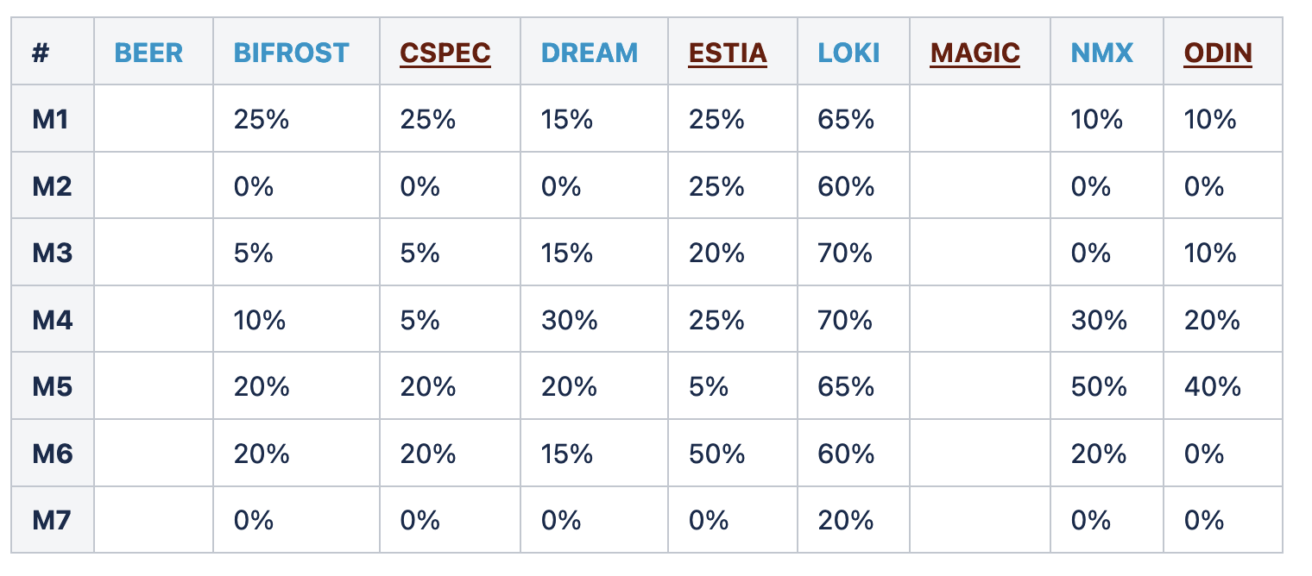
Dashboard
Reflecting the IDSs perception of status
DAQ ready for HC
User Office Software ready for HC
FAIR Data Management Ready for HC
Data reduction ready for HC
DMSC / scientific software ready for 1st science
Data analysis ready for SOUP
User interface for data reduction ready for SOUP
There are progress
Some of the estimates are based on hand waiving arguments,
some on level of completion for JIRA projects

Slide 23
New (potential) collaborations
Activity | Partner | Level of effort | Status
McStas RSE | DTU | 1 FTE 2023-2027 | Agreement signed
Mutual visits | JPARC (SAKURA) | 2 x week long mutual visits | In process
ShapeSpyer | Chalmers / STFC | 2 PostDoc years | Funded, but need formal collaboration agreement
IDS Spectroscopy | DTU | 1 FTE until 2027 | Still discussing
In kind | DTU, UCPH, UU |  | Expression of Interest
SciCat collab | Capital Region | 6 PM | Working on proposal
PhD program | DTU | 2 PhD projects | Expression of Interest

Slide 24
Instrument Data Scientists
IDS for reflectometry resigned:
- 41 applications for replacement position
- shortlist of 8 candidates
Approval to recruit for NMX IDS 1 year earlier than planned
Proposal to have 15 IDSs in 2028. Hence, need to start recruiting now.

Slide 25
Complementary activities in 2023
Keep track of research & dissemination activities
Activity | Level
Co-supervision | 1 MSc, 5 PhD, 3 PostDocs
Networks & Committees | 12
Conferences, workshops, etc | 13 Invited talks 9 Contributed talks 5 Posters 11 Others (e.g. codecamps)
Publications | 11 peer-reviewed
Training | 8 events
Beamtime | 7
Other visits to other institutions | 5

Slide 26
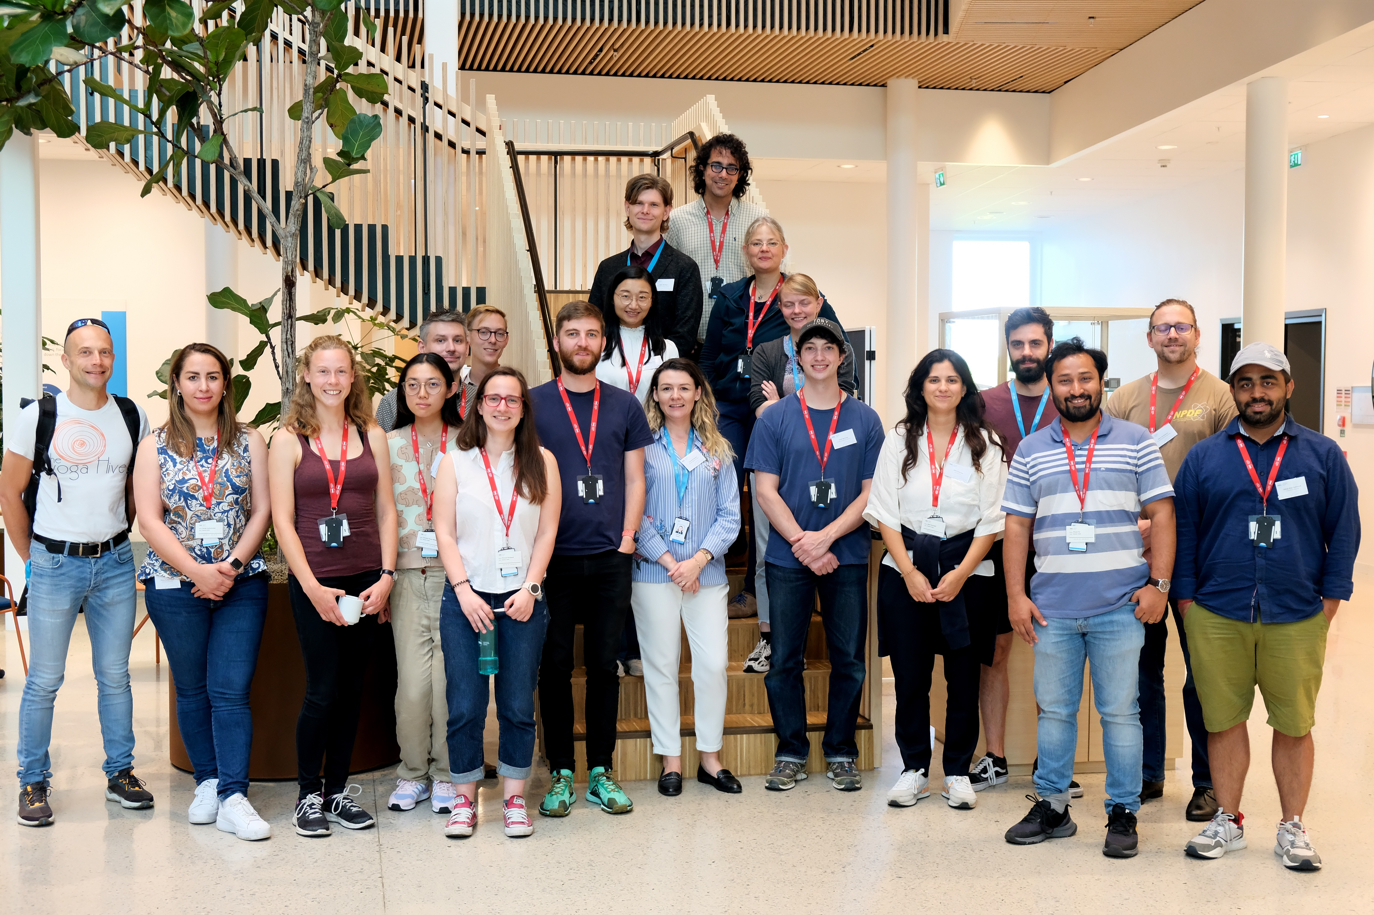
DMSC Summer school
Training in ESS software suite and FAIR data
(Andrew’s McCluskey last task for ESS)
Stream events & meta data
Data reduction & visualization
Data analysis
FAIR Data management
Experiment control
User office software
Following on from PaNOSC Summer school
Focusing on ESS software suite and FAIR data
1st school in Sep 2023
14 participants (over-subscribed)

Slide 27
DMSC Summer school
Training in ESS software suite and FAIR data
Working on report for Neutron News
Stream events & meta data
Data reduction & visualization
Data analysis
FAIR Data management
Experiment control
User office software
Following on from PaNOSC Summer school
Focusing on ESS software suite and FAIR data
1st school in Sep 2023
14 participants (over-subscribed)

Slide 28
Future
Status & Vision
Vision and Status were written in a hurry to counteract picture being painted of the DMSC
take ownership of the DMSC
To date, the mission, role and remit of the DMSC has been very clear to the SAC, with its activities well aligned to ESS project deliverables. Furthermore, DMSC’s impressive performance has commonly been a highlight for the SAC. The updated mission and vision presented in SAC.30 put this into question, introducing some ambiguity around alignment to the objectives of the ESS. We thus recommend further work on the new document.
Need to be followed up by new Head of DMSC
STAP
Discussion about pausing instrument STAPs
STAP’s role is to give advice, but it is also an important contact point to stakeholders
DK community (Chair of DanScatt?)
SE community?
European University from outside UK and Scandinavia?

Slide 29
Steady-state operations
Planning for 15 instruments and 2 MW in 2028
Group | #FTEs
Admin & Mng | 4 | 1 Head, 1 GL, 2 assistants
Data Systems & Technologies (DST) | 12 | May not be needed in 2028
Scientific Information Management Systems (SIMS) | 7 | 1 GL, 2 scientists, 4 engineers
Data Reduction, Analysis, and Modelling (DRAM) | 21 | Includes interfaces to simulation software and 2 GLs
Instrument Data Scientists (IDS) | 16 | 1 FTE/instrument + GL
Experiment Control and Data Curation (ECDC) | 15
Total | 75

Slide 30
Two closely related WBS Elements
For practical reasons we have kept the WBS names from 2016
WBS Element
Corresponding Group
Function
Data reduction and analysis
Data Reduction, Analysis, and Modelling Group
Developer teams (Research Software Engineers)
Computational modelling, theory and simulations
Instrument Data Scientists
Applications, require-ments, lighter develop-ment

Slide 31
Summary
Good progress on many frontiers
- both on project and complementary activities (e.g., research)
… but there are also reasons for concerns
- High risk to staff retention
- Challenges with recruitment
- Relocation (incl. mitigations) consumes time and energy
and hence risk to project deliverables

Slide 32
Finish presentation

