Slide 2
Scientific Information Management Systems
SIMS
PRESENTED BY Fredrik Bolmsten

Slide 3
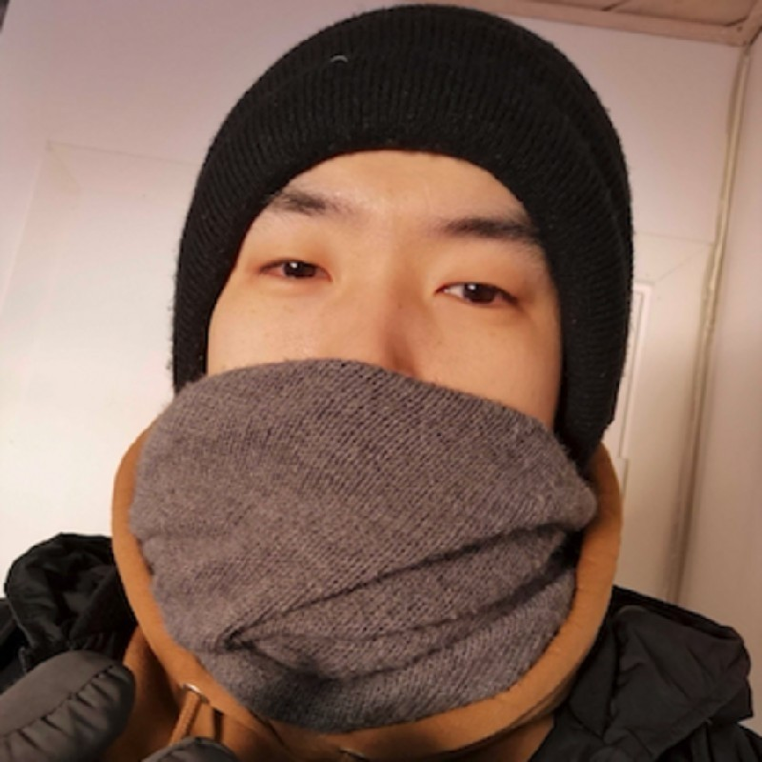
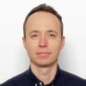
Group
Staff & Scope
Fredrik Bolmsten - Section lead
Max Novelli - Data curation scientist
Jay Quan - Software engineer
Yoganandan Pandiyan - Software engineer
Janos Babik – Software engineer
Martin Trajanovski - Service agreement
User Office:
Proposal system
Scheduling software
Statistics
Data Curation:
Metadata catalogue
Electronic logbook
Scientific data management
Miscellaneous:
E-learning platform
Publication system

Slide 4
The User Journey
Users notify ESS of team
User training
Experiment safety review
Travel and accommodation
Ship samples
Physical Access
Dosimetry
Feedback
Experiment report
Data curation
Expenses review
Publications
KPIs
Submit proposals
Technical review
Excellence review
Result notification
Registration
Proposal
Scheduling
Planning
Performing & Analysing
Wrap-up & Harvesting
Register
Personal Data
Digital Access
Experiments
Sample environments
Local contacts
User lab facilities
Experiment notification
Data directories in place
Automatic data processing
Manual data processing
Permissions for files
Done
To be done for HC
Not started

Slide 5
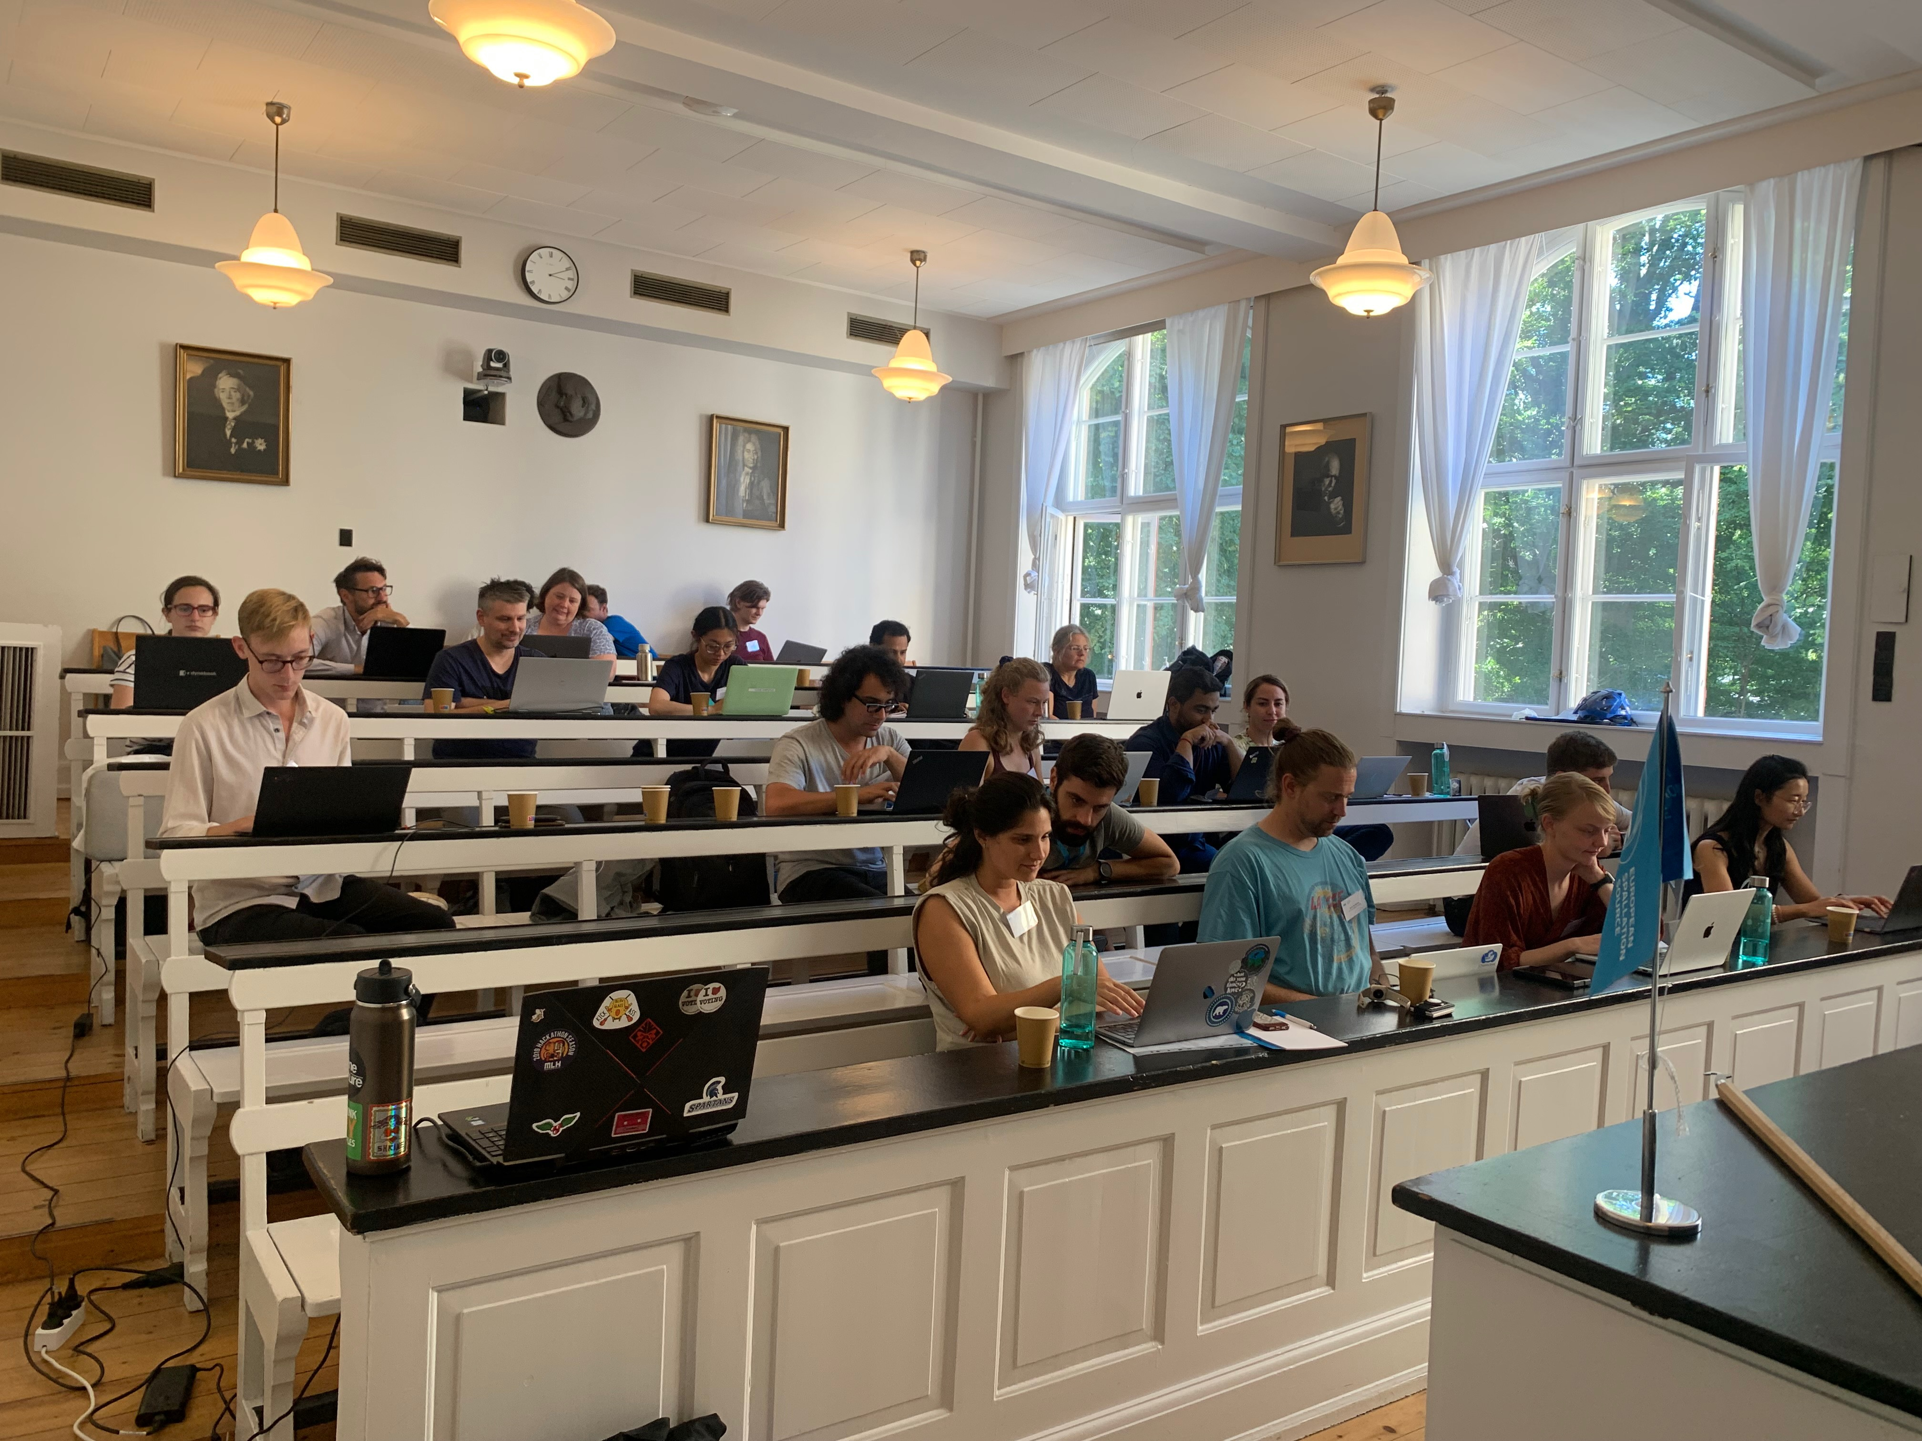
DMSC Summer school
SIMS held two sessions:
Proposal writing
With our User Officer students got a walkthrough of proposal writing and the the technical and scientific review proccess.
Data Curation
In collaboration with the DRAM group students got to collect and curate data inorder to make data FAIR.

Slide 6
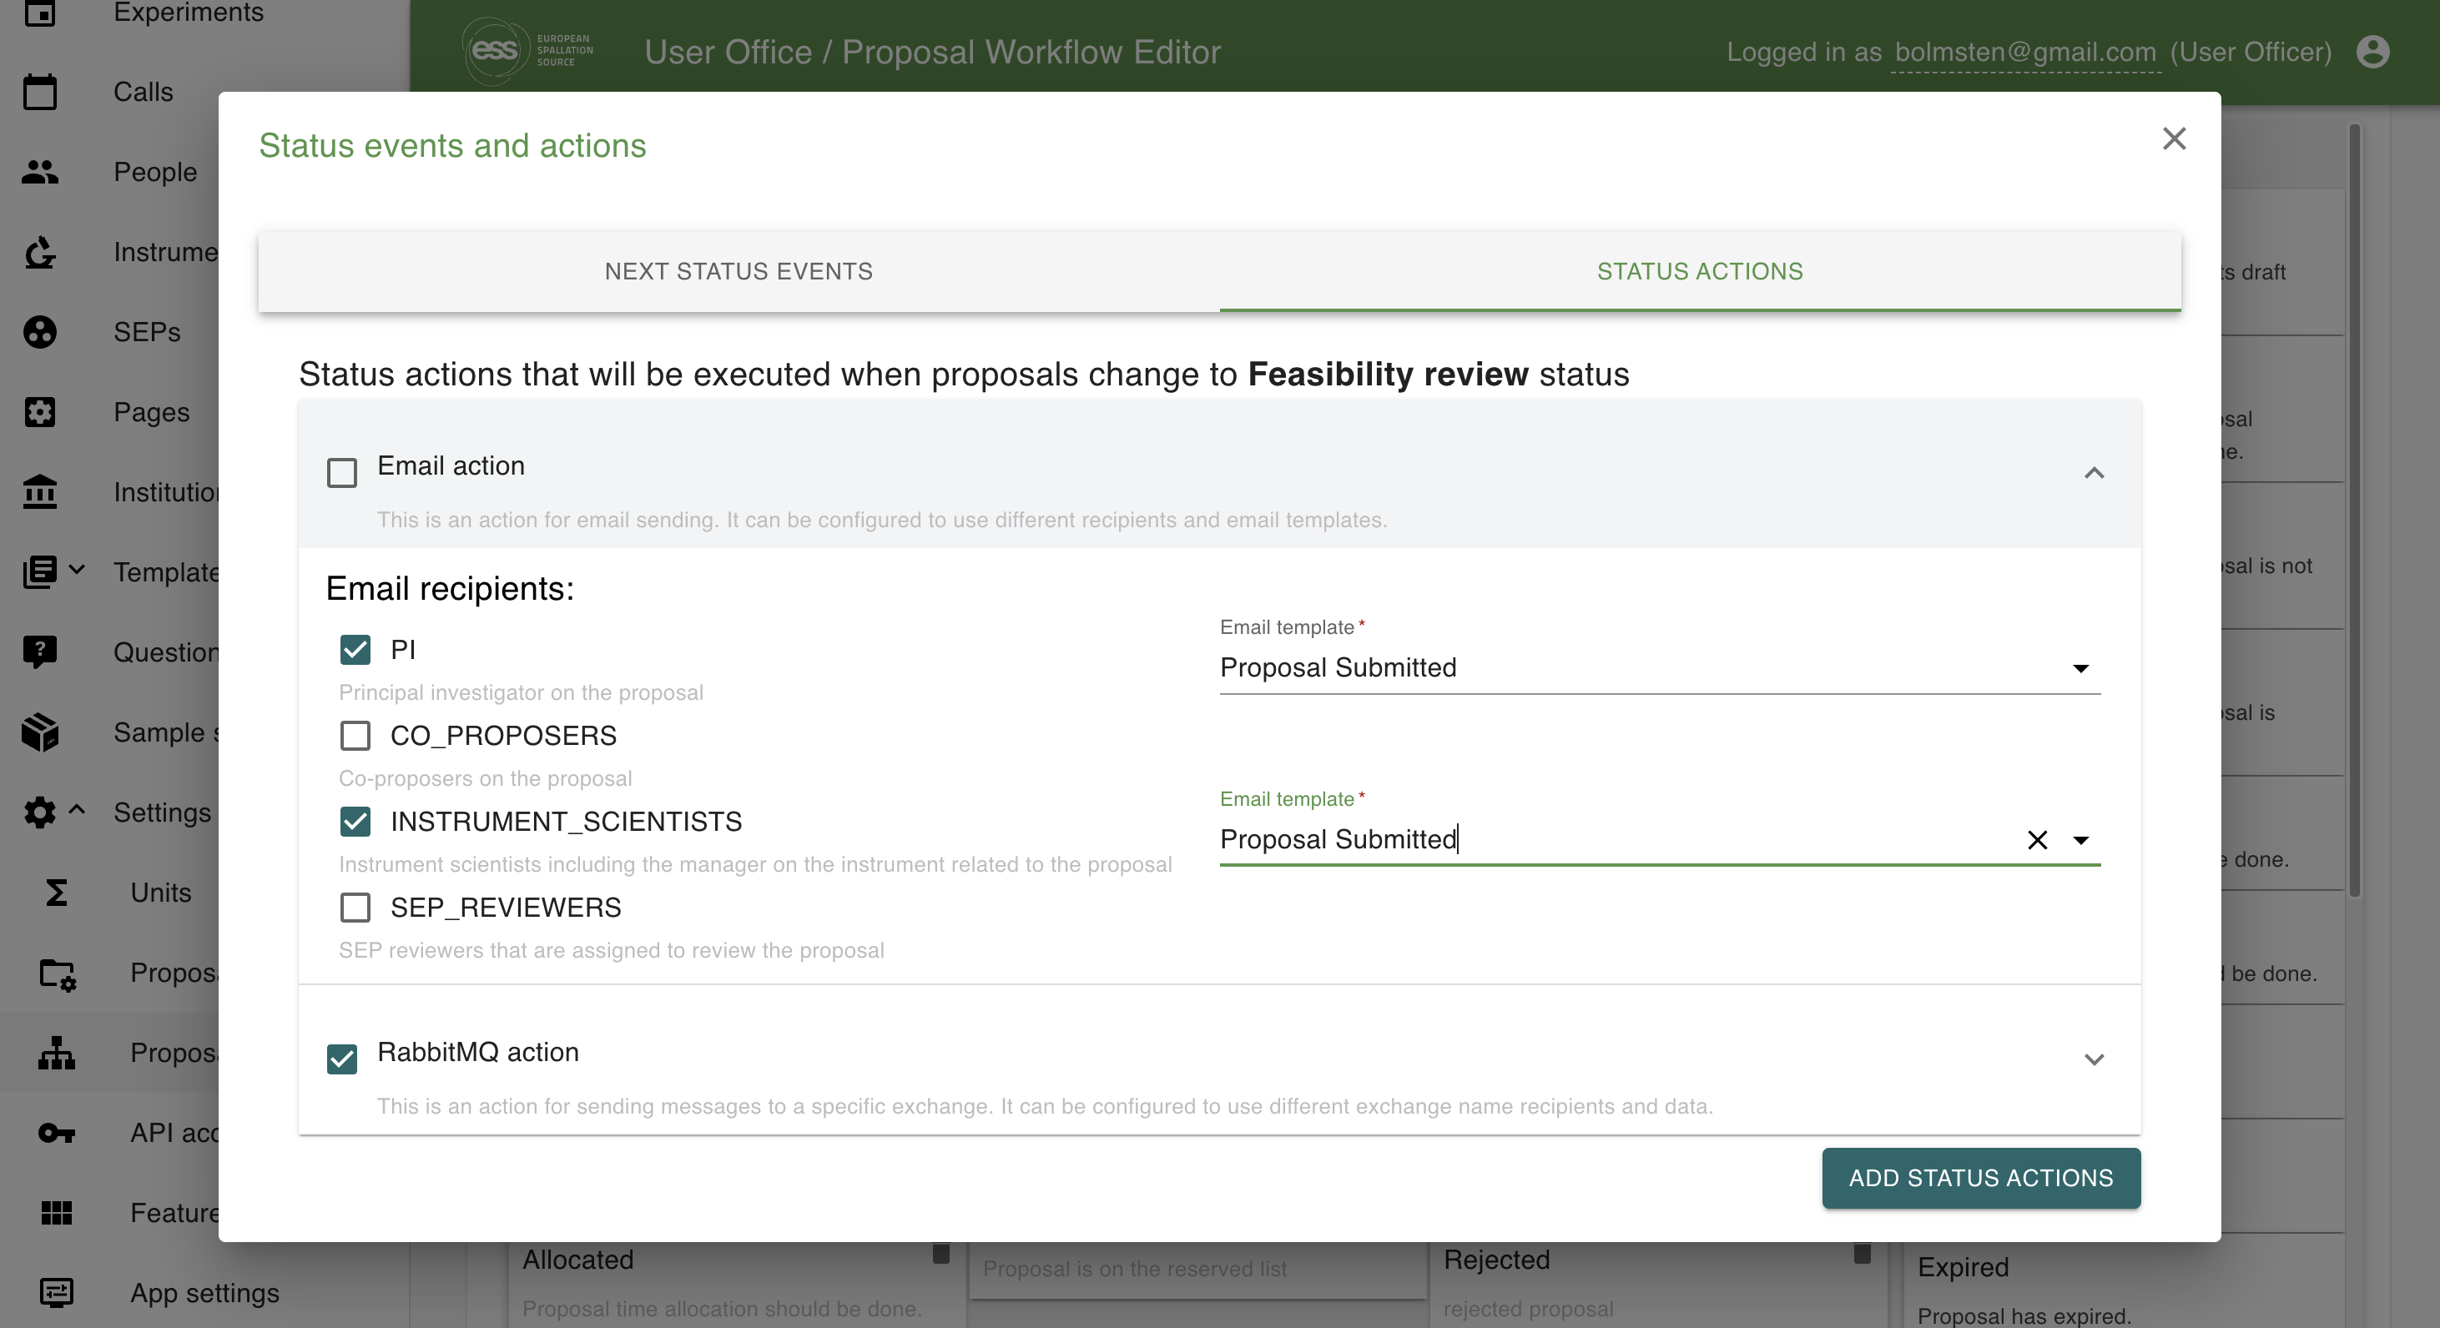
User Office
Supports:
Proposal submission
Technical Review
Scientific Review
Basic Scheduling
Folder creation
New developments:
Fully customizable PDF creation
Creation of side actions for proposal statuses
Automatic assignment of instrument & scientific panel for proposals
VISA integration
INSERT PHOTO

Slide 7
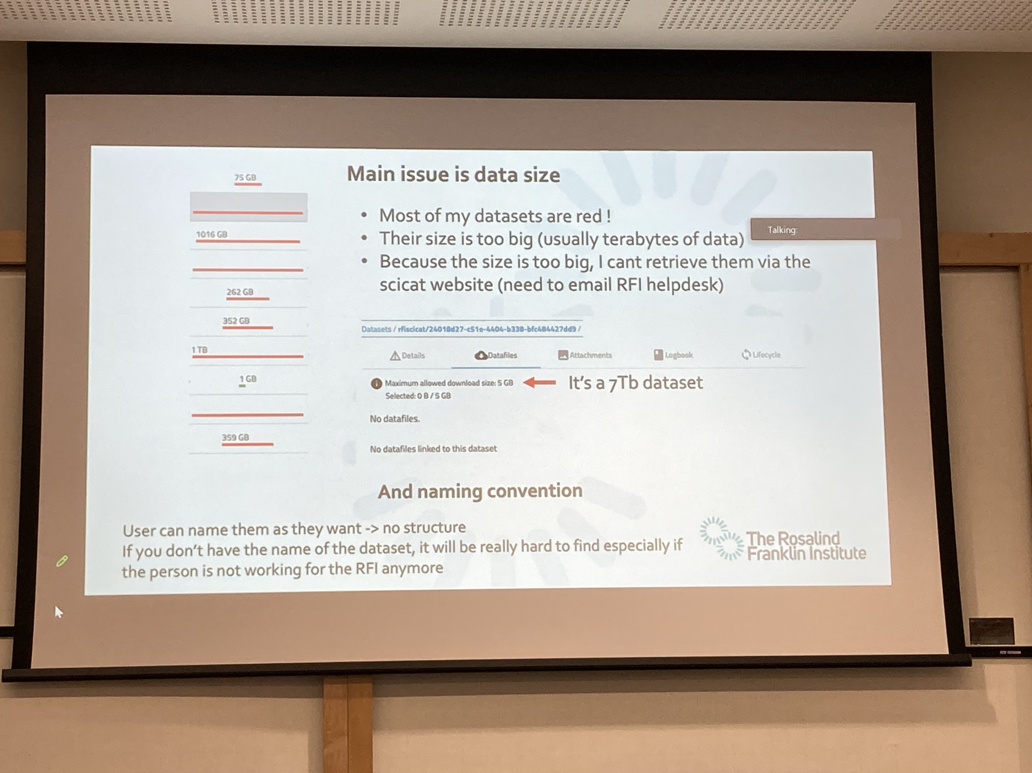
Data Curation
SciCat is used at more than 6 facilities, there is growing interest from the research community and a more mature community has developed.
New developments:
Elastic Search
New website
Release cycles
4.4 : Implement of jobs in backend
4.5 : Improve search functionalities and UI upgrade
DMSC summer school presentation
Drafted grant applications for:
HALRIC
Zuckerberg
RFI presentation at SciCat Conference

Slide 8
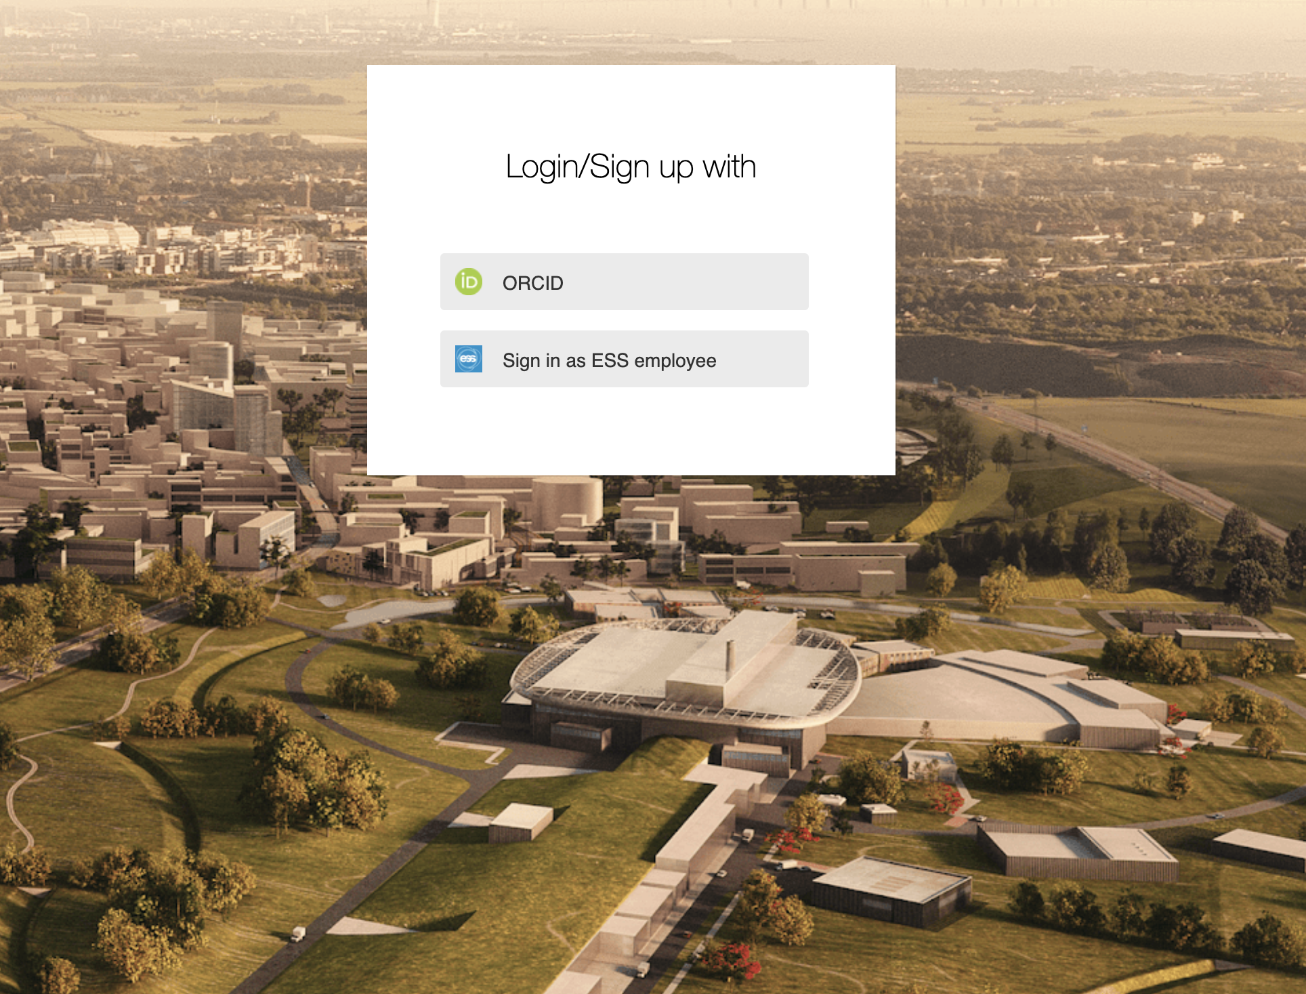
Access
User has access to site & software systems:
User in Identity Access Management
User in access card system
User training completed
User has access rights based on experiment status
GDPR Compliance
User can delete/deactivate account
User can retrieve user information
User account follows defined life-cycle
What is missing?

Slide 9
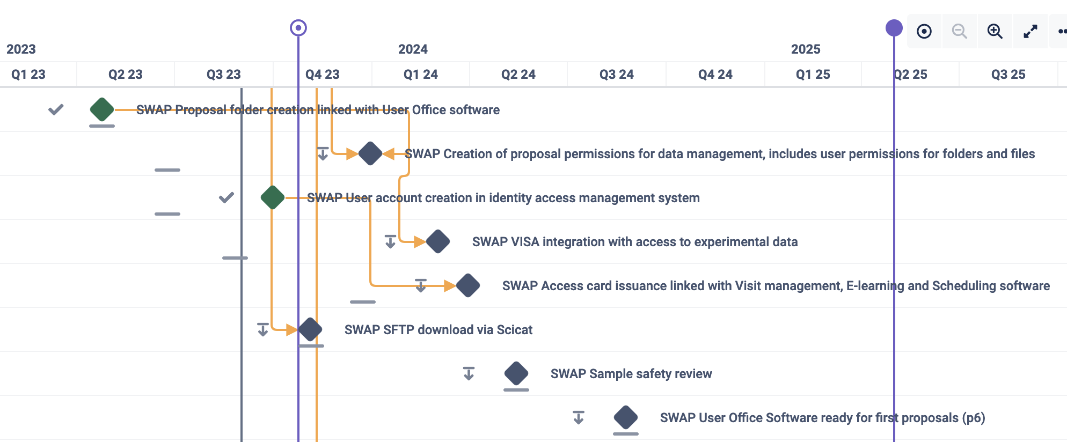
Project plan

Slide 10
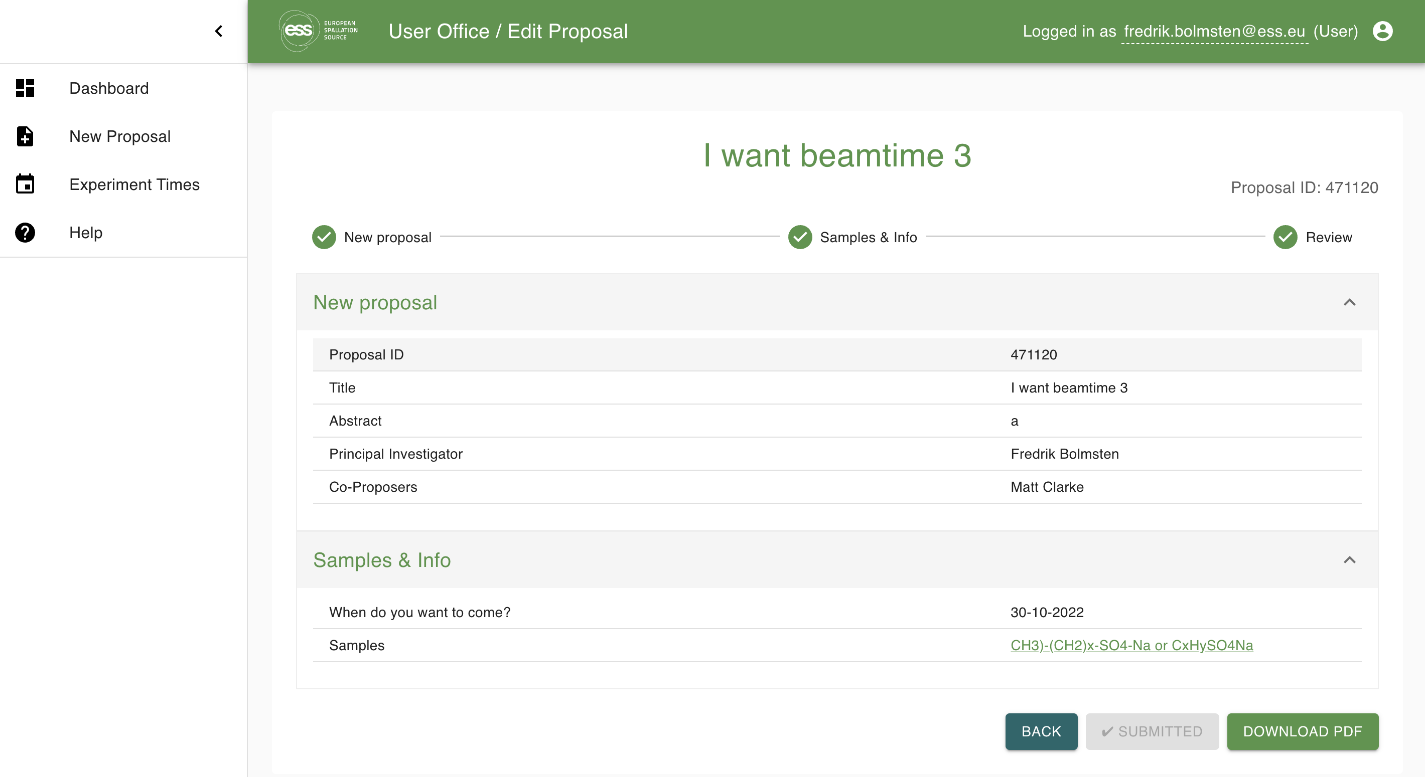
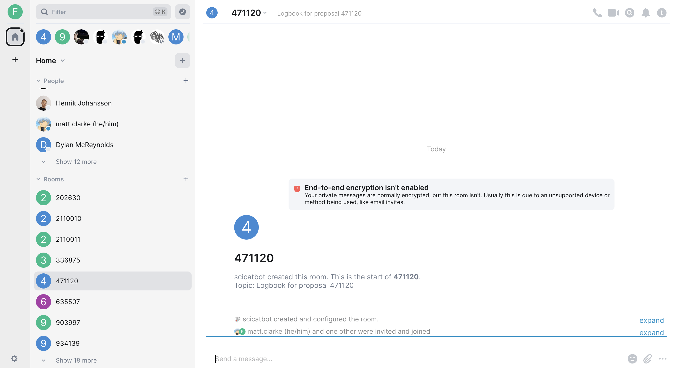
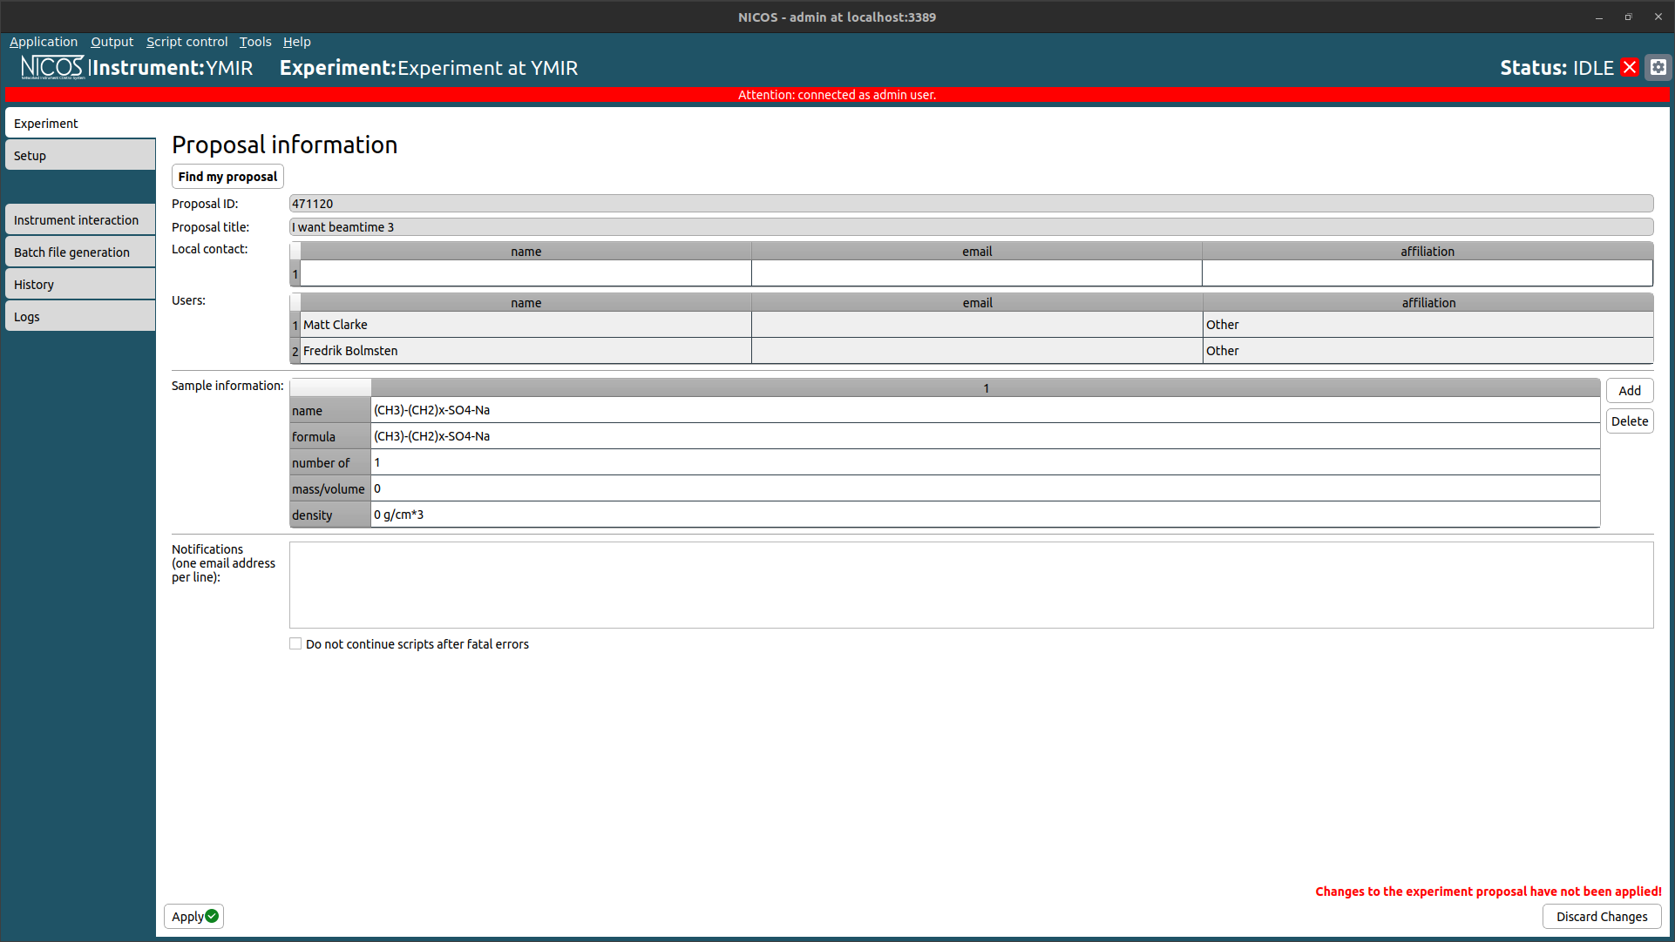
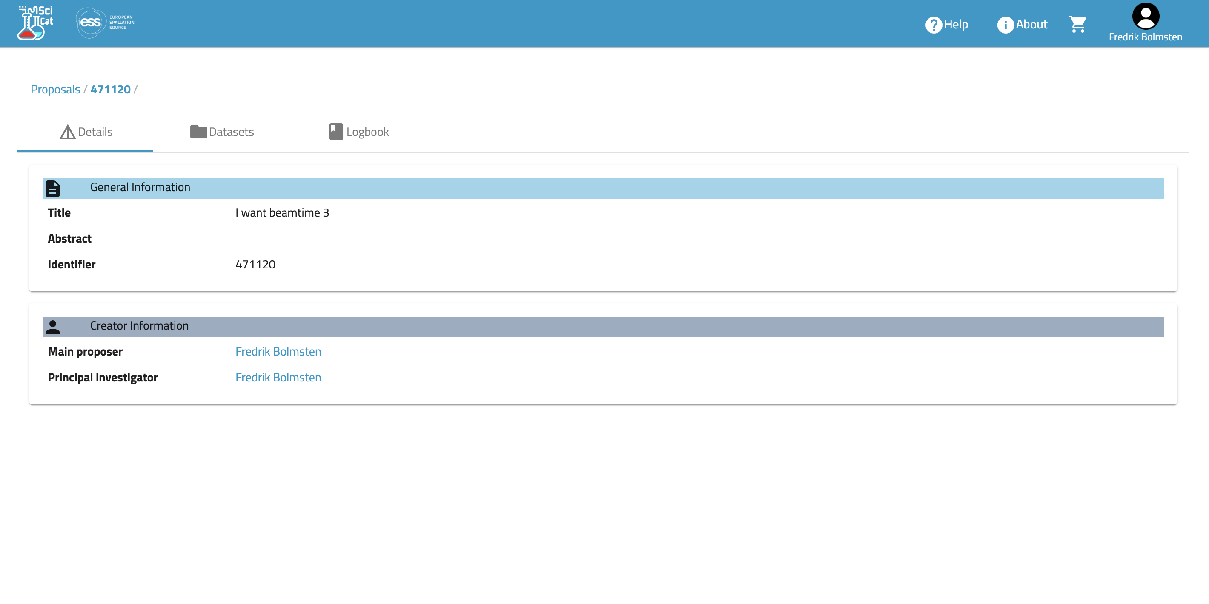
Demo – 2 weeks
Testing it all
After each sprint a demo is conducted:
Proposal creation
Review
Scheduling
SciChat room creation
SciCat dataset creation
Simulating NiCOS to SciChat messages
Jupyterhub to SciCat dataset creation
Folder creation
To be added:
File permissions
Download
“To this end, the STAP would like to volunteer themselves to test drive the system during the next STAP meeting”. -- Offer accepted

Slide 11
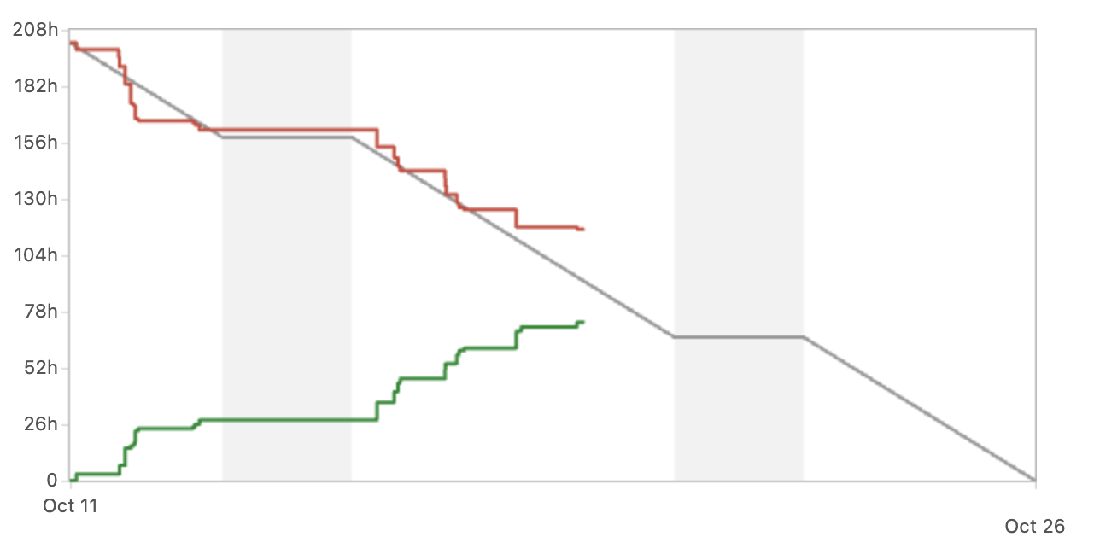
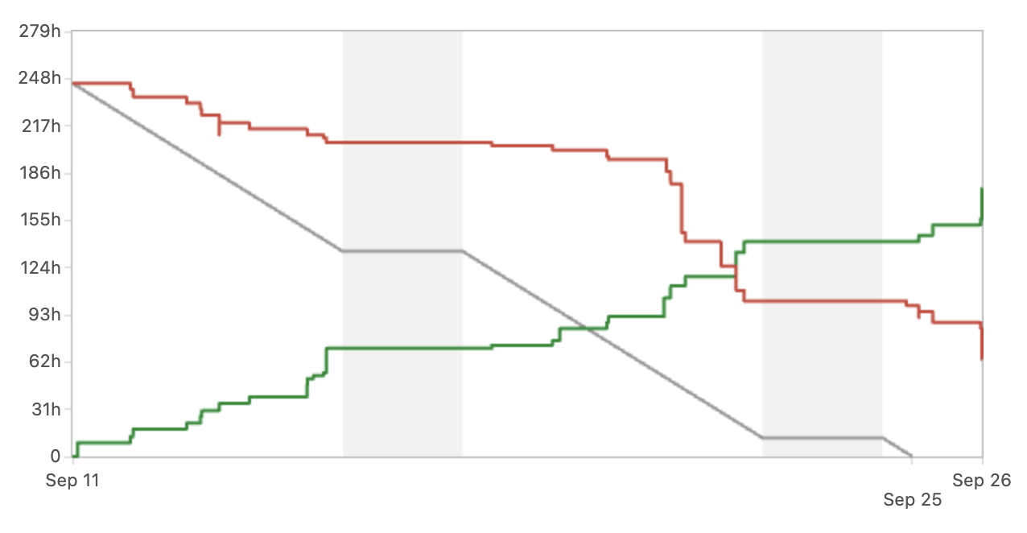
Tracking weekly progress
P6 tracking & JIRA
Insights:
Planning is becoming more accurate
IAM tasks underestimated
Progress heavily dependent on other groups availability
Increasingly hard to track overall progress
Paused:
Visits
Sample tracking
Experiment safety
October
September

Slide 12
Projected labour resources
SSO - 2027
1 Group leader
Manage and coordinate work
4 Software developers (+1 from current)
Upkeep of the metadata catalogue and the entire user office stack. Support for user authorization and new developments to cater the science directorate.
2 Data Curation Officers (+1 from current)
The data curation officers primary task will be to work closely with the instrument scientist, the controls group and scientific users in order to capture as complete set of metadata as possible. In addition it is foreseen to be a high level of integration with the data reduction group to enable automatic processing and data pipelines.
Resource loaded breakdown:
Data Curation:
1,5 FTE (0.1 x15 Instrument) Data Management & Curation, Instrument integration( Interface with IDS, ECDC, DRAM)
0.5 FTE Data visualization, Reduction/Analysis integration, Data pipelines, AI/ML, Grants
Software development:
1 FTE For all current and new software
Software maintenance(including support):
1 FTE User Officer (Proposal, Scheduling, Review)
1 FTE Metadata catalogue & services (Catalogue, ingestion tools, visualization )
1 FTE User authentication/authorization, E-learning, publication, Electronic logbook
12

Slide 13
Benchmarking
ISIS & ESRF
Benchmarking with the European Synchrotron Radiation Facility(ESRF) and ISIS Spallation Neutron Source(STFC).
ISIS (STFC) has 15 people working in similar roles and scope to those in SIMS and distributed over a number of different groups. 8 developers cover User Office including scheduling, risk assessment, visit management, safety testing. User authentication/authorization is covered by 5 developers, and metadata catalogue and data curation have 2 developers. The staffing does not include the maintenance and support of electronic logbooks, publication or e-learning solutions. (STFC employs early career staff which in turn results in higher number of staff needed.)
The ESRF has 8 people working in similar capacity, these people are; 2 data managers for data policy; implementation includes e-logbook, data curation, metadata catalogue, and 4 software engineers, 1 software technician, 1 manager for User Office/User management support. The staffing does not include E-learning or publication platform.

Slide 14
STAP Recommendations
The STAP recommends that the SWAP team tries to avoid taking on more tasks that are outside their scope but recognises that this is not always easy to do in practice.
One example is that the team run a Kubernetes cluster, which is a standard computing capability that should be provided as a service for the SWAP team to use and not administer themselves.

Slide 15
SWOT
Group is overall happy and working well together.
Knowledge transfer successful from people that have left
Large scope with small team means that single points of failure will continue being a issue
Strengths
Weaknesses
Losing key Employees due to DTU move,
Loss of connection with main site
High level of uncertainty in general at DMSC
Increased collaboration with other facilities for software development.
New grant opportunities consolidate software
Threats
Opportunities

Slide 16
Questions?

