Slide 1

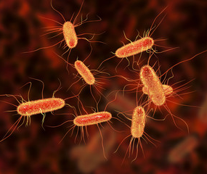
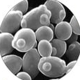
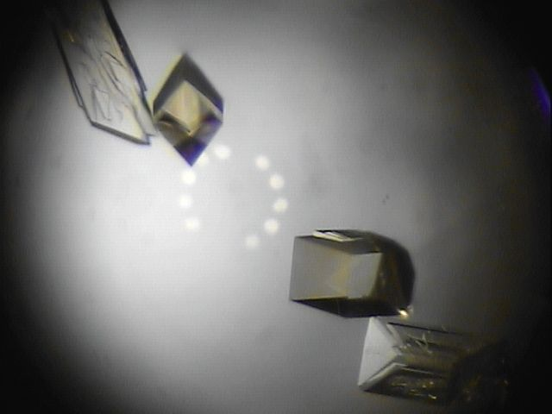
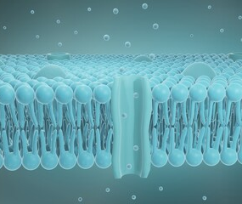
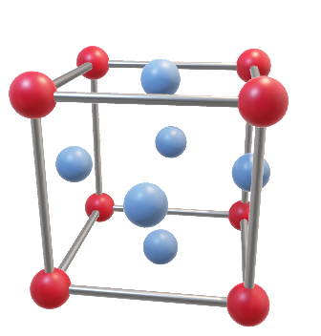
DEMAX update
CLS STAP
22-23 April 2024
Lund, Sweden

Slide 2
DEMAX overview
DEMAX is the team at ESS that offers deuteration and crystallization service & support within the CLS group
Goal: Enable high impact science on ESS instruments in life science, soft matter, chemistry
We operate on a peer review proposal system, but also collaboratively for method development and scientific research

Slide 3





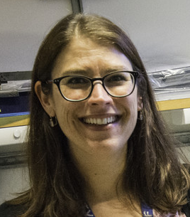
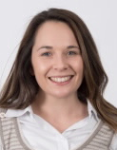
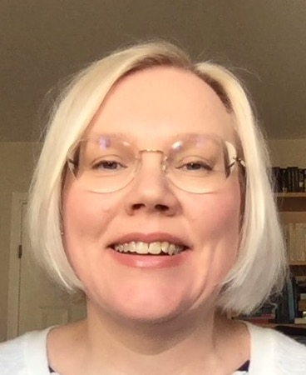
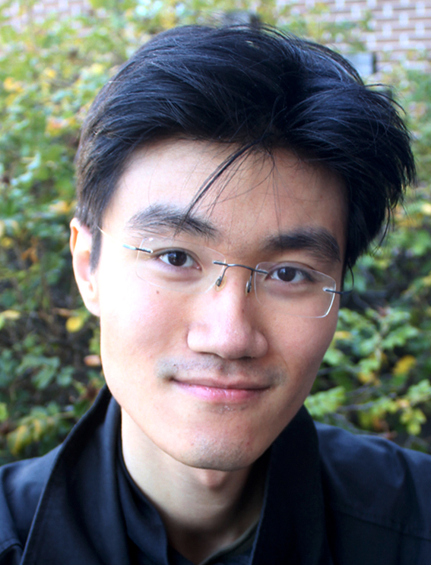

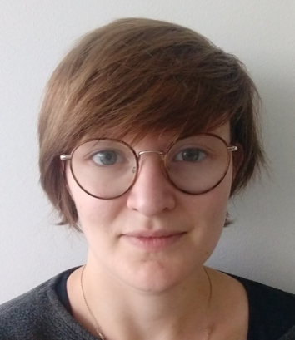

DEMAX Platform
Users can collaborate with us, get advice + access to expertise (us and within DeuNet)
Chemical Deuteration
Small organic molecules, monomers
Lipids (e.g. POPC, SOPC, POPE)
Surfactants (e.g. sugar-based)
Novel organic molecules for various applications
Biological Deuteration
Deuterated biomass from E. coli, B. braunii, P. pastoris
Recombinant soluble proteins, plasmid DNA, “other”
Yeast-derived lipids (total, phospholipid)
Protein Crystallization
High- and low-throughput screening
Fine screening in large volumes
Support for room temperature crystal mounting & data collection
X-ray testing (LU BAG at MAX lab)
Extended team
(incl. support
from LP3 @ LU & 0.2
FTE from ILL (lipids)
LU/LP3
Lipids
+
+
Zoë
Anna
Hanna
Jia-Fei
0.7 FTE
0.2 FTE
Sophie

Slide 4












Move lipid lab from LU to D08
Lab move
Finalized deliverables call 2’b’
2023Q3
2024Q1
2025
2023Q2
2023Q4
2024
Continue lab commissioning
HC & FS outreach to instrument teams
BioDeu recruitment
Rolling access extended
+

Slide 5
Chemistry lab move 2023
We moved out of MV and in to D08 on time and under budget
Unpacking & organizing went well but many basic utilities were not functional: electricity, nitrogen (Q1 2024), house vacuum (Q? 2024)
Total downtime was 4-5 months (Yeast lipid moved to Chemistry, Jia-Fei could do some work in E04 labs)

Slide 6
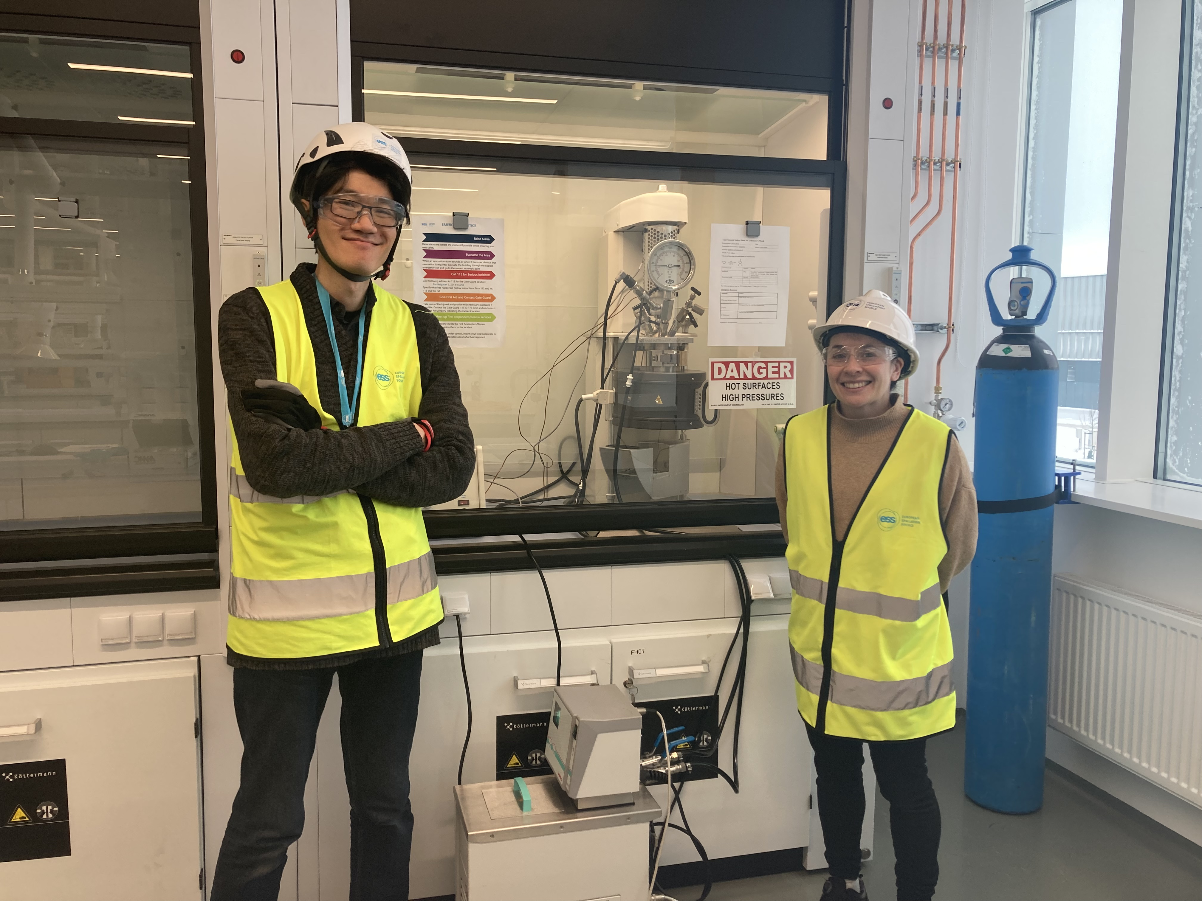
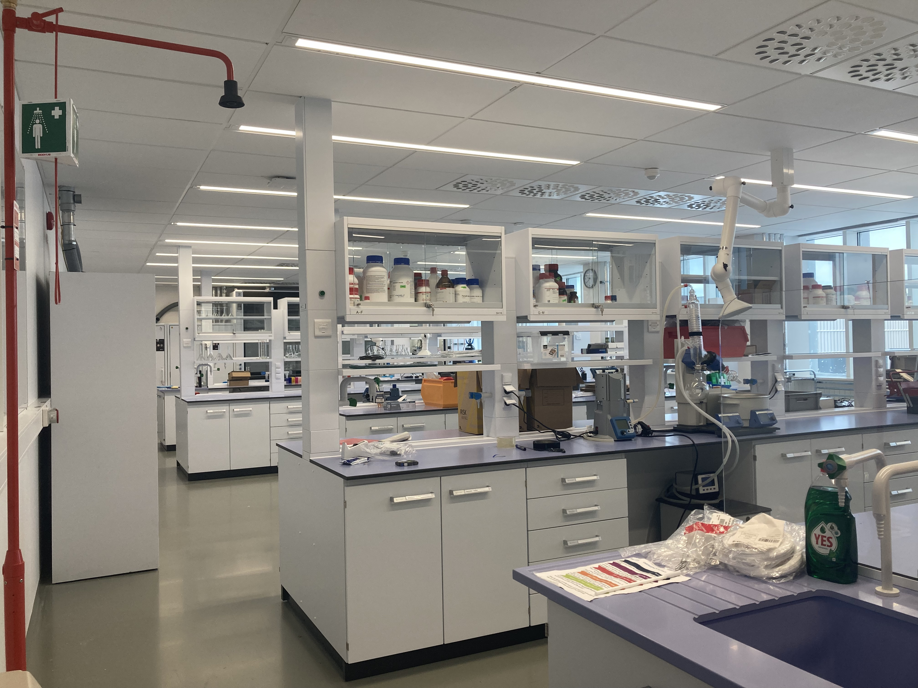
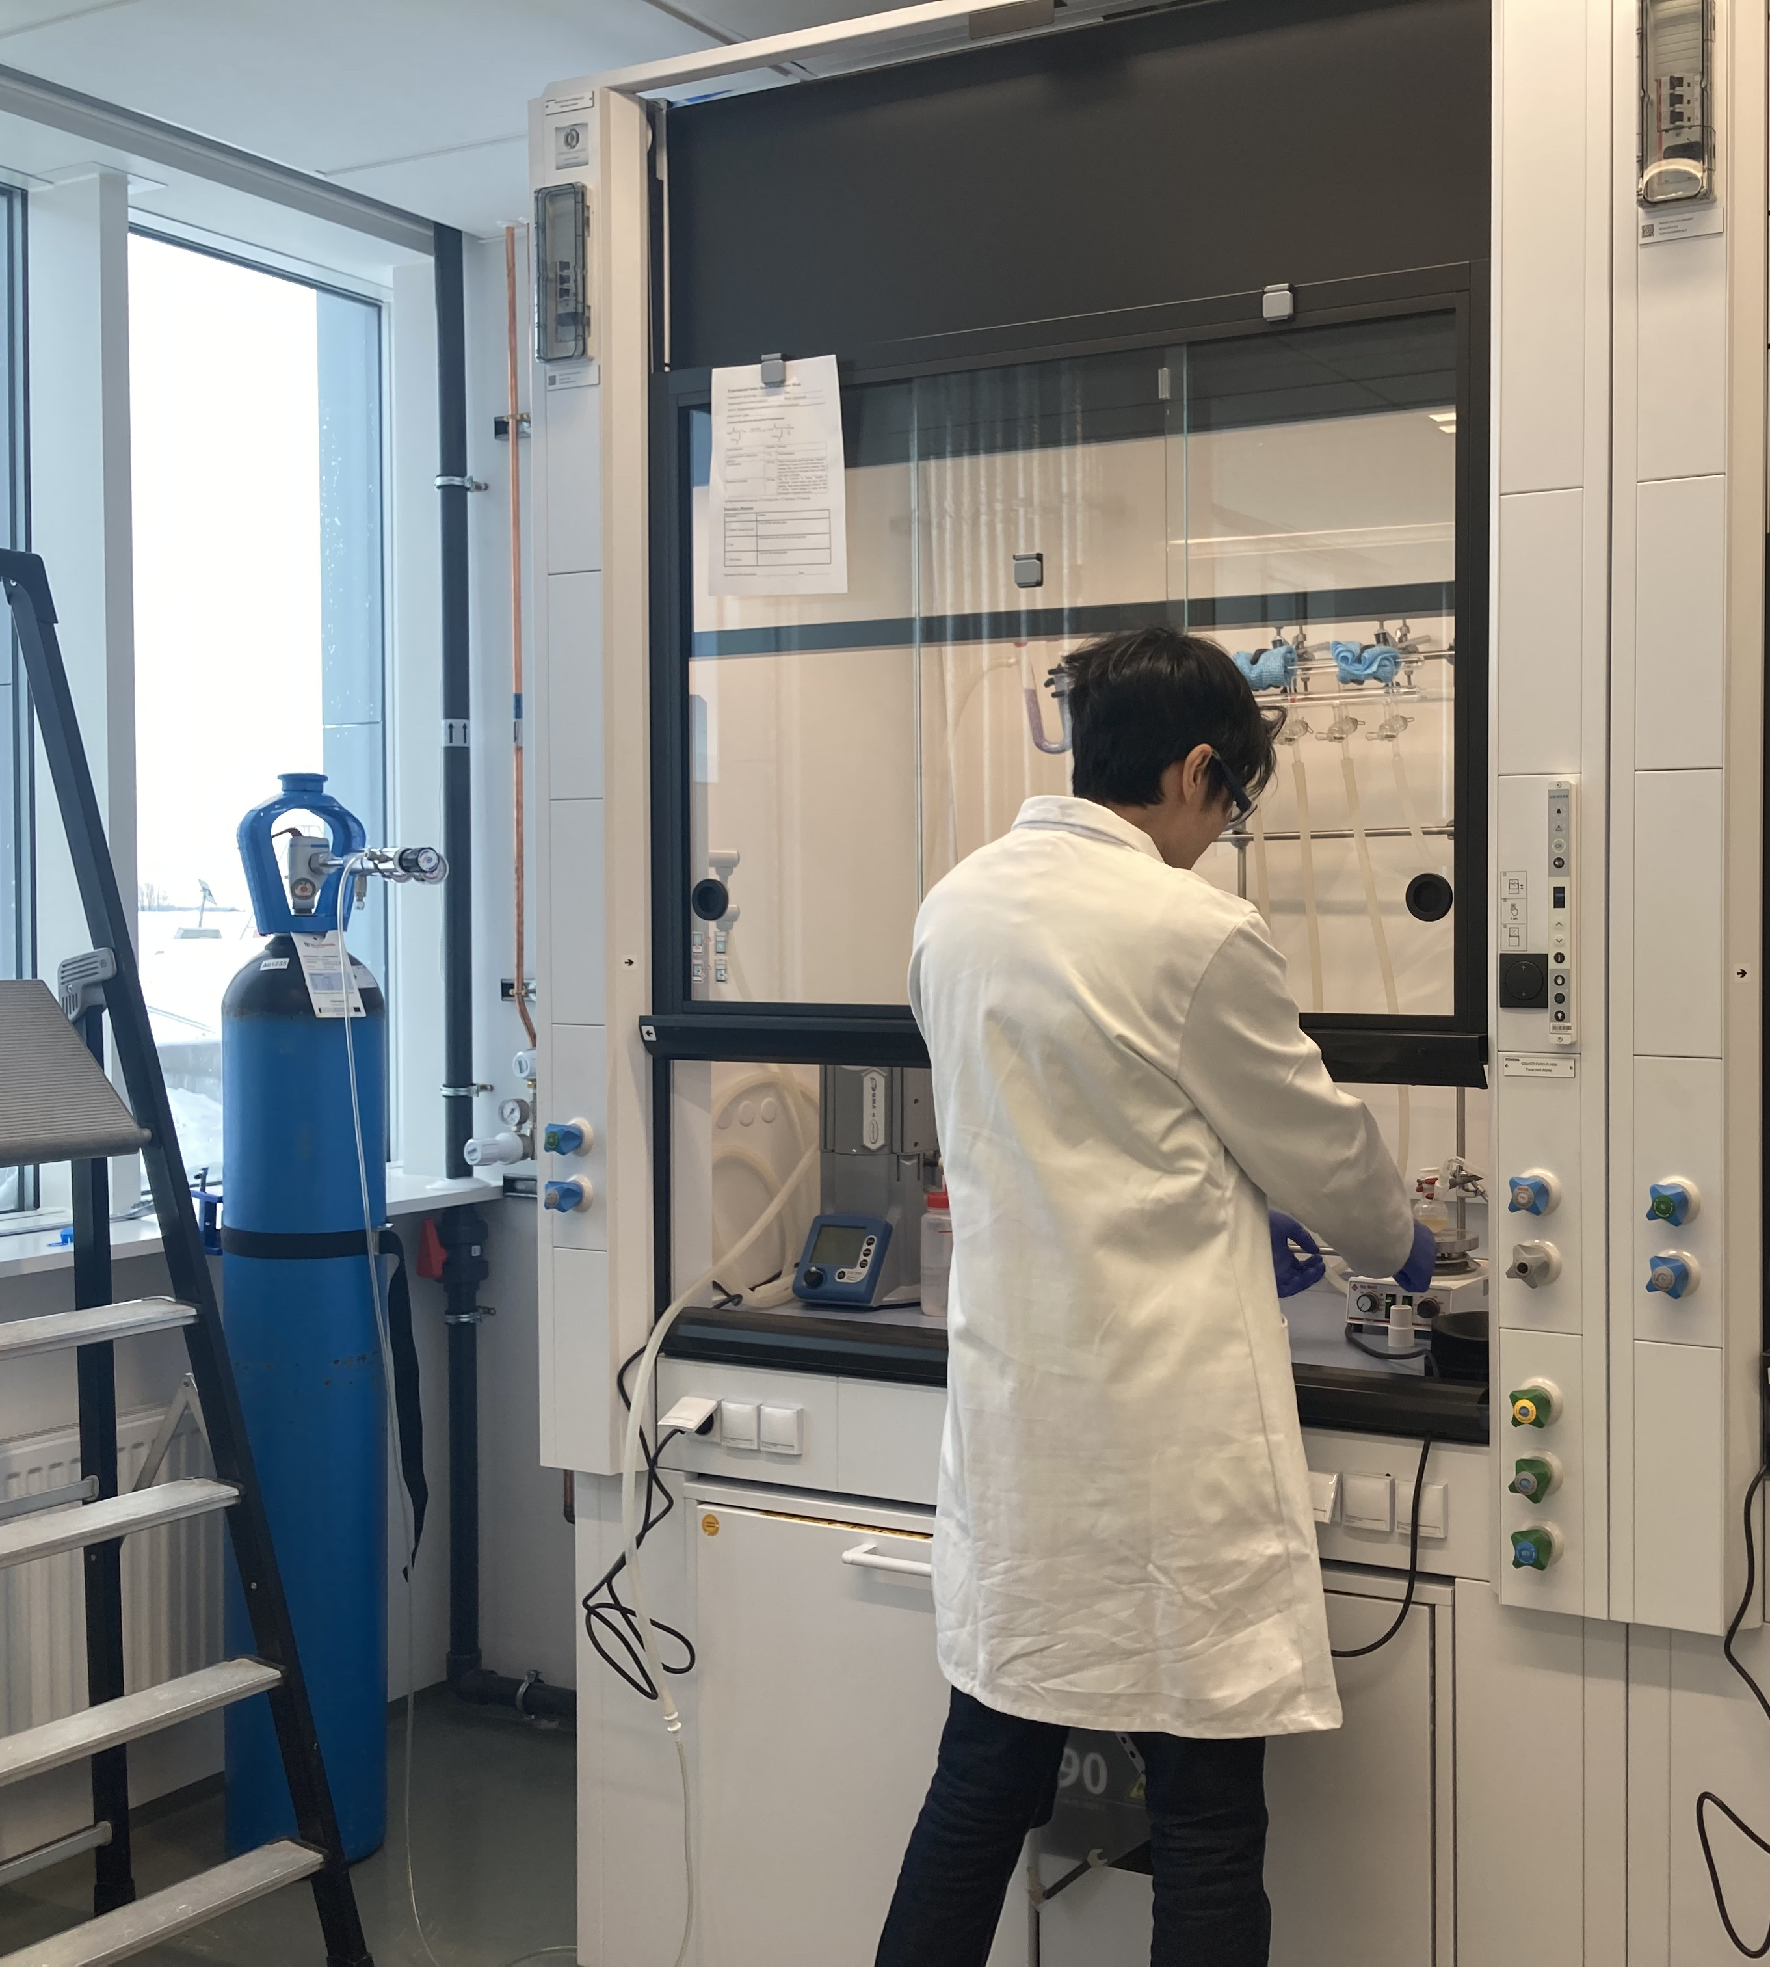
D08 labs “in action”!

Slide 7
Chemistry lab 2024-2025
Continue accepting and delivering on rolling access proposals
Some major procurements are in progress: Parr reactor repair, new Parr reactor “en route”, GC-MS tender
After summer, before the end of the year, the lipid separation and analysis equipment that is now at Chemistry Dept (LU) should move to site and establish the work flow here
Recruitment of a biodeu specialist will be in 2025 – they will establish cell culture here on site and cross-train in lipid (now) and protein production (future)

Slide 8
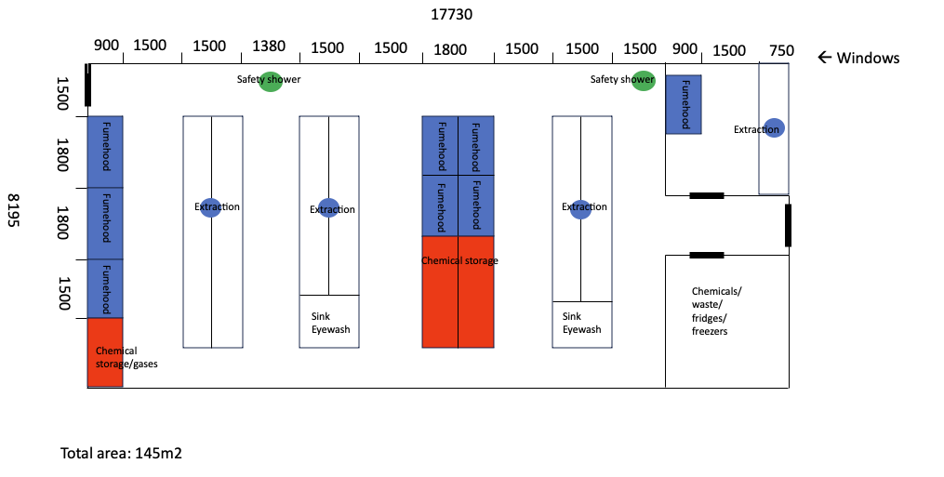
Chemistry lab 2027 and beyond
Current labs are really intended as USER labs (lots of benches but not sufficient ventilation for all DEMAX equipment and activities)
Our activities run all year and user program and users being around will be a disruption, location in supervised zone is a hindrance, not a bonus
We are part of a potential plan to build a new building on site and we have brainstormed some floorplans that would work for us.

Slide 9
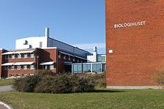
Biodeu & cryst lab activities
Biodeuteration & crystallization activities are co-located with the LP3 at Biology dept at LU (cross-faculty platform managed by Dr. Wolfgang Knecht)
2 Contracts: 1) Useage fee agreement (2021-2025, ~ 23 kEuro/yr, grants us access to centralized services, equipment, floor space for ESS equipment), 2) Swedish in-kind deuteration lab service (2023-2025, ~77 kEuro/yr for deuteration lab services, effectively we get 0.75 research engineer for general lab help, yeast cell culture, protein expression testing, X-ray data collection at BioMAX)
Both expire 2025 and we have to continue since no suitable space or infrastructure exists on site to support biodeuteration to the same extent

Slide 10
Crystallization moves to NMX
Consolidate DEMAX crystallization activities with NMX team
NMX is finishing build-out of sample prep lab and will soon start with furnishing
Helping with design, lay-out but will then move equipment from Biology at LU to E02 to establish complete crystallization pipeline here on site (from protein to crystal, both room temp & cryo)
1 x UV/Vis spec, 2 x microscopes, 2 x incubators, 2 x crystallization robots, and variety of small lab equipment + consumables
Conclude this by end of 2024

Slide 11
Expanding the team in 2025
Staff ramp-up plan includes 1 FTE “biodeu” to join in 2025
1 FTE ESS biodeu specialist for cell culture and protein & lipid purification, with emphasis on lipids
We need to establish basic biodeuteration, lipid extraction & analysis
Overlap with Krishna (ILL) to train and help set up the lab
Complementary support from from LP3

Slide 12
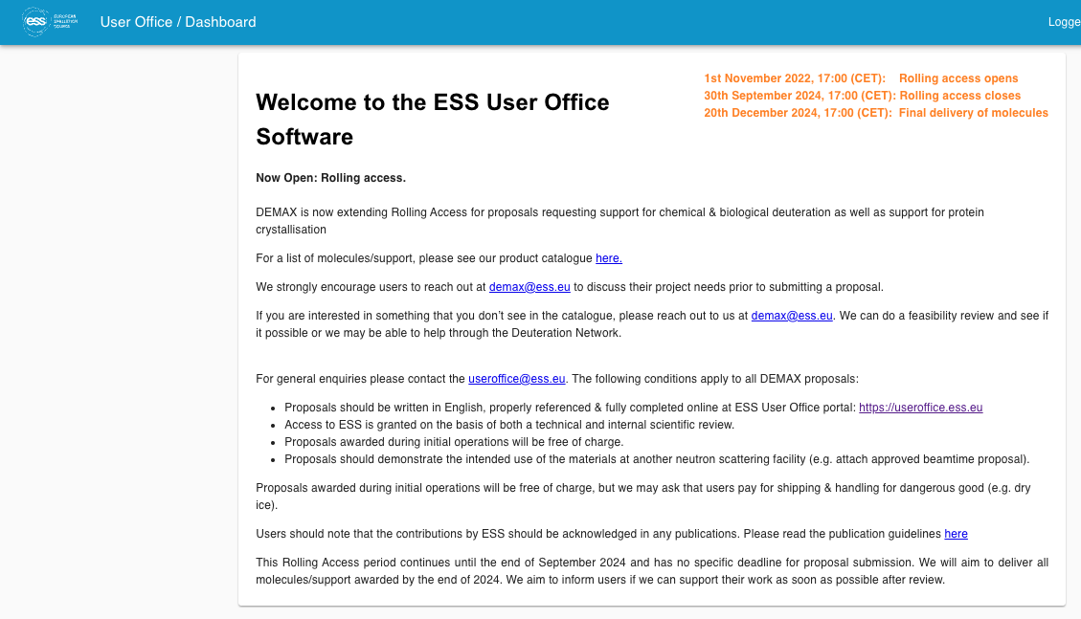
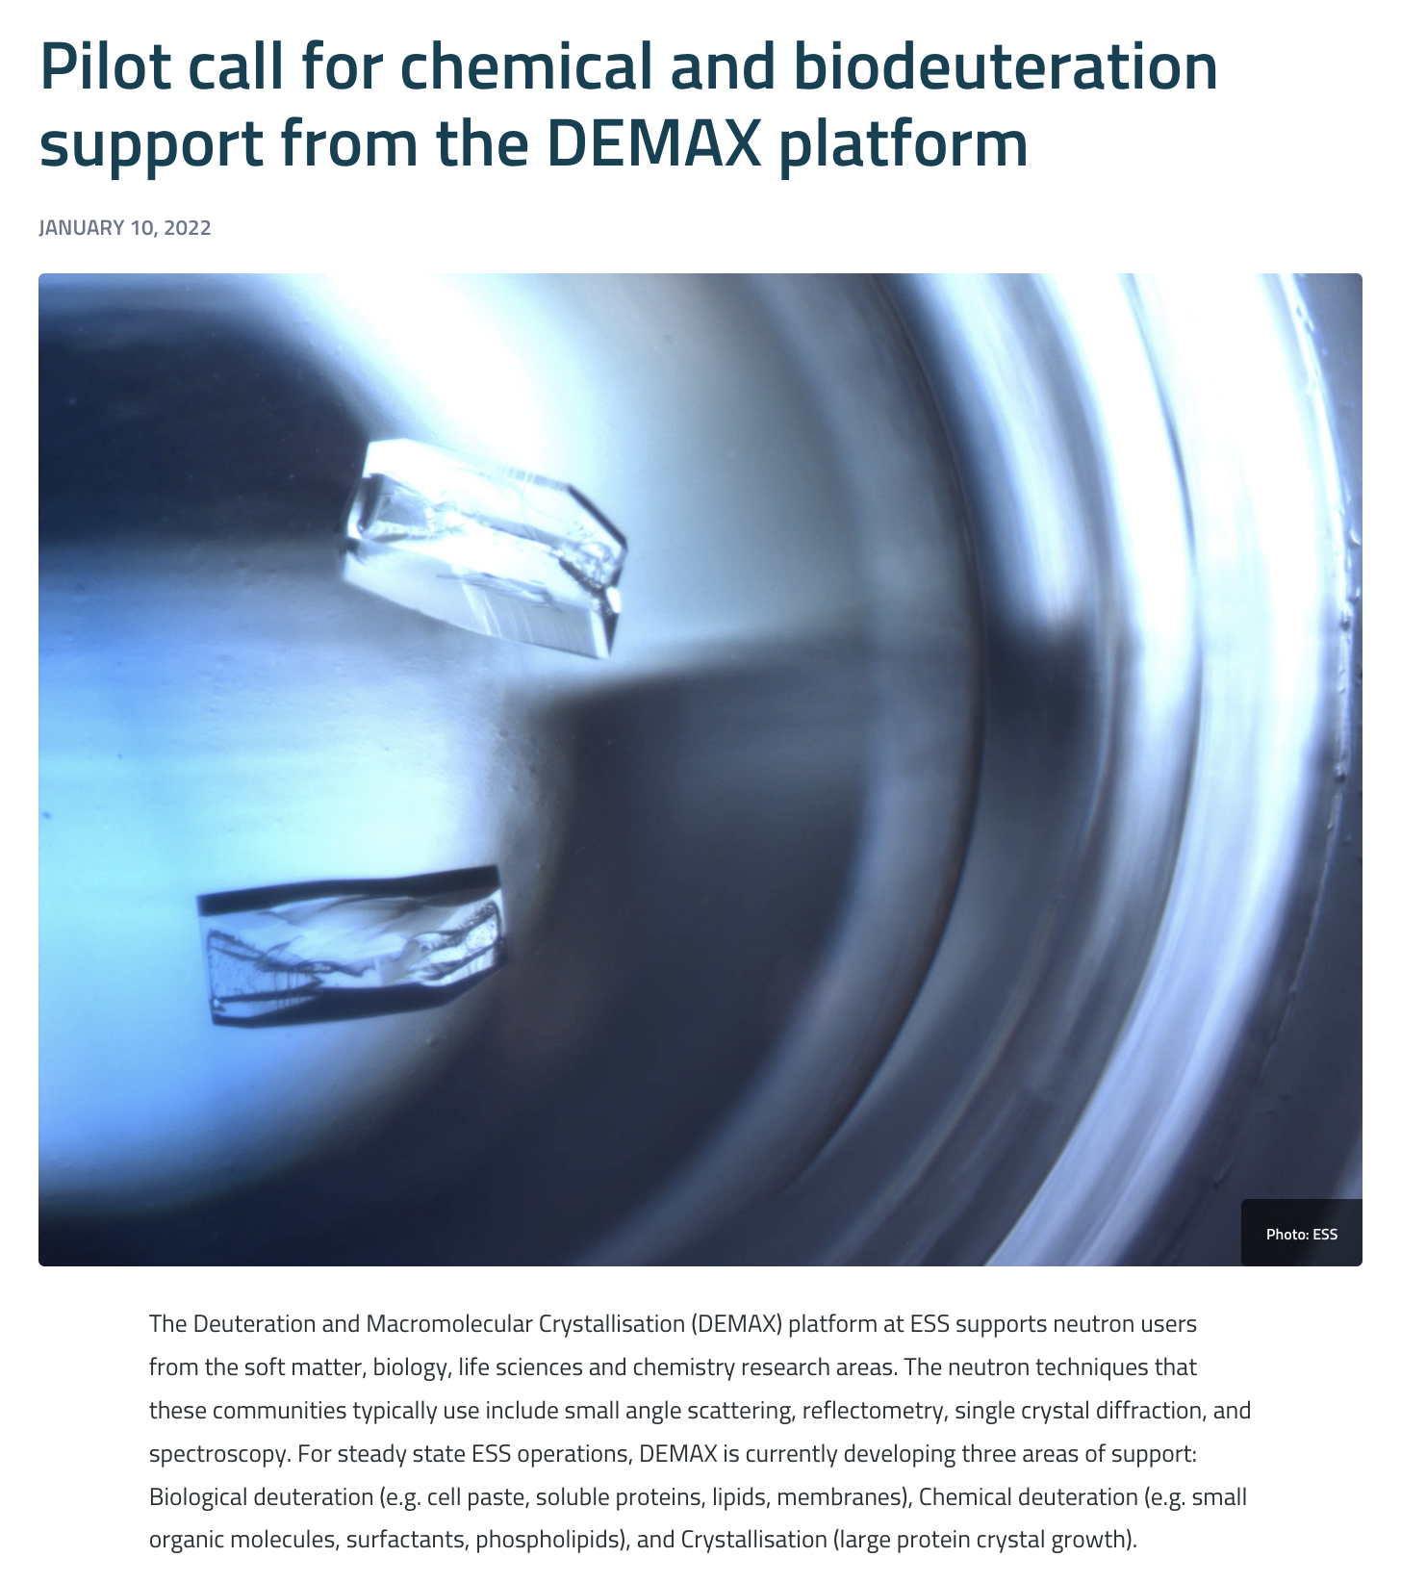
User proposals
Issued 3 pilot calls for user proposals (2019, 2020, 2022)
Rolling access is currently open until end of 2024
User should register and submit proposals online (URL above)
Users should talk to us before submitting a proposal
useroffice.ess.eu

Slide 13
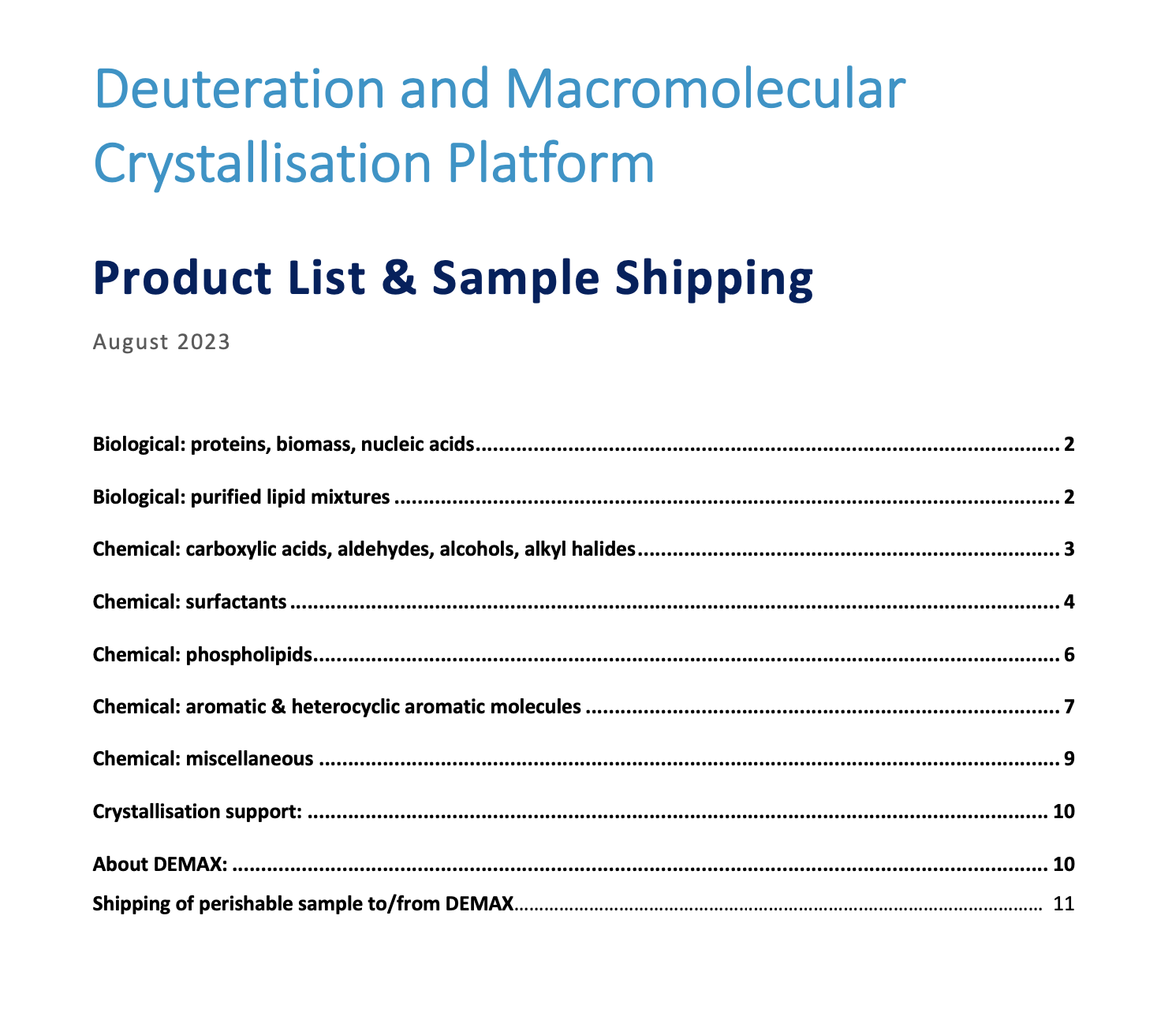

DEMAX product catalogue
demax@ess.eu
Product list updated in 2023, and is available on the DeuNet website
https://deuteration.org/demax/
Also includes instructions for the dry shipper we use for sending perishables

Slide 14











- Since starting (2019) we have now over 100 unique users
- DEMAX has published or has in preparation 39 papers in peer-reviewed journals
- In call 2b + Rolling Access we have received 27 proposals requesting 49 molecules/services (accepted 24 proposals, 41 molecules)

Slide 15
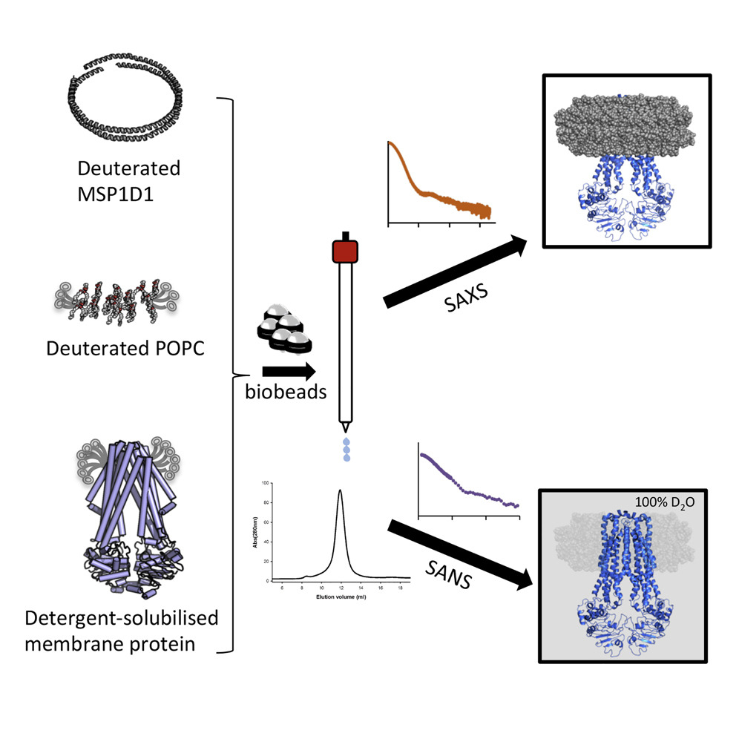
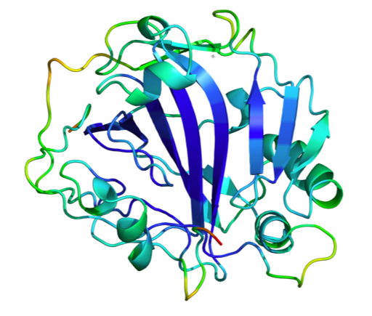
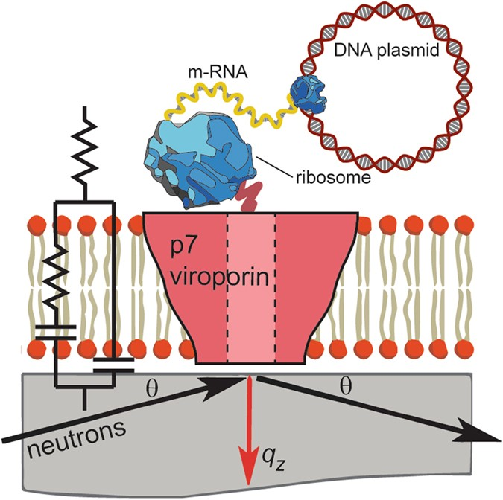
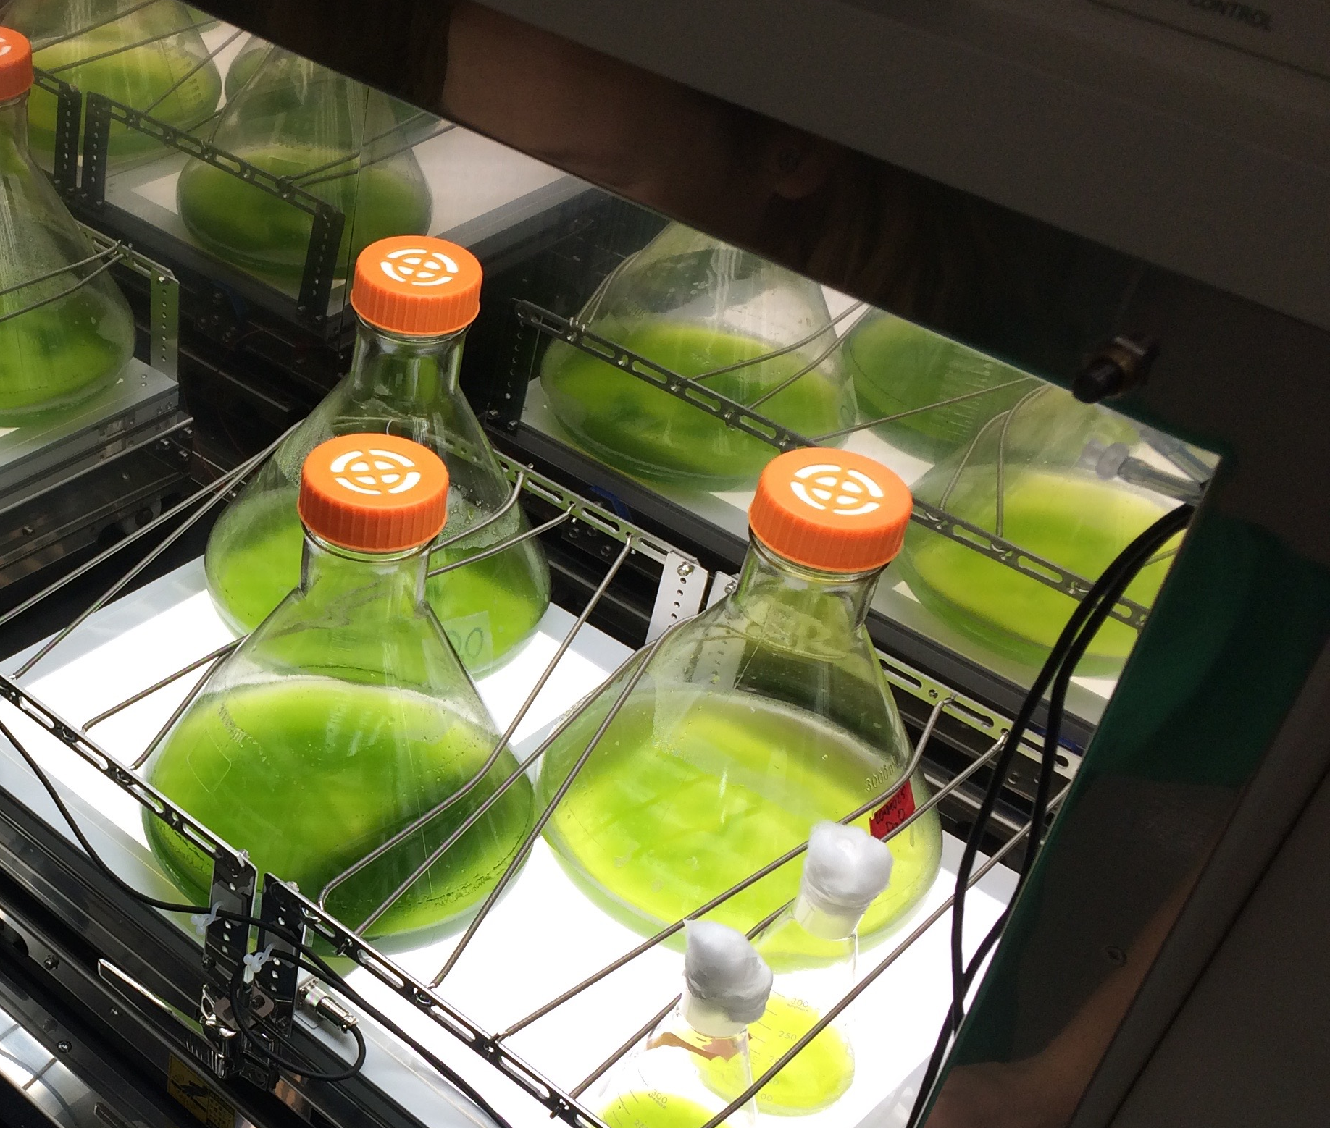
Goals 2026 and beyond!
Provide quality support and promote use of deuteration and neutrons in soft matter, life sciences, chemistry
Establish chemical and biological deuteration support on-site and integrate with neutron experiments
Balanced team of chemists and biologists with appropriate scientific and technical expertise to support the community

Slide 16
Questions:
Please advise on how cost recovery for deuterated materials can work and how to make the process and pricing fair and equitable. For e.g. we use far more D₂O for biodeuteration proposals than most chemical deuteration proposals, which mean these users will have a heavier financial burden than others. This may scare them off and we could inadvertently alienate this (important) user base.
Please comment on our plans for implementing the full workflow for yeast lipids to serve the user program (in view of the contract with ILL, recruitment of biodeu specialist in 2025 or earlier).
Please comment and advise on our efforts to engage with the instrument teams to ensure DEMAX is involved in planning for first science (specifically on the first instruments like NMX, DREAM, LOKI).

