Slide 2
As-built at ESS
Introduction
PRESENTED BY A. LEPINE

Slide 3
Summary
1 As-Built introduction
2 Benefits of As-Built
3 As-built process
4 Supporting tools and technologies
5 Current progress

Slide 4
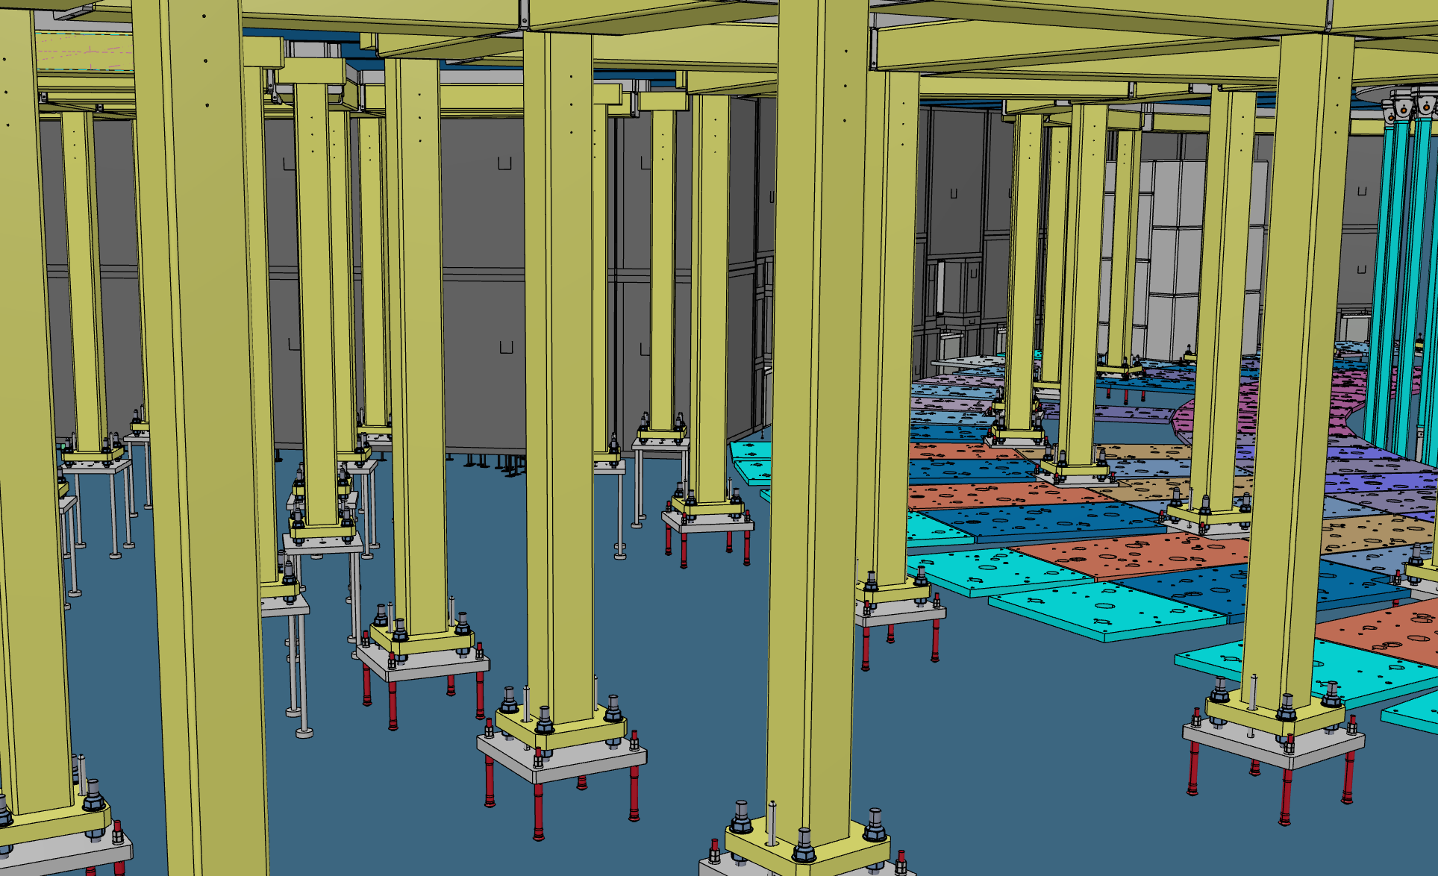
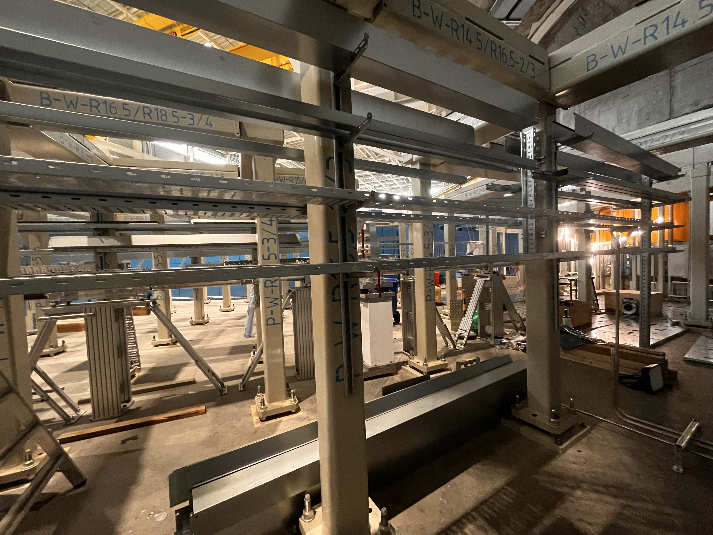
1. As-built introduction
Or why accuracy matters from blueprint to reality ?
“A set of drawings that are marked-up by the contractor building a facility or fabricating a piece of equipment that show how the item or facility was actually built versus the way it was originally designed. At the completion of a project, the as-built drawings describe what was actually built.” US DOE G 430.1-1
= or ≠
Expectation
Reality

Slide 5
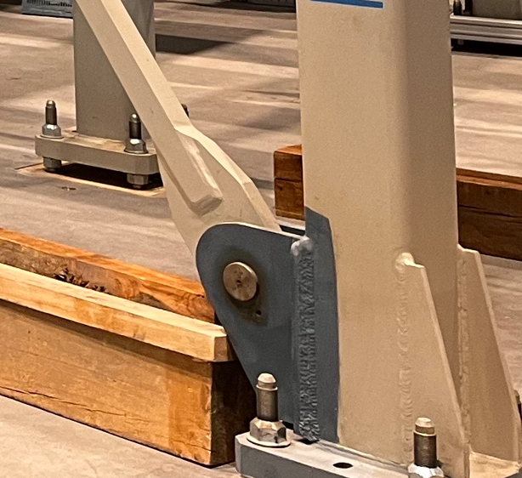
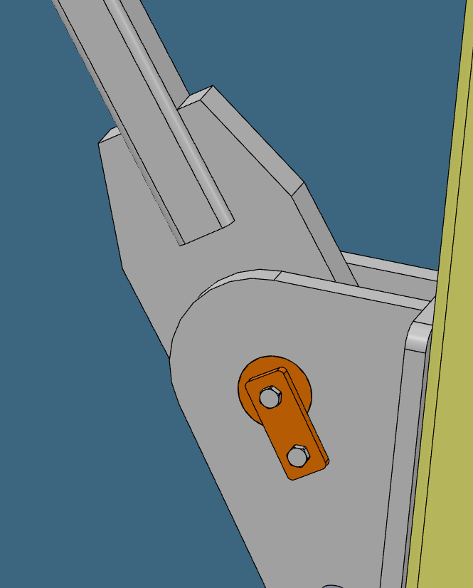
2. Benefits of as-built
What is the main impact of reliable data over the design
Accuracy Assurance: the project aligns with the initial design.
Compliance Verification: local codes and regulations.
Future Maintenance: reduce cost and time of future modifications, helping to take data driven decisions.
- Risk Mitigation: “One more check” is always good
= or ≠

Slide 6
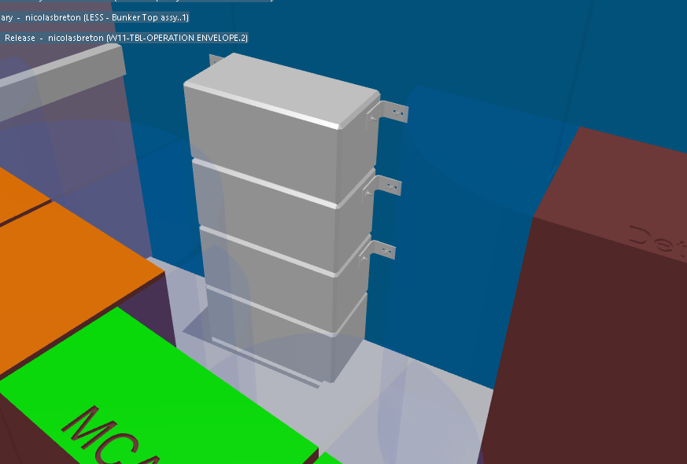
3. As-built process
Overview of the as-built workflow at ESS (1/2)
Main phases : - Preliminary data collection
- Inspection and deviations record
- Inspection and deviations implementation
- Final documentation compilation & consolidation
Main actors : - System lead
- Central team
- Installation stakeholders
- Design stakeholders
Concrete blocks added in the 3D model after sitewalks

Slide 7
3. As-built process
Overview of the as-built workflow at ESS (2/2)
Initial as built request
Preliminary meeting(s)
Model + documentation checks
Recording of deviation(s) and open issues
Sitewalk(s)
Preliminary data Collection
Inspection and deviations record
System “as-built”
CHESS LoM update
Deviation implemented
Deviation to be ignored by decision of the SL
Final documentation compilation & consolidation
Inspection and deviations implementation

Slide 8
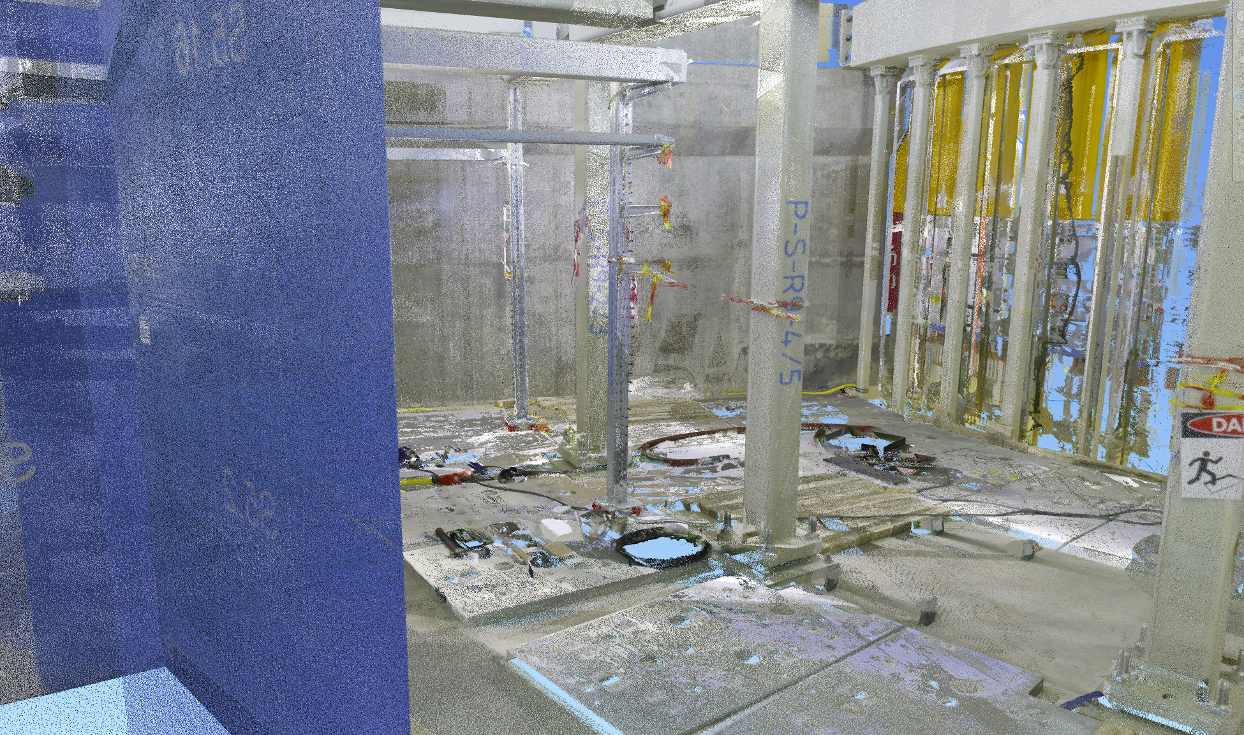
4. Supporting tools and technologies
Main software and ESS tools used for as-built
- CATIA 3D model
- CATIA 3D scans
- NavisWorks model for interface with other disciplines
- Supplier documentation
- Confluence shared page
- JIRA ticket system
Bunker scans in NavisWorks

Slide 9
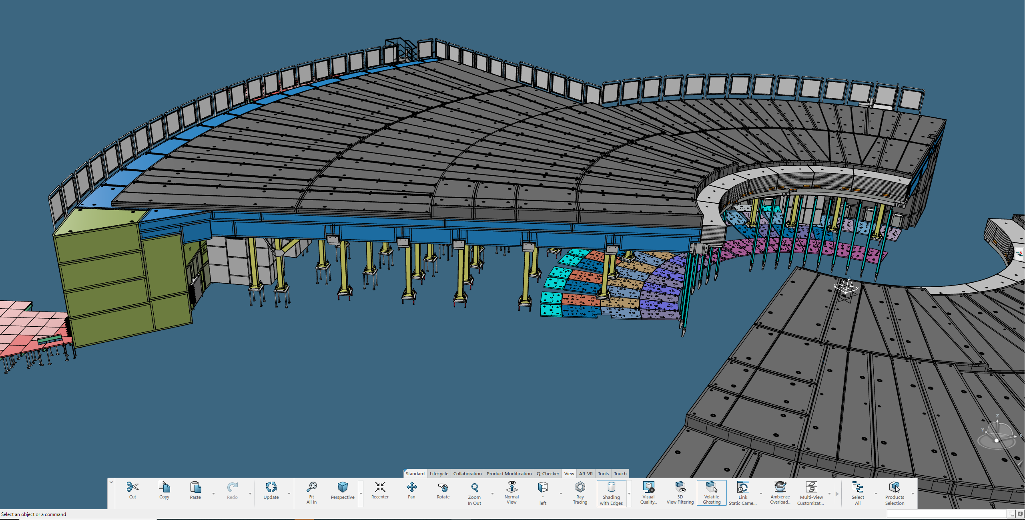
5. Current progress
Proof of concept overview
System used as a proof of concept : ESS.NSS.F01.F01 – Bunker top assembly
Done :
Preliminary meetings
Site walks
Model + doc checks
Recording of deviation and open issues
TBD :
Implementation of deviations
Chess LOM update
Handover
Overall bunker view in CATIA

Slide 10
Questions / Comments

