Slide 1
Magnets & more update
MSPS STAP April 2024
PRESENTED BY Alex Holmes

Slide 2
8T Magnet
LLB in-kind contribution to ESS
Most recent update from Cryogenic:
Design complete pending internal review.
Cryogenic had problems finding manufacture for coil former, causing slippage in design sign-off and start of manufacturing. This seems to be resolved but caused slippage.
Delivery delays likely of several months.

Slide 3
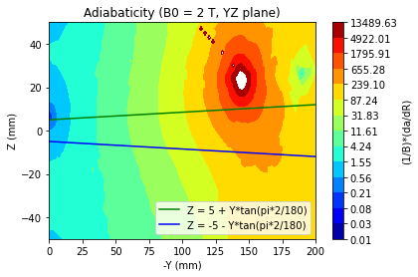
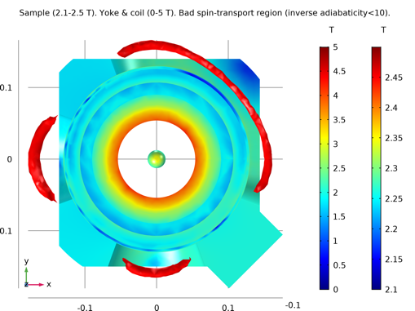
Warm bore magnet
2.1 T Assymmetric warm bore for ESTIA, LOKI, SKADI (and others)
HTS110 awarded contract to produce warm bore magnet
Design complete, manufacturing under way
Delivery due end July ’24
L1 adapter designed
Next steps:
FAT, delivery, SAT
Manufacture of adapter.

Slide 4
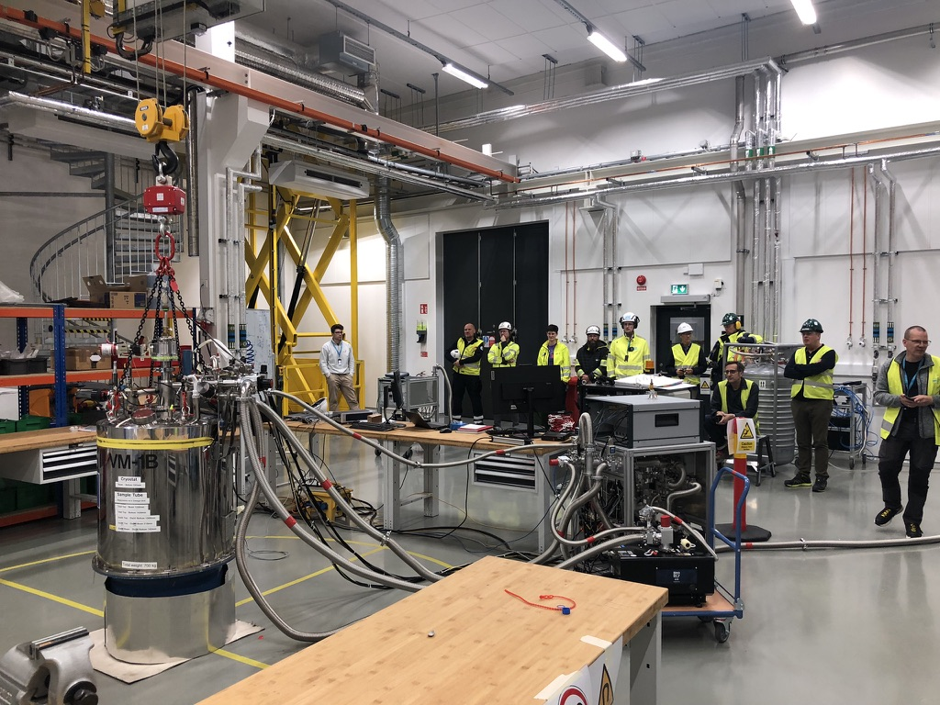
15T Magnets (ex HZB VM1B+VM1)
To be used on BIFROST
VM1B
Tested to full 15T field, including ‘training’ quench
Helium (mostly) recovered using ESS He recovery system installed in E03
Tested both with original electronics and updated Mercury controllers.
Basic Octopy/NICOS integration
Tested with DS-2 dilution (by OZ)
Next steps:
Mechanical integration ( L1 adapter)
Full magnet control logic in Octopy (switch heater control etc.)
VM1
Refurbushed and leak tested at RT
To be cooled and fully tested with new rack and Octopy logic.
Notes:
Also mention 6.5T magnet – refurbished, planned to be used on CSPEC but would not fit without major modifications.

Slide 5
VM2 (6.5T Magnet)
To be used on ESTIA
Tested to full 6.5T field,
Tested both with original electronics and updated Mercury controllers.
Fully controlled using NICOS via SECOP interface to Isaac (HZB software) – Ready for use on an instrument
New Mercury power supply delivered, rack under construction (IPS + lakeshore)
Next steps:
Full magnet control logic in Octopy
Mechanical integration

Slide 6
Spectroscopy magnet
High field low background magnet for CSPEC, TREX
Design study under way by Oxford Instruments - report due in May
Settled on novel design with radial supports.
Full electromechanical calculations being done on two configurations, 14T ±7°,±10° vertical opening.
Check of stray field, quench eddy current effects on instruments using inputs from instrument models.
Next step:
Preparation of full tender based on design study.
Proposed magnet design (bottom view), with two beam position for full detector coverage.

Slide 7
Existing & upcoming ESS magnets
VF = vertical field, HF = horizontal field
Name | Description | Max field (T) | Geometry | Principle instruments | Possible instruments | Status
VM1B | VF, symmetric | 15 | ± 2° vet. 335° horiz. | BIFROST |  | Fully tested, integration ongoing
VM1 | VF, symmetric | 15 | ± 2° vert. 335° horiz. | BIFROST |  | Leak tested at RT
VM2 | VF, asymmetric | 6.5 | ± 5° vert. 335° horiz. | ESTIA | MAGIC, BIFROST | Fully tested, integration ongoing
Warm bore | asymmetric | 2.1T | ±20° all dir. | ESTIA, SKADI, LOKI |  | In production
8T diffraction | VF, asymmetric | 8T | +14°/-26° vert. 130° hor., ±10° backscattering | MAGIC, DREAM, HEIMDAL |  | In production
Spectroscopy | VF, symmetric | ~14T | tbd | TREX, CSPEC |  | Design study under way

Slide 8
Magnet meeting held 29 Jan - Prioritised next magnet list
Description | Symm/Assym | Instruments | Priority
>10T horizontal split pair SANS | Symm | SKADI | 1
Electromagnet, 1-2T (with pole pieces) |  | LOKI, SKADI, ESTIA, | 2
10T wide opening ±10° diffraction | ? | MAGIC, DREAM, HEIMDAL, | 3
10T wide opening low stray field±10° spectr. | ? | TREX, CSPEC | 4
7T medium field full polarisation SANS/Refl VF split pair | Asymm, self shielded | SKADI, ESTIA | 5
5T small diameter | Asymm (self shielded?) | MIRACLES, CSPEC, TREX | 6
Horizontal spectroscopy |  | BIFROST, TREX, CSPEC | 7
2.X T Warm bore #2 | asymm | LOKI, SKADI, ESTIA | 8
5T warm bore | ? | SKADI, ESTIA | 9
Horizontal Diff |  | MAGIC, DREAM, HEIMDAL, BIFROST? | 10
BOBINE proposal – 10M€ EC INFRATECH joint proposal led by ILL for new generation 20T HTSC DC magnet and pulsed 40T magnet

Slide 9
Dry cryofurnace for Diffraction & Electrochemistry
100mm top loading vanadium tailed cryofurnace for DREAM, HEIMDAL
Contract awarded to AS Scientific
Kick-off held Dec ‘23
Design under way
Delivery planned Dec ’24
Next steps:
Preliminary design review

Slide 10
Helium management
Helium recovery commissioned and used for cooldown of cryostats, magnets.
HZB helium management software system installed and tested. ICS hosting database and management software.
HZB hardware received, tested.
Next steps:
Installation of Dewar parking station and workshop connections.
Dewar probes to be calibrated.
Instrument specific He transfer lines to be specified and bought.

Slide 11
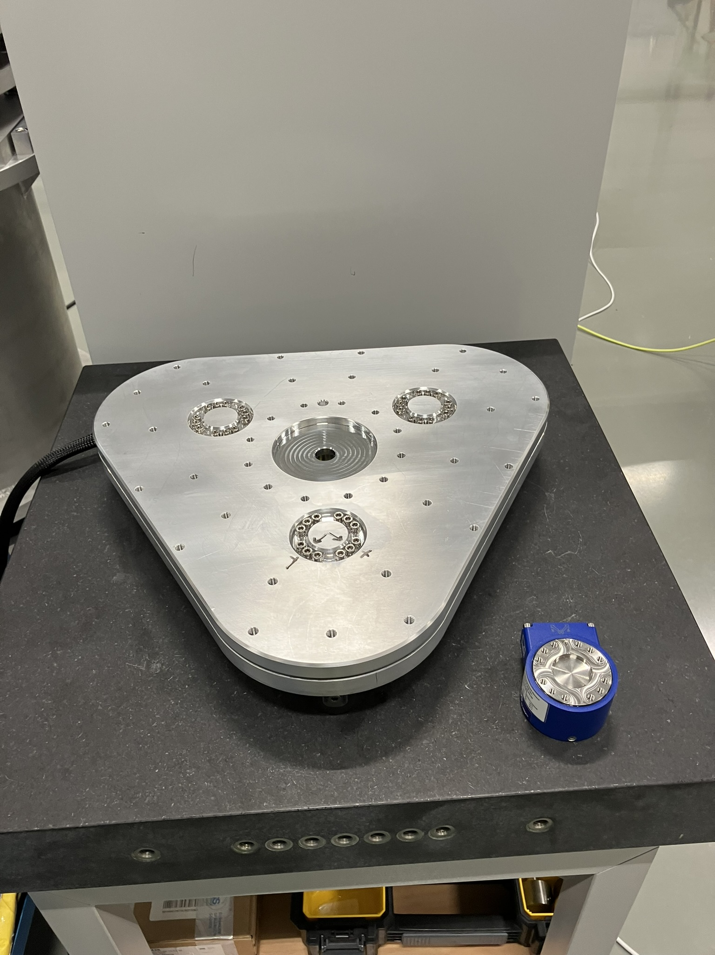
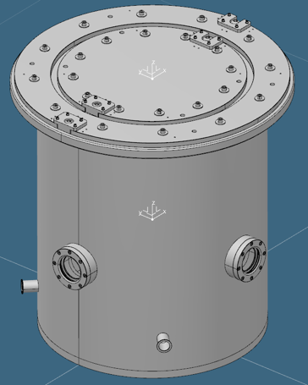
Other cryo/magnet related projects
In progress
Sample stick rotation stages for 50/70mm cryostats/magnets Parts delivered, assembly done.
Magnetic force testing rig Parts delivered. Some non-conformities, but good enough to use (manufacturer re-machining to fit flatness specs but we can keep and adjust previous parts). See demo E03
Vacuum interface testing vessel: Manufacturing procurement under way.
Pumping carts – 5 more in production, new vacuum gauges selected (leak found with MKS910 guages), level meter integration under way.

Slide 12
Conclusions
A lot of ideas turning into reality
Magnet provision should be reasonable for day 1
Some manufacturing delays, particularly 8T magnet
Basic functionality demonstrated and tested for many systems
Complete open projects, keep focus on necessary functionality for first science.
Fill gaps in provision with priorities set through consulation with instruments & other stakeholders.

Slide 13
Acknowledgements
Many thanks to
Richard Ammer, Caroline Curfs, Niklas Ekström, Andreas Hagelberg, Yulia Pederson, Luca Sagliano, Lauritz Saxtrup, Oleksiy Zadorozhko

