Slide 1


Slide 2
Low temperature udates:
Cryostats, Cryofurnaces,
Dilution refrigerators
PRESENTED BY Oleksiy Zadorozhko

Slide 3
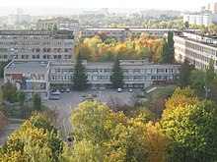
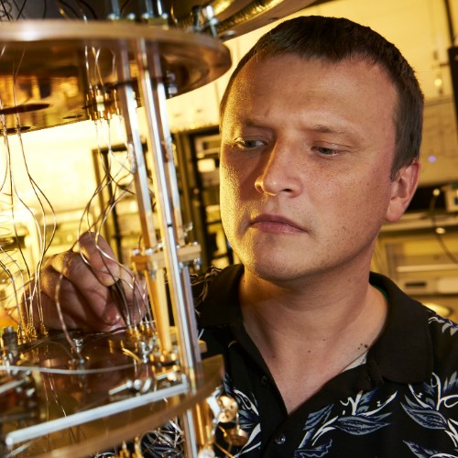
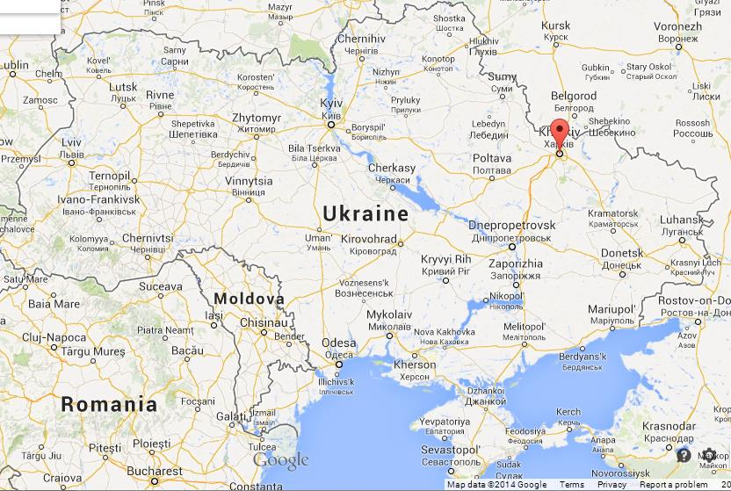
B. Verkin ILTPE of NASU - B.Verkin Institute for Low Temperature Physics and Engineering
of the National Academy of Sciences of Ukraine

Slide 4
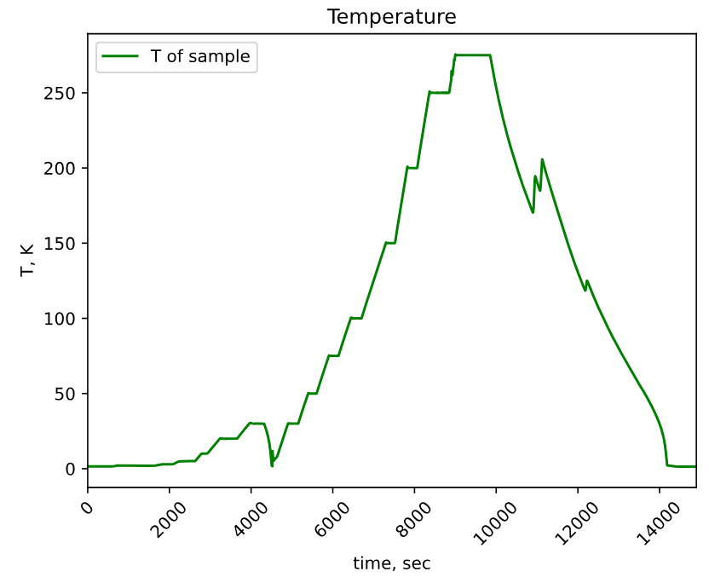
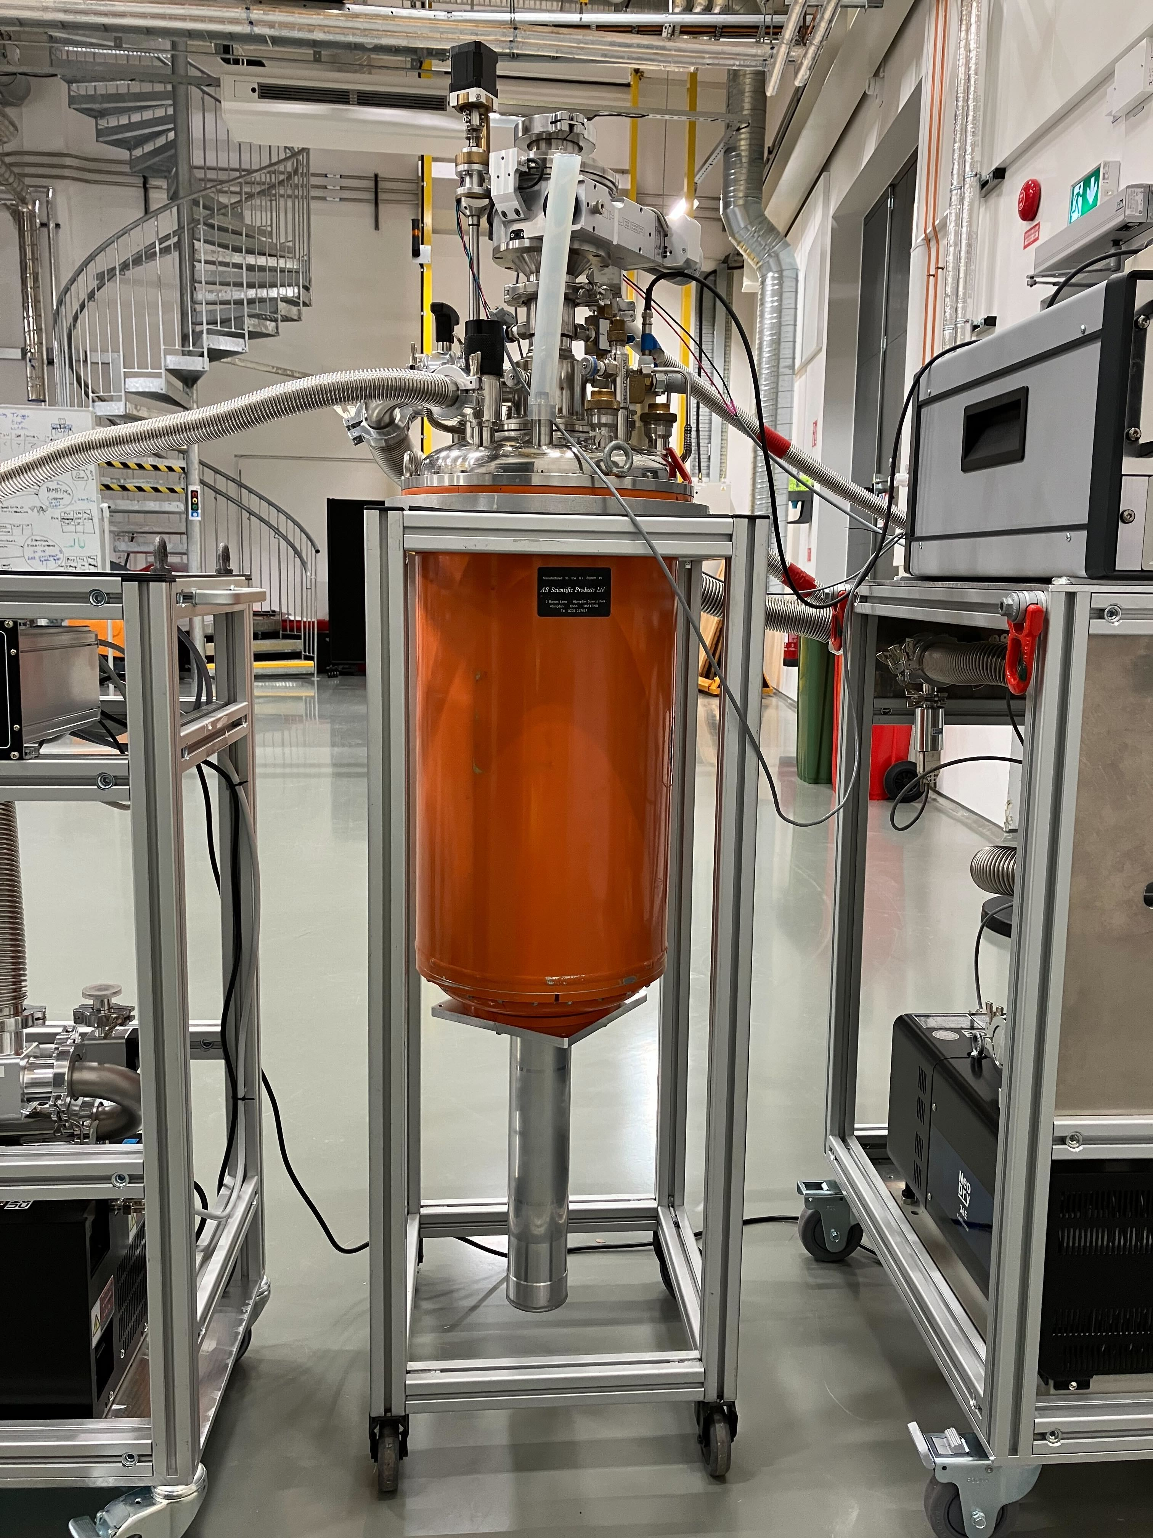
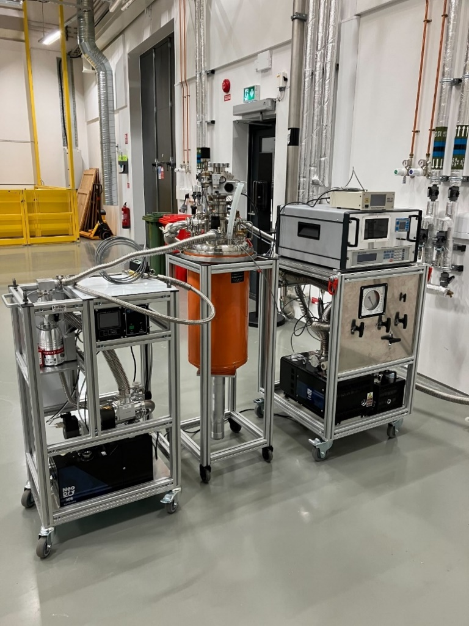
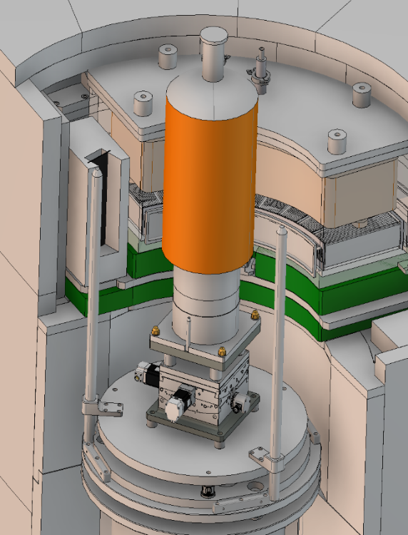
“Orange” cryostats
Progress
Performed the cooling down of Orange cryostats. The base temperature of the sample is 1.28 K.
Warmed up and cooled down the SAMPLE with three different value of exchange gas in temperature range 1.3 - 275K.
Found the parameter of PID controller of 336 Lakeshore.

Slide 5
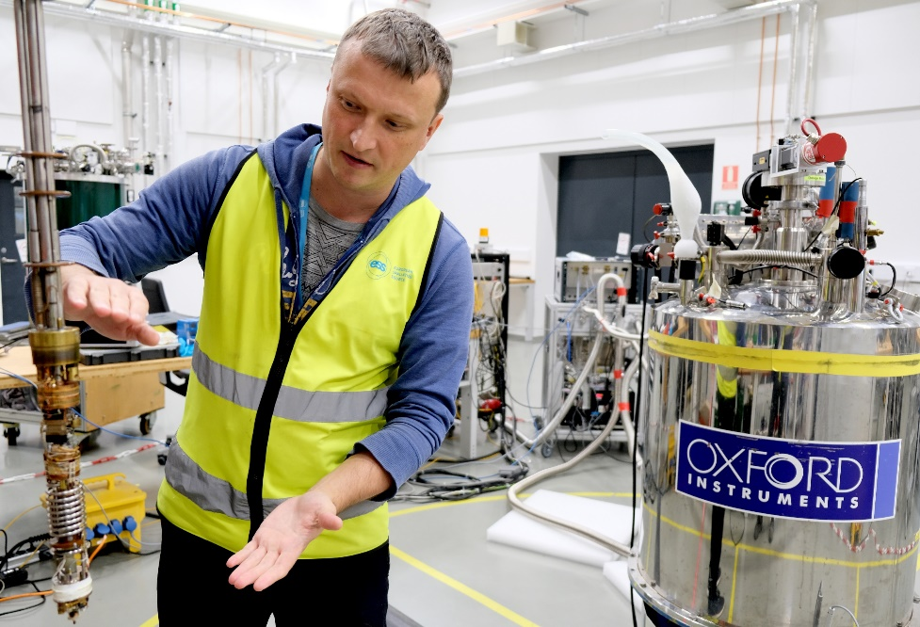
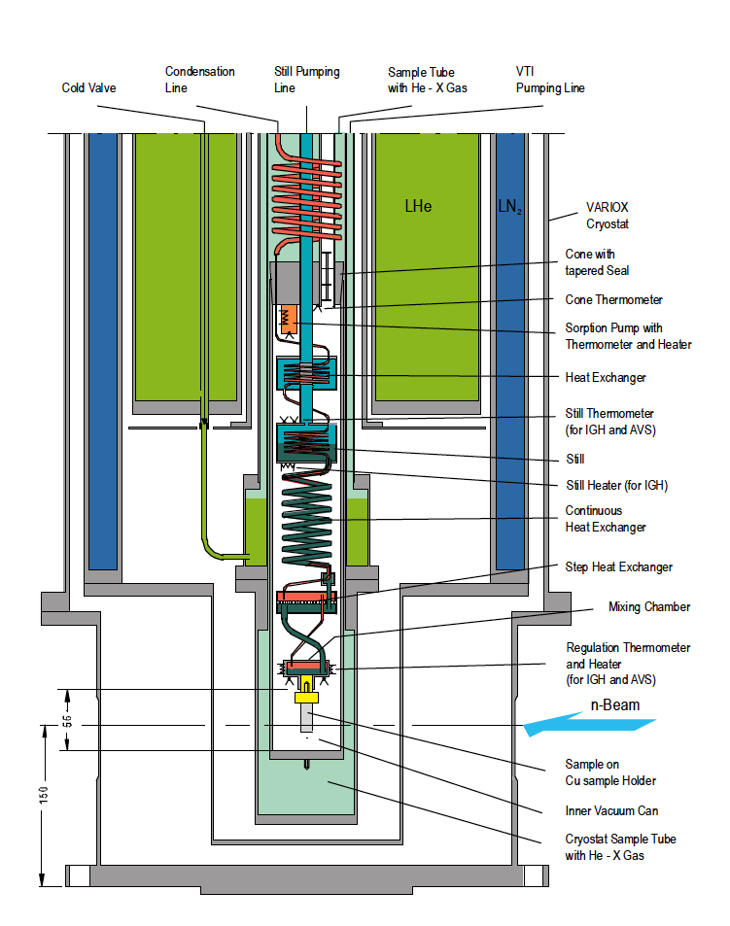
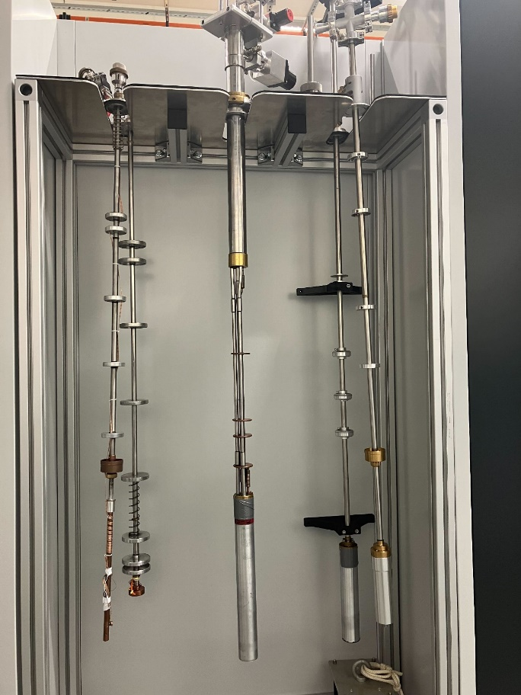
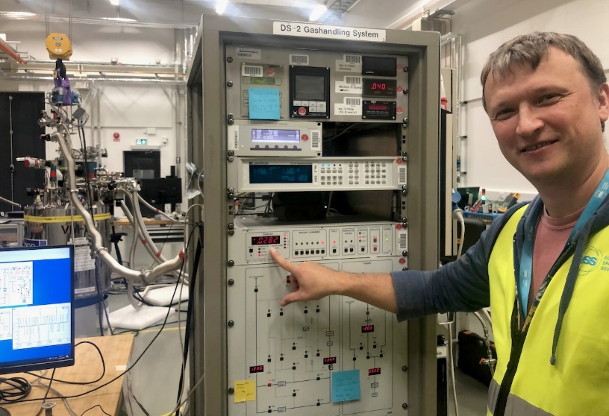
Dilution fridge
3He/4He dilution fridge drawing, courtesy of German research centre Helmholtz-Zentrum Berlin (HZB).
Progress
Dilution stick was successfully cooled down in the 15T magnet. The base temperature was 27 mK.

Slide 6
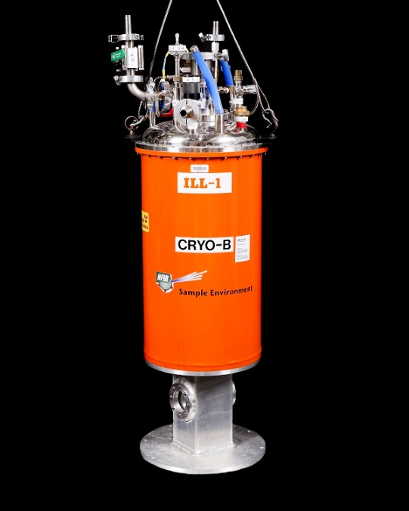
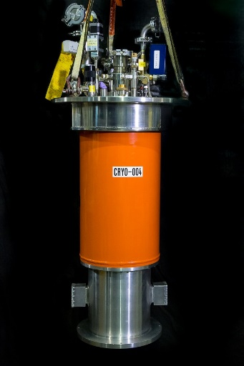
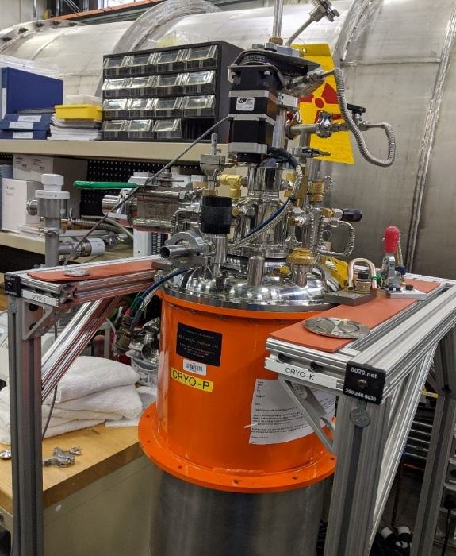
Planning
Example of cryostats
Tender for 8 cryostats and 2 cryofurnaces (under preparation)
 | Instrument | Type measurement | 2024 | 2025
Wet cryostat | BIFROST | Extreme Environment Spectrometer
Wet cryostat | LOKI | Broadband SANS
DRY cryostat | SKADI | SANS
Wet cryostat | HEIMDAL | Hybrid Diffractometer
Wet cryofurnace | HEIMDAL | Hybrid Diffractometer
Dry cryofurnace | MIRACLE | Backscattering Spectrometer
DRY cryostat | T-REX | Spectrometer
Wet cryostat | T-REX | Spectrometer
Wet cryostat | MAGIC | Magnetism Single-Crystal Diffractometer
DRY cryostat | POOL | Spectrometer

Slide 7
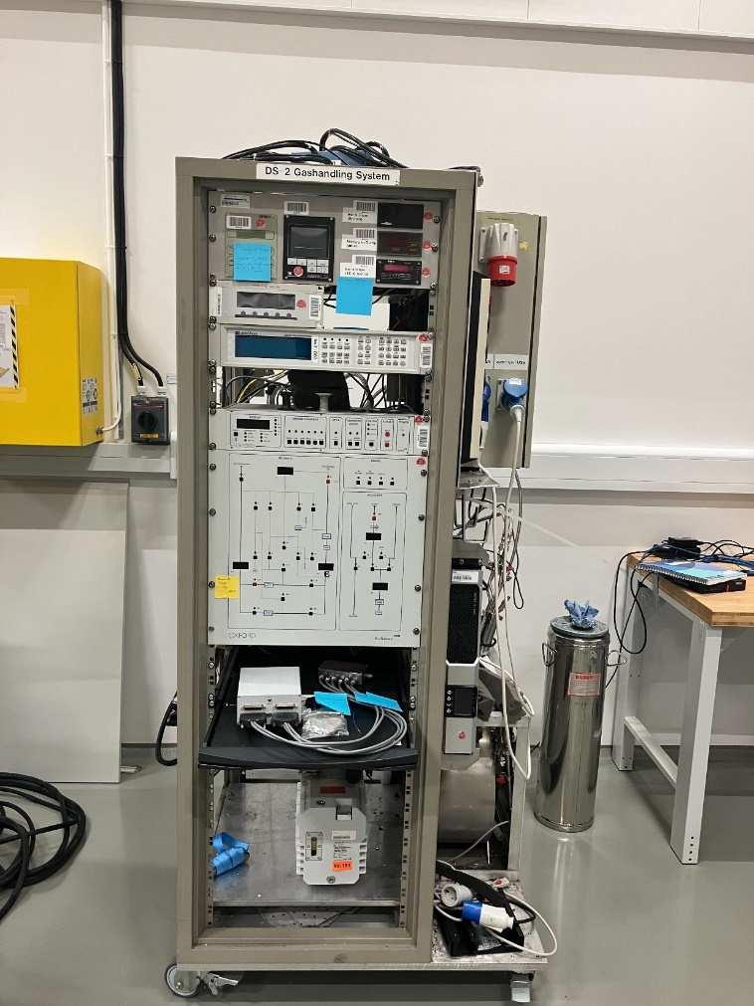
Planning
Issue:
Dilution stick to 8T magnet
(LLB in-kind contribution to ESS)
Example of dilution stick with GHS
Tender for 2 dilution refrigerators (under preparation)
 | Instrument | Type measurement | 2024 | 2025
Wet cryostat | BIFROST | Extreme Environment Spectrometer
Wet cryostat | HEIMDAL | Hybrid Diffractometer
Wet cryostat | MIRACLE | Spectrometer
Wet cryostat | MAGIC | Magnetism Single-Crystal Diffractometer

Slide 8
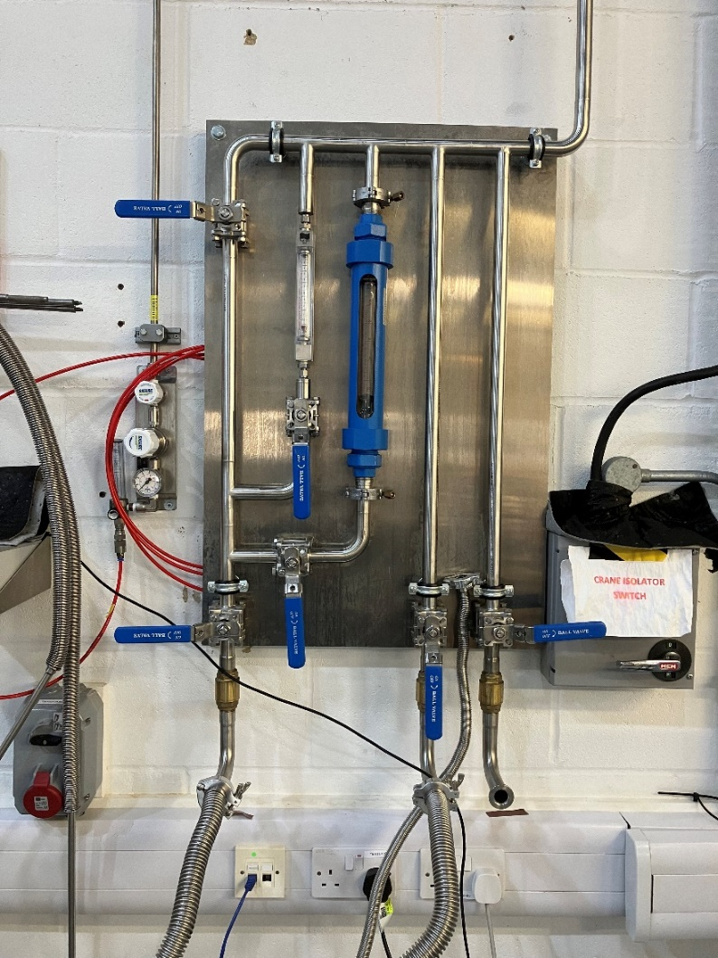
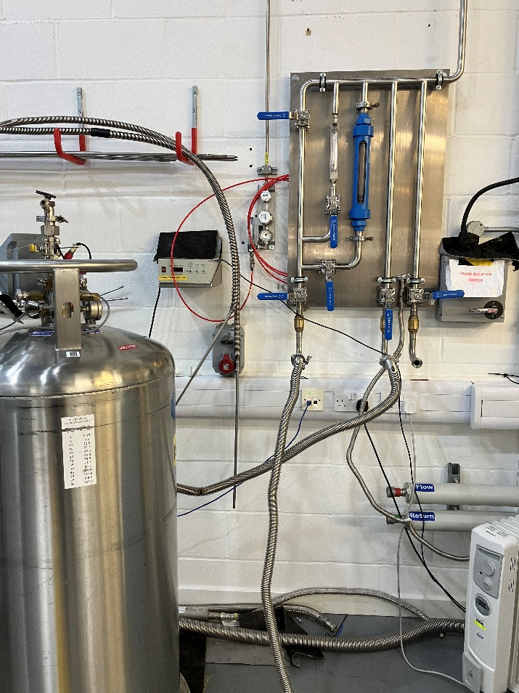
Planning
Recovery line. Filling lines for liquid helium
Design of pipe system for recovery line at ISIS
The design of pipe system will be implemented for each instrument.
Advantage: Integration of multiple sources of helium gas with recovery line

Slide 9
Thank you for your attention!

Slide 10
Status summary
Project | Status | Next step
8 cryostats and 2 cryofurnaces | Tender and purchase specification are ready. The final version was sent to Procurement section. | The tender should be announced as soon as possible.
Dilution refrigerator (in-kind LLB) | Tender for one stick was announced on January 2024. The offer cancellation is under preparation. | ESS reassess its approach to procurement. ESS is going to issue the tender itself.
Dilution refrigerator | Tender and purchase specification are under preparation. | The tender will be announced.
Dilution refrigerator from HZB | It was successfully cooled down in the 15T magnet. The base temperature was 27 mK. | Provide integration to Octupy.
Filling lines for liquid helium and nitrogen for instruments | Collect information. Working under design

