Slide 2
Steady-State Operations
PRESENTED BY caroline curfs

Slide 3
MPS specific charges related to SSO
Steady State Operation (SSO):
MSPS plan: ESS management will optimize the developed SSO model following advice from the reviewers. In this context we would like the STAP to comment on the completeness of the tasks presented (did we forget tasks which will require resources?)
The SSO review panel suggested to provide a full service to the users including the full installation of the sample environment equipment on the instruments and the refill of dewars, cryostats and magnets. Those services would be in addition to the more complex tasks (e.g. dilution fridge) which were originally foreseen. STAP is invited to comment on this service approach and advice on a possible implementation method. What are the advantages and drawbacks of this type of full service model? What tasks would be better performed by the instrument staff?
The SSO review panel suggested to increase the number of technicians. What would be an appropriate number for each planned task?

Slide 4
Agenda
1 MSPS proposition for Steady-State Operations
2 Comments from the SSO review panel
3 Open discussion

Slide 5
1
Proposition

Slide 6
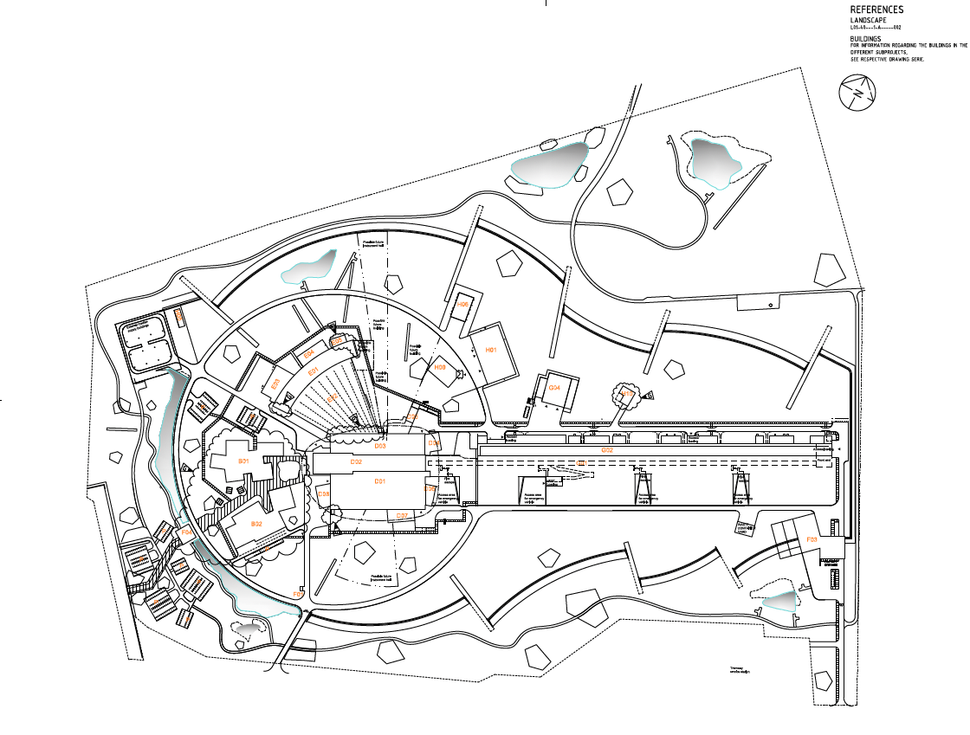
ESS 120.06.04 MSPS– location distribution
Workshops & labs :
B02 : Sample environment workshop – outside the supervised zone
E03 : main workshops (2 storeys, 4 spaces), mechanical workshop, mechanical processing users lab
D08 : 1 workshop for general SES and 2 labs for high-pressure
Instruments support : in all the experiment halls D01, D04 and E01

Slide 7
Staffing and competence
MSPS – Sample environment & mechanical processing users lab
Line manager
Manage the group (recruitment, administrative tasks)
Coordinate the efforts: organise the tasks, schedule the SES use (planning) during operation
Research engineers = Expert in one of MSPS scope fields (B, E, HT, HP, LT, MP)
Develop, procure, commission, calibrate and operate sample environment systems
Manage projects and take care of the documentation requested to be able to operate the systems
Procure sample environment systems
Control engineers
Develop electronics and control systems for sample environment systems
Control integration of complex systems, not directly integrable in EPICS
Technicians
Operate, maintain, refurbish, repair sample environment systems
Operate and maintain workshops, including mechanical workshop
Mechanical integration of sample environment systems

Slide 8
Approach to managing scope for reliable operation
MSPS – Sample environment & mechanical processing users lab
Get ready for experiments:
Clear SES schedule done in advance which include SES preparation time and available resources.
Regular training of instrument scientists and users by MSPS team
Clear documentation and procedures
Assure reliability of the sample environment systems with planned maintenance and tests
Reception of users’ SES well in advance to prepare for control and mechanical integration
Limit beamtime loss :
Quick SES change over with standardised mechanical integration and plug and play control integration
On call 24/7 to quickly solve issues
Spare equipment ready to be used and spare parts for each systems available
Interchangeability of MSPS members for current issues
Prepare the future:
Keep contact with the scientific community to determine future needs and create collaborations
Develop new SES with instruments scientists and the users community

Slide 9
Scope and associated requirements / functions
MSPS – Sample environment & mechanical processing users lab
Provide, maintain and operate sample environment systems (SES) in the fields of
Low and Ultra low temperatures
Magnetic and electric fields
High temperature
High pressure
Mechanical processing
Support instruments in installing and running complicated SES
Provide mechanical integration, control electronics and control integration of complex systems (not directly integrable in EPICS)
Provide users support for quantum materials, physics and mechanical engineering.
Run and operate the mechanical processing users workshop (BEER and ODIN) and the only mechanical workshop in the supervised zone
Organise the liquid helium cycle and monitor helium consumption

Slide 10
MSPS level of support for each SES
 | Full support | Limited support
Magnets | X
Dry cryostats/cryofurnaces |  | X
Wet cryostats/Cryofurnaces |  | X
Dilution fridge/ He3 insert | X
Gas Liquid clamp cells |  | X
PE, DAC | X
Stress rigs |  | X
Dilatometer/Gleeble | X
ILL-Type furnaces |  | X
Other furnaces | X

Slide 11
Projected labour resources
MSPS – Sample environment & mechanical processing users lab
Labour : 1 472 kEuros
 | Engineers | Technicians
High-Pressure | 1 | 1
Mechanical processing | 2 (including LM) | 1
Low and ultra low temperature | 1 | 3
Magnets | 1 | 2
High temperature | 1 | 1
Control | 2
Total : 8 engineers and 8 technicians

Slide 12
Projected non-labour resources
MSPS – Sample environment & mechanical processing users lab
Operations : 680 kEuros
Installation, maintenance, refurbish and repair sample environment systems SES including some instrument specific
Replacement of broken SES
Control and mechanical integration, including users’ and CLS’ SES
Labs and workshops tools and consumables
Renewal of sample cells and anvils
Liquid helium net costs.
Capital: 380 kEuros
Development of new sample environment systems to meet changes in science needs

Slide 13
Benchmarking
ILL SANE sample environment group: 14 FTE
9 FTE for temperature and extensive in-house maintenance and repair
3 FTE experts for pressure but without mechanical processing and DACs
2 FTE for integration efforts, electronics services/instrument control
ISIS: 18 FTE
7 FTE cryogenics team providing full service to instruments for low T and fields
5 FTE for HP and furnaces
6 FTE for SEE integration
SNS/HFIR:
˜15.5 FTE including 2.5 scientists for HP
NB: The user lab and mechanical workshop are not included
The MSPS workshop is the only mechanical workshop in the supervised zone – Operation and maintenance is crucial for and during operation

Slide 14
Summary
MSPS – Sample environment & mechanical processing users lab
Scope :
Provide, maintain and develop sample environment systems for high pressure, high temperature, magnetic and electrical fields, low and ultra-low temperature, mechanical processing
Provide mechanical and control integration (not integrable in EPICS) of all the SES, including users’ SES and CLS’ SES
Support instruments and users with use of SES – on call 24/7
Run users lab for mechanical processing (BEER & ODIN)
Coordinate Helium management
Labour: 16 FTE
6 research engineers (including line manager)
2 control engineers
8 technicians
Total cost = 2 532 kEuros
Labour : 1 472 kEuros
Operations : 680 kEuros
Capital: 380 kEuros

Slide 15
2
SSO review advice

Slide 16
CLS/MSPS
General comments
Separation of the sample environment teams into two groups may provide additional barriers to success
MSPS provides the only machining capabilities in the supervised zone
Workflow for providing this service (machining) to all of the SE teams as well as other interested parties in the Science Directorate has not been defined
Systems, responsibilities and ownership could fall between two stools in the model presented.
Recommendations: ESS should consider a single sample environment group

Slide 17
MSPS
Specific comments
Is the proposed organizational structure fit for purpose? NO – Separation of SE into 2 teams
Scope clear
Planning for resilience demonstrated
Provision of gases assigned to CLS --> issues of responsibilities
Level of research engineers too heavy justified by documentation
Weighting and cross-training for technicians AND research engineers
Is the full scope required for successful operation of all aspects of ESS properly identified?
Scope clear
Recommendations: Technical teams should be professional service providers and own the service until it is installed and working.
Are there opportunities for consolidation and increased efficiency that we have not yet recognized?
Recommendations : multiskilling and cross-training between the technical staff would be advised to minimize single point failures.
Are the resources (labor and non-labor) that have been identified for the defined scope reasonably estimated?
FTEs look appropriate but only if full-service mode is instigated and 24/7 on call. Need for 6 research engineers doubtful - should be experienced technicians
consumables and investment budgets a little thin

Slide 18
3
Open discussion

