Slide 2
Overview of the Target Station PSS (TS PSS)
Concept of Operations and Interfaces
PRESENTED BY Afshin farshidfar

Slide 3
Agenda
1 Target Station Utility Block
2 TS PSS Controlled Area and Main Functions
3 System Interfaces
4 Operational Activities

Slide 4
1
Target Station Utility Block

Slide 5
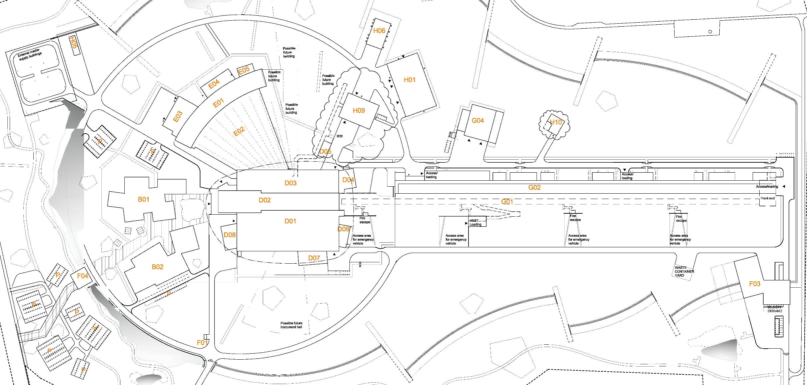
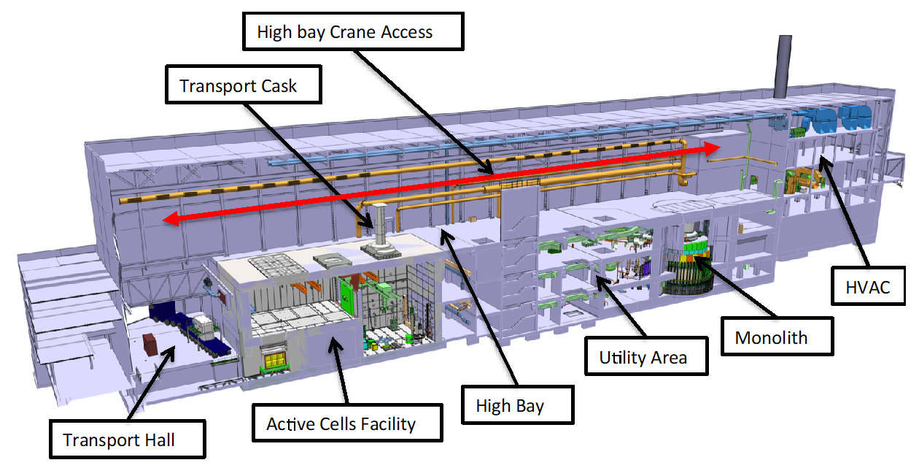
Target Station Utility Block

Slide 6
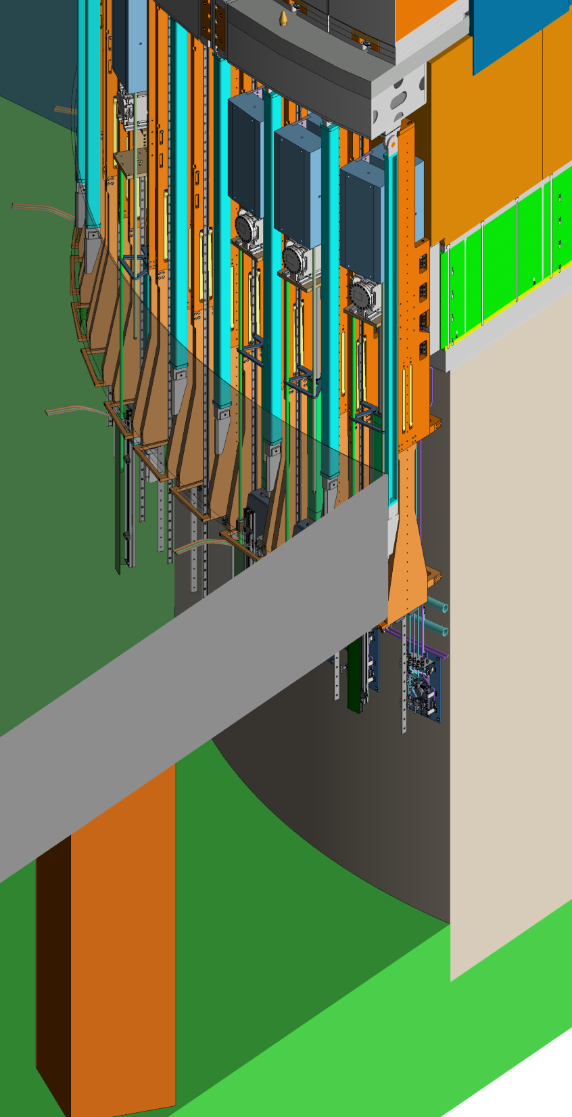
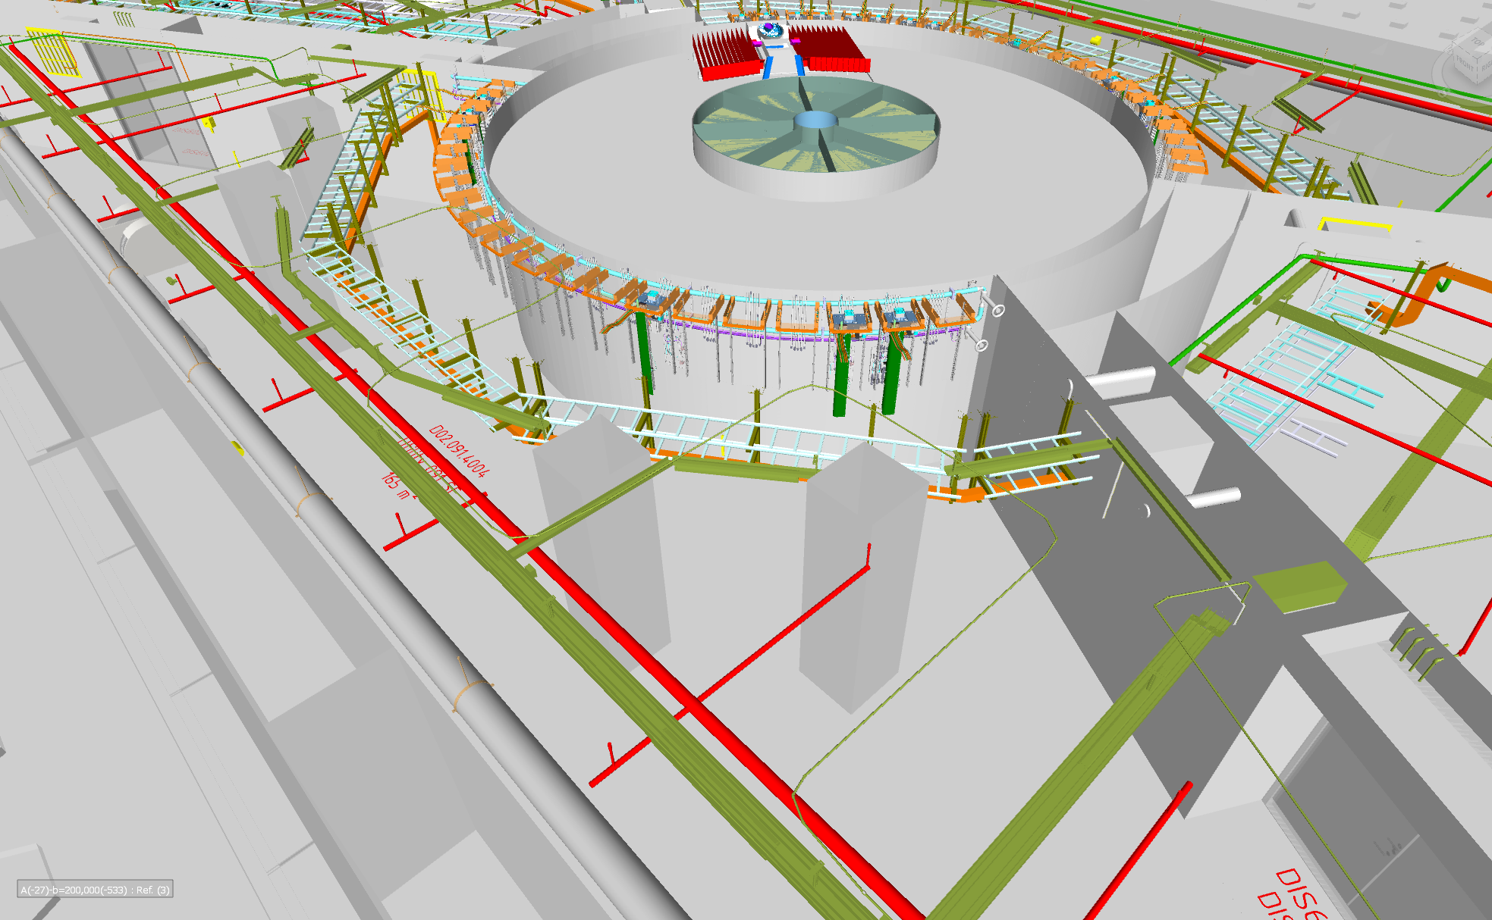
Target Station Utility Block
Target Basement
LSS
Bunker Floor
Target Basement Floor

Slide 7
2
TS PSS Controlled Area and Main Functions

Slide 8
TS PSS Controlled Area
Level 091(Target Basement)
 | Designated radiation areas
Definition
Criteria/Area classification | Green Supervised Area | Blue Controlled Area | Yellow Controlled Area | Red Controlled Area | Magenta Prohibited Area
Potential annual effective dose | <6 mSv | >6 mSv | >6 mSv | >6 mSv | -
Ambient equivalent dose rate | <3 µSv/h | <25 µSv/h | <2.5 mSv/h | <100 mSv/h | >100 mSv/h
Controls
Access control | Access control | Personal dose limits used for access, restricted access | Personal dose limits used for access, restricted access | Personal dose limits used for access, restricted access | Access Prohibited
Radwork permit | Required | Required | Required | Required

Slide 9
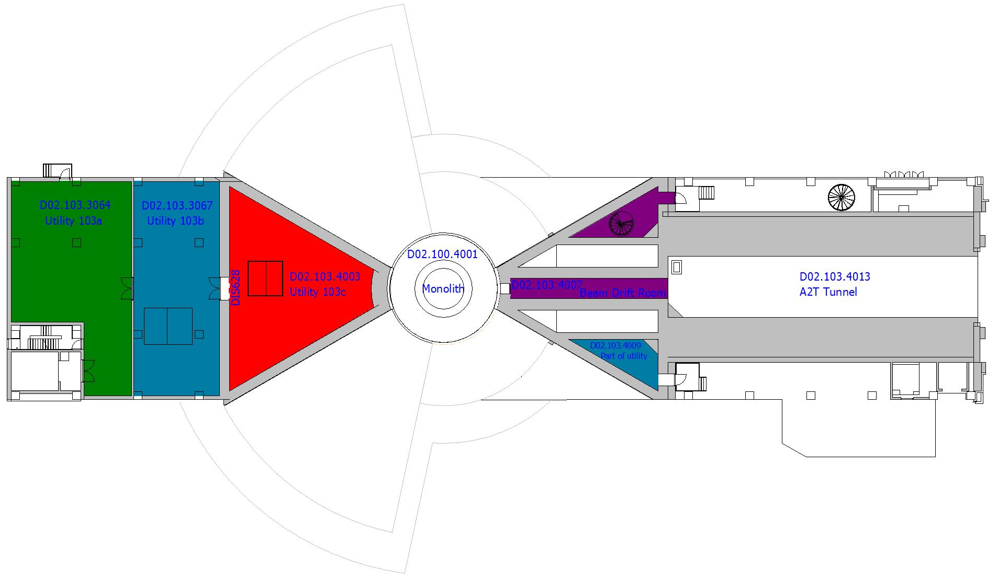
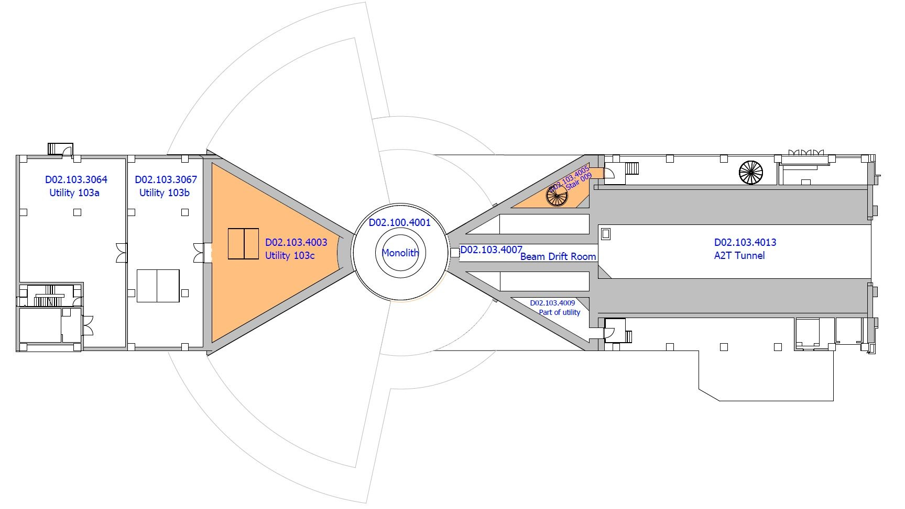
TS PSS Controlled Area
Level 103
 | Designated radiation areas
Definition
Criteria/Area classification | Green Supervised Area | Blue Controlled Area | Yellow Controlled Area | Red Controlled Area | Magenta Prohibited Area
Potential annual effective dose | <6 mSv | >6 mSv | >6 mSv | >6 mSv | -
Ambient equivalent dose rate | <3 µSv/h | <25 µSv/h | <2.5 mSv/h | <100 mSv/h | >100 mSv/h
Controls
Access control | Access control | Personal dose limits used for access, restricted access | Personal dose limits used for access, restricted access | Personal dose limits used for access, restricted access | Access Prohibited
Radwork permit | Required | Required | Required | Required

Slide 10
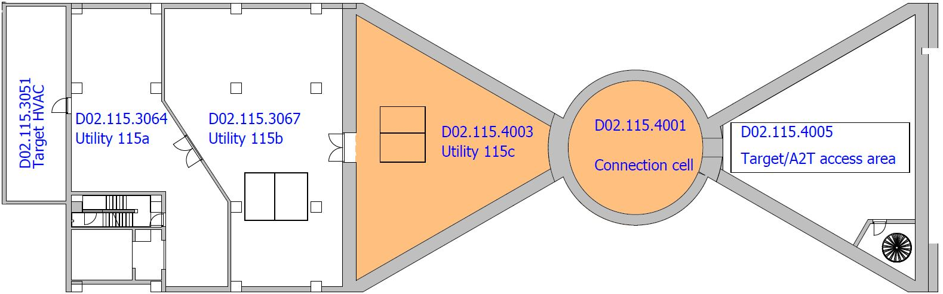
TS PSS Controlled Area
Level 115
 | Designated radiation areas
Definition
Criteria/Area classification | Green Supervised Area | Blue Controlled Area | Yellow Controlled Area | Red Controlled Area | Magenta Prohibited Area
Potential annual effective dose | <6 mSv | >6 mSv | >6 mSv | >6 mSv | -
Ambient equivalent dose rate | <3 µSv/h | <25 µSv/h | <2.5 mSv/h | <100 mSv/h | >100 mSv/h
Controls
Access control | Access control | Personal dose limits used for access, restricted access | Personal dose limits used for access, restricted access | Personal dose limits used for access, restricted access | Access Prohibited
Radwork permit | Required | Required | Required | Required

Slide 11
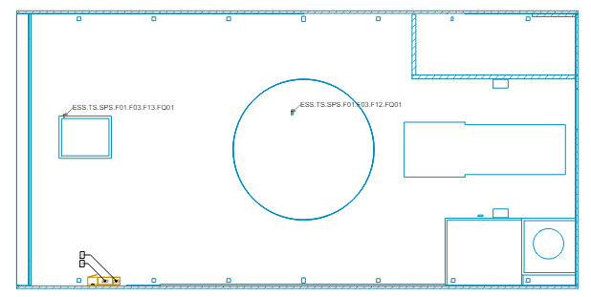
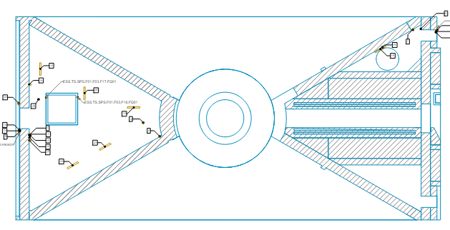
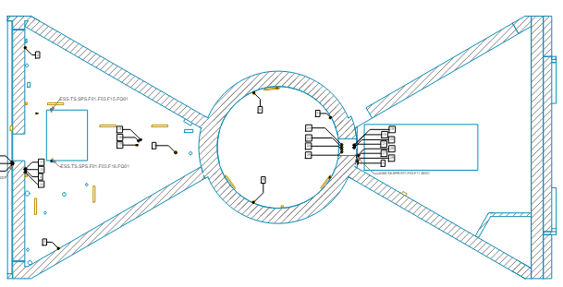
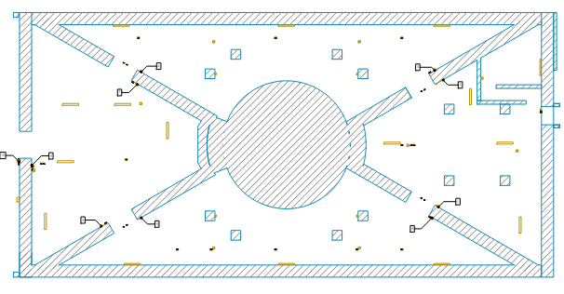
TS PSS
Level125
Overview
Level115
Level103
TS PSS has two HMIs:
An integrated ACC, Target and Bunker HMI in MCR(MCR PSS HMI)
A dedicated HMI in high bay
Level091

Slide 12
Main Functions
The TS PSS provides the following main functions:
TS PSS prevents access to TS PSS controlled area, by locking the access doors to the TS PSS controlled area in a closed position when the BoT is allowed.
TS PSS prevents inadvertent energization of the bending magnets if the TS PSS controlled area is not searched and locked.
TS PSS requests Accelerator PSS (ACC PSS) to switch off the proton beam, if an intrusion to TS PSS controlled area is detected when the BoT is allowed,
TS PSS requests ACC PSS to switch off the proton beam, if an ESOB is pressed in TS PSS controlled area when the BoT is allowed,
TS PSS prevents access to the TS PSS controlled area in the target basement if the light shutters are not closed
TS PSS prevents inadvertent opening of the light shutters if the TS PSS controlled area in the target basement is not searched and locked
TS PSS requests ACC PSS to switch off the proton beam if it receives a high radiation alarm or major fault signal from the designated radiation monitors installed in D02.120.4014 and D02.115.4005 when the BoT is allowed.

Slide 13
3
System Interfaces

Slide 14
Equipment Under Control
Proton Beam Actuators
The TS PSS interfaces with the proton beam actuators of ACC PSS to stop proton beam generation in certain hazardous scenarios.
The communication between ACC PSS and TS PSS is realised through Nexus PSS.
The TS PSS shall inform the Nexus PSS on the TS PSS Ready for BoT status.
The TS PSS shall receive feedback on the following:
BoT Status
Isrc HVPS status

Slide 15
Equipment Under Control
Proton Beam Actuators
TSPSS_SIF1: Emergency Stop Buttons
TSPSS_SIF2: E-Exit doors interlock
TSPSS_SIF3: Access Doors Interlock
TSPSS_SIF5: High Radiation Alarm
The controlled area is ready for operation if:
TSPSS_SIF1, 2, 3, and 5 are reset
All zone gates (including lead bunker door) are closed and error free
The controlled area is searched and locked
No SIS diagnostic alarms

Slide 16
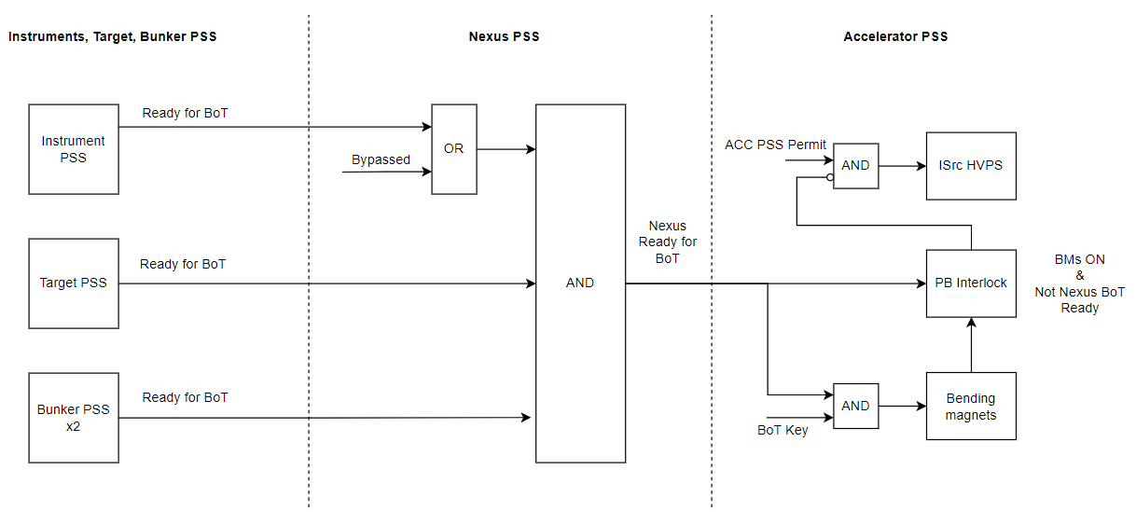
Equipment Under Control
Proton Beam Actuators

Slide 17
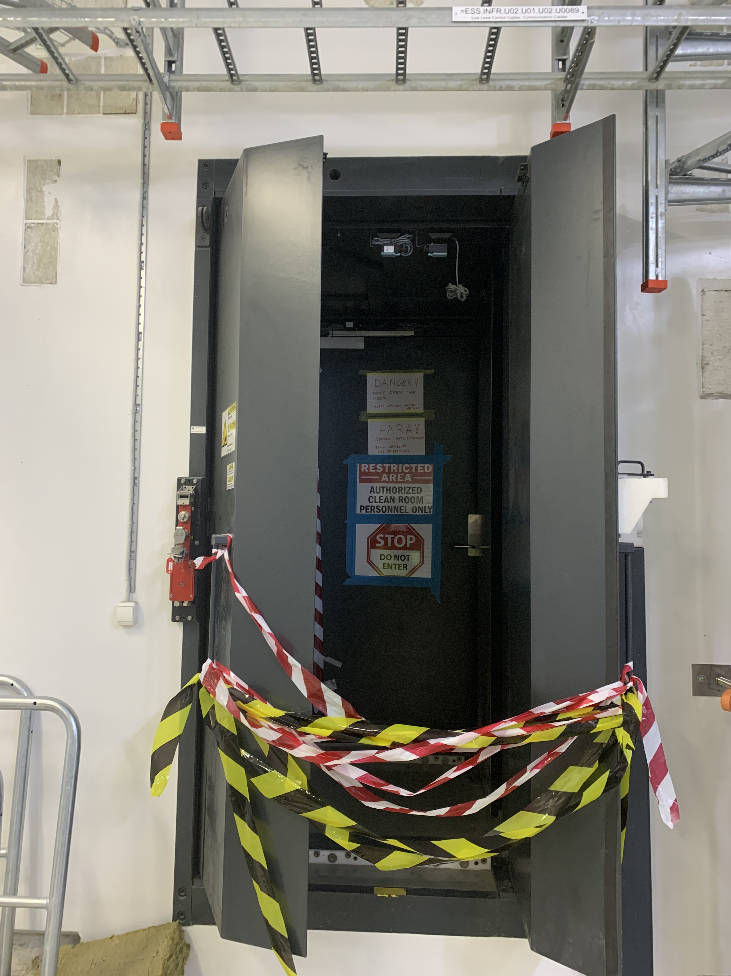
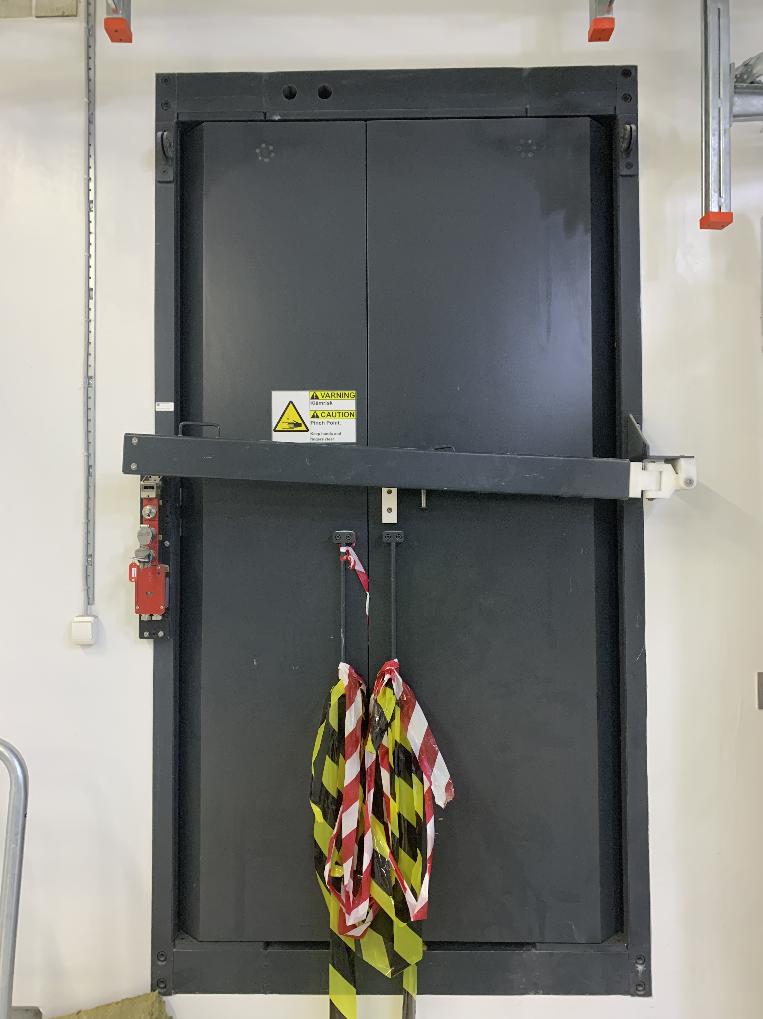
Equipment Under Control
Connection Cell Shielding Door

Slide 18
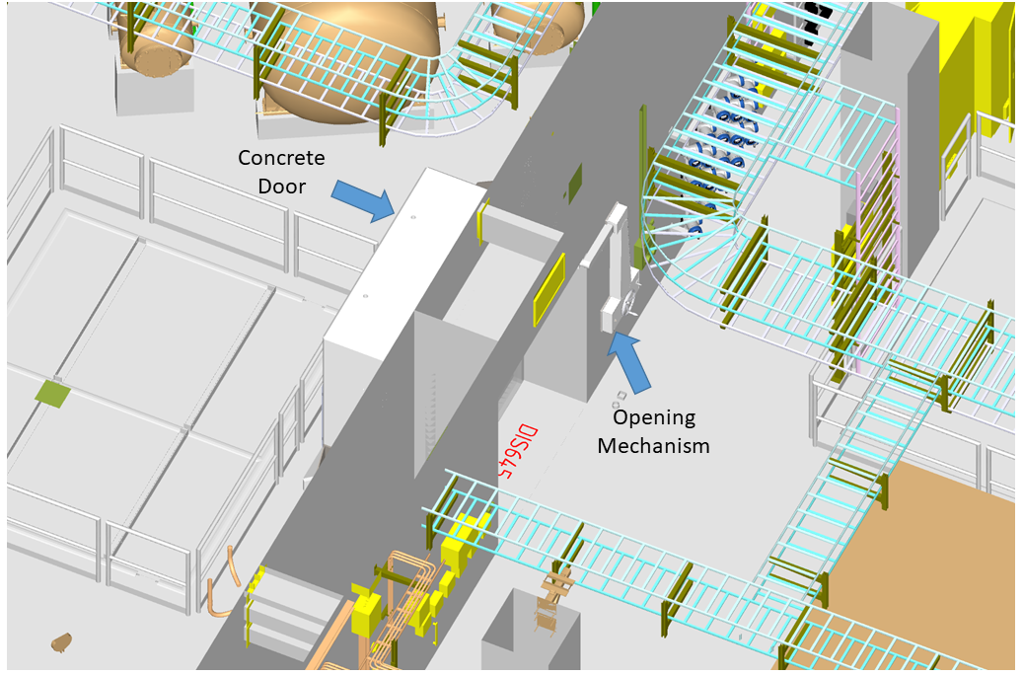
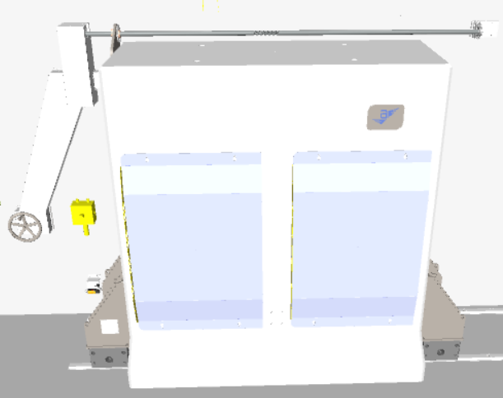
Equipment Under Control
Sliding Concrete Doors

Slide 19
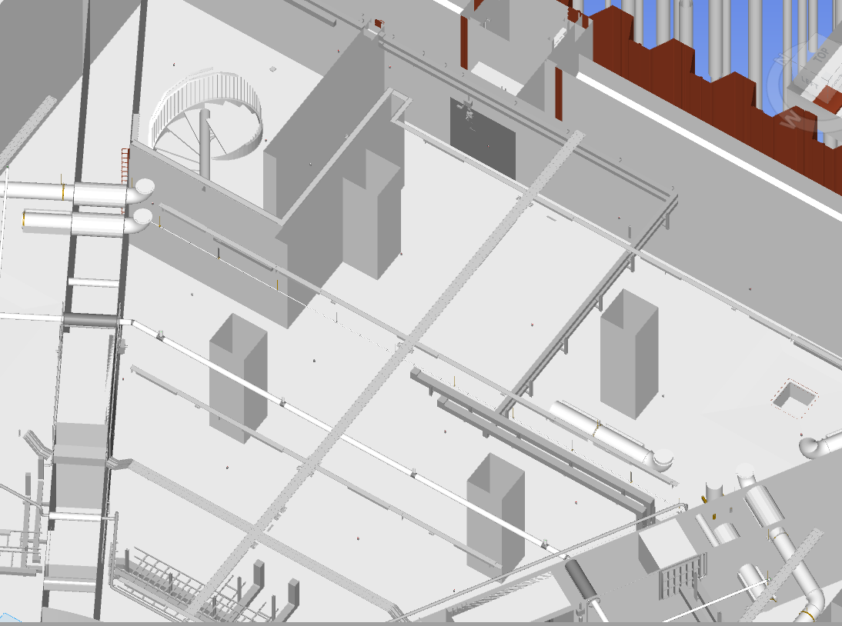
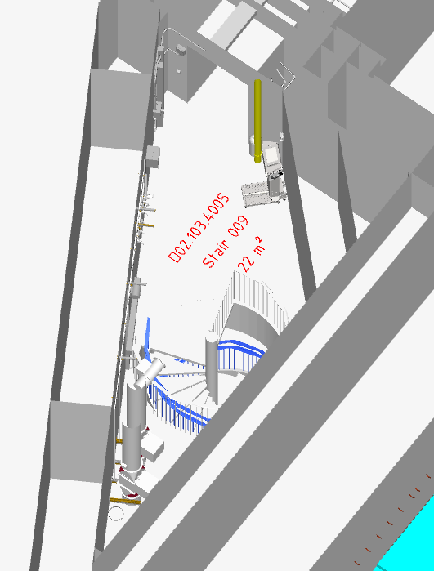
Equipment Under Control
Emergency Exit Doors

Slide 20
Equipment Under Control
Light Shutter System
TS PSS
Key Exch. Unit
Status
Status
Solenoid
Closed
Bunker
PSS
Closed
LSS
EK
Permit
Permit
Disabled
Disabled
TS PSS Functions
Prevent access to TS PSS controlled area in the Target basement when the Light Shutters are not closed,
Prevent inadvertent opening of the Light Shutters when access to the Target basement is allowed

Slide 21
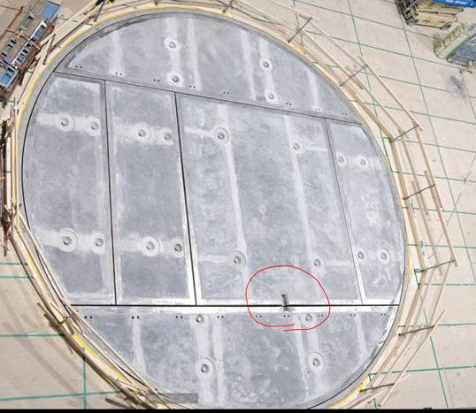
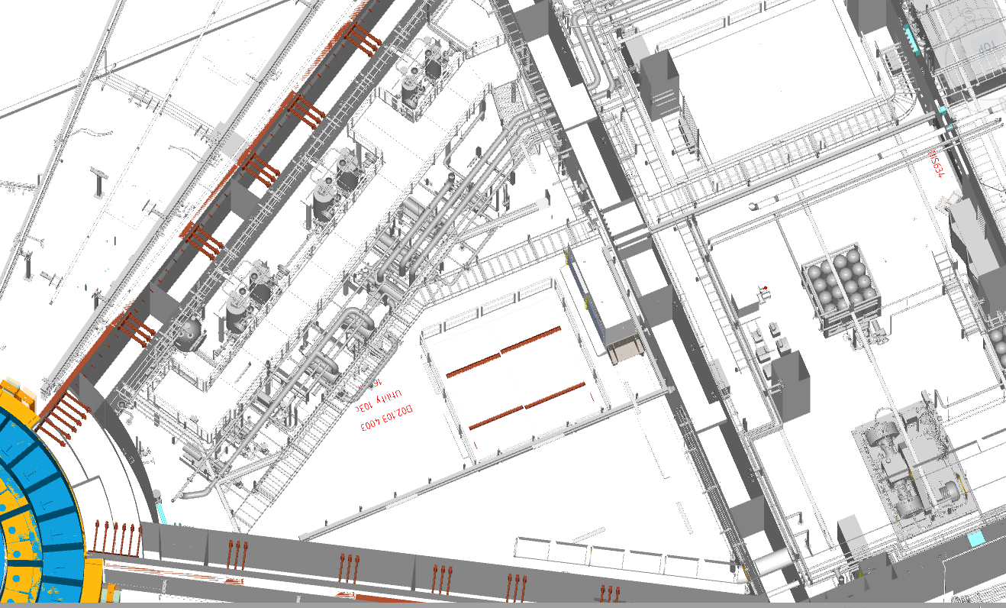
Interfaces
Removable Shielding Blocks
The TS PSS contributes to the shielding configuration management of removable shielding blocks.
Lifting the shielding blocks requires the use of a crane.

Slide 22
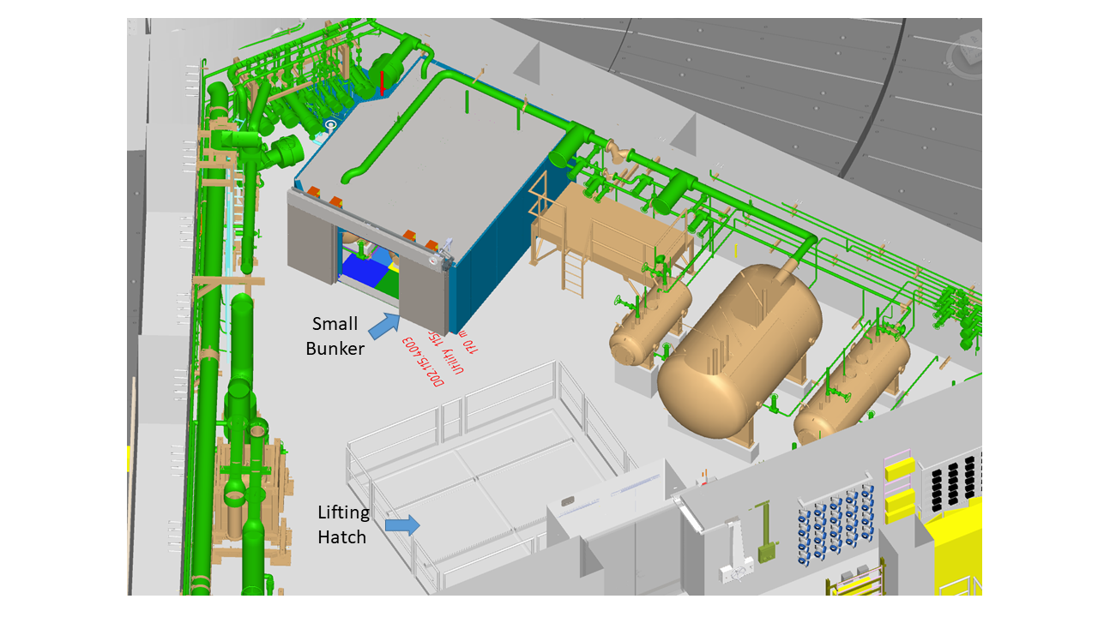
Interfaces
Lead Bunker Shielding Door
TS PSS interfaces with the door through position monitoring switches to ensure that the lead bunker sliding door is closed before allowing the BoT.
If the door is detected open after D02.115.4003 is searched and locked, an alarm shall appear on TS PSS HMI and OPI.

Slide 23
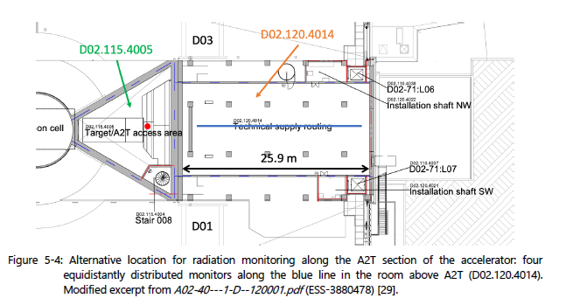
Interface Points
Radiation Monitors
Signal name | Signal status | NO contact status (Relay) | ACC PSS permit
Radiation alarm | TRUE (the radiation level is below set threshold) | Closed | Enabled
 | FALSE (the radiation level is above set threshold) | Open | Disabled
Major fault | TRUE (there is no fault in AMM) | Closed | Enabled
 | FALSE (the AMM is faulty) | Open | Disabled

Slide 24
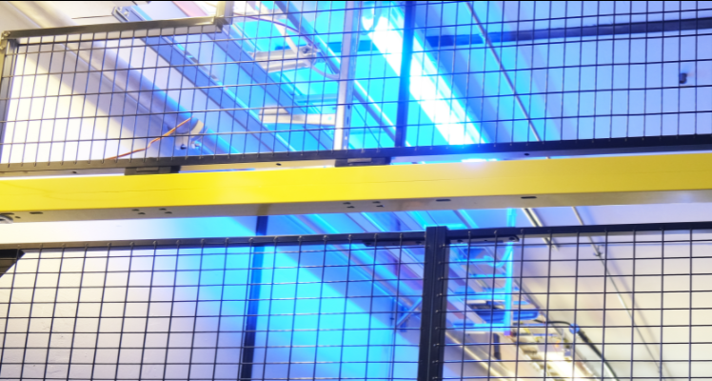
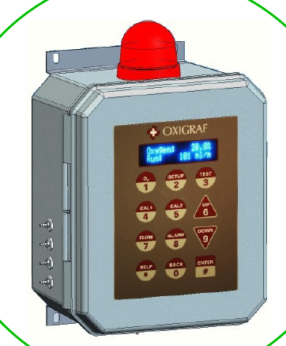
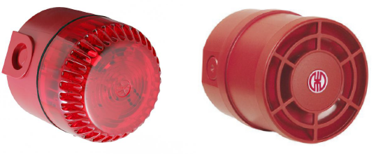
Other Interfaces
Blue Lights
Indicate that ionizing radiation is imminent or exists.
Turn ON when the beam on target is ALLOWED.
Installed in the controlled area.
Gas Detection System
ODH monitors measure and display the O₂ level.
ODH alarm devices alarm in case of oxygen deficiency.
The message display above the access door to D02.115.4003 will display “ACCESS PROHIBITED” if a ODH evacuation alarm is triggered in the room.

Slide 25
4
Operational Activities

Slide 26
TS PSS Operational Activities
Principles of Operation
Prior to enabling TS PSS permit to allow the BoT:
Trained operators carry out a formalised search in TS PSS controlled area,
TS PSS locks the access points to TS PSS controlled area.
Notes:
TS PSS protects workers by ensuring a safe state of TS PSS controlled area when it is accessible, as well as ensuring that no one is left inside the TS PSS controlled area when it is unsafe

Slide 27
TS PSS Operational Activities
Principles of Operation
Prior to granting access to TS PSS controlled area:
The operator stops the proton beam on the target through the control system,
The cool down time has to be elapsed before TS PSS allows access to the PSS controlled area,
The operator closes the light shutters through the control system if access to the target basement is required,
Upon initiating access to TS PSS controlled area, TS PSS interlocks the bending magnets, to prevent their inadvertent energisation. The bending magnets are secured against re-energisation until the TS PSS controlled area is searched and locked,
Upon initiating access to the TS PSS controlled area in the target basement TS PSS interlocks the light shutters, to prevent their inadvertent operation. The light shutters are interlocked in the closed position until the TS PSS controlled area in the target basement is searched and locked,

Slide 28
Target Station PSS Mode Transitions
Access
Mode
Beam ON Mode
Transition
Mode
PB Interlock Mode
Alarm Mode

Slide 29
TS PSS Modes of Operations
Access
Mode
Beam ON Mode
Formalised Search can be carried out only in this mode
Transition
Mode
TS PSS Ready for BoT :disabled
TS PSS Ready for BoT: can be enabled
TS PSS Ready for BoT: enabled
Blue Lights: OFF
Blue Lights: OFF
Blue Lights: ON
Access doors: can be unlocked
Access doors: closed and locked
Access doors: closed and locked
Shielding blocks: can be unlocked
Shielding blocks: locked
Shielding blocks: locked
Light Shutters: can be interlocked
Light Shutters: not interlocked
Light Shutters: not interlocked
Search: broken upon first access
Search is completed
Search is completed
BoT is Allowed
Feedback From Nexus
Notes:
Mode
Description
Access
This is the normal access mode of the system
BoT ON
In BoT ON mode, all prerequisite of allowing BoT by ACC PSS are provided.
Transition
The Transition mode is used when TS PSS transitions from BoT ON to Access mode, and vice versa. In this mode TS PSS issues all permits necessary for the Target Station user(s) to be able to initiate beam to Target and wait for other conditions that need to be received by ACC PSS to enable permit to allow BoT.

Slide 30
TS PSS Modes of Operations
Alarm Mode
In any TS PSS mode
TSPSS_SIF1(ESOB)
TSPSS_SIF1 is reset
SIS startup
TSPSS_SIF2 is reset
In Beam ON or Transition modes
TSPSS_SIF2(Intrusion)
Alarm Mode
PB is interlocked OFF the target
Access
Mode
TSPSS_SIF3(Intrusion)
No PB feedback error
TS PSS Ready for BoT is disabled
System is not in startup mode
PB actuator feedback error
In Access mode
Search is broken for certain triggers
Bad key combination

Slide 31
TS PSS Modes of Operations
PB Interlock Mode
TSPSS_SIF1(ESOB)
TSPSS_SIF5(High Radiation)
SIS startup
Alarm Mode
Beam ON Mode
PB Interlock Mode
TSPSS_SIF5 is reset
TS PSS Ready for BoT is disabled
Transition
Mode
Search is not broken
PB is interlocked OFF the target

Slide 32
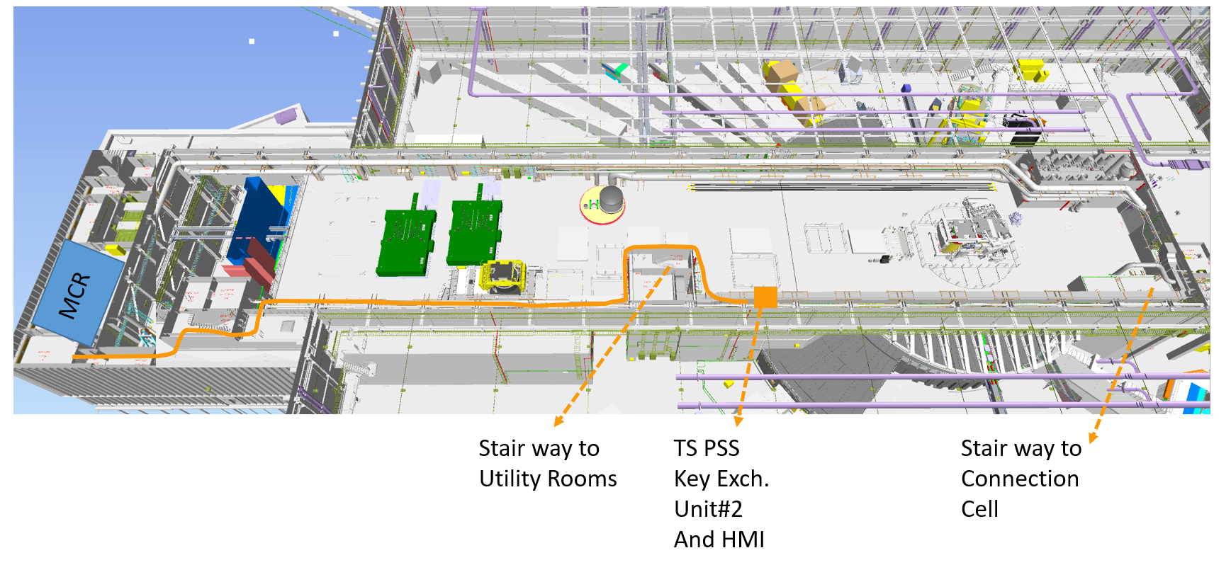
TS PSS key Exchange System
Integrated ACC – Target - Bunker PSS key exchange unit #1 (MCR)
Target PSS key exchange unit #2 and HMI

Slide 33
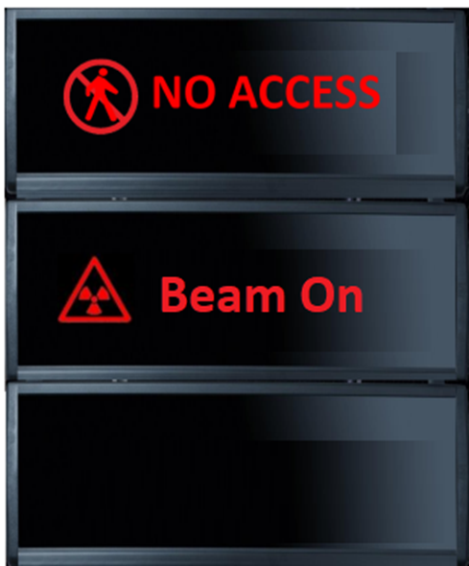
Target PSS Key Exchange System
BOT MK not in Slot 12 = Bending Magnets are interlocked
Unit #1
(ACC - Target – Bunker Scope)
Unit #2
Access Allowed
BOT MK is locked in slot 14 until BoT is permitted
Access Prohibited
Permit for Beam On Target
TS AK
TS SCMK
SLOT 12
SLOT 1
SLOT 7
Connection Cell Shielding Block
BOT OVK is managed by RP team. The solenoid is removed through HMI with RP credentials
BOT MK
D02.115.4001
TS
SCMK
TS SCMK
CCELL
SCMK1
S
S
BOT MK
Access Prohibited
SLOT 2
SLOT 8
TSCMK1
Hatch Door Slab1 in HB
Access Allowed
T AK is locked in Slot 16 until cool down time is elapsed
SLOT 13
SLOT 14
EK1-CCELL
HBAY
SCMK2
BOT
OVK
EK1
SLOT 3
D02.115.4003
SLOT 9
TSCMK2
Hatch Door Slab1 in 115.4003 Floor
T AVK is managed by RP team. The solenoid is removed through HMI with RP credentials
EK2-LVL115
LVL115
SCMK3
S
EK2
SLOT 4
SLOT 10
Hatch Door Slab2 in 115.4003 Floor
S
Access Allowed
T AK
Access Prohibited
TSCMK3
SLOT 15
SLOT 16
T AK
EK3-LVL103
LVL115
SCMK4
T AVK
SLOT 5
Hatch Door Slab1 in 103.4003 Floor
D02.103.4003
EK3
SLOT 11
TSCMK4
EK3-LVL091
S
LVL103
SCMK5
Beam ON Mode
S
S
SLOT 6
Access
Mode
NWB AK
Hatch Door Slab2 in 103.4003 Floor
Transition
Mode
Access Allowed
SLOT 12
SLOT 17
SLOT 18
Access Prohibited
EK4
TSCMK5
NWB AVK
LVL103
SCMK6
D02.091.4003
SLOT 13
TSCMK6
Spare
SCMK7
S
S
SEB AK
The Solenoid on slot 6 is removed only when all Light Shutters (LS) are closed. The LS are interlocked in the closed position when EK3 is not in the home position.
SLOT 14
SLOT 19
SLOT 20
SEB AVK

Slide 34
TS PSS Key Exchange System
Access Veto Procedure
Unit #1
(ACC - Target – Bunker Scope)
Permit for Beam On Target
SLOT 12
Handled by RP
BOT MK
S
S
BOT MK
SLOT 13
BOT
OVK
T AVK is managed by RP team. The solenoid is removed through HMI with RP credentials
S
S
T AK
SLOT 15
SLOT 16
T AK
TAK is locked in slot 2 until TAVK is back
T AVK
S
S
NWB AK
SLOT 17
SLOT 18
NWB AVK
S
S
SEB AK
SLOT 19
SLOT 20
SEB AVK

Slide 35
Formalised Search
TS PSS Search Zones
LVL091
Zone2
Zone1
Zone4
Zone3
LVL103
LVL115
Zone1
Zone7
Zone6
Zone5
Notes:
A Formalised Search is carried out by pressing search buttons which are distributed in a way that requires the search team to inspect all corners of the search area.
The search buttons are to be pressed in a predetermined sequence, with a time delay between pressing two buttons.
PSS controlled area is divided in 6 search zones.
A Formalised Search is to be performed by designated trained personnel, which is called the search team, when TS PSS is in Access mode.
The minimum number of personnel required in a Search Team is defined based on complexity of search zones

Slide 36
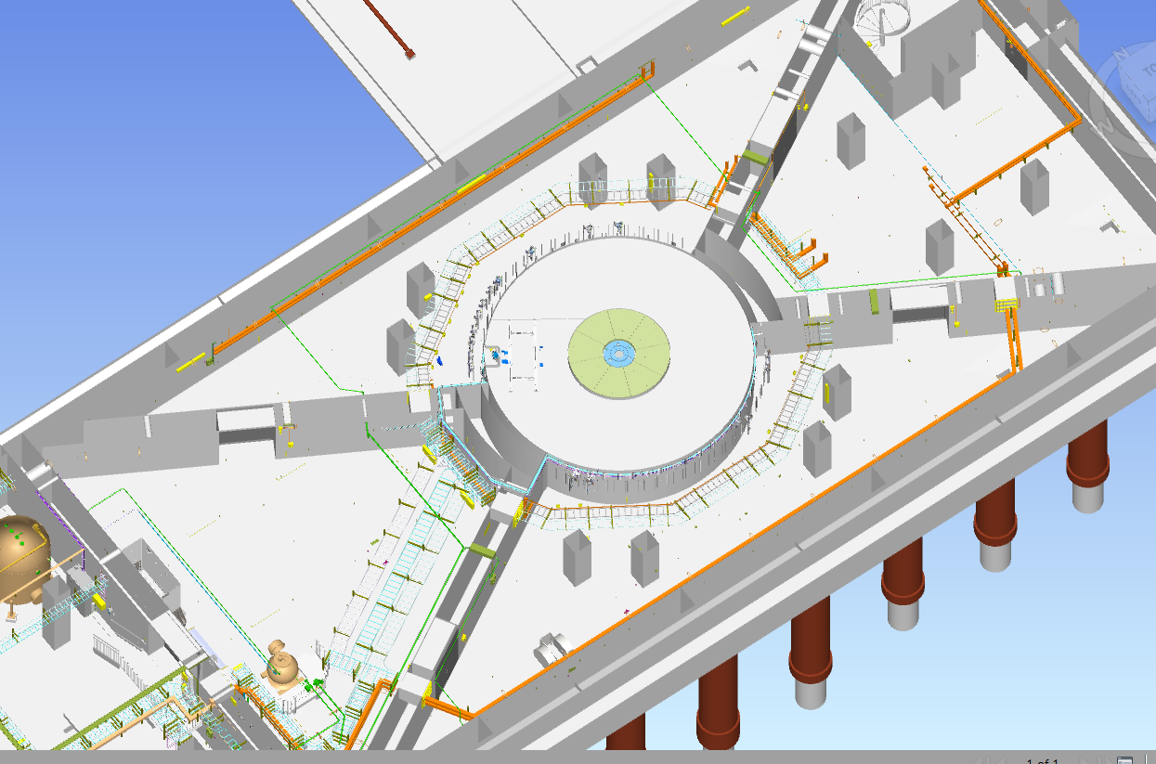
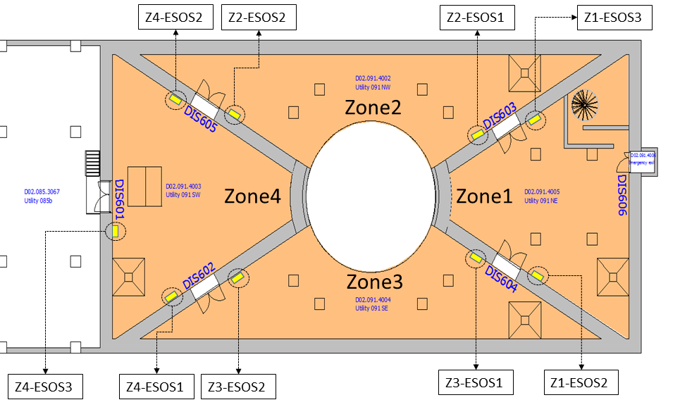
Formalised Search
Target basement
Zone No. | Search Time
1, 2, 3 | 3 min
4 | 3 min search + 4 min door closing

Slide 37
Formalised Search
Target basement
Zone1
Zone2
Zone2
Zone2
Zone4
Zone1
Zone4
Zone4
Zone1
Zone1
Zone3
Zone3
Zone3
Color Code | Definition
 | Searched
 | Not Searched

Slide 38
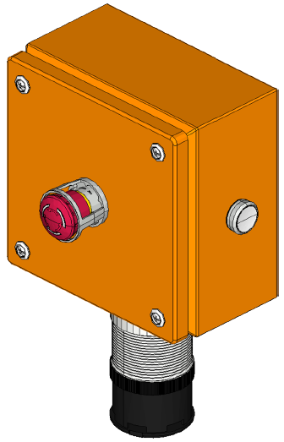
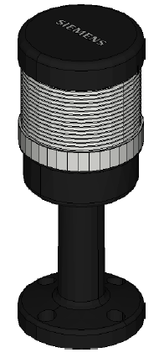
Formalised Search
Target basement
Zone2
Zone1
Zone3
Searching
Color Code | Definition
 | Searched
 | Not Searched
Notes:
The search can start only in Access mode when the precondition of the search are fulfilled.
Mention the key to start the search
Mention the PA

Slide 39
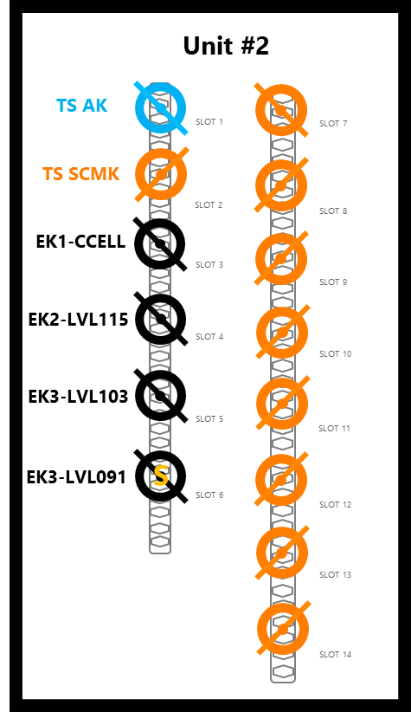
Formalised Search
Target basement
From LVL103
TSCMK5
Sliding concrete door detected closed
TSCMK6
Searching
Color Code | Definition
 | Searched
 | Not Searched

Slide 40
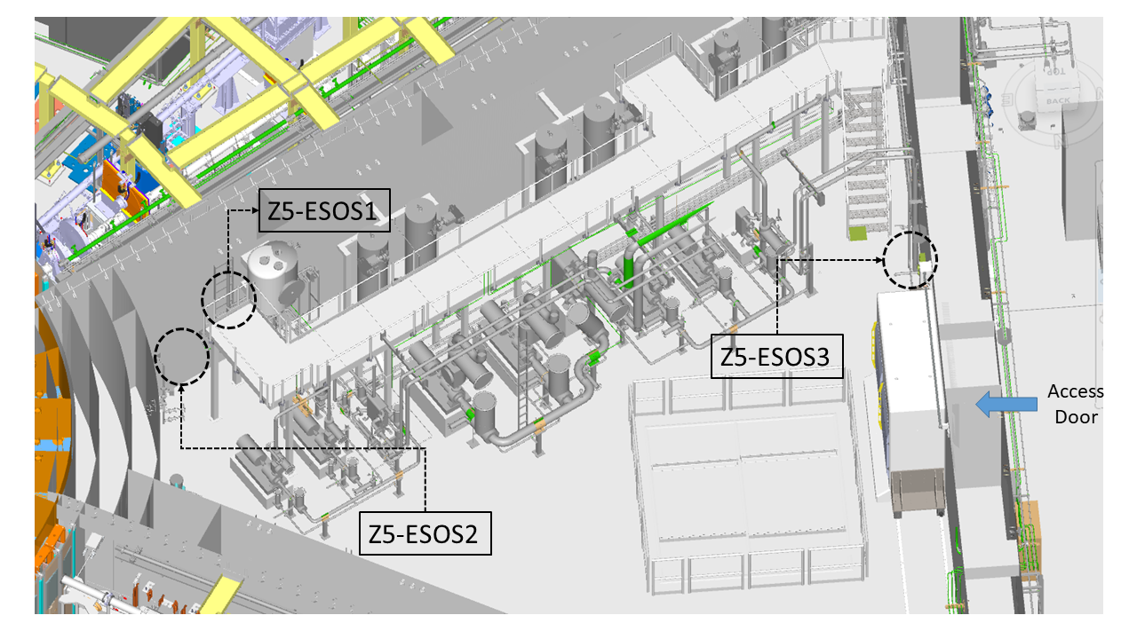
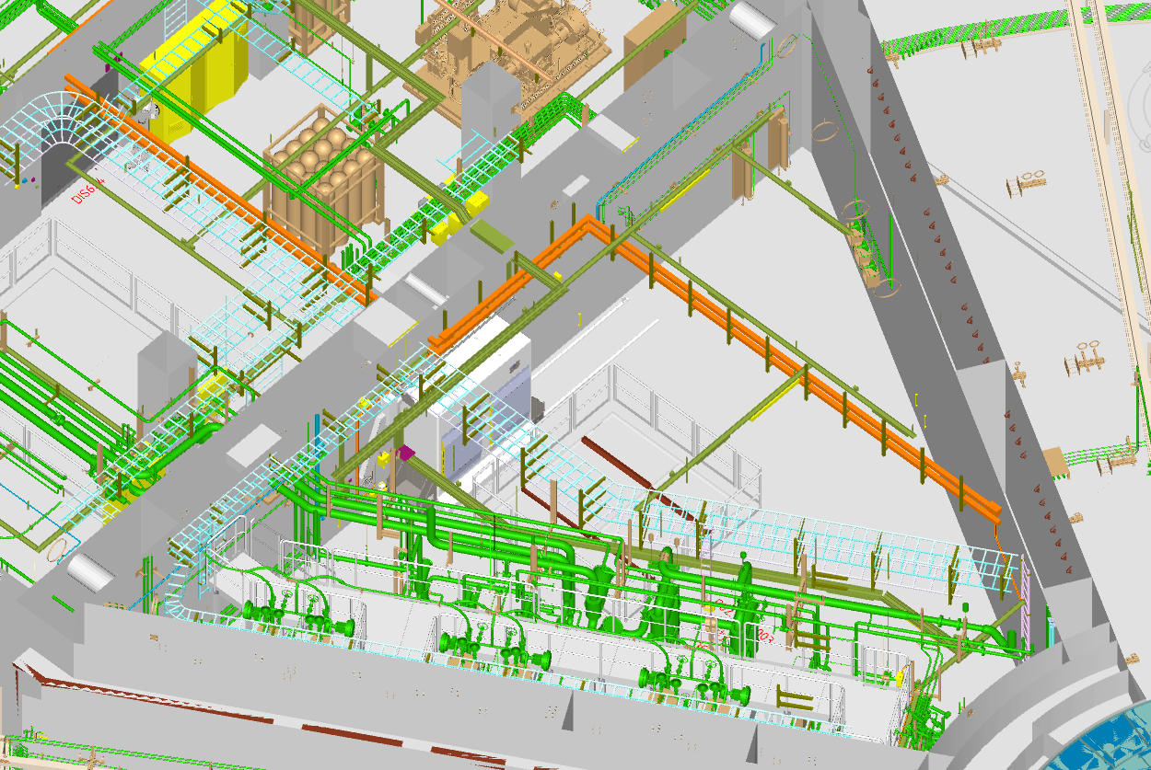
Formalised Search
Level 103 (D02.103.4003)
Zone No. | Search Time
5 | 4 min search + 4 min door closing

Slide 41
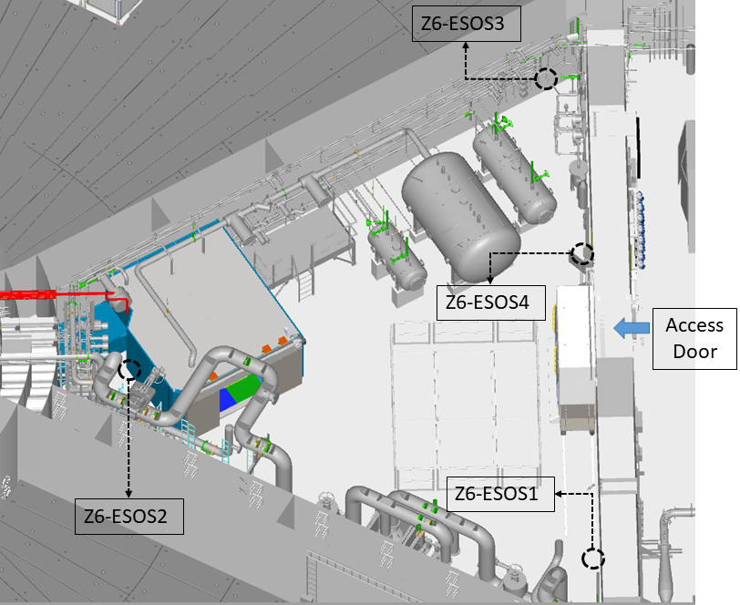
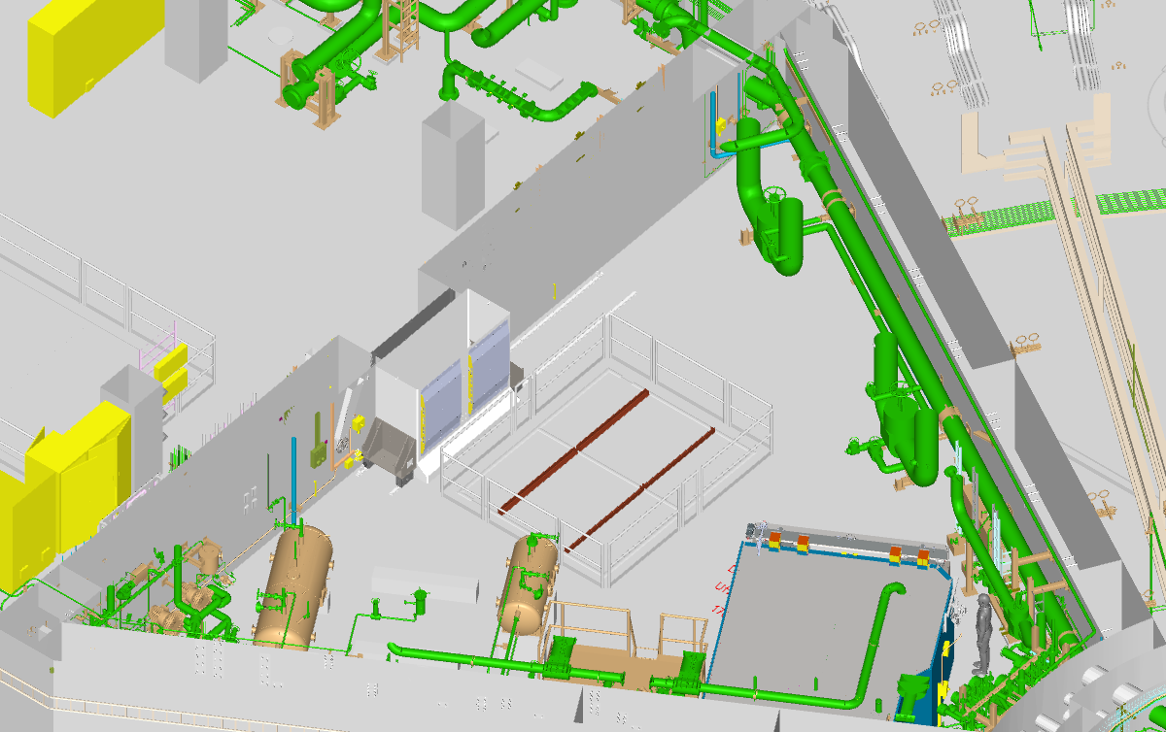
Formalised Search
Level 115(D02.115.4003)
Zone No. | Search Time
6 | 4 min search + 4 min door closing

Slide 42
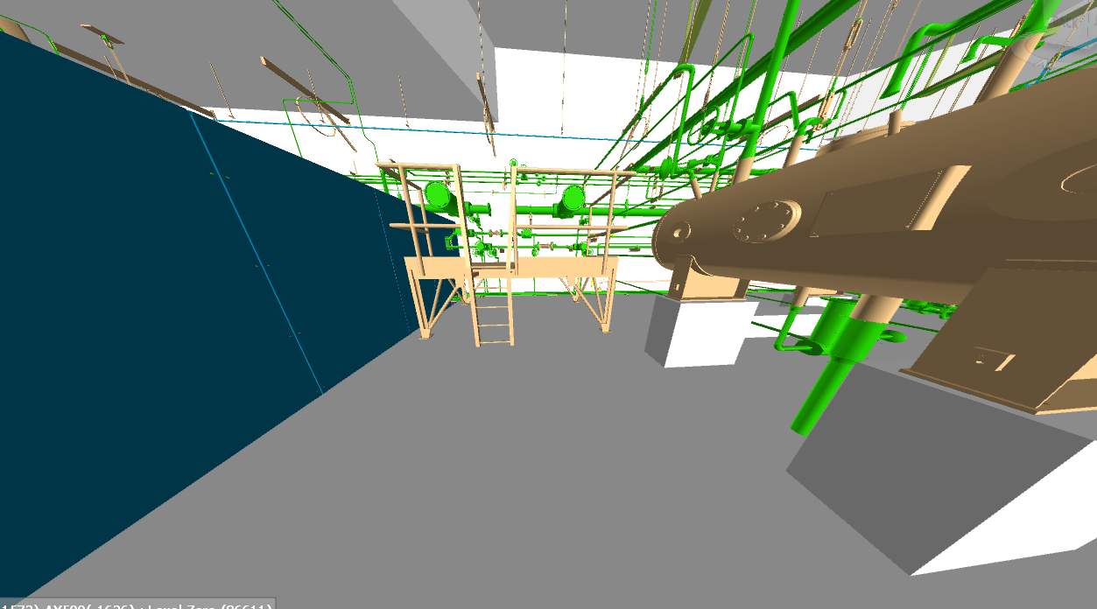
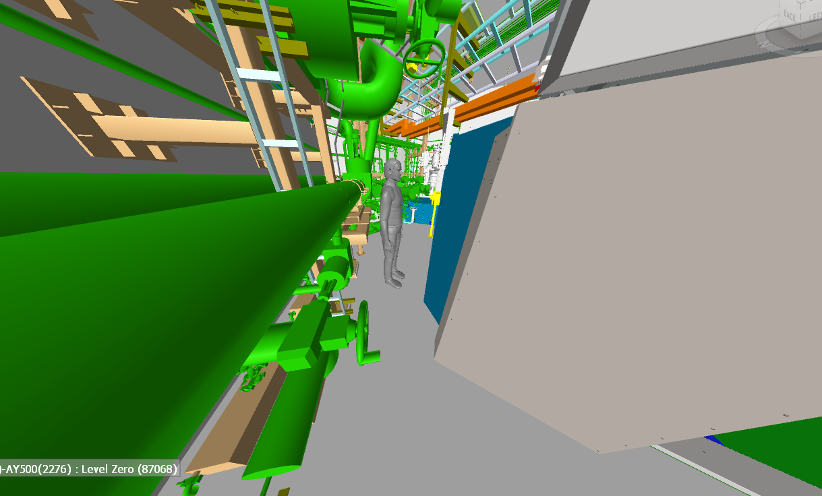
Formalised Search
Level 115(D02.115.4003)
An extra search button in this corner?
Is there any concern about the high dose rate in this corner?

Slide 43
Formalised Search
From High Bay
Formalised Search in D02.115.4003
TSCMK2
Lead bunker door detected closed
TSCMK4
TSCMK5
Searching
Color Code | Definition
 | Searched
 | Not Searched

Slide 44
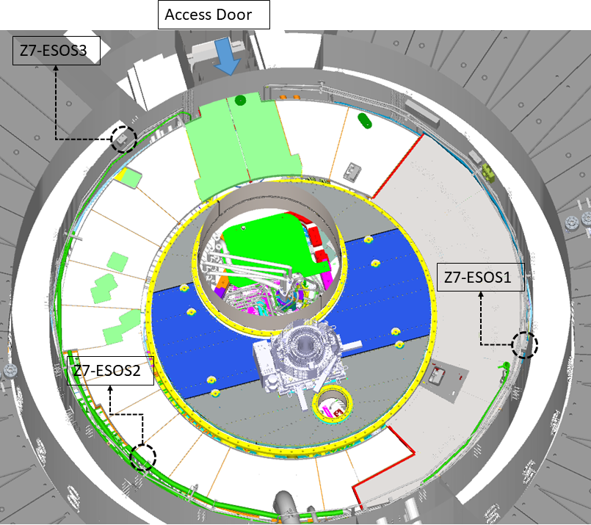
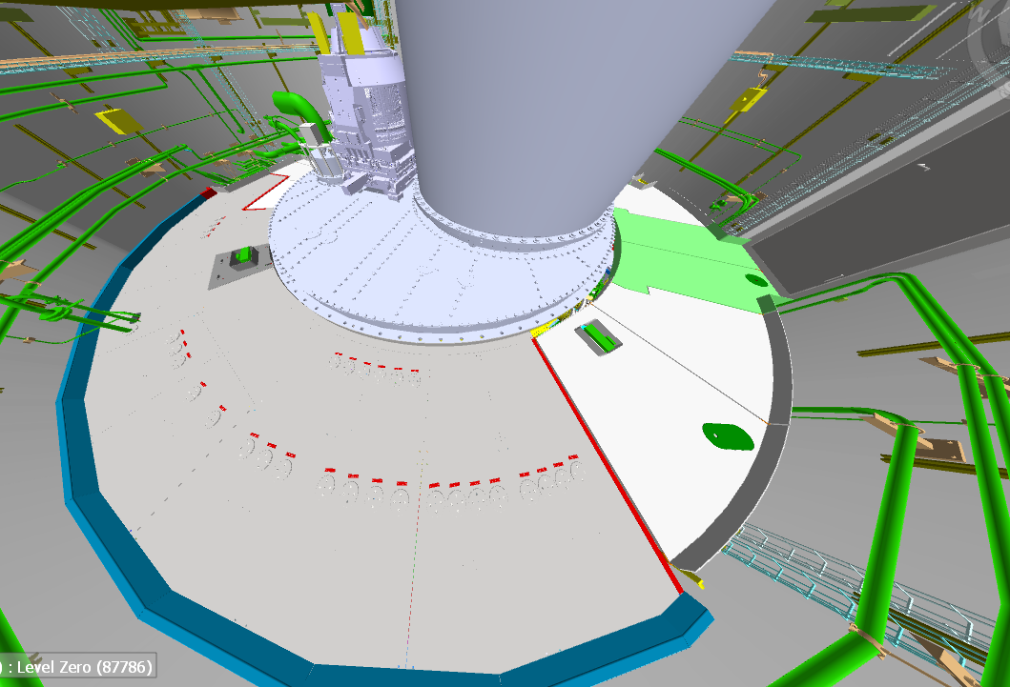
Formalised Search
Level 115(Connection Cell)
Zone No. | Search Time
7 | 4 min search + 2 min door closing

Slide 45
Preparing the Area for Operation
TSPSS_SIF1 and TSPSS_SIF2 are reset
Unit #1
(ACC - Target – Bunker Scope)
Unit #2
TS PSS controlled area is searched and locked
TS AK
TS SCMK
Permit for Beam On Target
SLOT 1
SLOT 7
The controlled area is ready for operation if:
TSPSS_SIF1, 2, 3, and 5 are reset
All zone gates (including lead bunker door) are closed and error free
The controlled area is searched and locked
No SIS diagnostic alarms
SLOT 12
TAK
All keys are brought back to Unit#2
TS SCMK
CCELL
SCMK1
If the area is ready for operation “Ready for BoT” will be enabled
SLOT 2
SLOT 8
S
S
BOT MK
EK1-CCELL
HBAY
SCMK2
SLOT 13
BOT MK
SLOT 3
BoT OVK is managed by RP team. The solenoid is removed through HMI with RP credentials
BOT
OVK
SLOT 9
EK2-LVL115
LVL115
SCMK3
SLOT 4
SLOT 10
BoTK is locked in slot 2 until ESS PSS BoT permit is enabled
S
S
T AK
EK3-LVL103
LVL115
SCMK4
SLOT 15
SLOT 16
SLOT 5
SLOT 11
T AVK
Blue lights turn on and PA broadcast a warning for 120 sec
EK3-LVL091
S
LVL103
SCMK5
SLOT 6
SLOT 12
S
S
NWB AK
LVL103
SCMK6
SLOT 17
SLOT 18
NWB AVK
SLOT 13
Spare
SCMK7
BoT ON Mode
Access Allowed
Access
Mode
Access Prohibited
SLOT 14
Transition
Mode
S
S
SEB AK
SLOT 19
SLOT 20
SEB AVK

Slide 46
Intervention Activities
LSS operators may need to have access to the target basement for LSS maintenance. During LSS maintenance some of the light shutters might fail to close or may have to stay open while the light shutter maintenance team are in the target basement. PSS has the ability to remove the interlock of one light shutter at a time during LSS maintenance. This will be done true Bunker PSS.

Slide 47
Thank you for listening!

Slide 48
Radiation levels(backup)
Radiological Hazards Induced In The Target Utility Block During Normal Operation And Corresponding Radiation Safety Provisions (ESS-2027007)
Area classification design requirements document for the D,E&G buildings (ESS-0057612)

Slide 49
Formalised Search(Backup)
A formalised search is carried out by pressing search buttons which are distributed in a way that requires the search team to inspect all corners of the search area.
To ensure that the search team performs the formalised search carefully, there is a time delay of 20 seconds between pressing two search buttons in the predefined sequence.
If the button that should be pressed next is pressed within that time, it is not registered as pressed (TSPSS_CON35).
A formalised search is to be performed by at least two designated trained operators, which is called the search team when TS PSS is in Access mode.

Slide 50
Formalised Search(Backup)
Search prerequisites
Zone No. | Conditions
1 | The door to the ACC emergency escape hatch (DIS606) is closed Emergency exit door to D03 (DIS624) is closed and locked Depending on the search scenario, either of the zone gates DIS603 or DIS604 are closed (see 10.1.2.2) TSPSS_CON37
2 | The annunciator light next to the zone gate DIS603 is lit, i.e. Zone 1 is searched DIS603 is closed TSPSS_CON38
3 | The annunciator light next to the zone gate DIS604 is lit, i.e. Zone 1 is searched DIS604 is closed TSPSS_CON39
4 | The annunciator light next to the zone gates DIS602, and DIS605 are lit, i.e. Zone 2 and Zone 3 are searched DIS602 and DIS605 are closed TSCMK5 and TSCMK6 are returned to KEU#2, i.e. the hatch in the ceiling is closed TSPSS_CON40
5 | TSCMK3, TSCMK4, TSCMK5, and TSCMK6 are returned to KEU#2, i.e. the hatches in the ceiling and the floor are closed. TSPSS_CON41
6 | TSCMK2, TSCMK3, and TSCMK4 are returned to KEU#2, i.e. the hatches in the ceiling and the floor are closed. The lead bunker door is closed and locked TSPSS_CON42
7 | TSCMK2 is returned to KEU#2, i.e. the monolith roof is closed TSPSS_CON43

Slide 51
Formalised Search (backup)
Zone No. | Events
1 | The door to the ACC emergency escape hatch (DIS606) is detected open in any TS PSS mode Emergency exit door to D03 (DIS624) is detected open in any TS PSS mode TS PSS transitions to Alarm mode due to a critical hardware failure Any ESOB in the zone is pressed in any TS PSS mode Any of the zone gates (DIS603 or DIS604) are detected open in Access and Alarm modes TSPSS_CON44
2 | TS PSS transitions to Alarm mode due to a critical hardware failure Any ESOB in the zone is pressed in any TS PSS mode Any of the zone gates (DIS603 or DIS605) are detected open in Access and Alarm modes TSPSS_CON45
3 | TS PSS transitions to Alarm mode due to a critical hardware failure Any ESOB in the zone is pressed in any TS PSS mode Any of the zone gates (DIS602 or DIS604) are detected open in Access and Alarm modes TSPSS_CON46
4 | TS PSS transitions to Alarm mode due to a critical hardware failure Any ESOB in the zone is pressed in any TS PSS mode Any of the zone gates (DIS602 or DIS605) are detected open in Access and Alarm modes TSCMK5, or TSCMK6 is removed from KEU#2 TSPSS_CON47
5 | TS PSS transitions to Alarm mode due to a critical hardware failure Any ESOB in the zone is pressed in any TS PSS mode Any of the zone gates (DIS602 or DIS605) are detected open in Access and Alarm modes Any of TSCMK3, TSCMK4, TSCMK5, and TSCMK6 is removed from KEU#2 TSPSS_CON48
6 | TS PSS transitions to Alarm mode due to a critical hardware failure Any ESOB in the zone is pressed in any TS PSS mode The lead bunker door is detected open in Access and Alarm modes Any of TSCMK2, TSCMK3, and TSCMK4 is removed from KEU#2 TSPSS_CON49
7 | TS PSS transitions to Alarm mode due to a critical hardware failure Any ESOB in the zone is pressed in any TS PSS mode TSCMK2 is removed from KEU#2 TSPSS_CON50
Search breaking events

Slide 52
1
Safety Instrumented Functions(SIF)

Slide 53
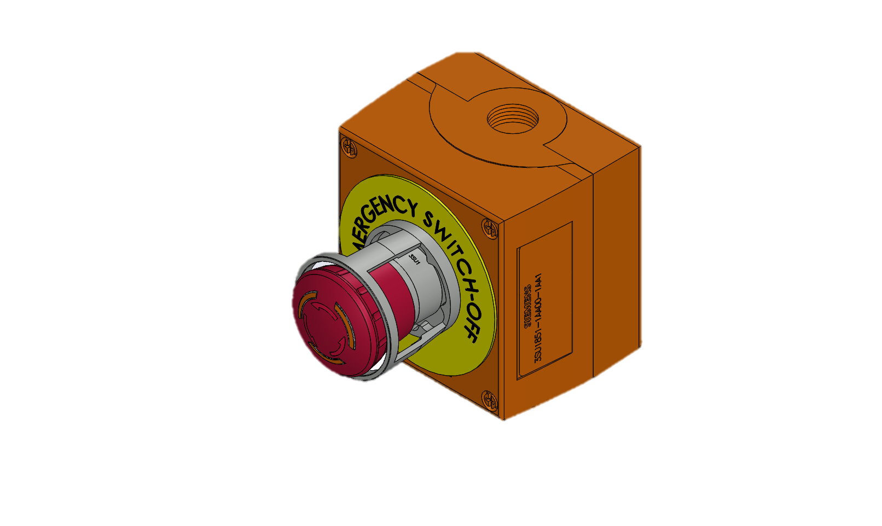
Safety Instrumented Functions (SIF)
TSPSS_SIF1 – ESOB Interlock
If any emergency switch-off button (ESOB) in the TS PSS controlled area is pressed, and the bending magnets are detected energised (Beam on Target (BoT) allowed) act on the following Equipment Under Control (EUC):
De-energise Ion Source High Voltage Power Supply (ISrc HVPS),
Connect the Grounding Relay to earth.
ESOB

Slide 54
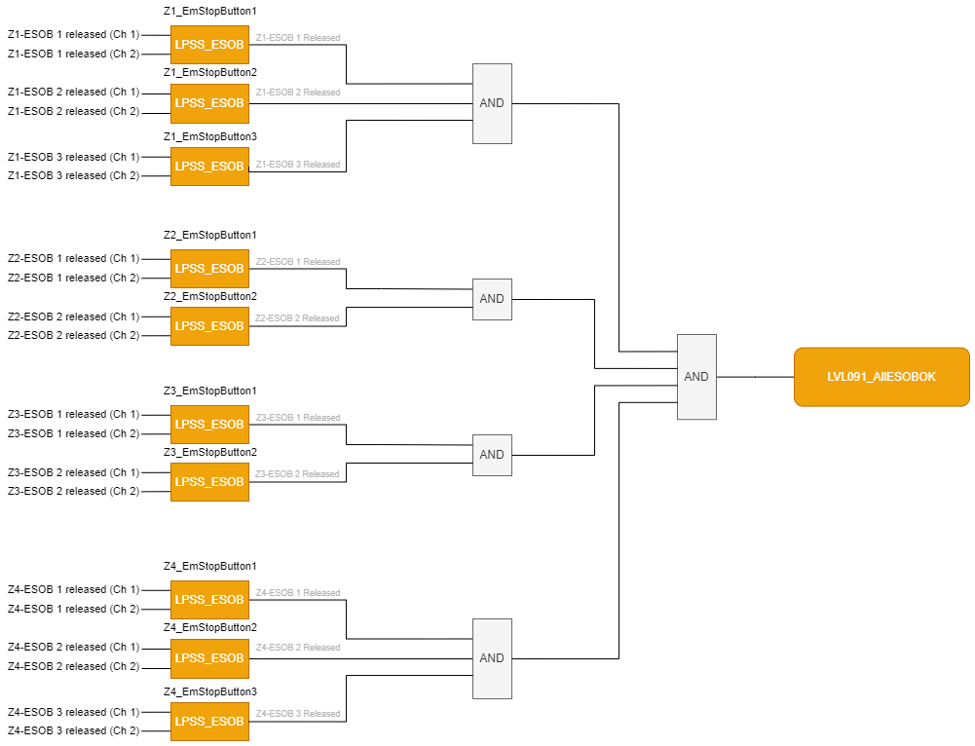
Safety Instrumented Functions (SIF)
TSPSS_SIF1 – ESOB Interlock

Slide 55
Safety Instrumented Functions (SIF)
LOKIPSS_SIF2 – Emergency Exit Doors Interlock

Slide 56
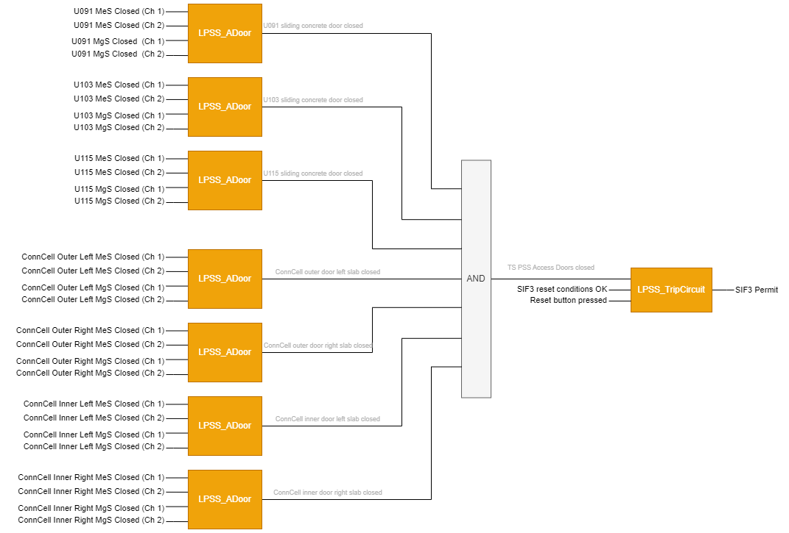
Safety Instrumented Functions (SIF)
LOKIPSS_SIF3 – Access Doors Interlock

Slide 57
Safety Instrumented Functions (SIF)
LOKIPSS_SIF4_1 to 4 –Doors Lock
The safety lock on the access doors on the TS PSS controlled area perimeters, to stay de-energised (locked) in order to prevent and block the access to TS PSS controlled area, when the door Entry Key (EK) is not in ON position on the lock unit

Slide 58
Safety Instrumented Functions (SIF)
LOKIPSS_SIF5 – High Radiation Interlock

