Slide 2
Target PSS and Bunker PSS Electrical and Mechanical Design CDR Presentation
PRESENTED BY anton andersson

Slide 3
Agenda
1 | E&M design documentation for this CDR
2 | Environmental conditions
3 | Power distribution and back-up power
4 | System Network architecture
5 | Target, Bunker PSS Control Cabinets and Field Devices
6 | Cable selection and Cable protection
7 | Grounding Strategy

Slide 4
1. E&M design documentation for the CDR
PRESENTED BY anton andersson

Slide 5
1. E&M design documentation for this CDR
Main E&M design documentation
IO-List:
Lists all IOs of the system
All Signal tags defined
All addresses defined
Electrical and Mechanical drawings:
Circuit Diagrams
Cabinet Layouts
Parts Lists
Cable Connection Lists
Electrical Verification report:
24VDC calculation
UPS calculation
Cabinet heat dissipation calculation
Current carrying capacity calculation
Autom. disc. of supply calculation
Voltage drop calculation
Equipment Layout drawings:
Placement of control cabinets
Placement of field devices
Cable pulling list:
Cable lengths
Cable routes
Cable types
Label list:
FBS Labels
Asset Labels
Control cabinet quality labels
Warning Signs

Slide 6
2. Environmental conditions
PRESENTED BY anton andersson

Slide 7
2. Environmental conditions
The components used in the design, have been checked to ensure they can sustain the environmental conditions where they are to be installed, see Appendix for Electrical Design Guidelines for PSS and Gas DS [2]
We have checked:
Radiation resistance
IP-rating
Temperature rating
Relative humidity rating

Slide 8
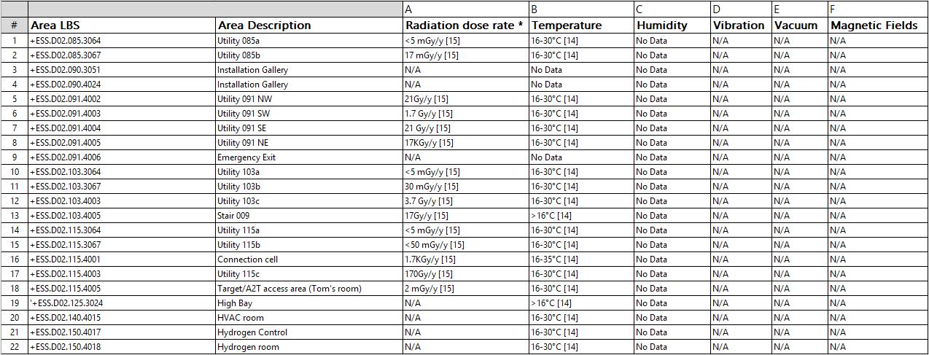
2. Environmental conditions
For more details, see TS rooms input data registry [7]
Environmental Conditions in D02 Target Building
Example for checking the radiation resistance of devices
Manufacturer | Part Number /product family | Description | Radiation resistance of device | Radiation Level in worst-case area
Huber+Suhner AG | Radox | Radox Multicore cables screened | 500 kGy [11] | <1.25 kGy/y
* For calculating the absorbed dose rate for material, 5000 hours of operation per year has been assumed and Conversion factor 3 has been assumed (3Sv=1 Gy) for converting Sieverts to Grey.

Slide 9
2. Environmental conditions
For more details, see DM--ID-TBSIDD----NSS-SI D01 D03 HVAC [8]
DM--ID-TBSIDDE---NSS-SI E01 E02 HVAC [9]
Environmental Conditions in NSS Buildings
Example for checking the radiation resistance of devices
Manufacturer | Part Number /product family | Description | Radiation resistance of device | Radiation Level in worst-case area
Huber+Suhner AG | Radox | Radox Multicore cables screened | 500 kGy [11] | <1.25 kGy/y
* For calculating the absorbed dose rate for material, 5000 hours of operation per year has been assumed and Conversion factor 3 has been assumed (3Sv=1 Gy) for converting Sieverts to Grey.

Slide 10
3. Power distribution and back-up power
PRESENTED BY anton andersson

Slide 11
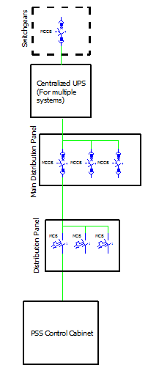
3. Power distribution and back-up power
Back-up Power D02 (Target PSS and Bunker PSS RIO Cabinets for LSS)
Example Target Building power distribution
(Back-up power from diesel generators)
If there is a power failure outside of the ESS facility, the diesel generators would start.
The power feeds to PSS equipment are backed-up by the diesel generators / centralized UPS for a minimum of 4 hours.
This is a requirement from the availability perspective, to avoid a power loss to a PSS control cabinet which would interrupt the operation of the facility.
If an event happens where PSS loses power to a control cabinet, we will interlock the hazardous equipment and go to a safe state.
Where our PSS control cabinet is not backed up by centralized UPS and diesel generators, we use our own UPS back-up inside the cabinets.

Slide 12
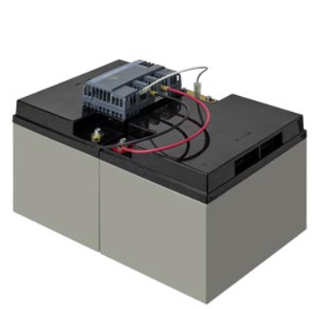
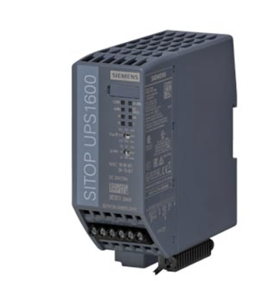
3. Power distribution and back-up power
Back-up Power Bunker PSS PLC Cabinets
The Control Cabinets in the instrument halls will not be backed by the diesel generators or a centralized UPS.
If there is a power failure, the internal UPS shall provide back-up for a minimum of 4 hours.
This is a requirement from the availability perspective, to avoid a power loss to a PSS control cabinet which would interrupt the operation of the facility.
If an event happens where PSS loses power to a control cabinet, we will interlock the hazardous equipment and go to a safe state.
Requirements:
The UPS unit provides back-up power to the 24VDC control circuits internally in the control cabinets and to field devices.
The Battery modules are designed so that they can be replaced individually during operation.
Due to small leaks of H2 from the battery modules SITOP BAT1600, it is required to have constant airflow in the control cabinets, which will be achieved with a fan and filter on the control cabinets.
8-year lifetime of battery modules.
The UPS system is designed to work for the full load for 4 hours and maintain a voltage of =>23VDC during that period (this shall be the case when the batteries are 8 years old).
Note: The minimum buffer voltage required is set to 23VDC since the worst-case voltage tolerance of the system is 21.6VDC for the Fortress Lock and Key Exchange Unit Solenoid.
For more details, see:
Electrical Verification Report Bunker PSS NWB [3]
Electrical Verification Report Bunker PSS SEB [4]
Electrical Verification Report Target PSS [5]

Slide 13
4. System Network architecture
PRESENTED BY anton andersson

Slide 14
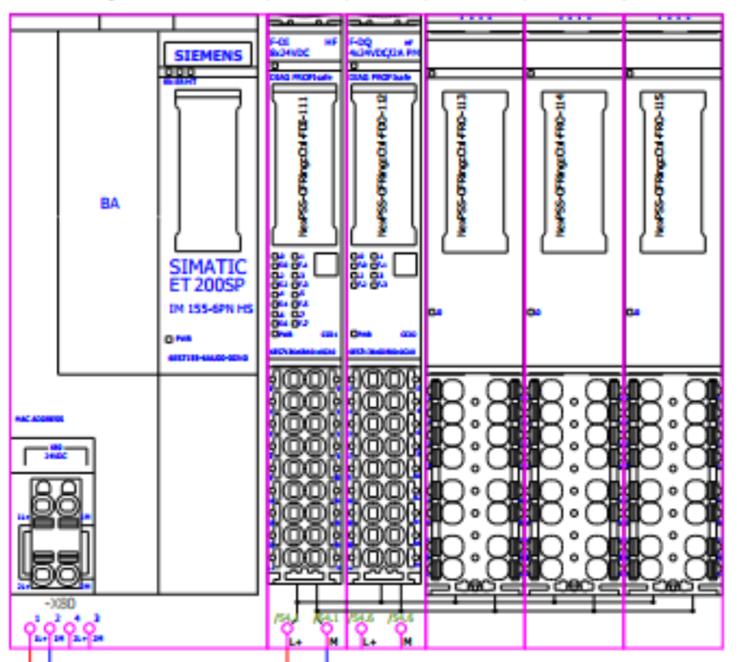
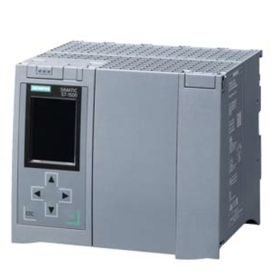
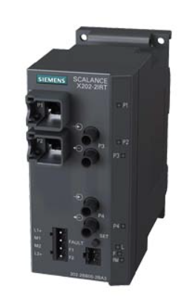
4. System Network architecture
Overview Nexus PSS Opt Fiber Ring
HMI
TS PSS
CPU
SEB PSS
IRT
IRT
Location: SEB PSS PLC Cabinet
Location: Target PSS PLC Cabinet
Nexus PSS Opt. Fiber Ring
Day1 Instruments
Odin PSS
Bifrost PSS
Acc PSS
Dream PSS
Loki PSS
NWB PSS
Location: NWB PSS PLC Cabinet
For more details, see System Architecture Specification for Personnel Safety Systems [6]
TBL PSS

Slide 15
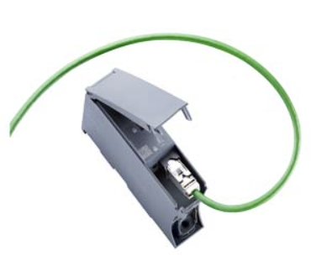
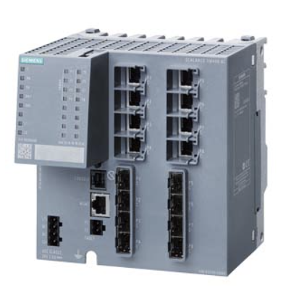
4. System Network architecture
Communication to HMI in MCR
Nexus PSS PLC Cabinet
MCR PSS Cabinet
Acc PSS PSS PLC Cabinet
TS PSS PLC Cabinet
NWB PSS PLC Cabinet
SCALANCE XM408-8C
MTP1500 Unified Comfort Panel
SEB PSS PLC Cabinet
Communications processor CP 1543-1

Slide 16
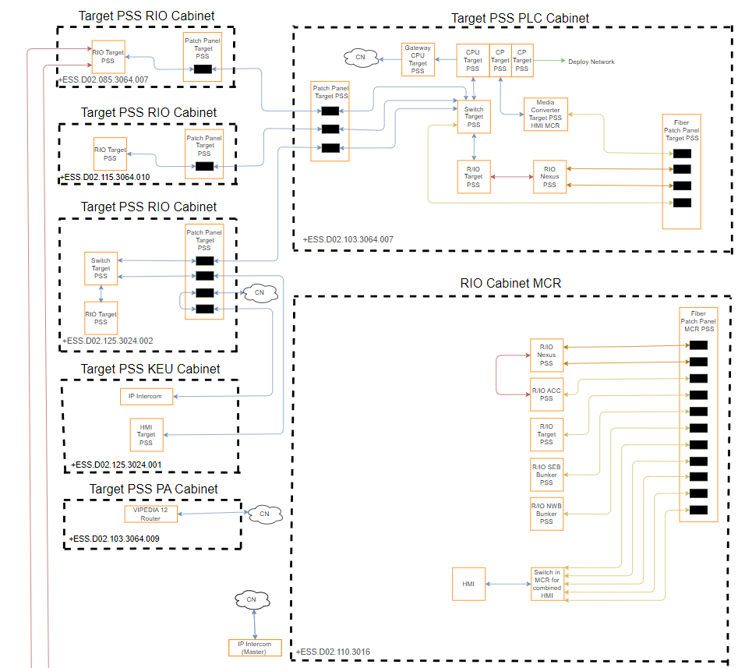
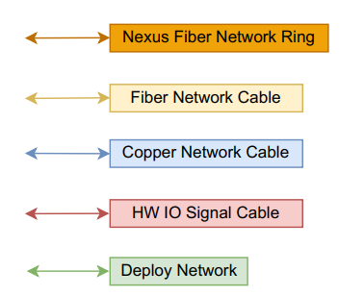
4. System Network architecture
Target PSS Network Architecture
-TS PSS to HMI in MCR
-Nexus PSS Fiber Ring
-Nexus PSS Fiber Ring
-TS PSS IOs in MCR
-TS PSS IOs in MCR
-TS PSS to HMI in MCR
HW interface to Bunker PSS

Slide 17
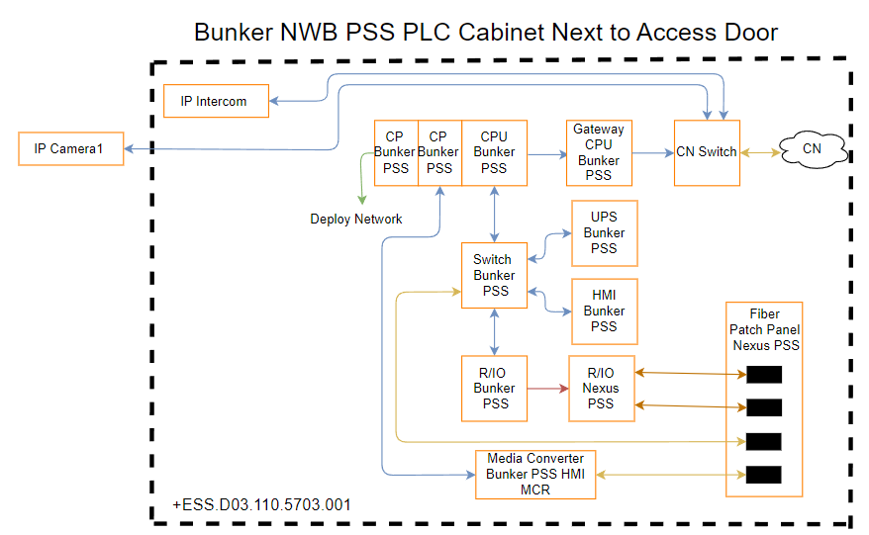
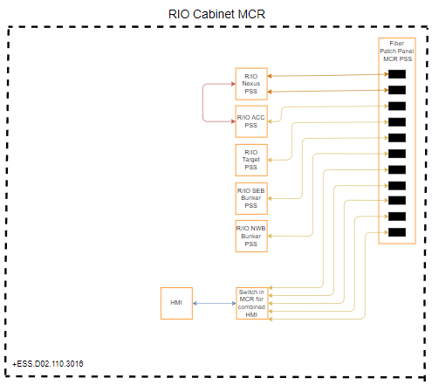
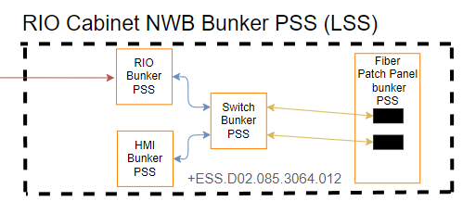
4. System Network architecture
Bunker PSS (NWB) Network Architecture
-NWB PSS IOs in MCR
-NWB PSS to HMI in MCR
-Nexus PSS Fiber Ring
-Nexus PSS Fiber Ring
-NWB PSS IOs LSS
-NWB PSS to HMI in MCR
HW interface to Target PSS
-NWB PSS IOs LSS
-NWB PSS IOs in MCR

Slide 18
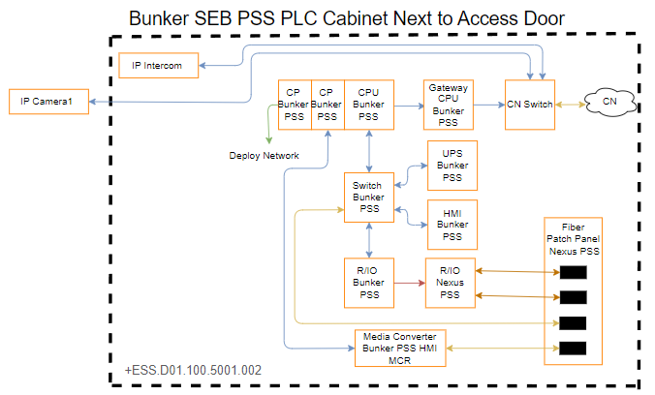
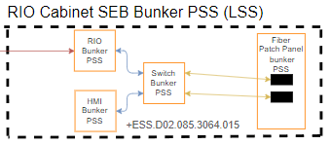
4. System Network architecture
Bunker PSS (SEB) Network Architecture
-SEB PSS IOs in MCR
-SEB PSS to HMI in MCR
-Nexus PSS Fiber Ring
-Nexus PSS Fiber Ring
-SEB PSS IOs LSS
-SEB PSS to HMI in MCR
HW interface to Target PSS
-SEB PSS IOs LSS
-SEB PSS IOs in MCR

Slide 19
5. Target, Bunker PSS Control Cabinets and Field Devices
PRESENTED BY anton andersson

Slide 20
5. Target, Bunker PSS Control Cabinets and Field Devices
Access to Control Cabinets and Enclosures
The following control cabinets and enclosures are locked by PSS
System | Description | Access by
Target PSS | PLC Cabinet | PSS
 | RIO Cabinets | PSS
 | PA system Cabinet | PSS
 | Key Exchange Cabinet | PSS, MCR
 | Blue Light ICCs | PSS
Bunker PSS | PLC Cabinets | PSS
 | RIO Cabinets | PSS
 | Cabinets for KEU for SCMKs | PSS, MCR
 | Cabinets for KEU Bypass Key | PSS
MCR PSS | MCR Cabinet (For access to KEU) | PSS, MCR
 | MCR Cabinet (For access IOs) | PSS

Slide 21
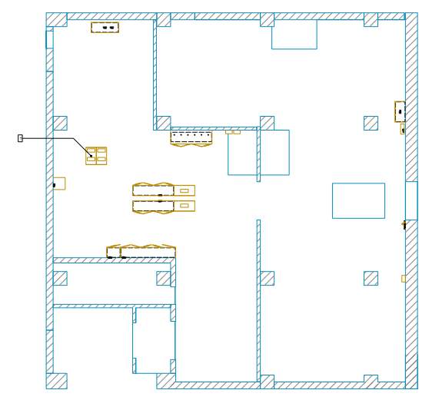
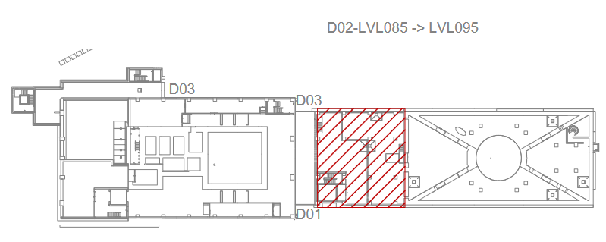
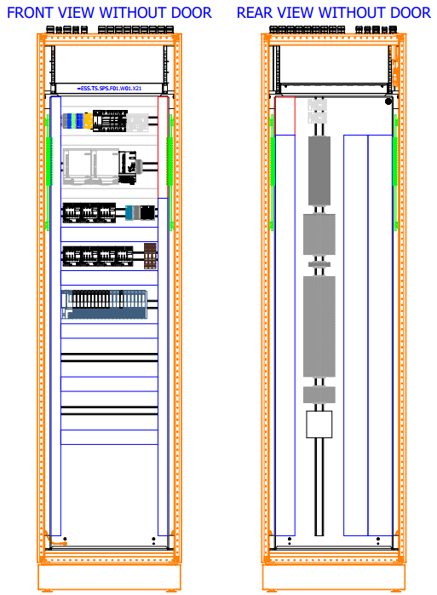
5. Target, Bunker PSS Control Cabinets and Field Devices
Target PSS equipment location Control Cabinets (D02 level 085)
RIO Cabinet

Slide 22
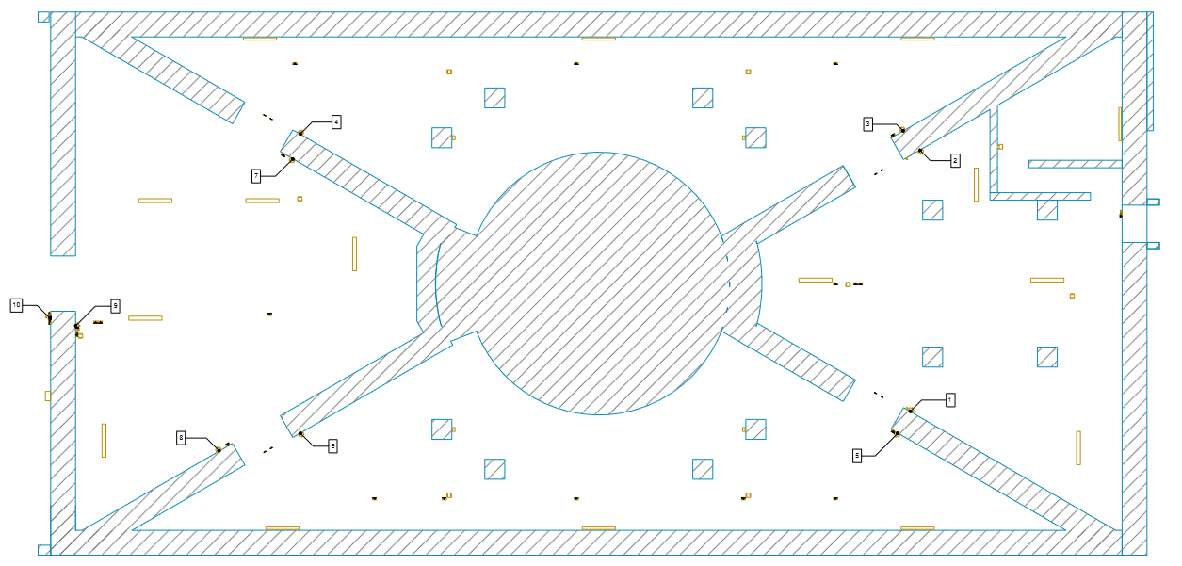
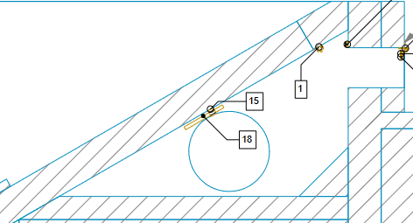
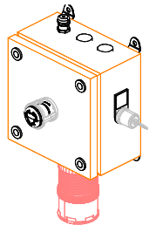
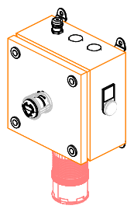
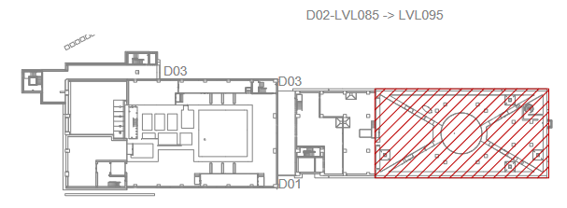
5. Target, Bunker PSS Control Cabinets and Field Devices
Target PSS equipment location ESOS (D02 level 091)
Level 103
2
1
1
1
2
2
1: ESOS (Key)
2
2
2
1
2: ESOS (search button)

Slide 23
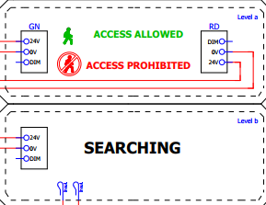
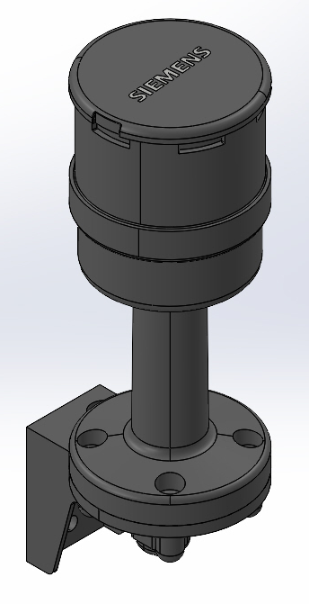
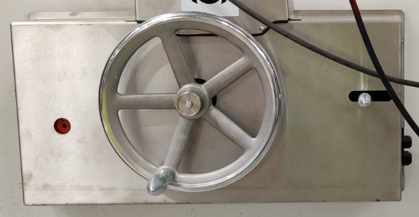
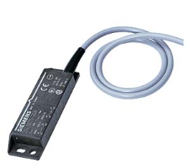
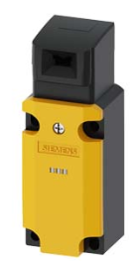
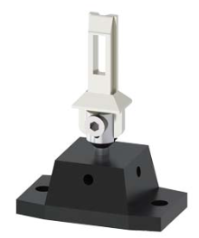
5. Target, Bunker PSS Control Cabinets and Field Devices
Target PSS equipment location Doors (D02 level 091)
Level 103
3
1
2
1
3
3
5
6
2
3
5: Electromechanical Lock E-Exit Door
2
4
1
1
3
3
3
6: Message Display
4: Electromechanical Lock Access Door
1: 2x magnetic switch
(1 for each door)
3: LED Annunciator for search
2: 1 magnetic and 1 mechanical switch

Slide 24
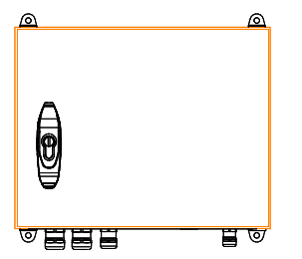
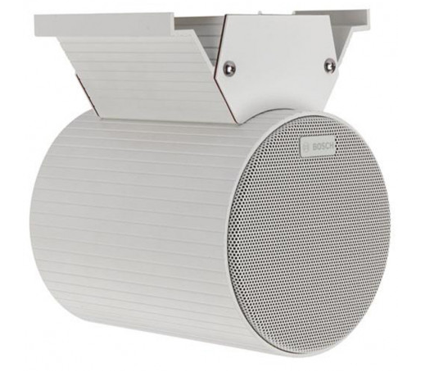
5. Target, Bunker PSS Control Cabinets and Field Devices
Target PSS equipment location Blue Lights and PA Loudspeakers (D02 level 091)
Level 103
1
1
1
3
4
1
1
3
1
4
1
1
1
1
4
1
1
1
1
3
4
3
2
1
1
1
1
3
1
1
4
1
2: Blue Light ICC
1: Blue Light
3: Loudspeaker Line 1
4: Loudspeaker Line 2

Slide 25
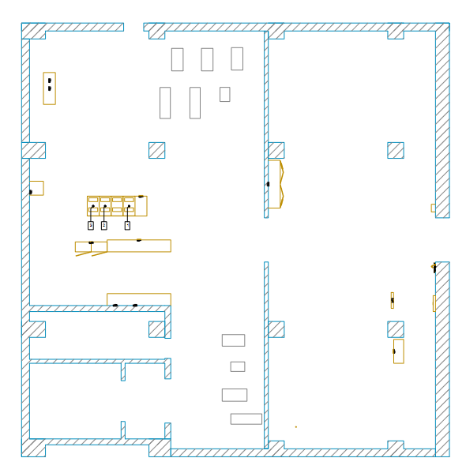
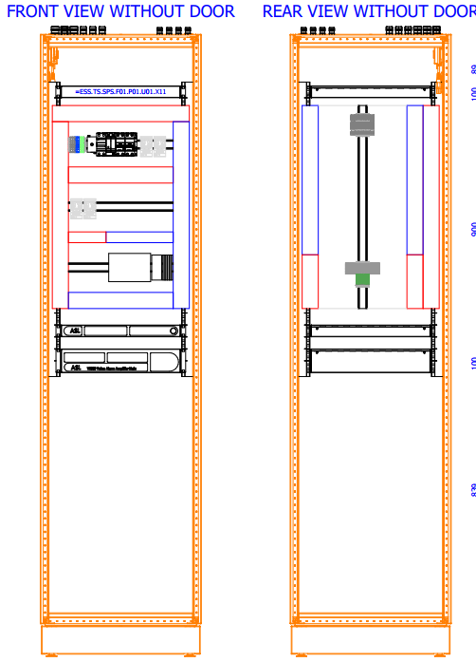
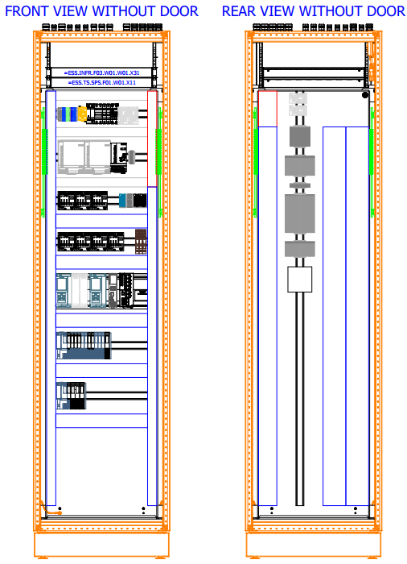
5. Target, Bunker PSS Control Cabinets and Field Devices
Target PSS equipment location Control Cabinets (D02 level 103)
PA System Cabinet
PLC Cabinet

Slide 26
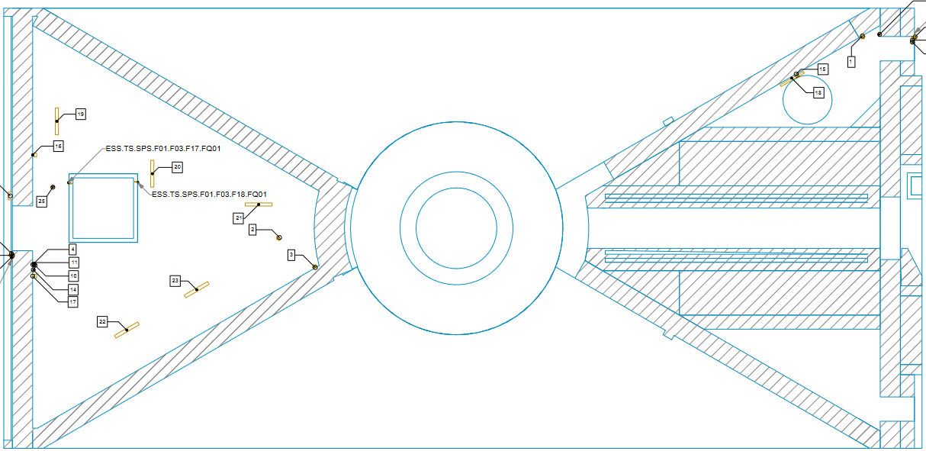
5. Target, Bunker PSS Control Cabinets and Field Devices
Target PSS equipment location ESOS (D02 level 103)
1
2
2
1: ESOS (Key)
2: ESOS (search button)

Slide 27
5. Target, Bunker PSS Control Cabinets and Field Devices
Target PSS equipment location Doors (D02 level 103)
5
5
4
2
1
3
1: 1 magnetic and 1 mechanical switch
2: LED Annunciator for search
3: Electromechanical Lock Access Door
4: Message Display
5: Mechanical Key Bolts

Slide 28
5. Target, Bunker PSS Control Cabinets and Field Devices
Target PSS equipment location Blue Lights and PA Loudspeakers (D02 level 103)
1
3
1
2
1
1
4
1
1: Blue Light
2: Blue Light ICC
3: Loudspeaker Line 3
4: Loudspeaker Line 4

Slide 29
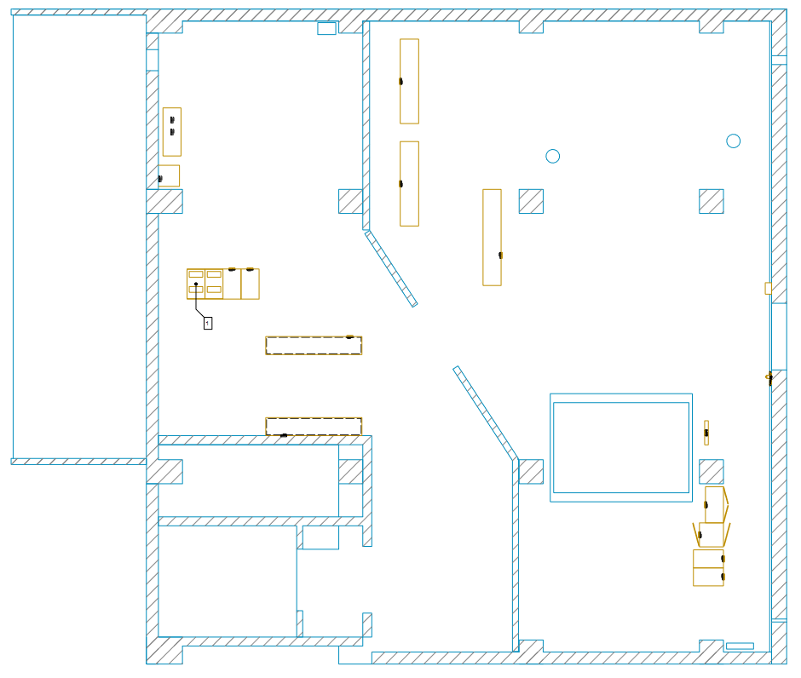
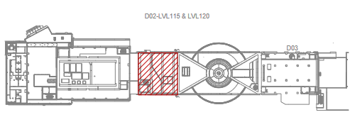
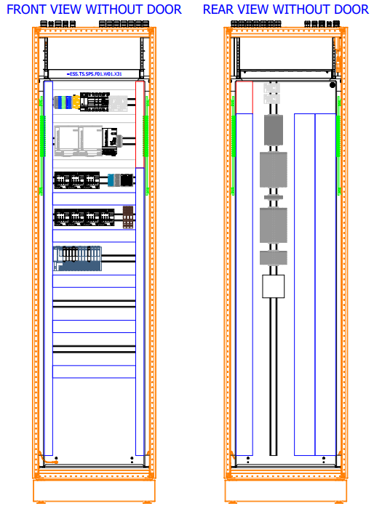
5. Target, Bunker PSS Control Cabinets and Field Devices
Target PSS equipment location Control Cabinets (D02 level 115)
RIO Cabinet

Slide 30
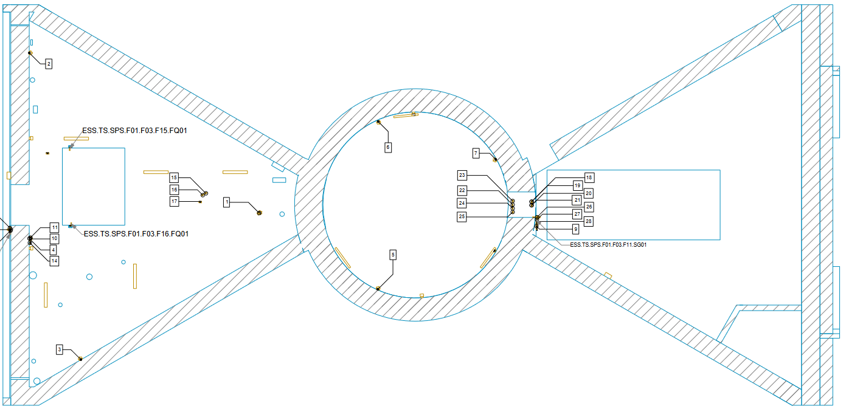
5. Target, Bunker PSS Control Cabinets and Field Devices
Target PSS equipment location ESOS (D02 level 115)
2
2
2
1
2
1
2
1: ESOS (Key)
2: ESOS (search button)

Slide 31
5. Target, Bunker PSS Control Cabinets and Field Devices
Target PSS equipment location Doors (D02 level 115)
5
4
5
1 (4pc)
4
2
2
1
3
3
1: 1 magnetic and 1 mechanical switch
2: LED Annunciator for search
3: Electromechanical Lock Access Door
4: Message Display
5: Mechanical Key Bolts

Slide 32
5. Target, Bunker PSS Control Cabinets and Field Devices
Target PSS equipment location Blue Lights and PA Loudspeakers (D02 level 115)
4
1
1
6
2
1
1
3
1
1
1
5
2
1
1: Blue Light
2: Blue Light ICC
3: Loudspeaker Line 5
4: Loudspeaker Line 6
5: Loudspeaker Line 7
6: Loudspeaker Line 8

Slide 33
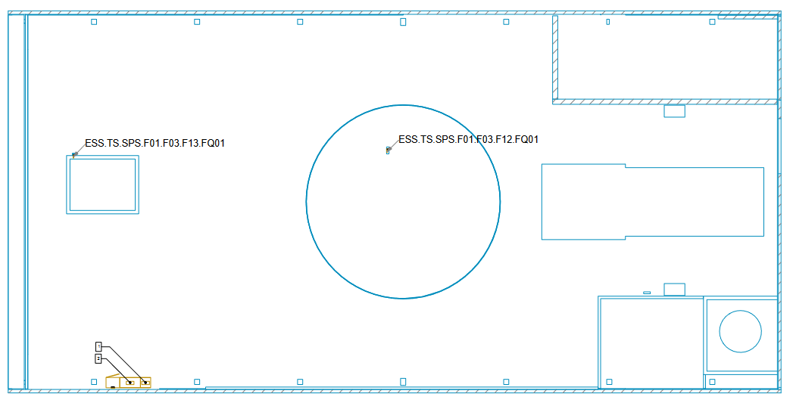
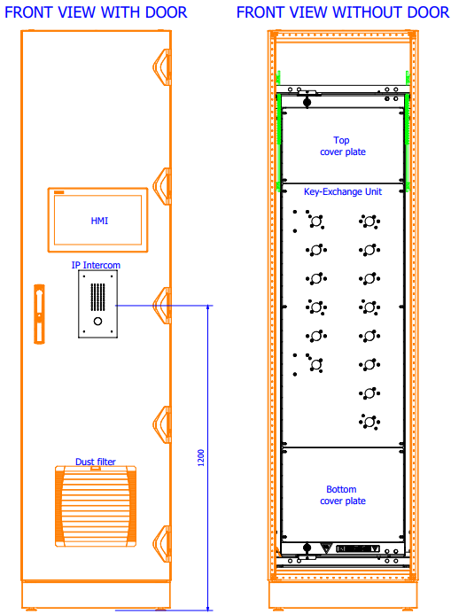
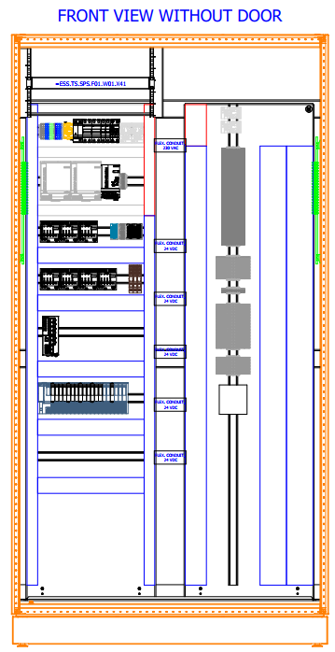
5. Target, Bunker PSS Control Cabinets and Field Devices
Target PSS equipment location (D02 level 125 High Bay)
Mechanical Key Bolt
Key Exchange Cabinet
RIO Cabinet

Slide 34
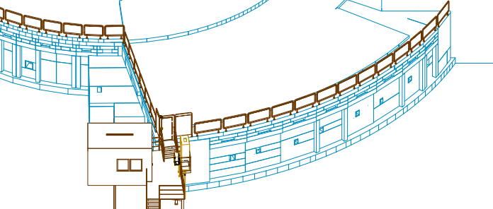
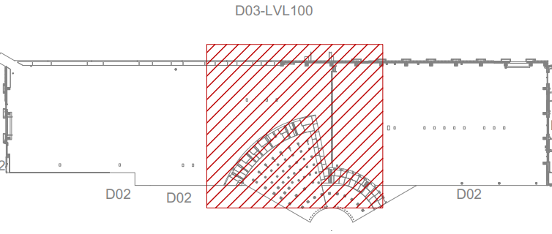
5. Target, Bunker PSS Control Cabinets and Field Devices
NWB Bunker PSS equipment location (D03 Overview)

Slide 35
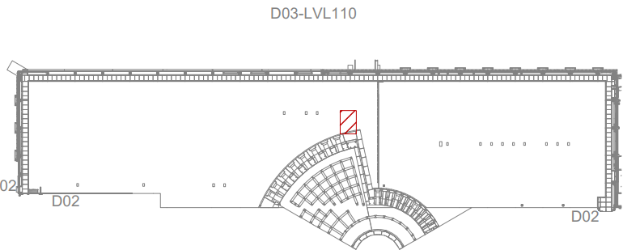
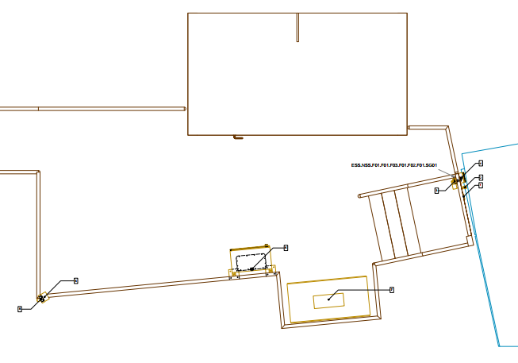
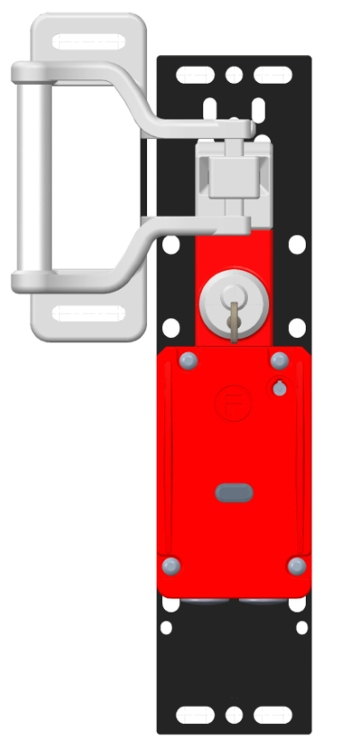
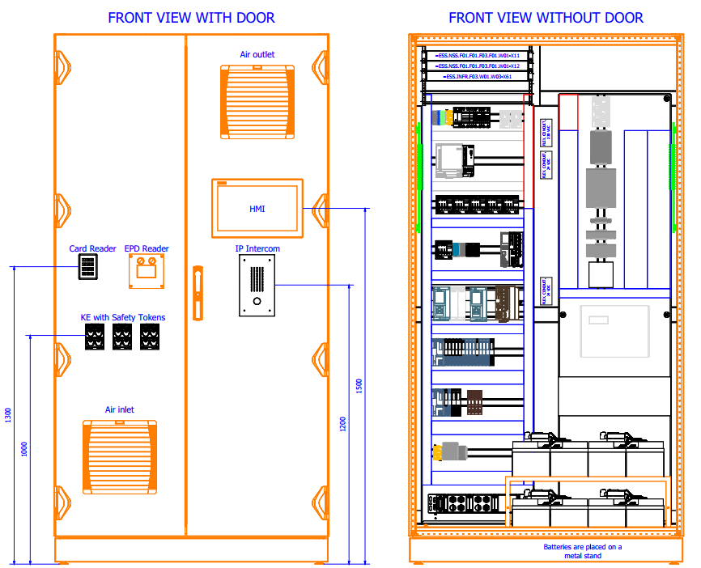
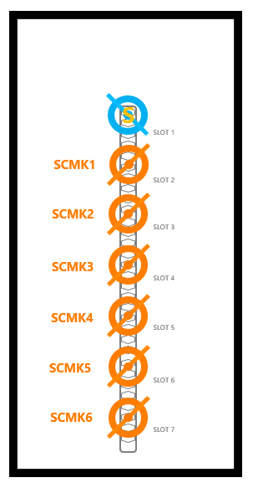
5. Target, Bunker PSS Control Cabinets and Field Devices
NWB Bunker PSS equipment location (D03 Access Door)
Electromechanical Lock Access Door
1 magnetic and 1 mechanical switch
PLC Cabinet
Cabinet for SCMK
IP Camera

Slide 36
5. Target, Bunker PSS Control Cabinets and Field Devices
SEB Bunker PSS equipment location (D01 Overview)

Slide 37
5. Target, Bunker PSS Control Cabinets and Field Devices
SEB Bunker PSS equipment location (D01 Access Door)
Cabinet for SCMK
Electromechanical Lock Access Door
PLC Cabinet
1 magnetic and 1 mechanical switch
IP Camera

Slide 38
5. Target, Bunker PSS Control Cabinets and Field Devices
Bunker PSS equipment location (D02 level 085)
RIO Cabinet NWB (LSS)
RIO Cabinet SEB (LSS)
Bypass Key Boxes for Light Shutters

Slide 39
5. Target, Bunker PSS Control Cabinets and Field Devices
Bunker PSS equipment location (D02 level 091)
1
1
1
1: 2x mechanical Switches
1
1
1
1
1
1
1
1
1
1
1
1
1

Slide 40
6. Cable selection and Cable protection
PRESENTED BY anton andersson

Slide 41
6. Cable selection and Cable protection
The following cables types have been selected for the defined application below.
Cable Types | Description | Where Used
UNITRONIC LiHCH (TP) | Signal Cable | Used as control cables, in general areas.
RADOX 125 BK | Radiation Resistant Signal Cable (500 kGy) | Used as control cables, in areas where the cable is exposed to ionizing radiation.
BETAflam 145 flex | Radiation Resistant Signal Cable (700 kGy) | Used as power cable, in areas where the cable is exposed to ionizing radiation (Blue light system).
INTEX24xxxC | Fiber Optic Cable | Used for the multi-mode, optical fiber.
All network and signal cables for PSS is generally protected by dedicated cable trunks and conduits for the full length between cabinet and field device.

Slide 42
7. Grounding Strategy
PRESENTED BY anton andersson

Slide 43
7. Grounding Strategy
PSS Grounding Requirements
Protective Earth
Are used when a dangerous voltage (risk for electric shock) could occur.
This is not required for PELV circuits.
Protective earth is generally connected through the PE conductor of the low voltage power cable.
Equipotential Protective Bonding
EPB is used to ensure that all mechanical parts in a certain area are interconnected which means they cannot obtain different grounding potentials in case of a fault within the facility.
All PSS components shall generally be connected to the EPB grounding network either by an electrical or mechanical connection.
PELV Circuits
For the 24VDC signals, PSS are using PELV circuits.
The main reason is to ensure a short-circuit if there is a fault in the signal cables, to avoid having a ‘’floating’’ voltage in the 24VDC circuit.
Rules in chapter 414.4 in [4] and chapter 6.4 in [3] are fulfilled so our 24VDC system are considered a PELV circuit.

Slide 44
7. Grounding Strategy
Electromagnetic Compatibility
EMC Shielding is used to protect a sensitive signal from external electromagnetic signals or preventing a stronger signal from leaking out and interfering with surrounding electronics.
The sensitive components (in terms of EMI) for PSS is generally the PLC related components.
PSS Mitigations against Electromagnetic Interference:
Using EMC rated Control Cabinets (with EMC rated cable glands to control cabinets)
Using Shielded Cables
Cables enclosed in cable trunks and conduits

Slide 45
7. Grounding Strategy
NSS Grounding zones
Within the ESS facility, neutron instruments contain many diverse systems which vary from high-powered electrical equipment to highly sensitive detector and electronic systems.
Each instrument and the bunker has its own grounding zone to prohibit EMI noise to travel from instrument to instrument, see grounding zone separation in attached image.
Only optical fiber cables are allowed between the different grounding zones, in this case it is for our communication from Bunker PSS PLC Cabinets to Nexus Network Cabinets.

Slide 46
Finish presentation

Slide 47
Reference Documents
[1] ESS-4077615 - Electrical Design Guidelines for PSS and Gas DS
[2] ESS-4226262 - Appendix for Electrical Design Guidelines for PSS and Gas DS
[3] ESS-5161534 - Electrical Verification Report Bunker PSS NWB
[4] ESS-5312931 - Electrical Verification Report Bunker PSS SEB
[5] ESS-5152288 - Electrical Verification Report Target PSS
[6] ESS-3739363 - System Architecture Specification for Personnel Safety Systems
[7] ESS-0043152 - TS rooms input data registry
[8] ESS-0048000 - DM--ID-TBSIDD----NSS-SI D01 D03 HVAC
[9] ESS-0056058 - DM--ID-TBSIDDE---NSS-SI E01 E02 HVAC

