Slide 2
Target Risk Assessment and High-Level Requirements
TS PSS & Bunker PSS CDR (2024-04-29)
PRESENTED BY Morteza Mansouri

Slide 3
Agenda
1 Target risk assessment
2 PSS high-level requirements

Slide 4
Risk assessment
Risk assessment for Target PSS (ESS-4121077)

Slide 5
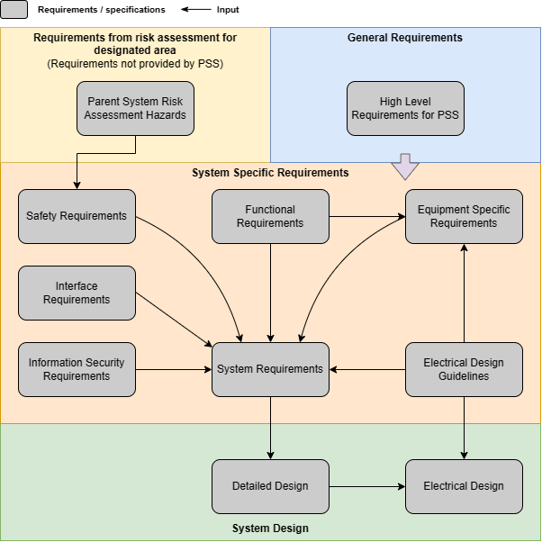
Requirements management for PSS

Slide 6
Thank you Questions/comments?

Slide 7
Back-up slides

Slide 8
Finish presentation

