Slide 2
ESS PSS overview
TS PSS & Bunker PSS CDR (2024-04-29)
PRESENTED BY Morteza Mansouri
2024-04-24

Slide 3
Agenda
1 PSS introduction, scope & stakeholders
2 ACC PSS, TS PSS, Bunker PSS & Instrument PSS
3 PSS overall structure
4 PSS supervision
5 PSS bypass

Slide 4
1
PSS introduction, scope & stakeholders

Slide 5
ESS PSS
Personnel Safety Systems at ESS (ESS PSS) can be considered as an integrated system that is composed of several PSS systems across the facility; ACC PSS, TS PSS, Bunker PSS an PSS systems for instruments.
The purpose of ESS PSS is to contribute to the overall personnel safety at ESS in order to enable safe commissioning and operation of the Linear Accelerator (Linac), Target, Bunker and Neutron Instruments.
Terminologies:
Parent system: The system hierarchically above a PSS in the ESS Facility Breakdown Structure (FBS). For examples the Accelerator (=ESS.ACC) as the parent system for Accelerator PSS (=ESS.ACC.F01).
PSS controlled area: An area within which a PSS mitigates designated hazards or the PSS contributes to access control.
EUC: Equipment that the PSS interlocks, in order to mitigate designated hazards associated with equipment and/or processes.

Slide 6
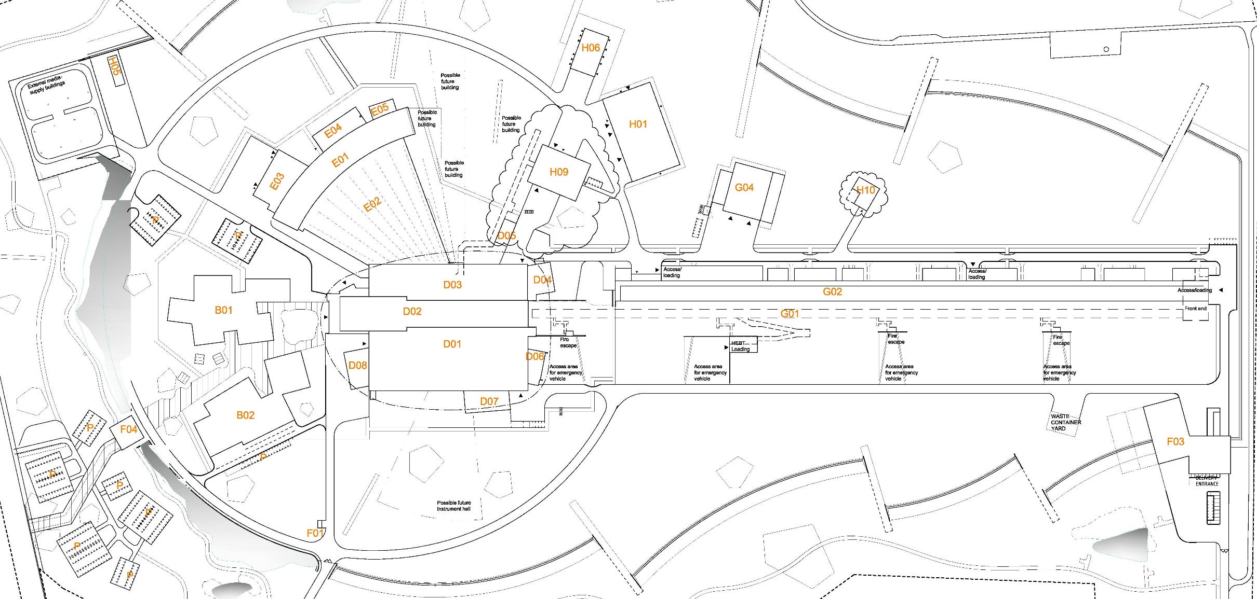
Personnel Safety Systems at ESS
Instrument 1 PSS
Instrument 2 PSS
Instrument 16 PSS
TS2 PSS
TS4 PSS
Bunker PSS
Target PSS
Accelerator PSS

Slide 7
General functionalities of a PSS
Safety interlock system: This is the core of a PSS and implements the safety instrumented functions, and search, interaction with key exchange system, etc.
Access control system: The access control system contributes to ensuring ‘registered access’ or ‘controlled access’ to a PSS controlled area, in conjunction with physical access control system.
Notes:
So far, ACC PSS and Bunker PSS include both functionalities of safety interlock system and access control system. The rest of PSS systems at ESS only include a safety interlock system.
Both functionalities can be implemented through one PLC-based system.

Slide 8
Mindset and approach in PSS design
Focus on
Adopting consistent systems design and implement standardization as much as reasonably practical in:
Technology (HW and SW)
User interfaces (trapped key interlock systems, OPI, HMI)
Documentation
Testing
Maintenance
Designing scalable systems
Accommodate planned upgrades, e.g. support additional RF systems in Accelerator, or additional instruments in NSS)
Accommodate predictable upgrades, e.g. the architecture to support additional instrument PSS (beyond the planned 16 instruments) at NSS.

Slide 9
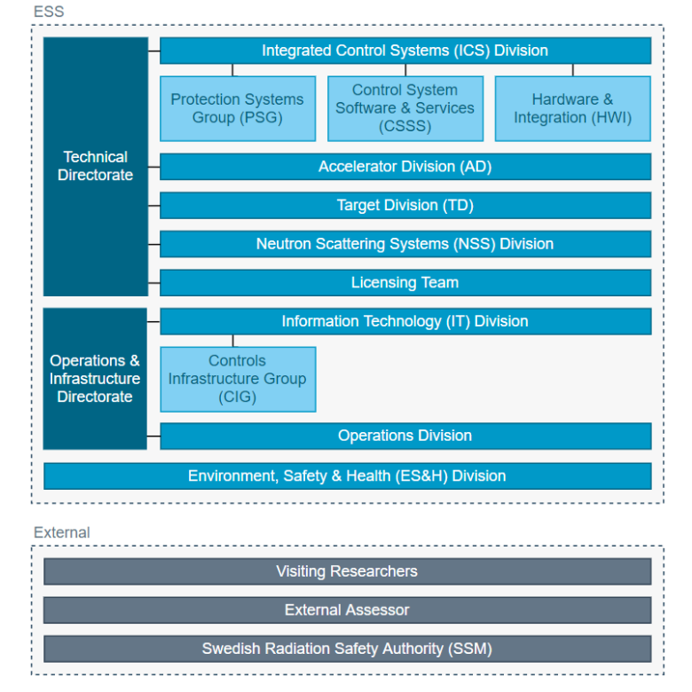
PSS stakeholders & interaction roles
A stakeholder is defined as a person, or group of people, linked to the system in any fashion. The concept includes everyone with an interest (or stake) in the system. These stakeholders interact with the PSS in different roles, called system interaction roles (owner, provider, operator (normal and expert), client.

Slide 10
2
ACC PSS, TS PSS, Bunker PSS & Instrument PSS

Slide 11
ESS PSS main functions
The main functions shared between the ESS PSS are the following:
Prevent access to the PSS controlled area, if hazardous equipment is energised.
Prevent energisation of hazardous equipment, if the PSS controlled area is not searched and locked.
Switch OFF the hazardous equipment, if an intrusion to the PSS controlled area is detected.
Switch OFF hazardous equipment, if an Emergency Switch-OFF Button (ESOB) is pressed in the PSS controlled area.
Switch OFF hazardous equipment, if the PSS receives a high radiation alarm or fault signal from the designated radiation monitor(s).
Furthermore, the ESS PSS provides the following functions:
Provide procedures and means to perform a formalised search of the PSS controlled area.
Provide personnel and operators with the information of the PSS controlled area, access stations, and PSS permits to EUC, locally and remotely.

Slide 12
Accelerator
Slide courtesy of Vincent Harahap

Slide 13
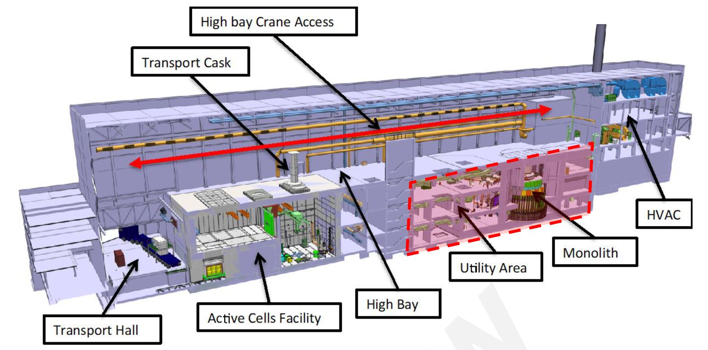
Target station

Slide 14
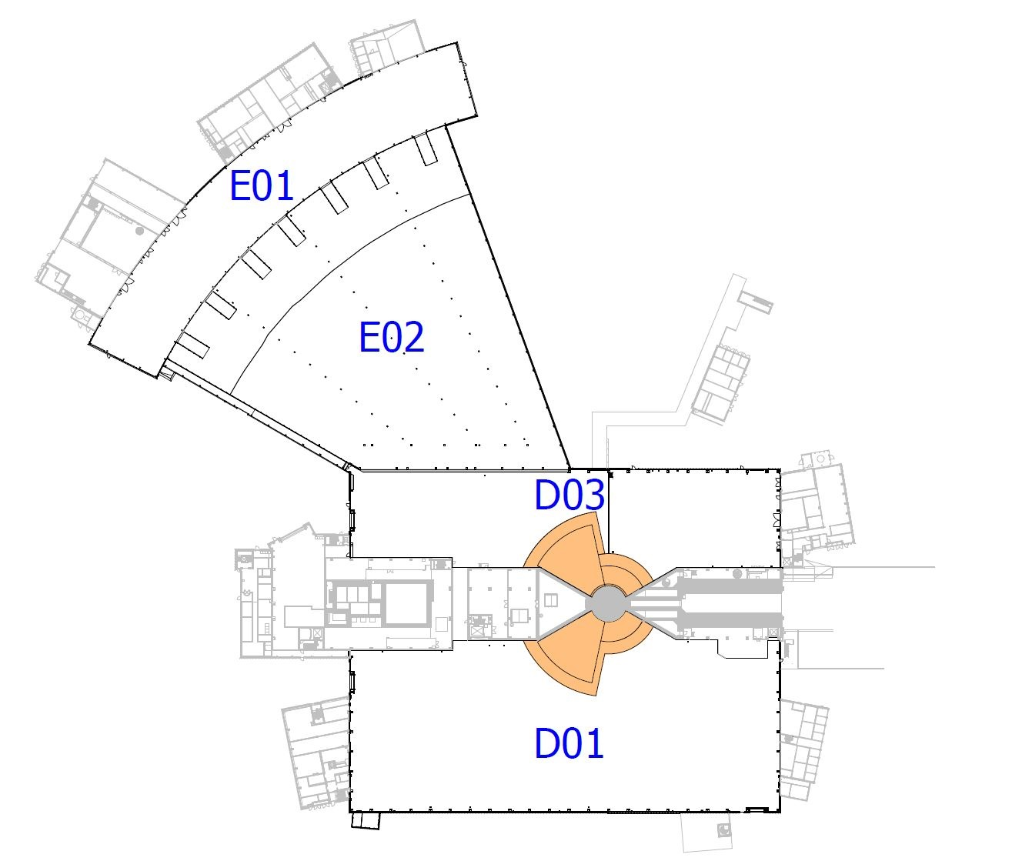
Bunker
Plan view of the NSS buildings, with the Bunker PSS controlled area marked in orange.

Slide 15
Instruments
LoKI PSS

Slide 16
3
PSS overall structure

Slide 17
Nexus PSS
In certain hazardous scenarios, TS PSS, Bunker PSS and each Instrument PSS need to request ACC PSS to prevent proton beam to Target. In order to ensure a robust and reliable interlink between different PSS Systems, a centralised system called Nexus PSS, which interfaces all other PSS systems, is used for this purpose.
System Requirements Specification for Nexus Personnel Safety System (ESS-4758307)

Slide 18
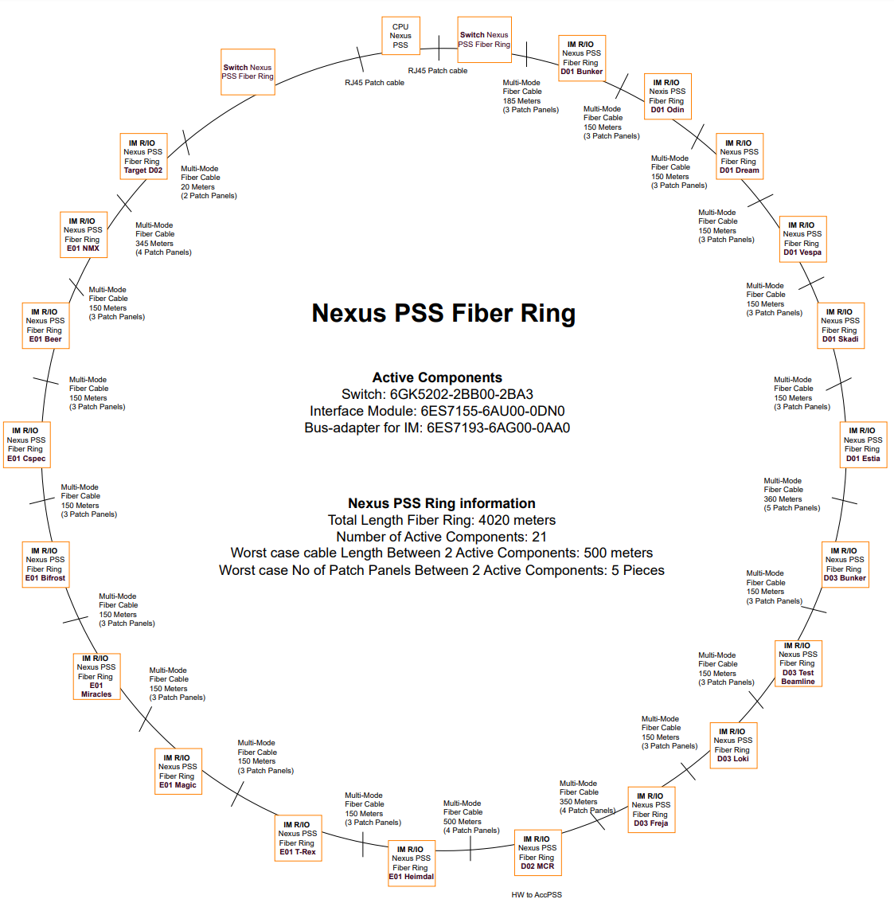
ESS PSS architecture
Architecture Specification for Personnel Safety Systems (ESS-3739363) provides the functional and physical architectures for PSS.
It depicts how various PSS (ACC PSS, TS PSS, Bunker PSS, Instruments PSS) are structured and how they are interlinked.
The PSS architecture is designed in a scalable fashion, and the adopted technologies have the capacity to support full accelerator power and energy, and 22 neutron instruments.

Slide 19
ESS PSS permit for Beam on Target (BoT)
PSS enables BoT, if “Nexus Ready for BoT is TRUE” AND “BoT Main Key is enabled”.
ISrc is switched off, if “Nexus Ready for BoT is FALSE” AND “BoT Main Key is enabled”.

Slide 20
4
PSS supervision

Slide 21
PSS supervision
Means to supervise PSS:
Locally, areas very close to PSS controlled area, e.g. near the access point to an instrument cave: Human Machine Interfaces (HMI)
Remotely, from anywhere with connection to ESS control network, e.g. MCR or instrument control hutch (read-only access): Operator Interfaces (OPI)

Slide 22
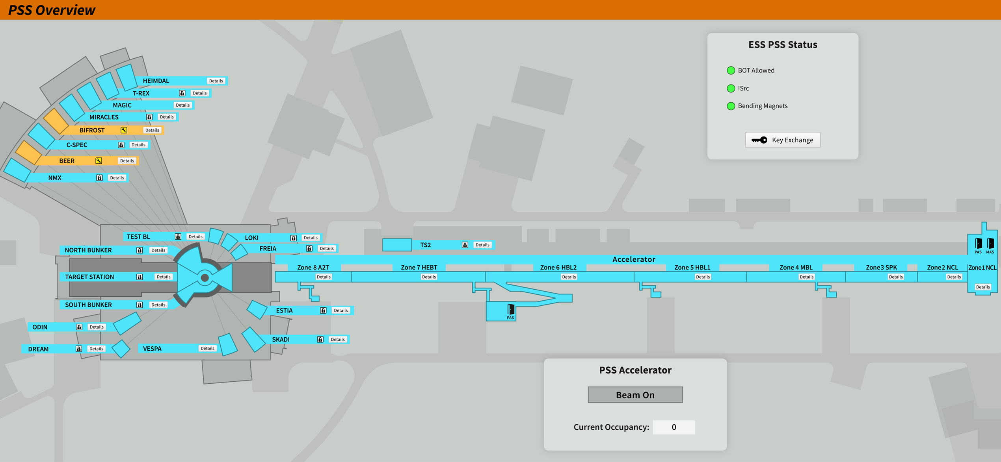
Overview OPI for ESS PSS

Slide 23
System specific OPI

Slide 24
5
PSS bypass

Slide 25
PSS bypass
The ESS PSS are designed to minimize the need to bypass the system while hazards are
present. However, in certain circumstances, such as during testing or performing maintenance of the EUC, a SIF (or parts of a SIF) may need to be temporarily disabled or bypassed.
Prior to bypassing the designated SIFs, written operational procedures shall be developed documenting how and when a SIF bypass may be used, by whom, and for how long. This procedure shall include a re-verification of the SIF, after the task is completed and the bypass is removed.
Moreover, a risk assessment shall be carried out to evaluate and determine the compensating measures that ensure continued safety, while the SIFs are disabled or degraded due to bypass.

Slide 26
Measures during PSS bypass
The following measures can be considered for providing bypass means for the ESS PSS:
A means of ensuring the hazard related to the SIF is removed shall be implemented such as a LOTO or Physical barrier installed.
When a bypass function is enabled, alarms and emergency switch-off SIFs shall not be disabled.
Bypass functions shall be removed, and bypass means returned to their normal position prior to the start of normal operations.
The bypass means are managed by an Expert Operator to prevent unauthorized use.
Where possible, time limits on bypass functions are enforced.
Where possible, limiting the number of bypasses that can be active at the same time is enforced.

Slide 27
Examples of PSS bypass
Below are a few examples of required bypass functions in PSS:
ACC PSS :
Bypass the PSS interlock on RF power actuators to enable warm coupler conditioning while access to the ACC PSS controlled area is permitted.
Bypass the PSS interlock on the gamma blocker to allow access to the ACC PSS controlled area in order to repair a failed (in open position) gamma blocker.
Bunker PSS & TS PSS:
Bypass the PSS interlock on a light shutter to allow access to the Bunker PSS controlled area in order to perform maintenance on a neutron beam port.
Bypass the PSS interlock on a light shutter to allow access to the TS PSS controlled area in order to repair a failed (in open position) light shutter
Instrument PSS:
Bypass the Instrument PSS interlock on proton beam actuators, when an instrument is offline.

Slide 28
Thank you! Questions/comments?

Slide 29
Back-up slides

Slide 30
PSS Interfaces
Interfacing system | Purpose
Data archiving service | To record PSS data (e.g. alarms, PLC diagnostics, etc.) during operation to allow for event reconstruction and analysis.
Alarm Service | ESS uses the EPICS alarm service to realise the provision of automated notifications for PSS related events (e.g. when PSS SIFs have been triggered, or PSS equipment failure). These alarms can be categorised based on their severity and provide operators with an instruction.
Technical Network | A routing instance of the Technical Network, the Controls Network (CN), is used for EPICS-based control systems. The CN enables all data transfers between the PSS and EPICS IOC, the data archiving service, and alarm service.
Radiation monitors | Radiation monitors are installed at the perimeters of designated PSS controlled areas to maintain the area classification with legal dose limits and dose rates set by the Operational Radiation Protection team, and alarm if those are exceeded. The ESS PSS interface with these radiation monitors through the Radiological & Environmental Monitoring System (REMS) (=ESS.INFR.B01) to mitigate radiation hazards in certain hazardous scenarios. In case of Instruments, PSS interfaces with radiation monitor downstream the instrument shutter, in order to mitigate the radiation hazard within the cave upon shutter failure.
Electronic Personal Dosimeter | Designated PSS (e.g. ACC PSS) need to interface with the Electronic Personal Dosimeter (EPD) System to ensure personnel carry an EPD upon access to PSS controlled area. The EPDs are used for direct reading of radiation dose and alarming capabilities in areas with higher radiation risk.

Slide 31
PSS Interfaces
Interfacing system | Purpose
Physical Protection System | The Physical Protection System (=ESS.INFR.R01) is a system in place to protect people, information and facility assets against antagonistic threats, e.g. unauthorised intrusion or sabotage. Designated PSS (e.g. ACC PSS) need to interface with the Physical Protection System to utilize card readers on the access stations for management of registered access.
Gas detection system | A gas detection system monitors oxygen level, release of Hydrogen or toxic gases in designated areas. It creates notifications and triggers evacuation alarms if the pre-defined thresholds are reached. PSS may need to interface some of the gas detection systems in order to prevent access to the PSS controlled area in case of a gas alarm.

Slide 32
PSS Interfaces
Interfacing system | Purpose
ISrc | Mitigate prompt ionizing radiation hazard from proton beam
RF systems | Mitigate prompt ionizing radiation hazard from RF-powered equipment
Instrument shutter | Mitigate prompt ionizing radiation hazard from Neutron beam
Bending magnets | Prevent proton beam to Target
Gamma blocker Light shutters | Mitigate gamma radiation hazard from target
PBDR isolation valve | Confine the radioactive inventory within monolith in case of failure in the monolith vessel
Access doors | Prevent access to hazardous area
ISrc HV PS Vacuum pumps, protective windows on detector vessels | Mitigate conventional hazards: high voltage, vacuum

Slide 33
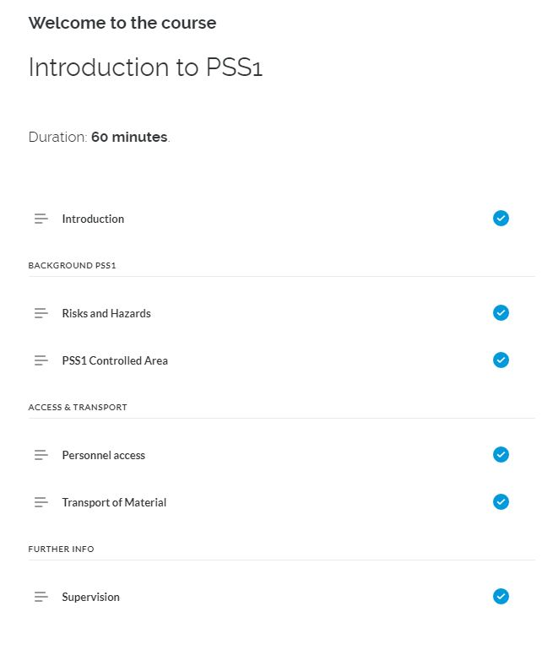
PSS training
Clients and operators receive training on how to interact with the designated PSS in the area. Operators receive additional training on how to manage mode transitions and acknowledge alarms using the HMI.
Trainings are developed by the PSS team in cooperation with the ESS Learning Management System (LMS) team. An operations manual is also provided for each PSS.
PSS1 online training course in ESS learning lounge
Hands on training to clients (e.g. how to use access stations), and to operators (e.g. how to perform the formalized search) is also provided by PSS team.

Slide 34
Finish presentation

