Slide 2
Introduction and follow-up from PDR
TS PSS & Bunker PSS CDR (2024-04-29)
PRESENTED BY Morteza Mansouri

Slide 3
Agenda
1 Introduction
2 Follow-up on the PDR for TS PSS & Bunker PSS

Slide 4
1
Introduction

Slide 5
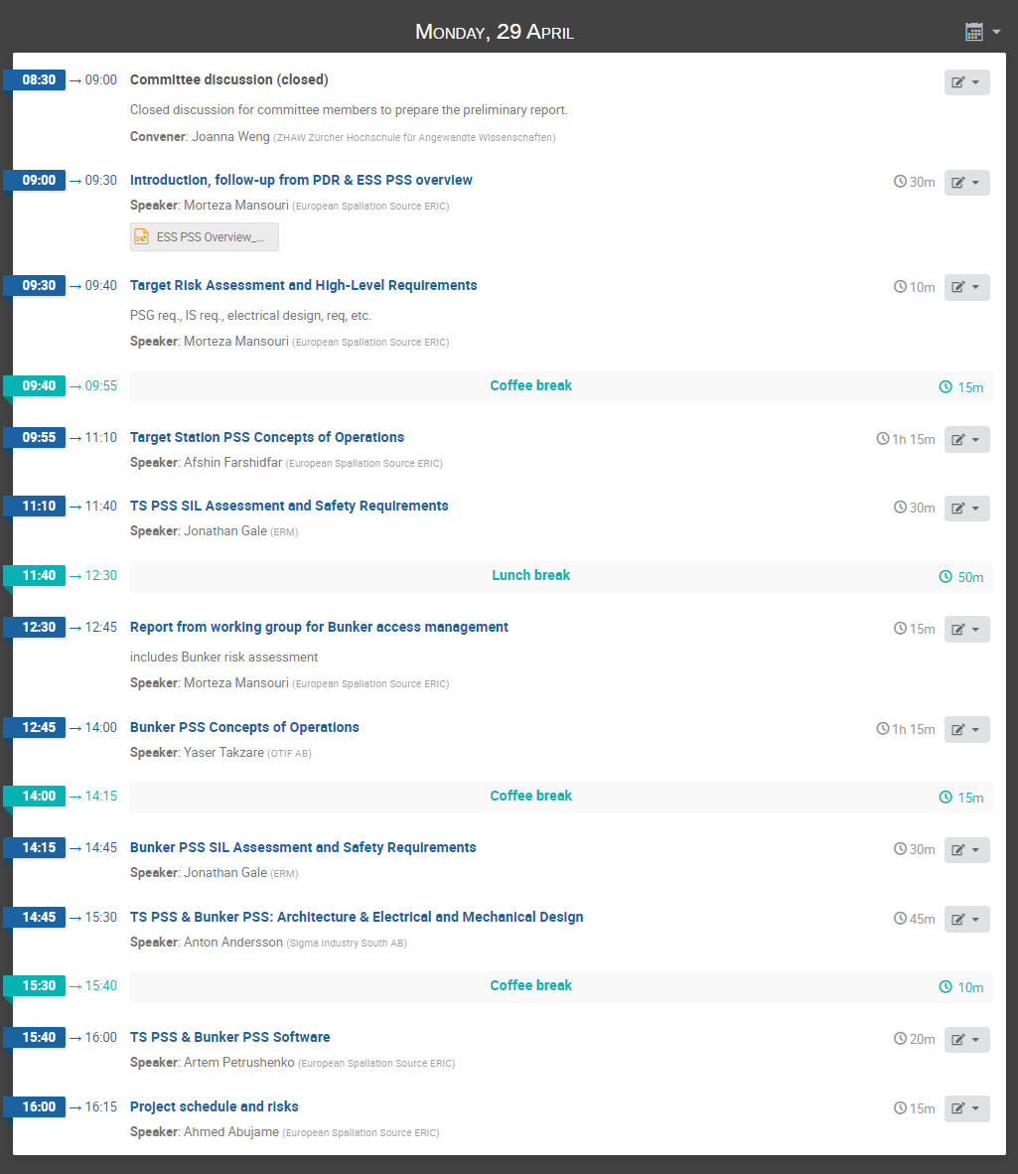
Welcome!
Introductory presentation
Focus is on TS PSS
Focus is on Bunker PSS
Addresses both TS PSS & Bunker PSS

Slide 6
Welcome!
No planned presentations for tomorrow.

Slide 7
A few notes
The attendees via Zoom, please keep your microphones muted during presentations.
We, the PSS team, are looking forward to a critical and constructive review!

Slide 8
2
Follow-up on the PDR for TS PSS & Bunker PSS

Slide 9
PDR for TS PSS and Bunker PSS
In Dec. 2022, an integrated PDR for the ACC PSS, and its interfacing PSS, i.e. Target Station PSS, Bunker PSS, and Instruments PSS was performed. The purpose of the integrated PDR was to review the functional dependencies among the various PSS that all together form the ESS PSS. This review included the PDR for Target Station PSS and Bunker PSS. The ESS Personnel Safety Systems Preliminary Design Review Report (ESS-4927155) contains recommendations and observations collected during the ESS PSS PDR.

Slide 10
Follow-up from PDR (general)
ESS-4927155
Recommendation/observation | Action
Clarify responsibility and accountability questions, define, and communicate who signs-off and accepts the residual risks of the final design. (4.1.1) | This is yet to be further followed up with upper management considering legal and organizational consequences of failures in e.g. PSS functions. So far, in PSS validation and handover meetings, the managers of parent system owner are invited for a demonstration of PSS functions.
Complete the System Requirements Specifications according to IEC61511 (pre-start). | The requirements and specifications for a Safety Instrumented System (SIS), such as functional requirements, performance criteria, environmental conditions, interfaces, Safety Instrumented Functions (SIFs), testing and maintenance requirements, are described in Safety Requirements Specification documents (see ESS-5301078, ESS-5342379).
EUC owners must provide the Protection-Systems-Group (PSG) with detailed documentation so the PSG can document and evaluate reliability, and configuration control boundaries | PSS interface with EUC is mostly realized through removing mains power from them. However, keeping the EUC documentation is still critical to PSS, and ESS configuration management procedures are used to keep the changes in EUC under control.
Develop configuration and work control processes such that owners of equipment performing safety functions must inform PSG of changes or maintenance to the EUCs.
The testability of SIFs should be considered already during the design phase. Since a test strategy should make sure that every reasonably possible failure will be discovered during installation testing and regular proof-testing, the testability sets further constraints on complexity.) | See Detailed Design Specification documents (ESS-5301086, ESS-5355884), where the verification method for each part of the design is specified. This document was not available at the time of PDR.
The design decisions, procedures and concepts related to bypass functions need to be added to a SIS System-Requirements-Specification as required by IEC61511 (see 4.1.6) and to the concepts of operations | See Safety Requirements Specification (ESS-5301078, ESS-5342379) and Concepts of Operations (ESS-4770860, ESS-4470664) documents for TS PSS and Bunker PSS.

Slide 11
Follow-up from PDR (general)
ESS-4927155
Recommendation/observation | Action
Ensure the completeness of the segmented hazard and risk analysis by especially considering risks that might be caused across boundaries of subsystems. | In case where the source of hazard is in the neighboring area (e.g. gamma radiation in Target basement and also within Bunker, when LSS is open), the risk assessed in both Bunker and Target RAs.
Ensure that a proper validation of the PSS design, based e. g. on a LOPA, confirms the selection of safety functions and SIFs with respect to the hazard and risk analysis. | The SIL Assessment documents (ESS-4747698, ESS-5298477) include the list of LOPAs for SIL determination of ACC PSS SIFs.
Ensure the traceability between hazards, risks and SIFs and verify consistency. Strongly consider the implementation of adequate document and data item management tools to support a proper requirements management at all levels. | See Target Risk Assessment and High-Level Requirements presentation for requirements management and traceability. Preliminary discussions held with ESS configuration management team for using requirements management tool within CHESS. For now, we address it through documentation.
The generic term “de-energize” might not be precise enough to clearly specify the intended action of a safety function. Consider reformulating the SIFs to fully reflect the intended action. | Adjusted the wording of the SIFs to implement this comment.
The derivation of SIF timing requirements from process safety time and hazard consequence levels should be made clear and be included into the SIF requirements specifications. | The definition (and rationality) of the Process Safety Time (PST) for each SIF is included in the Safety Requirements Specification document of each PSS.
Consider whether the use of “gates” (zone gate doors, light barriers, ...) to limit search areas requires consideration of gate failure mechanism in the SIL-Verification. | an Event Tree Analysis (ETA), ETA01b, is developed in SIL Assessment for Target Station Personnel Safety System (ESS-4747698)

Slide 12
Follow-up from PDR (TS PSS)
ESS-4927155
Recommendation/observation | Action
Search on level 091 Target controlled area layout (level 091) makes search slightly complicated. On the other hand, the rooms appear to be easily searchable, and the searches are required only rarely (4-5 times a year?) | See the Target Station PSS Concepts of Operations presentation.
PSS and ODH requirements for Target basement In case of the target basement the interface between ODH requirements and PSS requirements needs to be clarified. (Appeared to be resolved during the review meeting, but need to confirm) | Room D02.091.4003 is now part of PSS controlled area in order to avoid having an accessible area between an ODH zone and Magenta area during BoT. The interface between TS GDS and TS PSS is established, see Concepts of Operations for Target Station Personnel Safety System (ESS-4770860).
Beam destination In TS PSS Operational Activities (slide 23, Target PSS ConOps Presentation) it is stated that prior to granting access to TS PSS controlled are, the operator changes the beam destination out of Target. Is this monitored in PSS (implying an interface between PSS and the “machine” control system) and if yes, how? Or is this just procedural? | This is action is performed by operator through BPCS. PSS performs the interlock function.
Active cells Is there any interface between the Active Cells PSS and Target PSS? If yes, ensure that the two systems are consistent with each other and take a similar approach. | There is no interface between Safety Interlock System for Active cells and TS PSS.

Slide 13
Follow-up from PDR (Bunker PSS)
ESS-4927155
Recommendation/observation | Action
Bunker concepts of operations conceptual design decision for Bunker-PSS should be reviewed after clarification of hazard analysis and concepts of operation questions. | See Bunker Access Management Working Group Report (ESS-5063342).
Requirements for bunker roof Clarify requirements for SIFs related to bunker roof shielding. | There is no interface between Bunker PSS and Bunker roof shielding. See Bunker Access Management Working Group Report (ESS-5063342).
Mitigation measures Review the hazard analysis for bunker and confirm the adequacy of the selected procedural and technical risk mitigation measures: Are a full key exchange system and “tokens” really necessary for Bunker PSS to achieve the necessary risk reduction? Is it sufficient to rely solely on a process based on “tokens” or is there a need for Emergency-Stop buttons inside the bunker since there is no “search” of the bunker area when closing. | Using Safety Tokens are deemed necessary as reliable means to ensure no one is left behind in Bunker prior to start of operation. The need for emergency stops buttons were not identified during hazard analysis and risk assessment process. See Bunker Access Management Working Group Report (ESS-5063342) and Conventional and Radiological Hazard Analysis and Risk Assessment of NSS Bunker Area (ESS-3999144).
Safety tokens If a “token”-system is used, ensure that the mechanisms for counting the intervening personnel and the riggers are compatible and do not lead to a situation where a very accurate count of people (tokens) did not take into account the riggers or crane maintenance personnel. | The number of safety tokens is determined considering the max. number of entrants allowed at a time in Bunker, the potential number of confined space watchers, and also the rigging team. See Bunker Access Management Working Group Report (ESS-5063342).

Slide 14
Thank you Questions/comments?

Slide 15
Back-up slides

Slide 16
Finish presentation

