Slide 2
Bunker PSS Concepts of Operations
PRESENTED BY Yaser Takzare

Slide 3
Agenda
1. ESS Bunker
2. NWB/SEB PSS Controlled Area, Main Functions
3. System Interfaces
4. Key exchange System
5. Access Procedure
6. Preparation for operation
7. Operation
8. Intervention Activities

Slide 4
1
NEUTRON BUNKER

Slide 5
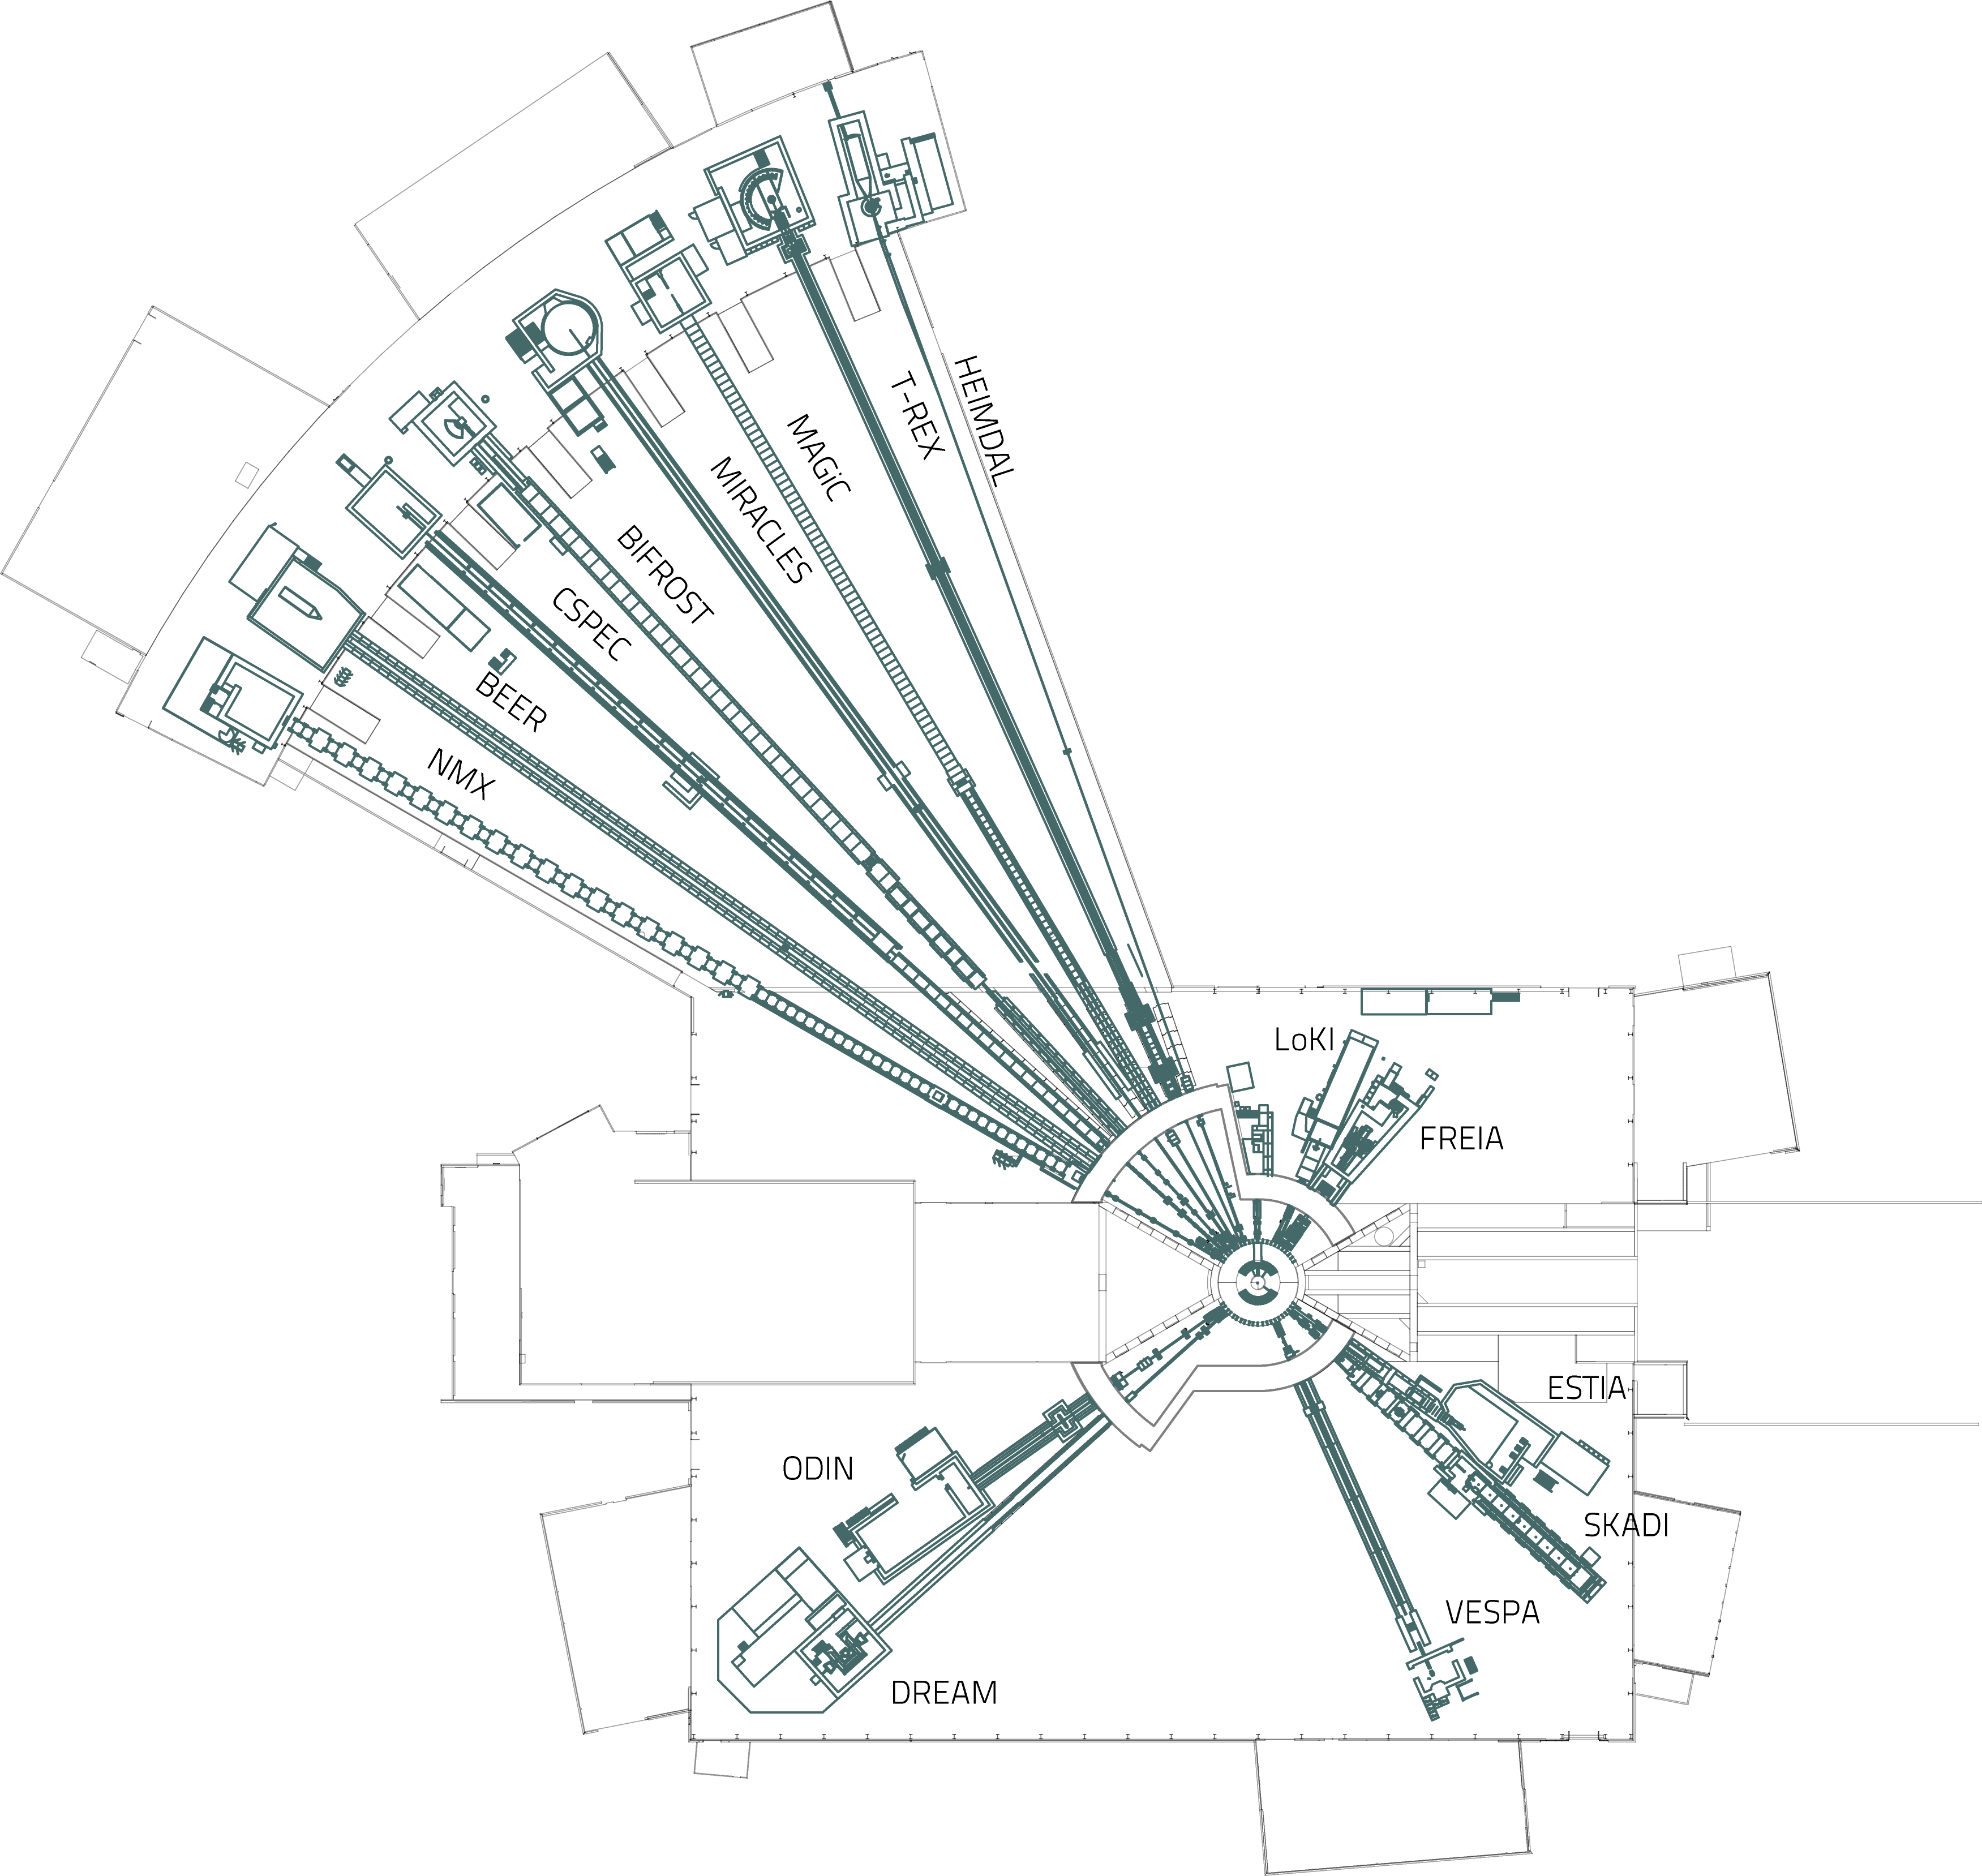
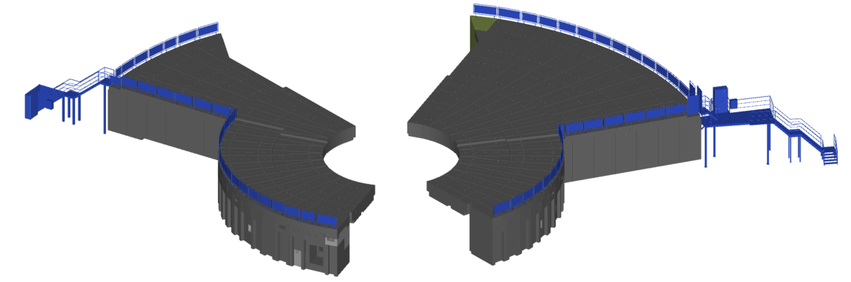
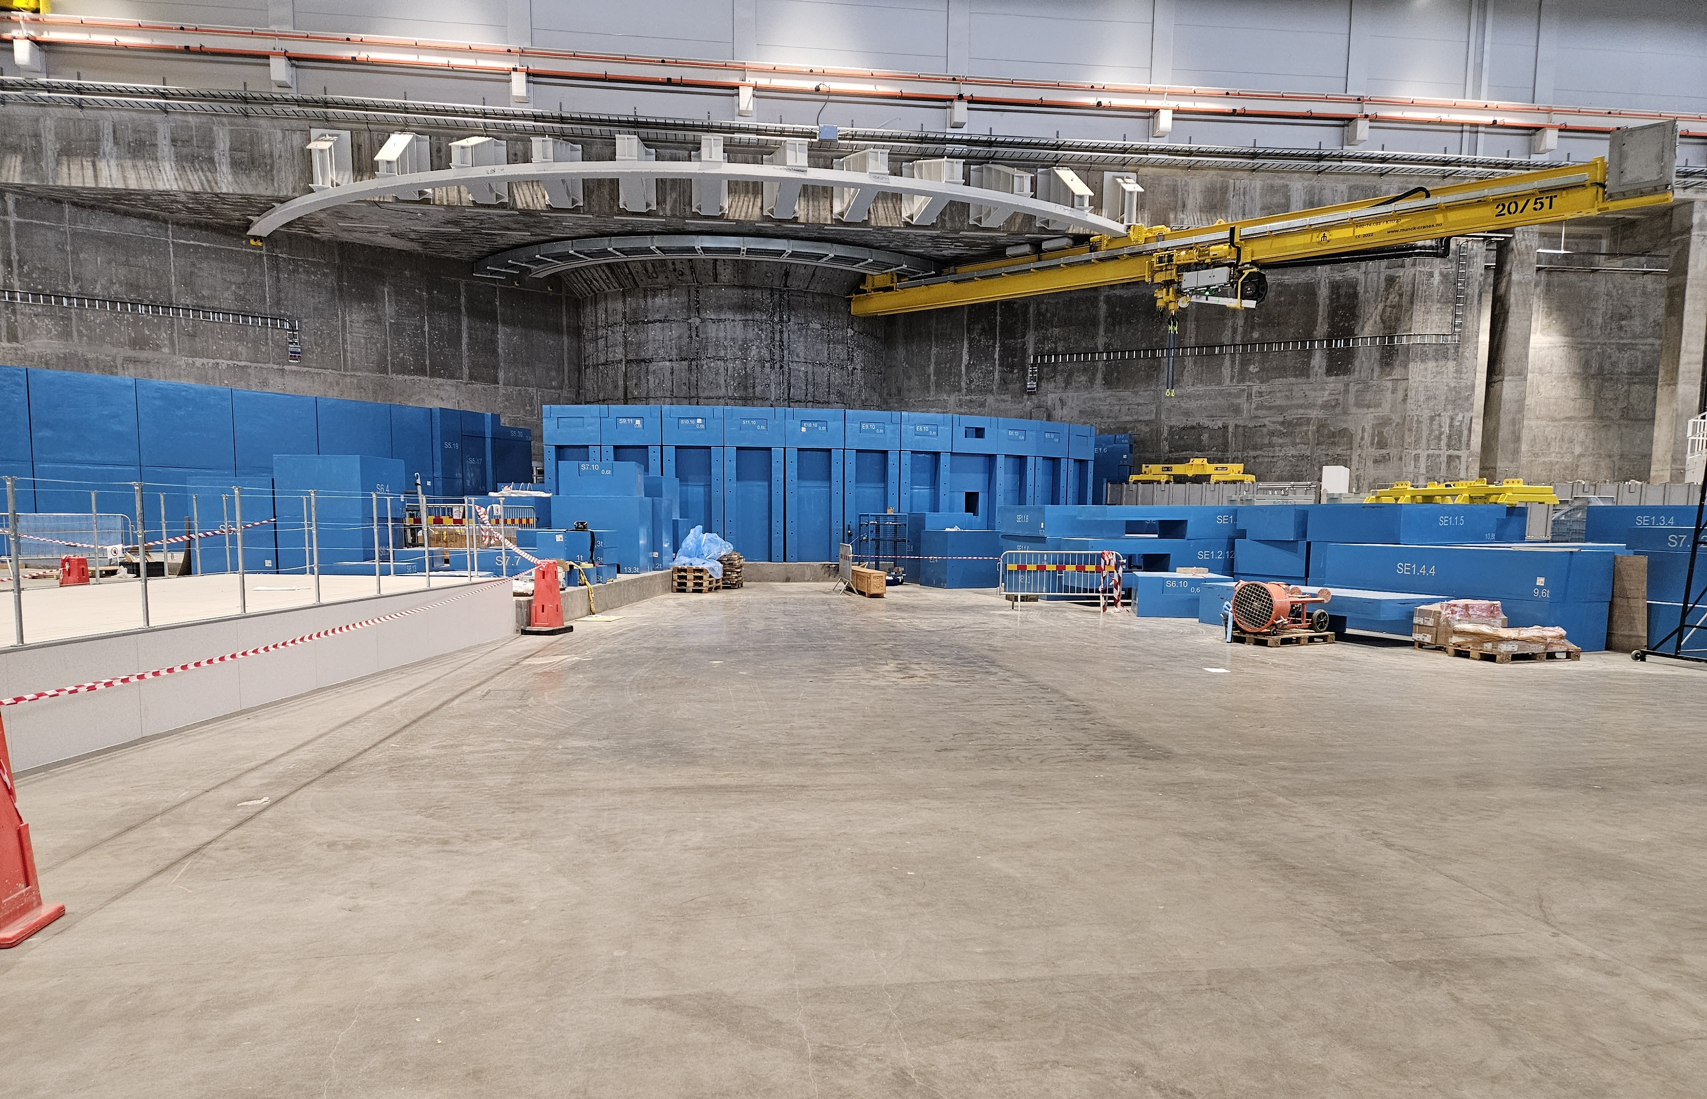
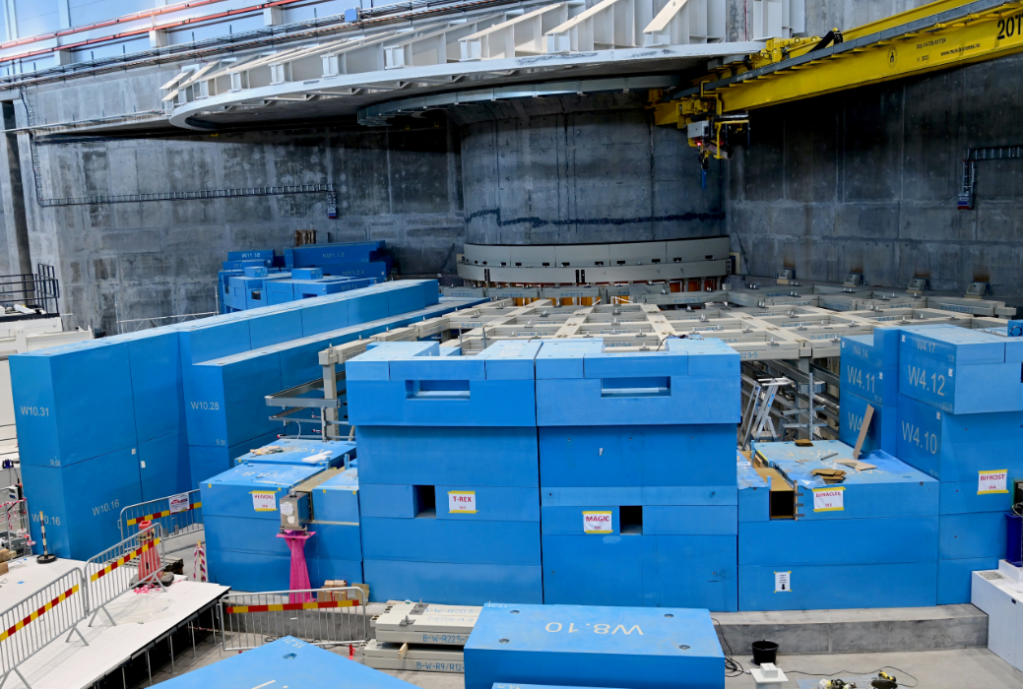
BUNKER
South-East Bunker (SEB)
Located in D01 building.
North-West Bunker (NWB) Located in D03 building.
Proton beam
Proton beam
The neutron bunker (=ESS.NSS.F01.F01) is the shielding structure outside the monolith shield wall surrounding the target in the centre.

Slide 6
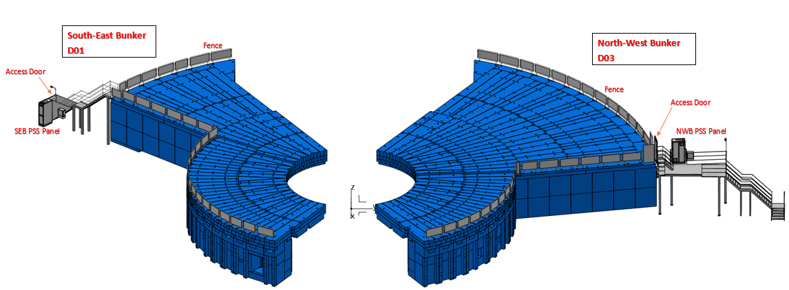
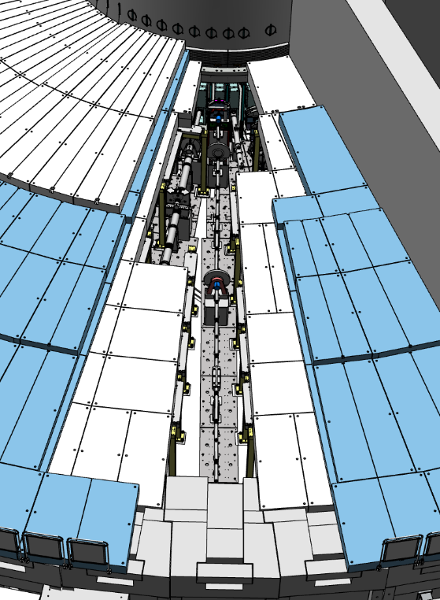
BUNKER
Sample In-Bunker Access by Removing Shielding
Bunker is a Confined Space and work shall be supported by a confined space watcher (CSW).
Monitor the entrants to the in-Bunker area.
Remain on the Bunker roof until all entrants have exited the Bunker and the entryway is secured to prevent unauthorized entry.
Do not allow entry to the Bunker to others than the entrants mentioned in the Bunker entry permit.

Slide 7
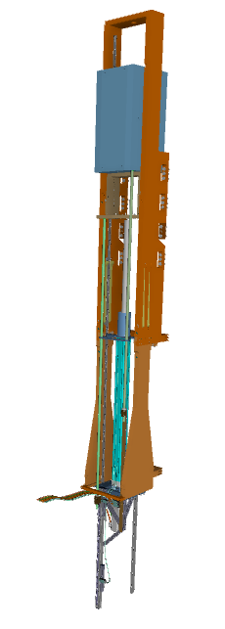
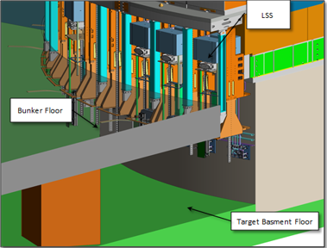
BUNKER
On the monolith, the Beam Ports without instruments are shielded off with Port Plugs, and the ones with instruments have light shutters. The Light Shutter Systems (LSS) shield off the gamma radiation from the Monolith, to enable safe access for personnel to the Bunker and also Target basement.

Slide 8
2
Bunker PSS Controlled Area and Main Functions

Slide 9
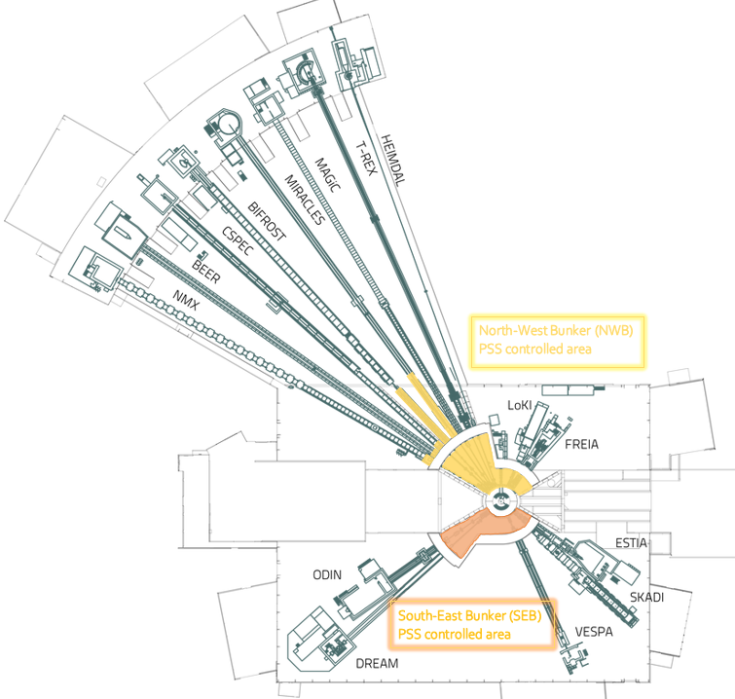
The Bunker PSS
Bunker PSS Controlled Area
Bunker PSS is composed of two independent systems:
North-West Bunker (NWB) PSS (=ESS.NSS.F01.F01.F03.F01)
South-East Bunker (SEB) PSS (=ESS.NSS.F01.F01.F03.F02)
Bunker PSS controlled area
Bunker Roof
Area inside of the Bunker
Some parts of the instrument beamlines up to the instrument shutter

Slide 10
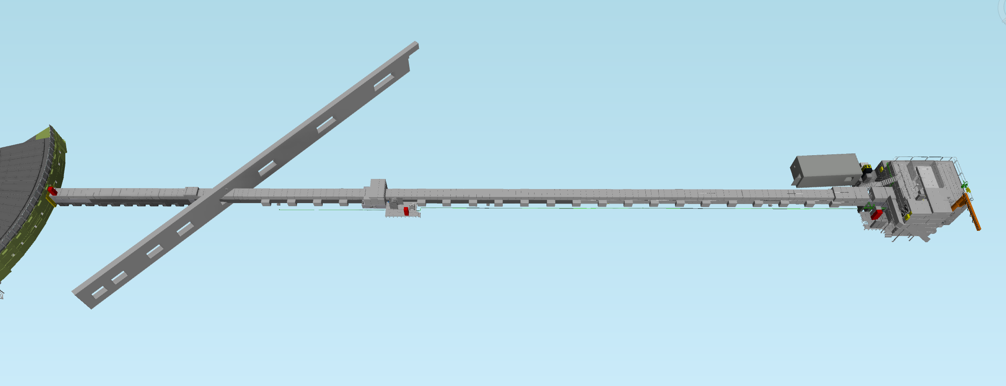
Bunker PSS Controlled Area
Instrument Shutter out of the Bunker Wall
D03: Experimental hall 2
E02: Beam line Galley
E01: Experimental hall 3
Control Hutch
Instrument Shutter Pit
Bunker Wall
Chopper Pit
Cave

Slide 11
Bunker PSS Main Functions
The Bunker PSS provides the following main functions:
Prevent and mitigate prompt ionizing radiation from proton beam to Target
The Bunker PSS prevents access to the Bunker PSS controlled area, if there is Proton Beam to Target.
Mitigate gamma radiation hazard from the monolith.
Preventing access to the Bunker PSS controlled area if any of the light shutters detected not closed.
The Bunker PSS prevents inadvertent energization of the bending magnets, if the Bunker PSS controlled area is not closed and locked.
Preventing inadvertent opening of the light shutters, if the Bunker PSS controlled area is not closed and locked

Slide 12
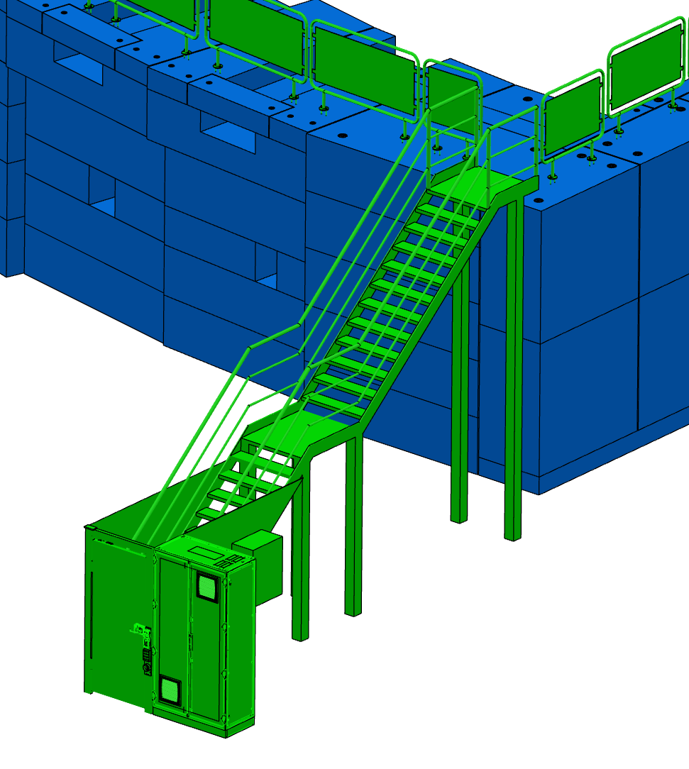
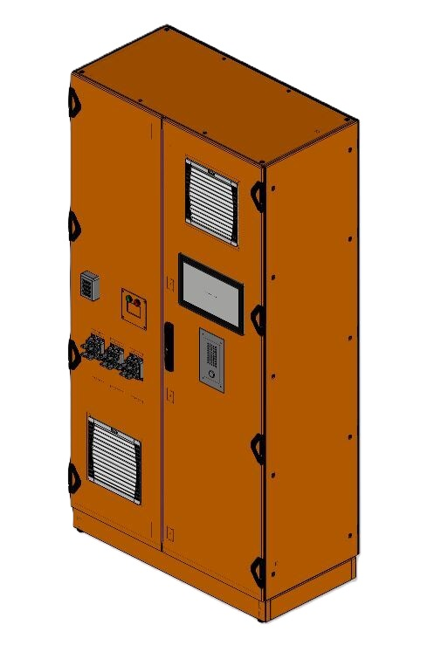
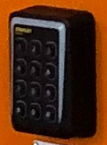
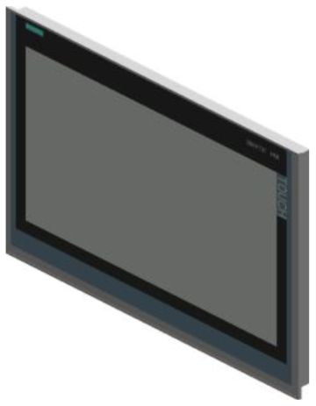
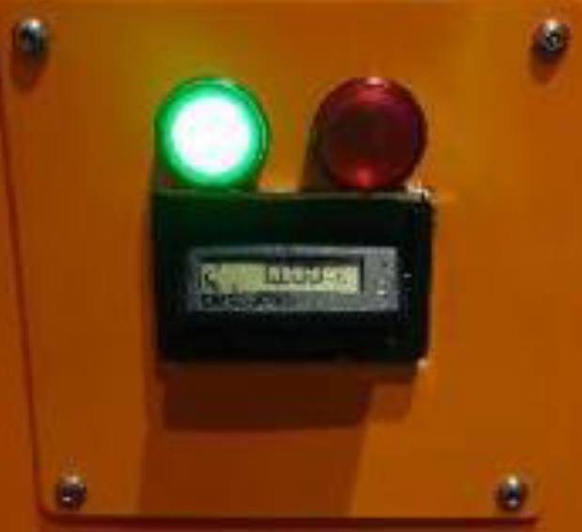
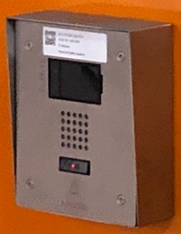
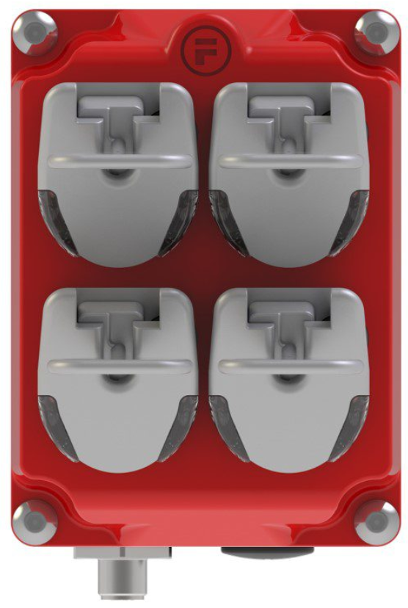
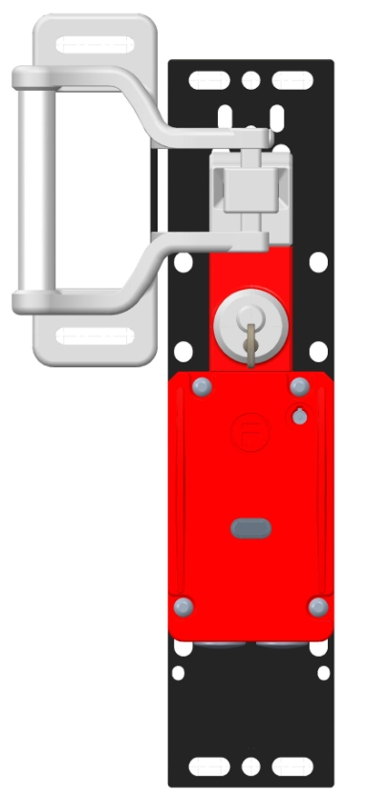
Bunker PSS Main Functions
Access to the Bunker PSS controlled area is regulated by ESS Physical Access Control system (=ESS.INFR.R01.R02).
Bunker PSS interfaces the ESS Physical Access Control system via the access doors to the Bunkers roof to ensure access management procedures required for a category 4 area.
CARD
READER
HMI MESSAGE
DISPLAY
IP Camera
EPD
READER
INTERCOM
RFID
SAFETY TOKEN
Lock

Slide 13
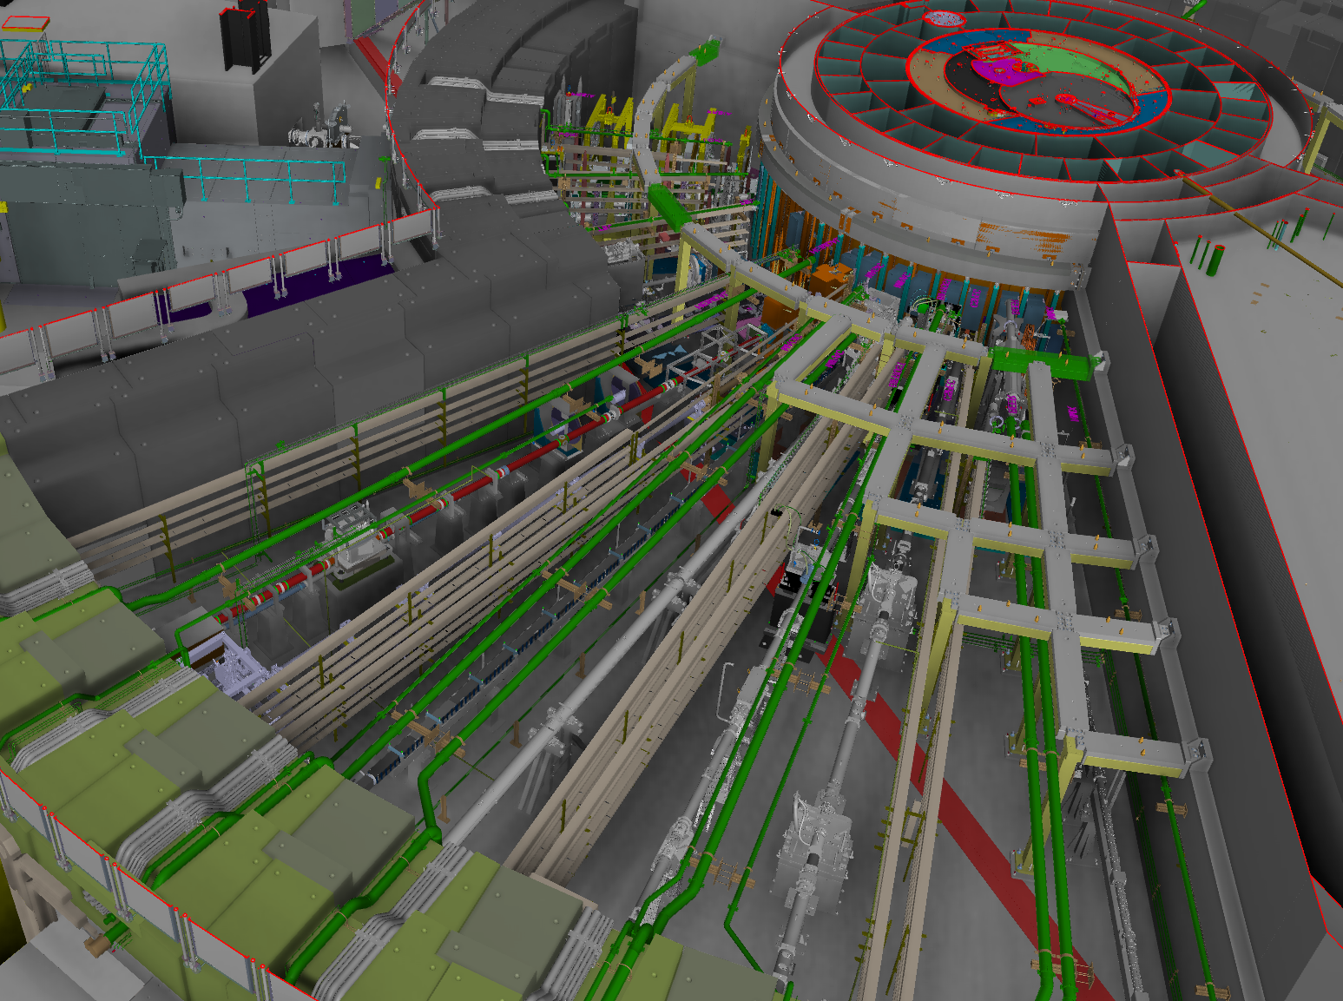
Principles of operation
Prior to enabling Bunker
PSS permit to allow
the Beam on Target :
The Bunker PSS ensures that no one is left inside Bunker PSS controlled area
The Bunker PSS ensures that the shielding blocks for Bunker PSS controlled area are in place.
Bunker is a high radiation zone and a complex area with instruments beamlines, choppers, pipping, and equipment, formalised search is not a feasible and safe solution, then:
Each entrant is provided with a Safety Token (ST)
Confined space watcher to be sure everyone left the area
Block the door by MCR for unauthorized access
Ensured that the shielding blocks are in place:
The rigging team confirm
RP check and confirm
RP controls the BoT OVK and NWB AK/SEB AK

Slide 14
Principles of operation
The operator changes the beam destination out of Target through the control system
The operators close the Light Shutters through the control system,
Upon initiating access to Bunker PSS controlled area, Bunker PSS interlocks the bending magnets and light shutters
The bending magnets and light shutters are secured against re-energisation until the Bunker PSS controlled area is closed and locked.
Prior to granting access to Bunker PSS controlled area:

Slide 15
Bunker PSS Modes of Operation
The Bunker PSS operates in four operational modes in order to:
Ensure safe access to the Bunker PSS controlled area.
Ensure safe initiation of Beam to Target
BoT ON Mode
Transition
Mode
Access
Mode
Alarm Mode

Slide 16
3
System Interfaces

Slide 17
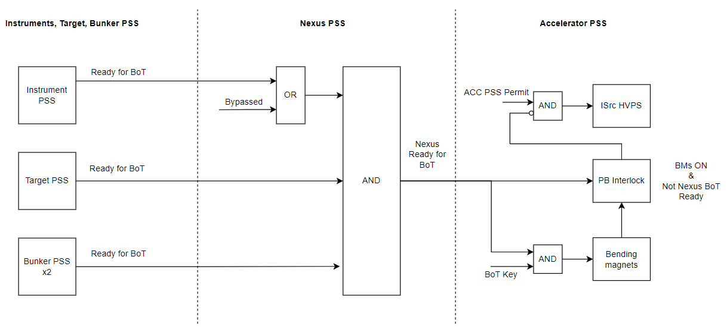
Proton Beam and Bending Magnets

Slide 18
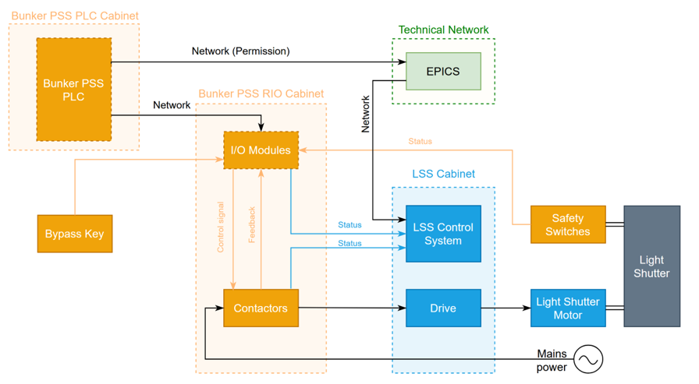
Light Shutters
The Bunker PSS interfaces with the Target Station PSS (TS PSS) in order to:
Inform TS PSS on the position of the light shutters
Receive requests from TS PSS to interlock the light shutters

Slide 19
Electronic Personal Dosimeter
Signal status | Relay K1, NO | Relay K3, NO | Relay K2, NO | NWB or SEB PSS signal
EPD out | FALSE | FALSE | FALSE | FALSE (ST cannot release)
EPD in and OK | TRUE | FALSE | FALSE | FALSE (ST cannot release)
EPD out and OK | TRUE | TRUE | FALSE | TRUE (ST can release)
EPD in and faulty | FALSE | FALSE | TRUE | FALSE (ST cannot release)
EPD
READER
SEB PSS PLC will show the EPD indication, as follows:
Green LED indication is ON when EPD is in the dummy reader and is good .
Red LED indication is ON when EPD is in the dummy reader and is bad .

Slide 20
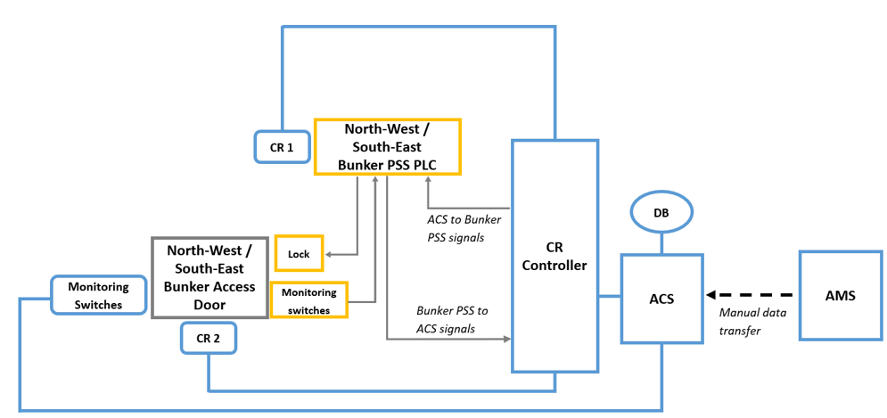
Physical Access Control System

Slide 21
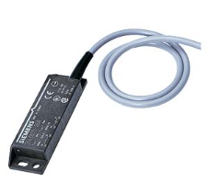
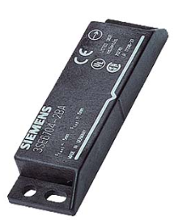
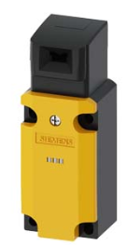
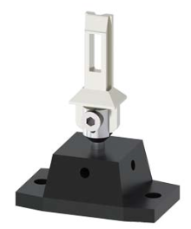
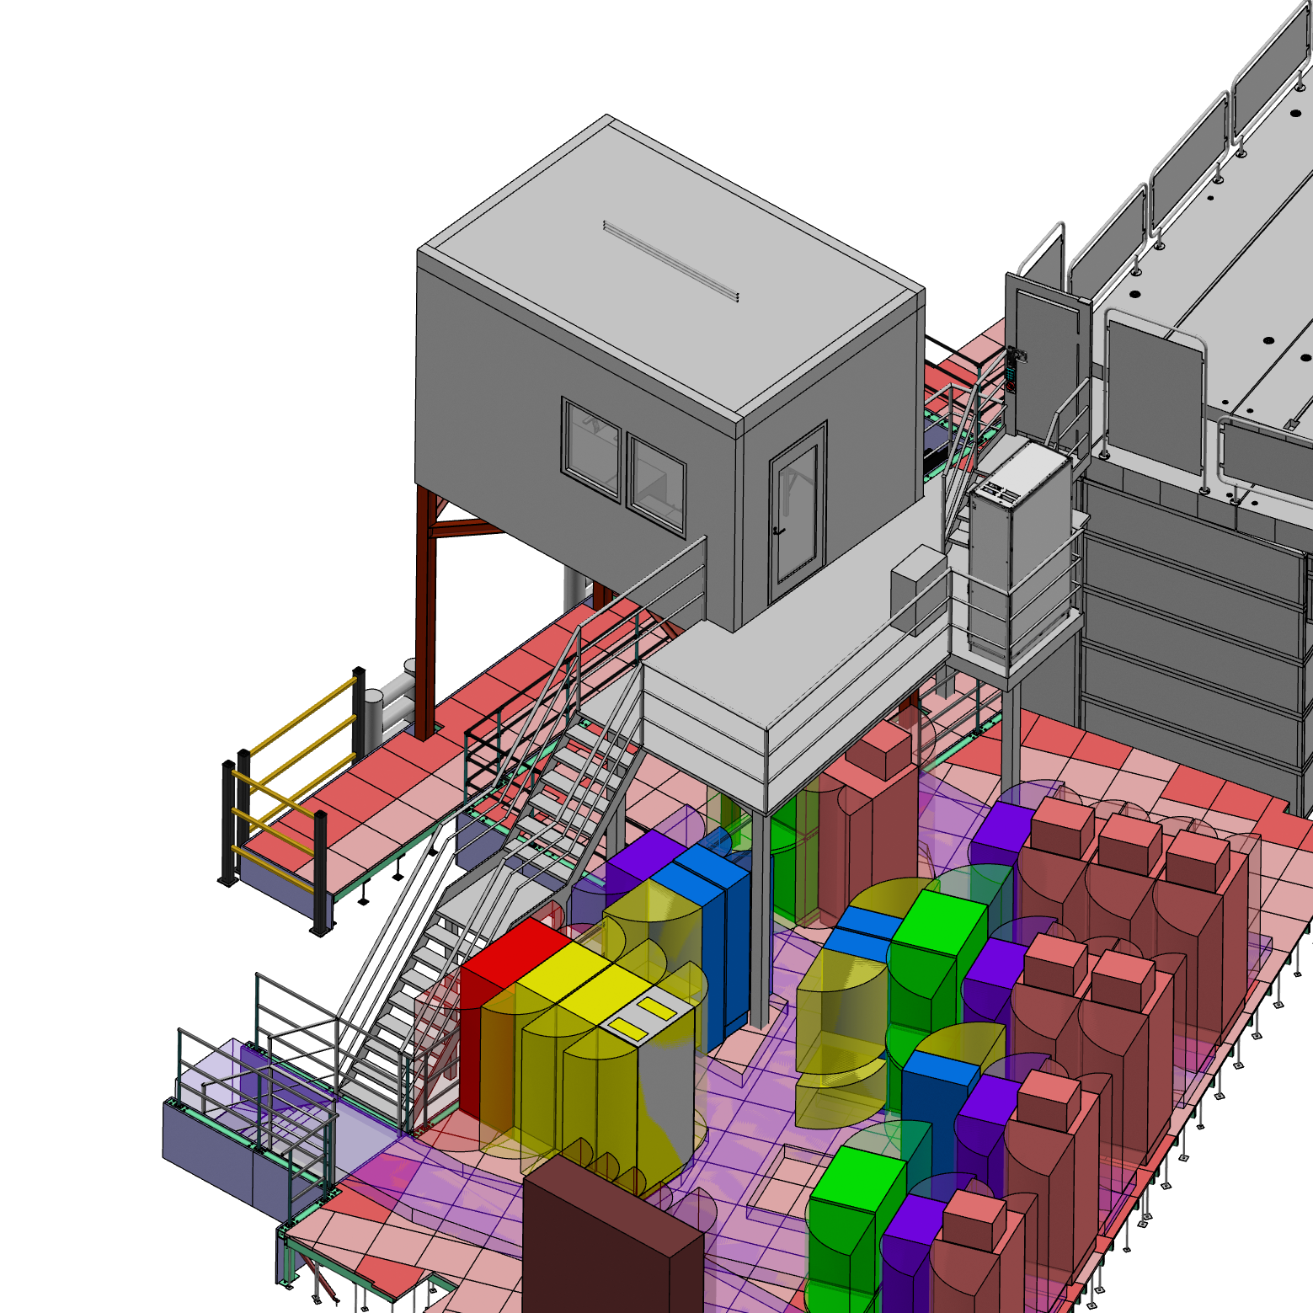
Access Doors
1 magnetic and 1 mechanical switch
Electromechanical Lock Access Door

Slide 22
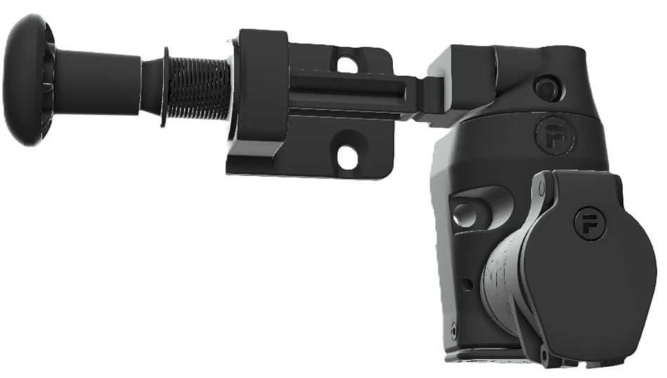
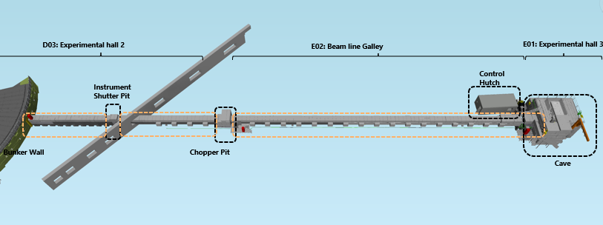
Instrument Shielding Blocks
Unit #2
(North-West Bunker)
S
SLOT 1
SCMK1
SLOT 2
SCMK1
SCMK2
SLOT 3
SCMK3
SLOT 4
SCMK4
SLOT 5
SCMK5
SLOT 6
SCMK6
SLOT 7

Slide 23
4
Key Exchange System

Slide 24
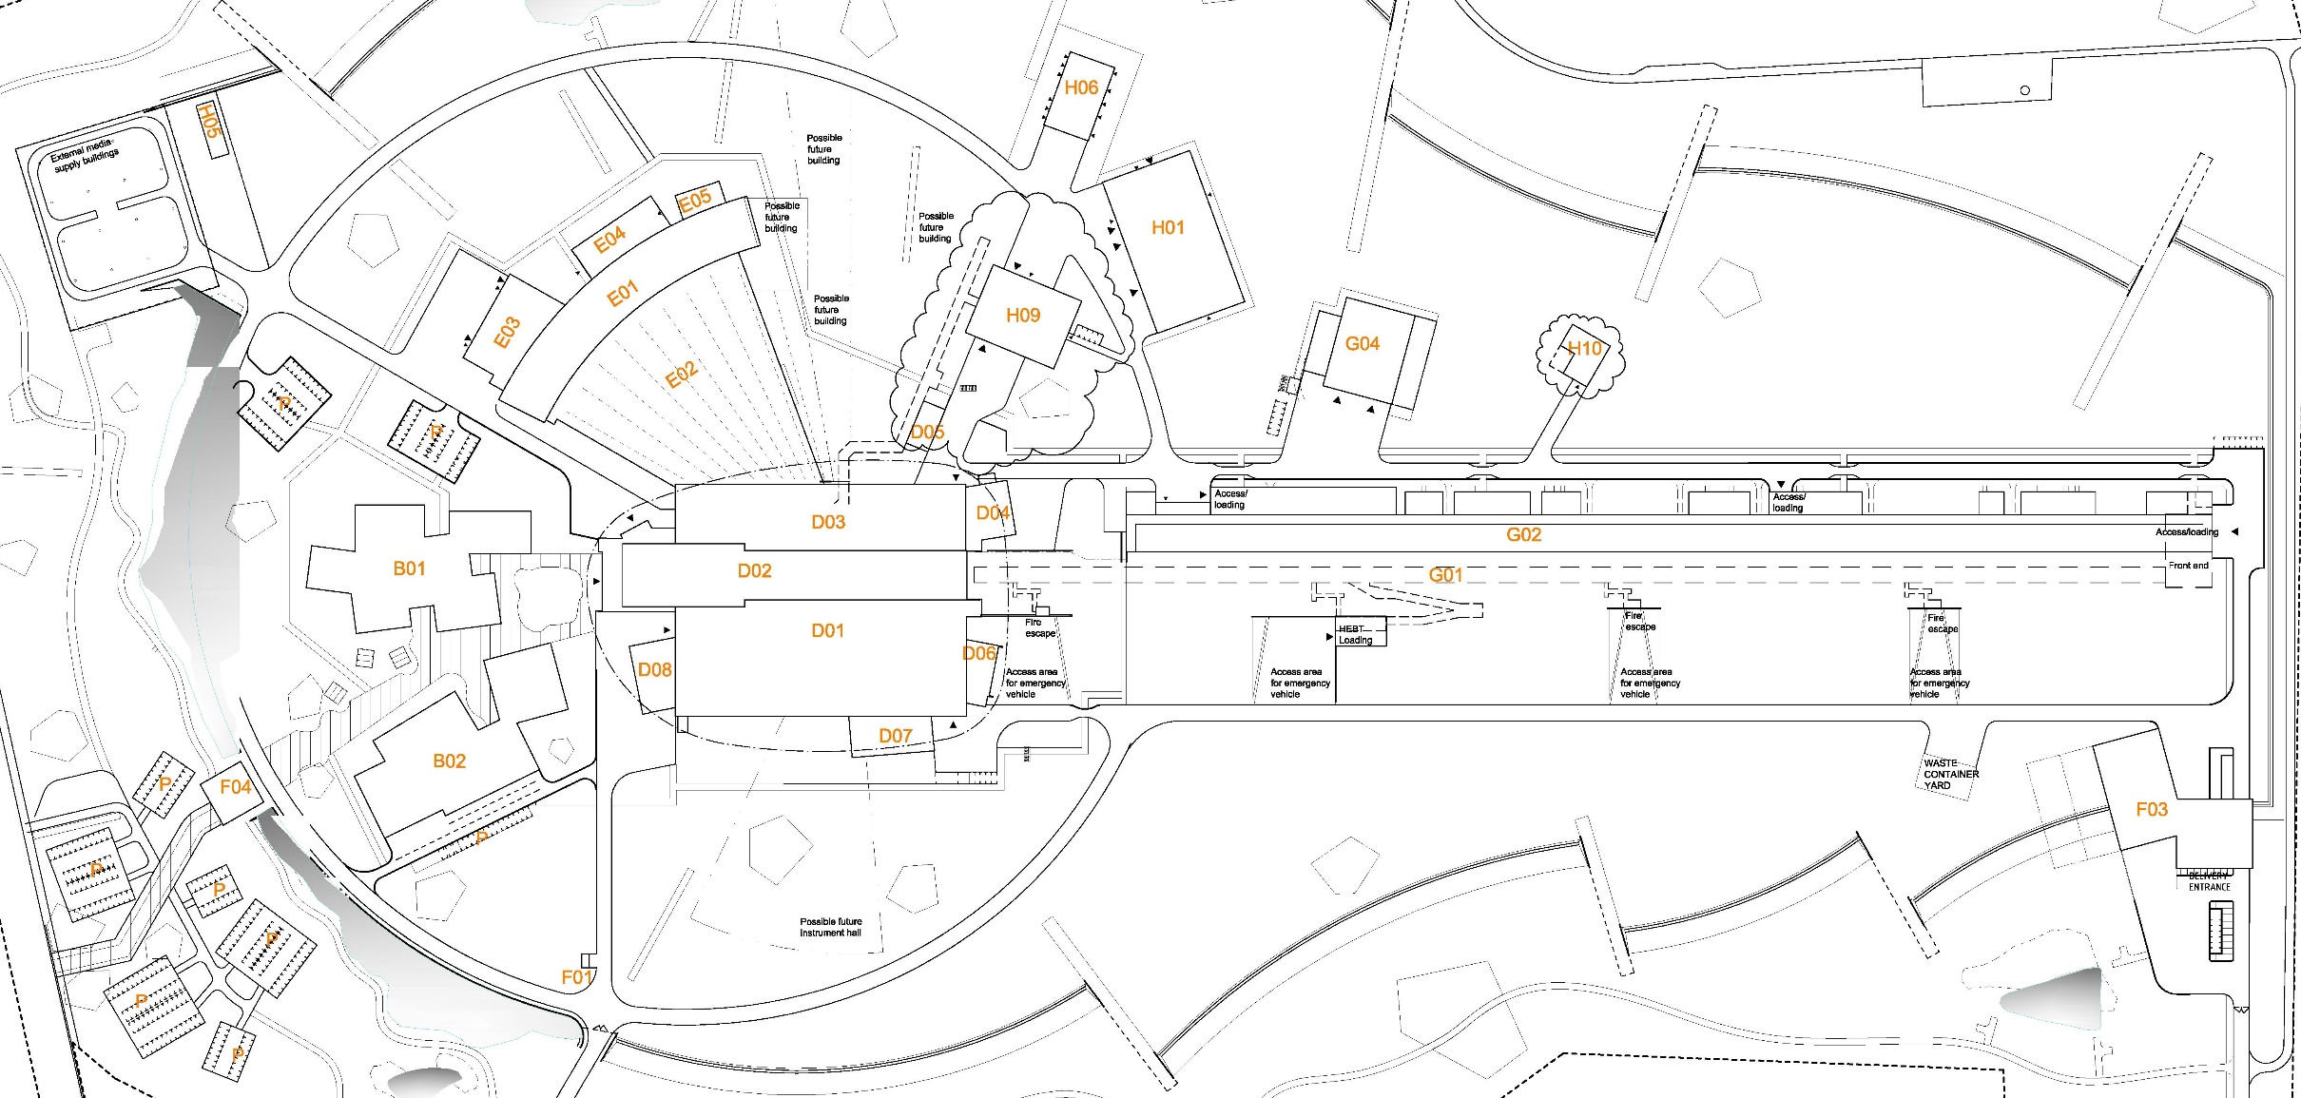
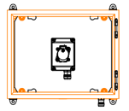
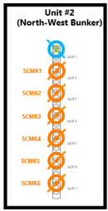
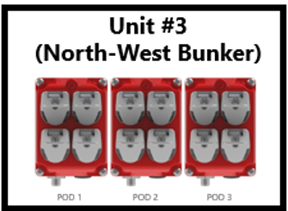
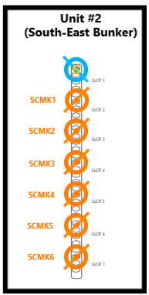
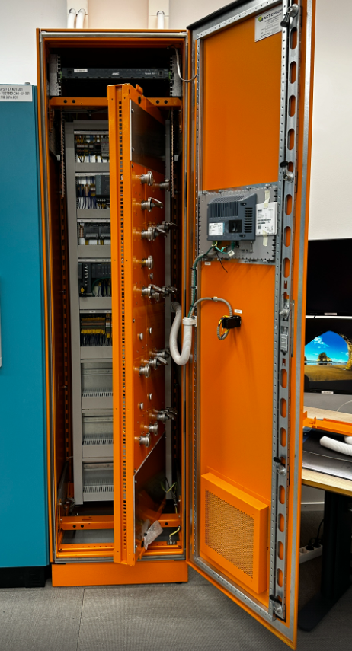
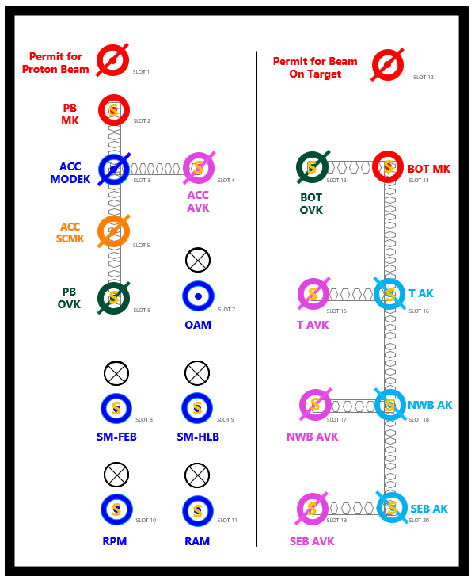
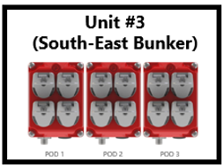
PSS key exchange system
North-West Bunker (NWB) PSS key exchange units #2 and #3
North-West Bunker (NWB), South-East Bunker (SEB)
PSS key exchange units #4
Integrated ACC – Target – NW Bunker – SE Bunker PSS key exchange unit #1 (MCR)
South-East Bunker (SEB) PSS key exchange units #2 and #3

Slide 25
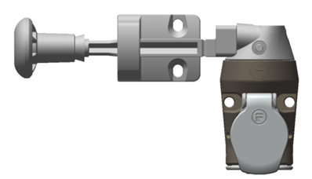
Bunker PSS Key exchange system
The NWB/SEB AK is locked by the solenoid in Unit 2 upon removing any RFID/SCMK keys and could be unlocked by the RP credential through the HMI when all RFID keys are in the home position.
(It means all instrument/Bunker shielding should be in place and confirmed by the RP team).
Unit #1
(ACC - Target – Bunker Scope)
Unit #3
(North-West Bunker)
BOT MK not in Slot 12 = Bending Magnets are interlocked
Permit for Beam On Target
SLOT 12
BOTK
Unit #2
(North-West Bunker)
BOT MK is locked in slot 14 until BoT is permitted
S
S
BOT MK
SLOT 13
SLOT 14
BOT
OVK
S
NWB AVK and SEB AVK are managed by RP team. The solenoid is removed through HMI with RP credentials.
By removing the NWB/SEB AVK, the bunker access door operation is vetoed by RP. IF the NWB/SEB AVK is in place door operation could be vetoed by the MCR through the HMI panel.
SLOT 1
SCMK1
POD 1
POD 2
POD 3
S
S
SLOT 2
Unit #4
(North-West Bunker)
T AK
SCMK1
SLOT 15
SLOT 16
SCMK2
T AVK
SLOT 3
NWB AK and SEB AK can be released if all Light Shutters are closed
SCMK3
SLOT 4
LSS BYPASS
S
S
SLOT 1
NWB AK
SCMK4
SLOT 17
SLOT 18
NBW AK
SLOT 5
Interlock module for Instrument beamline shielding (shutter pits)
NWB AVK
SCMK5
SLOT 6
S
S
SCMK6
SEB AK
SLOT 7
SLOT 19
SLOT 20
SEB AVK

Slide 26
5
Access Procedure

Slide 27
Access Procedure
NWB/SEB PSS is in Beam ON mode
Work order and related permits be prepared in EAM
The MCR operator checks and verifies the Work order and related permits
The MCR operator to interlock the BoT operation -: MCR operator removes the BoT MK from slot 12 of the integrated key exchange unit#1
The Radiation Protection (RP) team obtains the BoT OVK from Slot 13 of the unit#1 to veto the Beam on Target operation, independent of the access state to Target or Bunkers PSS controlled areas
The MCR operator closes the light shutters through the control system prior to initiating access to NWB PSS controlled area. All light shutter are closed + cooldown timer unlocks the solenoid of the NWB AK.
The RP team returns the NWB AVK to the slot 17 of the of unit#1 and turns to the ON position to permit the access.
The NWB PSS transitions from Transition mode to Access mode.
All Light shutter in NWB are interlocked by NWB PSS.
Unit #1
(ACC - Target – Bunker Scope)
Permit for Beam On Target
SLOT 12
BOT MK
S
S
BOT MK
SLOT 13
SLOT 14
BOT
OVK
BOTOVK
S
S
T AK
SLOT 15
SLOT 16
T AVK
NWB
AWK
S
S
NWB AK
SLOT 17
SLOT 18
NBW AK
NWB AVK
Access
Mode
S
S
BoT ON
Mode
Transition
Mode
SEB AK
SLOT 19
SLOT 20
SEB AVK

Slide 28
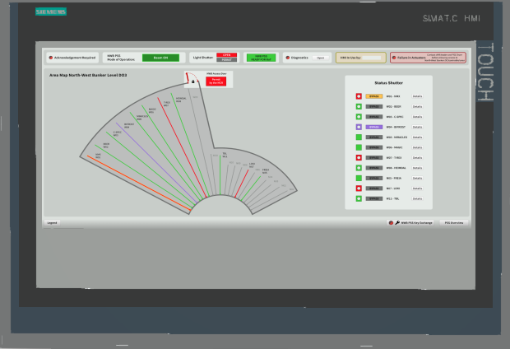
Access Procedure
Unit #2
(North-West Bunker)
The MCR operator inserts NWB AK in slot 1 of the key exchange unit #2 (located next to the access door) and turns to the ON position.
The working team, at the NWB access door, contacts the MCR through the intercom to enable the door operation.
The MCR operator can enable/disable the permit for opening the door via PSS MCR HMI only if the bunker PSS is in Access mode and NWB AK is in slot 1 of unit#2.
Each person accesses the area through the access door following the steps outlined in HMI as Entry Cycle
S
SLOT 1
NBW AK
SCMK1
SLOT 2
SCMK2
SLOT 3
SCMK3
SLOT 4
SCMK4
SLOT 5
SCMK5
SLOT 6
SCMK6
SLOT 7
ACCESS ALLOWED
ACCESS PROHIBITED

Slide 29
Access Procedure
If access to the In-Bunker is required, the Rigging team removes the Bunker roof shielding and installs the ladder for user access to the In-Bunker.
For Access to In-Bunker a confined space permit is required and a CSW must be present on the Bunker roof to ensure safety.
After completing the task, each person exits the area through the access door following the steps of exit cycle
The working group lead/CSW shall ensure all entrants exit the area and all STs are returned. At this point, the MCR should be contacted to remove the permit for opening the door via PSS MCR HMI.
The MCR operator then removes the permit for opening the door via PSS MCR HMI to prevent any uncontrolled access.
ACCESS PROHIBITED
ACCESS ALLOWED

Slide 30
6
Preparation for operation

Slide 31
Preparing the Bunker PSS Controlled Area for BoT
Work order and related permits be prepared in EAM
The MCR operator checks and verifies the Work order and related permits
The MCR operator checks all STs are in place through the PSS MCR HMI/OPI.
Each Rigging team member access to the area through the access door as per previous procedure
Rigging team is on the Bunker roof, they remove ladders and restore the shielding
Each Rigging team member leaves the area through the access door
The Rigging team lead shall ensure everyone has left the area and all STs are in place then ask MCR to lock the access door
The MCR operator removes the door operation permit through the PSS MCR HMI.
Rigging team lead shall confirm all shielding blocks (NWB and all instrument section in NWB PSS Control area) are in place.
RP shall check and confirm all shielding are in place.
When all STs and SCMKs in place and the access door is closed and locked, the NWB PSS allows RP to release the NWB AK from Slot 1 of the key exchange Unit#2 with RP credentials on the NWB door HMI
The MCR operator receives the NWB AK from RP and closes unit#2.
Unit #2
(North-West Bunker)
S
NBW AK
SLOT 1
SCMK1
SLOT 2
SCMK2
SLOT 3
SCMK3
SLOT 4
SCMK4
SLOT 5
SCMK1
SCMK5
SLOT 6
SCMK6
SLOT 7

Slide 32
7
Operation

Slide 33
Operation
The MCR operator puts the NWB AK in slot 18 of the integrated key exchange unit#1 and turns to ON position
NWB PSS transitions from the Access mode to the Transition mode.
The RP team takes the NWB AVK from slot 17 of the integrated key exchange unit#1 for prevent access.
None of the light shutters is Bypass
NWB PSS receives permission from TS PSS which means that Target basement is searched and locked.
Related SIF is properly reset and acknowledged through the PSS MCR HMI
NWB PSS sends the permission signal to the light shutter system and closes the PSS contactors of the light shutters
NWP PSS permit to Nexus PSS as “Ready for BoT” is enabled
The RP team should confirm BoT operation and return the BoT OVK to the slot13 of the integrated key exchange unit#1.
The MCR operator removes the BoT MK from Slot 14 and puts it in slot 12 of unit#1 and turns to the ON position
NWB PSS and SEB PSS transitions to the Beam ON mode after a predefined beam imminent time and ACC PSS enables the permit to BoT.
Unit #1
(ACC - Target – Bunker Scope)
Permit for Beam On Target
SLOT 12
S
S
BOT MK
SLOT 13
SLOT 14
BOT
OVK
BOT MK
S
S
T AK
SLOT 15
SLOT 16
T AVK
NBW AK
BOTOVK
S
S
NWB AK
SLOT 17
SLOT 18
NWB AVK
NWB
AWK
Access
Mode
S
S
BoT ON
Mode
Transition
Mode
SEB AK
BoT ON
Mode
SLOT 19
SLOT 20
SEB AVK

Slide 34
8
Intervention Activities

Slide 35
Intervention Activities
For maintenance purposes, LSS may need to be operated while access to Bunker PSS controlled area or TS PSS controlled area (Target Basement) is permitted.
The designated LSS needs to be bypassed:
The PSS contactors are energized
The LSS position switches status are ignored in safety functions
This bypass is only allowed if NWB/SEB PSS is in Transition or Access mode and NWB/SEB LSS bypass key is in position ON of slot 1 in the NWB/SEB key exchange unit#4.
This bypass can be enabled and disabled on the NWB/SEB PSS LSS HMI only by a PSS expert in agreement with the involved stakeholders.
The LSS bypass shall only be performed to one light shutter at a time in each Bunker.

Slide 36
Thank you for listening!

Slide 37
Back up Slides

Slide 38
RFID Keys
https://fortress-safety.com/product-expertise/heavy-duty/rfid-safety-key-for-prevention-of-unexpected-restart/

Slide 39
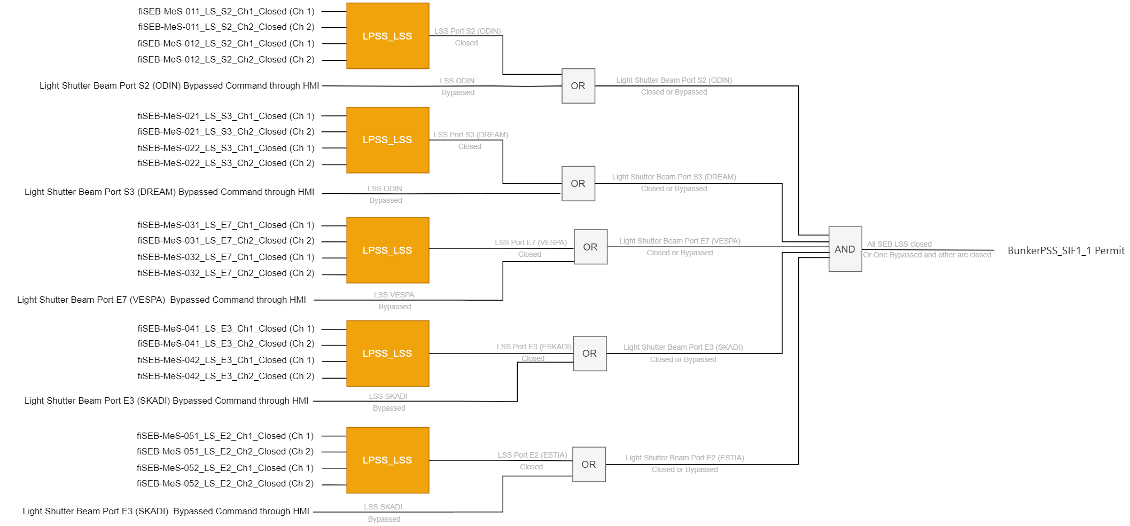
Safety Instrumented Functions (SIF)
BunkerPSS_SIF1_1: South-East Bunker Access Key (SEB AK) lock
If any of the LSS in SEB D01 is detected open, lock the SEB AK in position ON in slot 20 of Unit 1.
The SEB PSS PLC shall allow an auto reset of BunkerPSS_SIF1_1 when all light shutters in SEB are closed.

Slide 40
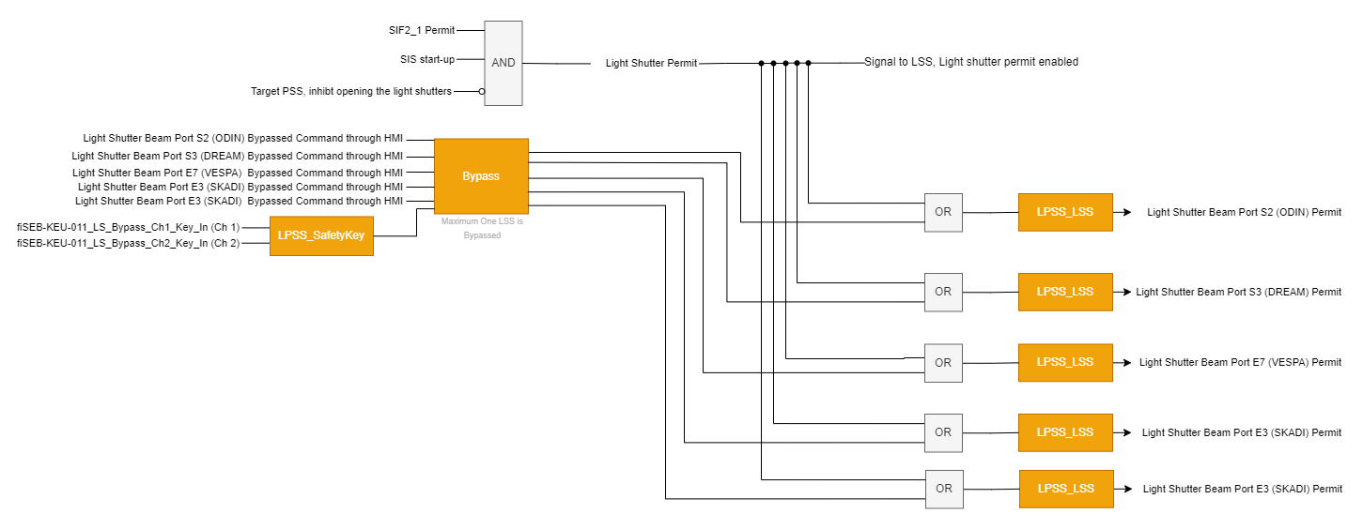
Safety Instrumented Functions (SIF)
BunkerPSS_SIF2_1: South-East Bunker Light Shutters System (LSS) Interlock
If the South-East Bunker Access key (SEB AK) is detected removed from position ON in Slot 20, de-energise the power contactors for the LSS in D01.
The SEB PSS PLC shall allow reset of BunkerPSS_SIF2_1 when the following conditions are in place prior to putting the BoT MK in the ON position in Slot 12:
All STs are returned to home position in key exchange unit#3
The BOT MK is in the OFF position in Slot 12
SEB AK is in the ON position in slot 20
No inhibition opening the light shutters from Target PSS
The SEB PSS LSS Bypass key is in OFF position

Slide 41
Safety Instrumented Functions (SIF)
BunkerPSS_SIF3_1: South-East Bunker Safety Tokens interlock
If any safety token is detected removed from unit 3 in South-East Bunker (SEB) PSS, lock the SEB Access Key in unit 2, slot 1 in place by de-energising the solenoid, to
Prevent initiating proton beam on Target, and
Prevent opening the Light Shutters System (LSS) in SEB D01.
The SEB PSS PLC shall allow an auto reset of BunkerPSS_SIF3_1 when all safety tokens are in home position.

Slide 42
Safety Instrumented Functions (SIF)
BunkerPSS_SIF4_1: South-East Bunker Access Door Lock
If the South-East Bunker (D01) Access Key (SEB AK) is removed from Unit 2 slot 1, lock the access door to SEB.
The SEB PSS PLC shall allow auto reset of BunkerPSS_SIF4_1 by manually putting the the SEB AK to ON position in slot1 of the unit#2.

