Slide 2
TS PSS & Bunker PSS Software
Strategy, architecture, integration
PRESENTED BY Artem Petrushenko

Slide 3
PSS MCR HMI
Strategy, architecture

Slide 4
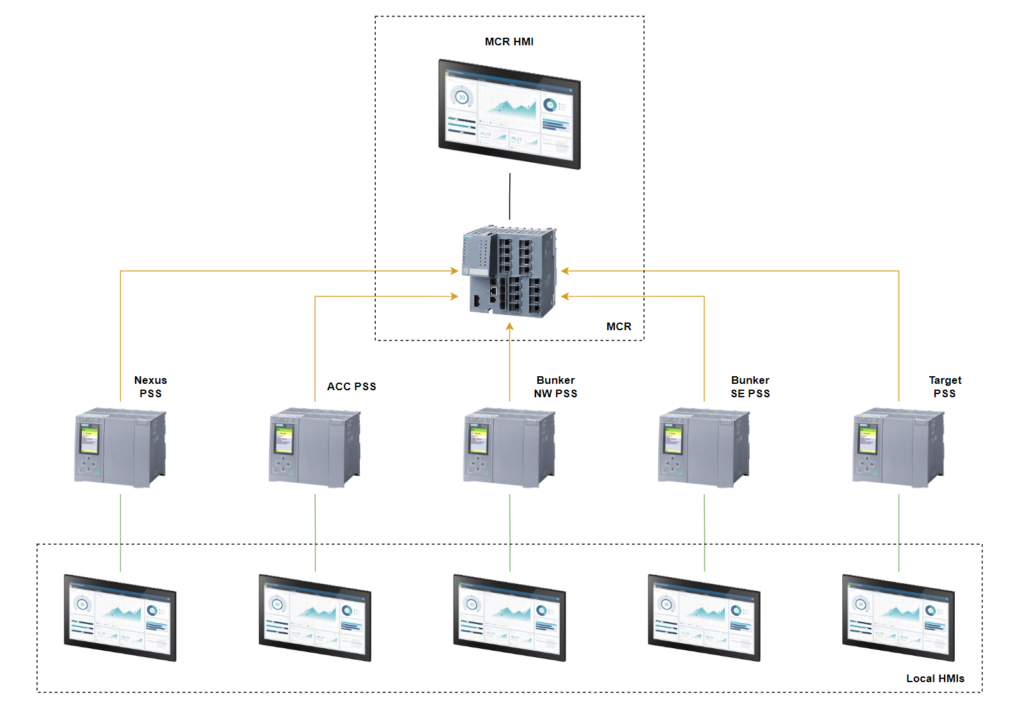
PSS MCR HMI
Architecture overview

Slide 5
PSS MCR HMI
MCR HMI and Local HMIs functions distribution
MCR HMI
Local HMIs
TS PSS (High Bay):
Overview
Cabinet diagnostics
SIF reset
Release of local keys
Test functions
Bypass
Operator instructions
Overview(including keys at field)
Cabinet diagnostics
SIF reset(per system)
Release of local keys
Ready for BoT status of each instrument PSS
Set cooldown timer(for each system)
Safety IO reintegration
Set search time for each system
Operator instructions
Bunker PSS (Door):
Overview
Cabinet diagnostics
SIF reset
Release of local keys
Test functions
Bypass(other than LSS)
Operator instructions
Bunker PSS (LSS):
Overview,
Bypass LSS

Slide 6
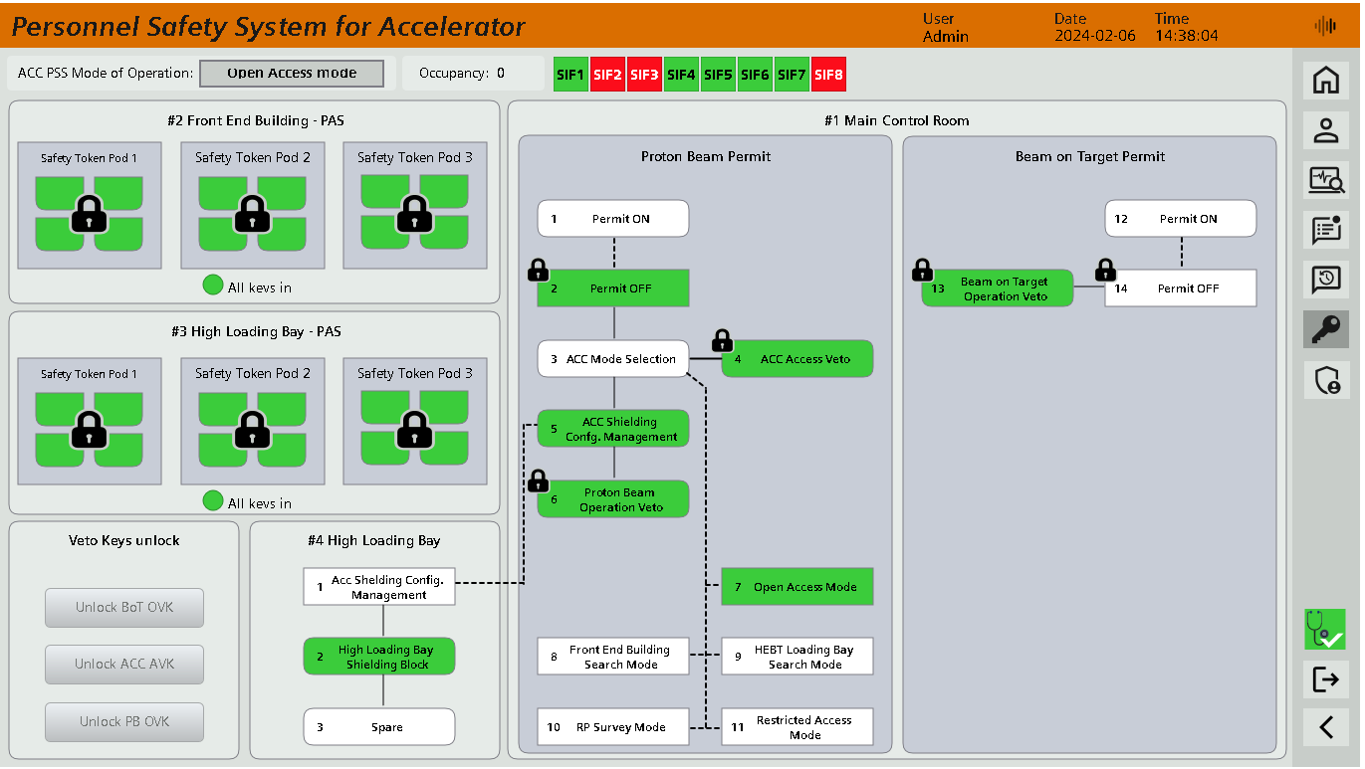
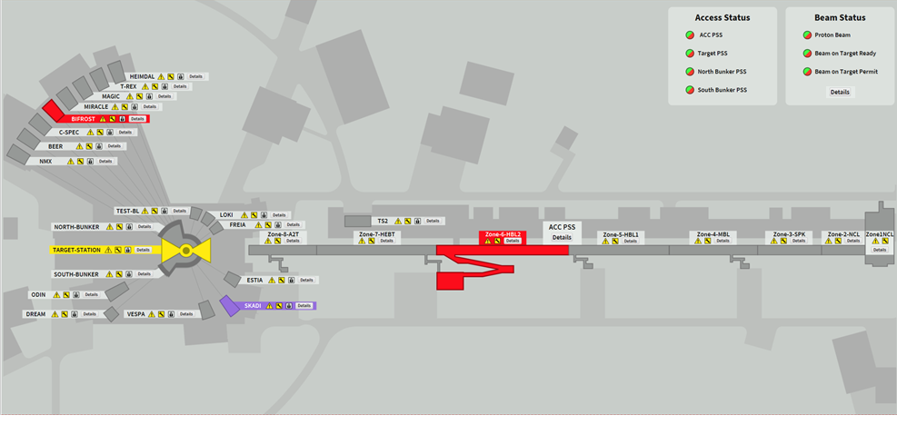
PSS MCR HMI
Overview
System overview
Nexus details screen

Slide 7
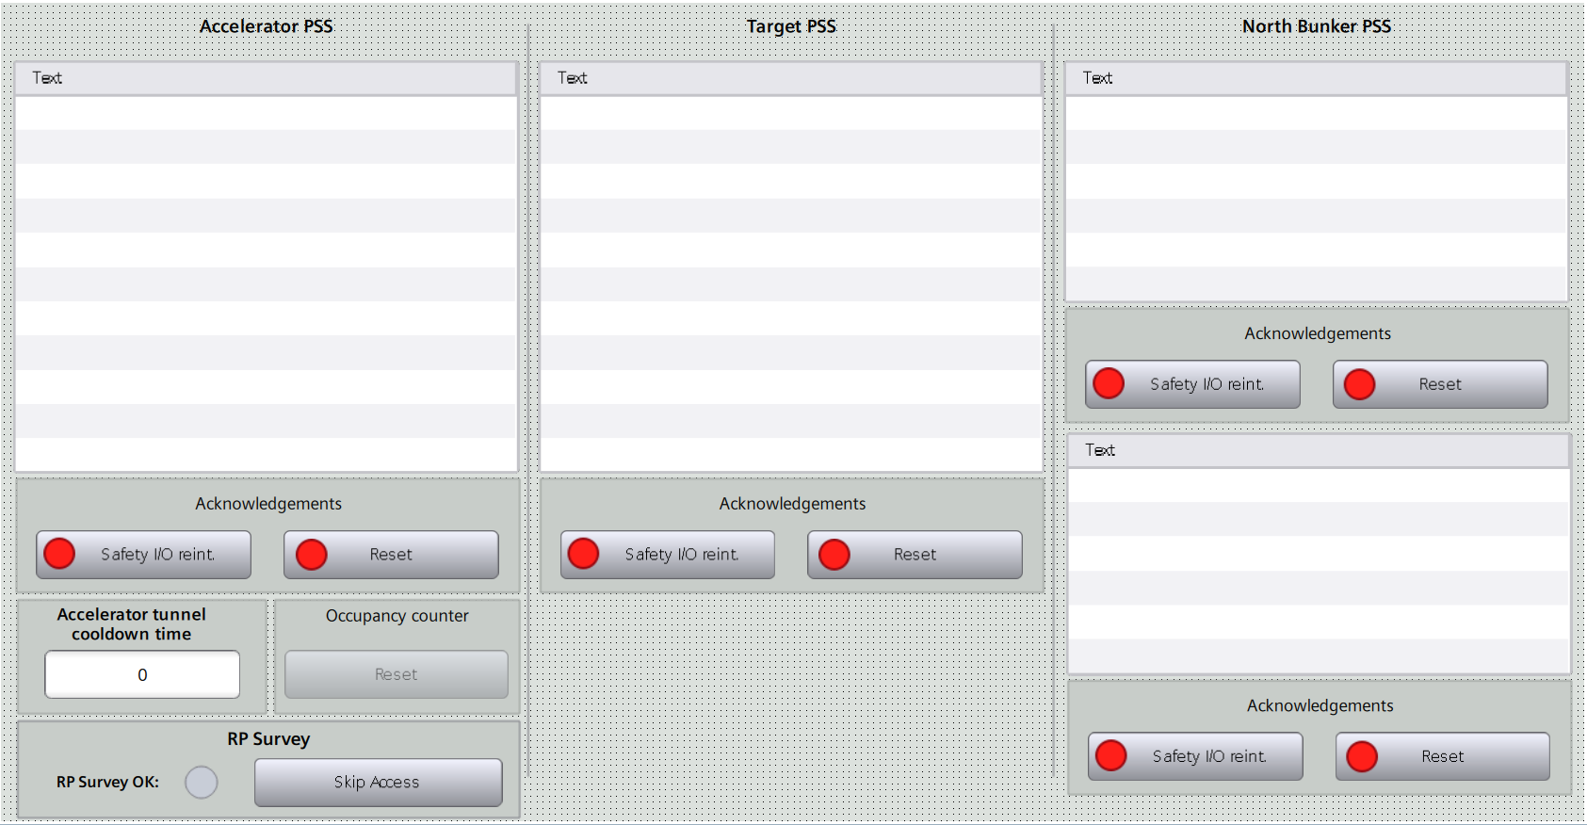
PSS MCR HMI
Operator Screen - Combined

Slide 8
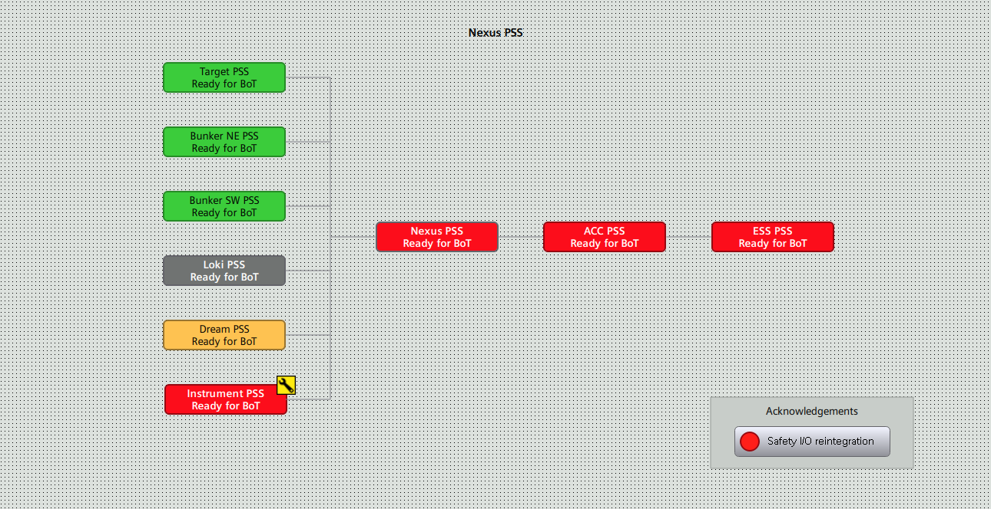
PSS MCR HMI
Nexus Overview

Slide 9
Operator Interface
TS PSS & Bunker PSS OPI

Slide 10
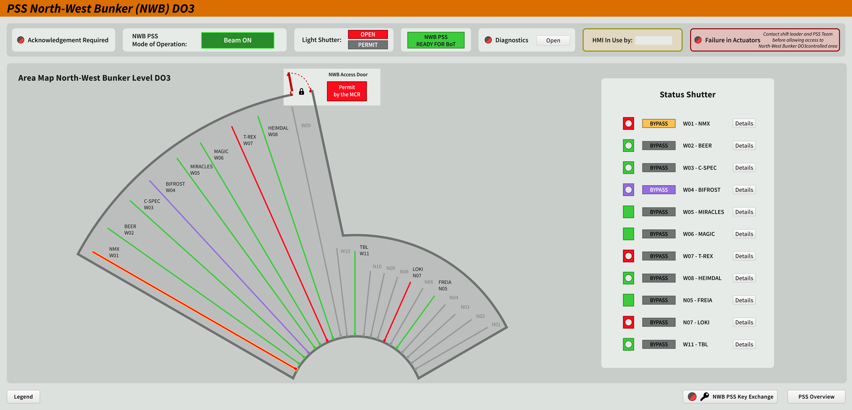
PSS OPIs
Bunker PSS OPIs (Overview)

Slide 11
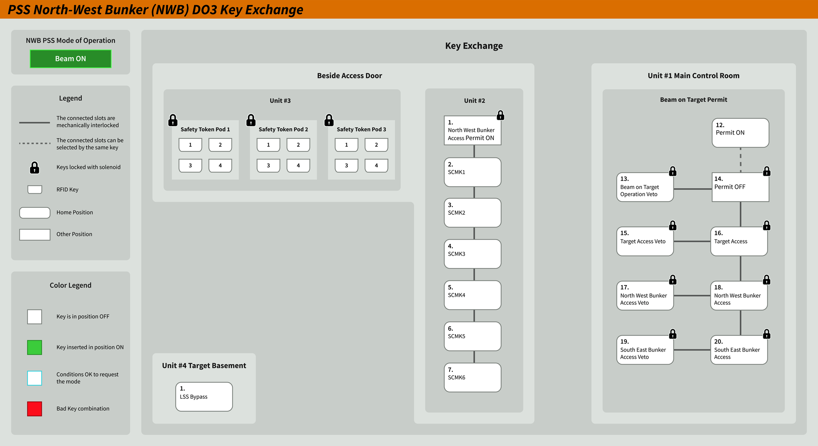
PSS OPIs
Bunker PSS OPIs (Key Exchange)

Slide 12
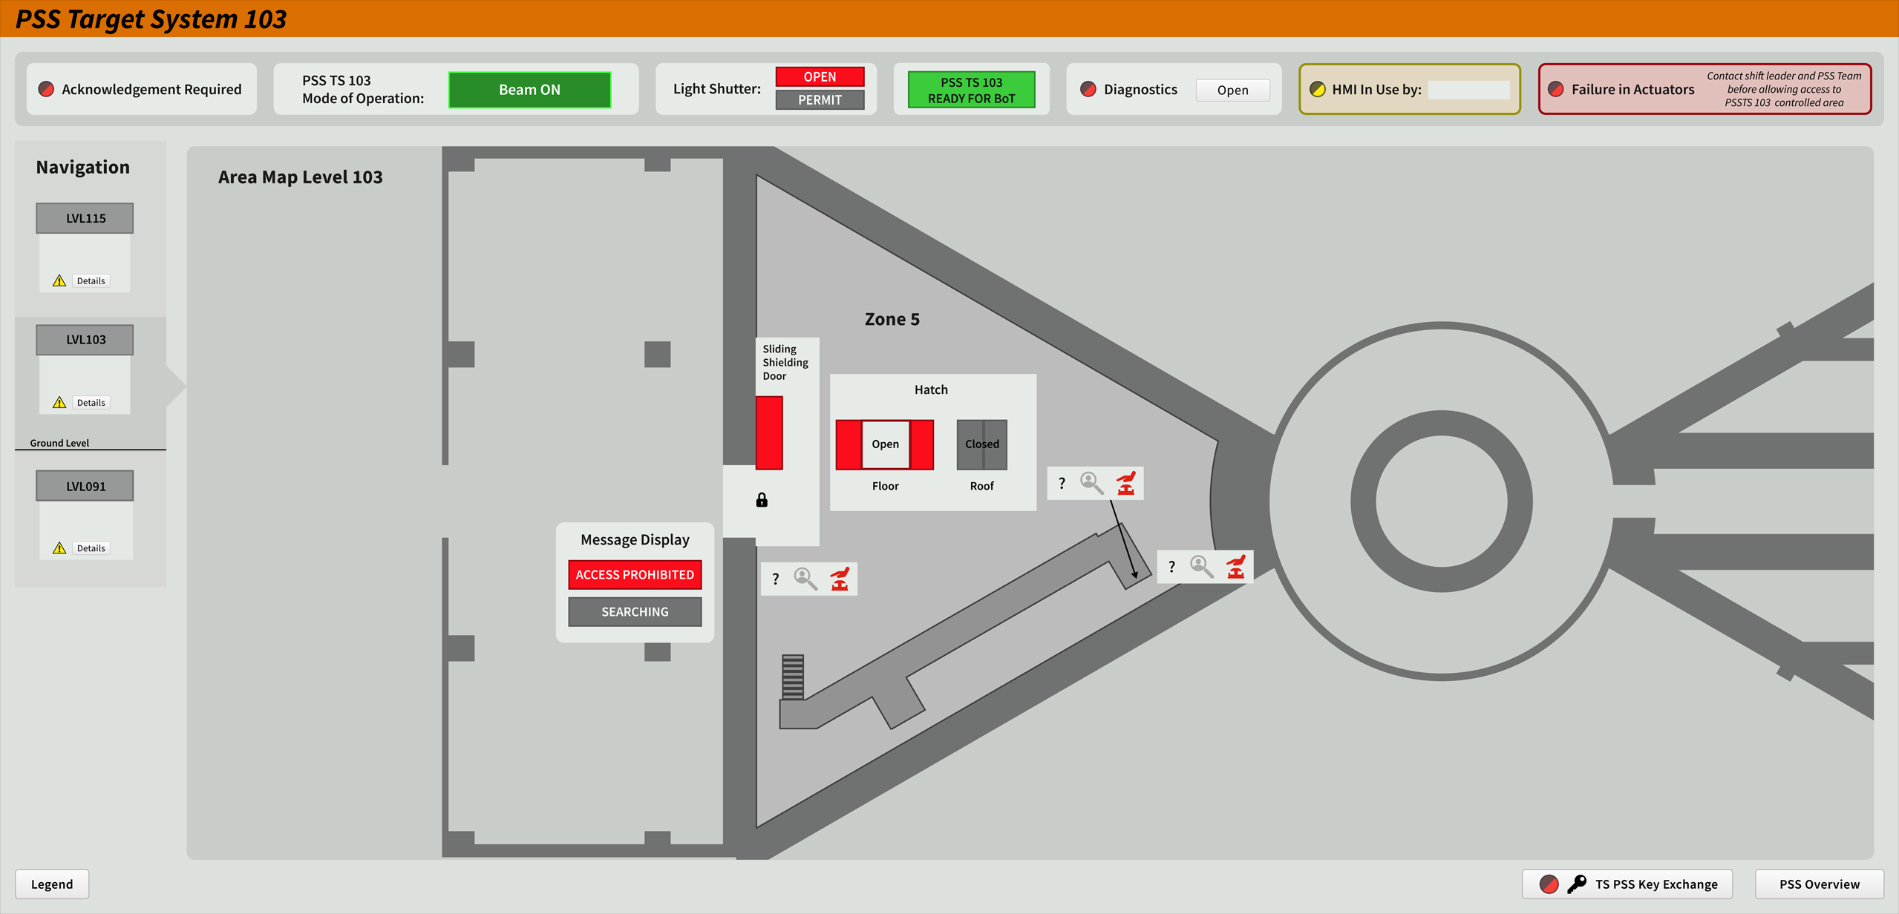
PSS OPIs
Target PSS OPIs

Slide 13
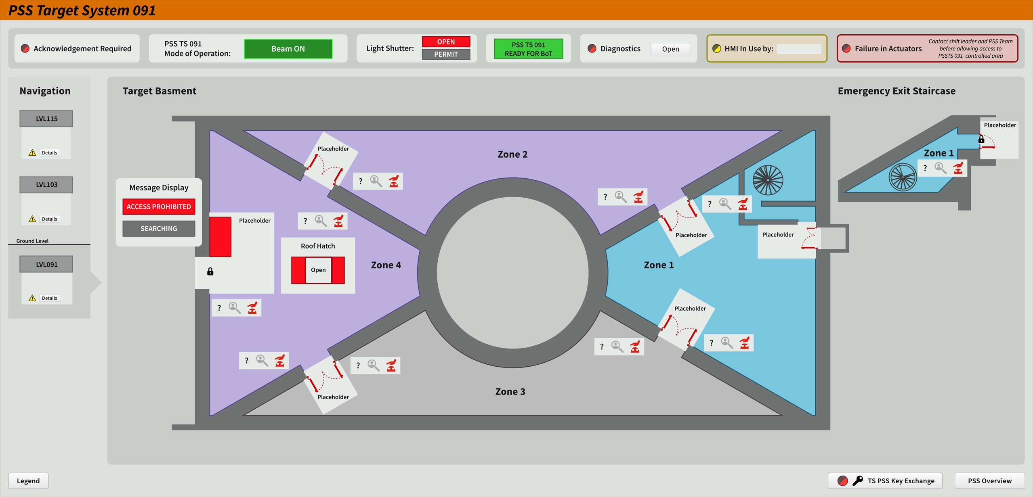
PSS OPIs
Target PSS OPIs

Slide 14
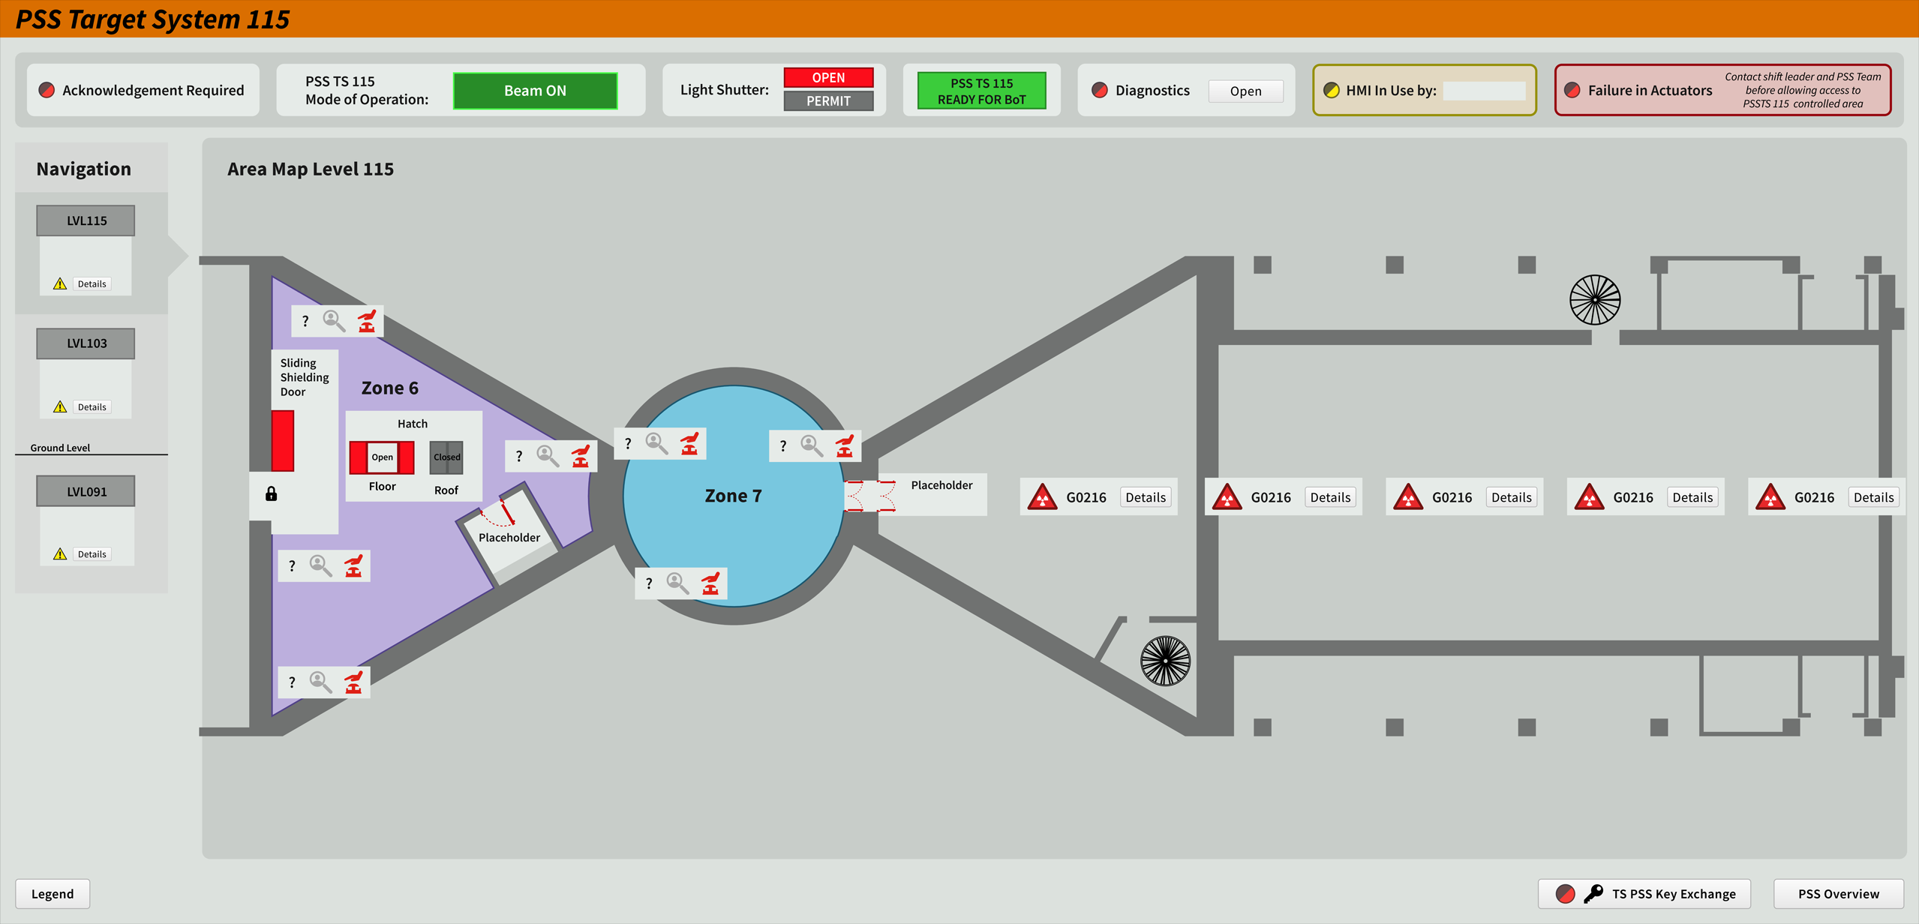
PSS OPIs
Target PSS OPIs

