Slide 1
Project Schedule and risks
CDR for PSS Target station and bunker
PRESENTED BY Ahmed Abujame

Slide 2
Agenda
1 Project status
2 Project Procurement plan
3 Project Schedule
4 Project Risks & Risk Register
5 Next Step

Slide 3
1
Project Status

Slide 4
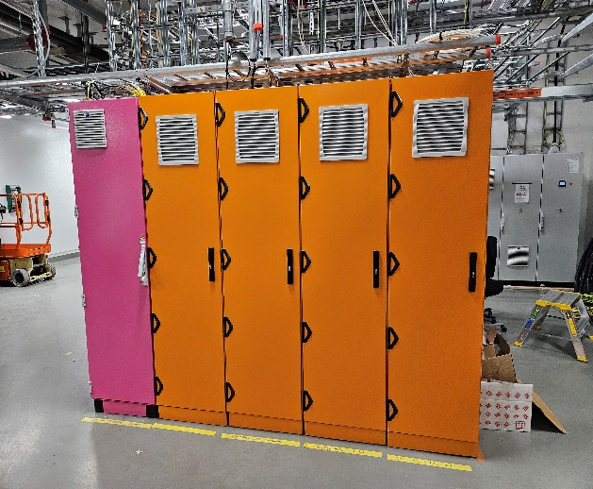
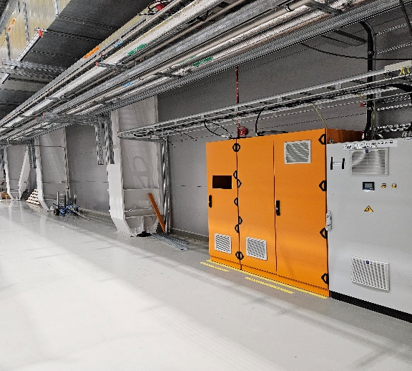
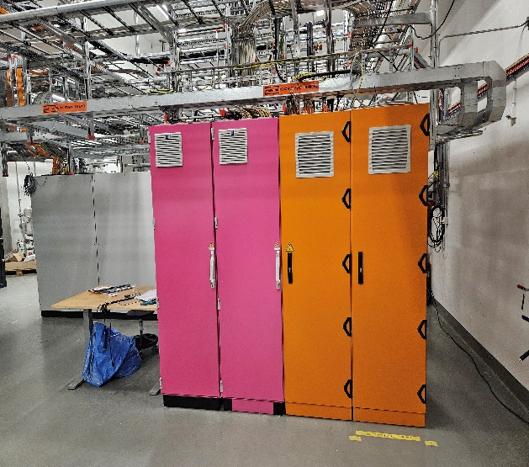
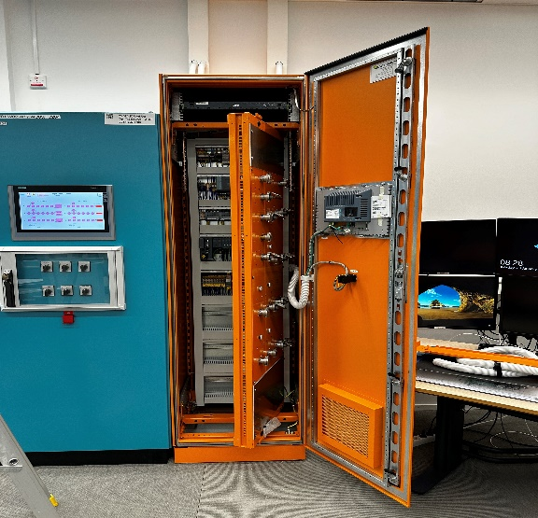
Project installation- Target
D02
Completed Installation
PSS raceways and supports are completed (inspected by ESS QC and approved)
Raceways earthing completed (inspected by ESS QC and approved)
All PSS Racks have been installed (PLC Rack, 3 RIO, KEU and PA system control cabinet)
Manufacturing of PLC racks and RIO racks are planned to start W19

Slide 5
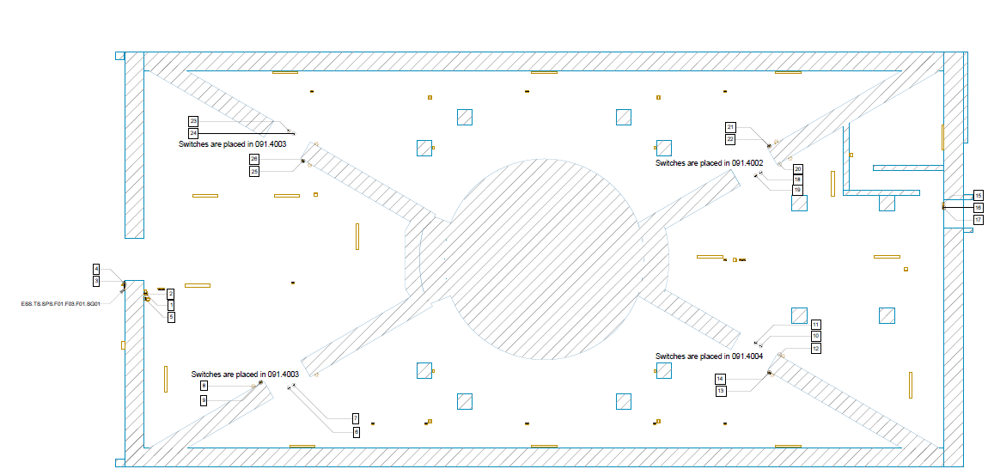
Project installation – Target Station
D02
Upcoming installation
Field devices
Emergency shutdown stations
Message displays
Mechanical and electrical switches
PLC & RIO racks population
Blue lights and ICCs
Fibers, power and signal Cables

Slide 6
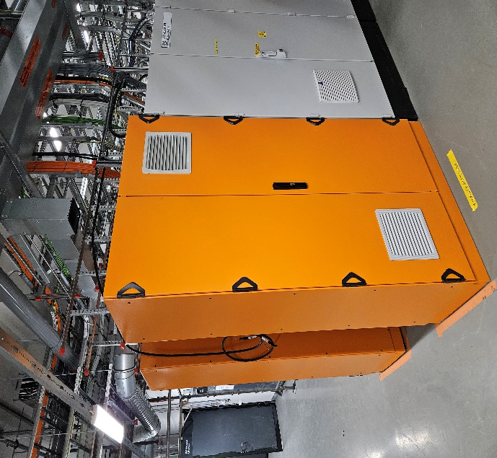
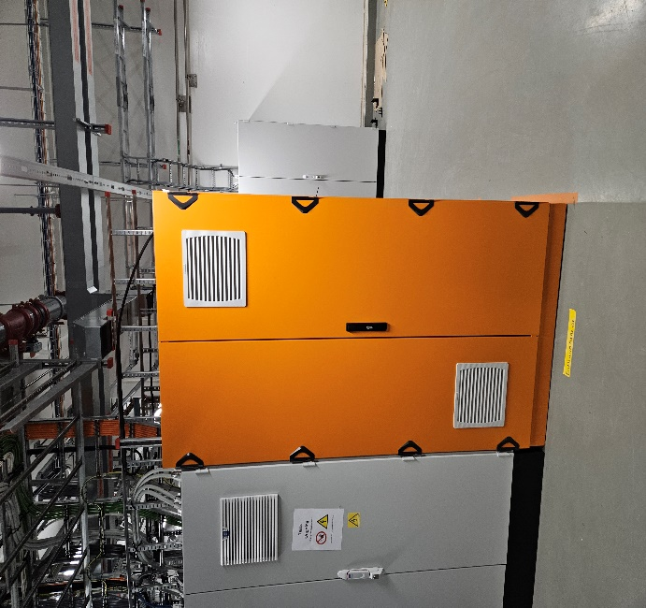
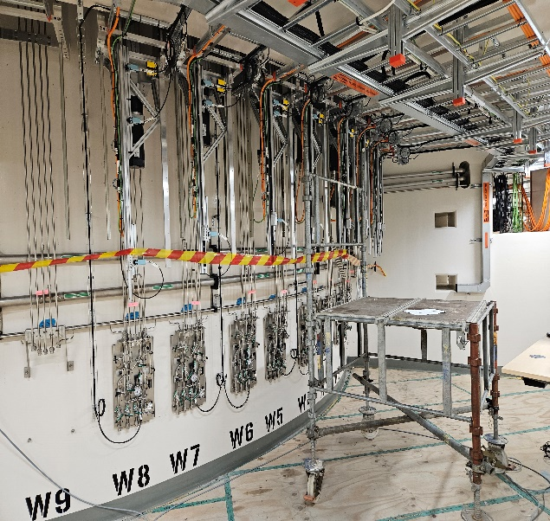
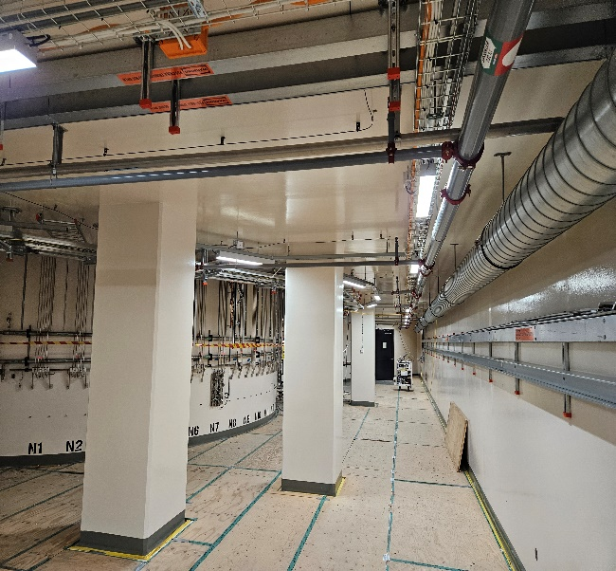
Project installation – Bunker PSS
D01/D02/D03
Completed Installation
bnrpss-NWBCtrl-Rack-002 installed in D02.085 utility room
bnrpss-SEBCtrl-Rack-002 installed in D02.085 utility room
Mechanical switches for NWB and SEB for Light shutter system are all installed
Installation of raceways and supports in D02 is completed

Slide 7
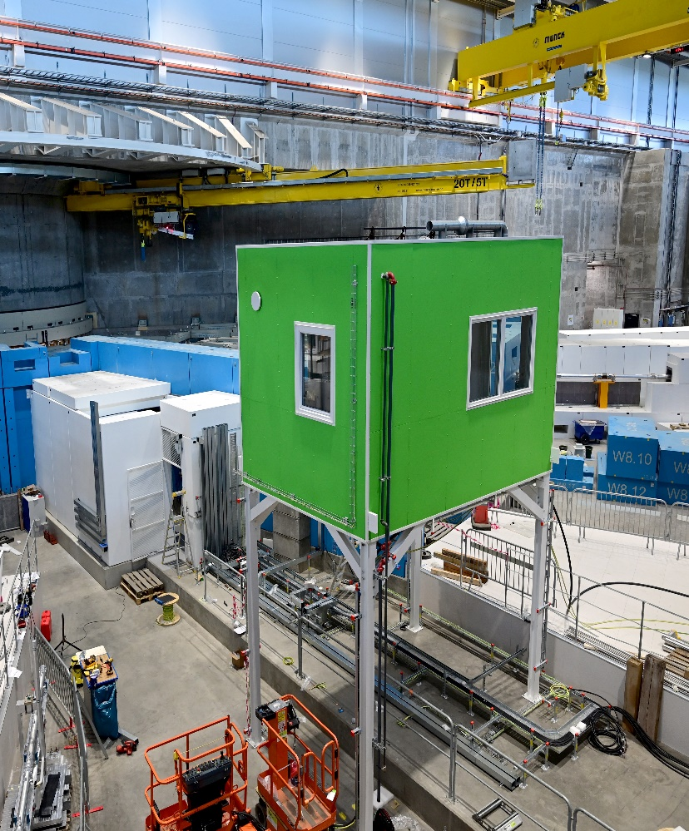
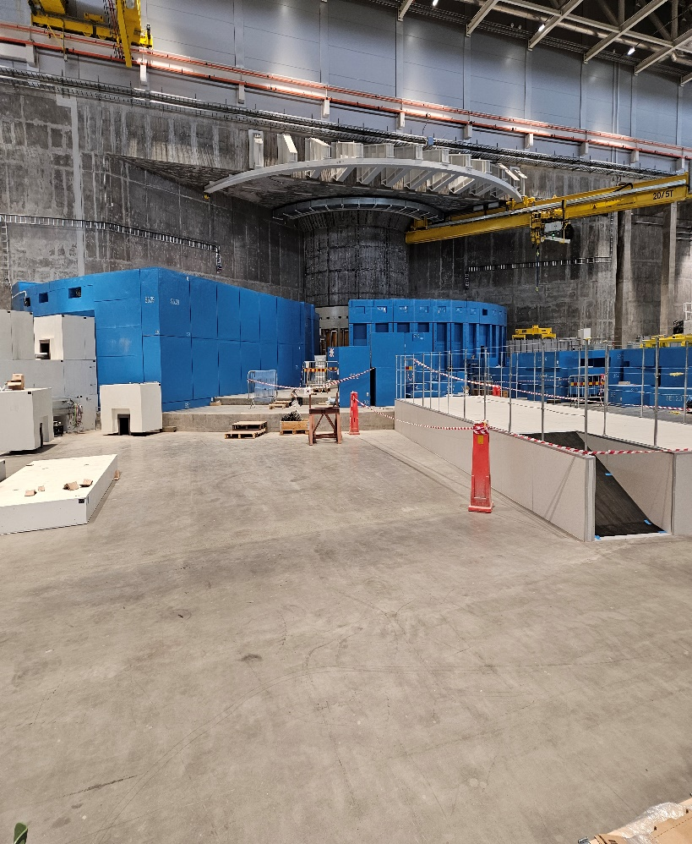
Project installation – Bunker PSS
D01/D02/D03
Upcoming installation
bnrpss-NWBCtrl-Rack-002 installed in D02.085 utility room
bnrpss-SEBCtrl-Rack-002 installed in D02.085 utility room
Raceways in D03/D01 to the racks, cable laying , earthing, etc…

Slide 8
2
Project Procurement plan

Slide 9
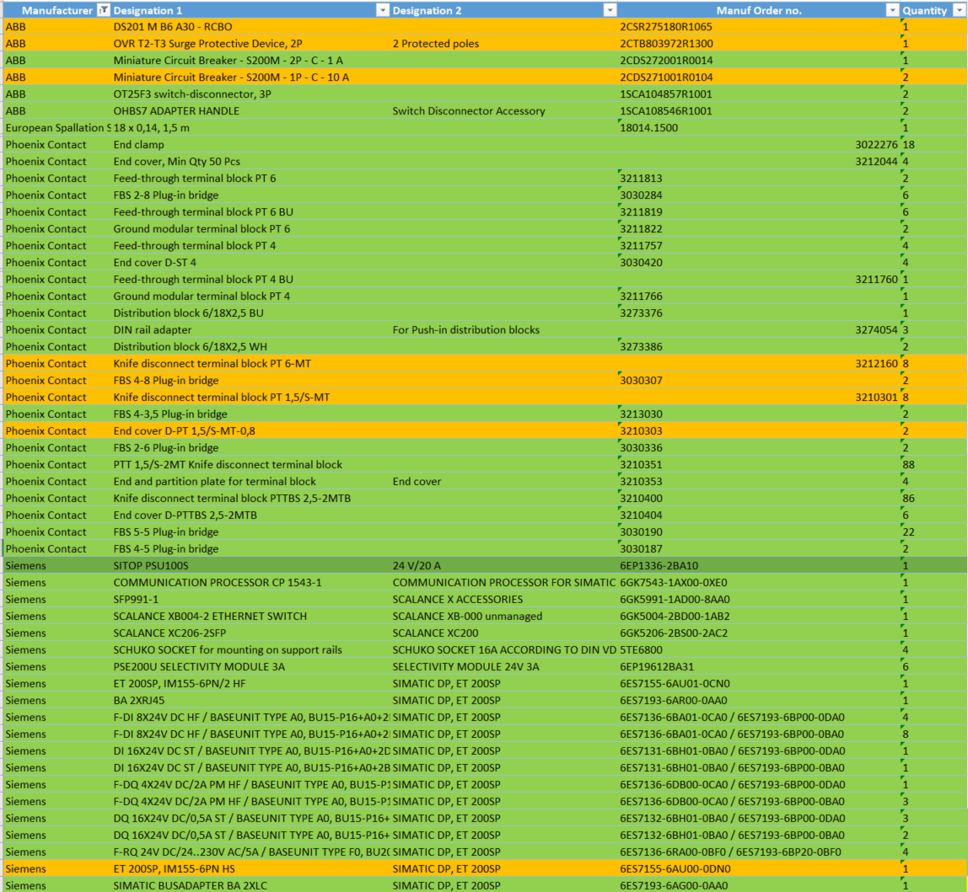
Project procurement plan
14-ICS-Live.9 Personnel Safety System
14-ICS-Live.9.1 Management and Administration
14-ICS-Live.9.1.5 Equipment
ICS-A20218250 | Access Stations & accessories NSS Bunker (Gunnebo)
ICS-A20218390 | Key exchange Accelerator PSS, Target, NSS Bunker (Fortress)
ICS-A20218430 | Message Displays Accelerator PSS, Target & NSS Bunker (Lasermet)
ICS-A20218550 | Equipment Installation support (from Service provider)
ICS-A20218570 | NSS PSS Equipment budget (TBL, Bunker1, Bunker2 Loki, Odin, Dream and Bifrost)
ICS-A2146942890 | NSS Infra for PSS
ICS-A2146942930 | Generic equipment for installations 2024
ICS-A2146943050 | NSS PSS Equipment budget (TBL, Bunker1, Bunker2 Loki, Odin, Dream and Bifrost)
ICS-A2146943070 | Equipment Installation support for NSS (from Service provider)
ICS-A20218290 | Racks NSS Bunker (Pentair)

Slide 10
3
Project’s Schedule

Slide 11
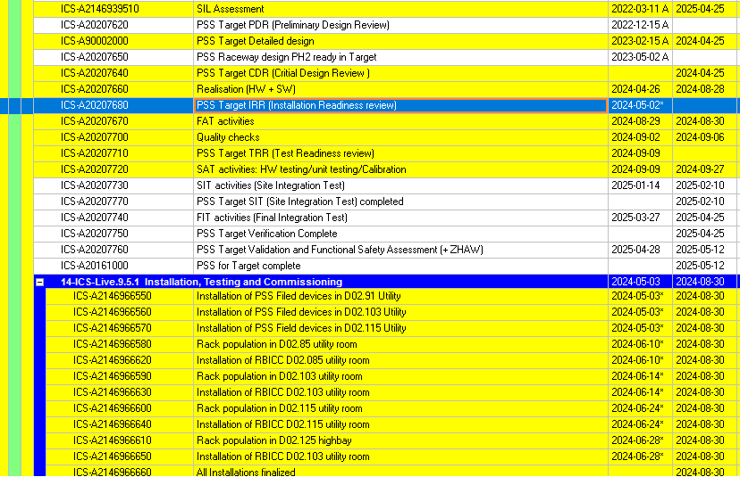
Project Schedule
P6 PSS Target Station

Slide 12
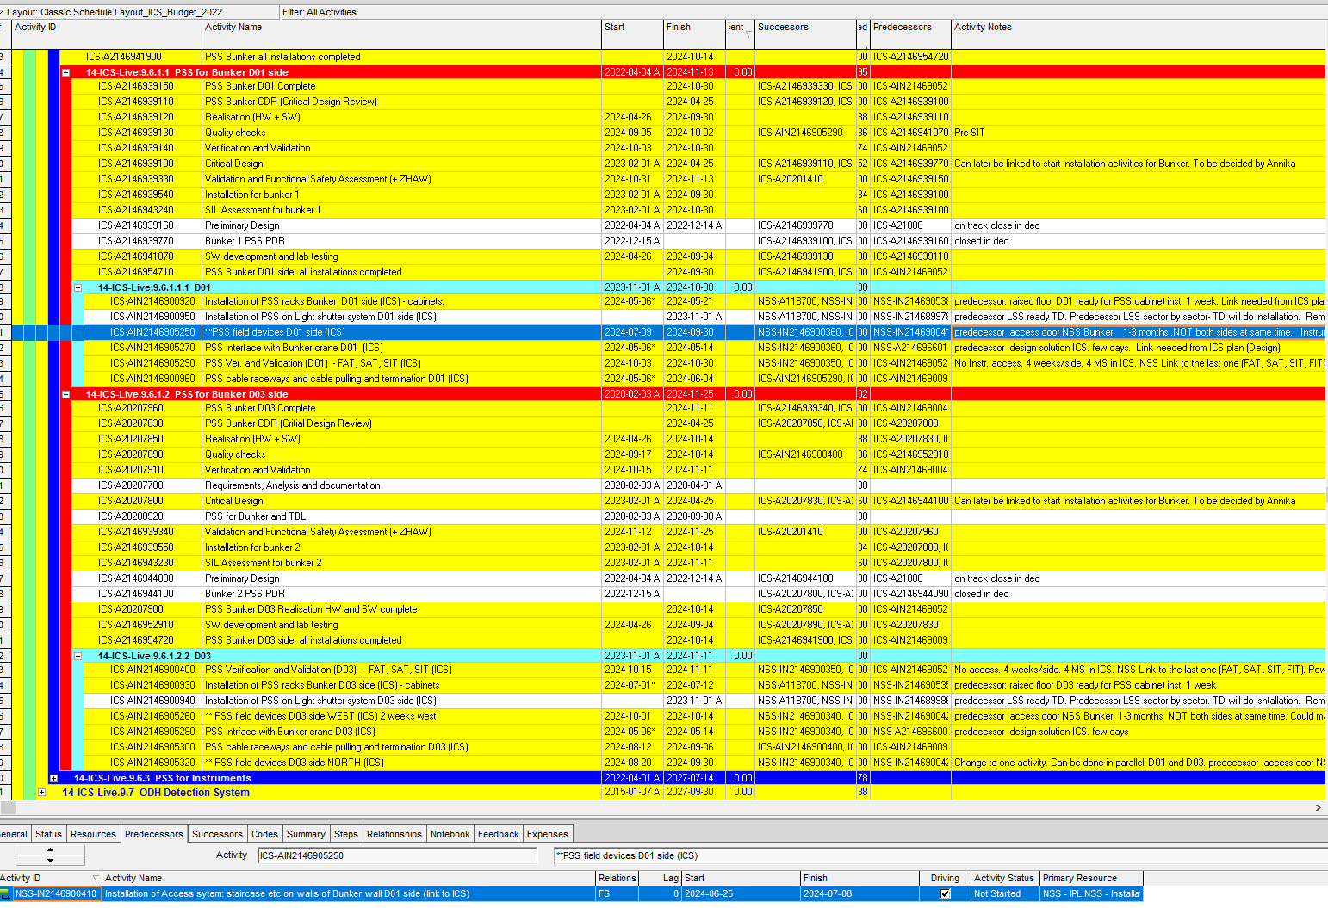
Project Schedule
PSS Bunker

Slide 13
4
Project Risks & Risk Register

Slide 14
Project risks
 | IMPACT
LIKELIHOOD | NEGLIGABLE | LOW | MODERATE | SIGNIFICANT | SEVERE
CERTAIN | MED | MED | MED | HIGH | HIGH
LIKELY | LOW | MED | MED | HIGH | HIGH
POSSIBLE | LOW | MED | MED | MED | HIGH
UNLIKELY | LOW | LOW | MED | MED | MED
IMPROBABLE | LOW | LOW | LOW | LOW | LOW
 | 1 | 2 | 3 | 4 | 5
0.9 | 0.9 | 1.8 | 2.7 | 3.6 | 4.5
0.7 | 0.7 | 1.4 | 2.1 | 2.8 | 3.5
0.5 | 0.5 | 1 | 1.5 | 2 | 2.5
0.3 | 0.3 | 0.6 | 0.9 | 1.2 | 1.5
0.1 | 0.1 | 0.2 | 0.3 | 0.4 | 0.5
Risk ID | RISK/Opp | Type | Description | System | PSS Milestone | Probability | IMPACT | Risk SCORE | RISK MITIGATION COMPLETION PLAN | Status of Action
1 | RISK | SCHEDUELING | high dependencies on stakeholders installation and commissioning plans | PSS-Bunker | PSS-Loki SIT | 0.5 | 2 | 1 | implement activities linking in P6, weekly coordination with concerned stakeholders
For this stage of the project, the risks are dependencies to the installation of stakeholder’s equipment in different areas as well as energization of various systems
Delays in any installation or energization will subsequently delay SAT/SIT/FIT

Slide 15
5
Next Steps

Slide 16
Next Steps
E01/D02/D03
Address any comments raised by CDR committee
Conduct installation readiness review (IRR) with relevant stakeholders
Commence installation activities on site
Complete all procurement and mounting plates for PLC/RIO racks manufacturing

Slide 17
Questions?

